Slide 1
Transatlantic
Trade & investment partnership
19/04/2017
Jacob A. Jordaan
Utrecht School of Economics
j.a.jordaan@uu.nl

Slide 2
Set up today
Literature
Free trade: public opinion
EU and US: Trade and investment patterns
TTIP
  Trade liberalisation
  Expected gains
  Criticisms
Questions and discussion

Slide 3
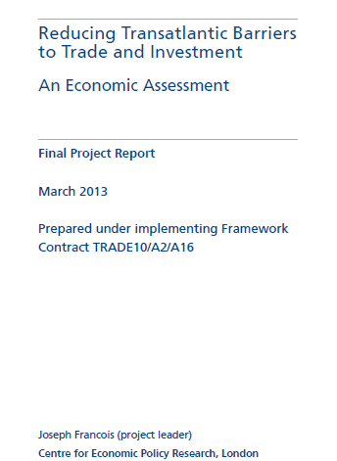

Literature

Slide 4



Slide 5
The Geopolitics of TTIP
Hamilton, D.S. (2014) The Geopolitics of TTIP: Repositioning the transatlantic relationship for a changing world. Centre for Transatlantic Relations. John Hopkins University
Novák, T. Chapter 6: TTIP’s implications for the Global Economic Integration of Central and Eastern Europe
Robertson, C. Chapter 9: CETA and TTIP: Implications and Lessons learned

Slide 6
1. Public opinion on free trade
EU and US are negotiating trade and investment agreement
  Is receiving a lot of attention
  Emotions are running high!
What is going on?
  This time it’s different?
Negotiations cover a lot of issues
  Not surprising?
  The easy stuff has already been done?
Free trade good or bad?
  Opinions have become very diverse
  Try to focus on economic issues

Slide 7
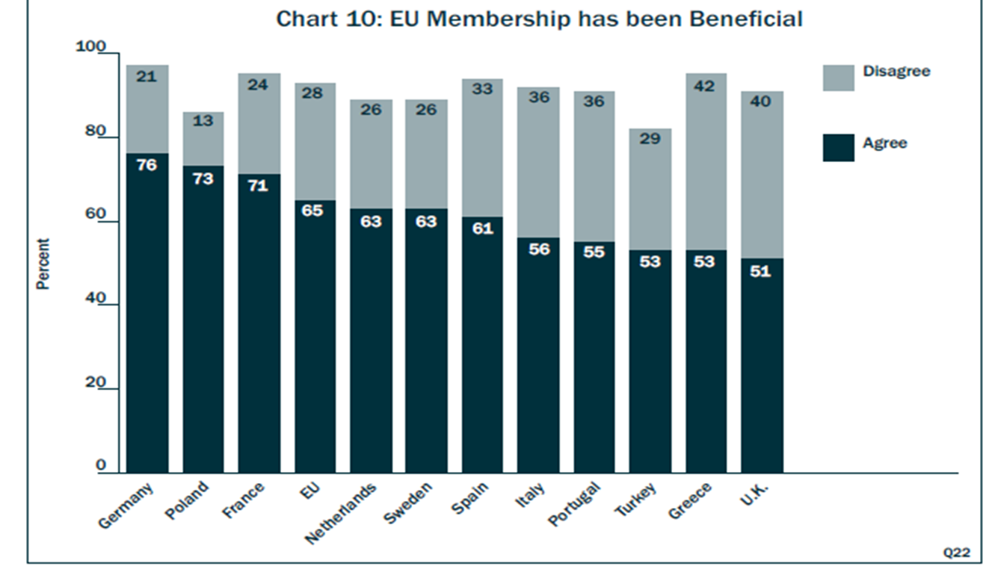
EU membership
Transatlantic Trends 2014 German Marshall Fund of the United States

Slide 8
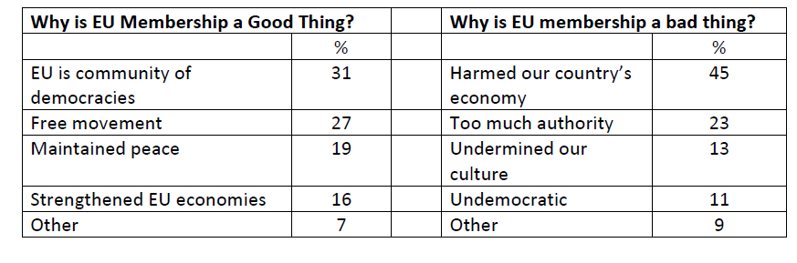
Opinions on the EU
Transatlantic Trends 2014 German Marshall Fund of the United States

Slide 9
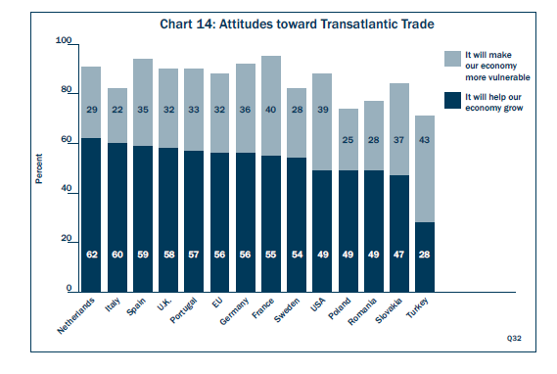
Transatlantic trade
Transatlantic Trends 2013 German Marshall Fund of the United States

Slide 10
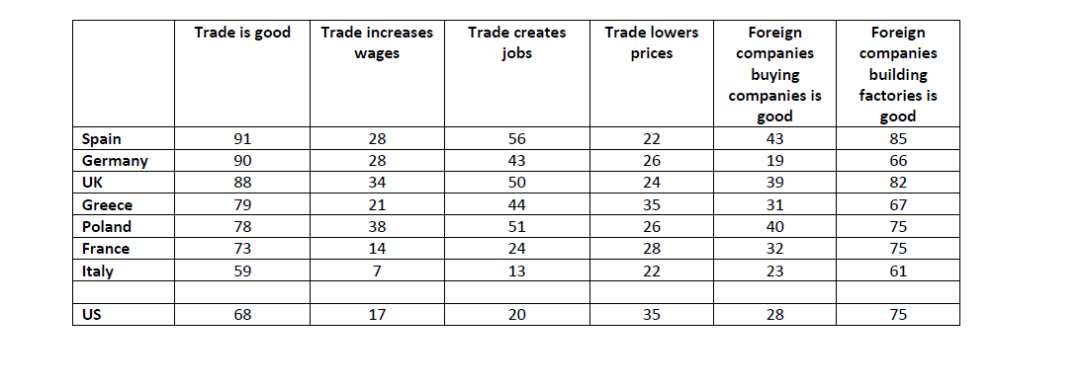
Effects of free trade
% of respondents agreeing with statements;
Pew Research Centre; Spring 2014 Global Attitude Survey

Slide 11
Economic development and free trade
Surprising results?

Slide 12
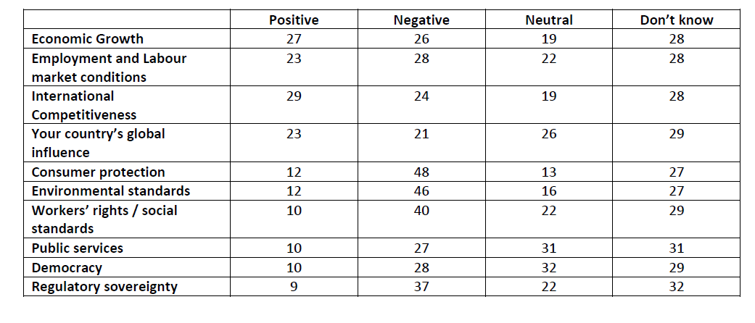
TTIP: the German perspective
Attitudes to global trade and TTIP in Germany;
Bertelsman Stiftung.

Slide 13
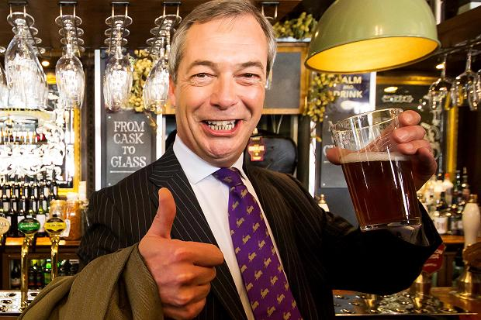
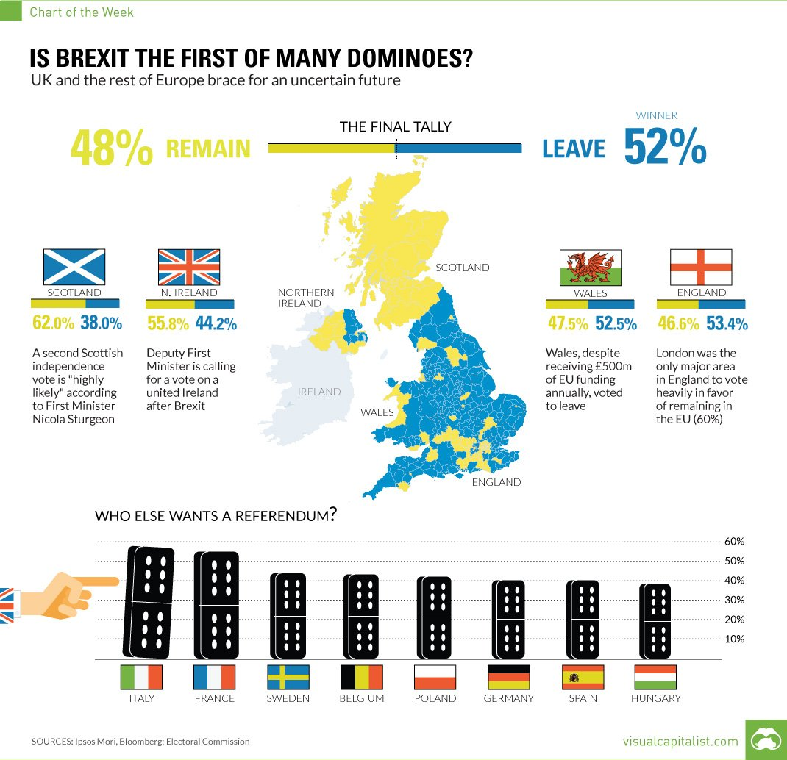
Brexit: EU has gone too far?

Slide 14
What do we see?
Free trade popular topic again
Overall, free trade is good
  But persistent minority against
Less support for positive effects of free trade (globalisation)
Level of development affects opinion
  More developed economies already experienced the majority of the positive effects?
Growing importance of “non-trade-related” issues
Brexit outlier or start of economic de-integration?

Slide 15
2. EU and US
Context of trade negotiations
US and EU problems with recovering from crisis / reinitiating growth
On-going integration in Asia
Stagnation trade liberalisation in WTO
Stagnation gains from integration in EU
Multinational enterprises are increasing pressure
Potential of trade agreement between two largest markets in the world economy

Slide 16
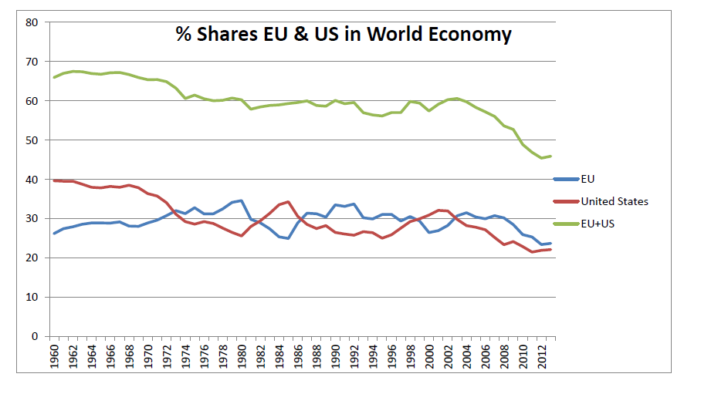
US and EU in world economy

Slide 17
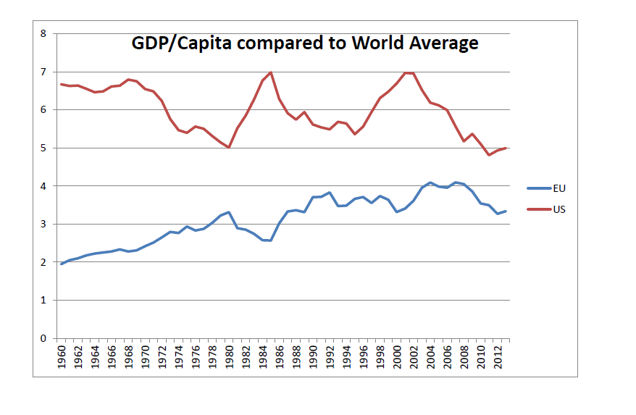
GDP/Capita US and EU

Slide 18
Key role in international trade

Slide 19
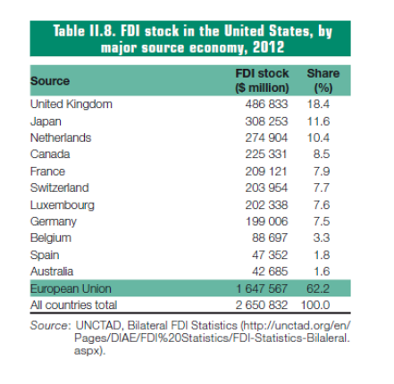
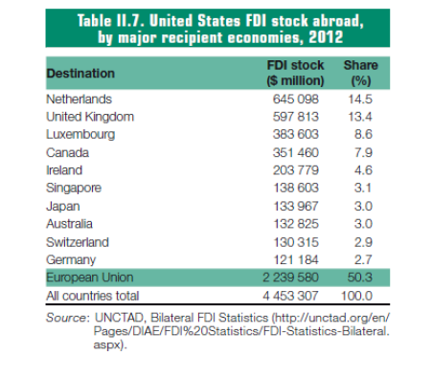
Key role in international investment
Share in worldwide Share in worldwide
inward FDI outward FDI
EU 35%; US 20% EU 40%; US 24%

Slide 20
Multinational enterprises
US and EU have many multinationals
Large shares in modern manufacturing industries
Key role in services
Dominance in international trade
Key role in creating new technologies
International diffusion of technologies
We cannot ignore this in discussions on trade liberalisation and agreements

Slide 21
3. TTIP
EU-Canada CETA
Negotiations have been completed, EU parliament has voted in favour
Now it’s with national governments
Now TTIP
Transparency and disclosure of information is much larger compared to previous trade negotiations
http://ec.europa.eu/trade/policy/in-focus/ttip/

Slide 22
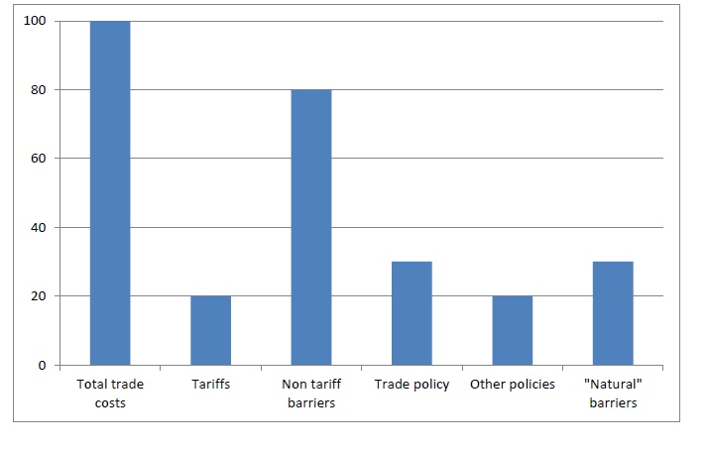
One of the key issues for TTIP
Where will the gains from trade liberalisation come from?

Slide 23
More general for developed countries

Slide 24
Non tariff barriers (1)
Limiting market access
  Import quotas, export restraints, discriminatory measures against foreign firms
Costs associated with operating in different markets
  Approval conditions and procedures
  Environment and health standards; consumer protection
  Industry standards; packaging and information requirements
How to assess need for NTBs?
  Some of the NTBs exist for good reasons
  Mixture of backgrounds (labour rights, environment)
  Mix of trade policy and other policies

Slide 25
Non tariff barriers (2)
Lowering NTBs important to increase gains from TTIP
Completely removing NTBs is going to be very difficult
Alternatives
  Harmonisation
  Mutual recognition
Public concern: race to the bottom?
  “Unfair” competition when NTBs differ: countries will be forced to accept lower standards
Is this really the case?
  No relation between trade openness and level of standards
  What about consumer choice?

Slide 26
Predicted effects of TTIP
Difficult art of forecasting
Computable general equilibrium models
Trade liberalisation = decrease in trade costs → increase in competition → competitive sectors grow → increase trade and GDP
Ecorys (2009) Non tariff measures in EU-US trade and investment- An economic Analysis. Study for European Commission
Fontagne et al. (2013) Transatlantic Trade: Whither partnership, which economic consequences? CEPII
Francois, J. et al. (2013) Reducing Transatlantic Barriers to Trade and Investment: An Economic Assessment. CEPR
FelberMayr, G. et al. (2014) Transatlantic Trade and Investment Partnership: Who benefits from a free trade deal? Bertelsman Stiftung

Slide 27
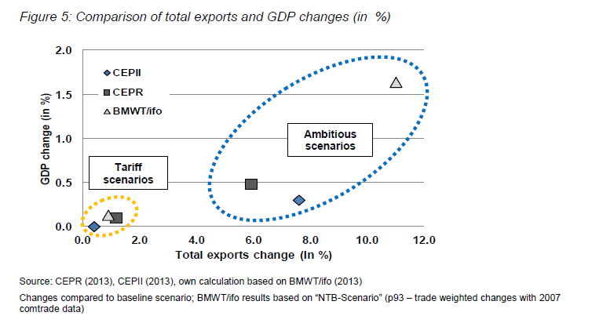
Source: Raza et al. (2014)

Slide 28
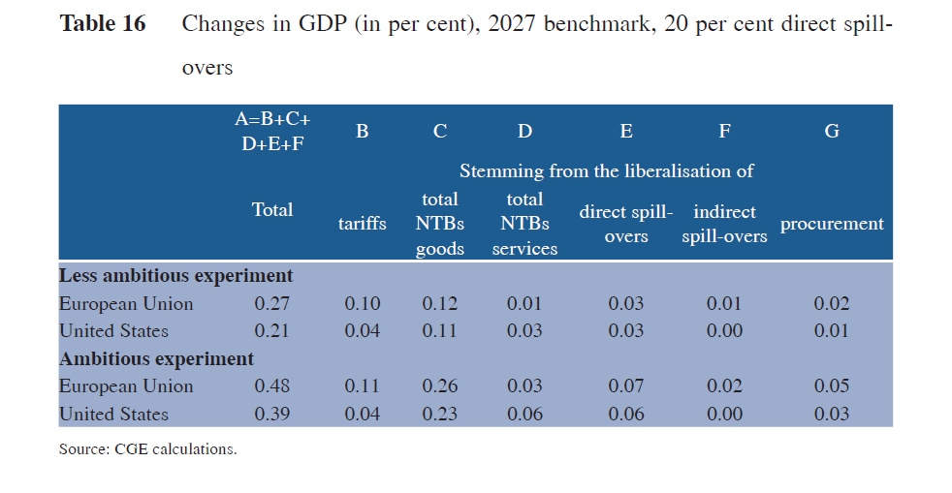
Effects according to CEPR
€ 500 per household in EU
€ 655 per household US

Slide 29
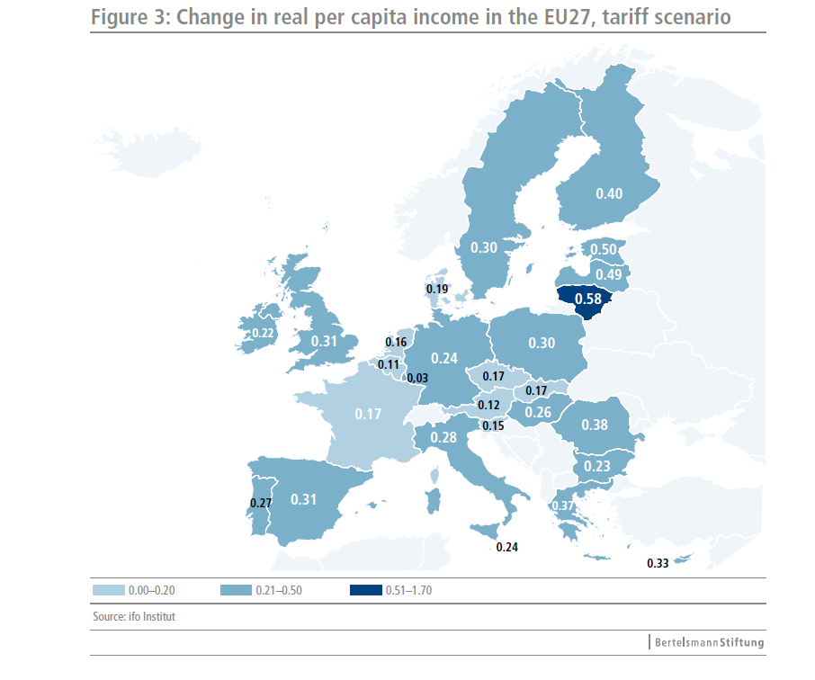
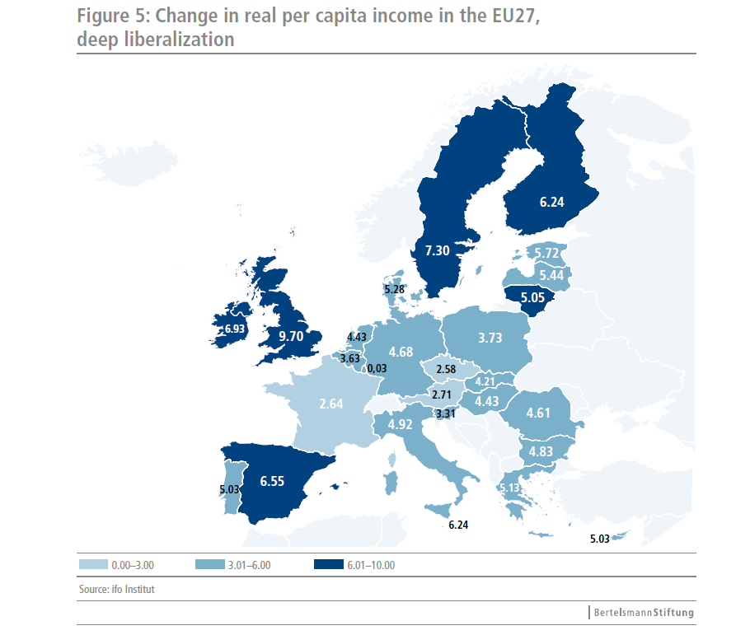

Slide 30
Additional positive effects
Consensus on moderate gains
Additional effects
  Dynamic effects
    Scale economies
    Productivity increases
    Development of new technologies & industries
  Restructuring and flexibilization EU economies
    See problems with recovering from financial crisis
  Positive effects on other countries?
    Increase in world demand & easier access to combined US & EU market
  Positive effect on trade liberalisation under WTO?
    Pressure on China?

Slide 31
Criticisms (1)
Impact studies have received a lot of criticism
Macroeconomic adjustment costs
  Changing capital flows
  Public sector
    Less income from tariffs → decrease government income
    Needs to be compensated by economic growth
Unemployment
  More trade, increase GDP → increase employment
  But: sectoral reallocation of labour!
  This takes time, is costly, spatially concentrated, not everyone will be successful
  Adjustment costs may be substantial!

Slide 32
Criticisms (2)
How to deal with unequal gains?
  Some countries will benefit more than others
  Gains unequally distributed within countries
  Coherence in EU?
  Is (Eastern) Europe ready for large increase in competition?
  Effect on third-party countries
Social costs of regulatory change
  Which NTBs can be removed, harmonised, mutually recognised?
  Change in regulation = cost for firms
  Danger of race to the bottom?
Horizontal versus sector specific
  Medicines, cosmetics, food, raw materials, motors, etc.
  What are the gains when there are so many exceptions?

Slide 33
Criticisms (3)
Investor state dispute settlement system (ISDS)
  System to solve disputes between foreign investors and state
  Many countries have bilateral treaties
  Concern: government constrained in designing policies?
What about WTO?
Public services under threat?
  Role of government versus private sector + increasing participation by foreign firms
TTIP is made for multinationals?
Threat to democracy?

Slide 34
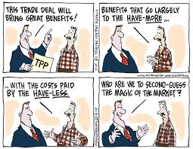
What is the key challenge?

Slide 35
Concluding remarks (1)
Globalising world economy
  Ongoing liberalisation of trade and investment
  What is the alternative?
Stagnation WTO → Countries are looking for alternatives
  (WTO has made a lot of progress!)
TTIP: potential trade agreement between the two largest markets
Negotiations surrounded by a lot of commotion
Difficult to appreciate all the arguments
  Substantial minority does not like free trade, even in EU!

Slide 36
Concluding remarks (2)
Key issues from economic perspective
Moderate gains versus adjustment costs?
Tariffs versus NTBs
  Lowering NTBs key for gains
  Harmonisation, mutual recognition, many areas affected
Unequal gains? Winners and losers?
  Redistribution necessary? Feasible?
  Within and between countries?
Effects on third-party countries?
Effect on trade liberalisation under WTO?

Slide 37
I hope you enjoyed the presentation!
Any questions?

