Slide 1
Policy Responsiveness
Lecture 2

Slide 2
Today
Theory of policy responsiveness
Techniques for studying policy responsiveness
More nuanced results
Ideas for research

Slide 3
1. Theory of policy responsiveness

Slide 4
What is policy responsiveness?
Politicians follow will of public
  Congruence: exact match between public preferences and policy
  Responsiveness: policy changes with changes in preferences
But
  Should they converge exactly?
  With no time delay?
  On all issues?

Slide 5
Potential mechanisms
Incentives – rational anticipation
  Politicians afraid of consequences of not listening: lose elections, protest, revolution
  Requires that voters (i) know what politicians do and (ii) punish them for doing different things
Selection of types
  Voters choose politicians that have similar beliefs and values
  Politicians then carry out those values
  Policy changes with elections
Altruism
  Politicians want to please people, want to be loved
  Public has good ideas

Slide 7
Case for responsiveness
Fundamental idea of democracy: people rule
Citizens know what is best for them
Wisdom of crowds
Politicians are corrupt and self-interested, need to be controlled and disciplined

Slide 8
Case against responsiveness
Citizens have no real opinions about most issues, especially complicated ones – can’t provide guidance
Citizens have uninformed or bad opinions
  Desire things which are bad for them and for society
  May wish to oppress others
Citizens can be manipulated by politicians or groups
Pandering: politicians try to please voters with policies that they know will have negative effects
Leadership is a good thing
  Should politicians do what is right or what people want?
  But Brecht: unhappy is the land that needs a hero

Slide 9
When will responsiveness yield the best policies?
Best = policies in the real interests of citizens
  Substantive representation
Citizens need to actually know and prefer the policies with the best consequences for society
  Or the aggregate average of opinions somehow = the best policies
How often does public desire what is right?
Where would you trust the Czech public?
Where would you not trust it?

Slide 10
2. Techniques for studying responsiveness

Slide 11
The major problems
Measures of what the public wants
  Can they identify exact policies?
  Or just more/less/about the same?
Measures of policy/actions of politicians
Controls for other causes of policy and opinion
Reverse causality: policy => preferences

Slide 12
Dyadic representation
Miller and Stokes (1963)
  Public opinion on issue positions in US Congressional districts
  Link to preferences and behavior (roll-call votes) of representatives in those districts
Results: good correspondence
  Social welfare: parties nominate different candidates and voters pick closer
  Civil rights: MPs anticipate what voters prefer
  Correspondence depends on salience of issue
Problems
  Need a common scale of measurement
  Roll call votes ≠ policy (position-taking)
  Who is influencing whom?

Slide 13
What about proportional systems like CZ
Can’t link citizens with individual MPs
  Multiple MPs represent each district
  Maybe for Senate?
Try to link parties with their voters
  Opinions of party voters
  Opinions of MPs or placement of party on left-right spectrum

Slide 14
Party representation
Luna and Zechmeister (2005)
Survey of voters on important policy issues
  Disaggregate by party identification or vote intention
  Is it true that parties only represent their own voters?
Survey of MPs – average ideology of party
Results
  Wide variations in Latin America
  More developed countries and more institutionalized party systems better
  Drastic neoliberal reforms make representation worse
Problems
  Are we measuring policy?
  Are we showing causality?

Slide 15
How to measure policy?
Survey of legislators – opinions on policies
  Sincerity? Is it policy?
Roll-call votes in parliament
  Party discipline, strategic voting
Interest group evaluations of MPs
Expert survey of positions of parties
Lists of major legislation (label as left or right)

Slide 16
Collective representation
Monroe (1979, 1998), Gilens (2005), also studies on France & Germany
Gather all national-level surveys asking about concrete policy changes
Is the change made or not?
Results
  50-70% of time government does what citizens want
Problems
  Depends on issues that surveys cover
  Is it causality or just correspondence?

Slide 17
How do we isolate causality?
Control for other factors
  Media, interest groups, parties, civil society
  Very few studies do this
Time-series
  Responsiveness is a temporal idea: changes in public opinion lead to change in policy
  Do changes in public opinion precede changes in policy?

Slide 18
One clever way
Page and Shapiro (1983)
Look at all significant changes in public opinion
What percentage of changes are followed by a change in policy?
Result
  In US, 2/3 of changes in public opinion => change in policy in same direction

Slide 19
Rights of same-sex couples in CZ

Slide 20
Can we be more systematic?
Dynamic representation
  Erikson, Mackuen, and Stimson (1995)
Policy mood: do citizens want large, more active government or smaller, less active government
  Advantage: long time-series, other policy issues come and go
  Disadvantage: very abstract
Measures of policy
  Interest group ratings of MPs
  Roll-call votes
  Lists of major legislation (they use this more in later work)

Slide 21
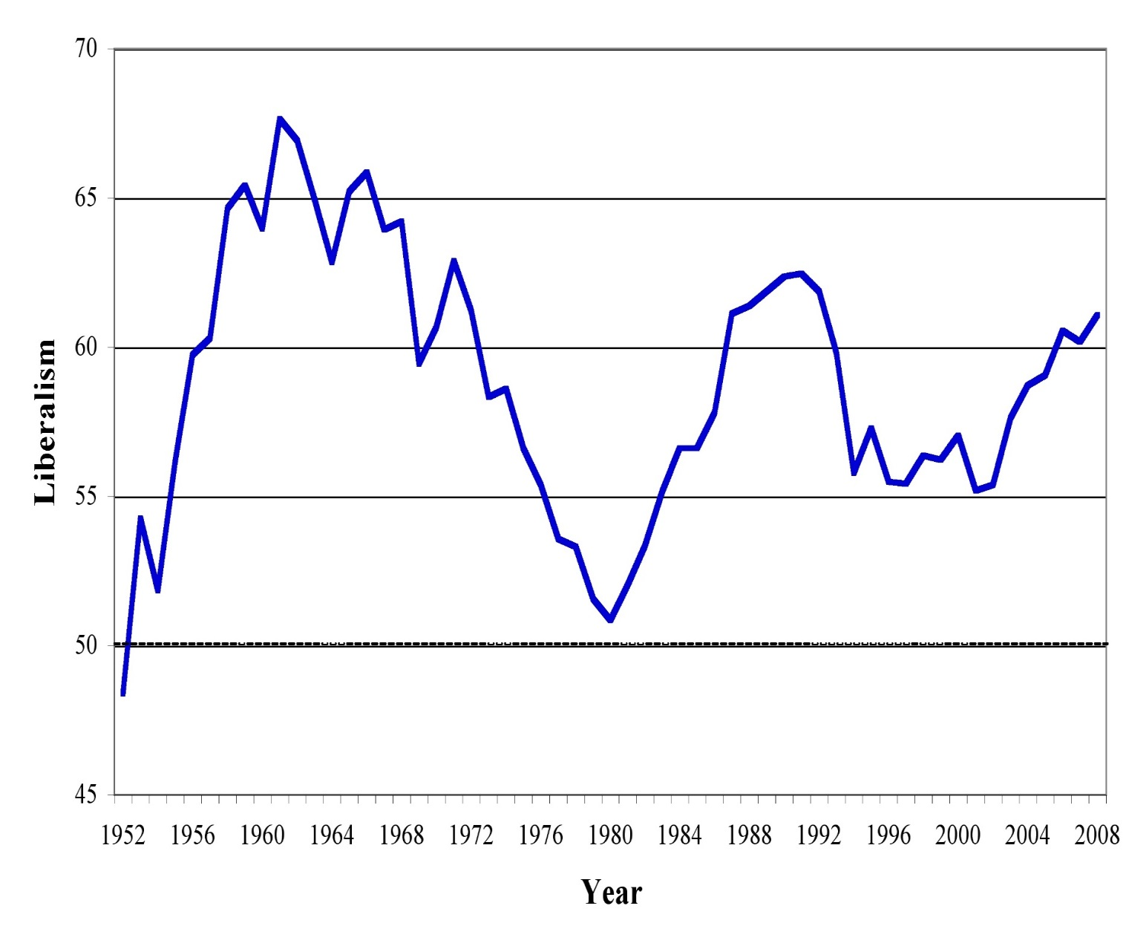
Policy mood in US

Slide 22
Putting policy and public opinion together

Slide 23
Results
Strong responsiveness for all four branches
  1 point change in mood => 1 point change in policy
Change is fast
  For legislature, most of public opinion change reflected in policy within 1 year
  For Supreme Court: 2 years
Differences across branches
  House of Representatives: direct effect of public opinion strongest
  Senate: indirect effect through elections stronger – change in Senators leads to change in policy
  President: change in party of president has largest effects

Slide 24
Why is the Supreme Court responsive to public opinion?
Judges have political motivations
Court depends on other actors for enforcement
  No control over police, bureaucracy
  If they take unpopular actions, then other actors (executive, legislative) won’t enfroce
Court needs to maintain legitimacy
  Countermajoritarian dilemma
  How can unelected judges make policy

Slide 25
3. Some more nuanced results

Slide 26
Lumpers and splitters
What are politicians responsive to:
  General public mood (lumpers)
  Opinion on specific issues (splitters)
Does politician say: “The public’s mood is becoming more hostile to government, let’s think of ways to cut government”
Or: “The public dislikes Church restitution, let’s limit or stop Church restitution”

Slide 27
Druckman and Jacobs (2006)
Private polls conducted by Richard Nixon
When Nixon has specific policy data, he uses it
  Tries to win over general public
When an issue is not so important, he doesn’t collect data about specific policy and focuses on general ideology trends
  Appeals to his core supporters

Slide 28
When are politicians most responsive?
When elections are near
  Public has short time horizon – only remembers most recent policy when voting
  Honeymoon effect – politicians get free rein at start of term, mandate to rule
When popularity is moderate
  High popularity (eg, 70% approval) – I can do what I want and ignore the public
  Low popularity (eg, 30% approval) – Small policy changes won’t help me, so just do what I want

Slide 29
Public as thermostat
Public can influence policy, but policy can also influence public
  Public may adjust preferences depending on what policymakers do
If policy becomes too liberal, public becomes more conservative
  Thermostat adjusts heat to keep temperature constant
Spending preferences of public (“Should we increase or decrease spending on defense?”) and actual spending
  Finds that policy has negative affect on public opinion
  More spending => preferences for less spending

Slide 30
Gaps in our knowledge
To what extent do politicians manipulate public opinion?
  How do they do it? Can you see it in CZ?
Can we control for other causes of policy?
  Media, interest groups, civil society
What about inequalities in responsiveness?
  Do politicians listen to some groups more than others?
  Most studies focus on average person

Slide 31
Collective representation in CZ
All questions on policy issues asked in national surveys of public opinion in the Czech Republic from 1990 to 2009
  Do you support or oppose tuition fees for university?
To date 586 questions from CVVM
Determine whether policy adopted within 4 years

Slide 32
Preliminary results
59% of policies supported by majority adopted
32% opposed by majority adopted
Altogether 62% of policies fit majority preferences
Comparable to studies of US, France, & Germany

Slide 33
What are policy areas where CZ politicians don’t listen to public?
Public opposed but adopted
  Social policy cuts (copays, retirement age)
  Church restitution (but opposite in past)
  Missile defense?
Public supports but not adopted
  Restrict MP immunity
  Referenda
  Death penalty
  Direct presidential election (in past)

