Slide 1
Corruption
Lesson 9

Slide 2
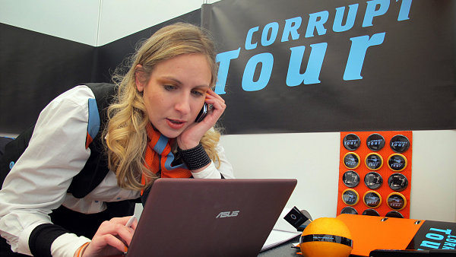
Corrupttour.cz
Our itinerary
  Magistrat: opencard (openkrad)
  Firm Cardiopont & Roman Janousek
  Dopravni podnik, Martin Dvorak, and Ivo Rittig
  House where Topolanek and Marek Dalik lived (prisednik)
  Ministry of Defense
  Parliament and Senate

Slide 3
Today
Does money matter in politics
Ways of limiting influence of money
Corruption and its causes
Solutions to the problem of corruption

Slide 4
Keep in mind
Political parties are necessary for democracy
Money is necessary for campaigns and competition between parties
Question is how to make sure money is used for the right purposes
Some corruption may be the price of democracy

Slide 5
1. Does Money Matter?

Slide 6
Why do firms give money?
Buy policy influence
Buy access to politicians
Try to influence election
Consumption

Slide 7
How much money is there?
Political campaigns only a small portion of GDP
Most contributions come from ordinary people or from state subsidies
A thought experiment:
  Contributions are a form of investment
  Imagine that for a relatively small contribution to a party, a firm can get very large benefits: eg, a 100% rate of return
  Then many more firms should give contributions
  Price of policy should rise until rate of return goes down to competitive level

Slide 8
Is campaign spending increasing?

Slide 9
Tullock paradox
Why is corruption so cheap? Why so little money in politics?
  Small contributions buy millions in benefits
Possible solutions
  Voters don’t like corruption – politicians can’t appear to be too rich
  Competition among politicians to sell their support
  Interest groups don’t trust politicians

Slide 10
Do contributions affect legislative behavior?
Hard to find connection between contributions and legislative votes
  Which policies are being sold and bought?
  Which parties are changing their positions?

Slide 11
Typical study design
Outcome is roll call votes of legislators
Independent variables
  Party
  Public opinion of constituency
  Contributions
Results
  Party and public opinion have very strong effects
  Contributions usually have weak effect

Slide 12
Problems with empirical analyses
Endogeneity: do contributions buy votes or do votes encourage contributions?
Omitted variables: ideologies of parties favor certain interests
  Parties receive money from groups with similar beliefs

Slide 13
Contributions as investment or consumption?
Contributions due to ideological motivations
People who contribute to politics also participate in other ways (eg, attend meetings, write letters, etc.)
Firms give more to charity than to politics

Slide 14
Better evidence that governments cater to preferences of rich
Good evidence that politicians follow preferences of richer
  Gilens and Bartels
Is it influence of money?
  Rich vote more
  Rich contribute more
  Rich are better informed
  Politicians identify with rich

Slide 15
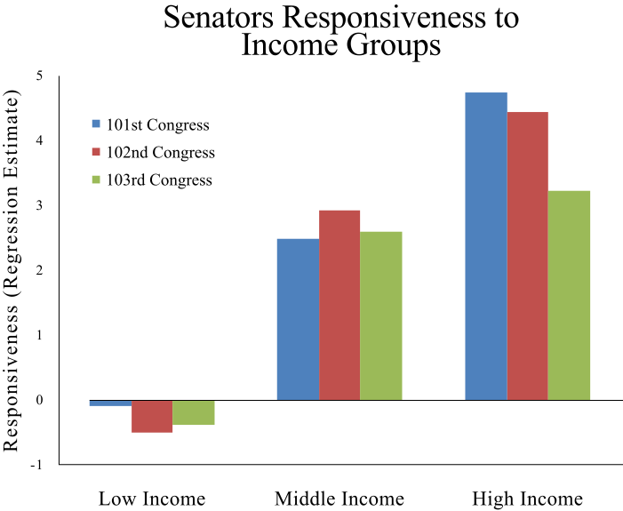
Bartels – Unequal Democracy

Slide 16
Does money influence election results?
Most studies find limited effects for campaign spending by incumbents, but stronger effects for spending by challengers
  Incumbents already have a record and familiarity
  Challengers need to spend to get noticed
  Spending often cancels out
  Difficult to study because money is endogeneous: good candidates get more money, parties allocate money strategically
Implication: By limiting money, we may be hurting challengers and helping incumbents

Slide 17
2. Ways of limiting influence of money

Slide 18
1. Contribution Limits
Contribution limits
  Worries about contributions in exchange for policy (quid pro quo)
  Economic inequality => political inequality
Issues
  Where should finances come from if not contributions?
  Limits on corporations? Trade unions? Foreigners?
  How high limits for individuals?

Slide 19
2. Expenditure Limits
Expenditure limits
  Worries that parties can buy elections
  Without limits parties of the rich have an advantage
Issues
  Limits freedom of speech
  How high to make limits
  Does it hurt new and smaller parties

Slide 20
3. Transparency and Enforcement
Transparency and Enforcement
  Donations publicly disclosed
  Party finances are made public
  Penalties for non-compliance
Issues
  Administratively difficult, especially for small parties
  Can public monitor? Does it care?
  Privacy issues – will firms worry about punishment if they support the wrong party

Slide 21
4. Public Funding
Public funding
  Attempt to limit influence of private money
  Response to fewer party members and volunteers plus increasing cost of campaign
  Subsides for (a) operational costs, (b) campaigns, (c) parliamentary groups
Issues
  Ideally helps small parties to survive
  But may benefit existing, large parties => freeze system (but this may be desirable)
  Issues of fairness: who gets how much
  Still want to preserve linkages between citizens and parties: contributions, volunteer work

Slide 22
Czech campaign finance
Public subsidies based on votes and seats
Certain donations illegal, but no limits on others
No limitations on expenditures, but disclosure of finances and contributions
Is this the problem?

Slide 23
Do restrictions clean up politics?
Hard to say – few good studies
Do least corrupt countries (eg, Scandinavia) have strictest laws?
  No, but they don’t need them because they have less corruption
  We see stricter regulations in places that suffer from corruption
How do restrictions affect public opinion?
  Can lead to more cynicism: more restrictions => more scandals
  But can increase sense of efficacy

Slide 24
Has public funding helped nurture small parties in CZ?
Cross-national research unclear
Are there cases where new parties survive and gradually build themselves up with public funding?
  Maybe Greens?
Successful new parties seem to build on other sources of funds
  VV, ANO, Usvit

Slide 25
3. Corruption

Slide 26
What is corruption?
Misuse of public office for private gain
Depends on country’s institutions
Consider a country with a good legal framework
  Then bribes are paid to do bad things (eg, pollute)
Or a country with a bad framework
  Then bribes are paid to do good things (eg, set up a business)

Slide 27
How to measure corruption?
Since illegal, actors will try to hide
All we know is exposed corruption
  But exposure depends on police, media
  Better police and media mean corruption more obvious
Standard method = surveys on perceptions of corruption (businessmen, experts, public)
  Problem: they are simply perceptions
  Advantage: multiple surveys give similar results (or similar biases?)

Slide 28
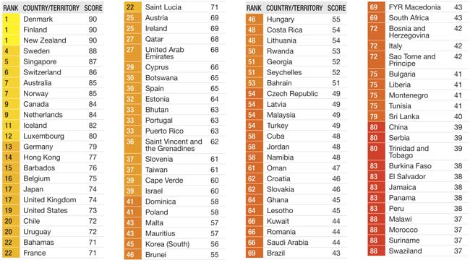
Transparency International Scores

Slide 29
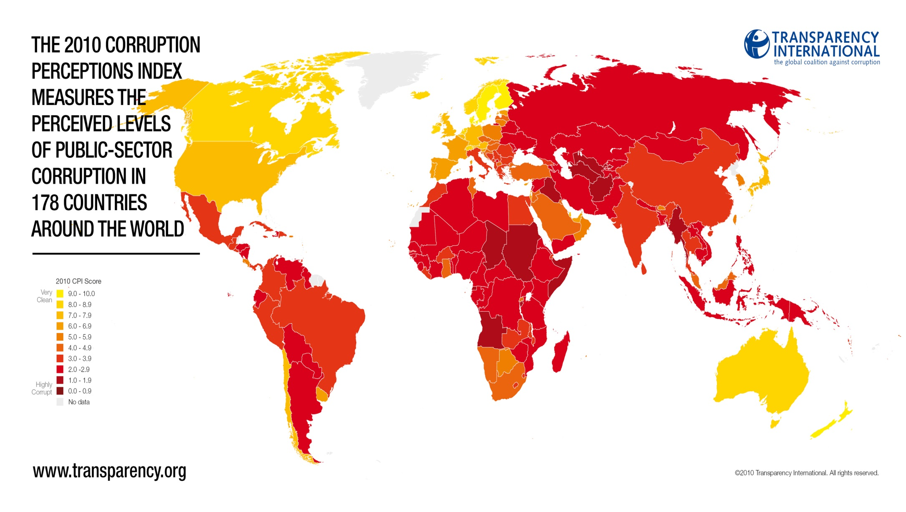

Slide 30
Causes of corruption
How to measure corruption?
  Transparency and WB measures of “perceived corruption”
Cross-national regressions
Key factors reducing corruption
  Protestant tradition
  history of British rule (common law versus civil law)
  high income
  long history of democracy (not current level)
  trade liberalization
It appears that corruption has deep roots
But potential for reverse causality & omitted variables

Slide 31
Corruption and income

Slide 32
Corruption and parking tickets
Some countries more corrupt than others
What happens when you take people out of corrupt environment?
Consider diplomats in NY who can ignore parking tickets
  How would diplomat from a corrupt country behave?
  How would diplomat from an honest country behave?

Slide 33
Who breaks the law?
Diplomats from corrupt countries break the law
But honesty is also sticky – internalized norms

Slide 34
Enforcement also matters

Slide 35
Two types of politics
You go into politics in order to get rich
You get rich and then you go into politics
Is this second better than the first?
Rich people in politics: Babis, Schwarzenberg, Barta, Topolanek

Slide 36
How would Czech politics look different without money?
Which policies would look different?
  Which parties would be more successful?
  Would policies be different? More conservative? Liberal? Social democratic?
Less corruption in form of kickbacks, public tenders, etc.
  How consequential is it for economy?

Slide 37
Some solutions

Slide 38
General ideas
Publicity for crimes
Increase penalties
Reduce size of government
More transparency
Anti-corruption bureau
Higher wages for bureaucrats
* But few have been tested

Slide 39

Master’s in Corruption Administration
Nevzali Vás na školu? Nebo Vás vzali, ale zjistili jste, že Vás vzít neměli? Nemáte prostředky na nákup běžného akademického titulu? Nechce se Vám ztrácet čas studiem? Právě pro Vás je skvělá nabídka Corrupt Tour University!
Žádné studium! Žádné zbytečné výdaje. Platíte pouze cenu papíru, tisku a administrativní poplatek 699 Kč. A nyní! V rámci předprodeje titulů na akademický rok 2013/14 mají první studenti50% slevu na pouhých 299 Kč!
Studium netrvá ani minutu a vede rovnou k cíli. Hit tohoto akademického roku! Nejžádanější obor, atraktivní titul. Pouze a jedině na Corrupt Tour University získáte krásný titul

Slide 40
www.nasipolitici.cz
Does this information help?
How should you act on it?
Does it encourage people to vote for new parties – ANO, Usvit, VV – because existing politics is corrupt?

Slide 41
www.ipaidabribe.com
Paid bribe for not having required papers
Police | Traffic Violations
Reported on April 02, 2014 from Pondicherry, Pondicherry | Report #100347
I was going on my friend's bike and i don't know where he will keep the papers for that bike. I said him i am a student and i don't know where the papers were and i have paid a bribe of Rs.200

Slide 42
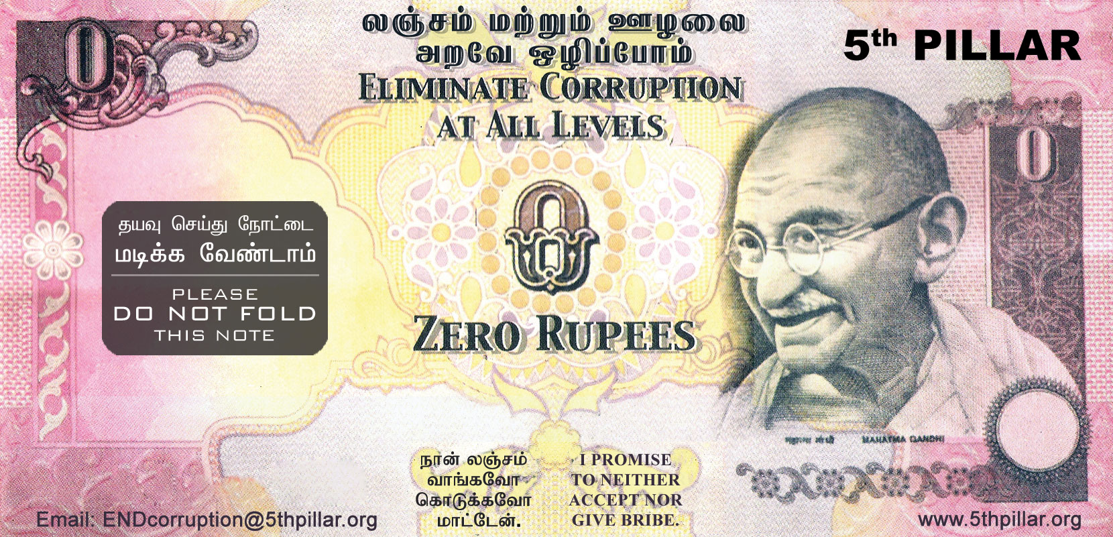
Zero rupee note

