Slide 1
Participation and tolerance
Lecture 6

Slide 2
Three forms of participation
Voting
Contentious politics
Civil society

Slide 3
Election turnout

Slide 4
Paradox of voting
You should vote if benefits > costs
  Costs = time and effort (C)
  Benefits = money, job if party wins
  p = probability of being decisive vote
  Vote if pB-C>0
But p = 0, your vote is almost never decisive
Therefore you rationally shouldn’t vote

Slide 5
Do we learn anything from rational model?
Higher costs => lower turnout
  Difficult registration or voting procedures
  More frequent voting
More competitive elections (higher p) => higher turnout
But still no reason to vote
How to think of benefits?
  Can add an extra term: D for civic duty
  Thus: pB – C + D

Slide 6
Another view of benefits
Benefits not just personal
If my candidate wins, it benefits many, many people
  Let’s say benefit = 5000 Kc and 5 million people benefit, then B = 2,500,000,000 Kc
Voting decisions are usually motivated by beliefs about social benefits not individual
  Sociotropic versus pocketbook voting

Slide 7
Turnout in advanced democracies
Average level of 70%
Declines from 80% in 1960s & 1970s to 60-70% today
More declines among young people

Slide 8
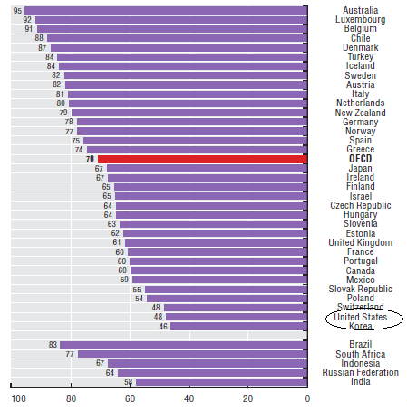

Slide 9
Explanations for variation
Lower stakes of elections
Cultural shift?
Compulsory voting in some countries
Proportional representation
  More choices
  More opportunities to be decisive vote
  But less clarity of results

Slide 10
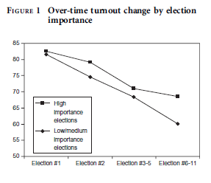
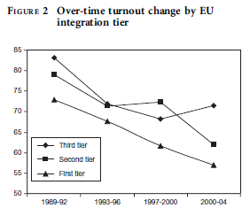
Postcommunist turnout
High turnout in first elections: >80%
Declining turnout since: range from 40% to 80%

Slide 11
Czech turnout

Slide 12
Why? Did it matter?
Has Czech politics stabilized at low level?
  What changed in early 2000s?
  Accession to EU
What would energize voters?
Who was helped and hurt?

Slide 13
Explanations for Czech turnout
Disenchantment
  Initially excitement, optimism
  Now corruption, economic problems
Importance of elections
  Decline after entering EU
  Higher for more important institutions
  Increase when democratization

Slide 14
Ways you can increase turnout
Key is social environment
Make voters feel wanted
  Personal invitation, live conversation on phone
Build on existing motivation
  Call back those who are interested
Show voters that others are watching
  Remind them that there is a public record

Slide 15
What works and doesn’t work
Works
Doesn’t work
Door-to-door canvassing
Telephone contact with live person
Direct mail
Leaflets
Robocalls
Email

Slide 16
Do we want to increase turnout?
Who doesn’t vote?
  Uneducated
  Uninformed
  Young
  Poor (except India – poor vote more)
Will they improve our choices?
But turnout as sign of legitimacy

Slide 17
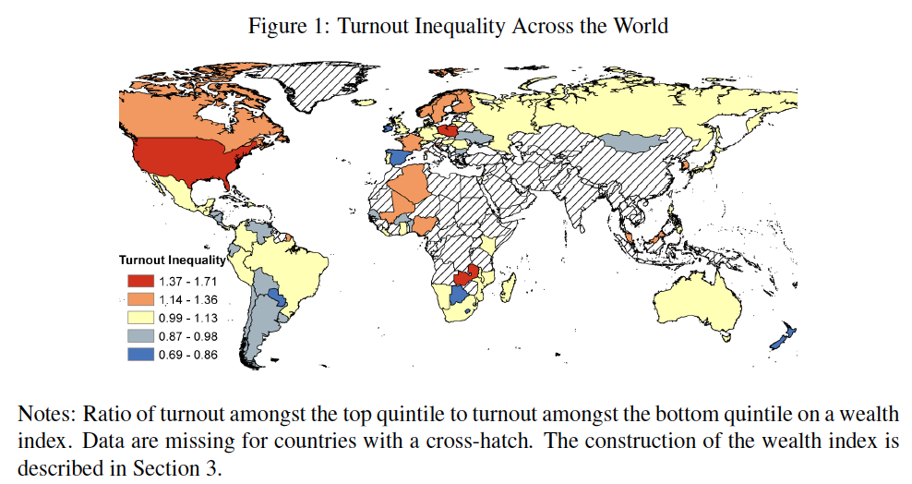
Turnout inequalities

Slide 18
Contentious politics

Slide 19
Contentious politics rising?
Increase in percentage of people who:
  Sign petitions
  Participate in boycotts
  Participate in demonstrations
Why does this increase when voting declines?
But still a small number

Slide 20
Why do people participate in contentious politics?
Resources
  Education, money, time
  Sense of efficacy
Mobilization by politicians and movements
  Social networks

Slide 21
Postcommunist patience
Big mystery is lack of protest given economic problems & corruption
  Signed a petition: 21% versus 58% in West
  Participated in boycott: 5% versus 12%
  Participated in demonstration: 13% vs 19%
  Compare Latin America: riots & demonstrations
Why?
  Older citizens
  Alternative sources of income
  Fewer urban poor

Slide 22
Civil society

Slide 23
Tocqueville’s Argument
Need voluntary groups for democracy to work
  Worry that expanding bureaucracy will overwhelm atomized citizens
  Groups enable citizens to defend themselves against government and limit what government needs to do

Slide 24
How does civil society help government work better?
Creates trust and cooperation among people
  Government can work with light touch: efficiency
People aware of public policy and able to express interests
  Government can be more responsive
Could there be tradeoffs?

Slide 25
Weakness of postcommunist civil society
Average number of organizational memberships
  Sports, church, unions, political party, environmental, professional, charitable
Western Europe: 2.4 organizations/person
Latin America: 1.8
Postcommunist: 0.8

Slide 26
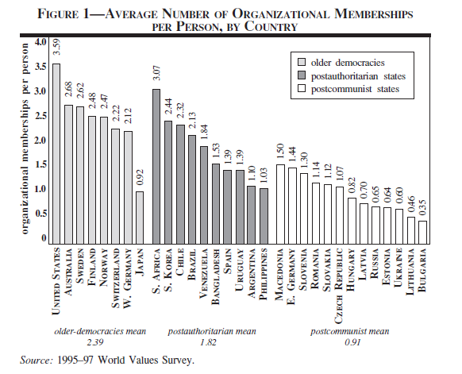
Civil society in postcommunist Europe

Slide 27
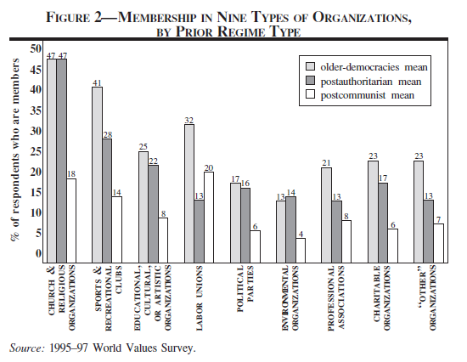
Types of organizations

Slide 28
Why so weak?
Marc Morje Howard: past experiences from communism
  Lack of trust
  Disappointment from transition
  Persistence of friendship networks
But shouldn’t this disappear over time?
Do you join clubs/organizations? Why? Why not?

Slide 29
How does civic community get started?
Collective Action Problem: everyone benefits and individual contribution doesn’t matter
Social context key (social capital)
  Where strong norms, networks, and trust, then civic community flourishes
Virtuous circle versus vicious circle

Slide 30
Creative leadership?
Antanas Mockus – mayor of Bogota
  7000 community security groups
  Homicide down 70%
  Traffic fatalities down 50%
  Drinking water provision up from 79% to 100%

Slide 31
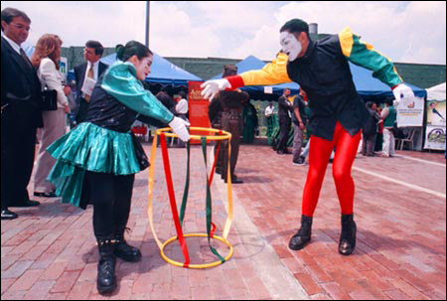

Slide 32
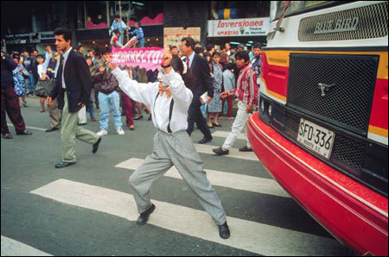

Slide 33
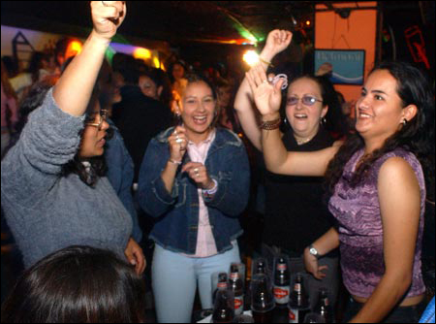

Slide 34
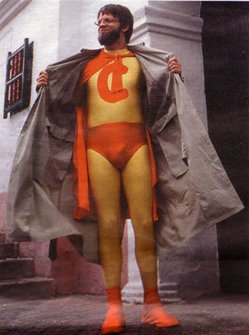

Slide 35
America the leader?
Traditionally very strong associational life
But large decline in last 50 years
Do new organizations make up for this?
  Contributing money versus attending a rally
Bowling alone?

Slide 36
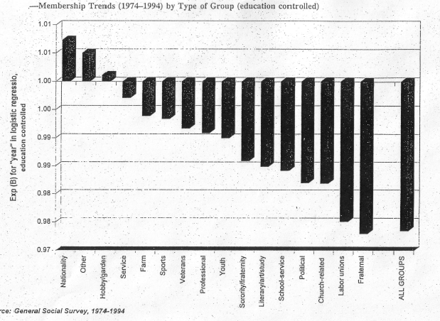

Slide 37
Why has social capital declined in America?
Time and money pressures?
Mobility?
Changing role of women?
Eclipse of traditional family?
Rise of welfare state?
Generational effects
  Yes, long civic generation born between 1910s and 1940s participates much more

Slide 38
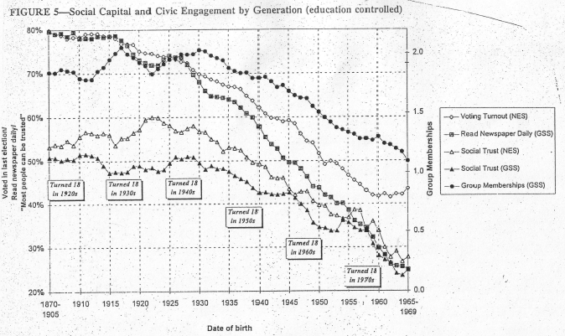

Slide 39
What happened?
Television
  1950: 10% of homes, 1959: 90% of homes
TV viewing strongly and negatively correlated with trust and membership; destroys social capital
When you are on your deathbed, are you going to say: “My one regret in life is that I didn’t watch more TV.”

Slide 40
What can you do?
Surprise a neighbor by making a favorite dinner
Help fix someone’s flat tire
Join an organization
Sing in a choir
Perform in a volunteer theater
Attend parades
Read the local news faithfully
Pick it up even if you didn’t drop it
Buy a big hot tub
Attend gallery openings
More at www.bettertogether.org

Slide 41
Tolerance

Slide 42
Measuring tolerance
Abstract:
  Do you agree with freedom of speech?
  Do you support rights for minority?
Least-liked group
  Which group do you like least: communists, atheists, fascists, homosexuals, racists, etc.
  Should this group be allowed to… hold a rally, run for office, give political speeches

Slide 43
Levels of tolerance
Initial studies: not as high as expected
Despite abstract support for tolerance, less tolerance of disliked groups
Trend over last 50 years is positive

Slide 44
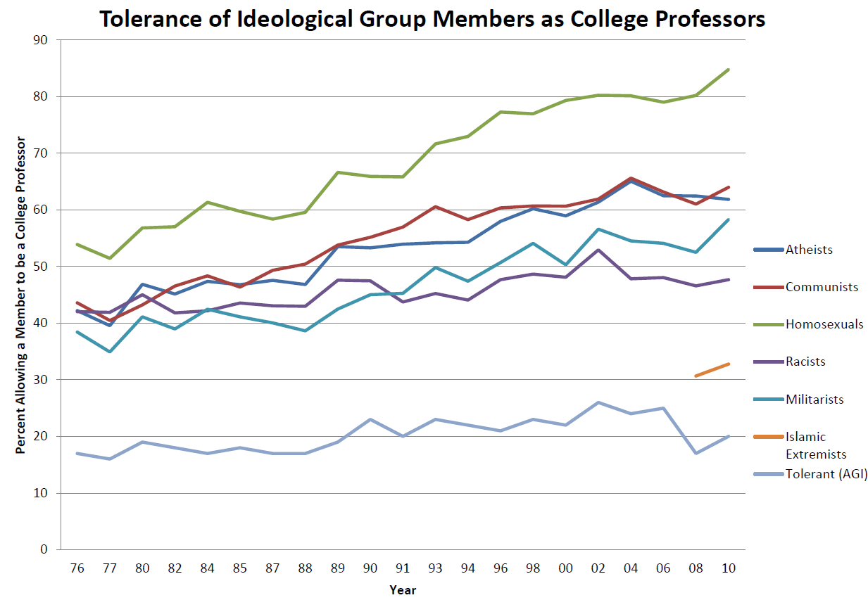

Slide 45
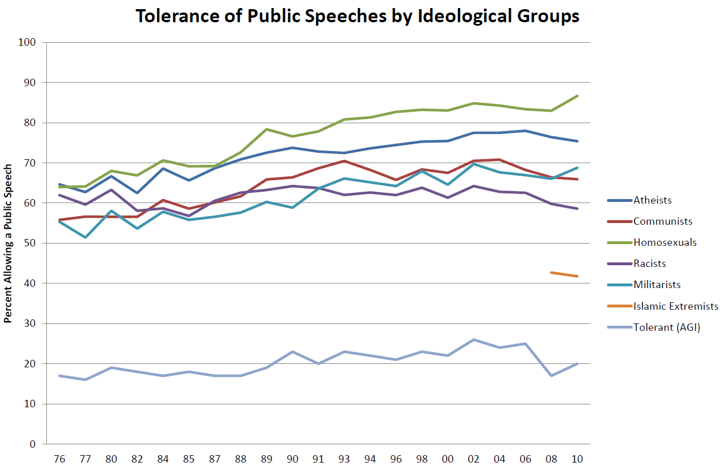

Slide 46
Determinants of tolerance
Portrayal of group/ideas by media & elite – threatening or not
Support for democratic norms
Personality
  Negative: insecurity, dogmatism, extroversion,
  Positive: openness to experience, trust

Slide 47
Recent work by Putnam
Finds that more diverse communities have
  Less trust both between and within groups
  Lower participation and volunteering
  Less happiness and fewer friends
  More time watching TV
Contradicts both contact hypothesis and conflict hypothesis

Slide 48
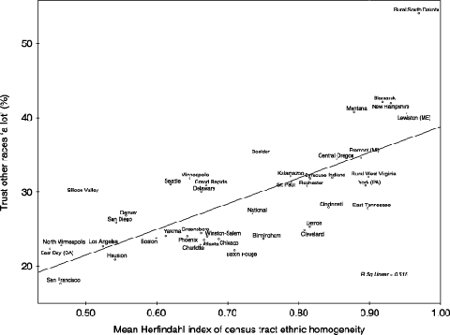
Ethnic homogeneity & trust

Slide 49
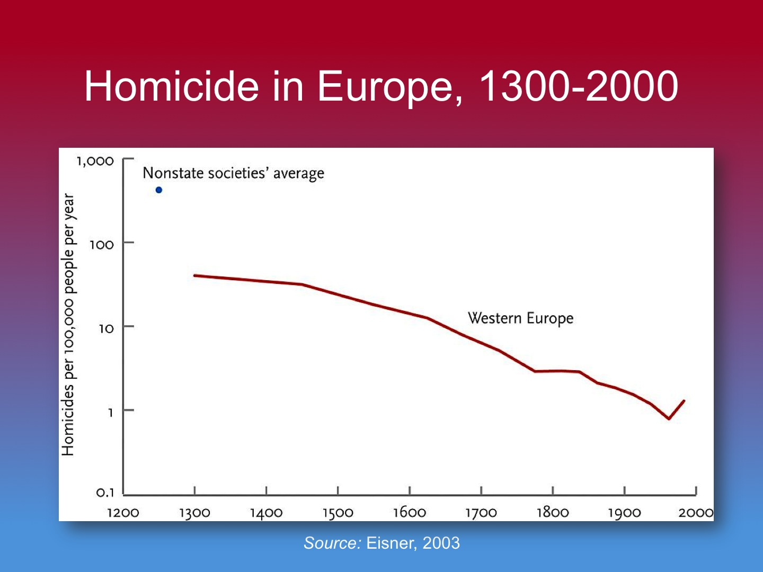
But also long-term decline in violence

Slide 50
Why?
Leviathan: power of state
Commerce: mutual benefit
Feminization: more respect for women
Cosmopolitanism: literacy, media – see perspective of others
Reason: come to see futility of violence

