Slide 1
Today
Feedback on assignments and some writing tips for the future
Health interventions
  Group work on intervention design
    Intervention mapping strategy
Technology-mediated interventions
  JITAIs
The process of illness and illness cognitions
  Illiness cognitions
  Stress, Pain (May 5)

Slide 2
Assignments
Assignment 3 – mismatch between theory and methods and strategies
APA formatting
Adhere to page limit
Academic writing tips
  Formal vs. informal
    Not necessarily passive voice
    Watch out for word choices (pretty, well, …)
  Do not abbreviate – it’s ….it is
  Effective transition sentences versus “filler” sentences
    Consider the difference
      In the next section, I will write about a theory that I can apply towards achieving my goals.
      Vs.
      Health behavior theories can be useful in guiding interventions towards achieving goals.

Slide 3
Focus on Theory-Based Interventions
Implementation and evaluation
Design and planning
Theoretical foundation

Slide 4
General Steps in Planning Models
Step 1
  Identify behavior and target population
Step 2
  Identify relevant influences on behavior
Step 3
  Select intervention methods
Step 4
  Develop intervention strategies

Slide 5
Steps 1 & 2
Should involve needs assessment
Should result in the identification of appropriate intervention goals and objectives

Slide 6
Need Assessment
Key is to identify needs based on evaluation of current conditions and desired conditions
Involves gathering of new data as well as use of existing secondary data sources
Ultimately should inform why intervention needs to take place and what may be the key intervention components.
Various methods utilized to complete need assessment (surveys, focus groups, observation groups, interviews, community or expert forum, public health data and databases, etc.)

Slide 7
Steps 3 & 4
Are informed by research in Step 1 & 2
Involve selection of intervention methods and strategies
  What will be done in order to change behavior?
These steps represent the creative part of intervention planning – this is where planning becomes reality

Slide 8
Steps 3 & 4
Brainstorming methods
  How can we use the performance objective to alter the determinant?
Delineating methods
  Which methods have been successfully used in the past?
  How were previous programs similar/different from this program?
Translating methods into strategies
  How can we deliver our program to our target population?
  Is there a necessary sequence in the methods we will use?
Operationalize strategies
  Organize strategies into a deliverable program
  Specify channels of delivery/communication
Design program materials
  Planning documents, schedules
  How do you hold yourself accountable?
Pretest instruction materials
Produce program materials

Slide 9
Intervention Mapping
Helps answer your questions:
How do I set appropriate intervention goals?
When in the planning process do I use theory to guide decisions?
How do I know what theory, methods to use?
How do I develop concrete strategies?
How do I implement them?
…

Slide 10

Let’s Create an Intervention Map

Slide 11
NEEDS ASSESSMENT
Identify the at-risk population, quality of life and health problem
Distinguish environmental and behavioral causes
Review key determinants
INTERVENTION MAP
Outcomes
Proximal Program
Objective Matrices
Theoretical Methods
and Practical Strategies
Program Design
Adoption & Implementation Plan
Monitoring & Evaluation Plan
Tasks
Specify the performance objectives
Specify important, changeable determinants
Differentiate the target population
Create matrices of proximal program objectives
Brainstorm methods to achieve proximal program objectives
Use the theoretical and empirical literature to further delineate methods
Translate methods into strategies
Operationalize the strategies into plans considering implementors and sites
Design instruction materials
Pretest instruction materials with the target group
Produce the materials
Develop a linkage system
Specify adoption and implementation performance objectives
Specify determinants of adoption and implementation
Write the implementation plan
Develop an evaluation model using information from previous steps of intervention mapping and information from the needs assessment
Develop effect evaluation questions, referring to the matrices of proximal program objective as blueprints for instrument development
Develop process evaluation questions from the needs assessment and intervention map
EVALUATION
IMPLEMENTATION

Slide 12
Intervention Mapping
Population: African American Urban Youth
Intervention Goal | Determinant | Determinant
 | Lack of Knowledge | Lack of Resources
Accumulate 30 minutes of VIGOROUS PA outside of school | ???
Limit time TV/computer screen time to 1 hour per day
Proximal program objective: Action statement indicating what individuals must learn or what must change in the social context as a result of the program.

Slide 13
Question
What is an appropriate proximal program objective for ???
Intervention Goal | Determinant | Determinant
 | Lack of Knowledge | Lack of Resources
Accumulate 30 minutes of VIGOROUS PA outside of school | ???
Lack knowledge about the benefits of vigorous PA and amount needed.
Understands the health benefits of vigorous PA and amount recommended.
Has barriers to performing 30 minutes of vigorous PA outside of school.

Slide 14
Question
What is an intervention method?
Use of exercise logs
Self-monitoring
Face-to-face instruction
Pedometers

Slide 15
Question
What is an intervention strategy?
Self-talk
Goal-setting
Weekly feedback forms
Reinforcement

Slide 16
Methods versus Strategies
Theoretical methods: A generalized technique used to influence a determinant
Practical strategies: A plan for organizing and delivering methods

Slide 17
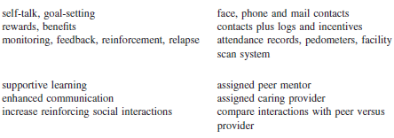
Methods versus Strategies

Slide 18
Methods versus Strategies
METHODS
STRATEGIES

Slide 19
Applying Intervention Mapping
Treatment Resistant Depression Exercise Trial – Planning Phase
Intervention objectives | Determinant 1 Lack of energy/fatigue | Determinant 2 Lack of enjoyment | Determinant 3 Time constraints
Reach level of PA guidelines | Understands importance of gradual progression and allowing time for adaptation | Understands importance of moderate intensity and explores enjoyable types of exercise | Learns how to schedule 150 min of physical activity into a week in a flexible manner
Improve symptoms of depression

Slide 20
Steps 3 & 4
Brainstorming methods
  How can we use the performance objective to alter the determinant?
Delineating methods
  Which methods have been successfully used in the past?
  How were previous programs similar/different from this program?
Translating methods into strategies
  How can we deliver our program to our target population?
  Is there a necessary sequence in the methods we will use?
Operationalize strategies
  Organize strategies into a deliverable program
  Specify channels of delivery/communication
Design program materials
  Planning documents, schedules
Pretest instruction materials
Produce program materials

Slide 21
TRD Example
Methods | Strategies
Information provision | Provide information in a booklet (importance of PA, recommended levels, relevance for depression and other health risks/benefits)
Teaching behavioral skills | In-person instruction and provide information in booklet, handouts, newsletters (self-monitoring, selecting appropriate activities across different settings)
Increasing motivation | Provision of feedback and encouragement through feedback reports and instructor consultation
Teaching self-regulation skills | In-person instruction and provide information in booklet (time management strategies, use of implementation plans, how to overcome common barriers and recover from setbacks)
Self-efficacy | Self-monitoring through exercise logs, feedback reports, in-person consultation about progress and success, vicarious learning through interaction with other participants

Slide 22
TRD Example
Program Description
Mode | Face-to-face
Location | University fitness center
Schedule | Flexible hours (morning, mid-day, evening classes) plus general membership
Treatment Duration | 12 weeks
Treatment Progression | Weeks 1-4 – 3 supervised + 2 home-based per week Weeks 5-8 – 2 supervised + 3 home-based per week Weeks 9-12 – 1 supervised + 4 home-based per week Weeks 1-6 – gradually increase duration per session (start at 15 min up to 45 min) at low-to-moderate intensity (RPE = 10-12; HR = 50-60% MaxHR) Weeks 7-12 – maintain duration and increase intensity to moderate range (RPE = 12-15; HR = 60-70% Max HR)

Slide 23
Group Activity
Create intervention objectives
Brainstorm methods using CALO-RE taxonomy
  Which methods can we use to achieve proximal objectives and change intervention determinants?
Translate methods into practical strategies
  How can we deliver the methods to participants?
Determine the overall parameters of your intervention
  Design, channel/platform, duration, frequency of contact, etc.
Intervention Goal | Determinant | Determinant

Slide 24
Logic Models
Logic models help identify the factors that will impact your program and enable you to anticipate the data and resources you will need to achieve success.
  Cataloguing of the resources and actions you believe you will need to reach intended results.
  Documentation of connections among your available resources, planned activities and the results you expect to achieve.
  Description of the results you are aiming for in terms of specific, measurable, action-oriented, realistic and timed outcomes.

Slide 25
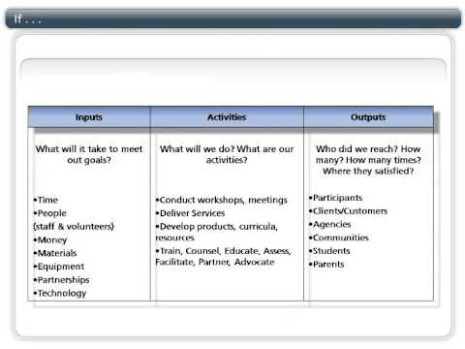
Logic Models

Slide 26
Logic Models

Slide 27
Logic Models
Resources | Activities | Outputs | Short & long-term outcomes | Impact
In order to accomplish our set of activities we will need the following: | In order to address our problem or asset we will conduct the following activities | We expect that once completed, these activities will produce the following evidence of service delivery: | We expect that the activities will lead to the following changes in the next 6 months – 1 year… | We expect that the activities will lead to the following changes in the next 5 years…
• Qualified & dedicated staff • Endorsement from Psychiatric clinic • Donated hospital fitness center time • Job descriptions for staff • First year’s funding ($50,000) • Equipment • . . . | Launch staff search Secure clinic endorsement and fitness center time Create job descriptions and staff manual Design and implement funding strategy Secure equipment . | # of patients recruited/referred # of staff members trained Level of funding secured .
Or:
Proximal Outcomes
Or:
Distal
Outcomes

Slide 28
Mediated Interventions
Use of non-face-to-face approaches (especially technology)
Goals
  Providing interventions to large numbers of people at low cost (SCALABILITY)
  Provide health messages to the population
What are the platforms?
  mass-reach broadcast media
  print-based materials (by mail)
  audiovisual materials (videos, tapes)
  newer multimedia (internet, cell phones, smartphones, ipads/tablets, exergaming, etc.)

Slide 29
Communication Theory
S-M-C-R model
Computer-mediated communication
S-M-C-R-F model
Human computer interaction
Source (interventionist/intervention system)
Message (content of intervention)
Channel (platform)
Receiver (users/participants)
Feedback (sensor device)

Slide 30
Mass Media Campaigns
Participaction
Since 1971
Social marketing approach to physical activity promotion
a national not-for-profit organization solely dedicated to inspiring and supporting active living and sport participation for Canadians
sectors represented include business, education, entertainment, media, social service, government, healthcare, physical activity, sport and recreation and research
http://www.youtube.com/watch?v=a6j9VdMcN9k

Slide 31
Other Media
Interactive Voice Recordings (IVR)
  Avatars
Social Media
  Populations?
  Your experiences?
Text messaging
  Content, frequency versus message exposure
Smartphones
  Integration of technology – built-in accelerometers
Other?

Slide 32
Apps
Apps generally observed to be lacking in theoretical content
The health belief model was the most prevalent theory
Higher priced apps and apps that addressed a broader activity spectrum associated with higher theoretical fidelity and credibility
More likely to be used personally or recommended to a health care client
Many cater to already active populations
What is their longevity????
What was your experience?

Slide 33
Apps – cont.
Cowan et al. (2012):
Content analysis of 127 apps from Apple's (App Store) Health & Fitness category
Inclusion of theoretical constructs from prominent behavior change theories (20 theoretical constructs)
Apps were generally observed to be lacking in theoretical content (89%)
Theory scores ranged from 1 to 28 on a 100-point scale.
The health belief model was the most prevalent theory, accounting for 32% of all constructs
Higher priced apps and apps that addressed a broader activity spectrum were associated with higher total theory scores.

Slide 34
Apps – cont.
West et al. (2012)
Content analysis of health and fitness app descriptions available on iTunes during February 2011 (3336 paid apps)
Only 1.86% (62/3336) included predisposing, enabling, and reinforcing factors
Compared to apps with a cost less than US $0.99, apps exceeding US $0.99 were more likely to be scored as intending to promote health or prevent disease to be credible or trustworthy
More likely to be used personally or recommended to a health care client

Slide 35
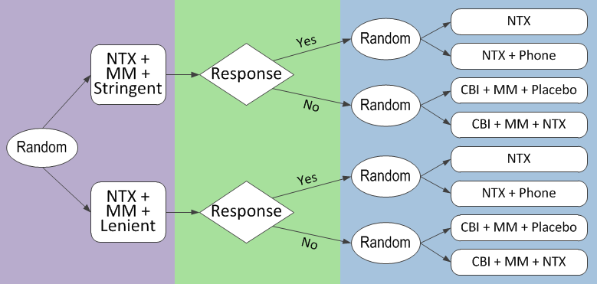
SMART
Sequential, Multiple Assignment, Randomized Trial
Adaptive interventions, individually tailored treatments
Lei H, Nahum-Shani I, Lynch K, Oslin D, Murphy SA. Annu Rev Clin Psychol. 2012;8:21-48

Slide 36
SMART
Just-in-Time Adaptive Interventions (JITAIs)
Adaptation guided by
  Distal and proximal reponse
Adaptation made up of
  Tailoring variables
  Decision rules
  Treatments
Adaptation triggered at
  Decision points
Nahum-Shani I, Smith SN, Spring BJ, Collins LM, Witkiewitz K, Tewari A, Murphy SA (2016) Ann Behav Med.

Slide 37
JITAI
Hypothetical example
Distal response – overal physical activity
Proximal response – step count over next hour
Tailoring variable (e.g., what could moderate response?)
  Availability
  Location
  Step count
Decision rule
  IF available, THEN
        If at home = Yes,
        THEN Text=prompt tip for home exercise
        Else if at home = No
        THEN Text=prompt tip for …..
  Else if not available, THEN Text= do nothing
Decision point (guided by dynamics of tailoring variable and effects of treatment)
  Every 2 hours
Treatment
  Self-monitoring (daily step count)
  Feedback provision (automated)
  Goal setting (medium)
  Daily prompts (tailored)

Slide 38
JITAI
In what context are pushed messages most effective? (home versus work or morning versus afternoon)
What is the appropriate frequency of pushed messages?
Micro-randomized trial
  Randomize each participant between treatments at each decision point
  (100-1000 or more randomizations)
  Sequential, factorial designs
    Time-varying main effects, interactions/moderation (are then used to inform decision rules…)
  This approach becoming a standard in developing mobile health interventions
Nahum-Shani I, Hekler EB, Spruijt-Metz D. (2015) Health Psychology.
www.methodology.psu.edu
Notes:
Link back to DREAM – combined with EMA, trigger intervention during hightened level of stress

Slide 39
The Process of Illness
Think of the last time you were ill (e.g., headache, flu, broken limb, etc.).
Consider the ways in which you made sense of your illness, how they related to your coping strategies and how you recovered.

Slide 40
What does it mean to be ill?
Not feeling normal
Specific symptoms
Specific illnesses
Consequences of illness
Time line
Absence of health

Slide 41
Illness Cognitions
A patient’s own implicit common sense beliefs about their illness
Provide schema for coping with illness, understanding their illness, warning signs
Leventhal et al. (1980)
Perceived cause
Identity
Illness cognitions
Time line
Cure / Control
Consequences

Slide 42
Self-Regulatory Model of Illness Behavior
Representation of health threat
Identity
Cause
Consequences
Time line
Cure/Control
Stage 1: Interpretation
Symptom perception
Social messages
Stage 3: Appraisal
Was my coping strategy effective?
Stage 2: Coping
Approach coping
Avoidance coping
Emotional response to health threat
Fear
Anxiety
Depression

Slide 43
Symptom Perception
Discuss
  Symptoms are more than just a sensation.
What influences symptom perception?
  Draw a model

Slide 44
Symptom Perception
Symptom perception
Demographics
Internal/external focus
Social context
Attachment style
Cognition
Mood

Slide 45
Coping
Illness as a crisis (Moos & Schaefer, 1984)
  Changes in identity
  Changes in location
  Changes in role
  Changes in social support
  Unpredicted event
  Insufficient or unclear information about illness
  Decision needed quickly
  Ambiguous meaning
  Limited prior experience
Coping as a process (Moos & Schaefer, 1984)
  (1) Cognitive appraisal (2) Adaptive tasks (3) Coping skills

Slide 46
Coping with the crisis of illness
Background factors
Demographic and social factors
Physical/social environmental factors
Illness-related factors
Adaptive tasks
Illness-specific
General
The crisis of illness
Cognitive appraisal
Is my illness serious?
OUTCOME
Coping skills
Appraisal-focused
Problem-focused
Emotion-focused

Slide 47
Videos
https://www.youtube.com/watch?v=YY3d4dyFRog
Harvard Innovation Lab talk
https://www.youtube.com/watch?v=oPrlBJZah5Y
https://www.youtube.com/watch?v=kVZLR_rxjfE

