Slide 1
Today
Health beliefs, health behaviors, and behavior change
  Addictive behaviors
  Eating behavior, exercise behavior
  MHBC, motivational interviewing

Slide 2
What are health behaviors?
Kasl and Cobb (1966)
Health behavior | Behavior aimed to prevent disease (e.g., eating a healthy diet)
Illness behavior | Behavior aimed to seek remedy (e.g., to the doctor)
Sick role behavior | Activity aimed at getting well (e.g., taking prescribed medication)
Matarazzo (1984)
Health-impairing habits | Behavioral pathogens (e.g., smoking, eating a high fat diet)
Health protective behaviors | Behavioral immunogens (e.g., attending a health check)

Slide 3
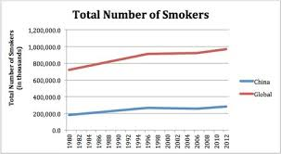
Smoking
Smoking behavior is on the decline but decrease I greater in men than in women
Smokers tend to be in the unskilled manual group
Smokers tend to earn less than non-smokers
Two-thirds of smokers report wanting to give up smoking
58% of smokers say that it would be fairly/very difficult to go without smoking for a whole day

Slide 4
Components of cigarettes
Nicotine
  Primary addictive substance, pleasurable
  Acts directly on CNS
Tars
  Chemicals which are carcinogenic
Carbon Monoxide (CO)
  CO reduced amount of O2 in blood and places strain on heart muscle

Slide 5
Smoking and Health
Smoking is the greatest single cause of preventable deaths (> 20% of all deaths)
  Half of those who smoke throughout their life will die as a direct result of their habit
  Half of these deaths will occur in middle age with an average of 21 years of life lost
  The rest will occur in old age, with around 8 years lost
  Average reduction of life expectancy = 5-9 years
  Smoking contributes to…
  Heart disease
  Cancer
  Stroke
  Influenza and pneumonia
  Chronic bronchitis
  Emphysema
  Peptic ulcers
  Respiratory disorders
  Lower birth weight in offspring

Slide 6
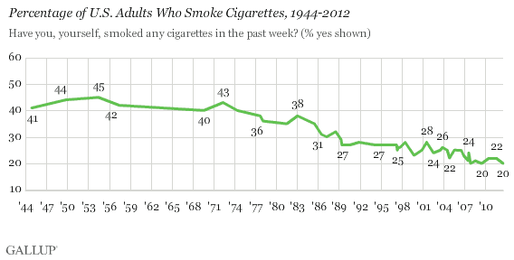
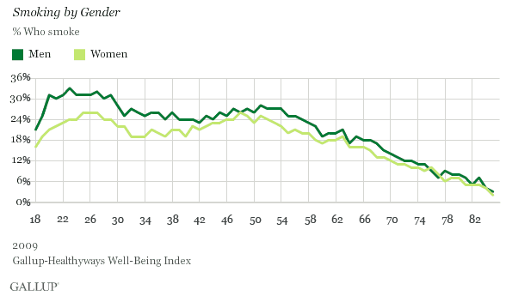
Smoking
- USA

Slide 7
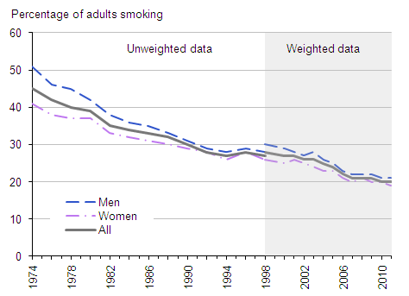
Smoking - UK

Slide 8
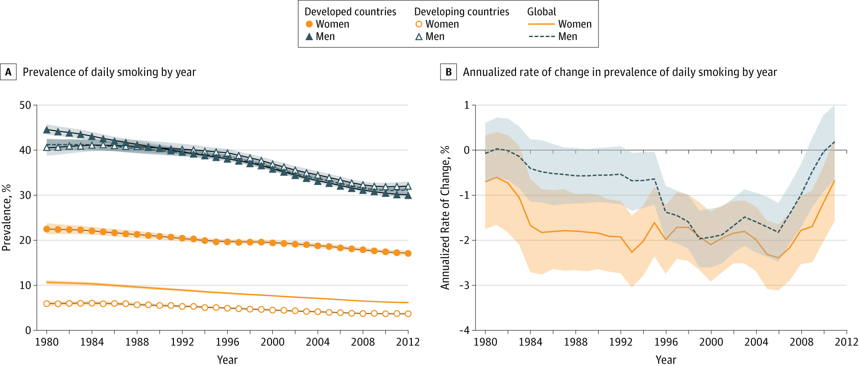
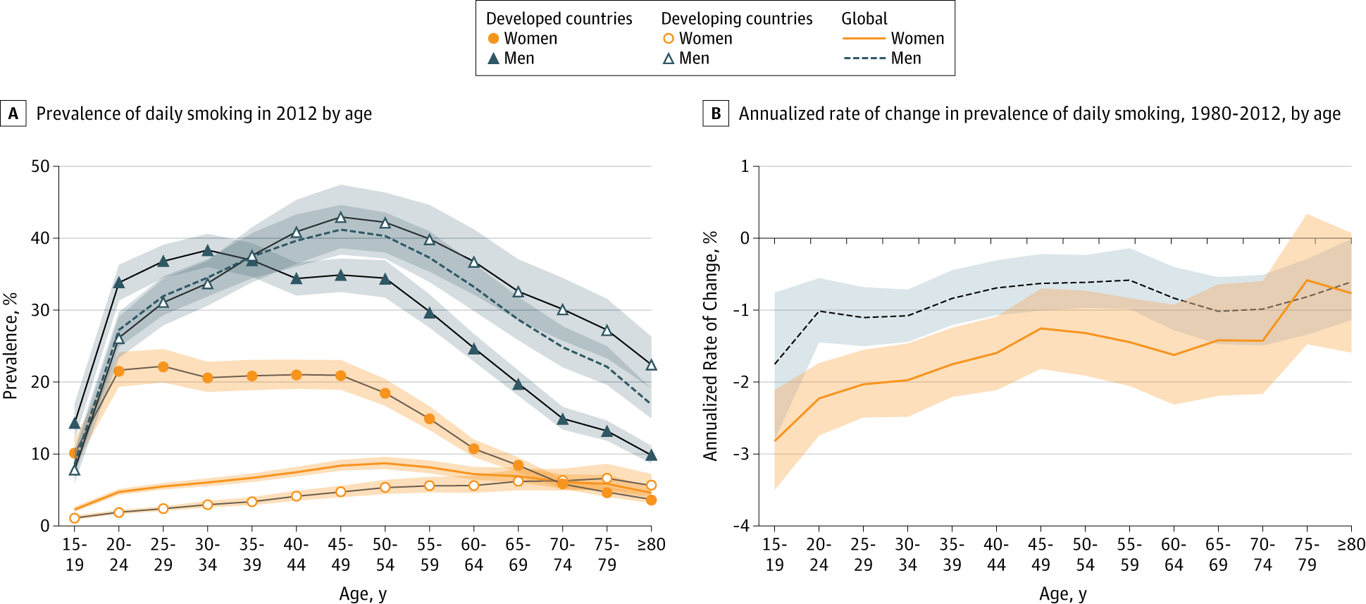
Smoking – Global (Ng et al., JAMA, 2014)

Slide 9
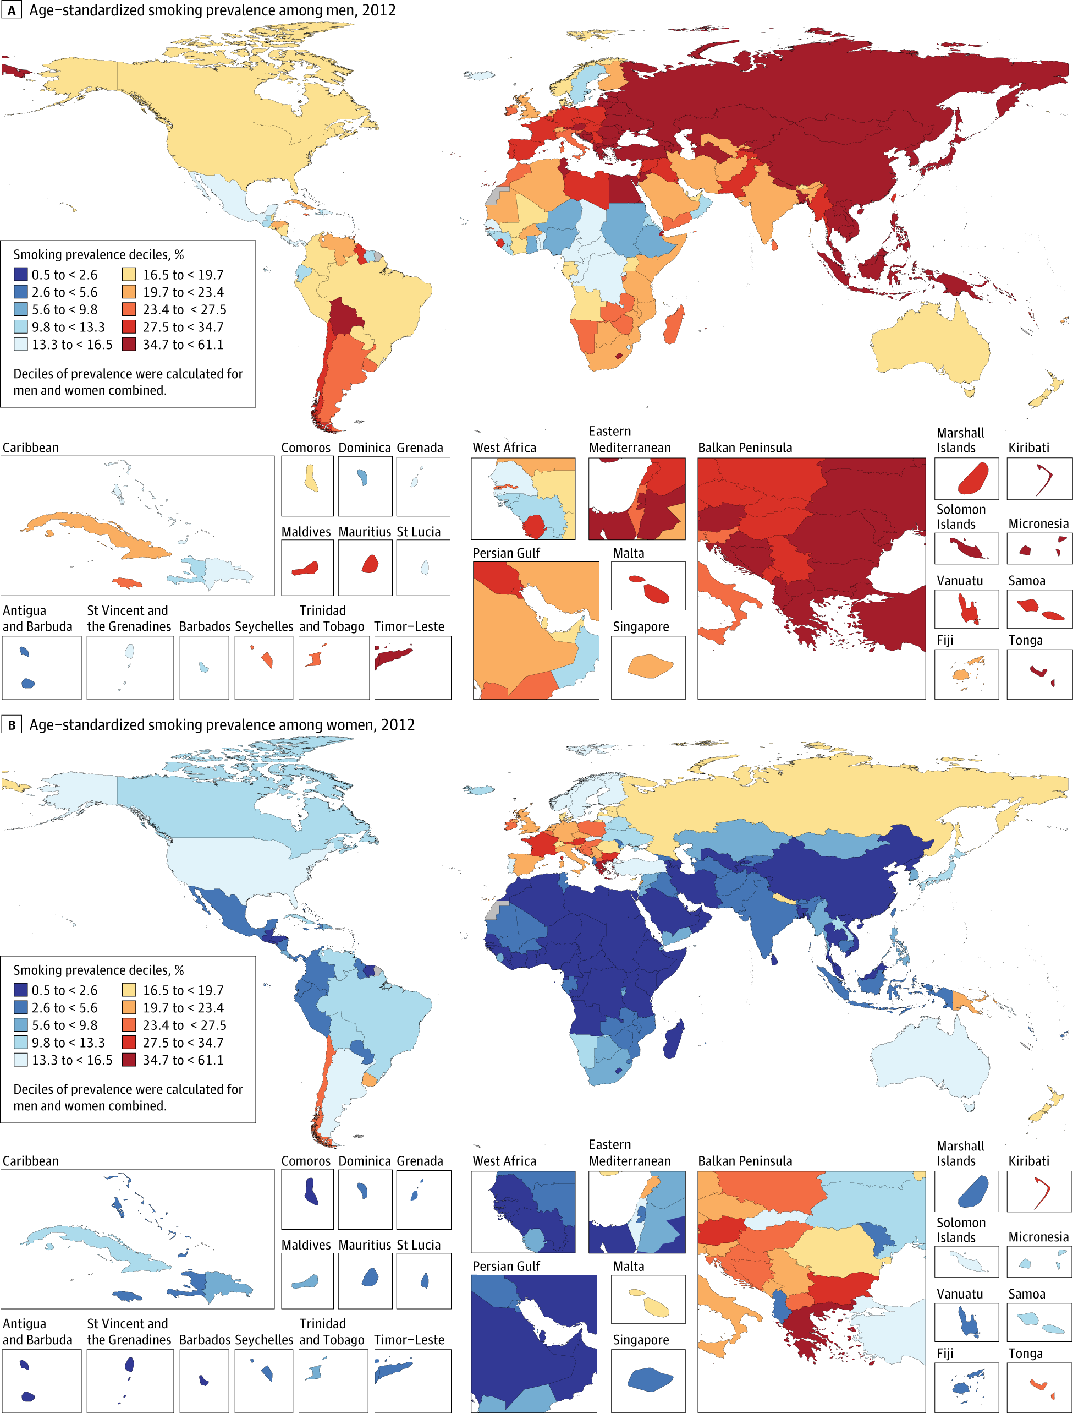
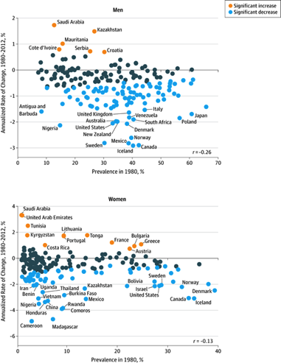
Smoking – Global (Ng et al., JAMA, 2014)

Slide 10
Why do people smoke?
Start
  Social learning (modeling)
  Peer pressure
    95% begin in teen years
    Know smoking is dangerous but say will stop
Continue
  Genetic (?)
  Dependence (nicotine-regulation)
  Reinforcement (peers, feeling good, performance)

Slide 11
Treatments for Smoking
Nicotine-replacement therapy
Aversion therapies
Self-management strategies
Multi-modal approaches
Relapse rate = 70-80% after 1 year
Factors
  Abstinence-violation effect
  Weight gain (2 pounds)
  Social support
  Intrinsic motivation (better than extrinsic)
  Stress

Slide 12
Helping Smokers
5 As (willing to quit)
  Ask about tobacco use
  Advise to quit
  Assess willingness to make a quit attempt
  Assist in quit attempt
  Arrange follow-up
5 Rs (unwilling to quit)
  Relevance
  Risks
  Rewards
  Roadblocks
  Repeat

Slide 13
Alcohol Consumption
The majority of adults have drunk alcohol in the past year
Men are more likely to drink alcohol than women
Men are more likely to have drunk on five or more days in the past week than women
Men aged 16-24 drink the most
There are no sex differences in the 24-35 age range
About 70% of adults drink alcohol at least occasionally
  about 10% are ‘problem drinkers’ (health damage)
  About 5% are ‘alcoholic’ (alcohol dependence)
Two vulnerable times
  Teenage years
  Late middle age

Slide 14
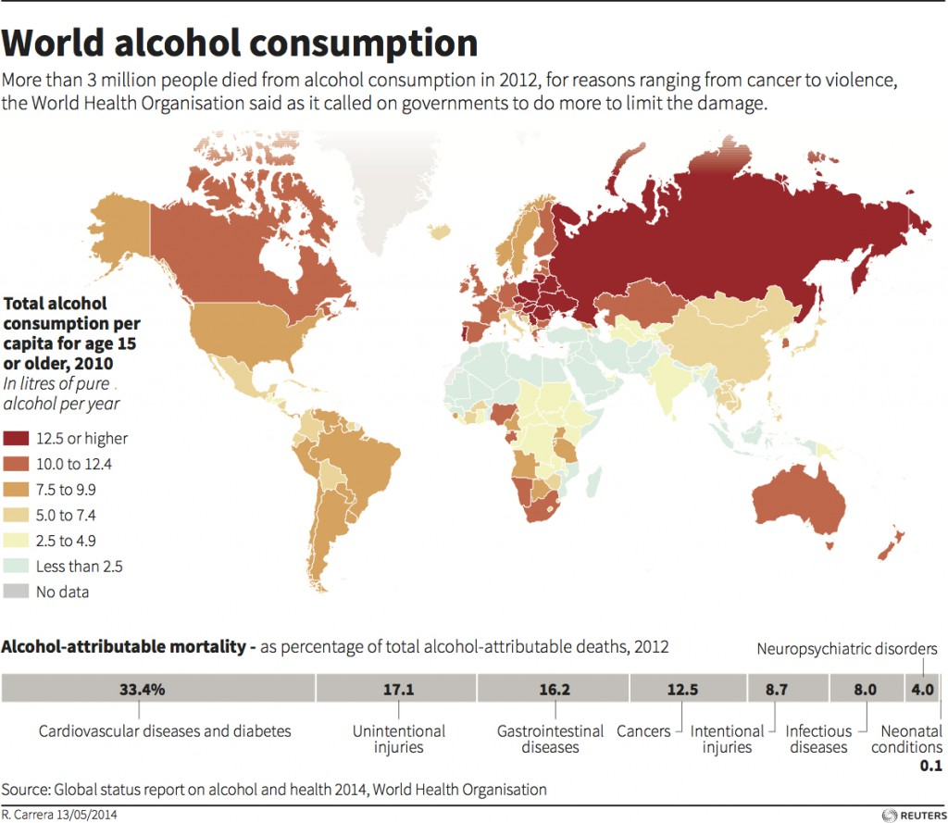
Alcohol Consumption - Global

Slide 15
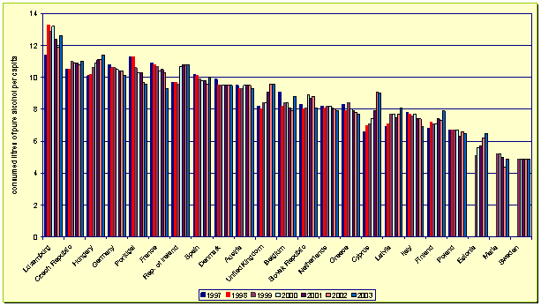
Alcohol Consumption - EU

Slide 16
Why do people drink?
Start
  Social learning (modeling)
  Peer pressure
Continue
  Dependence
  Reduce social anxiety
  Tension relief
  Reinforcement

Slide 17
Addictive Behavior
Psychological theories
  Social learning perspective
    (1) classical conditioning; (2) operant conditioning; (3) observational learning; (4) cognitive processes
Biological theories
  Disease perspective
    Addiction
Social theories
  Social reinforcement
  Social identity

Slide 18
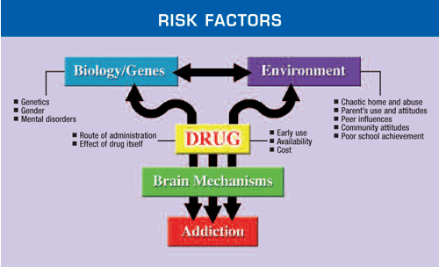
Addictive Behavior
Results of the interaction of person factors and the environment
https://www.drugabuse.gov/publications/drugs-brains-behavior-science-addiction/drug-abuse-addiction

Slide 19
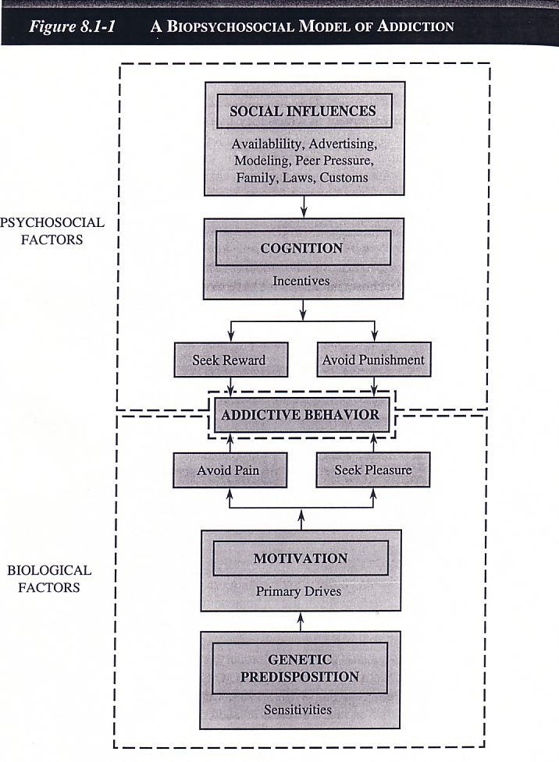
Addictive Behavior
Treatments for Alcohol Abuse
Detoxification
Alcoholics Anonymous
Psychotherapy
Aversion therapies

Slide 20
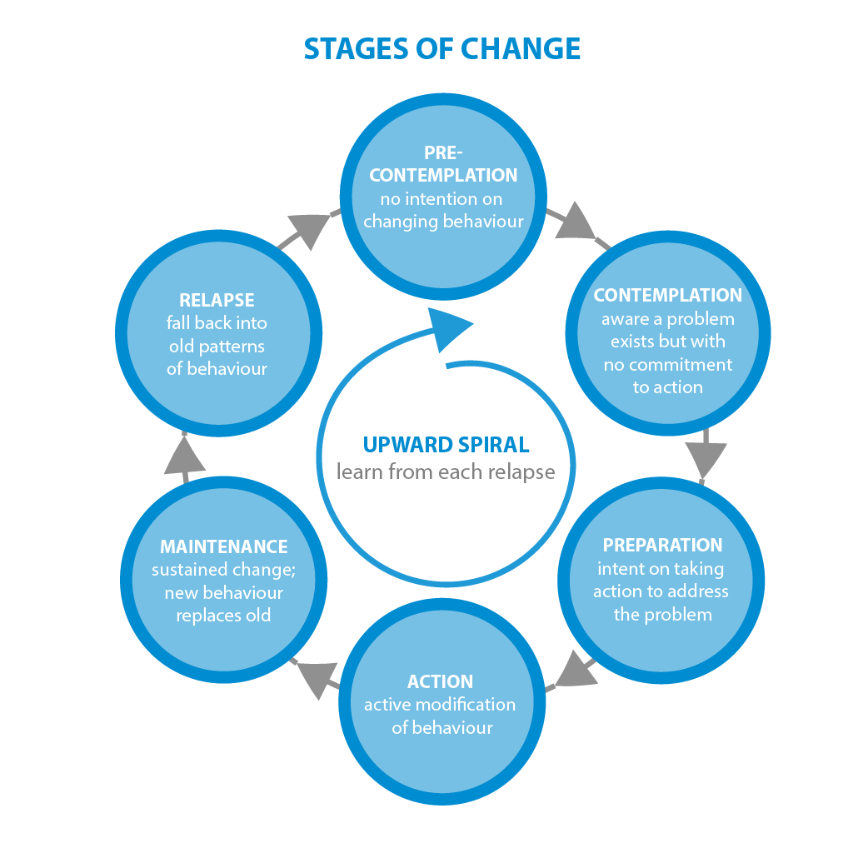
Addictive Behavior
Stage-based models used widely in addiction treatment programs
Relapse prevention and coping strategies key parts of addiction treatment programs

Slide 21
Discussion
Piper et al. (2016)

Slide 22
MOST
Multiphase Optimization STrategy
Inspired by engineering principles
Framework for development, optimization, and evaluation of behavioral/biobehavioral interventions (BBIs)
Desiging BBIs that meet cirteria for
  Effectiveness (does it do more good than harm?)
  Efficiency (does it avoid waisting time, money, and other valuable resrouces?)
  Economy/Scalability (does it offer a good value and can it be implemented widely with fidelity?)
  ….that is optimization criteria
Collins LM, Murphy SA, Nair VN, Strecher VJ. Ann Behav Med. 2005 Aug;30(1):65-73.
www.methodology.psu.edu
Notes:
Tension between Effectiveness and EES
Ongoing quest for incrementally better BBIs

Slide 23
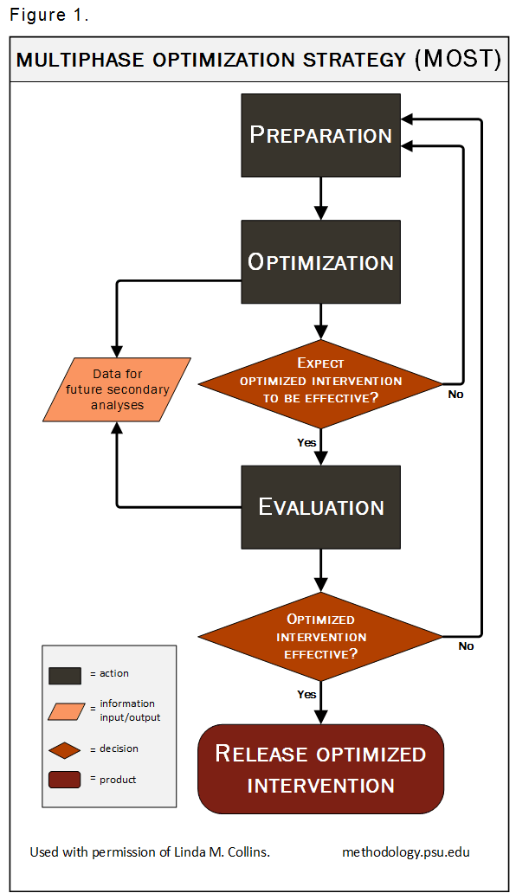
MOST
Which combination of intervention components is the most effective?
  Content
  Adherence
  Fidelity
Factorial or fractional factorial experiments
  Main effects
  Interaction/synergistic effects
Collins LM, Murphy SA, Nair VN, Strecher VJ. Ann Behav Med. 2005 Aug;30(1):65-73.
www.methodology.psu.edu

Slide 24
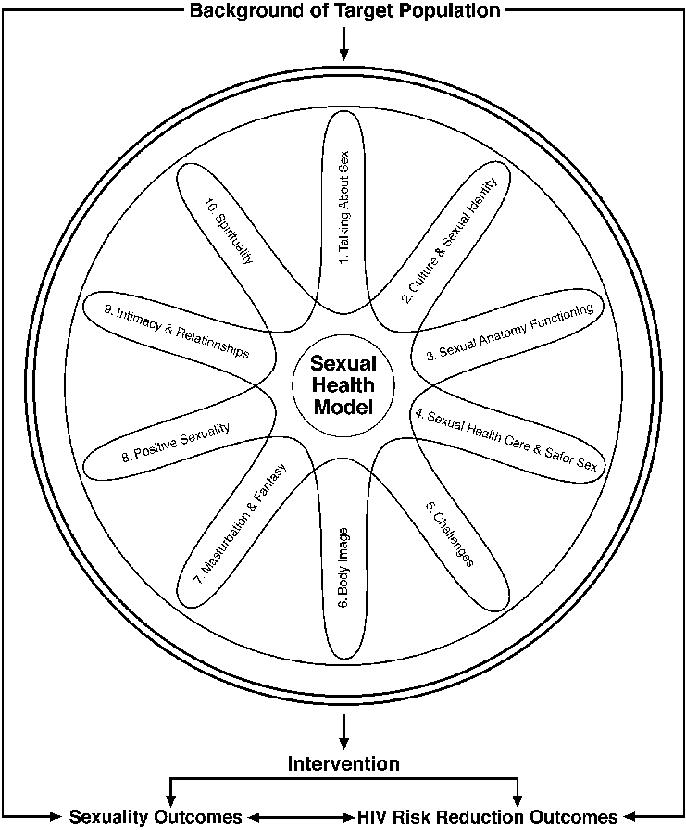
Sexual Behavior
Discussion about sexual behavior has evolved from focus on its biological functions, to focus on pleasure, to focus on sex as risk behavior for STDs and unplanned pregnancy
Challenging behavior to study because it involves
  Intrapersonal factors
  Interpersonal factors
    Sex as interaction; role negotiation
  Situational factors
Robinson et al. (2002)

Slide 25
Discussion
Billings et al. (2015)

Slide 26
Physical Activity and Diet

Slide 27
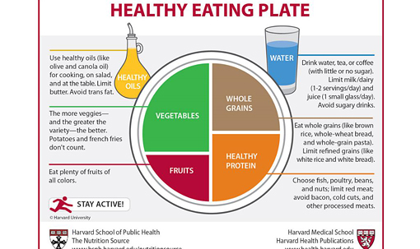
Diet

Slide 28
Diet
Factors impacting eating behavior
  Exposure
  Social learning (peers, parents, media)
  Associative learning (rewarding eating behavior, food as reward)
  Parental control
Theories of eating behavior (TPB, SCT)
Weight preoccupation, body dissatisfaction and body image
Dieting vs. Overeating
Intense debate over the most appropriate diet

Slide 29
Discussion
Carfora et al. (2016)

Slide 30
Physical Activity
Conceptual Human Movement Framework
Leisure
Occupational/
School
Physical Activity
Human Movement
Metabolic rate (basal, resting)
Household/
Caretaking/
Domestic
Energy expenditure
Thermic effect of food
Transportation
PA related EE
Sitting
Media Use
Non-occupational school
computer use
Behavior
Attributes
Discretionary
Cardiorespiratory Fitness
Physical Fitness
Sedentary Activity
Muscle Fitness
(strength vs. endurance)
Sleeping
Body Composition
Occupational/
School
Non-discretionary
Flexibity
Balance & Coordination
Sitting while driving/riding
Pettee & Morrow (2010). Measurement of Active and Sedentary Behaviors: Closing the Gaps in Self-report Methods. NIH, Bethesda MD (July 21, 2010).

Slide 31
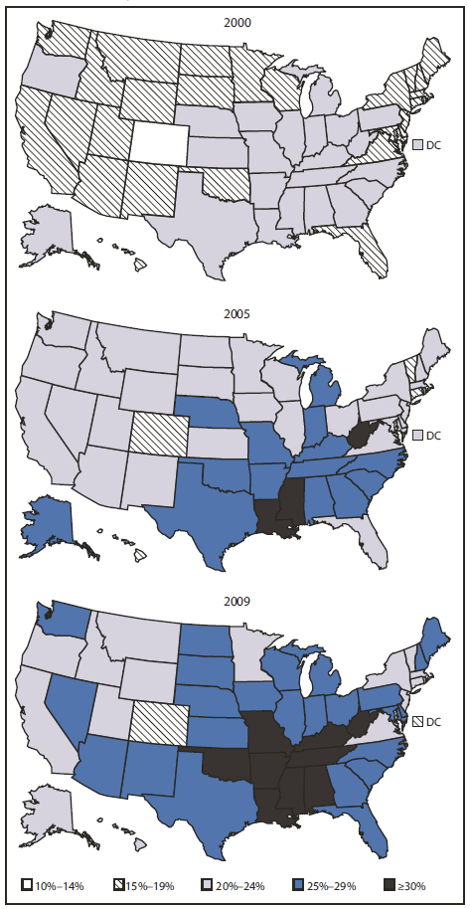
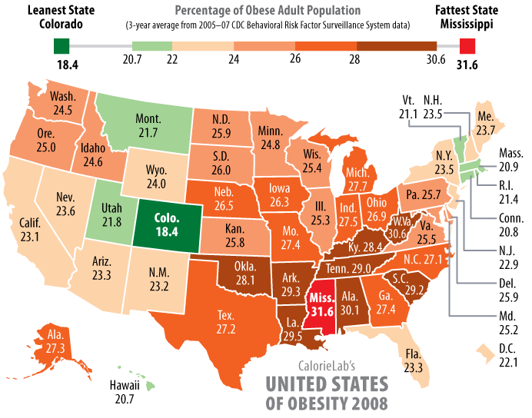
Obesity Prevalence Among U.S. Adults
BRFSS, 2000, 2005, 2009
Can physical activity save us from the obesity epidemic?

Slide 32
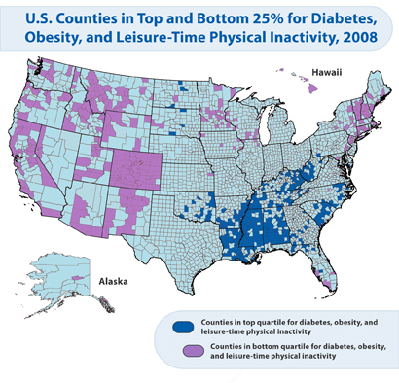
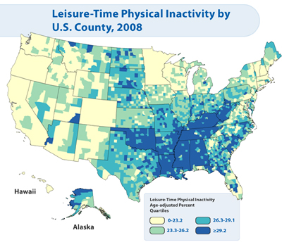
Content source: National Center for Chronic Disease Prevention and Health Promotion, Division of Diabetes Translation

Slide 33
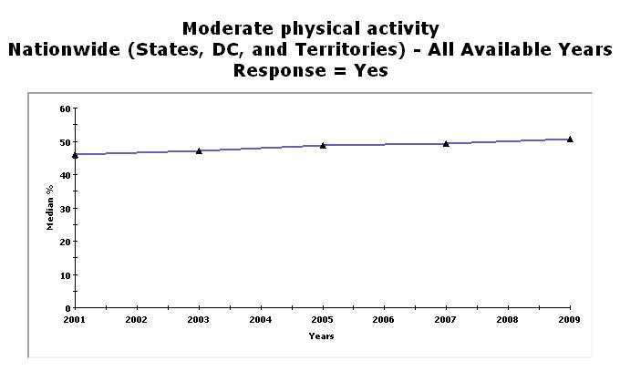
National Center for Chronic Disease Prevention & Health Promotion
Behavioral Risk Factor Surveillance System

Slide 34
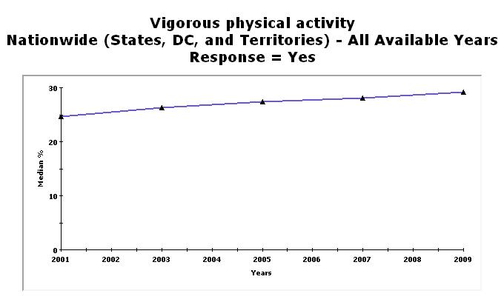
National Center for Chronic Disease Prevention & Health Promotion
Behavioral Risk Factor Surveillance System

Slide 35
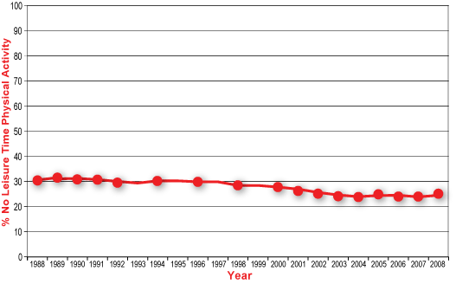
1988–2008 No Leisure-Time Physical Activity Trend Chart
National Center for Chronic Disease Prevention & Health Promotion
Behavioral Risk Factor Surveillance System

Slide 36
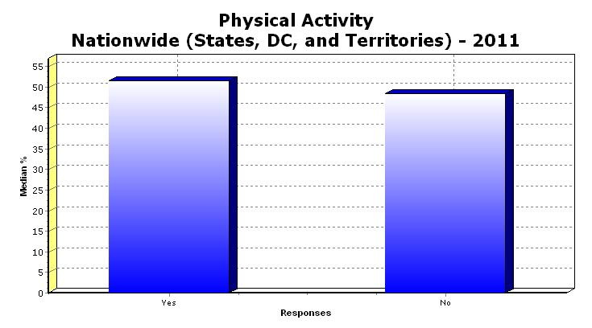
Participated in 150 minutes or more of Aerobic Physical Activity per week
National Center for Chronic Disease Prevention & Health Promotion
Behavioral Risk Factor Surveillance System

Slide 37
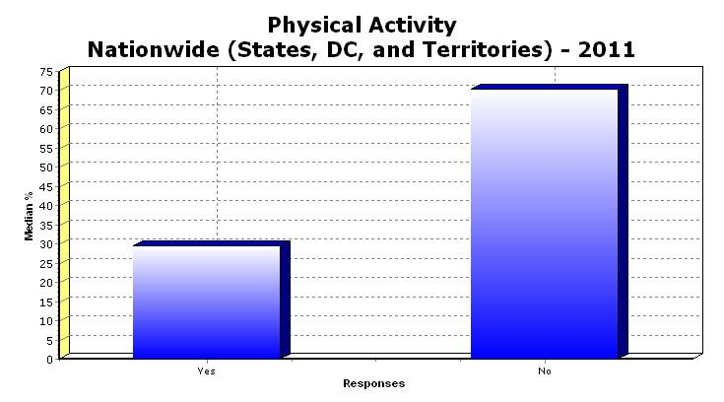
Participated Muscle Strengthening exercises more than twice per week
National Center for Chronic Disease Prevention & Health Promotion
Behavioral Risk Factor Surveillance System

Slide 38
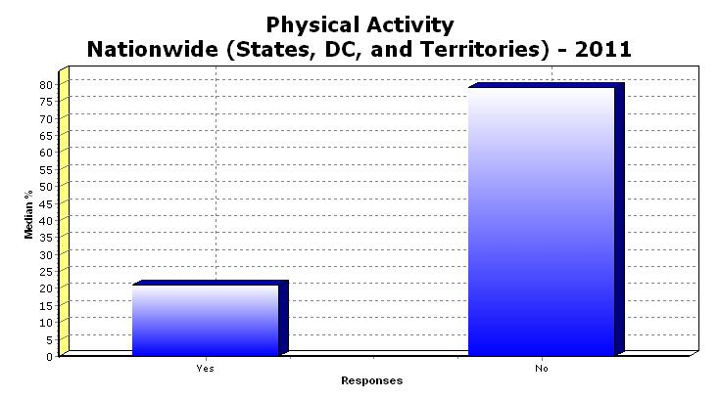
Participated in enough Aerobic and Muscle Strengthening exercises to meet guidelines
National Center for Chronic Disease Prevention & Health Promotion
Behavioral Risk Factor Surveillance System

Slide 39



Objective Physical Activity Surveillance (Accelerometry)
Troiano et al. (2008)
42% of children ages 6-11 yr obtain the recommended 60 min x d(-1) of physical activity
only 8% of adolescents achieve this goal
Among adults, adherence to the recommendation to obtain 30 min x d(-1) of physical activity is less than 5%.

Slide 40
Why do people not exercise?

Slide 41
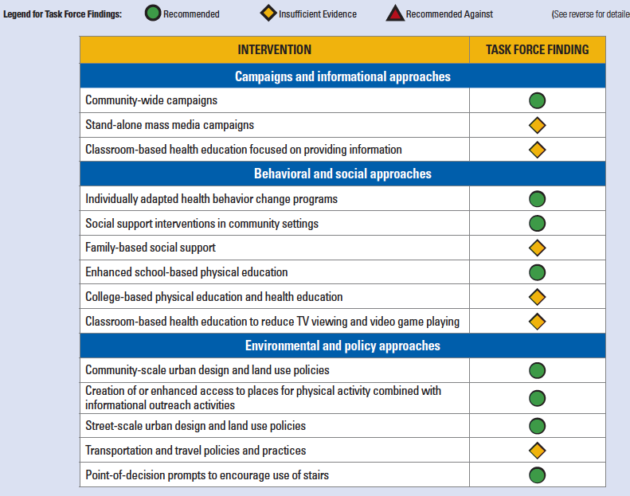

Slide 42
Individually-adapted PA interventions
Key elements
  Goal setting & self-monitoring progress towards goals
  Social support
  Positive reinforcement (self-rewards, positive self-talk)
  Self-regulation skills (problem solving, developing skills to prevent relapse)
Kahn et al. (2002)
Foster et al. (2005) – Cochrane review
  Stricter criteria for selection of intervention studies (RCTs)
  Smaller but positive effects
  Highlighted usefulness of telephone and printed educational materials

Slide 43
Multiple Behavior Change Research
Efforts to promote two or more health behaviors
The interrelationships among health behaviors and interventions designed to promote change in more than one health behavior at a time
Presents a unique set of challenges
  theoretical, methodologic, intervention, statistical, and funding issues

Slide 44
Rationale for MHBC Research
Approximately half of all causes of mortality in the United States are linked to social and behavioral factors such as smoking, diet, alcohol use, sedentary life-style, and accidents. Yet less than 5% of the approximately $1 trillion spent annually on health care in the United States is devoted to reducing risks posed by these preventable conditions. Behavioral and social interventions therefore offer great promise to reduce disease morbidity and mortality, but as yet their potential to improve the public’s health has been relatively poorly tapped.
— Institute of Medicine

Slide 45
Rationale for MHBC Research
The major causes of morbidity and premature mortality in the US (heart disease, cancer, and stroke) influenced by multiple health risk behaviors (including smoking, alcohol abuse, physical inactivity, and poor diet)
In the US, only 3% of adults meet all four health behavior goals of being a nonsmoker, having a healthy weight, being physically active, and eating 5 or more fruits and vegetables a day (Reeves & Rafferty, 2005)

Slide 46
Rationale for MHBC Research – cont.
Clustering of unhealthy behaviors
  In the US, the majority of adults meet criteria for two or more risk behaviors (Fine et al., 2004; Pronk et al., 2004)
92% of smokers exhibit at least one additional risk behavior (Fine et al., 2004; Klesges et al., 1990; Pronk et al., 2004)
9 out of 10 overweight women at least two eating or activity risk behaviors (Sanchez et al., 2008)

Slide 47
Rationale for MHBC Research – cont.
Success in changing one or more lifestyle behaviors may increase self-efficacy to improve risk behaviors individuals have low motivation to change
  Gateway behavior to overall healthy lifestyle?
Limited contact opportunities for health promotion – should aim for interventions that could simultaneously improve multiple risk behaviors
Interventions targeted at single risk behaviors, even if effective, will be limited in their impact

Slide 48
Methodological Issues in MHBC
Design issues
  How many behaviors to target at once?
  Specific combinations of specific behaviors? Are some more compatible than others?
  Differential motivation to change different behaviors
  Implications for timing? Introduce behaviors at the same time or sequentially?

Slide 49
Hyman et al. (2007)
Is sequential presentation of stage of change–based counseling to stop smoking, reduce dietary sodium level, and increase physical activity by at least 10 000 pedometer steps per week more effective than simultaneous counseling?
African Americans (N=289) with hypertension, aged 45 to 64 years, initially non-adherent to the 3 behavioral goals, were randomized:
  1 in-clinic counseling session on all 3 behaviors every 6 months, supplemented by motivational interviewing by telephone for 18 months;
  a similar protocol that addressed a new behavior every 6 months;
  1-time referral to existing group classes (“usual care”).
  The primary end point was the proportion in each arm that met at least 2 behavioral criteria after 18 months.

Slide 50
Hyman et al. (2007) - results
At 18 months, only 6.5% in the simultaneous arm, 5.2% in the sequential arm, and 6.5% in the usual-care arm met the primary end point
Results for single behavioral goals consistently favored the simultaneous group
  At 6 months, 29.6% in the simultaneous, 16.5% in the sequential, and 13.4% in the usual-care arms had reached the urine sodium goal
  At 18 months, 20.3% in the simultaneous,16.9% in the sequential, and 10.1% in the usual care arms were urine cotinine negative

Slide 51
King et al. 2013
Four intervention groups: a sequential exercise-first group, a sequential diet-first group, a simultaneous group, and a control group
12 months interventions; 4 months in between sequential behaviors
Telephone-based counseling (SCT, TTM); control received stress management advice

Slide 52
Fruit & Vegetable Intake
Calorie Intake from Sat. Fat
MVPA
The behaviors presented first, showed greater improvement in sequential interventions (suppression effect of “diet first” on physical activity)
In simultaneous group, changes in both behaviors comparable, the size of the effect similar to that of “first behavior” in the sequential group

Slide 53
Methodological Issues in MHBC
Measurement issues
  Separate or composite measures?
Data analysis
Theory testing across behaviors
Participant burden

Slide 54
Behavior Change from the Perspective of Motivational Interviewing
Motivational interviewing is a directive, client-centered counseling style for eliciting behavior change by helping clients to explore and resolve ambivalence.
Source: http://www.motivationalinterview.org/
Miller WR, et al. Motivational Interviewing, 2nd ed. Guilford Press; 2002.
Berger B. Motivational interviewing helps patients confront change. Available at:http://www.uspharmacist.com/oldformat.asp?url=newlook/files/Phar/nov99relationships.cfm&pub_id=8&article_id=450.
Notes:
Originally developed for problem drinkers

Slide 55
The Spirit of Motivational Interviewing
Collaborate with the patient
Evoke their readiness to take action (elicit “change talk”)
Develop patient’s autonomy to take responsibility for their own health
Behavior change can be facilitated
but not coerced.

Slide 56
Strategies for Successful Interaction with Patients
Elicit-Provide-Elicit
  Menu of Strategies
The Five Principles
  READS
Helpful Tools
  Readiness Rulers
  The Envelope
Rollnick S, et al. Health Behavior Change: A Guide For Practitioners. Churchill Livingstone; 2003.
Berger B. Motivational interviewing helps patients confront change. Available at: http://www.uspharmacist.com/oldformat.asp?url=newlook/files/Phar/nov99relationships.cfm&pub_id=8&article_id=450
Notes:
Rollnick S, et al. Health Behavior Change: A Guide For Practitioners. Churchill Livingstone; 2003:109.
Berger B. Motivational interviewing helps patients confront change. Available at: http://www.uspharmacist.com/oldformat.asp?url=newlook/files/Phar/nov99relationships.cfm&pub_id=8&article_id=450. Accessed January 13, 2004.

Slide 57
Strategies for Successful Interaction with Patients
ELICIT-PROVIDE-ELICIT
  The good things and bad things
  What do they like and dislike about the proposed changes?
  What is their representation of the illness and its treatment?
  Do they agree with the NP/MD?
  Do they believe they can do what is asked? What will help?
  What are the barriers?
  IS THE PATIENT READY FOR THE CHANGE?
Notes:
discussing patient’s lifestyle; how does the patient view it? A typical day?
Needed for tailoring, Identifying Problems, Exercise
Opening strategy: The good things and bad things
What do they like and dislike about the proposed changes?
What is their representation of the illness and its treatment?
Do they agree with the MD?
Do they believe they can do what is asked? What will help?
What are the barriers?

Slide 58
Five Principles of MI
Express empathy
Develop discrepancy
Avoid argumentation
Roll with resistance
Support self-efficacy
Notes:
Discrepancy between stated goals and current behavior (where I see myself at present and where I want to be
Listen for reasons to change; use of objective feedback to develop discrepancy
Goal to have client articulate – but not dwell on reasons not to change

Slide 59
Building Motivation
Explore ambivalence and build motivation
Open-ended questions
Reflective listening
Affirmations
Summaries
Elicit self-motivational statements (change talk)
Notes:
Reflective listening – involves making hypothesis and checking them out: avoid giving advice, providing solutions, persuading with logic, giving warnings about health
Improved outcomes – mediated by increased adherence
Issues: requires practice/ skill, dose issues; who should deliver? Peers/psychologists?

Slide 60
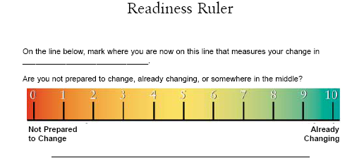
Readiness to Change: Eliciting Change Talk
“If I handed you an envelope, what would the message inside have to say to get you to ________?”

Slide 61
Building Motivation
Goal is to get patient/client to articulate:
  The steps I plan to take are:
  Challenges that may interfere:
  How I will handle these challenge
  I’ll know my plan is working if:
Notes:
Reflective listening – involves making hypothesis and checking them out: avoid giving advice, providing solutions, persuading with logic, giving warnings about health
Improved outcomes – mediated by increased adherence
Issues: requires practice/ skill, dose issues; who should deliver? Peers/psychologists?

Slide 62
MHBC Challenges
Timing of treatment
Measuring changes in multiple behaviors
Theory testing across behaviors
Participant burden

Slide 63
Some Statistics
(Lightwood & Glantz, 2007)
1% absolute reduction in smoking prevalence (AMIs and strokes)
In the first year, there would be 924±679 (mean±SD) fewer hospitalizations for AMI and 538±508 for stroke, resulting in an immediate savings of $44±26 million
A 7-year program that reduced smoking prevalence by 1% per year would result in a total savings of $3.20±0.59 billion in costs, and would prevent 13,100 deaths resulting from AMI/stroke.
Notes:
that occur before people reach the hospital. Creating a new nonsmoker reduces anticipated medical costs associated with AMI and stroke by $47 in the first year and by $853 during the next 7 years (discounting 2.5% per year).
Health Behavior
The first area, “unhealthy behavior” is the largest in magnitude and is the subject of a large
body of peer-reviewed research. The midpoint of the cost-savings estimates is $408 billion per
year, equivalent to 17% of 2008 national health expenditures (NHE). The range of expected
savings from the respective studies is $264 billion to $552 billion per year and includes several
significant studies by the CDC and NIH.2-11
The costs of unhealthy behavior are those that could be avoided through lifestyle changes that
would reduce disease and illness associated with alcohol and tobacco use and obesity. Obesity
increases the risk of many chronic diseases, including diabetes, heart disease, and some cancers.
The cost of obesity has been extensively modeled; estimates of potential cost-savings range from
$72 billion to $216 billion per year. Tobacco increases the risk of cancer, heart diseases and
pulmonary diseases; estimated cost savings range from $144 billion to $192 billion per year.
Alcohol abuse contributes to acute and chronic health problems and injuries. Eliminating
alcohol abuse is estimated to generate savings that range from $48 billion to $144 billion per
year. Exhibit 3 shows the problems that make up the health behavior category and illustrates
the respective cost savings using the midpoint of estimates.

Slide 64
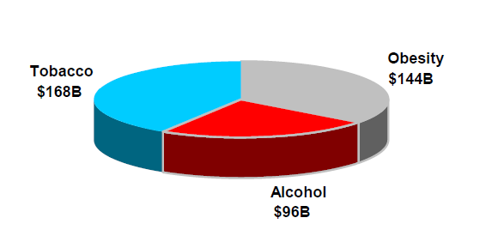
Some Statistics
(The Lewin Group Review, 2009)
The midpoint of the cost-savings estimates is $408 billion per year, equivalent to 17% of 2008 national health expenditures (NHE)
The range of expected savings from the respective studies is $264 billion to $552 billion per year and includes several significant studies by the CDC and NIH
Notes:
that occur before people reach the hospital. Creating a new nonsmoker reduces anticipated medical costs associated with AMI and stroke by $47 in the first year and by $853 during the next 7 years (discounting 2.5% per year).
Health Behavior
The first area, “unhealthy behavior” is the largest in magnitude and is the subject of a large
body of peer-reviewed research. The midpoint of the cost-savings estimates is $408 billion per
year, equivalent to 17% of 2008 national health expenditures (NHE). The range of expected
savings from the respective studies is $264 billion to $552 billion per year and includes several
significant studies by the CDC and NIH.2-11
The costs of unhealthy behavior are those that could be avoided through lifestyle changes that
would reduce disease and illness associated with alcohol and tobacco use and obesity. Obesity
increases the risk of many chronic diseases, including diabetes, heart disease, and some cancers.
The cost of obesity has been extensively modeled; estimates of potential cost-savings range from
$72 billion to $216 billion per year. Tobacco increases the risk of cancer, heart diseases and
pulmonary diseases; estimated cost savings range from $144 billion to $192 billion per year.
Alcohol abuse contributes to acute and chronic health problems and injuries. Eliminating
alcohol abuse is estimated to generate savings that range from $48 billion to $144 billion per
year. Exhibit 3 shows the problems that make up the health behavior category and illustrates
the respective cost savings using the midpoint of estimates.

Slide 65
Hyman et al. (2007) – results

Slide 66
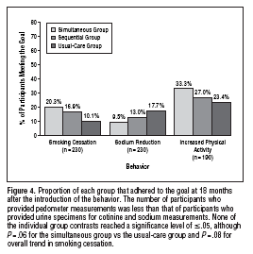
Hyman et al. (2007) – results

