Slide 1
Today
PTSD
Being ill
  HIV/AIDS
  Cancer
  Obesity
Gender and health
Quality of Life
Semester wrap-up

Slide 2
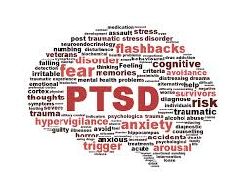
Post-traumatic stress disorder (PTSD)
PTSD versus Post-traumatic Growth (PTG)
PTG
  Subjective experience of positive psychological change reported by an individual following a trauma
PTSD
  Psychiatric disorder in people who experiences (directly or indirectly) or witnessed a traumatic event
  Includes symptoms such as intrusion, avoidance, numbing, and hyper-arousal
PTSS
  Post-traumatic stress symptoms – common negative reactions that occur in aftermath of trauma

Slide 3
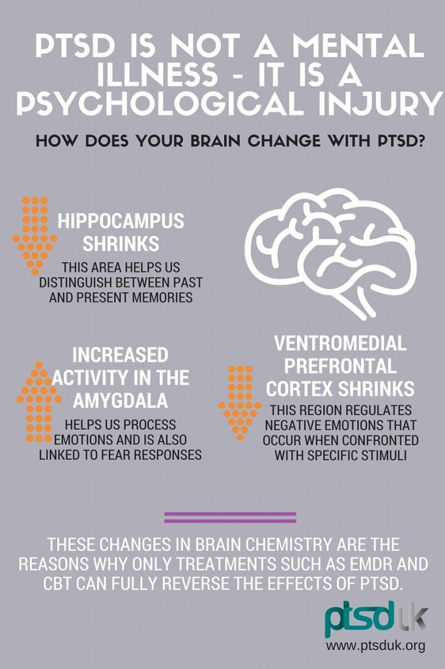
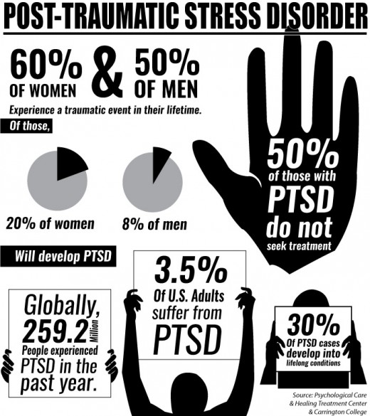

Slide 4
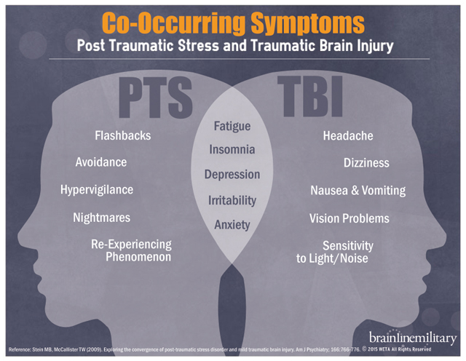

Slide 5
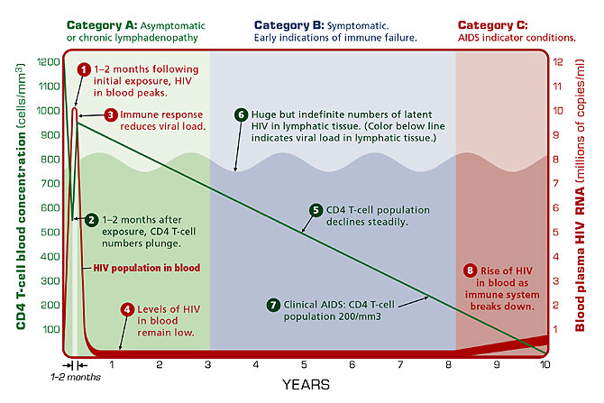
HIV / AIDS
Notes:
Initial viral seroconversion illness
Asymptomatic stage
Enlargement of lymph nodes, onset of opportunistic infections
AIDS-related complex (ARC)
AIDS

Slide 6
Psychology in HIV / AIDS
Susceptibility to disease
  Lifestyle behaviors (unsafe sex, drug abuse) -- exposure comorbid infections (herpes, CMV)
  Beliefs impact lifestyle behaviors (much work outdated)
  Women are more susceptible to HIV and AIDS
    Discuss WHY

Slide 7
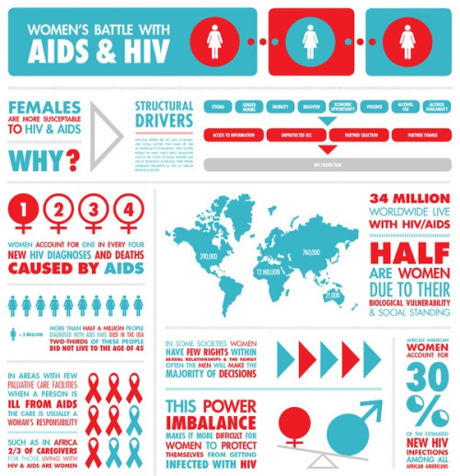

Slide 8
Psychology in HIV / AIDS
Progression of disease
  Lifestyle
  Adherence to medication (only 75% of eligible receive treatment) – AZT, HAART (adverse effects, question efficacy, difficult regimen)
  Stress - CBT effective in reducing viral load when added to medication treatment at 15-month follow-up controlling for medication adherence (Antoni et al., 2006)
  Cognitive adjustment – having negative expectancies of HIV at baseline predicts faster disease progression (Bower et al., 1998, Reed et al., 1999)
  Types C coping style – emotional inexpression, decreased recognition of needs and feelings worsens disease progression (as do high levels of emotional expression) (Solano et al., 2001, 2002)

Slide 9
Psychology in HIV / AIDS
Longevity
  Baseline factors such as
    Health status
    Health behaviors
    Hardiness
    Social support
    Type C coping (self-sacrificing, self-blaming, not emotionally expressive)
  Protective factors
    Realistic acceptance
    Social support
    Problem-solving
    Help-seeking behavior
    Low social desirability
    Expression of anger and hostility

Slide 10
Cancer
Initiation and promotion of cancer
  Behavioral factors
    75% of all cancers attributable to health behaviors (Mokdad et al., 2004; Khaw et al., 2008)
  Stress
    Experimental animal research studies (uncontrollable stressors linked to tumor growth)
  Life events
    Inconsistent, methodological problems
  Control
  Coping styles
    Disengagement strategies (smoking, alcohol)
  Depression
  Personality – “cancer-prone personality” (Eysenck, 1990) – high in helplessness and hopelessness, Type C
  Hardiness – control, commitment (meaning in life), challenge

Slide 11
Cancer
Psychological consequences of cancer
  Lowered mood
  Body image
  Cognitive adaptation
  Benefit finding
Interventions for symptom relief & QOL enhanecement
  Pain management
  Social support management
  Treating nausea and vomiting (visual imagery, relaxation, hypnosis…)
  Body image counselling
  Cognitive adaptation strategies (self-worth, meaning in life, self-transcendence)
  Fear reduction

Slide 12
Obesity
Causes
Physiological theories
  Genetics
    One parent obese – 40%; two parents obese – 80%; non-obese parent only 7% chance of having an obese child
    Twin studies (genetics 66-70% of variance in body weight), Adoptee studies (stronger association to biological parents)
  Metabolic rate theory
    Lower metabolic rate to begin with predicts weight gain
    Overweight people have higher metabolic rate – paradox
    Weak support
  Appetite regulation
    Genetics (leptin, grhelin)
    Diet may contribute to changes in appetite regulation (artificial sweeteners, high sugar diet, salt intake, fat intake)

Slide 13
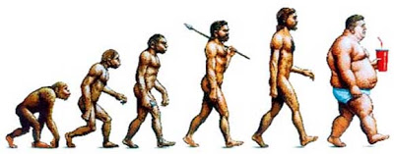
Obesity
Causes
Obesogenic environment
  What factors outside the individual could explain obesity?
  Discuss

Slide 14
Obesity
Causes
Behavioral theories
  Physical (in)activity
    Increase in obesity prevalence at the same rate as decrease in physical activity (or increase TV viewing)
    Obese people less active than non-obese
    Most evidence correlational – what is cause and effect?
  Diet
    Increase in obesity unrelated to overall decrease in calorie consumption in the home
    Obese do not seem to eat more than non-obese (but most research is self-reported)
    Obese may eat proportionately more fat and relatively less carbohydrates
  Calories in vs. calories out - ???

Slide 15
Obesity
Treatments
  Behavioral
    PA – takes a lot of PA, may be better as prevention strategy
    Dieting – restraint eating may promote overeating, weight cycling
    Role of cognitive restraint
  Drug treatments – side effects
  Surgical treatments
Should we treat obesity?
Discuss

Slide 16
Obesity
Halfron et al. (2013)
Discussion

Slide 17
Gender and Health
Persistent differences between men and women
  Health behaviors
  Health outcomes
  Longevity, morbidity, mortality
Women’s health
  Pregnancy, miscarriage, termination
  Menopause
Men’s health
  Health behaviors, risk-taking behaviors, help-seeking behaviors
  Andropause
  Prostate cancer, CHD, suicide

Slide 18
Menopause
Cessation of menstrual flow lasting at least 12 months
The median age at menopause is 52
Menopausal transition is a natural, developmental process
Changes health profile of women
Generally neutral or positive effects on wellbeing but impact will vary based on
  Premenopausal health
  Stress
  Menopausal symptoms
  Lifestyle
Matthews et al. N Engl J Med. 1989 ;321(10):641–64; Avis & McKinlay. J Am Med Womens Assoc. 1995;50(2):45-50.;
Mitchell & Woods. Maturitas. 1996;25(1):1-10.; Grisso et al. J Gen Intern Med. 1999;14(2):98-103. ;
Brown et al. Women Health. 1998;28(1):23-40; Sowers et al. Menopause: biology and pathology. 2000:175–188.
Dennerstein, et al. Menopause. 2007;14(1):53-62; Netz et al. Climacteric. 2008;11(4):337-344.

Slide 19
Article discussion
Lau 2013
Steel 2017

Slide 20
Quality of Life

Slide 21
Quality of Life
QOL rather than longevity is a vital goal in health promotion
Only partially reflected in existing mortality and morbidity indexes – traditional assessment of Q of L

Slide 22
What is Quality of Life?
How to define QOL?
What does QOL mean to you?

Slide 23
The New Science of Happiness
(Seligman, Diener)
Subjective experience that is about 50% determined
Experiencing self versus remembering self
  Are we our memories or sum of total experiences?
Keys: pleasure, engagement, meaningfulness
  Kindness, gratitude, capacity for life
  Gratitude journals/letters

Slide 24
Happiness: Enough Already
(Wilson)
Sadness is normal and salutary
Too much happiness can be detrimental
  The case of late-stage illness (happiest most likely to die)
Negative emotions needed – make us more analytical, critical, innovative
  If you are 100% what happens?
  Melancholia fueled many geniuses in history

Slide 25
What is Quality of Life?
How to define QOL?
What does QOL mean to you?
We know it when we see it (David Rowe’s collage….)

Slide 26
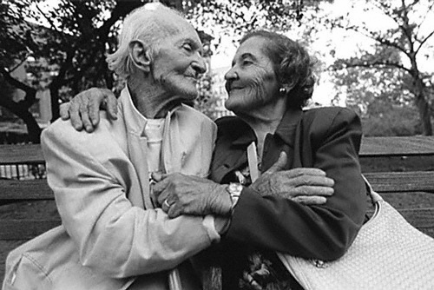
A married couple in their 90’s

Slide 27
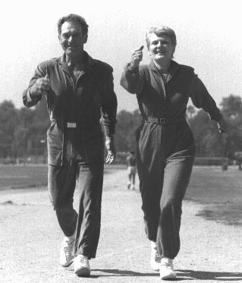
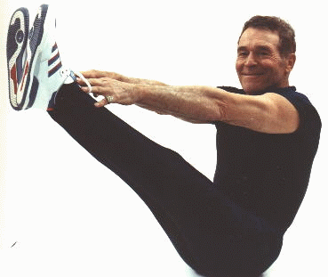
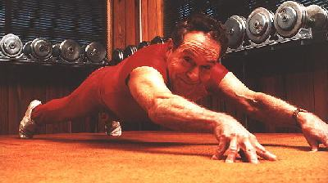
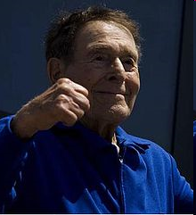
Jack LaLanne, 95, and wife Elaine, 83

Slide 28
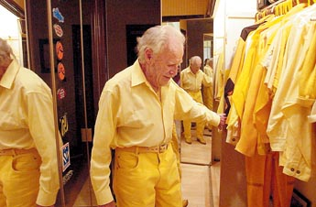
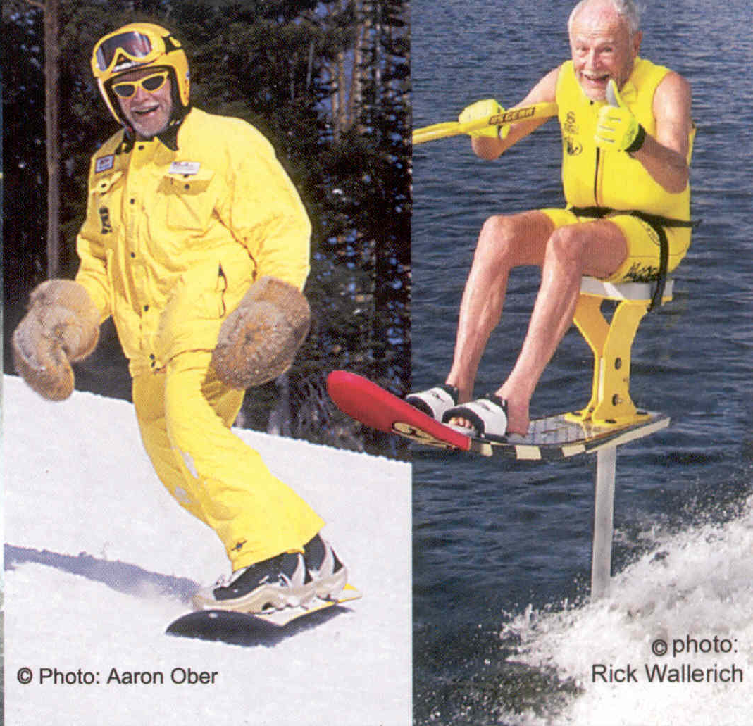
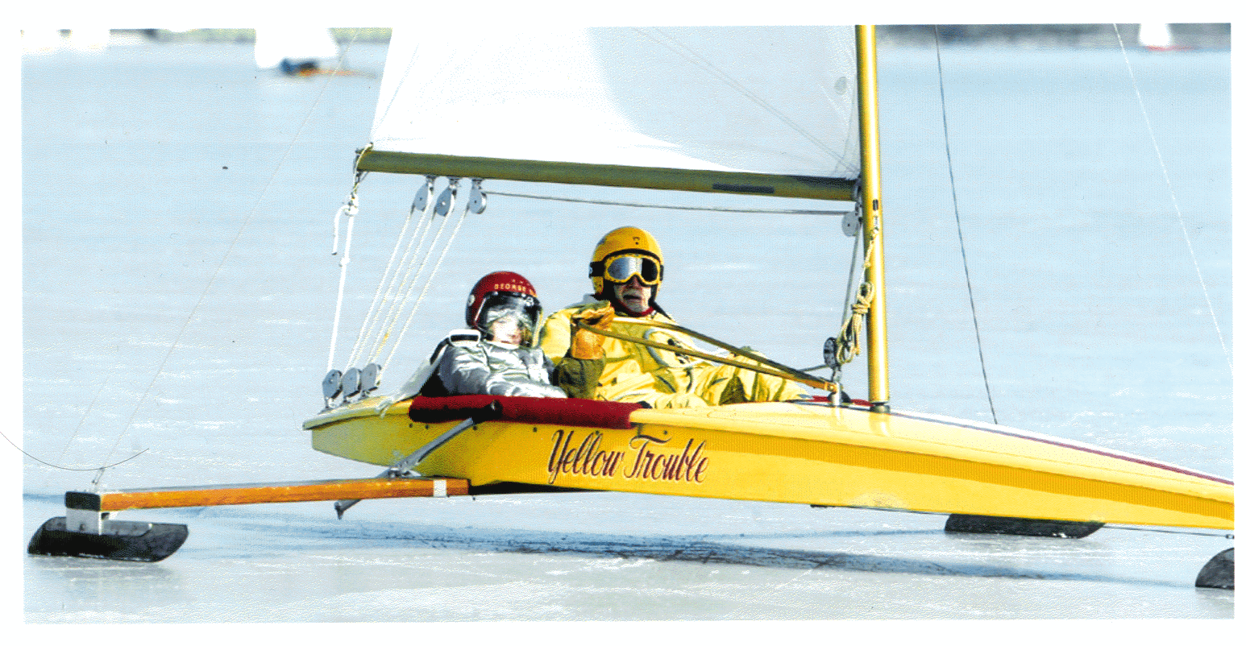

“Banana” George Blair (95 yr)
(George made it into the sexiest man list in SI’s 2002 Swimsuit Issue – at 87!)

Slide 29
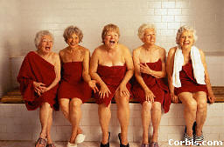
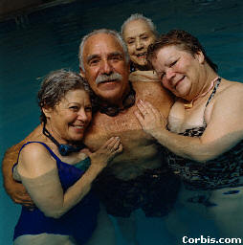
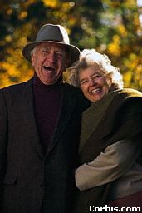
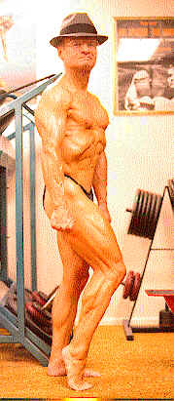
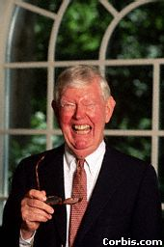
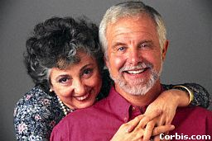
Notes:
16

Slide 30
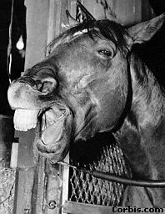
Notes:
16

Slide 31
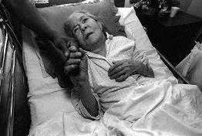
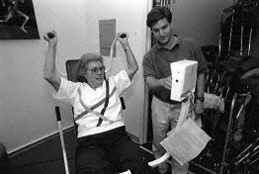
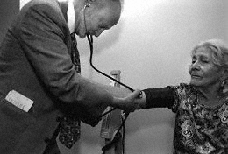
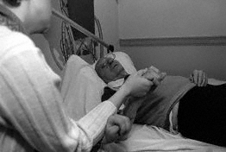

Slide 32
Quality of Life
Subjective and objective evaluations of the “goodness” of one’s life overall, and the “goodness” of the various domains that make-up one’s life
What are the domains?...

Slide 33
Infinite Dimensions of QOL….
Physical health
Social health
Cognitive health
Role limitations (physical)
Role limitations (emotional)
Pain
Mental health
Vitality, energy
General health
Personal development
Recreation
Symptoms
Mobility
Physical activity
Social activity
Emotions
Relationships/sexuality
General activities
Sleep
Practical problems
Independence

Slide 34
Defining Quality of Life
Multiple definitions and measures (300+)
Little consistency
Three most common approaches
  QOL as absence of disease or life expectancy (mortality, morbidity); quality-adjusted life years (QALY)
  QOL as function and well-being – Health-related QOL
  QOL as a “cognitive judgment of satisfaction with one’s life” (Pavot & Diener 1993)

Slide 35
QOL as Function and Well-Being
Function
Physical
  Cognitive
  Activities
Well-Being
    Bodily
    Emotions
    Self-Concept
    Global Perceptions

Slide 36
Quality of Life Measures
Objective Measures???
Subjective Measures
  Aggregated Measures
  Single Item Measures
  Perceived Change
  Multidimensional Measures
  Comparative Measures
  “Non-Measures” of QOL
Notes:
One can view QOL measures from several perspectives. For example:
Aggregate measures rely on Combining multiple categories to come up with single index (e.g., physical symptoms, physical function, depression, control etc.). Problems of lack of specificity in finding effects that may be specific to PA (i.e., effects are masked)
Single item measures Problem of reliability, validity, and sensitivity. Tendency to use these has been reduced but still may take this form in larger epidemiological studies
When QOL is measured as Perceived Change,one encounters the problem of response bias. Of ten used to assess benefits of PA at multiple levels. OK if accompanied by objective measures of change
Multidimensional measures employ assessments of primary domains of function including physical, mental, social, and spiritual function. The advantages lie in being able to document change in QOL at varying levels that may be more susceptible to change through PA (e.g., SF-36)
Comparative Measures are designed to allow respondent to decide which components of one’s life are important in making judgments relative to QOL. SWLS, for example, targets life as a whole rather than identifying particularized facets or domains.
So-called Non-Measures of QOL represent constructs like mood, anxiety, depression, etc. All are potentially related to QOL. However, they are theoretically and conceptually distinct from QOL. Yet, they are often assessed and QOL is inferred from their scores.
Important to remember that how one defines QOL dictates how it is measured.

Slide 37
Sample Measures of QOL
Sickness Impact Profile
  physical and psychosocial status; independence
SF-36, SF-12, SF-6
  overall physical and mental health status
Nottingham Health Profile
  Emotional reactions, social isolation, physical mobility, pain, energy, sleep
ADLS and IADLS
  bathing, transferring, dressing
  cooking, laundry, managing money
Satisfaction with Life Scale
Late Life Function and Disability Inventory
  Limitations in discrete activities
  Performance of socially defined tasks/activities

Slide 38
Psychological approach to QOL
Happiness or satisfaction with life the ultimate outcome
____ In most ways my life is close to my ideal.
____ The conditions of my life are excellent.
____ I am satisfied with my life.
____ So far I have gotten the important things I want in life.
____ If I could live my life over, I would change almost nothing.

Slide 39
Quality of Life
Top-Down Influences
(time invariant, individual difference or between-person characteristics)
Demographics Personality Functional status
Physical activity status
Physical & mental health status
QOL
Mental & physical health
Physical function Self-related function Cognitive functions
Daily physical activity
Bottom-Up Influences
(time varying, within-person changes)

Slide 40
Semester Wrap-Up
Health psychology - an interdisciplinary field concerned with the application of psychological knowledge and techniques to health, illness, and health care (Marks et al., 2011)
  Health beliefs and behaviors
  Health cognitions and the process of behavior change
  Illness cognitions and the process of illness
  Quality of life
The importance of learning to be critical
  Theories, constructs
  Finding commonalities and differences in theories
  Transtheoretical paradigms
  Methods and research designs
  Discipline problems – mind-body split; individual within context

