Slide 1
Today
The process of illness and illness cognitions
Illiness cognitions
Stress
Being ill – Pain

Slide 2
Illness Cognitions
A patient’s own implicit common sense beliefs about their illness
Provide schema for coping with illness, understanding their illness, warning signs
Leventhal et al. (1980)
Perceived cause
Identity
Illness cognitions
Time line
Cure / Control
Consequences
Notes:
Relate to coping, predict adherence to treatment, predict illness outcomes

Slide 3
Self-Regulatory Model of Illness Behavior
Representation of health threat
Identity
Cause
Consequences
Time line
Cure/Control
Stage 1: Interpretation
Symptom perception
Social messages
Stage 3: Appraisal
Was my coping strategy effective?
Stage 2: Coping
Approach coping
Avoidance coping
Emotional response to health threat
Fear
Anxiety
Depression

Slide 4
Symptom Perception
Discuss
Symptoms are more than just a sensation.
What influences symptom perception?
Draw a model

Slide 5
Symptom Perception
Symptom perception
Demographics
Internal/external focus
Social context
Attachment style
Cognition
Mood

Slide 6
Coping
Illness as a crisis (Moos & Schaefer, 1984)
Changes in identity
Changes in location
Changes in role
Changes in social support
Unpredicted event
Insufficient or unclear information about illness
Decision needed quickly
Ambiguous meaning
Limited prior experience
Coping as a process (Moos & Schaefer, 1984)
(1) Cognitive appraisal (2) Adaptive tasks (3) Coping skills

Slide 7
Coping with the crisis of illness
Background factors
Demographic and social factors
Physical/social environmental factors
Illness-related factors
Adaptive tasks
Illness-specific
General
The crisis of illness
Cognitive appraisal
Is my illness serious?
OUTCOME
Coping skills
Appraisal-focused
Problem-focused
Emotion-focused

Slide 8
Adjustment to illness
Theory of Cognitive Adaptation
Search for meaning “I know what caused my illness”
Attribution Theory (Weiner, 1986)
Taylor et al. (1984)
95% of women with breast cancer offer explanation for their cancer
41% stress; 32% carcinogens such as birth control; 26% genetics; 17% diet; 10% injury to breast
Taylor (1983)
>50% women said that cancer led to reappraising their life
Increased self-knowledge; Self-change; Change in priorities
Search for mastery “I can control my illness”
Believing that illness is controllable
Process of self-enhancement “I am better of than a lot off people”
To improve self-esteem
Developing illusions
Positive interpretations of reality, benefit finding

Slide 9
Post-Traumatic Growth
Experience of positive growth following illness involving transformation
Tedeschi & Calhoun (2004, 2006)
Perceived changes in self
Closer family relationships
Changed philosophy in life
A better perspective in life
Strengthened belief system
Hefferon et al. (2009)
Reappraisal of life and priorities
Trauma equals development of self
Existential re-evaluation
New awareness of the body
Notes:
Predictors of PTG: symptom severity, time elapsed since event, age, gender, social support, clear cause of event, responses of others, spirituality, optimism, financial stability

Slide 10
Discussion
Cormio (2017)
PTG in cancer

Slide 11
Videos
https://www.youtube.com/watch?v=YY3d4dyFRog
Harvard Innovation Lab talk
https://www.youtube.com/watch?v=oPrlBJZah5Y
https://www.youtube.com/watch?v=kVZLR_rxjfE

Slide 12
Stress
The response to events that are challenging or threatening
Involves biochemical, physiological, behavioral, and psychological changes
Acute stress versus Chronic stress
Distress versus Eustress

Slide 13
Stress models
Fight-or-flight model (Cannon, 1932)
Stress as response to external stressors, predominantly physiological (mostly adaptive but could result in medical problems)
General adaptation syndrome (Selye, 1956)
Stress as process: (1) alarm (mobilization to meet or resist stressor); (2) resistance (coping, attempts to reverse the effects of alarm); (3) exhaustion (coping exhausted, resistance unsuccessful)
Both models view individual as automatically responding to stressors (little consideration of individual variability)
Assume consistent physiological response to stress
Individuals seen as passive in responding to the external world

Slide 14
Stress models
Life events theory (Holmes & Rahe, 1967)
Measuring life experiences (from severe like death of spouse to moderate like child leaving home for college to minor such as vacation)
Life experiences as predictors of health outcomes or death (e.g., Phillips et al., 2008)
Does not take into account individual’s rating of event
Retrospective assessment
Life experiences may interact
Series of life experiences
Short-term versus long-term stressors

Slide 15
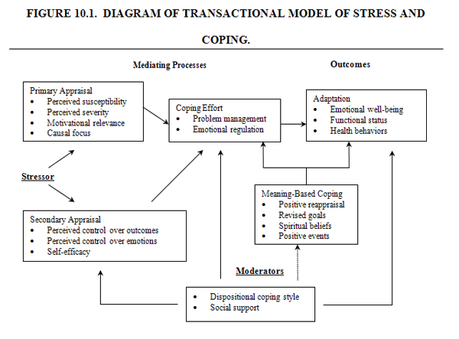
Transactional model of stress (Lazarus, 1975)

Slide 16
Stress - Appraisal
Appraised as more stressful
Salient events
Overload
Ambiguous events
Uncontrollable events
Protective factors
Self-efficacy
Hardiness (self-control)
Mastery

Slide 17
Physiological basis of stress
Sympathetic activation
Increased catecholamine production (adrenalin, nonadrenalin/epinephrine, norepinephrine)
Increased blood pressure, heart rate, sweating, pupil dilation = arousal….negatively impacts immune function
Hypothalamic-pituitary-adrenocortical (HPA) activation
Increased production of corticosteroids (cortisol) – impacts management of carbohydrates store stores, leads to inflammation, and impacts immune function
Stress reactivity, recover, resistance
Varies between people (some due to differences in appraisal but also regardless of appraisal)
Gender differences (men more reactive)
Allostatic load (McEwan & Stellar, 1993)

Slide 18
Measuring stress
Physiological measures
Self-report measures
Life events
Perceived stress (Perceived Stress Scale; Cohen et al., 1983)
Daily hassles
Each measure has pros and cons
Choice depends on purpose of measurement and research questions asked

Slide 19
How does stress impact health?
Discuss
Does stress cause illness? How?

Slide 20
How does stress impact health?
Chronic process
Acute process
Atherosclerosis, thrombogenesis
Demand on CV system
Immune system
Changes in behavior (health behaviors, accidents)
Effects depend on
Behavior (exercise)
Coping (avoidance vs. approach, problem-, emotion-focused)
Social support
Personality
Control
Notes:
--- load on CV system, atherosclerosis …increased CVD risk

Slide 21
Stress and health
https://www.youtube.com/watch?v=RcGyVTAoXEU

Slide 22
Being Ill - Pain
Sensation versus perception
Feedback about the body
Warning sign
Triggers help-seeking behavior
Has psychological consequences (fear, anxiety)
Acute vs. chronic (>6months)
Early models of pain – little role of psychology
Biomedical model (psychogenic vs. organic pain)
Stimulus – response
Single cause

Slide 23
Gate Control Theory of Pain
Melzack & Wall (1965)
Input to the gate – at the spinal cord level input from
Peripheral nerve fibres
Descending central influences from the brain
Large and small fibres
Output from the gate
Gate integrates all of the information and produces output from the gate to an action system resulting in perception of pain

Slide 24
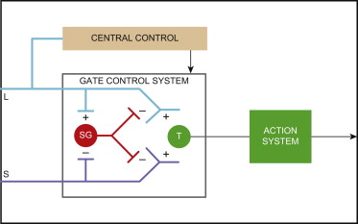

Slide 25
Discussion
Ruskin (2017)
Mindfulness and pain relief

Slide 26
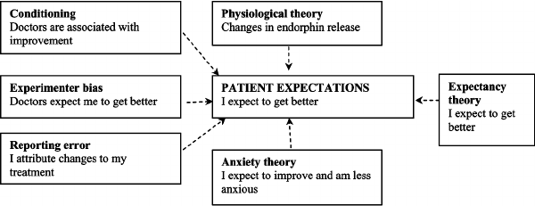
Placebo
Inert substances that cause symptom relief
Any therapy that is deliberately used for it non-specific psychological or physiological effects
Central role of patient expectations

Slide 27
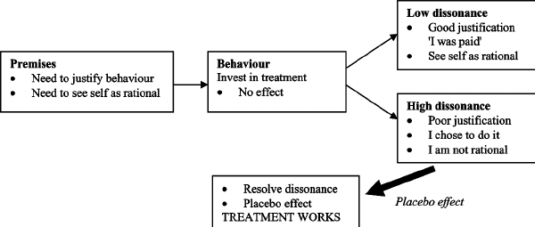
Placebo
Cognitive Dissonance Theory
Does not require expectations to explain placebo effect
Effect of investment (Totman, 1987)

Slide 28
Discussion

