Slide 1
Social Class
Yvon van someren, Nathalia doné, annalena von Hayn

Slide 2
Definition
„A class is defined as a large-scale grouping of people who share common economic resources that in turn influence their lifestyle.“
Anthony Giddens (2013)

Slide 3
Social Class in different countries
What meaning has Social Class in your Country?
What has or had influence on that?
- negative/ positive
- history
- political situation
- ……..

Slide 4
Types of Social Class
Ownership Classes (upper Class)
Commercial Classes (upper-middle Class)
Acquisition Classes (middle Class)
Major Classes (working and lower Class)

Slide 5
How do we measure Social Class in surveys?
3 Methods in Sociology:
subjective
reputational
objective
2 different views:
nominalist view
realist‘s view

Slide 6



Exercise

Slide 7
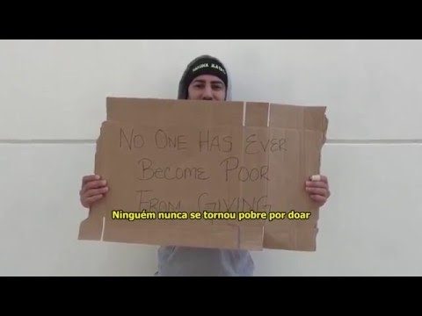
Movie:
What if the homeless gave you money?

Slide 8

Stereotypes: Positive? Negative?
“We see patterns, we make rules”
Keith Jason at TEDx Talks
“Give people and individuals the freedom to see a pattern, but give them the opportunity to break rules”
Keith Jason at TEDx Talks

Slide 9

Conclusion about Stereotypes
Be sensitive and aware of them
Reask them
don‘t stick to them
don‘t judge others, because of
them

Slide 10

Oppression, (Dis-)advantages, Privileges

Slide 11
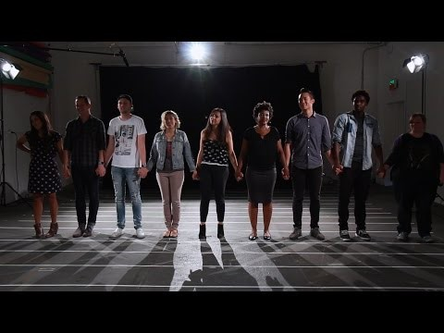
Movie: What is privilege?

Slide 12
How do we think about Social Class?
Concept which will always be there.
Results of different aspects and recources (privileges)
Change social classes can be really difficult, but not impossible
Social Class is a social construction that always changes, because it is made by people
Social Class is a hidden category in combination with other factors (gender, race, disability, religious belief, ethnicity, age, sexual orientation)

Slide 13

Movie: Stop thinking in boxes

Slide 14
References
GIDDENS, A. (2013). Sociology (Seventh Edition). Cambridge : Polity.
GIDDENS, A., & HELD, D. (1982). Classes, power, and conflict: classical and contemporary debates. Berkeley, University of California Press.
How is social class measured? Retrieved on 05. April 2017 from Reference: https://www.reference.com/world-view/social-class-measured-bc1492d432f170a7
Jason, Keith (08. May 2013). The Science of Stereotypes?: Keith Jason at TEDxEMU. Retrieved on 06. April 2017 from YouTube: https://www.youtube.com/watch?v=FySM-xiFef4
What if the homeless give you money? (19. April 2015). Retrieved on 30. March 2017 from Youtube: https://www.youtube.com/watch?v=oZvYvOkqxA8
What happens when we stop putting people in boxes... (03. February 2017). Retrieved on 30. March 2017 from Youtube: https://www.youtube.com/watch?v=Wh-xdZzyjVI
What is privilege? (04. July 2015). Retrieved on 30. March 2017 from Youtube: https://www.youtube.com/watch?v=hD5f8GuNuGQ

Slide 15
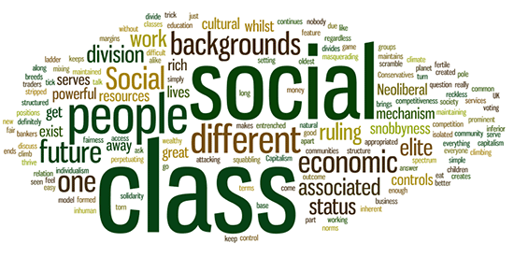
Thank you

