Slide 1
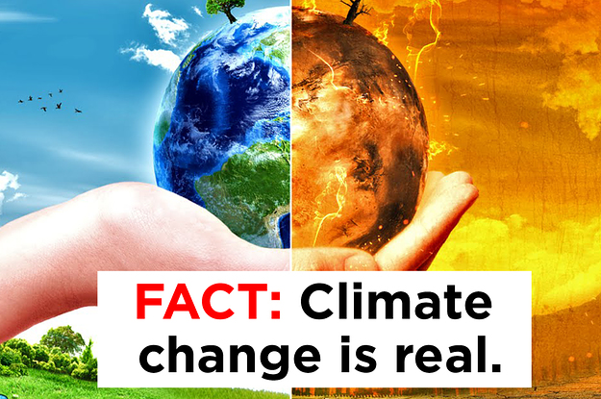
America’s Changing Global Role
*Climate change-Case Study
Image:www.researchgate.net
Pavel Šaradín, Vojta Kyselý,
Anna Mezhenskaya, Camilla Kelényová

Slide 2

Climate change: How do we know?
According to

Slide 3
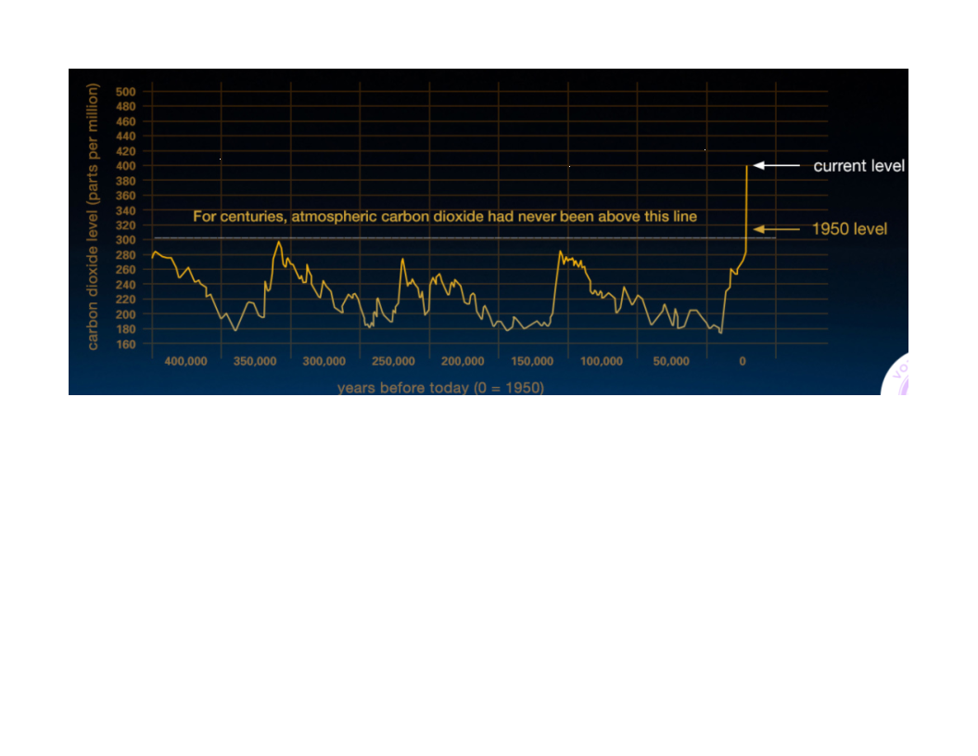
1.The Rise of Atmospheric Carbon Dioxide
Graph:climate.nasa.gov
*Atmospheric CO2 has increased since the Industrial Revolution

Slide 4
2.Global temperature rise
Average surface temperature has risen about 1.1 degrees Celsius since the late 19th century
A change caused largely by increased carbon dioxide and other human-made emissions into the atmosphere.
Most of the warming occurred in the past 35 years

Slide 5
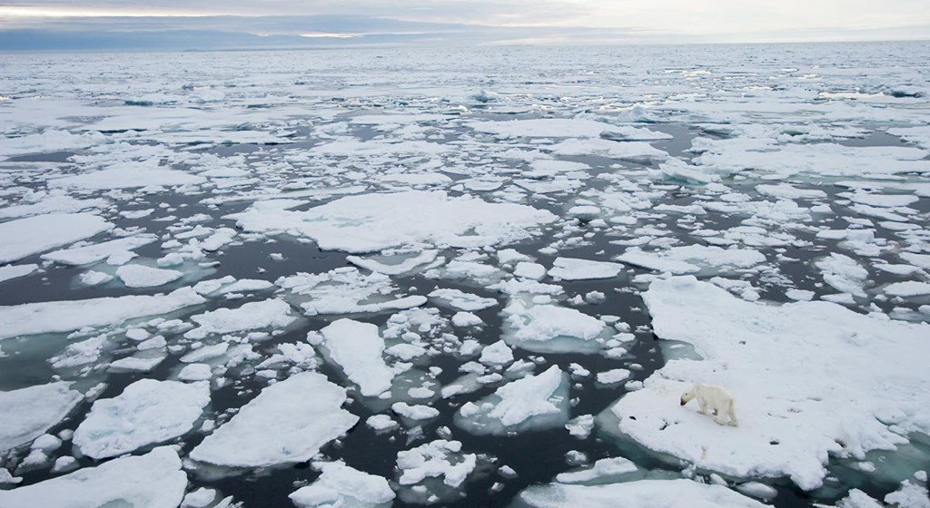
3.Shrinking ice sheets
Greenland lost 150 to 250 cubic kilometers of ice per year between 2002-2006
Antarctica lost about 152 cubic kilometers of ice between 2002-2005.
Image:National Geographic

Slide 6
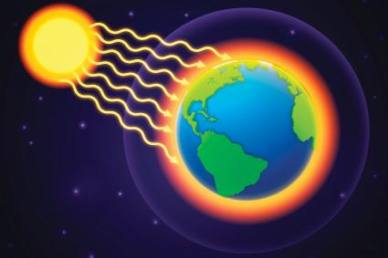
+We know because of:
Warming Oceans
Glacial retreat
Decreased snow cover
Sea level rise
Declining Arctic sea ice
Extreme events
Ocean acidification
Image:Green Living

Slide 7
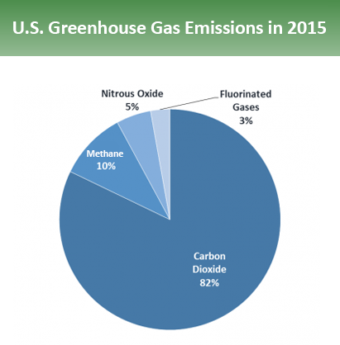
Image:www.epa.gov
:
,,Larger emissions of greenhouse gases lead to higher concentrations in the atmosphere.’’
Image:www.epa.gov

Slide 8
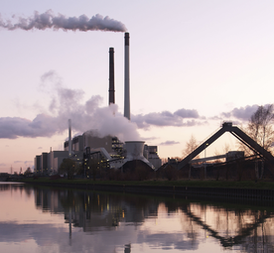
Fossil fuel/Coal power-plants
Produces large amounts of different pollutants which reduces air quality and contributes to climate change
Require enormous amounts of coal
The largest producers of electricity around the world
Image:wikipedia.org

Slide 9
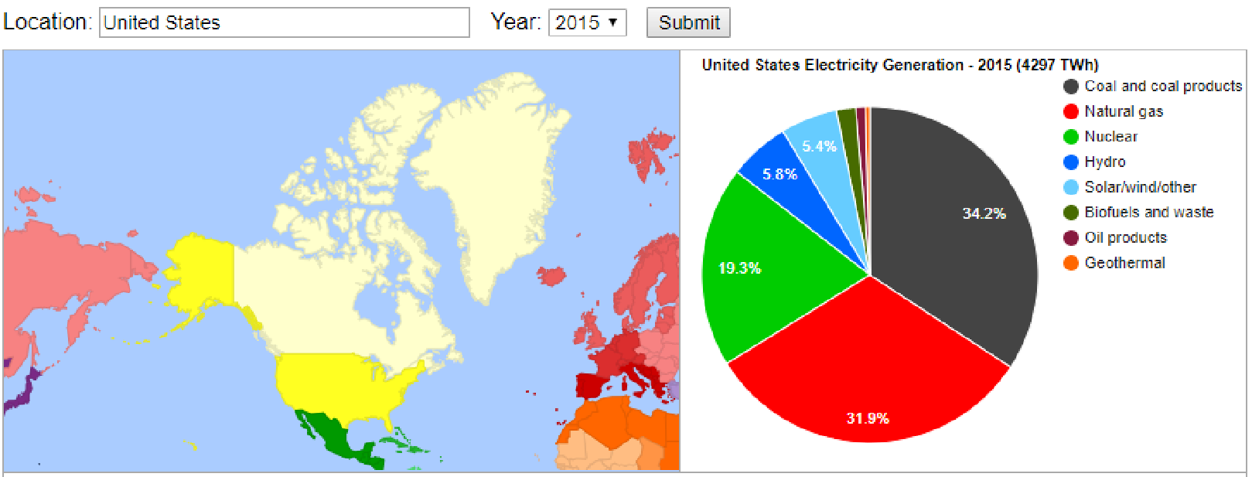
http://energyeducation.ca/encyclopedia/Power_plant
http://energyeducation.ca/encyclopedia/Power_plant
*2015, U.S. electricity is generated using fossil fuels- Coal 34,2%

Slide 10
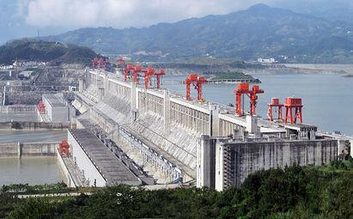
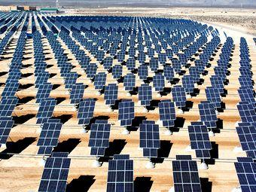
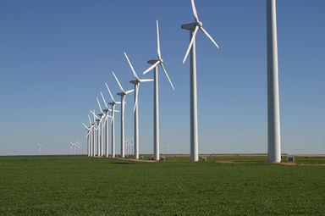
Green energy/Renewable energy power plants
Renewable energy sources provide less than 17% of U.S. electricity (2016)
Hydroelectric facilities (7%)
Wind turbines(6%)
Solar panels (1%)
Biomass(2%)
Geothermal power
(less than1%)
Images:wikipedia.org

Slide 11

.
Image:www.un.org
The United Nations Framework Convention on Climate Change agreement
Goal- reduction of greenhouse gas emissions
Starting in the year 2020
Each country plans and determines its own contribution that it should make in order to reduce/slow down global warming
Includes NO force mechanism
President Donald Trump decided to withdraw the United States from the agreement

Slide 12
References:
http://energyeducation.ca/encyclopedia/Power_plant#cite_note-2
https://www.eia.gov/energyexplained/index.cfm?page=electricity_in_the_united_states
https://climate.nasa.gov/evidence/
http://upload.wikimedia.org/wikipedia/commons/b/bb/Gundremmingen_Nuclear_Power_Plant.jpg
https://upload.wikimedia.org/wikipedia/commons/4/4d/Fermi_NPP.jpg
https://upload.wikimedia.org/wikipedia/commons/8/8b/GreenMountainWindFarm_Fluvanna_2004.jpg
https://treaties.un.org/pages/ViewDetails.aspx?src=TREATY&mtdsg_no=XXVII-7-d&chapter=27&clang=_en
https://www.un.org/sustainabledevelopment/blog/2016/04/parisagreementsingatures/
https://www.researchgate.net/post/Do_your_place_is_affected_through_climate_change_how_it_is_affected
https://greenliving.lovetoknow.com/Ways_to_Stop_Global_Warming

Slide 13
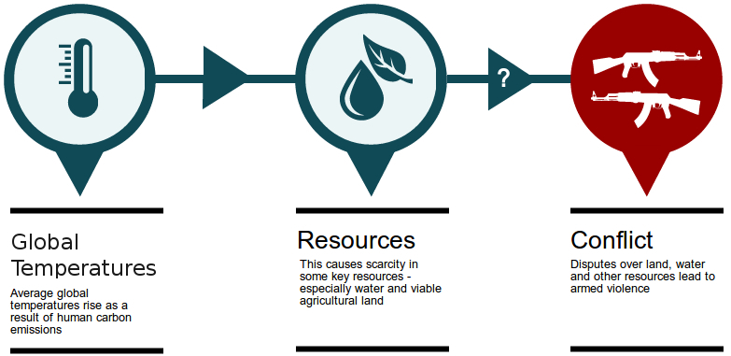
Climate change and other phenomena I
Securitisation of climate change
Environmental security (Buzan and Copenhagen school)
Apocalyptic visions(?)
- interconnection(?)
Environmental degradation
Economic decline & migration
Resource scarcity (not just water)
Weak & failing/failed states (esp. Africa, Near East)
Armed conflicts (esp. civil wars & spillover) Image: Alex Randall

Slide 14
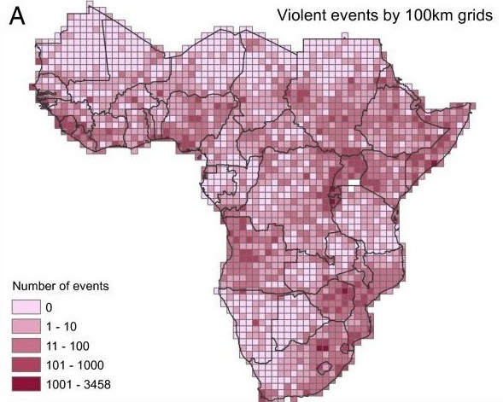
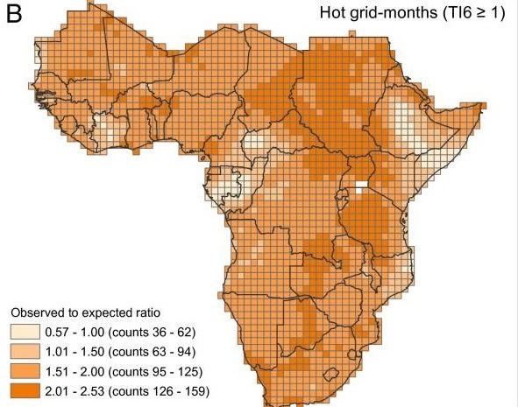
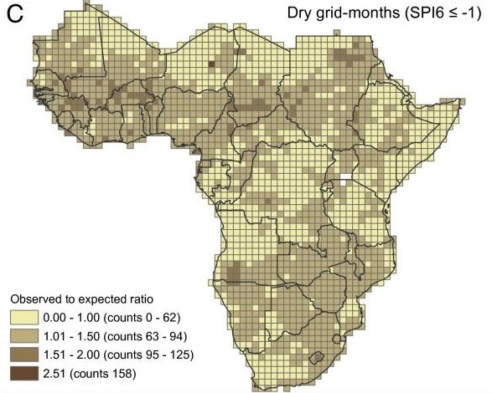
Climate change and other phenomena II
New (indirect) source of instability and/or conflict
Correlation, or (suggested) causality?
23% of armed conflicts in ethnically divided places were linked to climate disasters
Images: O’Loughlin - Linke - Witmerb

Slide 15
Climate change and other phenomena III
Lack of reliable data, evidence, and consensus
Elusive connection, not yet truly proven
Keep watching, studying, and proving...

Slide 16
References:
Carrington, D. (2016): Disasters linked to climate can increase risk of armed conflict. Available at https://www.theguardian.com/environment/2016/jul/25/disasters-linked-to-climate-can-increase-risk-of-armed-conflict
Mobjörk, M. - Eriksson, M. - Carlsen, H. (2010): On Connecting Climate Change with Security and Armed Conflict: Investigating knowledge from the scientific community. FOI, Swedish Defence Research Agency. ISSN 1650-1942.
O’Loughlin, J. - Linke, A. M. - Witmerb, F. D. W. (2014): Effects of temperature and precipitation variability on the risk of violence in sub-Saharan Africa, 1980–2012. Available at https://www.ncbi.nlm.nih.gov/pmc/articles/PMC4250158/
Theisen, O. M. - Gleditsch, N. P. - Buhaug, H. (2013): Is climate change a driver of armed conflict? Climatic Change, April 2013, vol. 117, iss. 3, pp. 613-625.
The Economist (2010): Climate wars. Available at https://www.economist.com/node/16539538
http://climatemigration.org.uk/infographic-exploring-evidence-for-the-climate-change-and-conflict-connection-2/

Slide 17
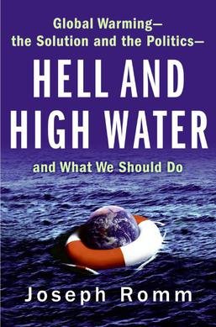
George W. Bush
https://www.goodreads.com/book/show/175796.Hell_and_High_Water
•In March 2001, the Bush Administration announced that it would not implement the Kyoto Protocol
•In February 2002, Bush announced his alternative to the Kyoto Protocol, by bringing forth a plan to reduce the intensity of greenhouse gasses by 18 percent over 10 years.
•Bush's do-nothing policy on global warming began almost as soon as he took office. By pursuing a carefully orchestrated policy of delay, the White House blocked even the most modest reforms and replaced them with token investments in futuristic solutions like hydrogen cars.
„They have a single-minded determination to do nothing—while making it look like they are doing something.“
•Political pressure on scientists

Slide 18
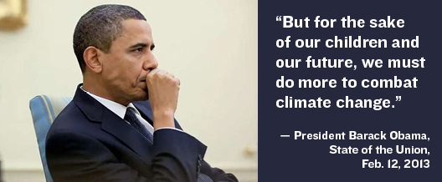
Barack Obama
•New Energy for America
• the White House Office of Energy and Climate Change Policy
•Obama administration added climate to list of threats to US interests
•The Clean Power Plan
“The time for denial, delay and dispute is over.... We can only meet the climate challenge with a response that is genuinely global. We will need to engage in vigorous, dramatic diplomacy.„
if the international community would not act swiftly to deal with climate change that "we risk consigning future generations to an irreversible catastrophe...The security and stability of each nation and all peoples—our prosperity, our health, and our safety—are in jeopardy, and the time we have to reverse this tide is running out.„
•transition from oil to alternative sources of energy
military security>envinronmental security 28x
www.solarsunwerx.com.au

Slide 19
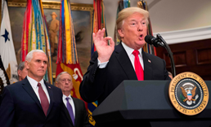
Donald Trump
•D. Trump drops climate change from US national security strategy
•“Climate change is not identified as a national security threat but climate and the importance of the environment and environmental stewardship are discussed.” (James Mattis)
•2016 withdrawing the U.S. from the Paris agreement:
“I was elected to represent the citizens of Pittsburgh, not Paris”
•cutting about 31% of the EPA as a result of budget decreases.
•People's Climate Movement, March 2017

Slide 20
Literature
•https://www.theguardian.com/us-news/2017/dec/18/trump-drop-climate-change-national-security-strategy
•https://www.theguardian.com/environment/climate-consensus-97-per-cent/2018/feb/01/its-not-okay-how-clueless-donald-trump-is-about-climate-change
•https://edition.cnn.com/2017/03/27/politics/trump-climate-change-executive-order/index.html
•https://www.theguardian.com/commentisfree/2016/oct/08/climate-change-defense-spending-fighter-plane-climate-change-defense-spending-fighter-plane-program
•http://www.planetexperts.com/republicans-democrats-differ-climate-environment-policies/
•https://www.nytimes.com/2017/06/04/us/politics/trump-paris-accord-bush-kyoto.html
•http://www.solarsunwerx.com.au/latest-news/obama-double-climate-change
https://www.goodreads.com/book/show/175796.Hell_and_High_Water

Slide 21
Dangers of climate change
Direct impact on agricultural production
Direct impact on sea levels
Some places will become uninhabitable
Huge waves of migration
Problem even for the richest states
Choices made today are very important

Slide 22
What should the US do?
Institution, projects, think-tanks (American Security Project, The Center for Climate and Security)
Should be priority of NSS again
Global and long-term threats will require collective action
Fun fact: 2009 Trump supported action on climate change

Slide 23
Important role of the US army?
Lieven (2017): the US army is the only force that can beat climate change
Militaries have the capacity to mobilize resources on the scale required
They can make link between the threat of climate change and patriotic duty to convince “ordinary people”

Slide 24
Important role of the US army?
Climate change as a topic divides the US society
The one American institution that retains the confidence and respect of the great majority of Americans from both political parties
Also, the US Army is currently the world’s largest polluter (Producing more hazardous waste than the five largest U.S. chemical companies combined)
However, there must be political will

Slide 25
Literature
http://foreignpolicy.com/2018/01/09/the-only-force-that-can-beat-climate-change-is-the-u-s-army/
https://eos.org/features/how-will-climate-change-affect-the-united-states-in-decades-to-come
https://www.theverge.com/2017/8/9/16116198/climate-change-report-extreme-weather-co2-donald-trump
https://www.ecowatch.com/military-largest-polluter-2408760609.html
https://www.washingtonpost.com/news/the-fix/wp/2016/06/09/in-2009-donald-trump-endorsed-action-on-climate-change-three-months-later-he-disparaged-it/?utm_term=.416c3b48cb39
U.S. National Intelligence Council, Global Trends: Paradox of Progress (2017)

