Slide 1
America‘s Global Role – Case study
Nuclear Proliferation
Course: BSS 187/487 America’s Changing Global Role (Spring 2018)
Faculty of Social Studies, Masaryk University
Jan Běláč, Julie Vinklová, Helena Worthington

Slide 2
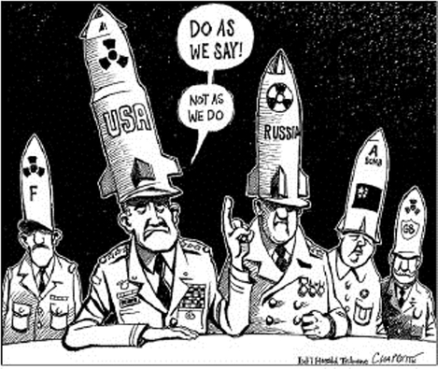
Nuclear Proliferation
The spread of nuclear weapons, nuclear weapons technology, or fissile material to state and non-state actors that do not already possess them. (Munro 2017) This includes spread of technology , know-how and material required to manufacture means of delivery of nuclear devices (e.g. aircraft, rockets, missiles).
Non-proliferation – Efforts to stop, limit or at least slow down process of proliferataion.

Slide 3
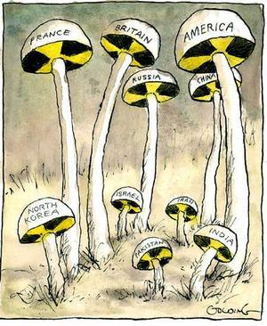
Types of Proliferation
Horizontal – more actors acquire military nuclear capabilities
Vertical – increase in size of nuclear arsenal, improvement of effectivity (of both weapons and means of delivery), development of new types of weapons or means of delivery

Slide 4
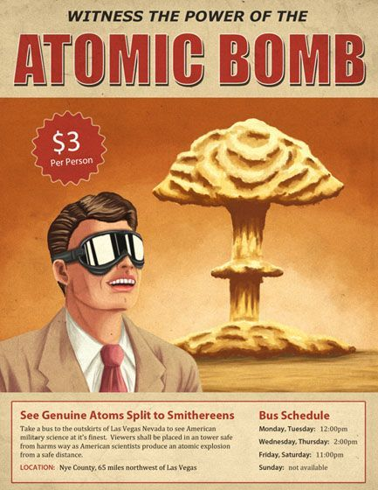
USA and Nuclear Proliferation
The United States always did everything they could to stop proliferation of nuclear weapons!
US efforts to limit and prevent nuclear proliferation were and still are by great part purely pragmatic!
Proliferation of WMDs was and still is viewed by the USA as one of the biggest security threats and risks.
It is very hard to imagine scenario in which the USA would be willing to give up their nuclear weapons.
At first the US were very reluctant to help their allies with their own nuclear programs.

Slide 5
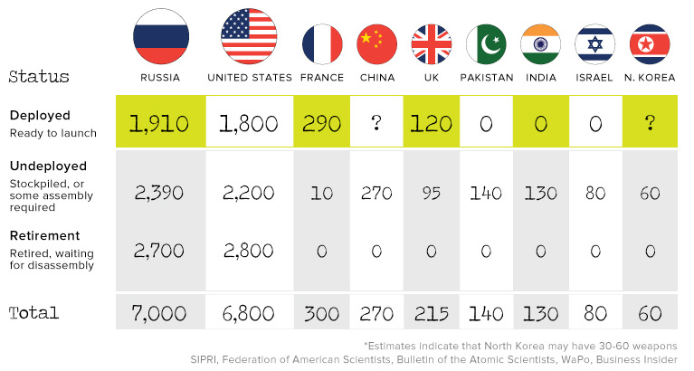
Countries with nuclear weapons

Slide 6
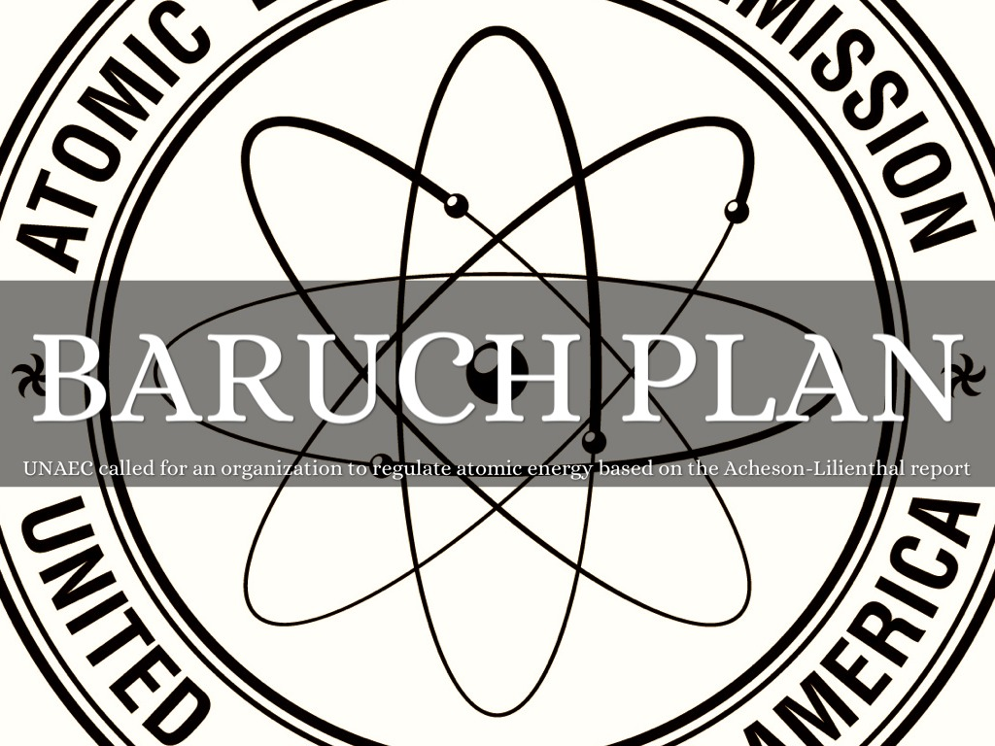
Post WW2 History
Baruch Plan (1946) – Proposal of the USA to give up its nuclear arsenal (only existing in the world at that time) if all other countries will pledge not to develop their own military nuclear capabilities. Peaceful development and use of nuclear energy would be still possible under international régime. Safeguards and control mechanisms to prevent proliferation would be implemented. Sanctions could not be vetoed by any member of UN SC. Proposal was rejected by the Soviet Union. (Atom Archive n.d.)
Atomic Energy Act of 1946 (McMahon Act) – Control over US nuclear research was placed under civilian supervision. The USA were prohibited to share any information regarding their nuclear program with any other country including the UK and Canada which participated on Manhattan Project. (US DOE n.d.)

Slide 7
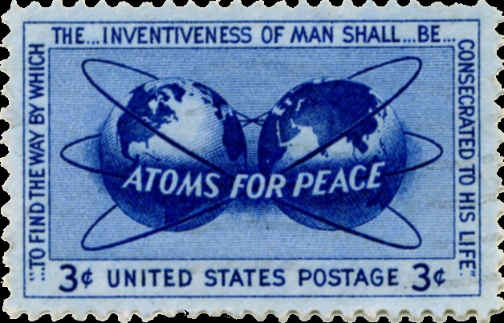
“Atoms for Peace”
“Atoms for Peace” (1953) – Program presented by US president Dwight Eisenhower to UN GA on December 8, 1953. The USA offered to share its know-how and technologies for peaceful use of nuclear power with other countries that will pledge not to seek to obtain nuclear weapons. As a result of this initiative International Atomic Energy Agency(IAEA) was founded in 1957. IAEA became the main global body for control of nuclear proliferation. (Hicks 2014)

Slide 8
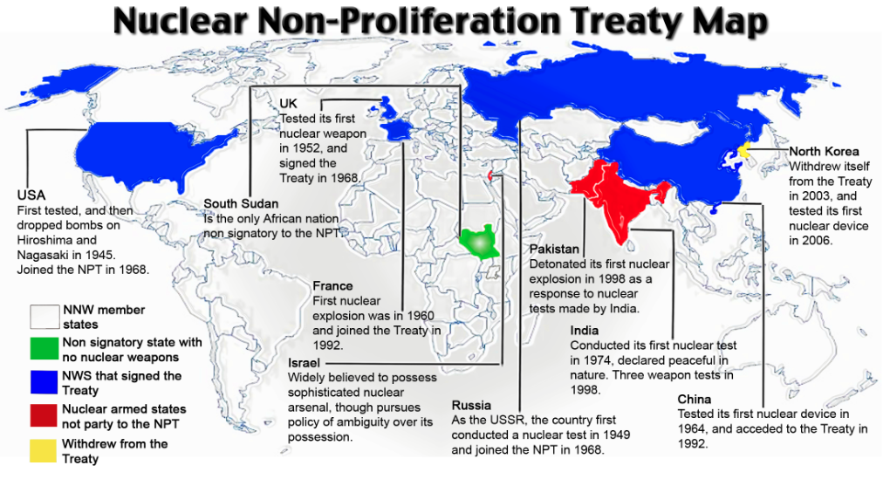
Treaty on the Non-Proliferation of Nuclear Weapons (NPT)
States without nuclear weapons will not acquire them;
States with nuclear weapons will pursue disarmament;
All states can access nuclear technology for peaceful purposes, under safeguards. (NTI 2017)
Source: https://www.pressenza.com/2015/06/npt-consensus-failure-a-good-thing-108-countries-pledge-to-help-ban-nuclear-weapons/

Slide 9
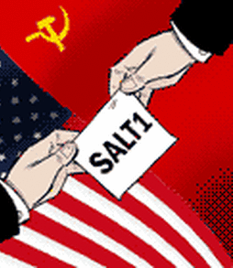
Cold War –
Vertical Proliferation
Examples of bilateral and multilateral treaties involving US that adressed vertical proliferation (ACA n.d.):
Limited Test Ban Treaty (LTBT) – 1963
Outer Space Treaty – 1967
Strategic Arms Limitation Talks (SALT I) – 1968
Seabed Arms Control Treaty - 1971
Anti-Ballistic Missile (ABM) Treaty – 1972
Threshold Test Ban Treaty (TTBT) – 1974
Peaceful Nuclear Explosions Treaty (PNET) – 1976
Strategic Arms Limitation Talks II (SALT II) – 1979
Intermediate-Range Nuclear Forces (INF) Treaty – 1987

Slide 10
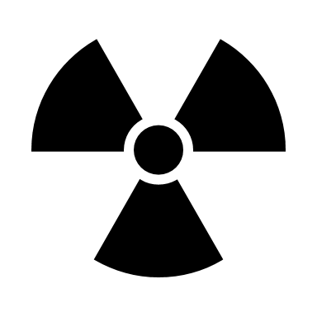
Sources
Munro, André (2010): “Nuclear proliferation.” Encyclopædia Britannica, 20th August 2017, on-line (https://www.britannica.com/topic/nuclear-proliferation). [verified 09/04/2018].
Atom Archive (n.d.): “The Baruch Plan.” Atom Archive, on-line (http://www.atomicarchive.com/History/mp/p6s5.shtml). [verified 09/04/2018].
Hicks, Jesse (2014): “Atoms for Peace: The Mixed Legacy of Eisenhower’s Nuclear Gambit.” Science History Institute, summer 2014, on-line (https://www.sciencehistory.org/distillations/magazine/atoms-for-peace-the-mixed-legacy-of-eisenhowers-nuclear-gambit). [verified 09/04/2018].
US Department of Energy (n.d.): “ATOMIC ENERGY ACT OF 1946.”, on-line (https://science.energy.gov/~/media/bes/pdf/Atomic_Energy_Act_of_1946.pdf). [verified 09/04/2018].
Nuclear Threat Initiative (2017): “TREATY ON THE NON-PROLIFERATION OF NUCLEAR WEAPONS (NPT).” Nuclear Threat Initiative, 25th July 2017, on-line (http://www.nti.org/learn/treaties-and-regimes/treaty-on-the-non-proliferation-of-nuclear-weapons/). [verified 09/04/2018].
Arms Control Association (n.d.): “Treaties & Agreements” Arms Control Association, on-line (https://www.armscontrol.org/treaties). [verified 09/04/2018].

Slide 11
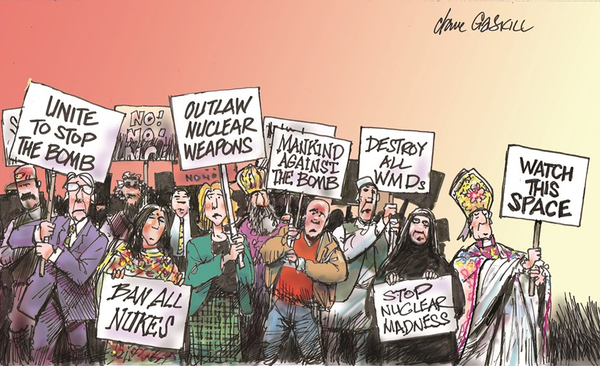
1990‘s, Nukes, and the US
South Africa gave up the bomb (1991)
US did its last nuclear bomb test (1992)
World Court says nuclear weapons illegal (1996)
Total nuclear test ban is signed (1996)
India and Pakistan conduct nuclear tests (1998)

Slide 12
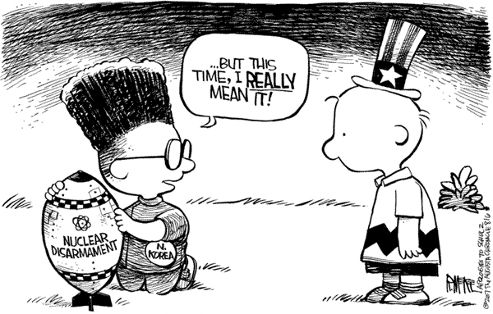
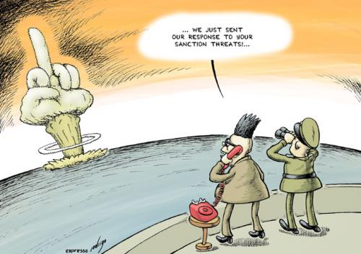
New millennium and problem called North Korea
2003 - North Korea withdraws from the NPT
2006 - North Korea conducts nuclear test
2007 - North Korea agrees to close its main nuclear reactor in exchange for an aid package worth $400 million, but they miss deadline
2009 - The UN Security Council condemns the nuclear test and imposes new sanctions

Slide 13
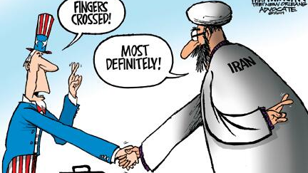
Nuclear threats to 21st century
North Korea - the deputy director of a North Korean think tank says the country has the missile capability to strike mainland United States and would do so if the United States forced their hand.
Nuclear terrorism - Nuclear Terrorism: The Threat is Real
Iran – since 2003, worldwide concern over Iran's nuclear program has increased as Iran and the International Atomic Energy Agency (IAEA) spar over investigation and details of Iran's program

Slide 14
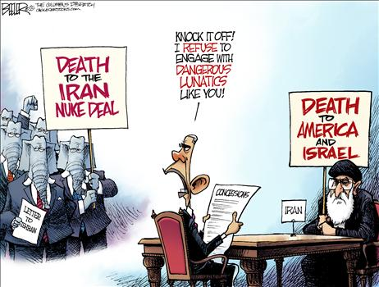
America‘s view
„Today, in the post-9/11 world, the most urgent nuclear weapon threats to the United States are not from another major power’s deliberate use of them, but instead are from non-state terrorist actors or from the regional proliferation of such weapons into unreliable hands“
- Nuclear Weapons in 21st Century U.S. National Security report

Slide 15
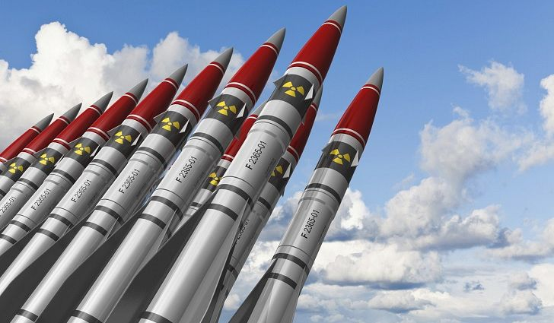
America‘s view
„U.S. nuclear policy and strategy in this post-Cold War and post-9/11 security environment have not been well articulated and as a consequence are poorly understood both within and outside American borders. This situation has led to doubts and uncertainties about the roles and missions of nuclear weapons and their value against 21st century security threats, including allies’ uncertainties about U.S. assurances as they relate to emerging nuclear-armed neighboring states“
- Nuclear Weapons in 21st Century U.S. National Security report

Slide 16
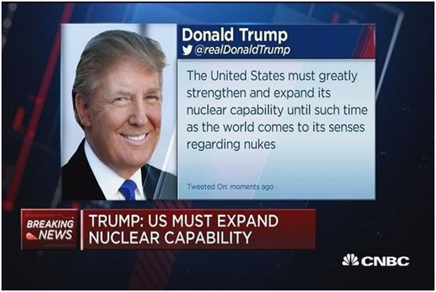
America‘s view
„Lacking a coherent and compelling rationale for U.S. nuclear strategy and policy, Congress has been unwilling to fund some Bush Administration requests for new nuclear refurbishment efforts (both stockpile and infrastructure). Meanwhile, serious strains on the human, technical, and scientific infrastructure could undermine whatever strategy is ultimately adopted. Clearly, this policy vacuum regarding our nuclear deterrent must be addressed alongside our efforts to prevent further nuclear proliferation“
- Nuclear Weapons in 21st Century U.S. National Security report

Slide 17
Sources
http://www.icanw.org/the-facts/the-nuclear-age/
https://www.aps.org/policy/reports/popa-reports/nuclear-weapons.cfm
https://edition.cnn.com/2013/10/29/world/asia/north-korea-nuclear-timeline---fast-facts/index.html
http://www.nti.org/about/nuclear-terrorism/
https://edition.cnn.com/2013/11/07/world/meast/irans-nuclear-capabilities-fast-facts/index.html

Slide 18
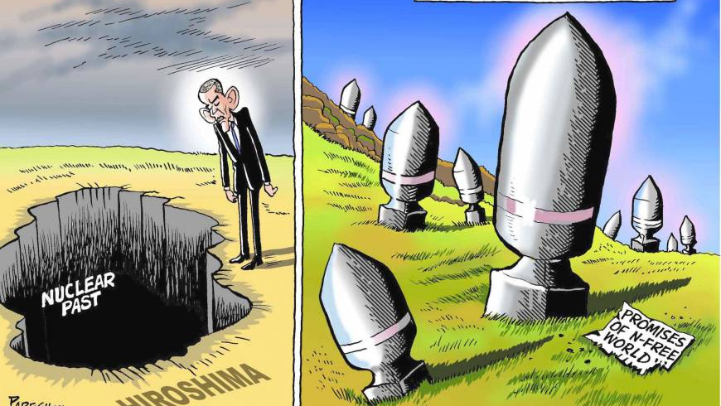
U.S. - Nuclear Proliferation and the Future
U.S. and Iran
U.S. and North Korea
U.S. and Russia
U.S and Future Prospects → NPR
U.S. and Future Concerns

Slide 19
U.S. and Iran
NOW
In January 2018 President Trump waived, for the last time, the sanctions on Iran following the nuclear agreement (JCPOA) from 2015.
Trump‘s administaration laid down new conditions to be met in the period of four months.
FUTURE
May 12, 2018 – a date of the next waiver.
IS IT GOING TO HAPPEN?
What are the chances of not destroying the nuclear deal with Iran?

Slide 20
U.S. and North Korea
NOW
FUTURE
‚North Korea is pursuing its nuclear and missile programs in defiance of U.N. Security Council sanctions and has made no secret of its plans to develop a missile capable of hitting the U.S. mainland.‘
(CNBC)
By the end of May 2018 – (currently) a proposed meeting between the President Trump and Kim Jong-Un.
IS IT GOING TO HAPPEN?
What are the anticipated outcomes?

Slide 21
U.S. and Russia
NOW
FUTURE
‚Both the United States and Russia have now outlined expansions of their nuclear arsenals, ….
‚Each has also charged the other with violations of the Intermediate-Range Nuclear Forces (INF) Treaty.‘
‚… and it remains unclear whether New START, the primary arms-reduction treaty in effect between the two, will remain viable beyond its expiration date of 2021.‘
(March 1, 2018, Kare DeYoung)

Slide 22
U.S. and Future Prospects -The 2018 Nuclear Posture Review (NPR)
‚We must keep America‘s deterrent credible by making it modern. The 2018 NPR calls for modernizing the nuclear triad and command and control system, which is necessary, affordable and long overdue. Our nuclear triad has kept us safe for over 70 years. We cannot afford to let it become obsolete. ‘

Slide 23
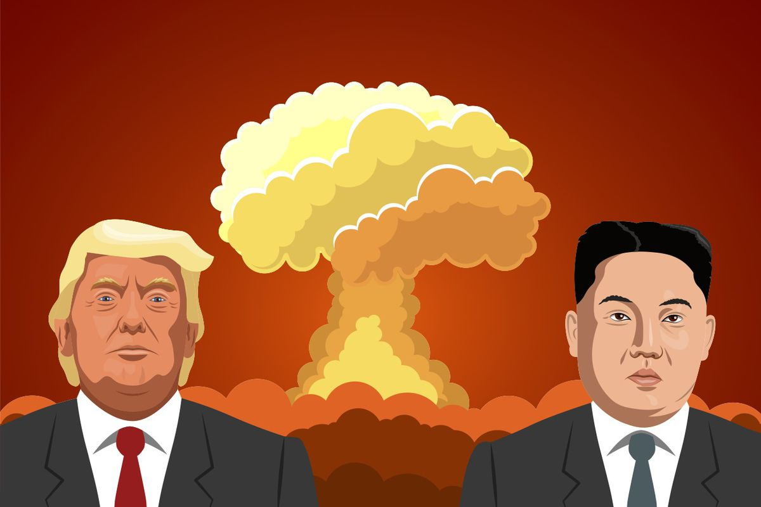
U.S. and Future Prospects -The 2018 Nuclear Posture Review (NPR)
„The United States would only consider the use of nuclear weapons in extreme -- in extreme circumstances to defend the vital interests of the United States, its allies and partners.„
Example of extreme circumstances:
a significant nonnuclear strategic attacks
The United States does not want to use nuclear weapons.
(Deputy Secretary of Defence Patrick M. Shanahan)

Slide 24
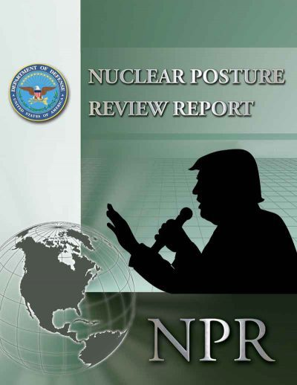
U.S. and Future Prospects -The 2018 Nuclear Posture Review (NPR)
The 2018 NPR reflects the president‘s priority to put America first…
The potential threat of non-state actors getting their hands on a nuclear weapon remains at the front of all of our minds.
( Under Secretary of State for Political Affair Thomas Shannon)

Slide 25
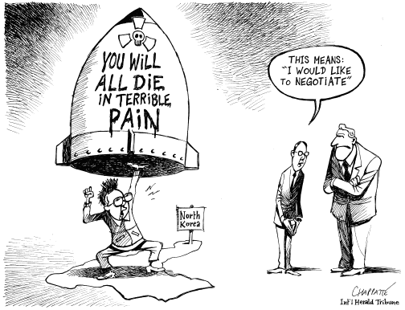
U.S. and Future Concerns
Other than nuclear mass destruction threats:
Cyber or Biological Attacks.
Development of new bans and control measures for new types of bio-weapons (genetic engineering and so on) would be possible on a multilateral basis only in the context of cooperation among the major powers.
(Atlantic Council Global Risks 2035)
Nuclear weapons in possession of non-state actors.
Further division between U.S. and Europe over JCPOA.

Slide 26
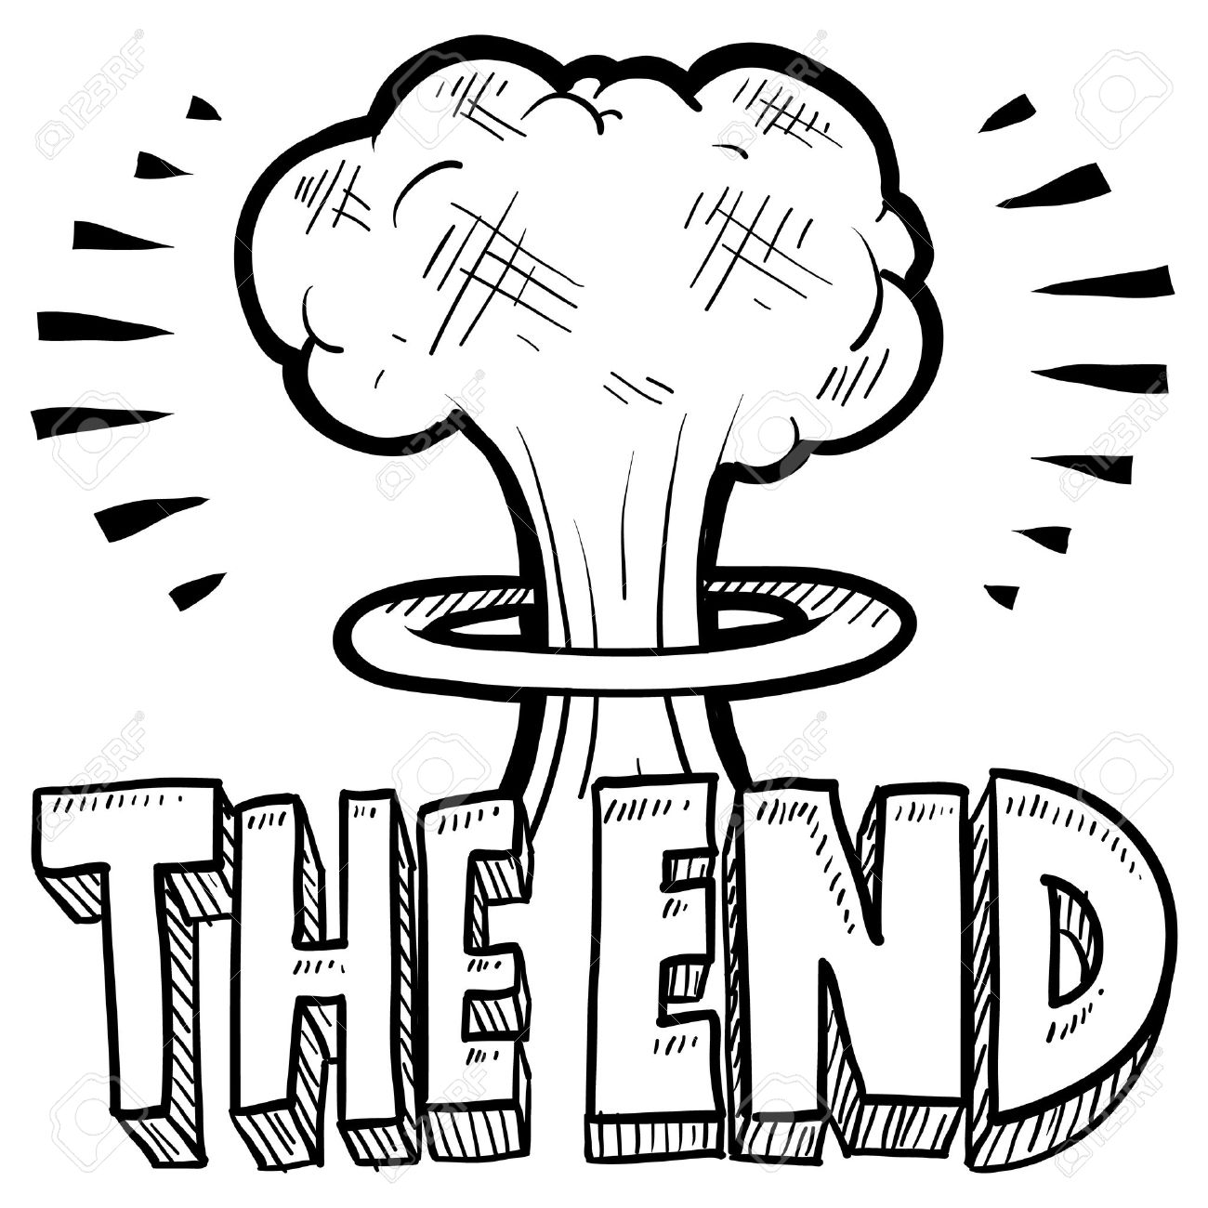
Thank you for your attention

Slide 27
Sources:
Gordon P., Malley R. (2018). Destroying the Iran Deal While Claiming to Save It. In The Atlantic. Retrieved from: https://www.theatlantic.com/international/archive/2018/01/trump-iran-deal-jcpoa/551066/ on April 11, 2018
Senior Administration Official, The White House (2018). Background Press Call on Iran Sanctions. Retrived from: https://www.whitehouse.gov/briefings-statements/background-press-call-iran-sanctions/ on April 11, 2018
CNBC (2018). North Korean diplomat heads to Finland for talks ahead of possible summit with US: Report. Retrieved from: https://www.cnbc.com/2018/03/18/north-korean-diplomat-heads-to-finland-possible-us-north-korea-talks.html on April, 11, 2018
Atlantic Council, (2016). Global Risks 2035: The Search for a New Normal.

Slide 28
Sources:
DeYoung K. (2018). Putin speech adds to freeze in U.S.-Russia relations. In the Woshington Post. Retrieved from: https://www.washingtonpost.com/world/national-security/putin-speech-adds-to-freeze-in-us-russia-relations/2018/03/01/ffab9174-1d8d-11e8-ae5a-16e60e4605f3_story.html?utm_term=.819f8206f4a0 on April 11, 2018
U.S. Department of Defense (2018). News Briefing on the 2018 Nuclear Posture Review. Retrieved from: https://www.defense.gov/News/Transcripts/Transcript-View/Article/1431945/news-briefing-on-the-2018-nuclear-posture-review/ on April 11, 2018
Wicket X. (2018). Transatlantic Relations: Converging or Diverging?
House C. Report: US and the Americas Programme.

