Slide 1
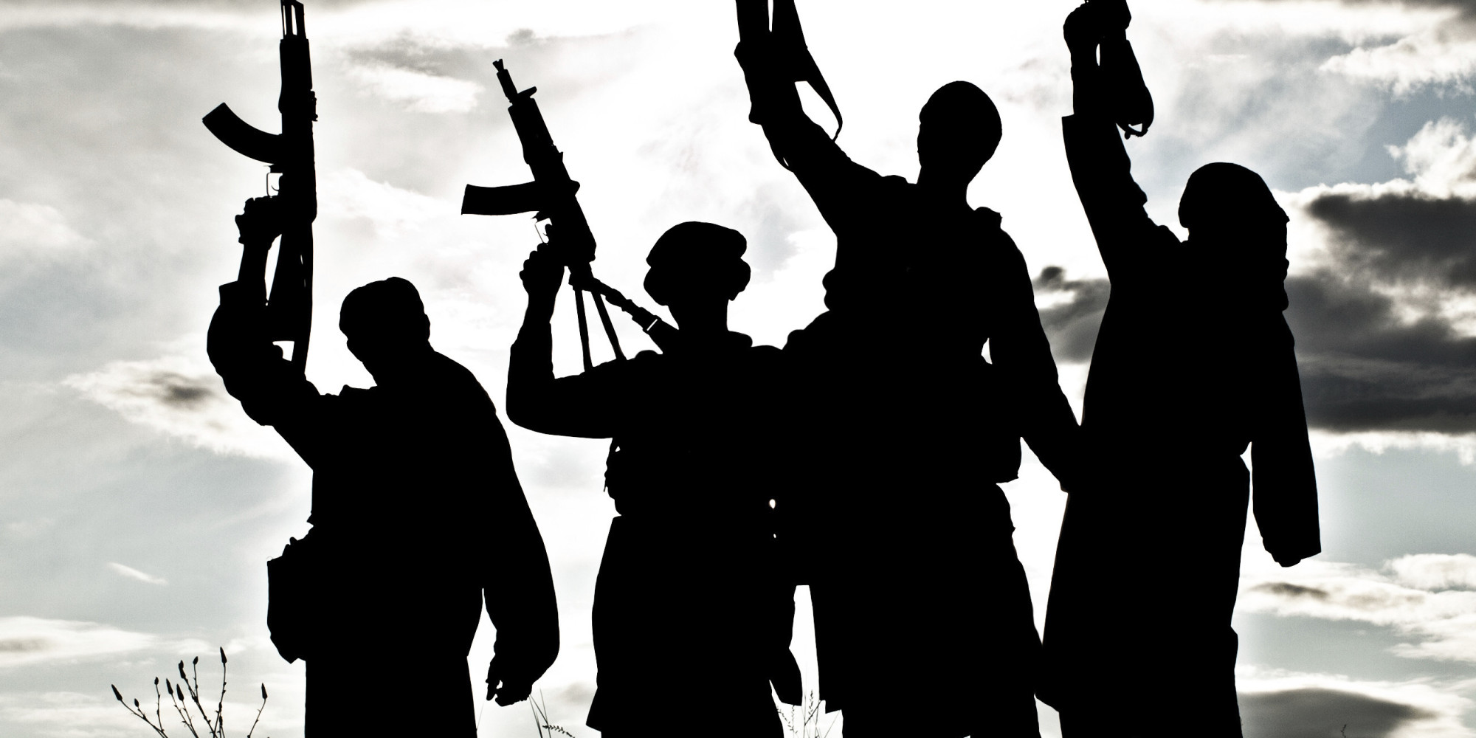
Terrorism in the Age of Globalization

Slide 2
Terrorism has become a festering wound. It is an enemy of humanity
Atal Bihari Vajpayee

Slide 3
What is Terrorism ?
The unlawful use of violence and intimidation, especially against civilians, in the pursuit of political aims
Causes of Terrorism
Ethno-nationalism
Alienation /Discrimination
Religion
Socio-Economic Status
Political Grievances
Individual motivations

Slide 4
Types of Terrorism
State-Sponsored terrorism
consists of terrorist acts on a state or government by a state or government.
Criminal Terrorism
terrorists acts used to aid in crime and criminal profit
Terrorists and the Left and Right
groups rooted in political ideology.
Dissent terrorism
terrorist groups which have rebelled against their government
Religious terrorism terrorist groups which are extremely religiously motivated

Slide 5
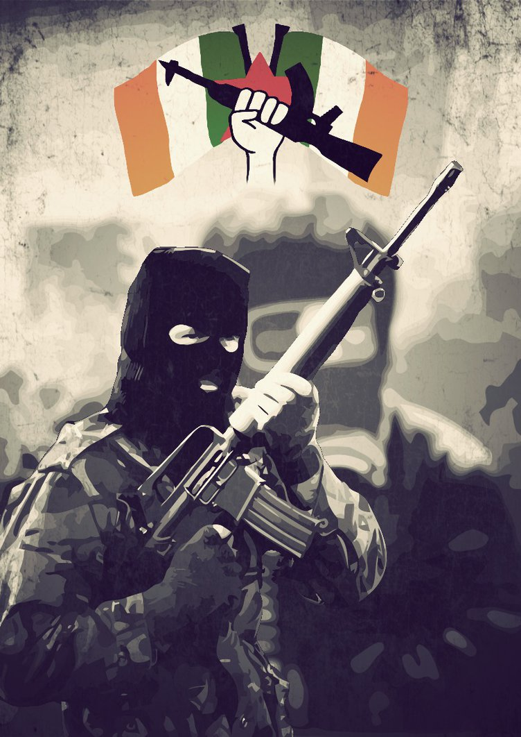
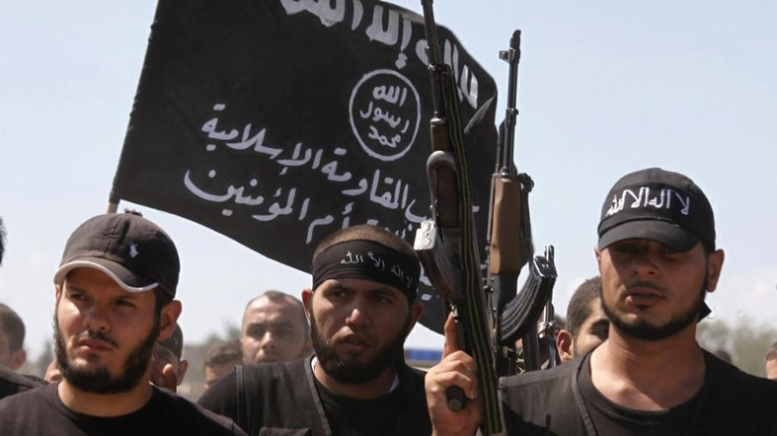
The history of modern terrorism
French revolution
Evolution

Slide 6
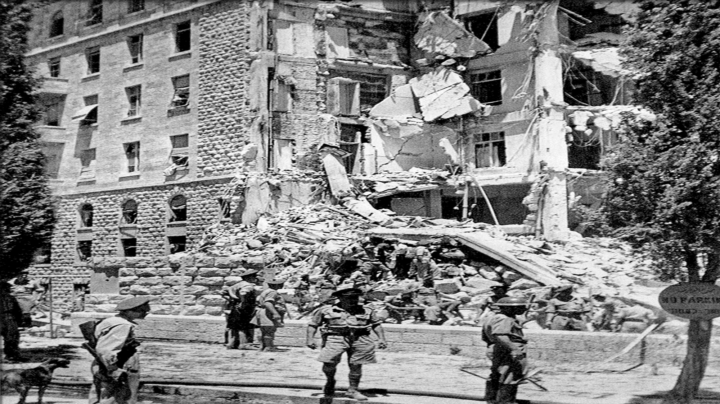
King David Hotel 1946

Slide 7
Assassination of Archduke Franz Ferdinand 1914

Slide 8
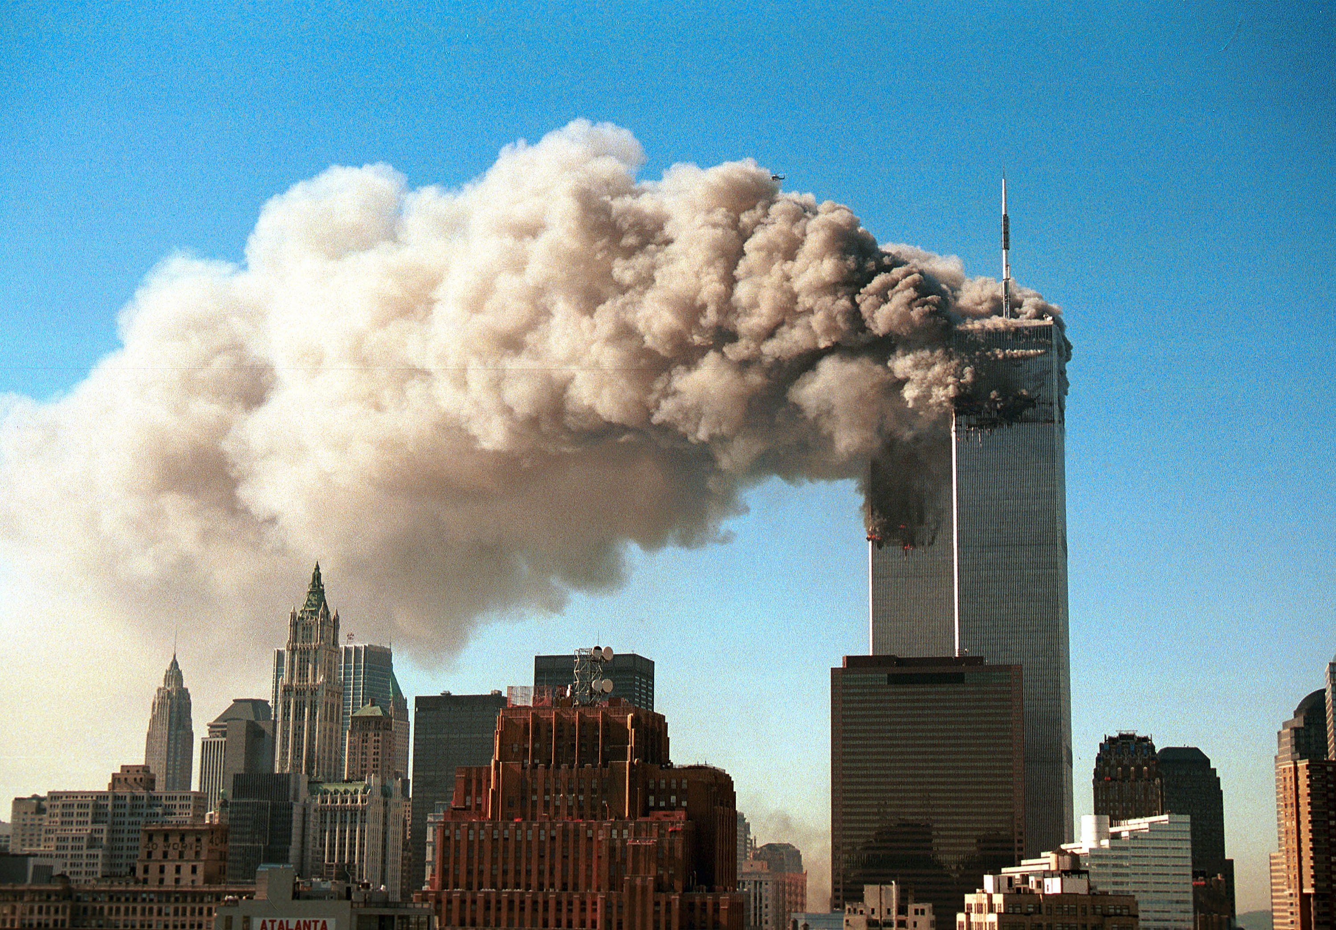
September 11 attacks

Slide 9
Americas longest running conflict
War declared on a non-state actor
Invasion of Afghanistan and Iraq
A lot of critique to the U.S for how they reacted to the attack
Guantanamo and Abu Ghraib

Slide 10
The connection between regime type and terrorism
Has regime type anything to do when it comes to terrorism and terrorist attacks?

Slide 11
Amichai Magen
Global terrorism database (gtd)

Slide 12
Six different regime types
Minimalist Democracies
Electoral Democracies
Polyarchys
Liberal Democracies
Closed Autocracies
Multiparty autocracies

Slide 13
The Ultimate argument for democratization

Slide 14
Globalization and Terrorism
Is terrorism part of globalization?
Local issues
Poverty
Exclusion from the free market
Basques in Spain
Hindu Tamil Tigers in Sri Lanka
Sikhs and Hindu nationalists in India

Slide 15
Benefits of globalization for the international terrorism
Technology and communication
Propaganda
Recruitment of insurgents
Migration
Risk of the proliferation of nuclear, chemical, and biological weapons
Cyber attacks

Slide 16
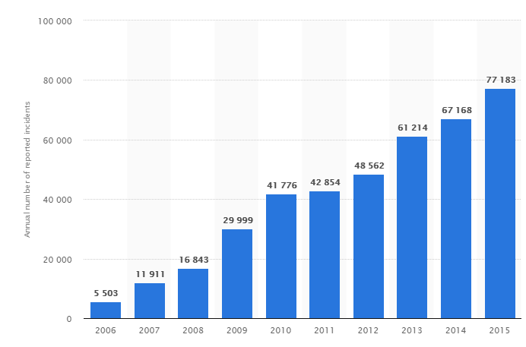
Number of cyber security incident reports by federal agencies in the United States from FY 2006 to 2015
https://www.statista.com/statistics/677015/number-cyber-incident-reported-usa-gov/

Slide 17
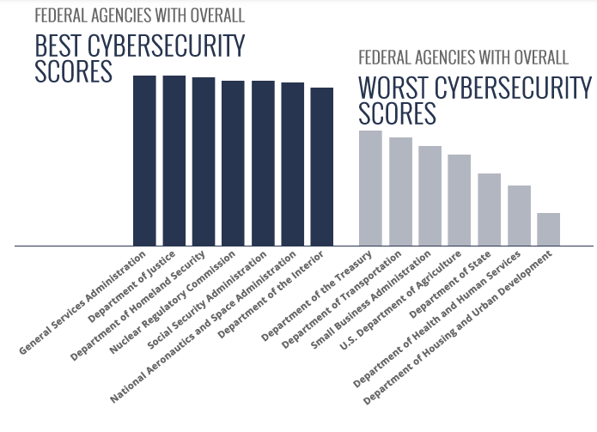
http://www.norse-corp.com/markets/government/

Slide 18
Benefits of globalization for anti-terroristic forces
Technology and communication
Information
Intelligence Agencies
Anti-terrorist strategies
Cyber attacks

Slide 19
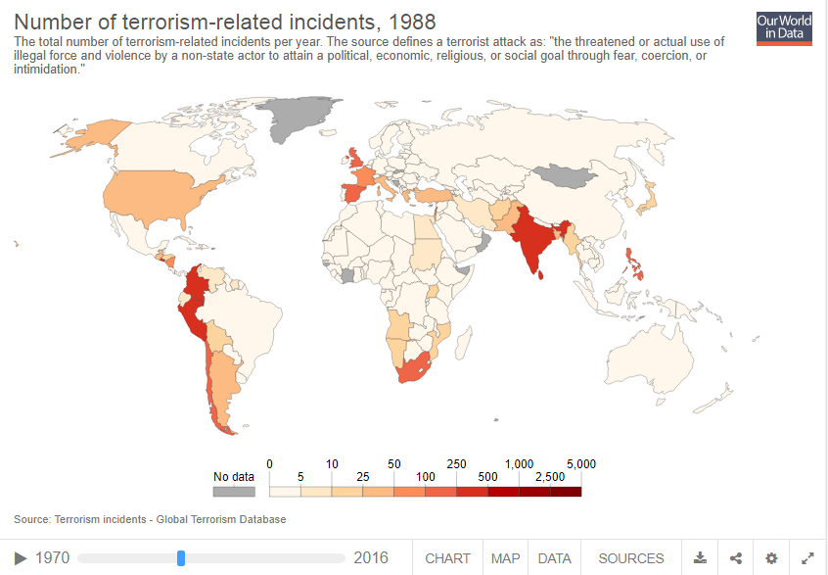
https://www.start.umd.edu/gtd/

Slide 20
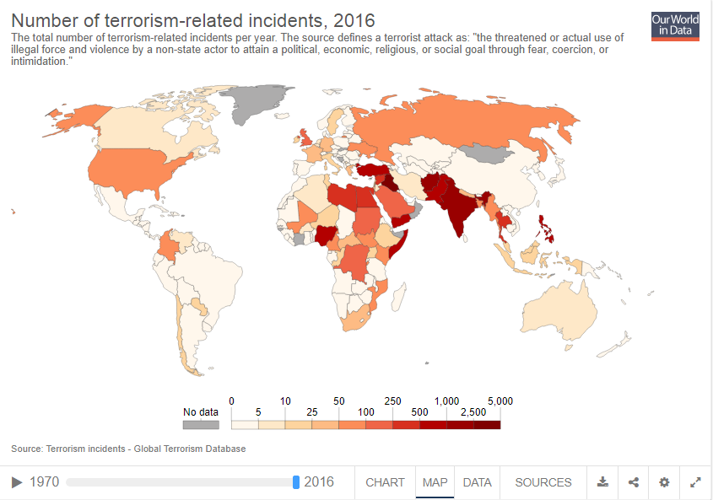
https://www.start.umd.edu/gtd/

Slide 21
Future of America´s fight against terrorism
Only one thing is for sure – the war is not ending anytime soon
What should USA do?
When fight, then fight in different way
Stopping propaganda
Spreading democracy, is it what locals really want?

Slide 22
"One man's terrorist is another man's freedom fighter"
 | Terrorism | Guerrilla/Insurgents | Conventional army
Units in fight | Small (approximately 10man) | middle (platoons) | Big (Armies, Corps, Divisions)
Weapons | Hand guns, grenades, rifles, bombs | Infantry weapons (s. artillery) | Full extent of military capabilities
Tactic | S. tactics: kidnapping, assassination, bomb attacks, hostages | Commando tactics | usually combined operations
Targets | State symbols, political opponents and generally public | Military, Police, political opponents | Military targets, traffic and industry infrastructure
Intentions | Psychological pressure | Weakening of the enemies military | Physical destruction
Control of the territory | No | Yes | Yes
Uniform | No | Usually wearing uniform | Wearing of an uniform
War zones | Unrecognizable war zone | War limited on the area of conflict | Geographically recognizable war zone
International legality | No | Yes - if it follows the rules | Yes - if it follows the rules
Home legality | No | No | Yes

Slide 23
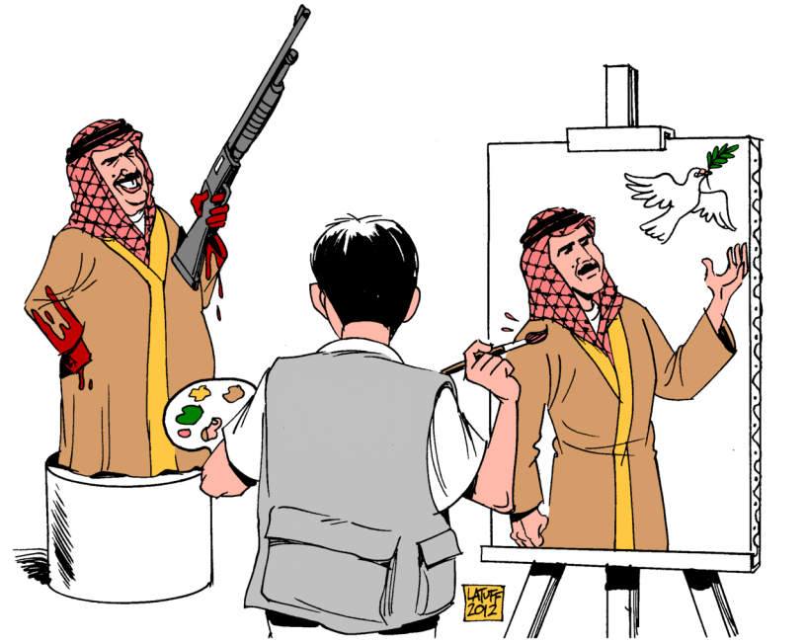
Propaganda
"We're in a world in which the possibility of terrorism, married up with technology, could make us very, very sorry we didn't act."
— Condoleeza Rice
Picture: http://barenakedislam.com/2017/07/10/you-probably-dont-watch-cnn-anymore-but-you-should-boycott-their-sponsors-too/

Slide 24

Using principles of war against Insurgents in war against the terrorism
The ultimate goal is to cut bonds with insurgent groups
Fight to protect the local citizens
Creating the local police and military units
Securing the basic needs of the local citizens
Establishing the stable government
Supporting the economical development
-> The fight is about who wins the hearths and minds of the local population
Is it what people in the Middle East really want?

Slide 25
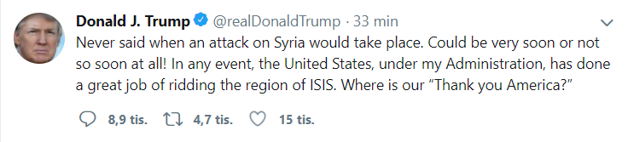
How will D. Trump´s administration proceed to the problem of terrorism and other.
12.4.2018

Slide 26
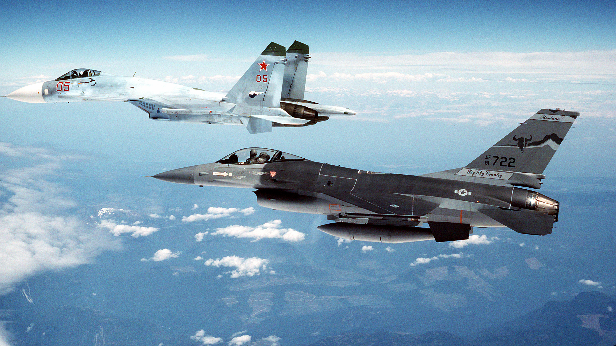
- USA should stay a leader
- put more emphasis on cooperation with UN, NATO, Russia
Should USA be a leader?

Slide 27
Thank you for your attention
V. Neradná
E. Gustavsen
M. Bukovský

Slide 28

References
Crenshaw, Martha. “The Causes of Terrorism.” Comparative Politics, vol. 13, no. 4, 1981, pp. 379–399. JSTOR, JSTOR, www.jstor.org/stable/421717.
Foreign Policy Annual, 2003, Vol. 2 p.139
Global Terrorism Database (GTD): https://www.start.umd.edu/gtd/
Khan, A., Ruiz Estrada, M.A.: Globalization and terrorism: an overview. Qual. Quant. (2016). doi: 10.1007/s11135-016-0367-5
Magen, Amichai (01/2018) Fighting Terrorism: The Democracy Advantage, Journal of Democarcy Volume 29, Number 1 2018. National Endowment for Democracy and John Hopknins University Press.
Mearsheimer, John (08/04/2002) Interview: Through the realist lens. Conversations with History: Institute of International Studies, UC Berkeley. Read 29/03/2018
Notaker, H. (22/09/2018) Terrorangrepet 11. September 2001.
Store Norske Leksikon. Read: 09/04/2018
https://www.statista.com/statistics/677015/number-cyber-incident-reported-usa-gov/
http://www.norse-corp.com/markets/government/
https://www.start.umd.edu/gtd/
http://globetrotter.berkeley.edu/people2/Mearsheimer/mearsheimer-con5.html
http://www.mepc.org/commentary/war-terror-future-directions 8.4.2018
https://hlsonline.eku.edu/hls-101-terrorism
https://storymaps.esri.com/stories/terrorist-attacks/?year=2017
https://storymaps.esri.com/stories/terrorist-attacks/?year=2018

