Slide 1
Migration
Jennifer Purser
Elizabeth Anderson
Notes:
Jen
Describe issue
Analyze U.S. historical/current role in dealing with this issue
Assess U.S. role … what IS vs. what SHOULD BE

Slide 2
FIRST....JUST A BIT OF HUMAN HISTORY....
Notes:
Jen

Slide 3
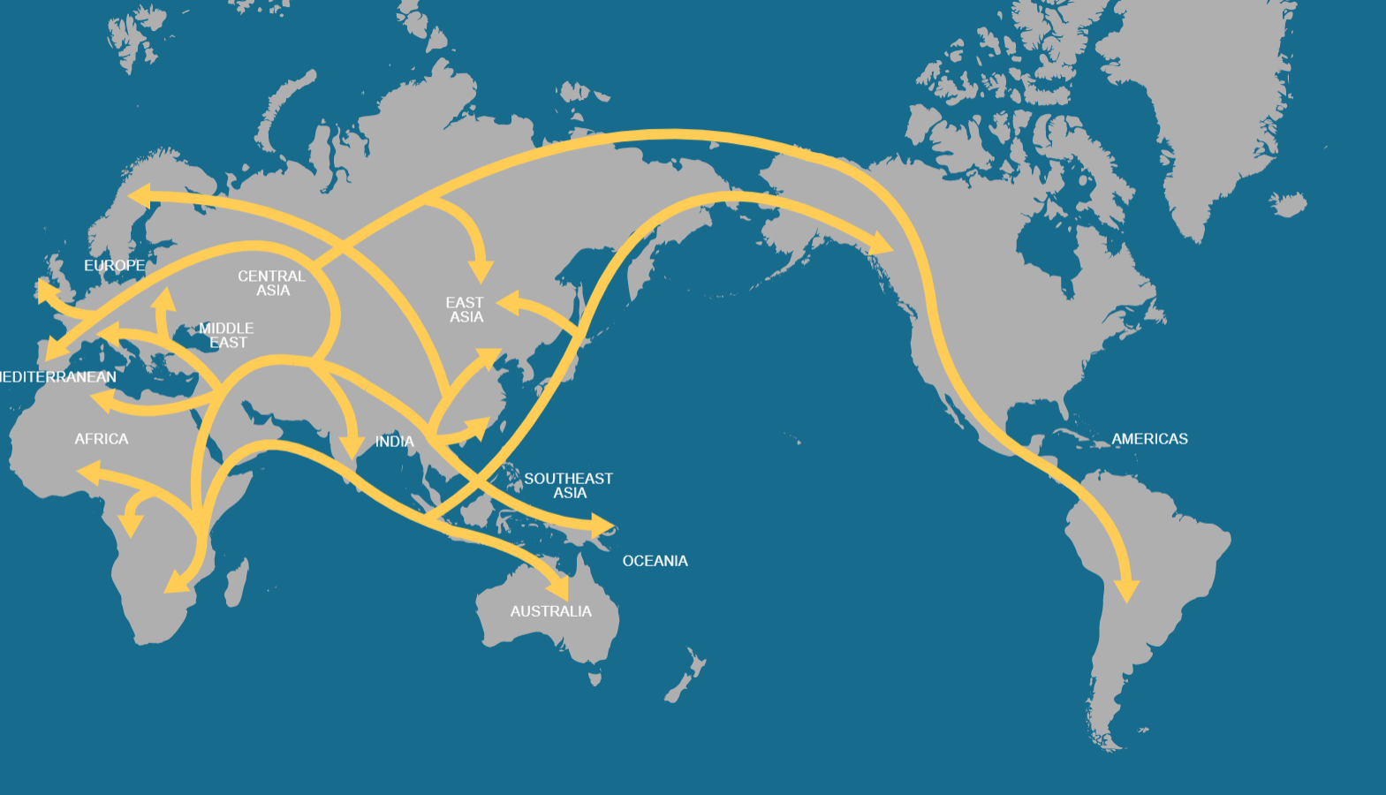
Source: https://genographic.nationalgeographic.com/human-journey/
Notes:
Jen

Slide 4
migration is a natural human phenomenon
MIGRATION has been a part of human life from our existence
Movement from poorer conditions to better conditions
Initial migration: a result of climate changes (rapid cooling)
Humans in Europe 40,000 years ago
Glacial period 20-15,000 years ago
Notes:
Jen
migration is a natural human (AND ANIMAL!) phenomenon
MIGRATION has been a part of human life from our existence
Movement from poorer conditions to better conditions
Climate, food/water shortage, war, etc.
Initial migration: a result of climate changes (rapid cooling)
Reduced human pop to only 10,000
Human species survived only because of migration
Glacial period 15,000 years ago
Ocean levels dropped 300 feet
Land bridge exposed to the Americas

Slide 5
Description of the Issue: Bottom Line in today’s world
Migration:
…is happening at a greater level than ever before in human history
…and its effects are controversial topics in the United States and all over the globe
…touches all levels of a society: economics, politics, security, demographics, education
…is hard to prevent if the preconditions are present (i.e. from worse to better situation)
  Discussion: Is it inevitable?
…may be necessary to curb future international catastrophes (i.e. Syria)
  Migration can alleviate crisis situations. While migration controls can compound crisis.
Notes:
Jen
It is clear that immigration can be beneficial for migrants, but only if their rights are protected properly. It can also be economically beneficial for both countries of origin and host countries; however, with present economic and trading structures it is the rich and powerful countries that benefit most. Migration brings social and cultural pressures that need to be taken into account in planning for future services.
Migration also has the potential for bringing peoples together culturally but friction occurs if efforts are not made to dispel the myths held by local people. It is also essential to provide good information about the local way of life to newcomers and ensure opportunities for people to mix and integrate.
Where the economic preconditions exist, migration is inevitable. When people try to prevent immigration it just goes underground.

Slide 6
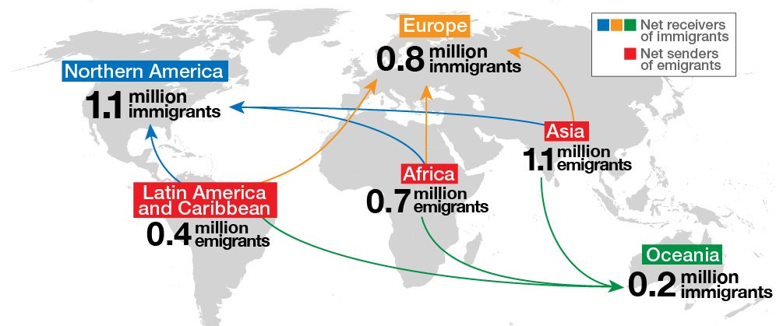
Global migration trends today
Source: UN DESA
Notes:
Jen
Between 2010 and 2015, North America, Oceana, and Europe had a net inflow of over 2 million immigrants per year. The United States had the highest net and per capita rates of immigration of any country.
The UN assess international migration to be a positive force for the economic and social development of the world.
19.8 percent of the world's international migrants live in the United States.

Slide 7
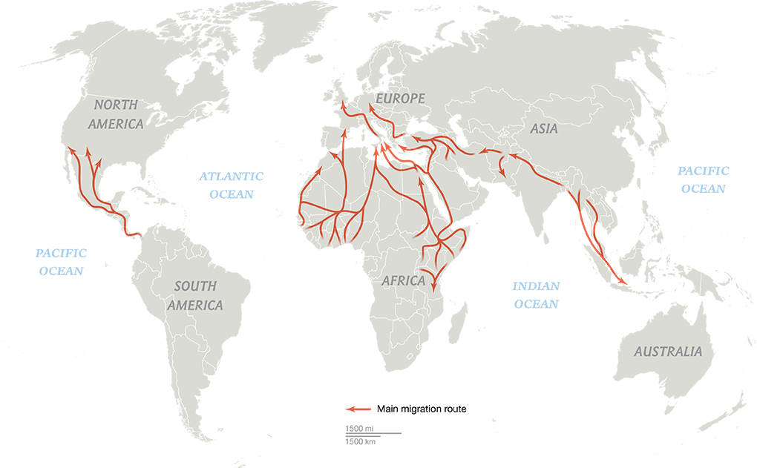
Global Migration trends today
Almost 60 million individuals displaced in 2014; a 14% increase from the previous year (source: UN)
Compare to previous slide: “NET” immigration/emigration statistics
What does this mean?
  Intra-regional/state migration
  Movement to cities
  Implications?
Sources: National Geographic, Missing Migrants Project, International Organization for Migration; UNHCR; I-map; Regional Mixed Migration Secretariat
Notes:
Jen
Last year saw the highest levels of global forced displacement on record—59.5 million individuals left their homes in 2014 due to “persecution, conflict, generalized violence, or human rights violations” according to the United Nations. That's 8.3 million more people than the year before.
Movement to cities

Slide 8
Description of the issue: Pros and Cons for Host countries
Positives
Job vacancies and skills gaps can be filled
Economic growth
Services to an aging population
Pension gaps can be filled
More workers = more taxes = more federal $
Immigrants bring energy/innovation
Cultural diversity
Negatives
Depression of wages may occur
Economic deficit due to immigrant remittances
Migrants may be exploited
Pressure on public services
Unemployment may rise
Potential for ethnic/religious violence
Increased security monitoring is necessary
Notes:
Liz Positives: Job vacancies and skills gaps can be filled.
Economic growth can be sustained…companies can expand domestically rather than outsourcing labor (potentially better for company and country)….several recent instances (including 2004-2008 economic boom) are in large part because of migrant labor
Services to an ageing population can be maintained when there are insufficient young people locally.
The pension gap can be filled by the contributions of new young workers and they also pay taxes.
Immigrants bring energy and innovation.
Host countries are enriched by cultural diversity.
Failing schools (and those with falling numbers) can be transformed.
Negatives Depression of wages may occur but this seems to be temporary.
Having workers willing to work for relatively low pay may allow employers to ignore productivity, training and innovation.
Migrants may be exploited.
Increases in population can put pressure on public services.
Unemployment may rise if there are unrestricted numbers of incomers.
There may be integration difficulties and friction with local people.
Large movements of people lead to more security monitoring.
Ease of movement may facilitate organized crime and people trafficking.
***Often, the perceived negatives far outweigh the FACTUAL negatives

Slide 9
Description of the issue: Pros and Cons for countries of origin
Positive
Developing countries benefit from remittances
Unemployment is reduced
Migrants enhance their life prospects
Returning migrants bring savings, skills and international contacts
Negative
Economic disadvantage through the loss of young workers
Loss of highly trained people, especially health workers
Social problems for children left behind or growing up without a wider family circle
Notes:
Liz
Positive
Developing countries benefit from remittances (payments sent home by migrants) that now often outstrip foreign aid.
Unemployment is reduced and young migrants enhance their life prospects.
Returning migrants bring savings, skills and international contacts.
Negative
Economic disadvantage through the loss of young workers
Loss of highly trained people, especially health workers
Social problems for children left behind or growing up without a wider family circle

Slide 10
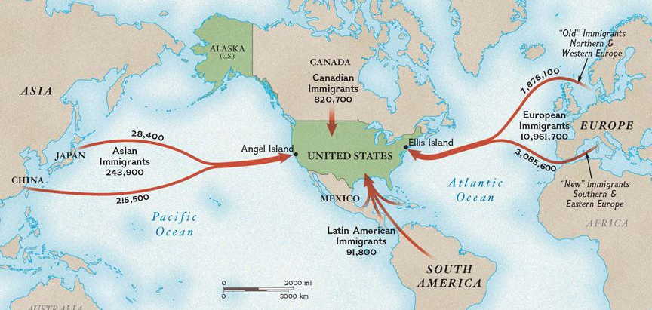
US historical role in migration
Source: National Geographic Society
Notes:
Liz

Slide 11
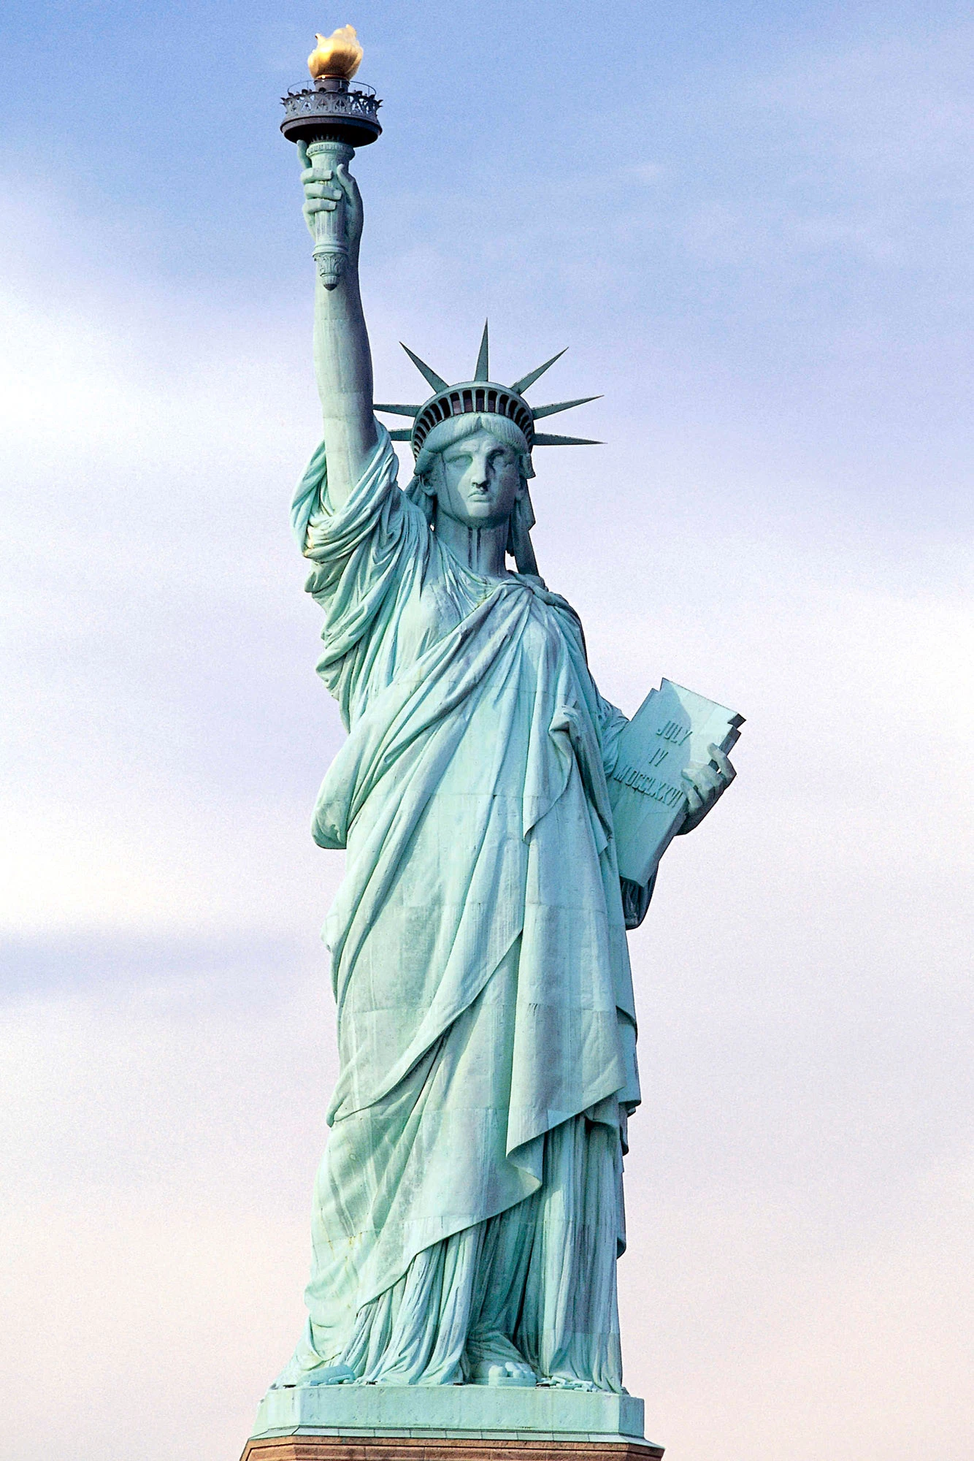
US historical role in migration
  Give me your tired, your poor;
  Your huddled masses yearning to breathe free;
  The wretched refuse of your teeming shore;
  Send these, the homeless, tempest-toss’d, to me;
  I lift my lamp beside the golden door.
  —Emma Lazarus, 1883
Notes:
Liz
The most famous immigrant:
Of course, the Statue of Liberty was itself an immigrant. It was designed and cast in copper in France over the span of a decade, from 1876 to 1884, as an intended gift from the French government to the United States. But the statue then had to wait in France for several months until the Americans had done enough work on its pedestal. It was then shipped to the United States in 350 separate pieces, housed in 214 crates, to be assembled by American workers once it arrived.

Slide 12
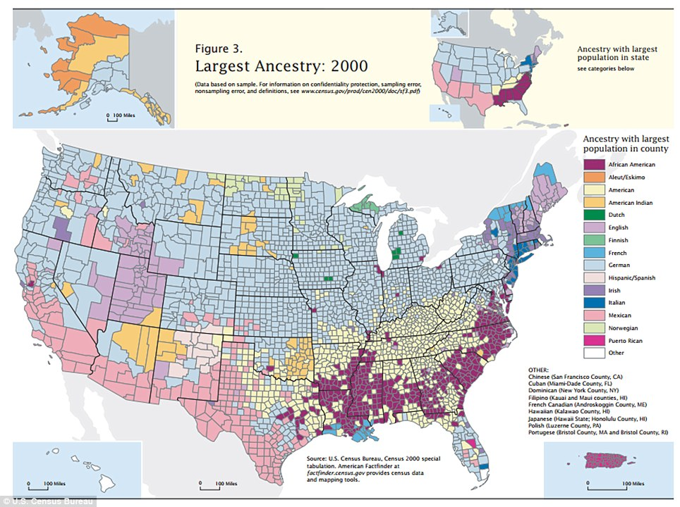
US historical role in migration
Since and because of America’s foundation, the US has been a leader in migration/immigration policy
Known as “the melting pot” for a reason
America HAS been a leader and an example…
Source: 2000 US census
Notes:
Liz
Interesting the “bible belt” area that call’s itself ethnically American
Now, 18 years later, many immigrants from Middle East, Northern Africa, South East Asia, India, and South America as well
Contrary to popular perception, since 9/11 only three individuals in the US have been arrested for planning terrorist activities
In 2015 the US admitted the most permanent immigrants in the world (US News and World Reports)
US resettlement program is the largest in the world according to UN refugee agency…but that trend appears to be starting to change…

Slide 13
President Trump’s Immigration Actions so far
Executive Order 13767, “Border Security and Immigration Enforcement Improvements”
  Signed January 25 2017. Border wall with Mexico.
Executive Order 13768, “Enhancing Public Safety in the Interior of the United States”
  Signed January 25, 2017. Migrant sanctuary jurisdictions/cities would not be eligible to receive Federal grants
Executive Order 13769, “The Muslim Ban”
  Signed January 27 2017. No Syrian refugees; hundreds detained; tens of thousands suspended entries. Superseded by EO 13780.
Executive Order 13780, “Protecting the Nation from Foreign Terrorist Entry into the United States”
  Signed March 6, 2017. Placed limits on travel to the U.S. from certain countries, and by all refugees who do not possess either a visa or valid travel documents. 84,995 refugees (FY 2016), to 53,716 (FY 2017…lowest since 2007). FY 2018: capped at 45,000 (lowest since est. in 1980).
Executive Order 13802, “Amendment of Executive Order 13597”
  Signed June 21, 2017. Removed “ensure that 80% of nonimmigrant visa applicants are interviewed within 3 weeks of receipt of application.”
Notes:
Liz
Executive Order 13767, titled Border Security and Immigration Enforcement Improvements, is an executive order issued by United States President Donald Trump on January 25, 2017. The order directs a wall to be built along the Mexico–United States border. In September 2017, the U.S. federal government announced that prototypes of the wall are under construction. Construction began on February 22, 2018, with 2 miles replacing the old border wall.
Executive Order 13768 titled Enhancing Public Safety in the Interior of the United States was signed by U.S. President Donald Trump on January 25, 2017.[1][2] The order stated that "sanctuary jurisdictions" including "sanctuary cities" who refused to comply with immigration enforcement measures would not be "eligible to receive Federal grants, except as deemed necessary for law enforcement purposes" by the U.S. Attorney General or Secretary of Homeland Security.
13769: lowered the number of refugees to be admitted into the United States in 2017 to 50,000, suspended the U.S. Refugee Admissions Program (USRAP) for 120 days, suspended the entry of Syrian refugees indefinitely, directed some cabinet secretaries to suspend entry of those whose countries do not meet adjudication standards under U.S. immigration law for 90 days, and included exceptions on a case-by-case basis. Homeland Security lists these countries as Iran, Iraq, Libya, Somalia, Sudan, Syria, and Yemen.[2] More than 700 travelers were detained, and up to 60,000 visas were "provisionally revoked"
13780: Trump called the new order a "watered down, politically correct version" of the prior EO.
13802: Amendment of Executive Order 13597: Removed “ensure that 80 percent of nonimmigrant visa applicants are interviewed within 3 weeks of receipt of application,” recognizing that resource and security considerations and the need to ensure provision of consular services to U.S. citizens may dictate specific exceptions;

Slide 14
President Trump’s Immigration Actions so far
Revised eligibility system for family-based green cards
  August 2, 2017, Senate bill could reduce family-based green card immigration by more than half (not passed yet)
H-1B (Highly Skilled Workers) Visas heavily scrutinized
  From January 1 to August 31, 2017 85,000 H-1B Visas were under heavy scrutiny, an increase of 45% from the previous period
Deferred Action for Childhood Arrivals (DACA) suspended
  September 5, 2017: DACA rights suspended as of March 5, 2017. 700,000 DACA enrollees are now not eligible for protection from deportation (pending court decision)
Diversity Visa Lottery
  On November 1, 2017, President Trump asked Congress to repeal to Diversity Visa Lottery (this has yet to happen)
Temporary Protected Status (TPS) suspensions (refuge to victims of war, hurricanes or other disasters in their home countries)
  Trump Administration will not renew the TPS program for refugees from El Salvador, Haiti, Nicaragua, and Sudan
Notes:
Liz
Commerce department will add a question about citizenship to the 2020 census
Attorney General Jeff Sessions reopened an immigration court precedent that he himself can singlehandedly overrule looking at whether the government need to pause deportation proceedings until an immigrant is done pursuing legitimate claims to stay in the US. Can deport before citizenship defense is complete
Trump decided not to extend work permits and protections for 840 Liberians who have been working in the US for decades
Previous president had extended the permits on humanitarian grounds
National Guard (military resources) sending to border wall with Mexico, even though Congress has rejected his request for funds and authority to do so

Slide 15
What will the future hold?
How will these actions concretely affect immigrant numbers?
  Hard to say; Definitively, immigration to the US will see major reductions
Is the US [still] a leader in migration?
  In reference to the old, liberal, “normal” system, the trend appears to be reversing
  The US does appear to be leading/providing fuel for other “populist” dominated countries
  But…US is still leading acceptor of immigrants worldwide
Implications?
  Global population , Climate Change (temps) , Livable Area/resources = Conflicts
  Can migration actually be stopped? Or will active pushback only cause more crises?
Notes:
Jen

Slide 16
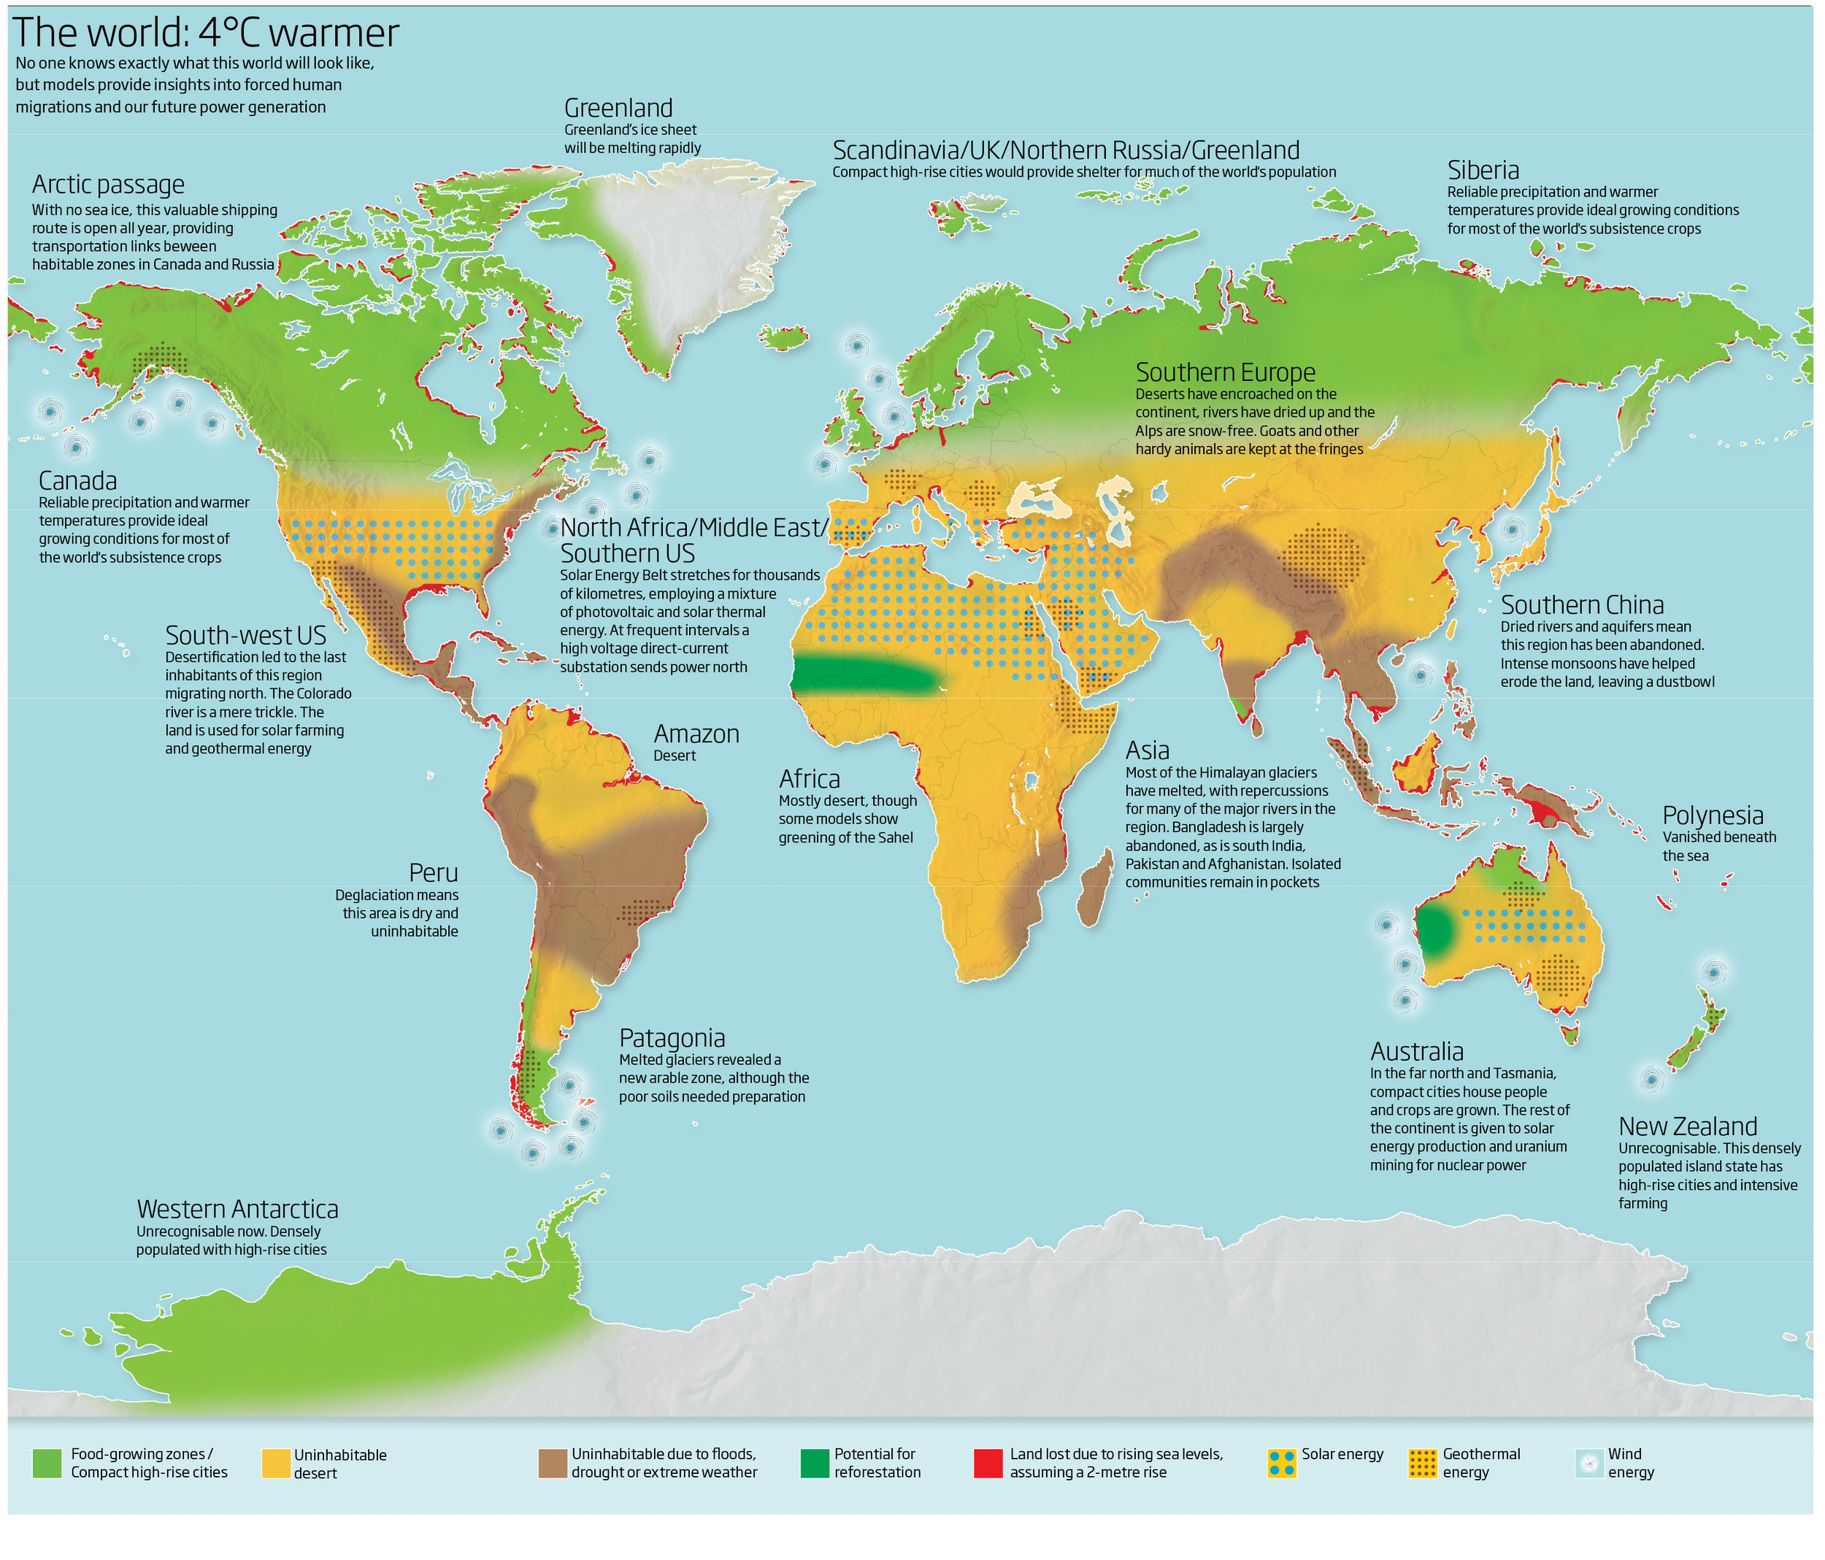
Source: https://www.paragkhanna.com/home/2016/3/9/the-world-4-degrees-warmer
Notes:
Jen

Slide 17
So… what should the us role be?
A leader in coordinating balanced migration policy in developed countries
Must set the example
All migrants have a capacity to benefit economies and society
Bad situations do not get better with time
More crises, directly or indirectly related to the effects of migration, will eventually involve the US at some point (whether this administration has to deal with the fall-out or not)
Thus, averting any crisis through smart policy-making
  is far better than dealing with the consequences of the alternative
  Even if it costs $ or votes in the near term
We are all human; migration is a natural human phenomenon
Notes:
Jen
Reverse Executive Orders and migration policy limits
Invest in migrant education
Establish some path to citizenship for those already in the United States
Perhaps we have some incentive program for businesses and migrants to move into less-inhabited areas (such as previous policy with movement to Alaska) to protect against urban sprawl
Lead by example and by influence: other developed and even developing countries must also play an increasing and positive role in support to migrants
Most migration happens among poorly developed and developing countries, developed/better off countries have a responsibility to act
Ten countries, account for only 2.5% of global economy, host more that half of world’s refugees: Jordan, Turkey, Pakistan, Lebanon, and Iran are top five (no western democracies are even in the top ten) (Amnesty international)

Slide 18
Questions? Comments?

