Slide 1
America´s Changing Global Role Trade policy
Pavla Pitruchová, Tomáš Lalkovič, Michal Sojka
Faculty of social sciences Masaryk university
11.04.2018

Slide 2
Overview
U.S trade politics to East Asia – Michal Sojka
United States trade policy to Latin America´s states – Tomáš Lalkovič
Trade balance of US – Pavla Pitruchová

Slide 3
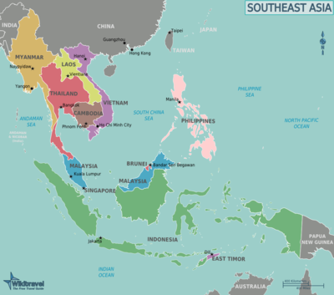
U.S trade politics to South-East Asia
Michal Sojka

Slide 4
Overview
Past and evolution up to recent time
Current development
Possible future development
How should U.S. act?

Slide 5
Past and evolution up to recent time
False assumptions about Chinese economic development
  X continued market reform
  X opening its market
  U.S. did not anticipate China to become trade power so rapidly
China: U.S.´s largest merchandise trading partner; third-largest export market; biggest source of imports
Globalisation: interconnected economies
  Sequential manufacturing processes
  Multidimensionality – beside merchandise trade also possible investments into trust companies, financial leasing, auto finance and consumer finance

Slide 6
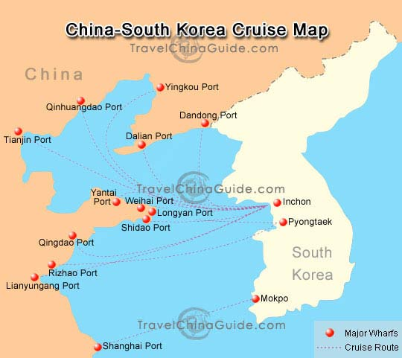
Current development
Trump’s sharp reversal of the historical U.S. role in trade area
  Rejection of TPP - (Trans-Pacific Partnership) and renegiotation of KORUS - (U.S.-Korea Free Trade Agreement)
D.Trump´s interest to reach bilanced deficit
Trade policy:
    Negotiating Better Trade Deals
    Aggressive Enforcement of U.S. Trade Laws
    Reforming the Multilateral Trading System: China described as a marked distorting country
  Main principle: America first, but expressing willingness to cooperate with like-minded countries in order to build an prosperious global economic system
Risks of bicameral agrements – e.g. Indonesian pal oil, decrease of U.S. working places

Slide 7
Possible future development
D. Trump´s trade policy effects to:
  U.S. economy -) societal response:
    Positive: societal support for such approach -) possible re-election -) continuity -) creating functioning ,,new normal“ or semi-anarchy
    Negative: societal upport dependent on interpretation -) possible re-election or D.T. leave -) any option ☺
  East-Asian trade architecture -) implications for E-A trade relations:
    China and its neighbours: Japan, Korea, Vietnam, Indonesia etc.
    Long-term horizon: advantage, or disadvantage for EU, Russia etc.? -) declining or strengthening position of U.S. in the region

Slide 8
How should U.S. act?
According to an aim – whether would (or should) be relevant ,,America first“ approach or extended ,,U.S. National interest“
  If „America First“ approach: to ensure stable, strong and beneficial position in the E-A trade area -) either diplomacy (consensus) or power
    If power = no leadership
  If extended ,,U.S. National interest“: leadership based on generally-beneficial values BUT fixing current issues and preventing others
Depends on position of three combining dimensions: altruism-egoism, rationality-irationality and limited A1.– enlightened A1.

Slide 9
Sources:
https://www.reuters.com/article/us-china-boao-pboc/china-pledges-to-allow-more-foreign-investment-in-financial-sector-by-year-end-idUSKBN1HI074?utm_campaign=trueAnthem%3A+Trending+Content&utm_content=5acda5a204d3015525bc5c88&utm_medium=trueAnthem&utm_source=facebook
https://ustr.gov/sites/default/files/files/Press/Reports/2018/AR/2018%20Annual%20Report%20I.pdf
http://foreignpolicy.com/2018/01/05/will-global-trade-survive-2018/
https://www.everycrsreport.com/reports/RL33536.html
https://www.thebalance.com/u-s-china-trade-deficit-causes-effects-and-solutions-3306277
https://www.thebalance.com/u-s-trade-deficit-causes-effects-trade-partners-3306276

Slide 10
United States trade policy to Latin America´s states
Tomáš Lalkovič

Slide 11
Overview
The Past
The Present
Trends
Solutions

Slide 12
Historical Role of the U.S.
Primacy of the U.S. since 1820s
The Big Brother policy 1880s
Bilateral and plurilateral free trade agreements (FTAs)
  NAFTA, CAFTA-DR, TPP and others
Global value chains

Slide 13
Trade with Latin America
The fastest growing partner (2014)
  Mexico, Brazil
U.S. trade deficit
  Imports crude oil, semi-finished products, raw materials
  Exports final products (petroleum, electronics...)
Intra-regional trade relatively low
  U.S. role?

Slide 14
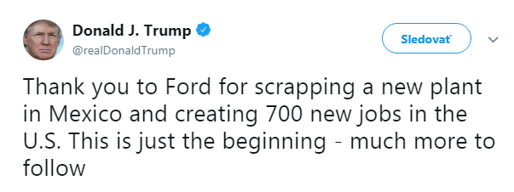
Current Developments
Trump
  Withdrawal from TPP (NAFTA?)
  LAC countries uncertain about their FTAs
  Search for new partners

Slide 15
Competition with China
  U.S. trade still larger, China catching up
  Chinese president on tour days after Trump’s election
  Infrastructure, energy, defense projects
  Nicaraguan canal
Notes:
Hydroelectric dam ecuador, highways in chile, jet fighters argentina, nuclear plants, PLA satellite tracking centre

Slide 16
Future of U.S. Policy
U.S. withdrawal from important trade deals
  China fills the vacuum - Security threat?
  Economic influence = political
U.S. leadership
  Unification, liberalization
  Region-wide FTAs
  Friendly, open policy
  Isolate China

Slide 17
Sources
http://www20.iadb.org/intal/catalogo/PE/2014/13718.pdf
https://www.latlegal.com/2017/02/u-s-and-latin-america-trade-who-could-be-affected-by-a-shift-in-u-s-trade-policies/
https://www.imf.org/~/media/Files/.../CR/.../cr1766-ap-5.ashx
https://www.telegraph.co.uk/news/2017/01/17/donald-trumps-trade-policy-driving-latin-america-chinas-arms/
https://ustr.gov/about-us/policy-offices/press-office/reports-and-publications/2018/2018-trade-policy-agenda-and-2017

Slide 18
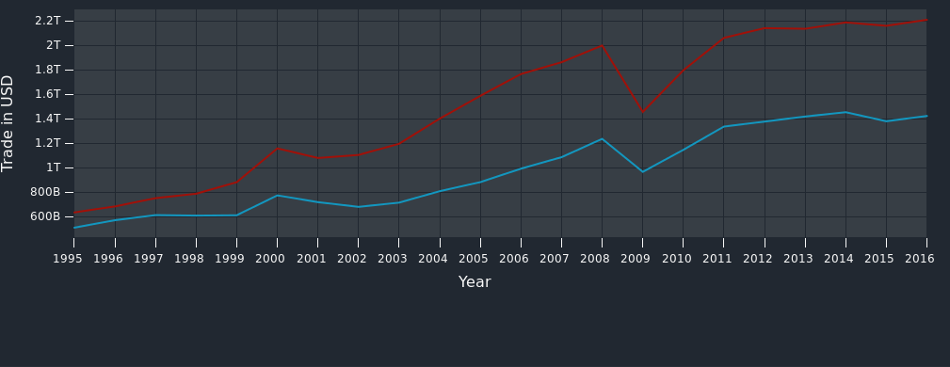
Trade balance of US
Pavla Pitruchová

Slide 19
goal of trade politics was : reduce difference between import and export
strenghtening home economy
applied globaly
side damages
neccesarry effect on EU, although EU region is not main reason

Slide 20
US-EU: EU view
“The European Union and the United States have the largest bilateral trade and investment relationship and enjoy the most integrated economic relationship in the world.”
(European Committee)

Slide 21
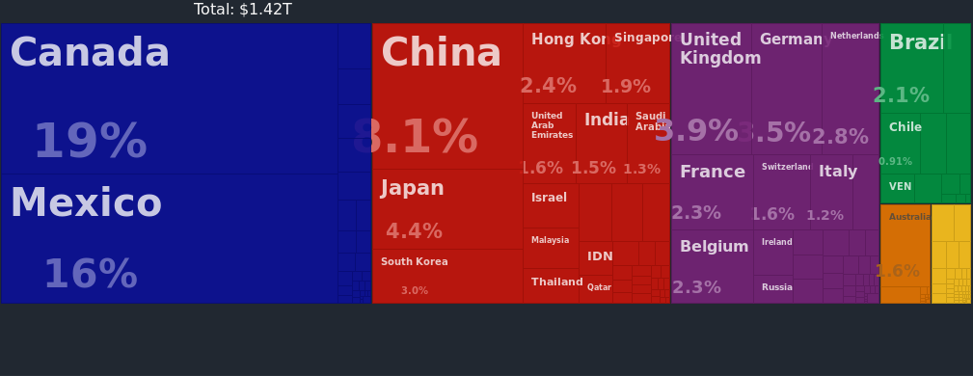
Us-EU: US view

Slide 22
Import Export Balance
In Goods - millions of dollar
Years | Exports | Imports | Balance
2017 | 283,517.4 | 434,933.1 | -151,415.6
2016 | 269,616.6 | 416,376.9 | -146,760.3
2015 | 271,879.5 | 427,536.7 | -155,657.3
2014 | 276,274.4 | 420,608.8 | -144,334.4
2013 | 262,095.3 | 387,510.4 | -125,415.0
2012 | 265,372.5 | 381,755.4 | -116,382.9
2011 | 269,068.7 | 368,463.9 | -99,395.2
2010 | 239,591.0 | 319,263.8 | -79,672.9
(2018) | 48,235.0 | 73,898.6 | -25,663.6

Slide 23
without important changes in balance
slowly growing trends
US- EU trade like more diplomatic than economic issue
Is it possible to win trade war? Peartnership vs. Business
both positions aren’t equal
importance of import for US
Eu profit, but dependency is obvious

Slide 24
Obama
American Recovery and Reinvestment Act of 2009
primary objective was to save existing jobs and create new ones as soon as possible
“Buy American” again
idea 1933, Hoover
crisis was global, not only US problems

Slide 25
Transatlantic Trade and Investment Partnership
TTIP
““The EU and the US would like to inform the WTO Secretariat that on 8 july 2013 we started the negotiations for the EU-US Transatlantic Trade and Investment Partnership (TTIP). “
2016 : “Obama says EU and U.S. must move forward with TTIP”
2018: under negotiations...
first priority is protection US economic, then relations with EU

Slide 26
Trump
duty, import restriction, trade barriers (steel 25% and 10% aluminium)
"Today I'm defending America's national security by placing tariffs on foreign imports of steel and aluminium," he said in the White House on Thursday (8 March) surrounded by US steel workers.
before 23 March exception
negative effect on both (economic laws work under expectations, home production is expensive)
EU is close ally
risk of losing strategic industry (EU- Germany, Italy, Sweden)

Slide 27
Protection of domestic market vs. benefits of free market?
Support home production vs. partnership and cooperation?
“YES”

Slide 28
What should be?
Succesfull finishing of treaty
Leave ad hoc negotiations with EU, find long term partnership
Support US-EU Transatlantic trade area (and its importance) with bigger obligation than just speaches.
Why?
-Trade wars doesn’t work, it isn’t possible be a winner
- EU import is important, not threatening
- It is useful to have a partner (in competition with China)

Slide 29
Sources
http://rtais.wto.org/UI/PublicShowMemberRTAIDCard.aspx?rtaid=865
https://roklen24.cz/a/SmgNh/trump-se-myli-obchodni-valky-nelze-vyhrat
http://ec.europa.eu/trade/policy/countries-and-regions/countries/united-states/
https://www.census.gov/foreign-trade/balance/c0003.html
http://trade.ec.europa.eu/doclib/docs/2011/december/tradoc_148391.pdf
https://atlas.media.mit.edu/en/profile/country/usa/#Trade_Balance
http://www.businessinfo.cz/cs/clanky/eu-ziskala-docasnou-vyjimku-z-cel-usa-na-dovoz-105210.html
https://www.reuters.com/article/us-europe-usa-trade/merkel-obama-say-eu-u-s-free-trade-deal-would-benefit-both-sides-idUSKCN0XK09Q
https://www.reuters.com/article/us-usa-germany-obama-trade/obama-says-eu-and-u-s-must-move-forward-with-ttip-idUSKCN0XL0O7
https://www.politico.eu/article/donald-trump-slams-eu-trade/
https://euobserver.com/economic/141261

Slide 30
Thank´s for your attention

