Slide 1
US ROLE IN YUGOSLAV WARS
BSS 187/487
Terézia Rekšáková, Peter Koles, Kryštof Šír

Slide 2
Main topics
About Yugoslav wars
Role of the USA in conflict management
Political situation in USA
The current role of the USA
Future

Slide 3
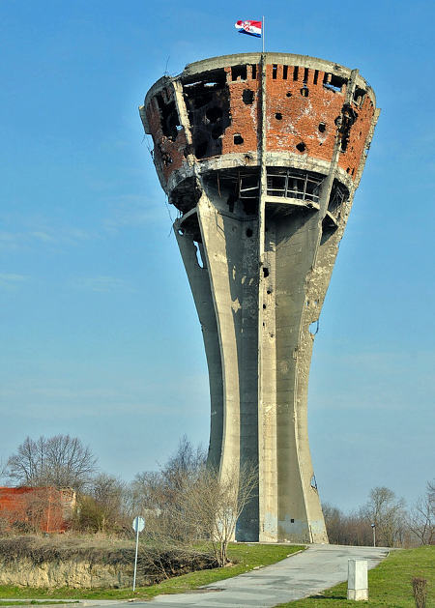
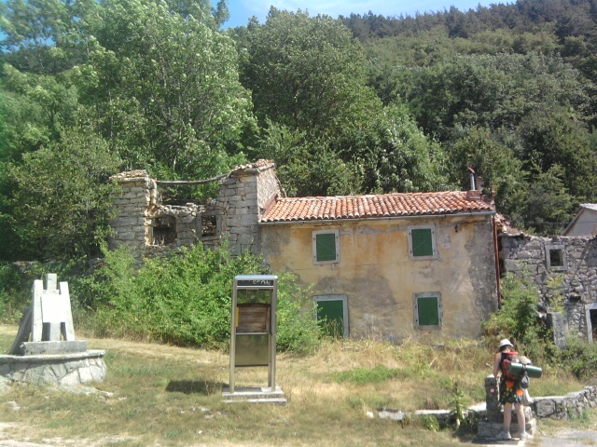
Little intermezzo: personal experience

Slide 4
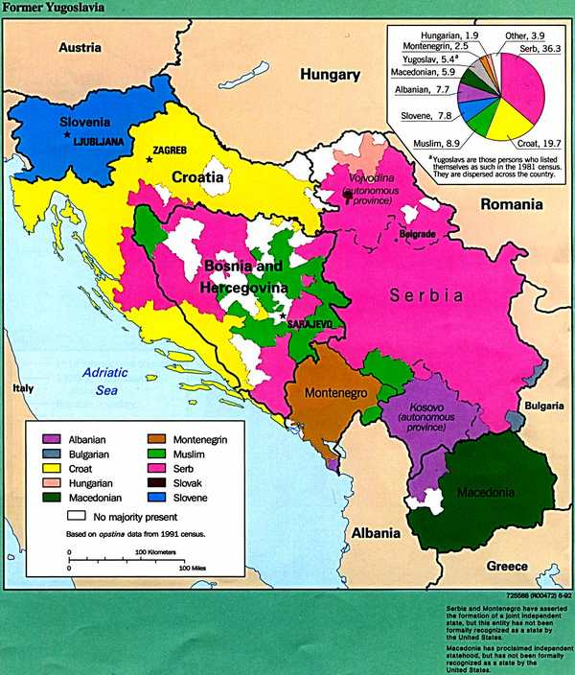
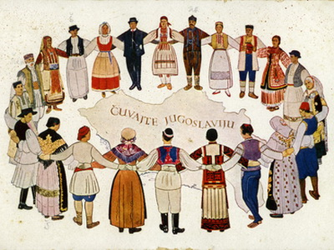
Yugoslav wars: Roots
Yugoslavia
Established after WWI
Multi-ethnic country
Different religions, languages, conflict areas …

Slide 5
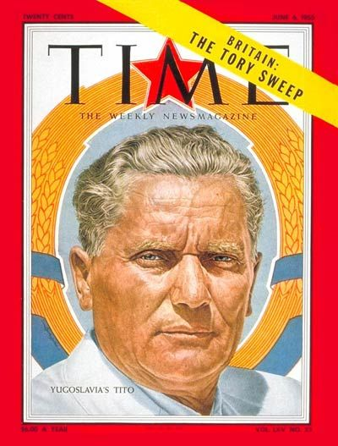
Yugoslav wars: Path into the Hell
Reasons:
Economic situation
Marshall Tito‘s dead
His strong leadership suppressed nationalist
Nationalism
1990 - 14th Extraordinary Congress of the League of Communists of Yugoslavia
Milošević – Serbia – more centralized
Croatia and Slovenia – more federalization

Slide 6
Yugoslav wars: Different Conflicts
1991 - Croatia and Slovenia declaring independence
1991 – Ten-Day War: Slovenia x Yugoslav‘s People Army
1991-1995 – Croatia War of Independence
1992-1995 - Bosnian War
Karadžič – ethnic cleaning
Daytonon Agreement
1998-1999 – Kosovo War – Serbia x Albanians
NATO engagement!

Slide 7
Role of the USA in conflict management: concrete historical period
focus - the Balkans in 90´s
complexity, geostrategic position, historical importance, mixture of nationalities, ethnicities, political personalities
former USSR, great temptation but also great problems to deal with
ongoing ethnic clashes resulted into serious war

Slide 8
USA x NATO
leadership of the group is in the hands of the nation with the most powerful economy
winner of the Cold War
thinking of main policy advisors still in Cold War terminology
NATO membership first offered to FYROM and Albania – why?
Not developed but with desire to participate (air campaign in Kosovo)
Turbulent inner conditions had to be solved --- West will help with reestablishment according to its ideals before anyone else could do so
1991 Strategic Concept: to assure and maintain balance throughout Europe
Spread of Western ideology and values, new allies, historical and political importance (East – West ideological borders)
To assure the post-Cold War dominance the US was actually seeking for

Slide 9
Political situation in the US
Change of administrations --- Clinton in the office
high priority on domestic policy
hesitancy between pragmatic moral principle connected with ethnic cleansing in Bosnia
Administration was opposing every plan proposed for the recovery of Yugoslavia
The change of presidents had obvious impact over the situation in Yugoslavia´s most turbulent territories
ethnically mixed citizens
call over ethnic or national recognition
empathy with the fate of citizens, who were under various types of attacks because of their ethnicity or desire to show US influence in former USSR countries

Slide 10
VANCE-OVEN
UN arms embargo --- disarm all sides of the conflict
Hard to reach an international agreement about ethnic war; many critics
Main obstacles:
taking away guns discontent ethnic majority, but also from self-defending minority
Muslims in Bosnia should have surrendered and possessed no weapons for their defense against mostly Serbian aggression and ethnic cleansing
Difficulties with moral principles + Incoherence of international actors --- Conflict management troubles
Dayton agreement

Slide 11
VANCE-OVEN
Its initial aim was not to end the war in Bosnia, but to look after heavy weapons on the international scene and thus reduce friction among international actors
Plan was than modified to stop the war, prevent Serbs from establishing contiguous territories and avoid ethnic purification
HOWEVER, this plan was primarily not designed for Yugoslav recovery
The main obstacle of application
New plan should have been created, obtaining main points of struggle and ideas for transformation
Dayton 1995 – 3 more years of war and casualties because of the lack of coherence

Slide 12
Conflict management critical points
Key results concerning the end of Bosnian war would have arrived earlier in time, if major contributing states would have acted differently than the way they actually did
Approach of the USA as major power --- confusion within international actors
Reluctance of Clinton´s Administration towards the use of force
Change in administrations during most critical period of Bosnian civil war
Against ethnic cleansing as well as weapons embargo, at the same time as he was new in the presidency and focused primarily on domestic development
Resulted into UK – France cooperation in air forces, under the management of the US
Preserve a chief position in decision making
Example of great ambitions, but the frailty of common policy and an absence of common understanding

Slide 13
The current role of the US
US less dominant than in 1990’s
The role of the leader was overtaken by the EU
US still engaged
NATO
Financial aid
„We will continue to stand with you as you persue your European future togather“ Mike Pence, august 2017

Slide 14
FUTURE
Strategic importance of the region for the EU and US
Challenges for the region
spillover of the conflicts in North Africa, Middle East
propaganda and radicalization
migration crisis
Russian influence
Cooperation with the EU

Slide 15
THANK YOU
For ATTENTION!
☺

