Slide 1
Far Right in Central Europe
Věra Stojarová
CDS 441 Far Right and Left Parties

Slide 2
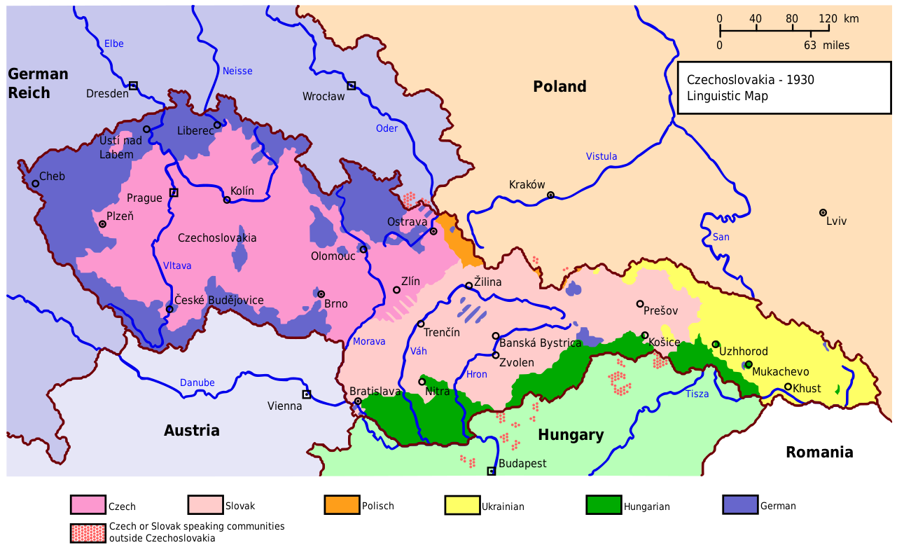
Czech Republic

Slide 3
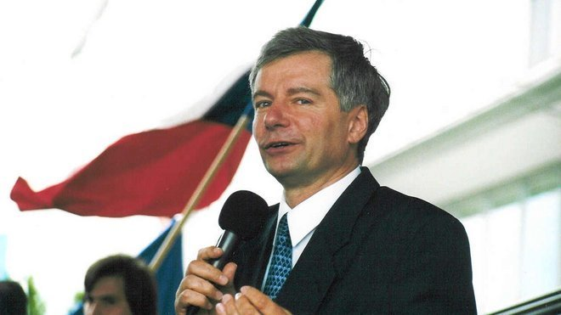
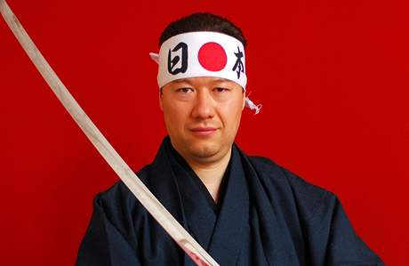
Czech PRR an unsuccessful story
SPR-RSČ and DAWN (SPD)
SPR-RSČ 1992: Federal Assembly (with 6.48% of ballots cast for the Chamber of the People and 6.37% of those for the Chamber of Nations) and in the Czech National Council (with 5.98%)
SPR-RSČ 1996 : 8.01%
SPR-RSČ since 1998 non-parliamentary party
DAWN 2013: 6.88% of the vote.
Dawn split internally in 2015: SPD
SPD 2017, 10.64%
Notes:
Czech Republic praised for peaceful divorce with Slovakia

Slide 4
Political opportunity structures
no major group that would feel forgotten or under threat
the number of anti-system parties is high
the 5% electoral threshold
Historically, these parties have not attracted large numbers of adherents
the anti-establishment niche in the Czech party system is already occupied by the ‘patriotic’ Communist party.
The PRR parties have consistently failed to come up with a compelling programme.
Their organizational is weak, charismatic leaders are lacking, and internal tensions have run high.
The Czech Republic is ethnically homogenous
Topics the PRR might otherwise exploit to its benefit have become political capital for virtually all the players

Slide 5
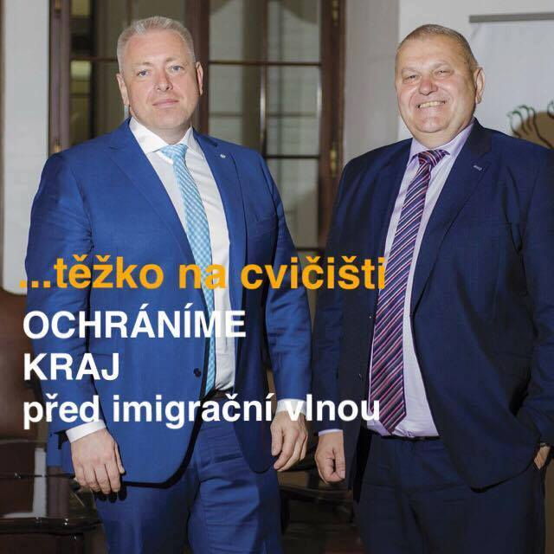
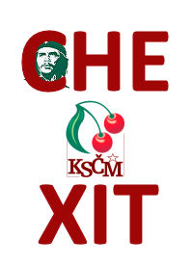
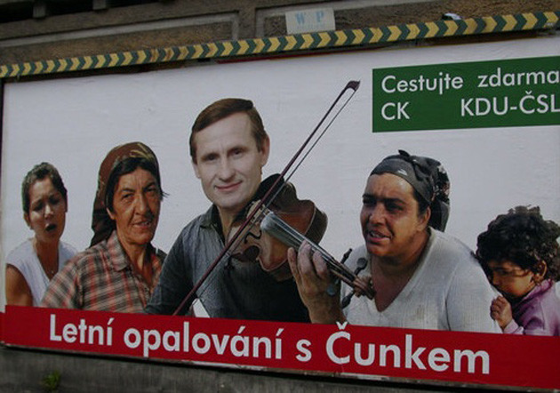
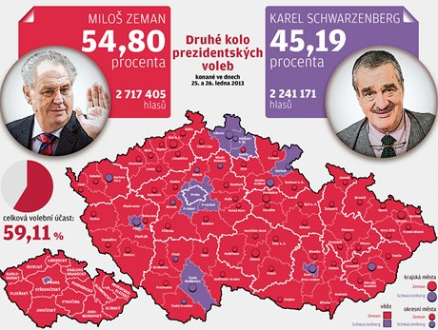
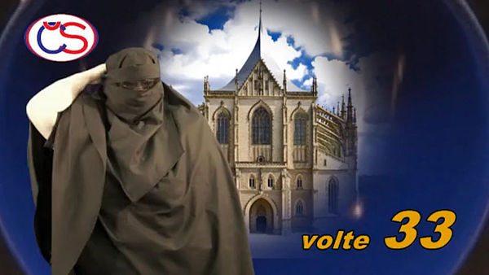
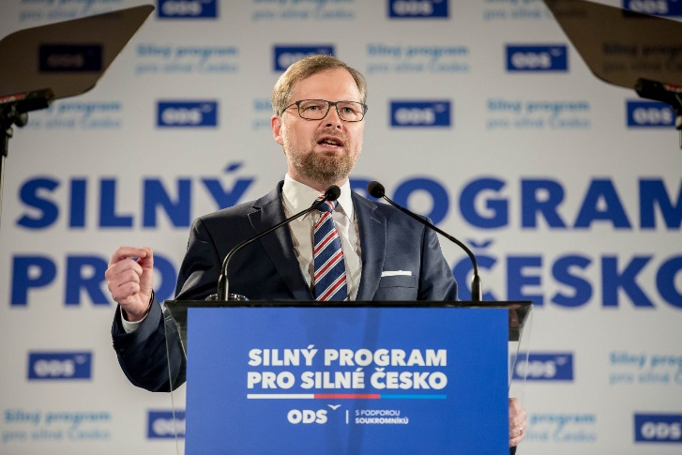
Diffusion of PRR topics into public sphere
Beneš Decrees and Czech-German Declaration
Migration quoatas, EU
This legitimation of nationalism at the highest levels of government has been reflected at lower levels of the political hierarchy as well: Roma issue
Notes:
Shortly after Václav Havel was elected president of Czechoslovakia in 1989, he took up the issue of Czech-German relations and apologized for the Beneš Decrees and the expulsion of Sudeten Germans. The Czech-German relations has resurfaced as a political issue from time to time ever since, greatly influencing political battles along the way. :Almost all of the PRR’s competitors, though played the anti-German card.

Slide 6
2017 elections campaign
Country with no refugees but refugees main topic
Country with no violence but EU regulation about wearing a gun main topic
Country which profitted mostly from the EU, Czexit a topic
Country with Václav Havel heritage truth and love voted for STB agend being sued by the courts for misappropriation of the EU funds
Victory of protest parties
Victory of professional Political campaign – language, FB, newspapers, radio, TV

Slide 7
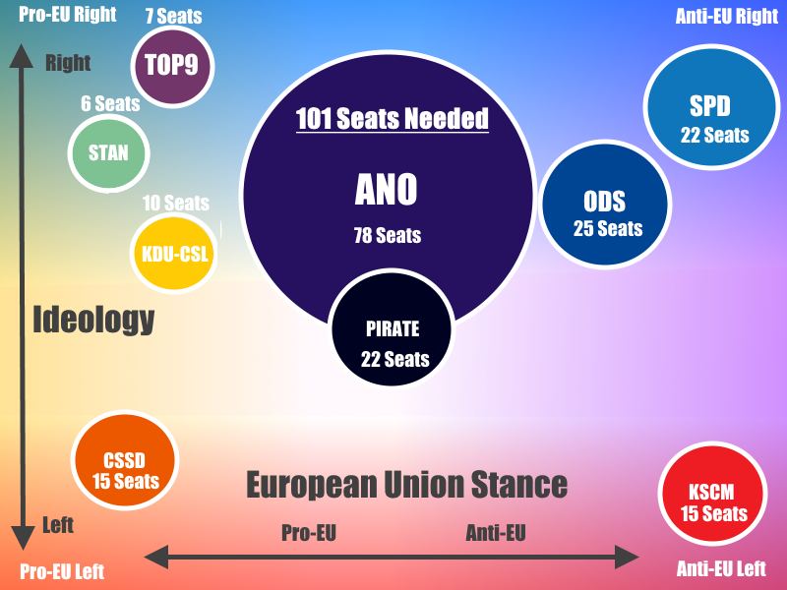
Czech Political spectrum

Slide 8
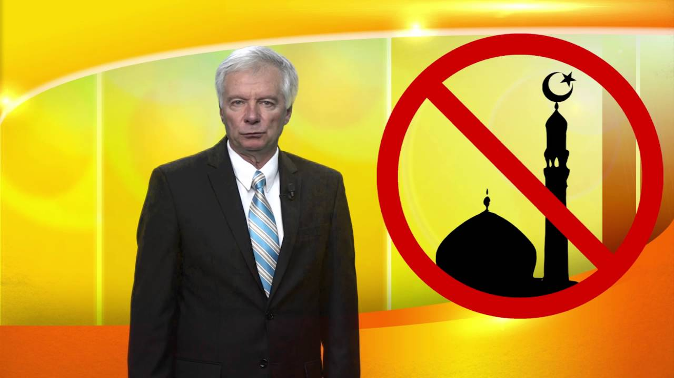
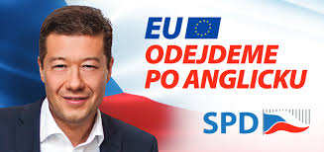
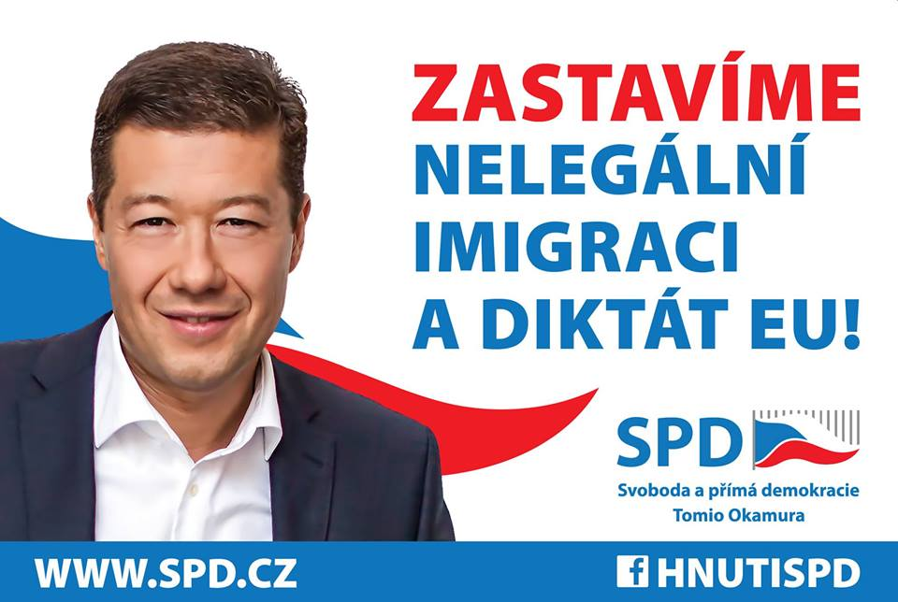
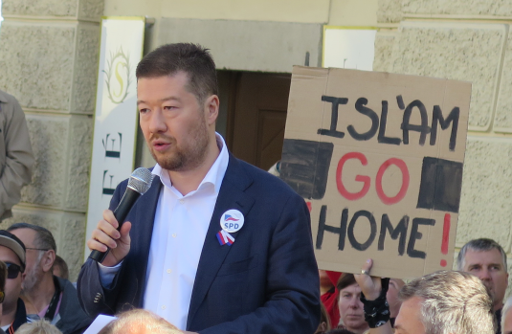
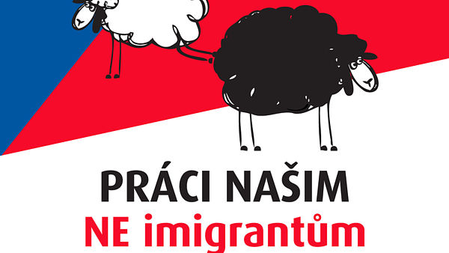
Far right and its repertoire
Direct democracy, anti-establishment, referendum
targets Islam, the EU and advocates a nationalist state and sovereignty as the remedy for the crisis.
never an anti-Semitic or anti-LGBT agenda
Anti-Roma, anti-Vietnamese
Anti-EU, anti-NATO
Russia big friend, anti-German

Slide 9
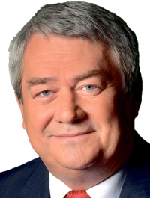
Anti-EU Far Left : KSČM
Politically isolated for a long time as being extremist
Did not drop „communist“ from the name
After 2012 accepted as ally in regional elections with social democrats
Against quotas, sovereignity not Brussel dictate
Dissolution of NATO

Slide 10
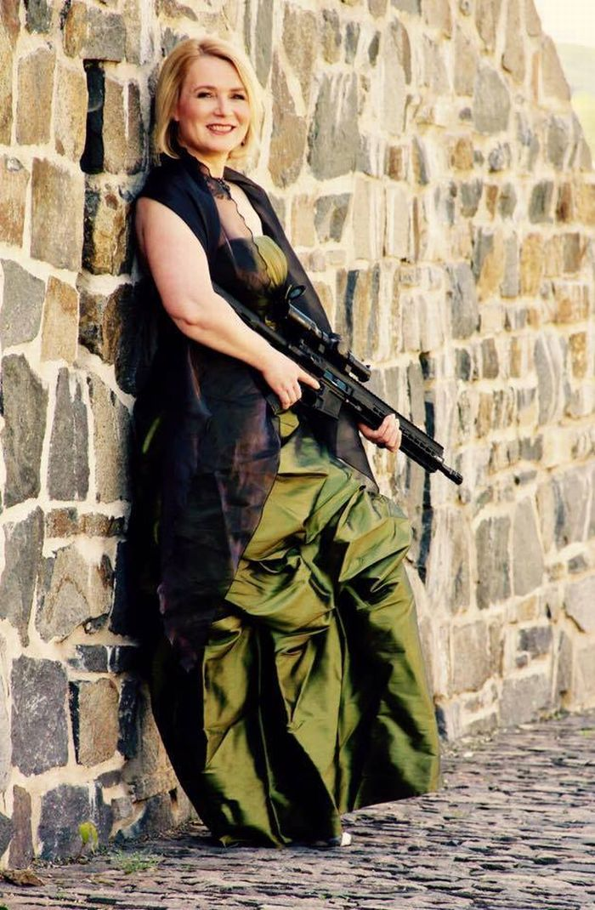
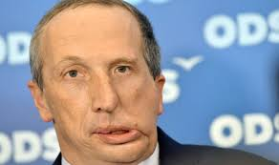
Conservative right ODS
For the EU and NATO but…
Václav Klaus jr.
Freedom to have gun vs. EU regulations

Slide 11
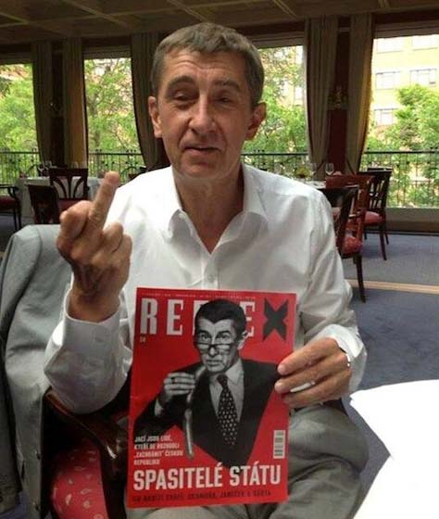
ANO
Populist
Complete change of the political system, reduction of local autonomies
Opportunist
EU??
To use the EU for assertion of Czech national interests
Czech sovereignity
Against migration quotas
Against euro
https://www.youtube.com/watch?v=WNvxlm9CQ_U

Slide 12

Pirates
Protest party without clear programme
Unreadable
Direct democracy
Democratisation of the EU
Czech republic active within the EU

Slide 13
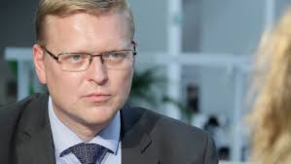
KDU-ČSL
Pro-EU but
Stabilisation of the failed states
Accepting war refugees
Protection of borders
For the EURO
Notes:
Předseda a volební lídr strany KDU-ČSL Pavel Bělobrádek se dnes na sociální síti Facebook rozjel. Žena se ve smutném příspěvku loučila se svým psem a mimo jiné pro jeho odchod použila slovo zemřel. Toho si povšiml Bělobrádek, a jal se ženě ihned vysvětlovat, že zvířata neumírají. Zvíře podle něj může jen "chcípnout, uhynout, pojít, padnout nebo zhasnout". Dinosauři vychcípali, prezident pošel. Češi si dělají legraci z Bělobrádka Podle Bělobrádka je používání lidských výrazů pro zvířata levicová věc, která se hodí k městské eko-etno-bio vychrtlině.
/

Slide 14
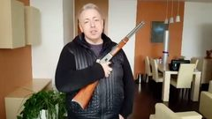
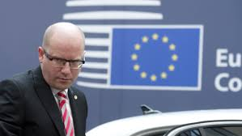
ČSSD
For the EU BUT
Wing of Milan Chovanec and migration quotas
For EURO

Slide 15

STAN
For the EU
For EURO
marginal

Slide 16
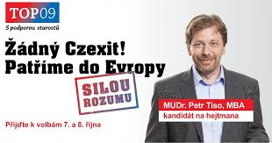
TOP 09
Clearly and openly For the EU
For EURO
Refugees welcome
liberal, city voters

Slide 17
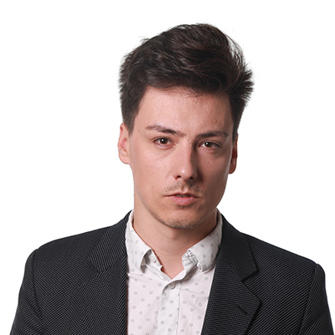

The Green Party
Liberal city voters
For the EU
Marginal

Slide 18
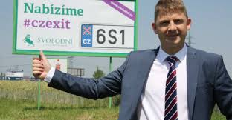
Other players
Svobodní – Czexit, againt the euro, 1 MEP
Jana Volfová
https://www.youtube.com/watch?v=X9uRgiOvoi8

Slide 19
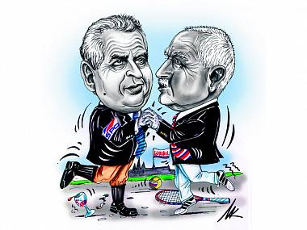
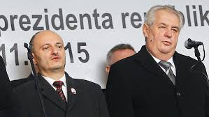
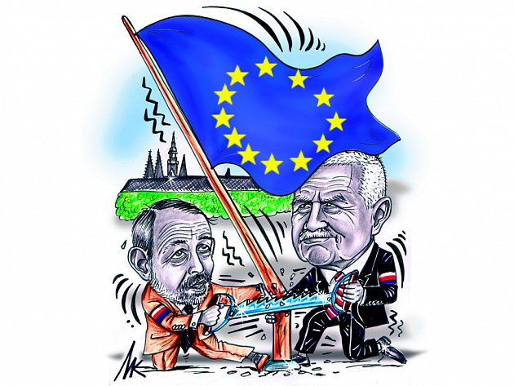
Top statesmen and the EU
Miloš Zeman
Václav Klaus

Slide 20
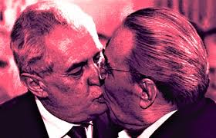
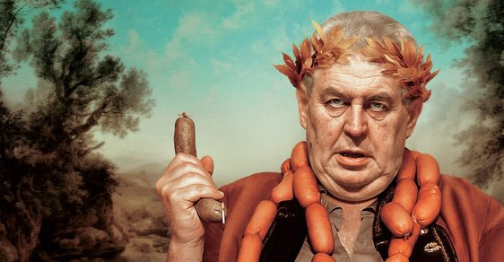
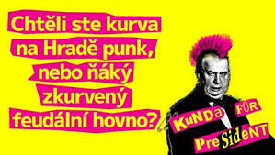
President of the Czech Republic: Miloš Zeman
Populist techniques
„ I am the people“ - Working class
Immigration, muslims
EU foreign policy (Izrael/Palestina, Ukraine, Russia, China)
Inclusion at schools
People around Zeman

Slide 21
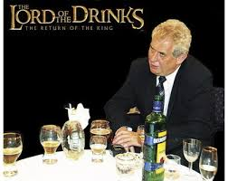
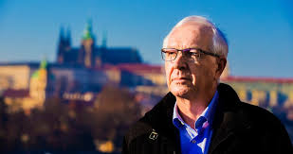
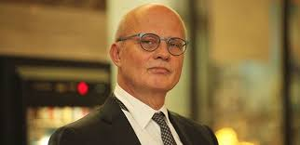
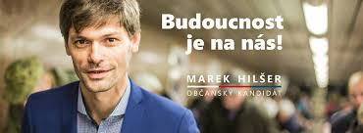
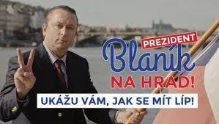
Czech presidential elections 2018
Zeman
Drahoš
Horáček
Marek Hilšer
Tonda Blaník

Slide 22
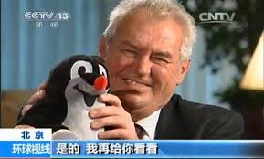
Czech foreign policy
Prime minister and president
Externalisation of responsibility
Self-victimisation
Domestification of the topics
No interest in the foreign affairs
Polarisation
Utilitarian politicisation

Slide 23
Czechs and the EU
2003 A referendum on joining the European Union : was supported by 77.3% of voters, with a turnout of 55.2%
2004 EU enlargement
2017, 29% of Czechs were in favour of introducing the euro while 70% were opposed and 1% undecided.
there is no target date by the government for adopting the euro.
Notes:
Shortly after Václav Havel was elected president of Czechoslovakia in 1989, he took up the issue of Czech-German relations and apologized for the Beneš Decrees and the expulsion of Sudeten Germans. The Czech-German relations has resurfaced as a political issue from time to time ever since, greatly influencing political battles along the way. :Almost all of the PRR’s competitors, though played the anti-German card.

Slide 24
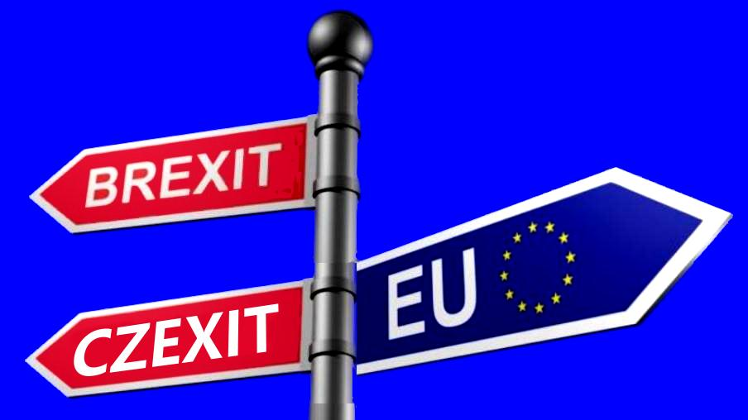
Czexit??
2015 – parliament 11 MPs asked for Czexit
2016 debate about the Czexit referendum in the parliament : 29 communists and 12 from ODS for debate
After Brexit referendum Campaign of Svobodní party We offer Czexit

Slide 25
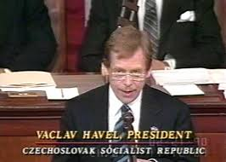
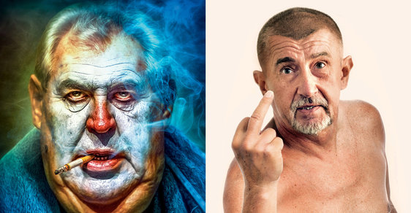
Polarisation of the society
EUROoptimists/for euro/for immigration/ liberal/ anti-#ZemanBabiš
Anti-EU directivism, Czech nativism/Czech national interests/anti-immigration/conservative
For# ZemanBabiš
TOP09, Green party
Prague café
Sluníčkáři
Pravdoláskaři
„those welcoming migrants“
NGOists
Liberals and anarchists
„Inclusionists“
„Anti-vaccinationists“
Zeman, Klaus,
SPD, ODS, KSČM
Martin Konvička
Alternative for Czech Republic
Angry mothers
No pasarán
Andrej Babiš

Slide 26
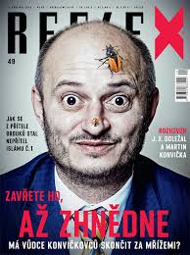
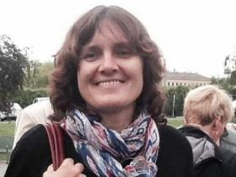
Public discourse, social initiatives
Václav Klaus
Martin Konvička
Alternative for Czech Republic
Angry mothers
No pasarán
Notes:
Klaus : Elitism, the country to the EU, Open nationalism, xenophobia, anti-EU
Tomáš Ortel, Vilém Čok, but also of more ephemeral performers like Olivie Žižková, Dominika Myslivcová, and many others. The last-noted became popular online as a blogger and then stood as a candidate in the 2016 regional elections for Dawn

Slide 27
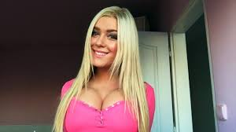
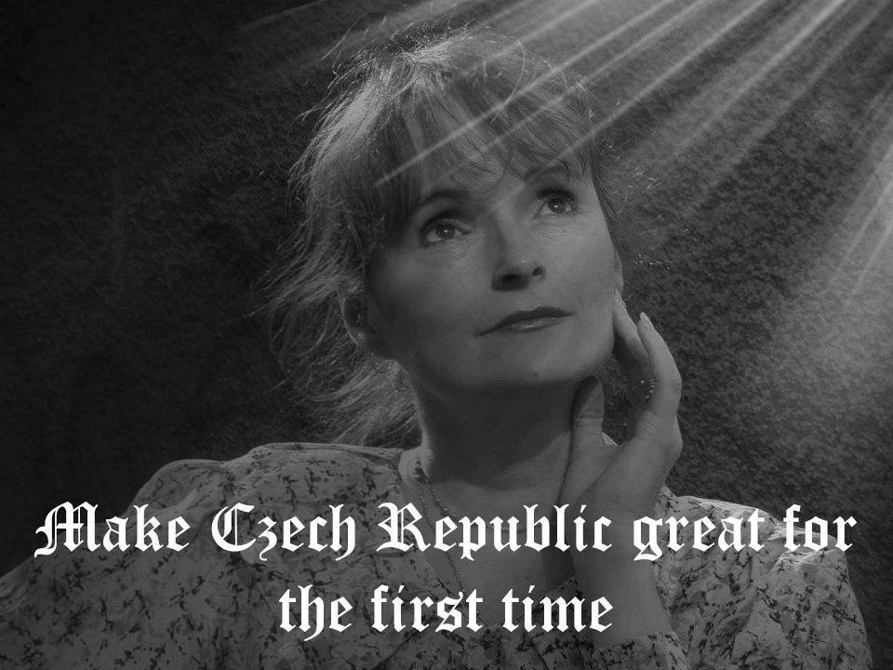
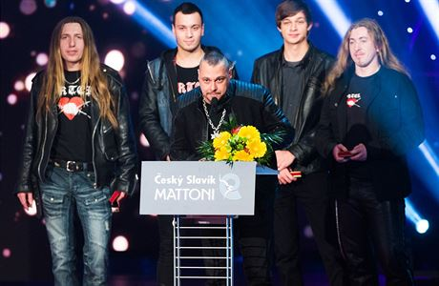
Populist pop
Olivie Žižková: Europe, breathe https://www.youtube.com/watch?v=meXpKEhXKxw
Dominika Myslivcová – youtube star, blogger, model, candidate for Usvit
http://www.myslivcova.com/volby/ voltebarbie.cz
Vilém Čok: „Lets hold the identity of own nation. Spring will give us new patriots!.
Tomáš Ortel : competition Czech nightingale 3. place
Aleš Brichta singing on Tomio Okamura meetings: Red, blue, white, Foreigner in own land
Pepa Nos also on Tomio Okamura demonstrations
Trend is from neo-Nazi subcultures into mainstream pop
Jana Yngland Hrušková – singer and candidate for a president?
Notes:
Ortel: They will cut your head just cause Allah
Yngland Hrušková je velkou euroskeptičkou. Do České republiky se vrátila v roce 2013 jednak proto, že se jí podle vlastních slov začalo stýskat po domově, a také proto, že byla velmi nespokojena s výměnou marky za euro. „Německá marka byla velmi silná měna. Nahradily ji skoro bezcenné papírky. Slibovalo se, že výměna bude jedna ku jedné. Ale euro najednou mělo jen poloviční hodnotu,“ uvedla v rozhovoru pro server aktualne.cz
Ve volebním programu možné budoucí prezidentky se například dočtete, že by ráda prosadila vytvoření nových pracovních míst v různých oblastech a zvýšení minimální mzdy. Také by ráda zrušila finance pro zbytečné lidskoprávní organizace a snížila daně.

Slide 28
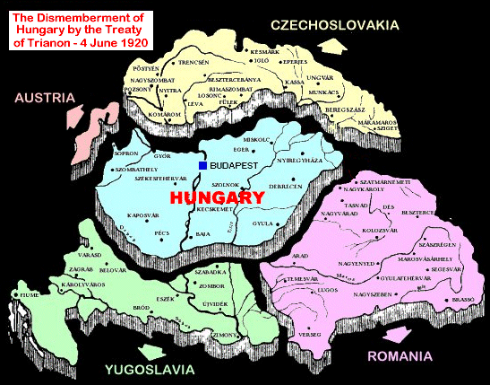
Hungary
a

Slide 29
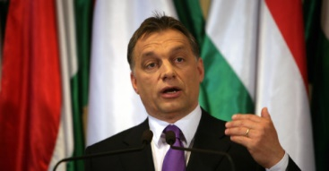

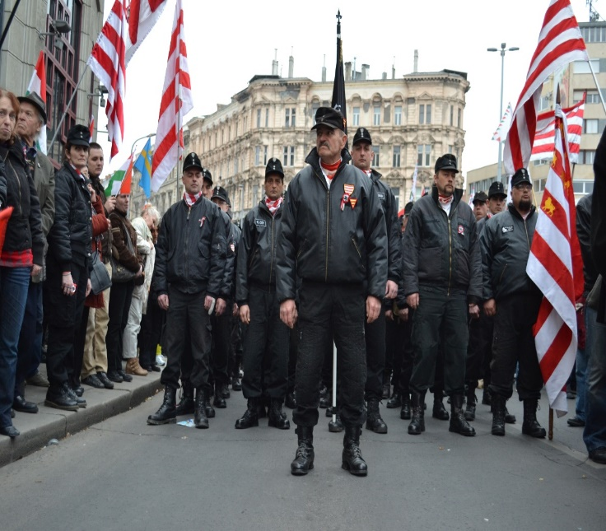
Hungarian Political parties
Fidesz : appropriation of nationalism
MSZP – discredited, rejecting nationalism
LMP – green, pro-European, in opposition
DK – discredited
Jobbik: Trianon Treaty, and revisionism, anti-Semitism, anti-Ziganism, anti-EU and anti NATO, becoming mainstream
MIEP: Trianon Treaty, and revisionism, anti-Semitism, anti-Ziganism, anti-EU and anti NATO
The scholar Heller notices that the lines between the discourses of moderate right and radical right politics have been blurring. As the boundaries become more and more porous, the languages of right wing radicalism become more and more accepted in Hungary (Heller 2010)

Slide 30
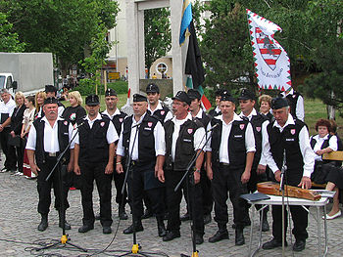
Polarisation in Hungary
Fidesz and Viktor Orbán 1998-2002,
Jobbik
Magyar Guarda
Népszabadság
Euro-optimists, against Orbánistán
Together – Party for a New Era – movement transformed into party in 2013, anti-Orbán, for democracy, liberal (out of Patriotism and Progress Association, One Million for Press Freedom (Milla) and Hungarian Solidarity Movement)

Slide 31
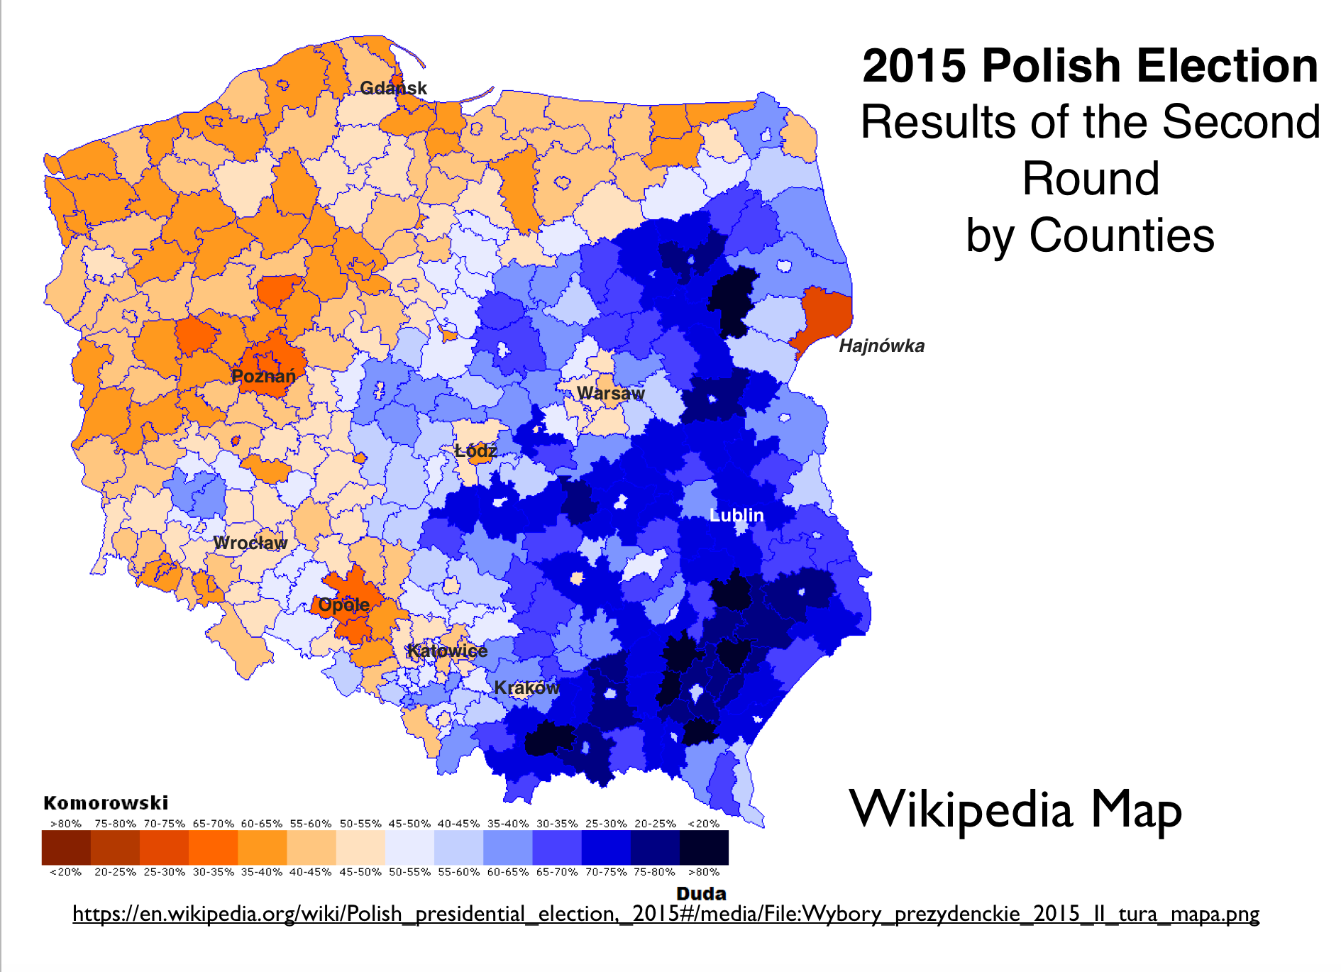


Poland
s
Notes:
Poland’s electoral divide is rooted in historical and cultural factors. The regions that generally vote for centrist or left-center candidates had all been part of Germany (and more specifically, Prussia) before World War I, whereas those that vote for center-right candidates had all been part of either the Russian or the Austro-Hungarian empire in the same period.
Source: http://www.geocurrents.info/geopolitics/elections/polands-stark-electoral-divide#ixzz59dXoGieJthis divide persisted after the massive population dislocations that occurred at the end of World War II, when millions of ethnic Germans were expelled from what is now western and northern Poland and replaced by millions of poles transferred from the east.
Oppole- german minorrity which was kept and Hajnowka, belarus minority not following the pattern.

Slide 32


Polish Political parties
PiS : mainstreaming nationalism
PSL: conservative
Modern : pro-European, liberal
Kukiz : eurosceptic, populist, soft-nationalist
PO : opposition to nationalism but discredited
LPR: Euroscepticism, national and Christian narrative, focusing on the national values against the ill liberal Europe (LGBT rights, feminism, right to abortion, legalisation of euthanasia). Becoming marginal
Notes:
PiS Law and Justice Party

Slide 33


MEP Janusz Korwin Mikke: several times suspended and fined from the European Parliament for Nazi salute, harsh nationalism referring to migrants as “human garbage” and denigration of women.

Slide 34
Polarisation in Poland
League of Polish families – anti-liberal, natioanlist, part of Kaczynski government 2006-7
Law and Justice Party- largest Polish party, national conservativism, Kaczynski, Beata Szydlo PM since 2015 removed EU flag, Polish Constitutional Crisis 2015
﻿ “strong” state instead of a “lawful” state, to be guided by “Polish values” and “Christian traditions,”
deeply hostile to any political opposition,
battle with a Europe committed to “totalitarian” ideas like gender equality and resettling refugees.
﻿ In the PiS worldview there are no opponents, only traitors
Krytyka Polityczna – Polish left wing intellectuals and its founder
Sławomir SIERAKOWKI
New left
Feminists and greens

Slide 35

Slovakia
a

Slide 36



Slovakian Political Parties
SMĚR: light pragmatic nationalism
OLANO : light pragmatic nationalism
We are a family : anti-immigration, eurosceptic card
Freedom and Solidarity (SaS) “put the immigrants on the military boat and send them back home” as “the great amount of migrants means less freedom for our citizens” asserting that he is a Slovak nationalist: “As the Mohamed is a key figure in Islam, Jesus is a key figure in Christianity. However, Jesus spread Christianity with word, Mohamed with a sword”.
Bridge: ethnic hungarian party
SNS – far right becoming mainstream
LSNS : admiration to the WWII formations, strong anti-Semitism and anti-Ziganism, Anti-EU, anti-NATO, Heterosexuals vs. Ill homosexuals, anti migrants
All main competing parties played in the past with nationalism
BUT NOW U-TURN BACK TO EUROPE – we are the only pro-European island in central europe

Slide 37

Polarisation in Slovakia
Slovak National Party
Fico and SMĚR- pragmatic in relations with Russia, anti mandatary quotas on refugees,initially strongly anti-Hunggarian and anti-Orbán, anti-migrant rhetoric
People´s Party- our Slovakia and Marián Kotleba, anti-Roma, then anti-immigrants, governor of Banská Bystrica, neo-Nazi background
Similarities to the Czech case
Intelligentsia
New left

Slide 38



How media refer to radical right populism and shape the public discourse?
Berlusconisation of the media
Neutral or negative framing (Sládek, Slota, Okamura)
Leaders framed as psychopats, lunatic
Increased media attention faciliating electoral success
Jobbik as persona non grata
radical right narratives appear in the Hungarian media but the radical right politicians and parties are treated as persona non grata of the Hungarian media space

Slide 39

How media refer to radical right´s topics and shape so the public discourse?
TV Prima and refugees
avoid showing images of women and children in their coverage of the refugee crisis in Hungary
newspapers in WE were generally more compassionate towards the plight of refugees compared to CEE
minority is presented in a negative and stereotypical and prejudiced way (Romas, Muslims)

Slide 40


Concluding remarks
the lines between the discourses of moderate right and radical right politics have been blurring
Rise of populist formations which use nationalist card (all cases)
Zemanisation (mainstreaming of nationalism and xenophobia)
Marginalisation of the far right (czech r., poland)
Berlusconisation (media in the hands of politicians)
Kremlinization (pro-Russian campaigns)
Orbanisation (dismantling democracy)
Polarisation of the society and politics
The only clearly pro-European state – Slovakia

Slide 41


Populism: Threat or a Challenge?
Populism can be like a guest who comes late and drunk to the dinner, does not respect the manners but spells out the painful troubles of the group (Arditi 2005).
Notes:
So far, in Poland and in Hungary, the guest not only disrupted the party, but dissolved it and launched a new one under his rules. Not only that, the guest started to delimit the party along the ethnic lines, oppose the other supranational parties previously befriended with and brainwash the people with his own ideology hindering the new guests to come and stay labelling them as strange and threatening. The party got polarized, half of it started to believe a new leader, half of it started to oppose the new rules. In the Czech Republic and Slovakia, the party was only disrupted and painful troubles were spelled out but it was enough to polarize the society along the cleavage cosmopolitan vs. communitarian and enlarge already existing gap between the EU older states and the new ones. A new specter of national populism spread its claws over Central and Eastern Europe and became a many headed beast that takes different forms and is extremely difficult to fight with. The question remains open whether this is the beginning of an end of the great multi-ethnic supranational party.

Slide 42
Concluding remarks
the lines between the discourses of moderate right and radical right politics have been blurring
Rise of populist formations which use nationalist card (all cases)
Zemanisation (mainstreaming of nationalism and xenophobia)
Marginalisation of the far right
Berlusconisation (media in the hands of politicians)
Kremlinization (pro-Russian campaigns)
Orbanisation (dismantling democracy)
Polarisation of the society and politics

Slide 43
Concluding remarks
Czech political parties have a long tradition of promoting Czech nationhood—it has in fact been promoted by virtually every relevant political party in the contemporary political milieu
Nationalism has been misused, appropriated and legitimized by top governmental leaders.
Their legitimation of far right topics has led to the marginalisation of the far right.
The day-to-day use of discriminatory, exclusionary, and xenophobic speech by Czech leaders is reflected in media accounts that transmit the message that negative stereotypes are normal, casual, and ultimately neutral.
This serves to reproduce and further reinforce societal prejudices, and the result is visible in an intolerant public discourse
As it stands, the Czech Republic is a country with no potential for a significant populist radical right party but with nationalism on the agenda of almost all the parties. Because of unfavourable political opportunity structures, that should remain true into the foreseeable future.

Slide 44


Slide 45
How to fight against political parties that threaten the rule of law, human rights and democracy?
Media ownership
Political culture, elite behaviour.
Middle class discontent, economic variables (unemployment, economic crisis, foreign domination welfare payment cuts)
Avoid referenda and polarization of the society
International context
Fake news, Kremlinization of the media.
Charismatic leader
Work with youth, social media, FB and new media
Education projects for secondary schools – history lessons, democracy classes, EU classes, human rights classes
Cultural projects, face to face
Language knowledge promotion
Professional political campaign
Give up political correctness

