Slide 1
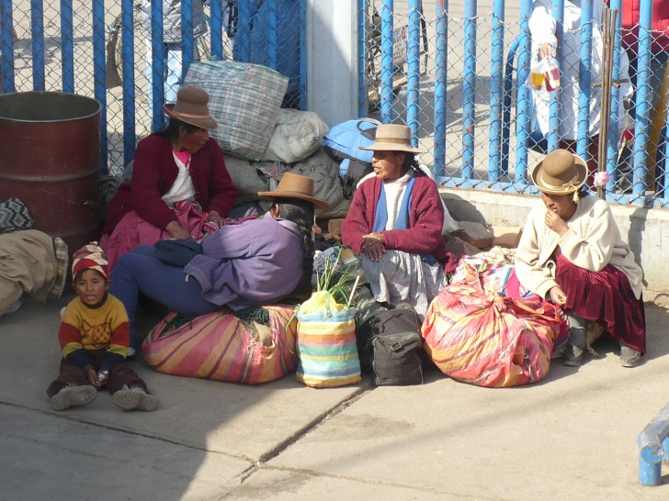
Far Left in Latin America
Věra Stojarová
CDS 441 Far Right and Left Parties

Slide 2
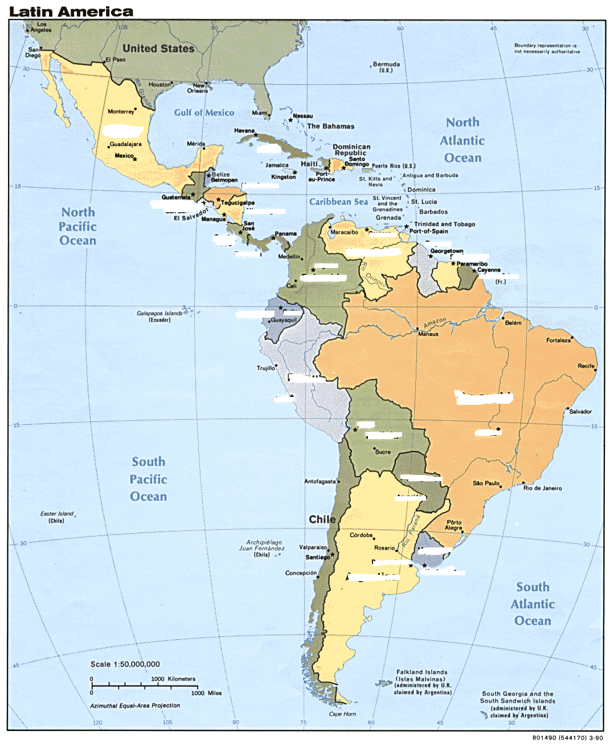

Slide 3
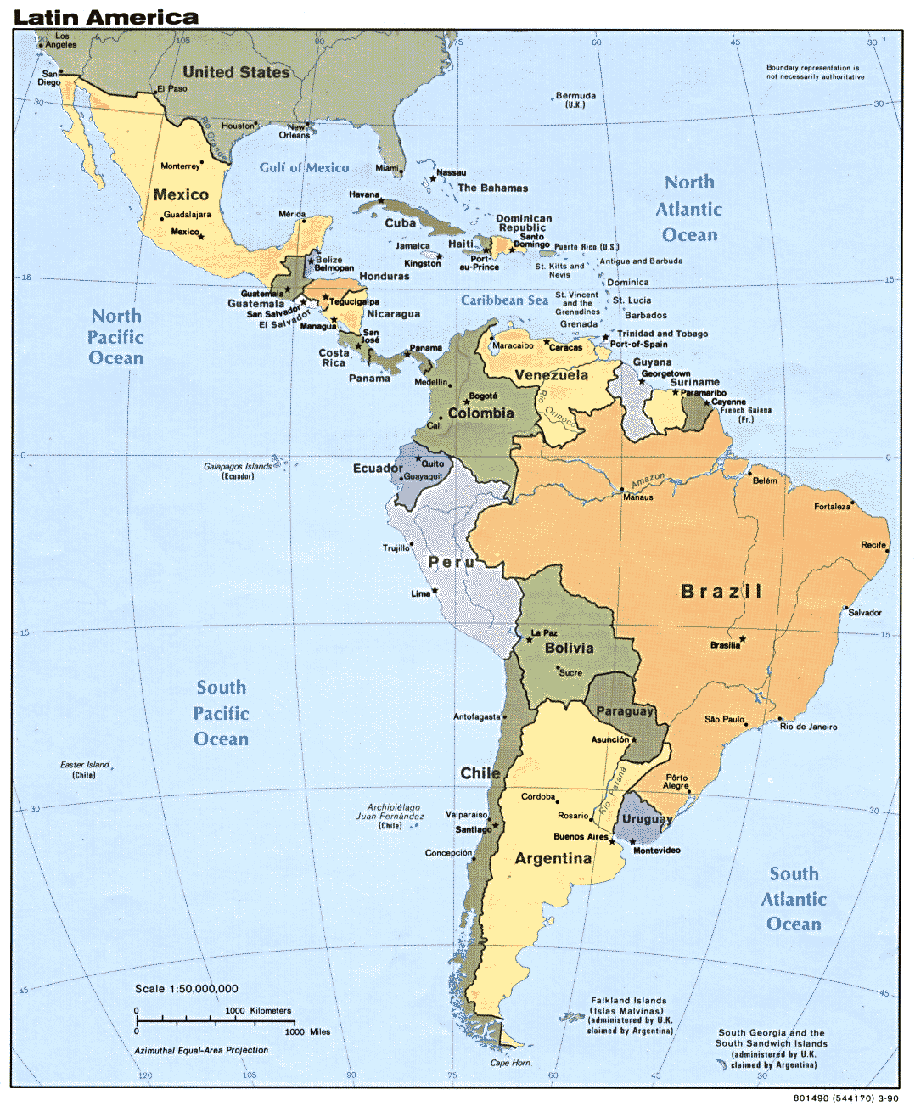

Slide 4
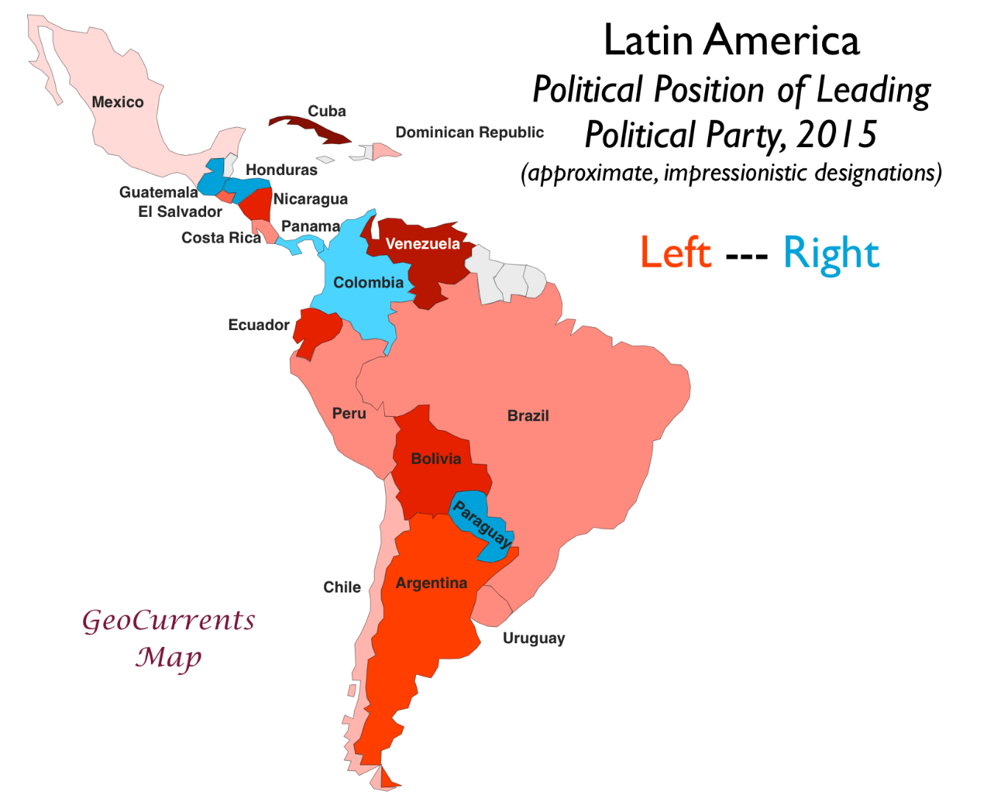
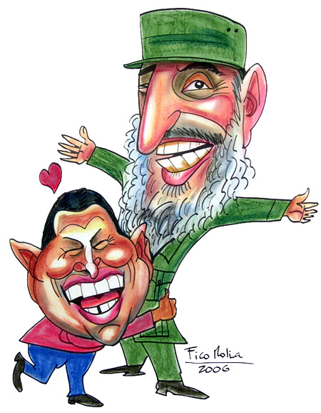
LA Political spectrum

Slide 5
Latin America
Unequality
Populism relies upon nationalism or indigenism
Seduction by charismatic leader able to distinguish from the traditional establishment
Always men with exception of Eva Perón – LA machismo
Populist origins are quite different from traditional while elite. (“The Turk” was the nickname of Carlos Menem (Syrian in origin), while Alberto Fujimori was “The Chinaman”, Evo Morales is indigenous, while Hugo Chávez is said to have the native physique of the Venezuelan people, former president of Ecuador, Abdalá Bucaram (parents were Lebanese) Néstor Kirchner (origins are Swiss and Chilean)
High public support
Mostly presidential systems without checks and balances
Fragile party system
Aim to create“new type of democracy“ usually ending with illiberal regime

Slide 6
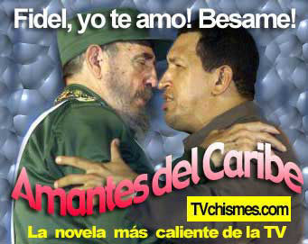
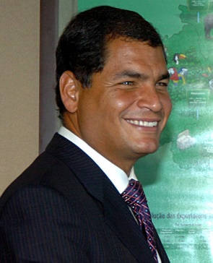
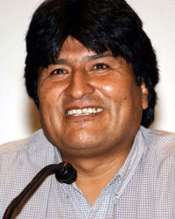
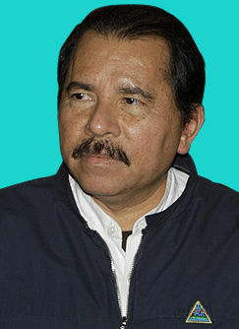
Against the USA United we stand
Left populism, socialism and indigenism
Venezuela: Hugo Chavez 1999-2013
Bolivia: Evo Morales since 2006
Argentina: Nestor Kirchner 2003-2007, Christina Fernandez de Kirchner since 2007
Ecuador: Raffael Correa since 2007
Cuba – Castro
Nicaragua – Sandinistas and ORtega

Slide 7
Fidel Castro and Cuba
execution of about 500 police officers and others accused of being agents of the Batista regime
land reform, the nationalization of public utilities and the ruthless suppression of corruption, including closing down the gambling industry and evicting the American firms.

Slide 8
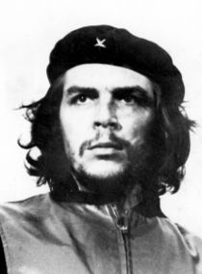
Ernesto Che-Guevara
an Argentinian marxist and one of Castro’s closest advisers.
The coordinator of the economical reforms even having no economical education
Lost his interest in the internal Cuban affairs for the revolutionary movements in Dominican republic, Nicaragua, Panama, Guatemala, Peru, Bolivia, Argentina, Venezuela, Kongo, guinea- Bissau, Angola, Kongo-Brazaville, Mosambik, Algeria, Ghana, Egypt and Ethiopia…..

Slide 9
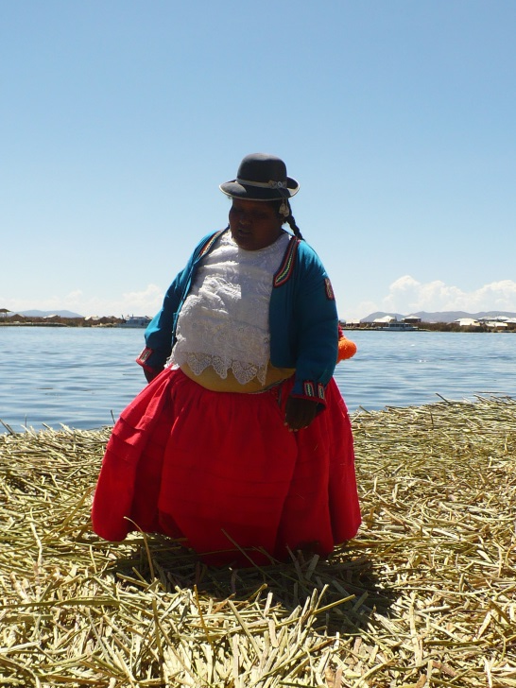
Social conflict in Bolivia before Morales
Bolivia is South America's poorest country, with 60 percent of the population living below the poverty line, and 38 percent in extreme poverty,"
Bolivia is 2nd after Venezuela with the natural reserves
30% Quechua, 30% Mestizo, 25% Aymara, 15% White
Exploitation of gas resources: capitalisation vs nationalisation
Coca eradication/cultivation
Military responses towards strikes
1964-85 junta, coups, counter coups, hyperinflation,
1985 -2005 transition to (weak) democracy

Slide 10
Bolivia: Evo Morales
the first Native Bolivian president in history
announced the increase of the minimum wage by 50%
nationalizing most of Bolivia's natural gas fields
nationalised the oil and gas industries, begun redistributing land, cut public sector salaries and hopes to promote some legal uses of coca leaves.
Some have called the changes in Bolivia a democratic revolution.
close ties to governments in Venezuela and Cuba

Slide 11
Bolivia: New constitution introduced by Evo Morales
Re-election: Allows Mr Morales to stand for re-election in Dec 2009
Indigenous rights: Stresses importance of ethnicity in Bolivia's make-up. A whole chapter devoted to indigenous rights
Autonomy: Power decentralised, four levels of autonomy - departmental, regional, municipal and indigenous
Resources: Sets out state control over key economic sectors, state sovereignty over vast natural gas fields, redistribution of revenues to poorer parts of the nation
Judiciary: Indigenous systems of justice same status as official existing system. Judges will be elected, and no longer appointed by Congress.
Land: New limit on ownership 5,000 hectares (12,355). But measure not retroactive.

Slide 12
Evo Morales administration
Rise of tensions against redistribution
Anti-imperialism

Slide 13


Venezuela before Hugo Chavez
1820s-1935 caudillismo
1935-58 democratisation however interrupted by junta regime, universal suffrage, political parties,
1958-1998 transition towards democracy
Agreement from Punto Fijo – power in hands of two parties AD and COPEI, corporativism,nepotism, high oil revenues flowing through the government, corruption
1989 Caracaro protests – protest violently suppressed
1992 unsuccessful coup d etat, Chavez inprisoned and becomes national hero

Slide 14
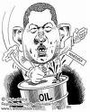
Venezuela: Hugo Chavez 1998-2013
Bolivarian revolution
New constitution 1999: Reform of the judiciary power, More opportunities for referenda, Stronger presidential power, The role of the state in economy stronger, President can issue the decrees which have the power of law without consultation of approval by the parliament
The president term was extended to 6 years (5 before) with the right of re-election
Firstly popularity
Since 2001 increase in the opposition due to the nepotism, aggressive style, revolutionary extremist rhetoric
2002 unsuccessful coup d´etat organized by the opposition with the cooperation of oil company PDVSA, businessmen and USA

Slide 15
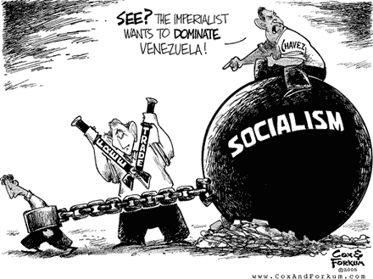
Venezuela under Hugo Chavez
New Constitution severely limits checks and balances
High government spending on populist policies
Maintained fixed exchange rate for a long time
Expanded role of the military
Nepotism and corruption
Stronger OPEC relationships → oil prices
Growing tensions: poverty, crime & corruption

Slide 16
https://www.youtube.com/watch?v=Wsxmod0TSAo (hugo chavez at un assembly, devil)
https://www.youtube.com/watch?v=qlbJW7Bw1uQ (memorable speeches 2min)
https://www.youtube.com/watch?v=JzQCQm77GK4 (last speech 18 min)

Slide 17
Ecuador before Rafael Correa
1978 towards democracy
Weak democracy, permanent crisis
Correa since 2006, Hugo Chavez his mentor

Slide 18
Ecuador: Rafael Correa
(1) a constitutional and democratic revolution, including a deep reform of state institutions,
(2) a moral revolution through a media campaign and tougher penalties against those guilty of corruption,
(3) an economic and productive revolution against the interests of big business,
(4) an education and health revolution through the creation of new social programmes, and
(5) a revolution for dignity, sovereignty and Latin American integration.

Slide 19
Nicaragua - FSLN
Sandinistas against the Contras supported by the USA
nationalization of property owned by the Somozas and their supporters;
land reform;
improved rural and urban working conditions; free unionization for all workers,
price fixing for commodities of basic necessity; improved public services, housing conditions, education; equality for women;

Slide 20
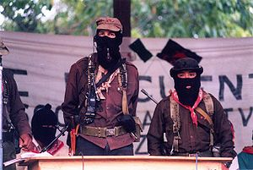
Intra-state conflicts and the far left
Peru- Shining Path
Colombia – FARC et al
Venezuela since 2014
Paraguay: EPP (Ejercito del Pueblo Paraguayo and splinter Armed Farmers Group ACA since 2005
Chiapas

Slide 21
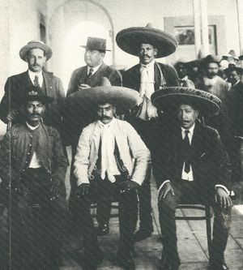
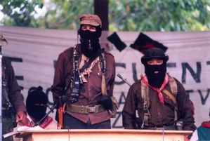
Mexico: Zapatistas and Chiapas
Zapatista
1994 uprising in Chiapas
Presidential elections in 2000 and ceasefire
Subcomandante Marcos
Notes:
whose Liberation Army of the South (Ejército Libertador del Sur) fought during the Mexican Revolution for the redistribution of agricultural land.
Zapata, his army and allies, including Pancho Villa at one point, fought for agrarian reform in Mexico and specifically the establishment of communal land rights for indigenous population.
January 1994 - Zapatistas in the state of Chiapas briefly took arms against the government, protesting alleged oppression and governmental indifference to poverty.
After 12 days of fighting, a cease-fire was negotiated that remains in effect. Since 1994 sporadic clashes have continued to occur between armed civilian groups, usually over disputed land claims.
As a presidential candidate, Fox promised to renew dialogue with the EZLN and address unresolved problems in the state. Following his inauguration, he ordered many troops out of Chiapas, dismantled roadblocks, closed military bases, and submitted revised peace accords to Congress.
Nonetheless, Chiapas has the largest military presence of any other state of the country. In August 2001, the peace accords became Mexican law, after having been passed by Congress and ratified by more than half of the state legislatures.
The Zapatista Army of National Liberation (EZLN), has not accepted the laws passed, claiming they fail to address certain points.
Subcommandate Marcos, once spokesperson for the EZLN has proclaimed that he will oppose any form of government.

Slide 22
Mexico: Oaxaca
two armed groups in the state of Oaxaca
Revolutionary Democratic Tendency - Army of the People (TDR-EP)
Lucio Cabanas Barrientos Revolutionary Movement
Both of these are originally splinter groups of the People's Revolutionary Army EPR.
Neither is considered to have any conventional military capacity

Slide 23
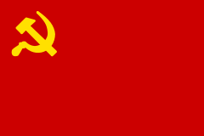
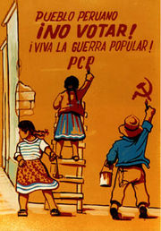
PERU: The communist party of Peru -Shining path
1960´s
Abimael Guzman
Universities, intelectuals
Marxism-leninism, maoism
Terrorist activities

Slide 24
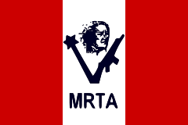
PERU: The Túpac Amaru Revolutionary Movement (MRTA)
marxist-leninist revolutionary movement formed in 1983
communist state
In December 1996 Japanese embassy hostage crisis
Notes:
MRTA suffered from infighting as well as violent clashes with Maoist rival Shining Path, the imprisonment or deaths of senior leaders, and loss of leftist support.
Its last major action resulted in the 1997 Japanes embassy hostage crisis. fourteen MRTA members occupied the Japanese Ambassador's residence in Lima, holding 72 hostages for more than four months.

Slide 25
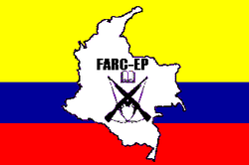
COLOMBIA: FARC/EP
Oldest,largest revolutionary guerilla group
the military wing of the communist party.
12,000-18,000 members
present in 35-40 percent of Colombia's territory
terrorist group
Peace accord 2016
Alleged ties with venezuela and Ecuador
Notes:
On June 23, 2016 a ceasefire accord was signed between the FARC Guerilla Army and the Colombian Government, in Havana, Cuba. Leaders of several Latin American countries which contributed to the deal, including Cuba and Venezuela, were present. A final peace accord will require a referendum to be approved.^{[204]}
Under the accord, the Colombian government will support massive investment for rural development and facilitate the FARC's reincarnation as a legal political party. FARC promised to help eradicate illegal drug crops, remove landmines in the areas of conflict, and offer reparations to victims. FARC leaders can avoid prosecution by acts of reparation to victims and other community work Colombian peace agreement referendum, or FARC referandum, to ratify the final agreement on the termination of the Colombian conflict will be held on 2 October 2016. ^{[1]}

Slide 26
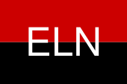
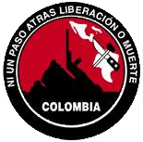
Colombia: National liberation army ELN
Ejército de Liberación Nacional (ELN)
Revolutionary, marxist, insurgent guerilla
since 1964
3,500 to 5,000 guerrillas.
Perceived as terrorist group

Slide 27
Colombia: Other guerilla/paramilitary groups
Ejército popular de liberación EPL
M-19 Movimiento 19 de Abril
Movimiento Quintín Lame handed in weapons together with EPL in 1991
Autodefensas unidas de colombia UAC – created in 1997 with the aim to unite and centralize all paramilitares.

Slide 28
chinchoneros
active in the 1980s in Honduras.
century Honduran peasant leader Serapio Romero (nicknamed Cinchonero), who was executed by the Catholic Church in 1865 for refusing to pay taxes.
The MPL was believed to be linked to other leftist movements in El Salvador, Cuba, and Nicaragua.
hijacking aircraft, kidnapping, and hostage-taking, often targeting international corporations in Honduras.

