Slide 1

Nostalgia
And its role in post-war and post-colonial

Slide 2
What is “nostalgia”?
“Oh, what happened to you?
Whatever happened to me?
What became of the people we used to be?
Tomorrow's almost over,
Today went by so fast,
Is the only thing to look forward to the past?”
The Likely Lads, British sitcom from 1960s

Slide 3
What is “nostalgia”?
Nostos to return home and algai a painful condition
Common features:
  the material of nostalgic experience is the past
  A personal past, not one based on second-hand experience
  How long is “the past”?

Slide 4
What is “nostalgia”?
“…a normal psychological reaction triggered by fear of actual or impending change”
Nostalgia uses the past “falsely” in “specially reconstructed ways”, but it is not the product of the past
Nostalgia is memory with the pain removed
Matt McCullock 2016

Slide 5
What is “nostalgia”?
Nostalgia is the continuity of identity in the face of new demands;
Nostalgia thrives on transition;
“…the nostalgic reaction is most pronounced at those transitional phases in the life cycle that exact from us the greatest demands for identity change and adaptation” (Davis 1979: 49)
Pathological condition bordering on depression

Slide 6
What is “nostalgia”?
“Nostalgia is a mourning for the impossibility of mythical return, for the loss of enchanted world with clear borders and values”
Nostalgia, as a historical emotion, is a longing for that shrinking “space of experience” that no longer fits the new horizons of expectations.”
Svetlana Boym,
Professor of Slavic and Comparative
Literatures at Harvard University

Slide 7
Three conditions for nostalgia:
Linear time
Deficient present
Material objects from “the past”
Matt McCullock 2016

Slide 8
Nostalgia and its relevance for social sciences
Nostalgia is a “psychological telephoto lens” that “Idealises the past and presents it as a sentimental realm of pure innocence. Nostalgia idealizes its object”
Module can be placed in general field of
  Politics of nostalgia
  Politics of decline
Matt McCullock 2016

Slide 9
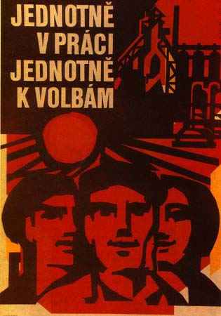
Post-war and post-colonial Czechoslovakia
The main Czechoslovak clichés constantly brought up about the past socialist/communist regime:
  Housing
  Labour
  Vehicle Industry

Slide 10
Post-war Sweden
clichés brought up about the past:
  Unemployment almost disappeared from Swedish consciousness in post-war period
    However found again in 1990s
  Housing

Slide 11
Nostalgia in Sweden
Reaction to:
  European integration
  Geopolitical change around the Baltic sea
  Rapid industrial change → knowledge economy and neocolonial
  Diversity policies
  Younger generation confronted with new social reality, compare to the generation of their parents
  Generation who grew up in steady welfare and economical expansion have to confront their children with new reality

Slide 12
2005 and 2006 debate on Swedishness
Nordic modernity – gender equality, work ethic, secular Protestantism, consensus culture, assumptions of sameness, cultural homogeneity
VS.
Perceived threats like Muslim communities
= delayed post-colonial debate in Swedish academic discourse
Sweden Democrats – Swedishness is under a siege

Slide 13
Sweden Democrats
Nationalist response to the nostalgia
„Looking to history for sources of identity in a time where, allegedly, all identities are in flux.“ (Andersoon 2009: 241)
Roots in Nazi movement: party leader Anders Klarström associated with the Nazi Nordic National Party
Ties to white power movement
founded in 1988
Todays chairman: Jimmie Åkesson

Slide 14
Party in parliament
2010 elections – in Parliament for the 1st time: 5.7% (20 seats)
  (4% election threshold)
2014 elections: 12.9 % (49 seats)
In isolation; no cooperation with other parties
2018 elections?

Slide 15
Sweden Democrats
„Cultural reproduction of the Swedish nation is a central theme running through all of the gender-related efforst of Sweden Democrats.“ (Towns, Karlsson, Eyre: 2014)
Xenophobic populist party
1991-1994 – New Democracy
Cultural racism is central

Slide 16
Sweden Democrats
Women to a lesser degree than men vote and participate in these parties (Towns, Karlsson, Eyre: 2014)
Migration sceptics, anti-immigration, nativism, xenophobia
xxxx racism
Racism expressed in ways witch does not include „race“

Slide 17
Sweden Democrats
Exclusionary racism – getting rid of them, losers' racism
Exploitative racism – winners racism, labor force that can be used for low-paid work, aspect of global reproduction of capitalism
(Mulinari and Neergaard 2014: 45)
Patriarchal order at the heart of men´s support of the party
Concept of caring racism: party creates community where people care for each other, time and resources for common good, caring of their people, women- caring mothers and men- protectors and caring fathers of the nation
(Mulinari and Neergaard 2014: 53)

Slide 18
Anti-immigration, anti-liberal: meet Sweden's far-right future – video
Guardian
https://www.youtube.com/watch?v=A84b7qIxQMU
https://www.theguardian.com/world/video/2015/nov/23/meet-the-young-supporters-of-swedens-far-right-video

Slide 19
Spot I.
https://www.youtube.com/watch?v=VR-lAGj_dlQ
https://www.youtube.com/watch?v=pumIT31qqQQ
https://youtu.be/n40tm2P374w

Slide 20
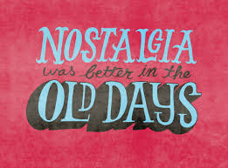
Questions:
Do you think that nostalgia is somehow present in the heritage of your nation, country, ethnicity, minority, …?
Can you identify the main features of nostalgia within your nation, country, ethnicity, minority, …?
Does it have any nationalist outcomes?

