Slide 1
Full Metal Jacket - Questions
To what extent is the movie critique or celebration of the ideology of the U.S. Marine Corps?
How would you politically evaluate the film’s representation of Vietnam?
How are perceived American and consequently Vietnamese soldiers in the movie?

Slide 2
Full Metal Jacket part I
First part of the movie:
new recruits are transformed into soldiers (or machines for killing?) at the training camp
Mentally damaged private Pyle kills Hartman (commanding and training officer and then turns the weapon against
Hartman: “if you ladies leave my island, if you survive recruit training, you will be a weapon, you will be a minister of death, praying for war” (Full Metal Jacket).
Loss of individuality
Totally reshaping the guys in according to the desires of military so they are more likely to survive the war
Stripping the guys off their pre-war identity and replace their identity with unified picture of soldier
Replacement of their old names with new nicknames by Hartman
Becoming a small part of the “big machine“.

Slide 3
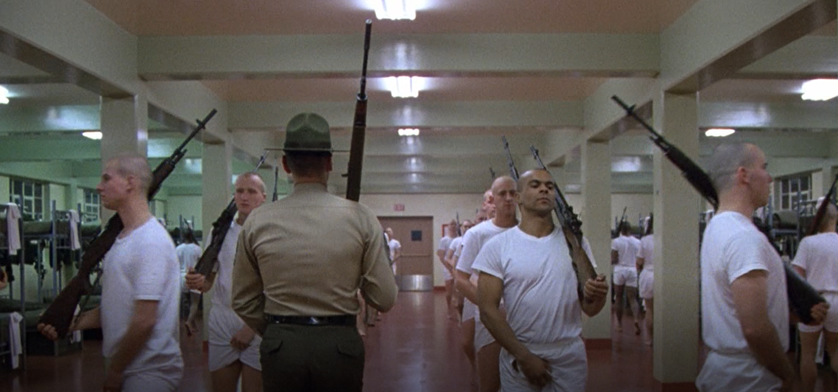

Slide 4
Full Metal Jacket part II
Second part of the film takes us to Vietnam and takes place around and during the 1968 Tet Offensive
Kubrick’s film is seen primarily as carrying a strong anti-war message
(Kolcún 2008)
Notes:
The Tet Offensive
Year 1968
A combined Vietcong and North Vietnamese Army operation launched during the Tet holiday in January of 1968. The Vietcong seized over 100 towns and cities all over South Vietnam while the NVA engaged U.S. forces in the northern part of South Vietnam. Intense fighting lasted for several weeks. The Vietcong/NVA suffered heavy losses and the U.S./ARVN forces regained all lost territory. The offensive, however, was a turning point in the war, intensifying anti-war protests in the U.S., leading to gradual withdrawal of U.S. troop and subsequent “Vietmanization” of the war. (Clark 506-507; “Tet!”); (KOLCÚN 2008: 23).

Slide 5
Message
„On one hand, Kubrick follows the typical combat film/war drama pattern—boot camp, firefights, brutality of the war, the life of the soldiers etc.“(Kolcún 2008: 23).
Vietnamese women depicted as a prostitutes
Enemy depicted as a cold piece of meet
Mortality
BUT
It supplies “the neat parcel of guilt” (Klein 29).
lacks any redeeming philosophy
lacks any ideals, or a cause which might serve as a
lacks any justifycation for all the horrors
Vietnamese girls depicted as a fearless combatants
(Kolcún 2008)

Slide 6
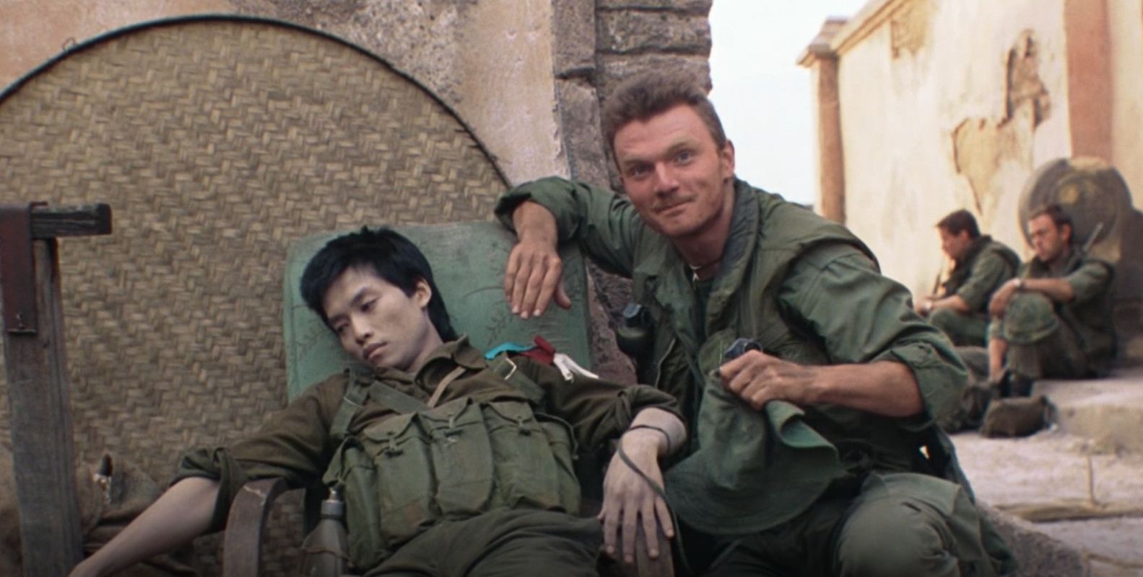
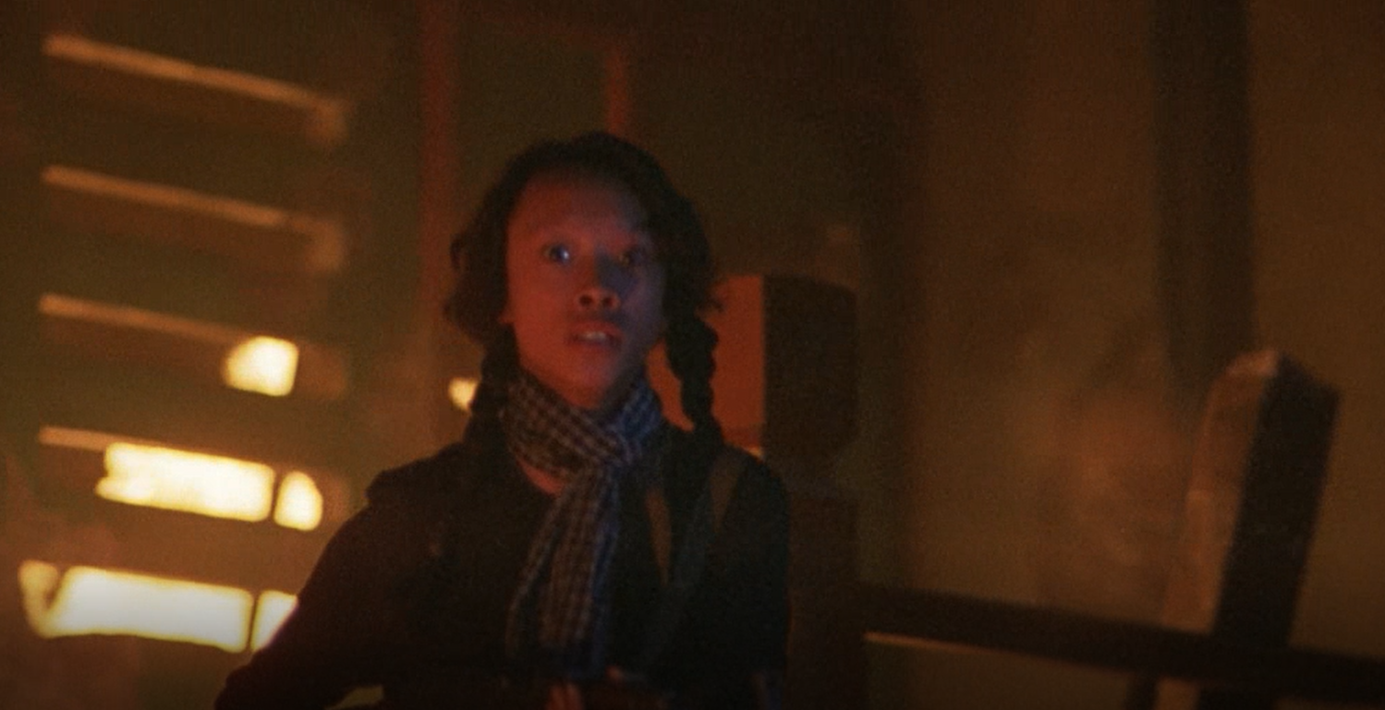
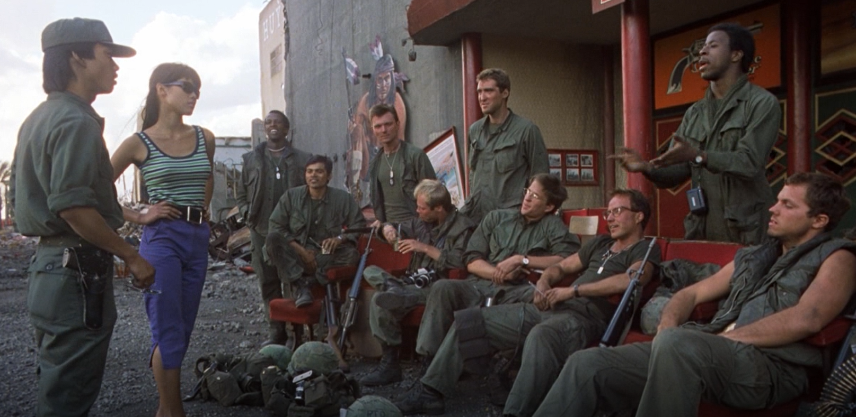

Slide 7
How to describe the movie?
nihilistic
emotionally distant (Hillstorm and Hillstorm 123),
devoid of what we normally called human response (Gilman 206)
dehumanization” in relevance to the people involved in the war
Deglorification of the war and sides involved - The war itself is deglorified and reduced to “a slaughter.”
“Kubrick’s war” is neither explained, nor judged. It simply is, being “reduced to [its] most basic elements” (Falsetto 73).
Superficially unconcerned with representation of women
a construct of the American psyche (Westrup 2006)
(Kolcún 2008)

Slide 8
How to describe the movie?
satirical inversion and parody of the combat film/war drama genre
Emphasizing the negative aspects of the war and the hardships the soldiers have to suffer both during basic training and during the war itself.
It provides no explanation why this should be done or why this is worth it.
Kubrick delivers a very strong anti-war message. However, it is not overtly presented and is hidden behind a seemingly unremarkable, and cold spin-off of the combat film/war drama.
(Kolcún 2008)

Slide 9
Propaganda in Communist Vietnam
Notes:
Hanoi – Historical and War Museum

Slide 10
Propaganda in Communist Vietnam

Slide 11
French Colonization and Ho Chi Minh´s Life
BBC Documentary
https://www.youtube.com/watch?v=7era7dT-zGg

Slide 12
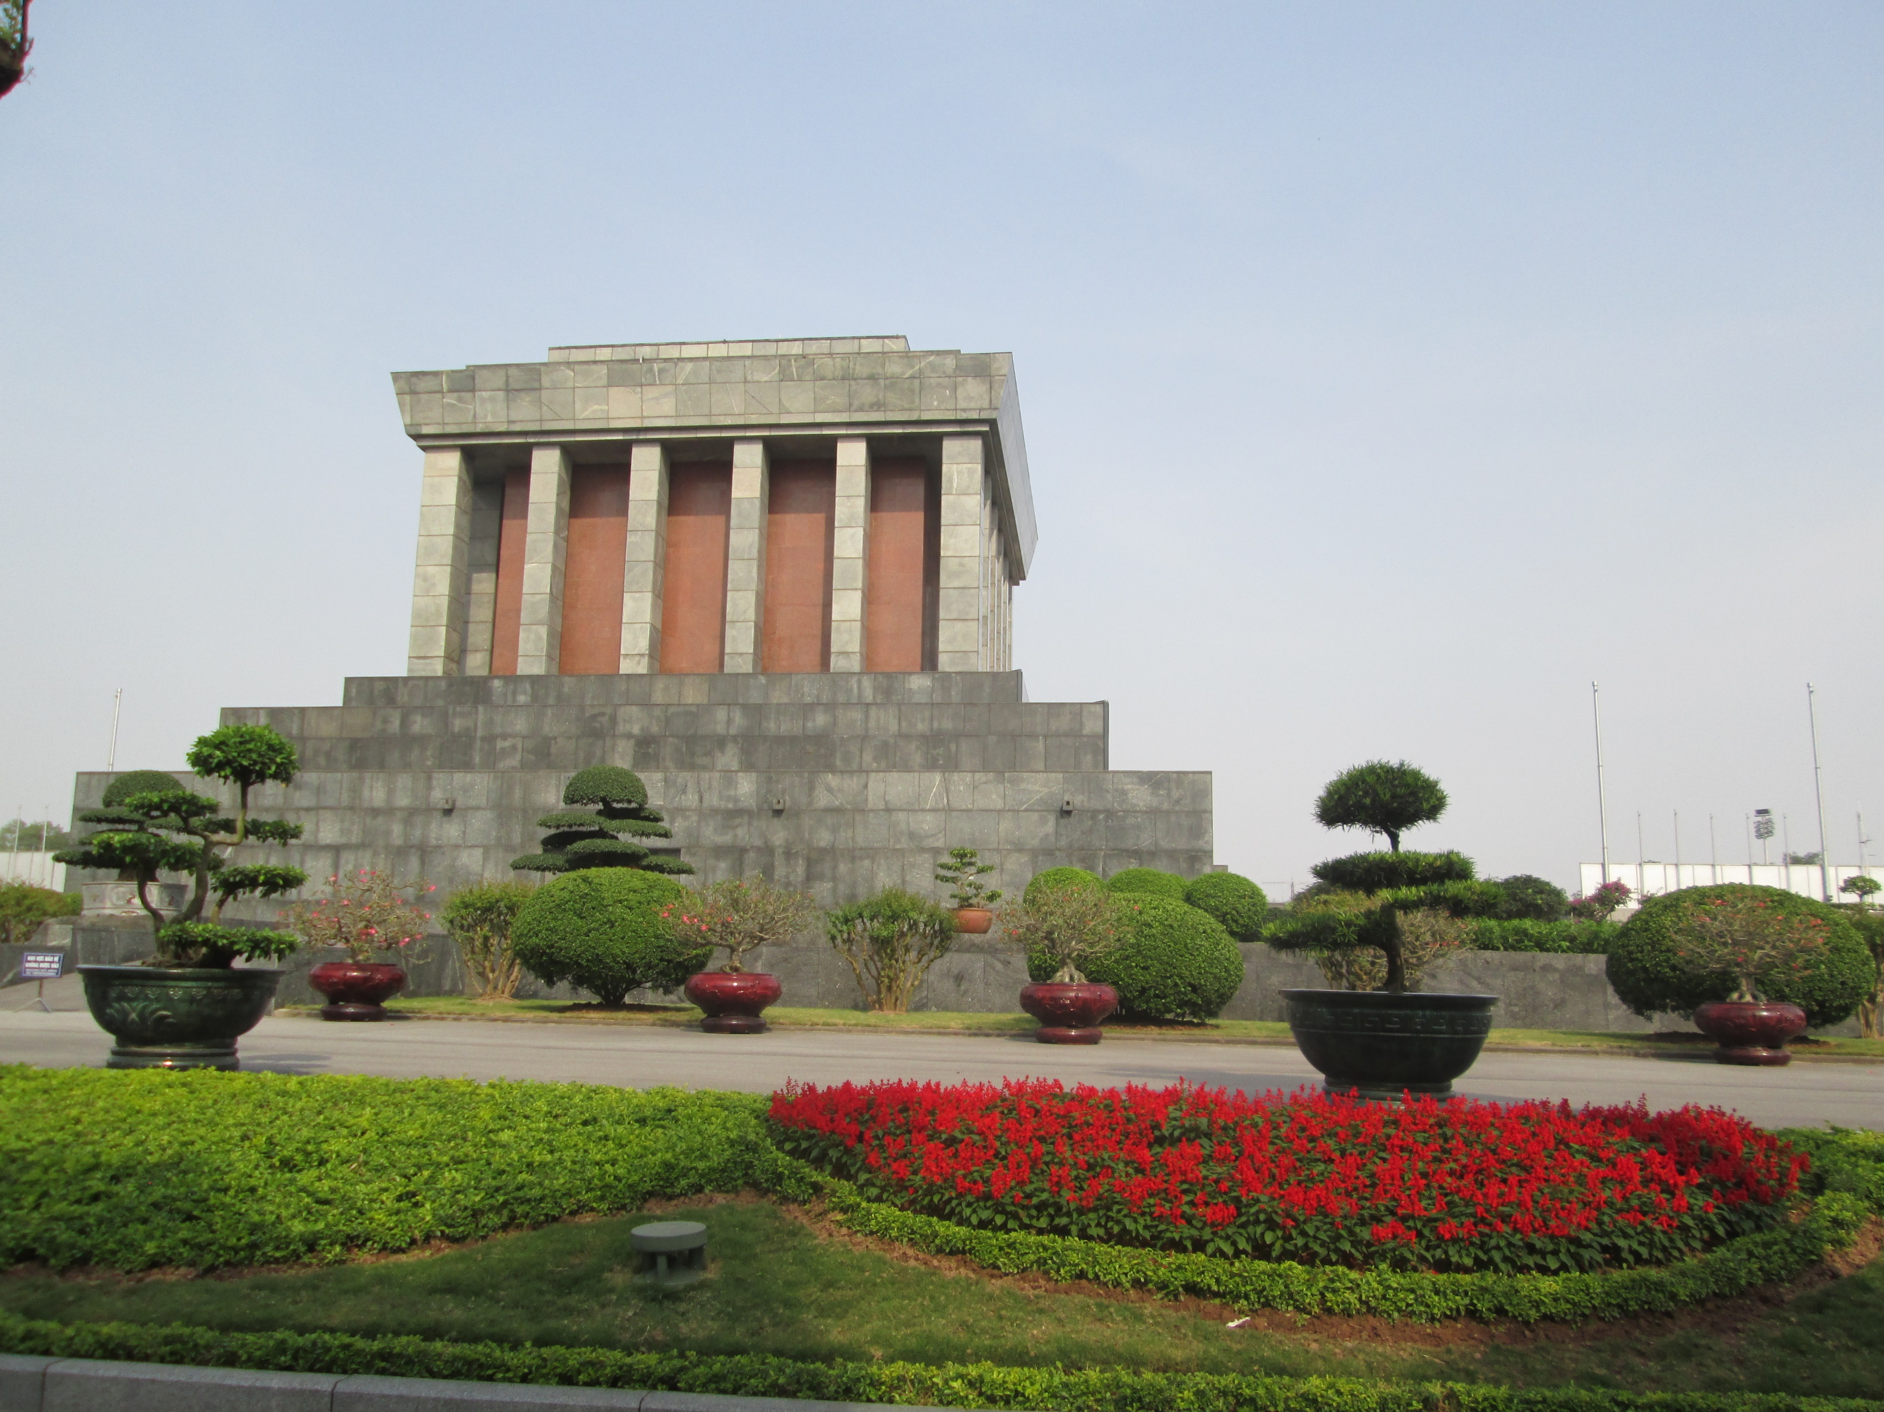
Ho Chi Minh Mausoleum

Slide 13
French colonization

Slide 18
Vietnamese laborers tranporting good and weapons by bicycle to the battlefield in 1954.

Slide 19
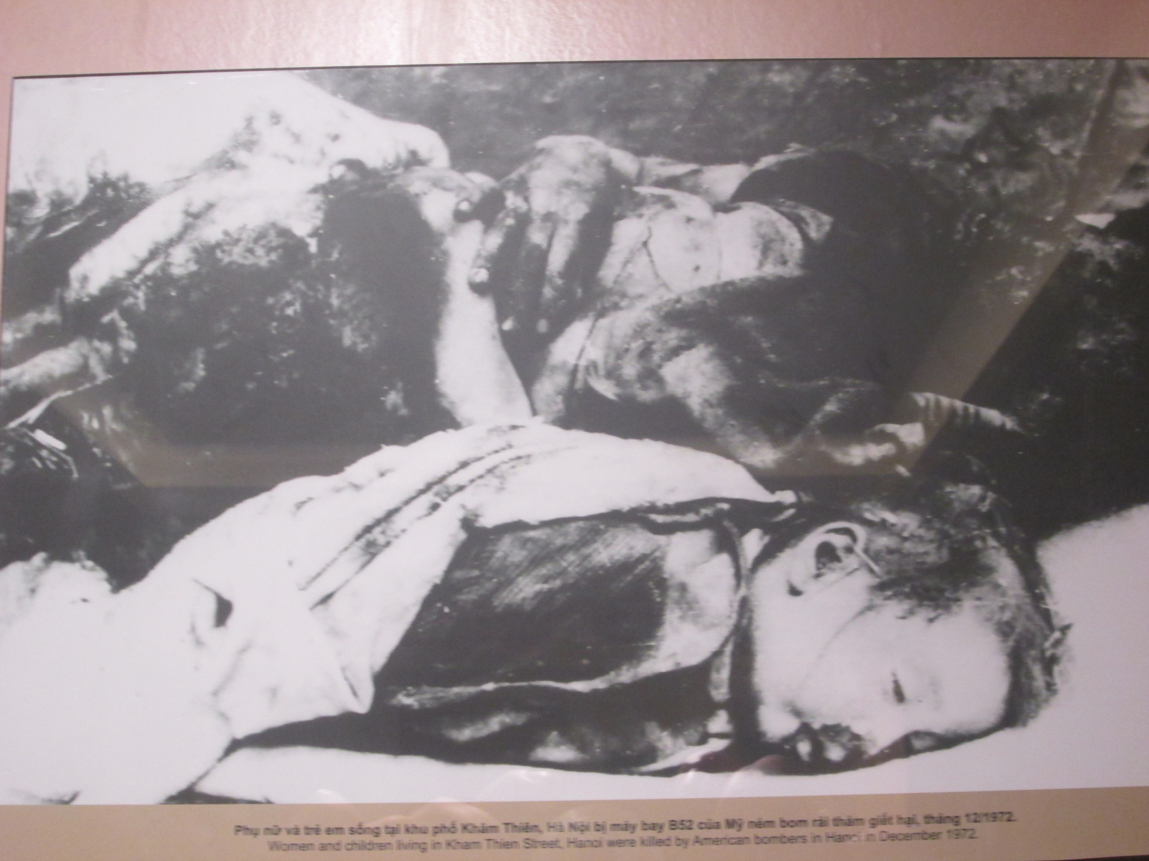
Women and children living in hanoi, who were killed by American soldiers in 1972.

Slide 20
End of the civil war and „liberation of the south“ in 1975 and 1976

Slide 21
U.S. Forces going home

Slide 22
Meanings of counter-insurgency war in Vietnam „winning hearts and minds“

Slide 23
References
KOLCÚN, Dušan. Lights, Camera, Vietnam: Depiction of the Vietnam War in Selected Movies [online]. Brno, 2008 [cit. 2018-05-06]. Dostupné z: <https://is.muni.cz/th/mt94d/>. Bakalářská práce. Masarykova univerzita, Filozofická fakulta. Vedoucí práce Tomáš Pospíšil.
Clark, Gregory R. Words of the Vietnam War. Jefferson: McFarland, 1990. Questia. 17 Apr. 2008 <http://www.questia.com/read/96311651#>.
Falsetto, Mario. Stanley Kubrick: A Narrative and Stylistic Analysis. 2nd ed. Westport: Praeger, 2001. 71-75. Questia. 17 Apr. 2008 <http://www.questia.com/PM.qst?a=o&d=102112713>.
Hillstrom, Kevin, and Laurie Collier Hillstrom. The Vietnam Experience: A Concise Encyclopedia of American Literature, Songs, and Films. Westport: Greenwood Press, 1998. Questia. 17 Apr. 2008 <http://www.questia.com/PM.qst?a=o&d=101047108>.
Klein, Michael. “Historical Memory, Film, and the Vietnam War.” From Hanoi to Hollywood: The Vietnam War in American Film. Ed. Linda Dittmar and Gene Michaud. New Brunswick: Rutgers UP, 1990. 19-40.
Gilman, Owen W. “Male Bonding, Hollywood Orientalism, and the Repression of the Feminine in Kubrick’s Full Metal Jacket.” Inventing Vietnam: The War in Film and Television. Ed. Michael Anderegg. Philadelphia: Temple UP, 1991. 204-223.

