Slide 1
EU a EÚLP
EVS450 EU a LP
Hubert Smekal
(hsmekal@fss.muni.cz)
23. dubna 2018

Slide 2
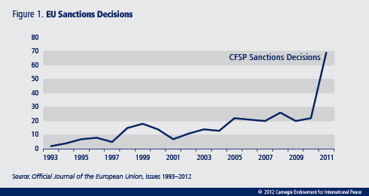
Sanctions
Lehne 2012

Slide 3
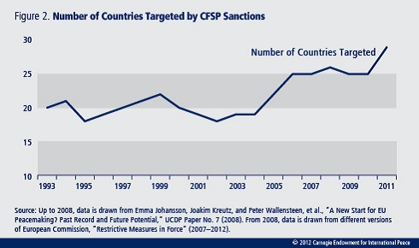
Sanctions
Lehne 2012

Slide 4
Přistoupení v běhu let
70. léta
EÚLP / vlastní listina práv
  Funkce přistoupení
  Funkce vlastní listiny práv
Posudek 2/94
Ústavní smlouva
Lisabonská smlouva
Posudek 2/13

Slide 5
Posudek 2/94
 |  | Přípustnost žádosti
 |  | ANO | NE
Právní základ pro přistoupení | ANO | EK, EP, Belgie, Německo, Itálie, Řecko, Rakousko | Dánsko, Finsko, Švédsko
 | NE | Francie, Portugalsko, Španělsko | UK, Irsko

Slide 6
Posudek 2/94
 |  | Přípustnost žádosti
 |  | ANO | NE
Právní základ pro přistoupení | ANO | EK, EP, Belgie, Německo, Itálie, Řecko, Rakousko | Dánsko, Finsko, Švédsko
 | NE | Francie, Portugalsko, Španělsko | UK, Irsko

Slide 7
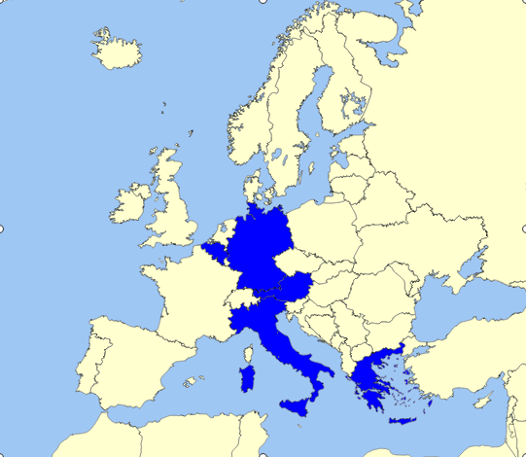
Aplikace pro tvorbu map: Phil Archer

Slide 8
Posudek 2/94
 |  | Přípustnost žádosti
 |  | ANO | NE
Právní základ pro přistoupení | ANO | EK, EP, Belgie, Německo, Itálie, Řecko, Rakousko | Dánsko, Finsko, Švédsko
 | NE | Francie, Portugalsko, Španělsko | UK, Irsko

Slide 9
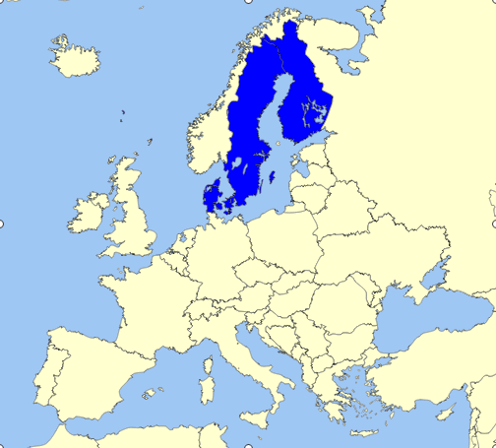

Slide 10
Posudek 2/94
 |  | Přípustnost žádosti
 |  | ANO | NE
Právní základ pro přistoupení | ANO | EK, EP, Belgie, Německo, Itálie, Řecko, Rakousko | Dánsko, Finsko, Švédsko
 | NE | Francie, Portugalsko, Španělsko | UK, Irsko

Slide 11
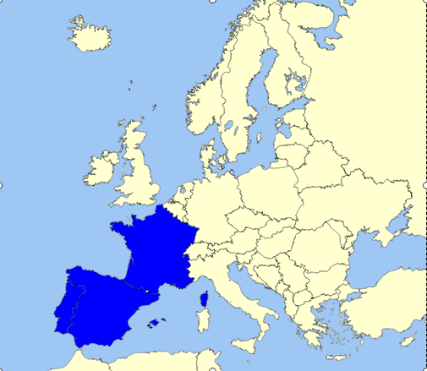

Slide 12
Posudek 2/94
 |  | Přípustnost žádosti
 |  | ANO | NE
Právní základ pro přistoupení | ANO | EK, EP, Belgie, Německo, Itálie, Řecko, Rakousko | Dánsko, Finsko, Švédsko
 | NE | Francie, Portugalsko, Španělsko | UK, Irsko

Slide 13
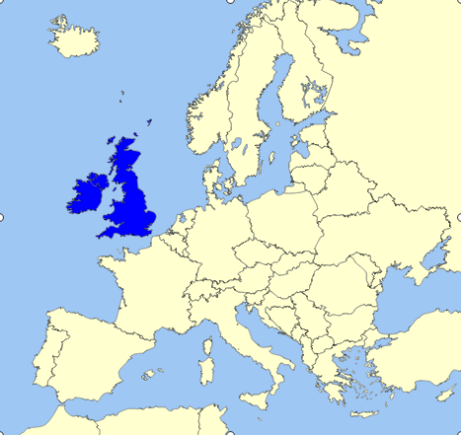

Slide 14
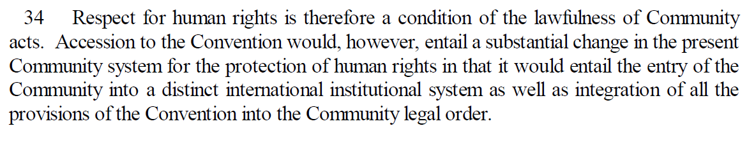
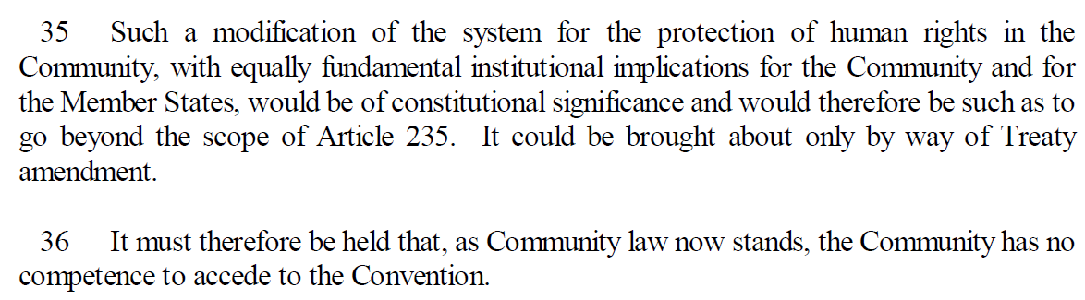
Opinion 2/94

Slide 15
SDEU a ESLP
Komise v soutěžní politice
Connolly
ESLP: Matthews, Bosphorus
ESLP, SDEU: N.S. a MSS – Dublin II

Slide 16
MATTHEWS v. THE UNITED KINGDOM (Application no. 24833/94)
32. The Court observes that acts of the EC as such cannot be challenged before the Court because the EC is not a Contracting Party. The Convention does not exclude the transfer of competences to international organisations provided that Convention rights continue to be “secured”. Member States’ responsibility therefore continues even after such a transfer.
33. In the present case, the alleged violation of the Convention flows from an annex to the 1976 Act, entered into by the United Kingdom, together with the extension to the European Parliament’s competences brought about by the Maastricht Treaty. The Council Decision and the 1976 Act (see paragraph 18 above), and the Maastricht Treaty, with its changes to the EEC Treaty, all constituted international instruments which were freely entered into by the United Kingdom. Indeed, the 1976 Act cannot be challenged before the European Court of Justice for the very reason that it is not a “normal” act of the Community, but is a treaty within the Community legal order. The Maastricht Treaty, too, is not an act of the Community, but a treaty by which a revision of the EEC Treaty was brought about. The United Kingdom, together with all the other parties to the Maastricht Treaty, is responsible ratione materiae under Article 1 of the Convention and, in particular, under Article 3 of Protocol No. 1, for the consequences of that Treaty.

Slide 17
MATTHEWS v. THE UNITED KINGDOM
34. In determining to what extent the United Kingdom is responsible for “securing” the rights in Article 3 of Protocol No. 1 in respect of elections to the European Parliament in Gibraltar, the Court recalls that the Convention is intended to guarantee rights that are not theoretical or illusory, but practical and effective (see, for example, the above-mentioned United Communist Party of Turkey and Others judgment, pp. 18-19, § 33). It is uncontested that legislation emanating from the legislative process of the European Community affects the population of Gibraltar in the same way as legislation which enters the domestic legal order exclusively via the House of Assembly. To this extent, there is no difference between European and domestic legislation, and no reason why the United Kingdom should not be required to “secure” the rights in Article 3 of Protocol No. 1 in respect of European legislation, in the same way as those rights are required to be “secured” in respect of purely domestic legislation. In particular, the suggestion that the United Kingdom may not have effective control over the state of affairs complained of cannot affect the position, as the United Kingdom’s responsibility derives from its having entered into treaty commitments subsequent to the applicability of Article 3 of Protocol No. 1 to Gibraltar, namely the Maastricht Treaty taken together with its obligations under the Council Decision and the 1976 Act. Further, the Court notes that on acceding to the EC Treaty, the United Kingdom chose, by virtue of Article 227(4) of the Treaty, to have substantial areas of EC legislation applied to Gibraltar (see paragraphs 11 to 14 above).
35. It follows that the United Kingdom is responsible under Article 1 of the Convention for securing the rights guaranteed by Article 3 of Protocol No. 1 in Gibraltar regardless of whether the elections were purely domestic or European.

Slide 18
Posudek 2/13

Slide 19
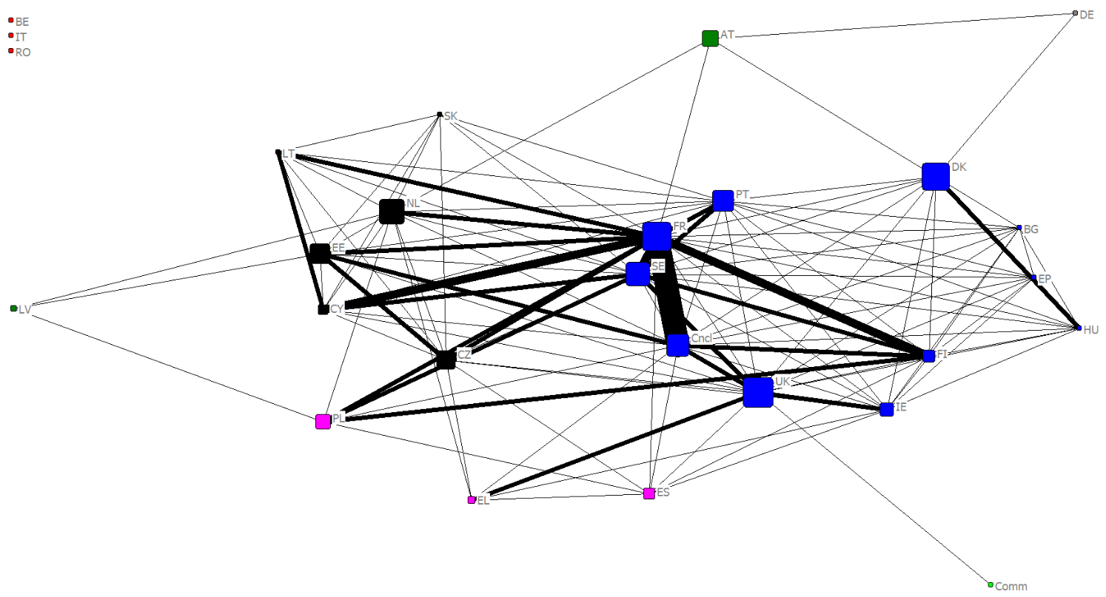

Slide 20
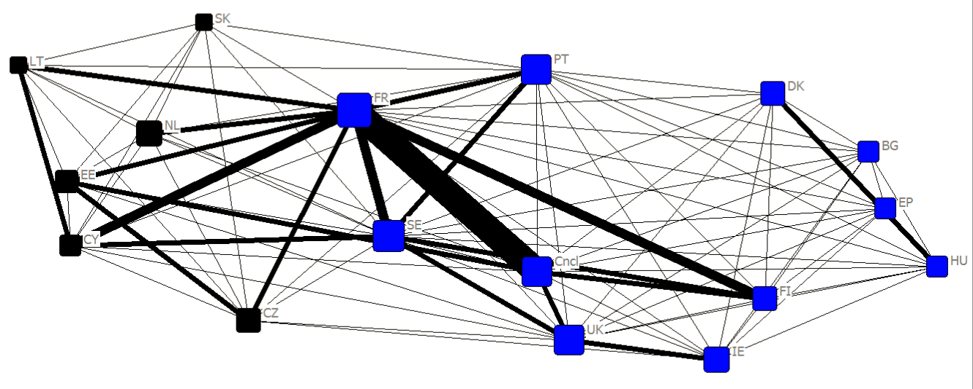

Slide 21
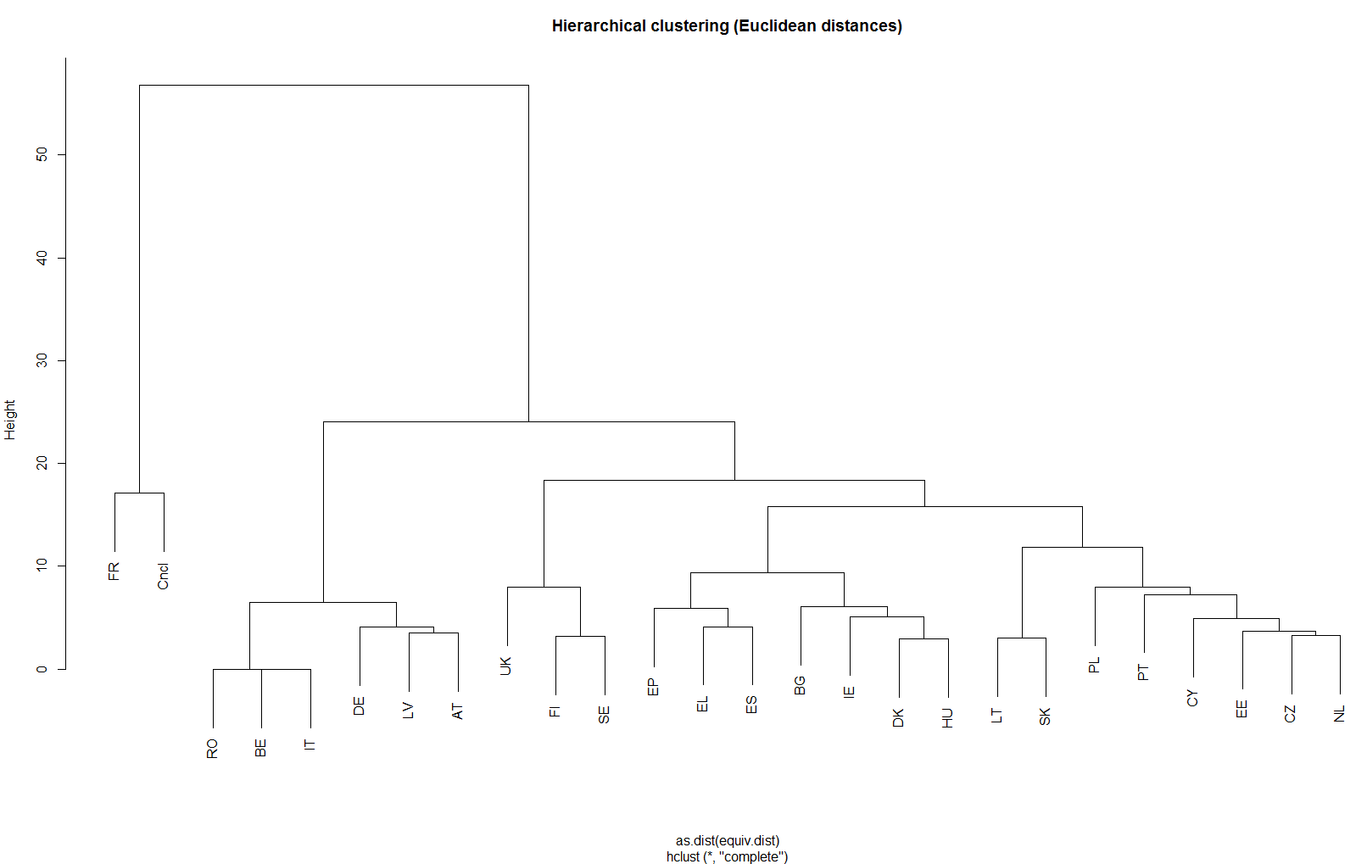

Slide 22
Co dál?
Nemilé překvapení
  24 států pro
  AG pro (s výhradami)
  Kritika komentátorů
  Rozladění prezidenta ESLP
Rada Evropy – Ruská federace?
  EU by neměla mít specifické postavení

