Slide 1
Mandate responsiveness
Lecture 4

Slide 2
Today
Theory of mandate responsiveness
Techniques for studying mandate responsiveness
Results

Slide 3
1. Theory of mandate responsiveness

Slide 4
What is mandate responsiveness?
Citizens control politicians by choosing among different programs offered by parties which those parties then fulfill in office
Selection of types or programs
  Selection of types: more honest, competent
  Selection of programs
Programmatic links: parties connect to voters through their proposals of public policies that will apply to all (collective goods)
  Eg, raising taxes, environmental regulations

Slide 5
Elements of mandate responsiveness
Programm-aticness
Parties present clear and distinct programs
Issue/spatial voting
Voters understand campaigns and choose based on them
Promise Fulfillment
Governing parties follow through on their promises

Slide 6
Where can it fail?
Parties may not propose clear and distinctive programs
Voters may not be aware of these programs or cast votes based on them
Parties may not fulfill their programs while in office
  Pursue own corrupt/personal interests
  Institutions make it difficult
  Situation changes
  Parties make bad promises
Other modes of linkage

Slide 7
Why do parties fulfill programs?
Policies are important to parties
Party activists/contributors want them to fulfill program
  Parties that ignore program lose contributions, activists
Afraid of being punished for not fulfilling promises
  Parties that break promises lose votes

Slide 8
How else can parties link to citizens if not through their programs?
Charisma: sympathize with personality of candidates
  Is it a bad thing? Everyone wants strong, inspirational leader
Clientelism: particularistic benefits in exchange for votes – vote buying
  But how do you do it with secret ballot?
Partisan hearts and minds: socialized through family to associate with party
Competence/valence: politicians have skill and honesty to do a good job

Slide 9
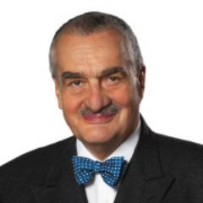
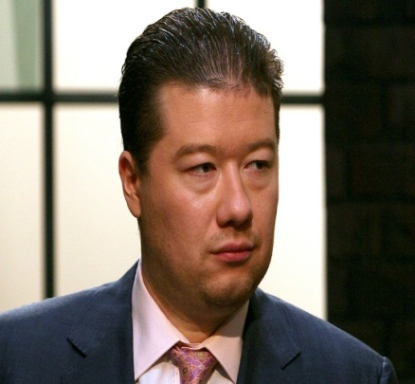
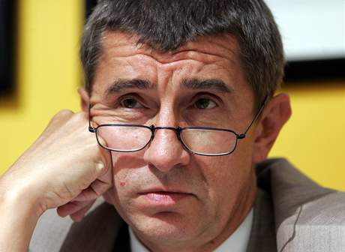

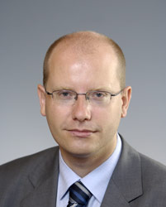
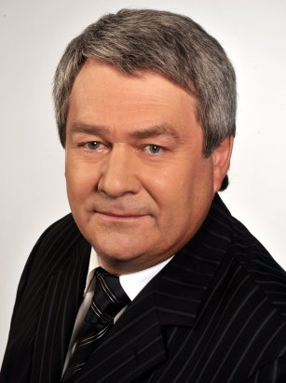
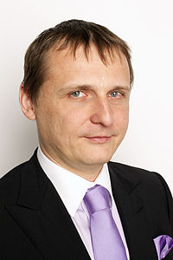
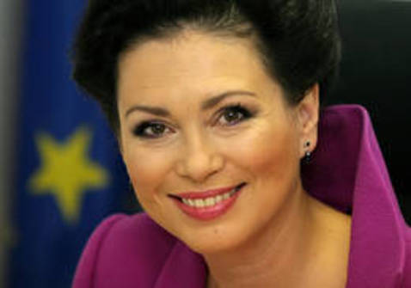
Which of these are charismatic?

Slide 10
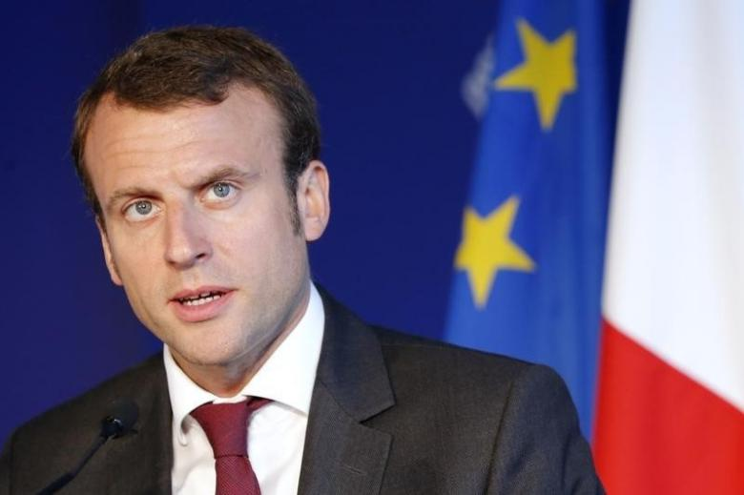
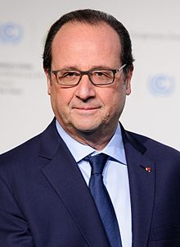
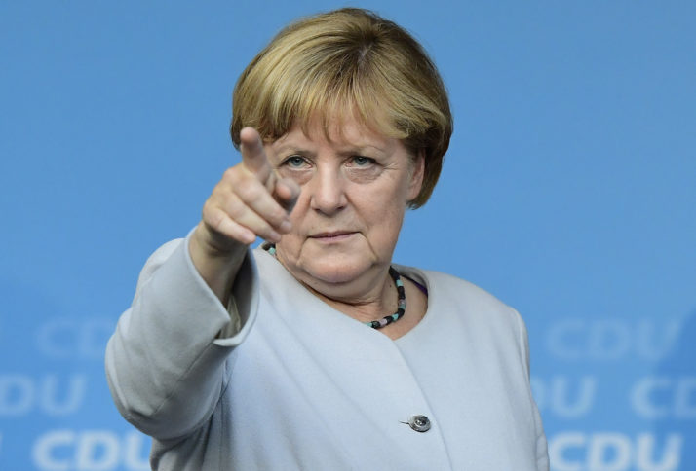
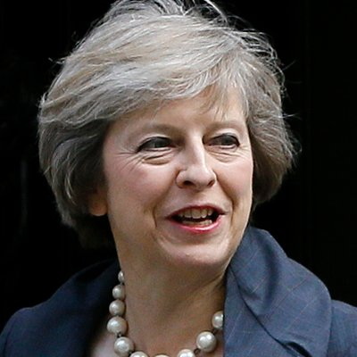
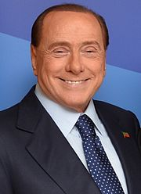
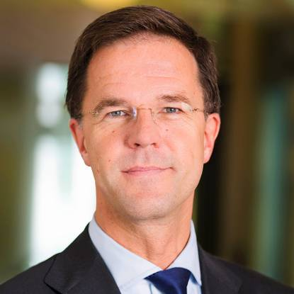
Or these

Slide 11
Proof that charisma is key?
Students asked to rate competence of faces of real candidates (Todorov et al. 2005)
Candidate whose face was viewed as more competent won 70% of the time
What are the potential problems here?
Selection effects
  Parties choose more competent-looking candidates where they expect to win
  More competent-looking reflects other factors like incumbency, ability to raise money

Slide 12
Case for mandate responsiveness
Closest to standard civic ideal
Citizens can directly set policy
Forward-looking
Functions even in between elections
Control can be nuanced – individual policy areas
Governments have mandate/justification for actions

Slide 13
Case against mandate responsiveness
Requires voters to be fairly well informed
Parties can only present a limited set of options
How to enforce? Need to punish parties for broken promises
Coalitions and veto points can prevent fulfillment
What if conditions change?
Limits leadership

Slide 14
“The Myth of the Mandate” – Robert Dahl
If a party wins the election, do they have a mandate to implement their program?
Parties often claim that they have a mandate from voters
But:
  How do we know what voters actually want?
  What exactly are they voting for?
  Do they really want party to do everything in their program?
Can public opinion tell us the answer?

Slide 15
When does mandate responsiveness produce best policies?
Some party platforms include the best policies
Citizens are aware of platforms and choose those which will have the best consequences
Conditions do not change substantially in between elections

Slide 16
2. Techniques for studying mandate responsiveness

Slide 17
Key issues
Some measure of programs that parties are proposing
  Clarity, distinctiveness, substance
Determine whether they actual fulfill these programs
Are voters voting based on these programs_

Slide 18
How to measure programs?
Assumptions
  Parties have positions
  Parties are unitary – they have a single position
    But can also try to measure divisions
  These positions matter for policy, coalition
Techniques
  Surveys – public opinion, expert
  Political texts – manifestoes
  Promises
  Roll call votes

Slide 19
Surveys
Public opinion survey
  Ask voters where parties are located on 7 point scale (left/right, pro-EU/anti-EU, high taxes-spending/low taxes-spending)
  Or ask them them about their own beliefs and which party they support
  Grandmother test: what would your grandmother say?
Expert survey (eg, political scientists)
  Experts knowledgable and unbiased
  Takes into account lots of information: programs, voting

Slide 20
Political texts
Comparative Manifesto Project
  56 (or more categories)
  Every sentence placed into 1 or more categories
  % of sentences determines party’s position
Problems
  Good for historical research
  Do manifestoes matter?
  Does # of sentences = priority?
  Not a standardized document
  Hard to get left-right measure

Slide 21
Categories for coding
Anti-imperialism
Military – positive
Military – negative
Peace
Internationalism – positive
Internationalism – negative
EU – positive
EU – negative
Democracy
Constitutionalism – positive
Constitutionalism – negative
Federalism
…

Slide 22
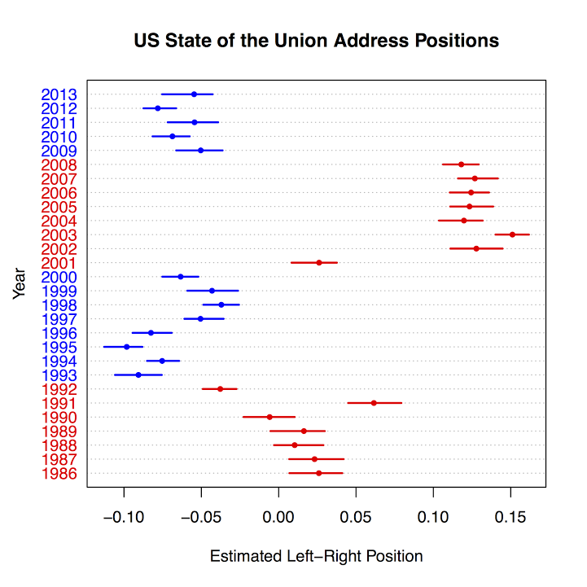
Political texts 2
Automated coding of relative word frequencies
One US study finds 2 dimensions
  Left-right: welfare, peace versus market, war
  Style: folksy, simple words versus elevated rhetoric
Maybe do this with New Year’s speeches in CZ?

Slide 23
Most common words of Democrats and Republicans in US Congress
Rosa Parks
Wildlife refuge
Republican Party
War in Iraq
Middle class
Trade deficit
Poor people
Stem cell
Death tax
War on terror
Tax relief
Illegal immigration
Saddam Hussein
Increase taxes

Slide 24
Election promises
Do parties fulfill their election promises?
Find concrete promises in manifesto
  Hardness: “We will” or “We promise” versus “We support” or “We are for”
  Specificity: Definite outcome (raise minimum wage) versus General principle (help the poor)
  Policy (lower taxes) versus Outcomes (increase economic growth)

Slide 25
Roll call analysis
How similar are voting records of different MPs and party groups
  Real and consequential actions
  But also strategic: quid pro quo
Usually low number of dimensions
  Simple left-right divisions
  Each vote is yea/nay and high discipline

Slide 26
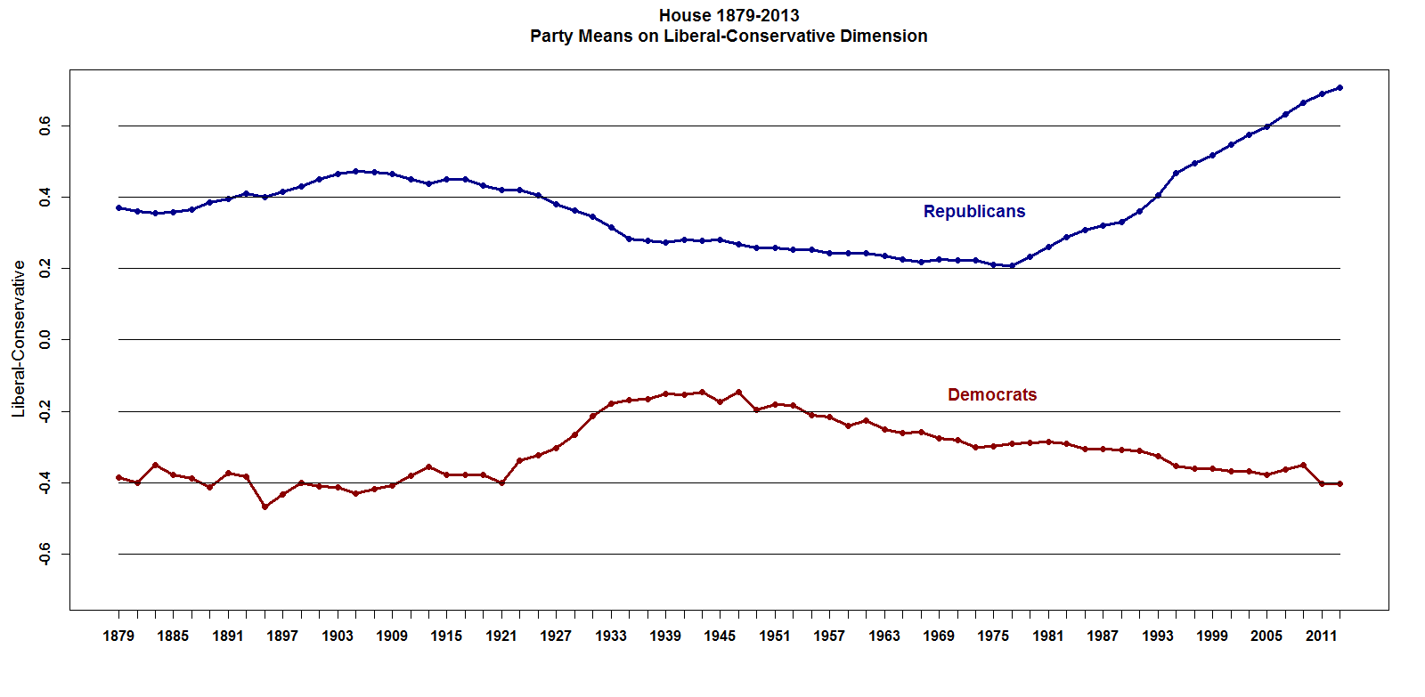
Roll call history of the US

Slide 27
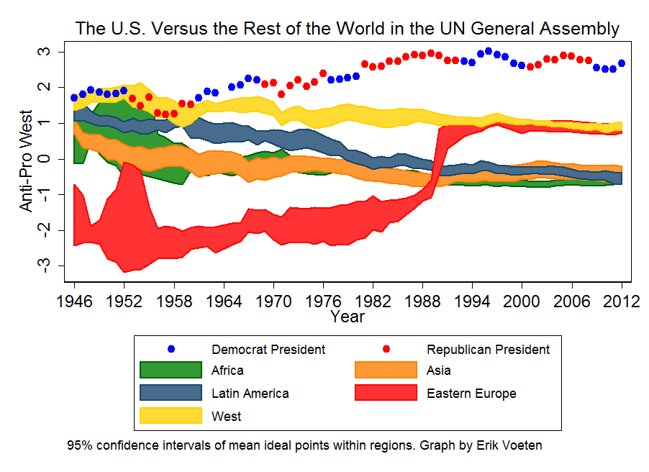
Roll call history of the UN

Slide 28
3. Results

Slide 29
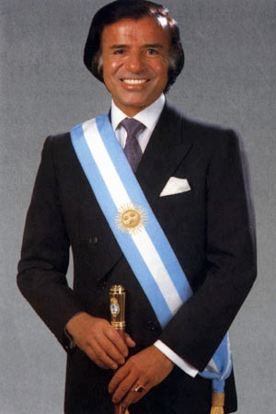
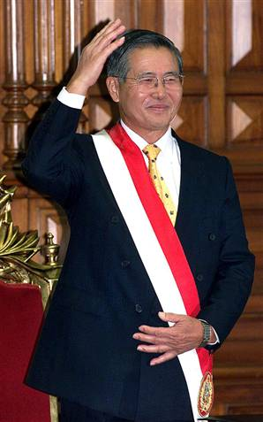
Policy Switches in Latin America
Carlos Menem (Argentina) and Alberto Fujimori (Peru) campaign against neo-liberal reforms
Immediately after elections they introduce massive neo-liberal reforms – privatization, spending cuts, deregulation, etc.
Common in Latin America: 12 of 44 presidents do the same
  Always in same direction: anti-reform campaign => reform policy
Is it a failure of democracy?

Slide 30
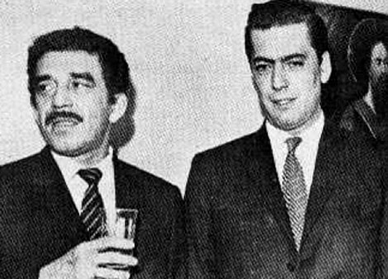
How to explain these switches?
Politicians can’t win with neo-liberal program (cf., Vargas Llosa)
But know that anti-reform policies will lead to economic disaster
Therefore lie in campaign and then switch when in office
Evidence
  Switch immediately after elections
  Presidents are punished for switching
  But reform leads to more growth
  Presidents also rewarded for growth
Prospective mandates fail, but retrospective accountability works

Slide 31
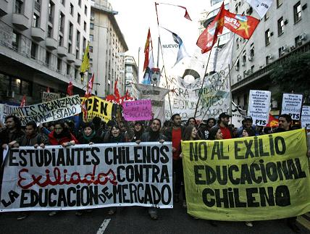
What is the problem?
Politicians do try to “represent”
  Representation = do what is best for society
  Responsiveness = do what people want
Voters oppose neo-liberal reform, uninformed about necessity
  Are they stupid?
  Should politicians teach them?

Slide 32
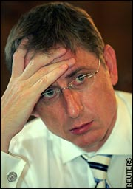
Switches in post-communist Europe
Fewer clear cases of switches
  Hungarian Socialists in 1994 & Polish SLD in 1993?
  Gyurcsany 2006: “I had to pretend for 18 months that we were governing. Instead we lied morning, noon, and night”
  Any changes in opposite direction: reformist programs => anti-reformist policy?
What about Czech governments?
  Klaus 1992: Reformist program =>
  Zeman 1998: Anti-reformist program =>
  CSSD 2002:
  ODS 2006: Reformist program =>
  ODS 2010:
  CSSD 2013:

Slide 33
What is different in postcommunist Europe?
Citizens accept necessity of neo-liberal reform
  Parties can win with reformist program and then carry out reform
Why?
  Failure of communism
  Transition associated with national freedom (in Latin America, reform associated with dictatorship)
  European Union as prize

Slide 34
More general tests of mandate conception
Typical design: regression analysis of cross-national time-series data
  Partisanship and macroeconomics (growth, inflation, unemployment)
  Manifesto data (emphasis on policy area) and government spending on that area
Results:
  Left-wing governments do seem to devote more attention to poor
  Governments that emphasize a particular policy area do spend more
But
  Many other influences on economy besides government
  Government has to respond to previous government

Slide 35
Election promises in advanced democracies
High levels of promise fulfillment
  Typically over 50% for governing parties
  Often 70-80%
  One review of 21 studies finds average of 67%
  Is this a surprise?
Higher for parties with control over government
Strong economy helps
Status quo promise easier to fulfill than promise of change

Slide 36
Czech anecdotes
Klaus in 1996: Average incomes will reach 20,000 Kcs by 2000
Zeman in 2002: Promises infrastructure projects at each campaign stop equal to 1/5 of budget
  Sobotka in 2002: “The promises were not put in a realistic economic framework… We’d be fools to insist on what isn’t economically feasible and push the country into a bigger deficit just to fulfill our promises”
  Skromach in 2002: “We got 30% of the vote in the last elections and we certainly fulfilled that much of our program.”
CSSD in 2006
  Changes webpage from 2002 to eliminate promises
  Tries to pass legislation at end of term to improve fulfillment

Slide 37

Skromach again
Taková malá dovolená bez mobilu, s kafíčkem, nafukovacím bazénkem a pár dobrými lidmi. Trochu mě zarazila debata v rádiu, že je snad nějaké divné nosit v sandálech ponožky, Prý snad nějaká národní podivnost. No nevím, ale bez ponožek si sandále neumím představit. A co Vy? Hezký večer.

Slide 38
Promise fulfillment in the Czech Republic
(preliminary results)
 | 1992 | 1998 | 2002
ODS | 65% (26) | 24% (74) | 44% (32)
CSSD | 14% (7) | 35% (107) | 58% (40)
KSCM | 50% (6) | 12% (115) | 27% (97)
KDU/CSL | 41% (63) | 32% (119)
ODA | 45% (40)
US |  | 36% (135)
Koalice (KDU + US) |  |  | 25% (113)
Total (all parties) | 46% (142) | 28% (551) | 32% (282)

Slide 39
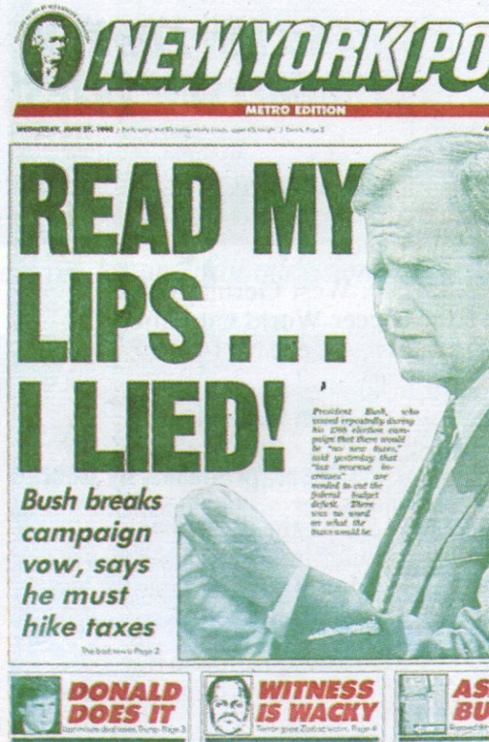
What sort of promises should parties make?
George H.W. Bush in 1988: “Read my lips: No new taxes”
  Later he raises taxes and loses in 1992 to Bill Clinton
What should he have done?
What was the problem? A bad promise or bad fulfillment?
What should politicians promise?
  Specific policies or outcomes?
  Avoid populism? Avoid vagueness?
What should they do when conditions change?
  Need to explain why they are changing?
  In Latin America, they blame former government for misinformation

Slide 40
What do voters think of promises?
Widespread belief that politicians never fulfill their promises
  Even in Sweden 2/3 of citizens think that parties usually break their promises
Are you surprised that governing parties usually fulfill promises?
Why do voters not trust promises?
  Psychological biases: we remember promises that were broken?
  We don’t trust politicians?

Slide 41
Summing up

Slide 42
Tradeoffs
Can we have everything?
How should voters vote?
  Sanction governments for past behavior (economic accountability)
  Choose best options for future (mandate responsiveness)?
How should politicians behave?
  Listen to public (policy responsiveness)
  Follow through on promises and manifesto (mandate)?
  Try to produce the best outcomes (substantive representation)

Slide 43
But maybe some complementarities
Voters can punish politicians for not fulfilling promises or not listening to public
  Electoral accountability helps mandates and responsiveness
If promises reasonable and public opinion stable, then mandates and policy responsiveness go together

Slide 44
Do we want the people to rule?
Citizens uninformed or misinformed
  Later: think about the quality of citizens
But politicians greedy and self-interested
If not the people, then who?
  Technocrats – Economists? Judges? Bureaucrats?
Who do you fear more: state or market?

