Slide 1
Seminar, March 20, 2018
POL612 Women and Politics

Slide 2
The aim of the seminar
The concept of women‘s interests
https://www.nytimes.com/2018/03/19/us/native-american-woman-congress.html?smid=fb-nytimes&smtyp=cur
WHAT IS A WOMEN‘S INTEREST? WHY? Discuss
How can we identify women‘s interest? Suggest methodology.
Why are we talking about this?

Slide 3
Beckwith, K. 2011. Interests, Issues, and Preferences: Women‘s interests and epiphenomena of activism
What is the key argument?
How can we identify the interest?
What do we measure it?

Slide 4
Beckwith, K. 2011. Interests, Issues, and Preferences: Women‘s interests and epiphenomena of activism
Interests: fundamental to women‘s life chances and options for action
Issues: strategic choices, components of interests as points of mobilization
Preferences: choice of alternative (discrete and limited)
Interests not as past of essentialist understanding of women but rather as recognition of constant contexts of women‘s life circumstances and effort to promote women‘s opportunities for advancing their capabilities, improving their life chances.
Meta-interest: across all groups of women, at all periods of time, in all countries and contexts = access to political power
Interests articulated in process of political deliberation, but women not present in institutions
Research of self-organized interest groups and social movements to identify their interests and issues)
There might be differences within a movement: different preferences on an issue

Slide 5
WELDON, L. 2011. Perspectives against interest: Sketch of a feminist political theory of women
What is the key argument?
How can we identify the interest?
What do we measure it?

Slide 6
WELDON, L. 2011. Perspectives against interest: Sketch of a feminist political theory of women
Shared interest = unnecessary concept
Because all conceptualization say that those interests are subjective and context specific, which means that they are basically useless
Interest understood as self-interest
As maximizing one owns utility
But women DO NOT share identity, nor experience, nor interest
It leads to further marginalization of unprivileged women
She prefers „women‘s perspective“ – not based on shared identity but on belonging to the same collectivity (defined by external factors such as oppression or misrepresentation)
Women who fought against violence on women = do not necessarily shared the experience. Their perspective is driven by the wish of solidarity and justice for all women
Women's organization and deliberation can create shared perspective, opening up possibilities for building solidarity and identifying shared priorities.
Overlaps with Beckwith = looking at the level of social movements and actors of civil society
Does not accept strategic framing (Reigold and Swers)

Slide 7
Reingold and Swers.2011. An ENDOGENOUS APPROACH TO WOMEN‘S Interests: when interests are interesting in and of themselves
What is the key argument?
How can we identify the interest?
What do we measure it?

Slide 8
Reingold and Swers.2011. An ENDOGENOUS APPROACH TO WOMEN‘S Interests: when interests are interesting in and of themselves
They avoid a prior top-down definition
How to define it and how to measure it?
In the deliberative processes in political institutions
How women MPs define women‘s interests in their work
How it operates among different groups of legislators
Low-income minority district vs. white upper-middle-class district
Who do they have in mind? (voters, co-partisans, party leadership etc.)
Defining women‘s interest is a political matter

Slide 9
Campbell and Childs. 2015. to the left, to the right: representing conservative women‘s interests
What is the key problem?
What is the argument?
How do they proceed?
What is the conclusion?

Slide 10
Campbell and Childs. 2015. to the left, to the right: representing conservative women‘s interests
Gender-gap in attitudes and party vote
Women tend to vote more to the left
But not universally
UK not the case
But- within party voters – evident gender gap
Conservative members and voters – gender difference in economic issues
Women to the left
Women in the UK suffering from the politics of Conservatives (cuts in public benefits, cuts in public services, cuts in public services jobs (65% of them are female ). D: Cameron – tries to attract female voters.

Slide 11
Constituting women's interests
Promoting women's interest is the main argument of people pursuing political rights of women
It is the matter of democracy (right?)
But debates about the core of substantive representation

Slide 12
Constituting women's interests
Celis, Childs, Kantola, Krook 2014
Research emphasizes political representation
Doesn‘t reflex aesthetic and cultural aspects of representation in broad sense
Speaking for somebody, but also speaking about somebody!!
Related to construction of group goals and interests also related to WHO the people are
Politicians portrayers of the represented: Representative Claim (Saward 2016): „ongoing process of making and receiving, accepting, and rejecting claims – in between, and outside electoral cycles“

Slide 13
Constituting women's interests
Call for including deliberation into the concept of interest
Traditional approach: gendered division of labor
Reproductive and productive labor
Later scholars left this approach (reduction to biology – or market)
Emphasis on their experience
1) Traditional role in patriarchal society
2) Participation in the labor market
3) Possibilities and opportunities to transform their social role (in terms of more gender equality)

Slide 14
Constituting women's interests
The Representative Claim
1) Both elected an non-elected actors make them
2) Actors don’t promote preexisting interests but they create them by framing and depicting women and their characteristics
3) Actors are restricted by their context (structure of opportunities)

Slide 15
Who makes representative claims?
1) those who participate in official decision making
2) Those who participate in civil society mobilization
Acknowledgement of the role of men (and their position in the process)
Representative claims when
1) directly constructed as important to women
2) only affecting women
3) discussed in terms of gender difference
4) spoken of in terms of gendered effects
5) framed in terms of equality between women and men (Celis, Childs, Kantola, Krook 2014))

Slide 16
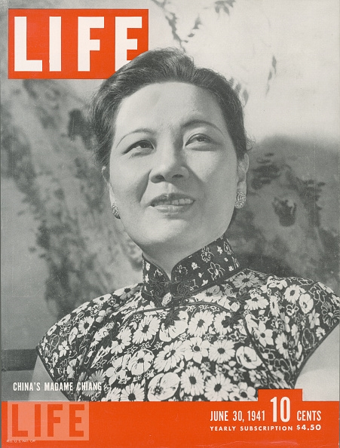
Women and political leadership
Executive powers and leadership
1960-2017 a total of 54 women in the highest executive offices
The first woman: Sirimavo Bandaranaike, 1960
But which is the supreme executive office??

Slide 17
Gro halem Brundtland

Slide 18
Edith Cresson

Slide 19
SiriMaVo Bandaranike
Change of powers in time
1960-65
1970-77
Change of constitution in 1978

Slide 20
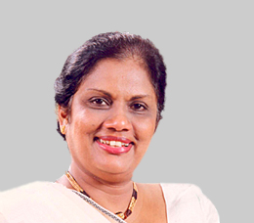
Chandrika Kumaratunga
President 1994-2005
Appointed her mother PM

Slide 21
What country was the first to have women in all constitutional offices?

Slide 22
New Zealand (march 2005-august 2006)

Slide 23
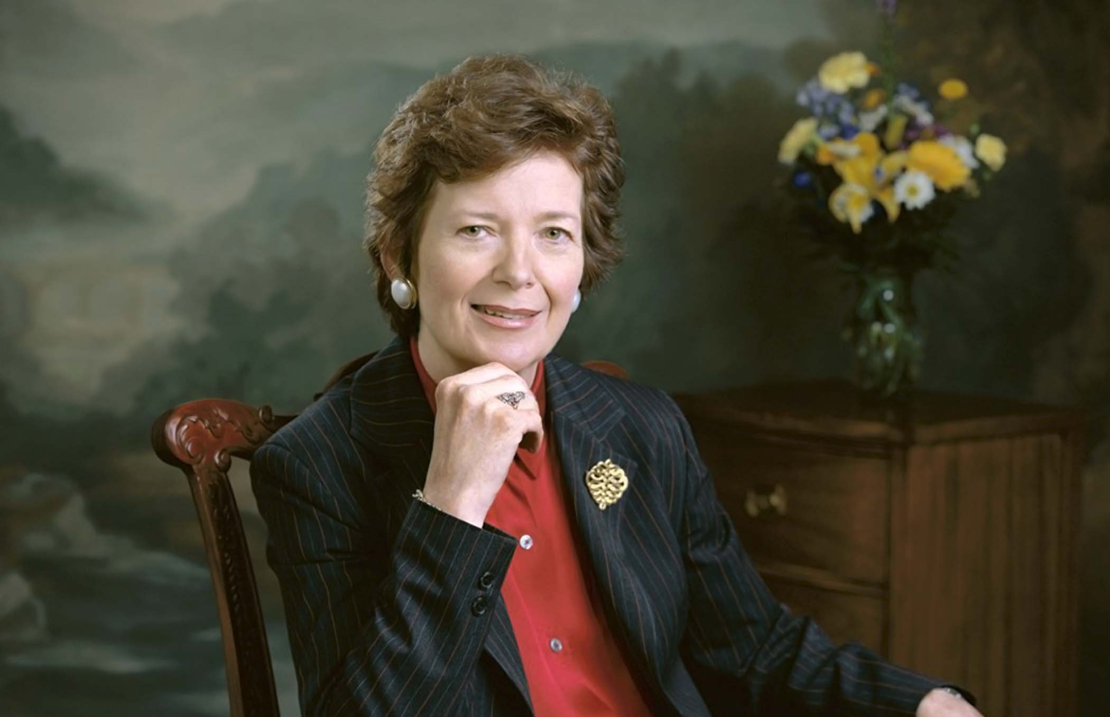
Ireland
President Robinson (1990-97)
President McAleese (1997-2011)

Slide 24
History of women in powerful offices
Usually wives or daughters of politicians
42 % women in offices before 1995
“Widow‘s walk to power“
Especially in countries with traditional view of women
Helping men, controllable
Keeping husband‘s (father‘s) legacy
Indira Ghandi, Benazir Bhutto
Violeta Chamorro (president of Nicaragua 1990-1997): „I‘m doing this for Pedro and the Country“
Ásif Alí Zardárí (president 2008-2013)

Slide 25
History of women in powerful offices
Mostly countries of the Global South
The first woman in power in the Global North was …?

Slide 26
Margaret Thatcher

Slide 27
Women In power
Through political parties
To be a leader of the state requires people to be leaders of a party first
O‘Brien 2015: 1965-2013 in 11 countries, across 71 parties, only 14 female leaders
(AUS, AUT, CAN, DEN, FIN, GER, IR, JAP, NZ, SWE, UK)
Female leaders more likely in small parties, parties losing votes
Female leaders tend to leave when party is losing votes (compared to men)

Slide 28
Glass cliff
More opportunities in times of crisis
When parties lose electorate
Women asked to lead organizations facing difficulties
Examples?

Slide 29
Miroslava Němcová

Slide 31
Glass cliff
Jalalzai 2013, how women come to power:
19% after transition to another pol. system
45 % in times of significant political instability
33% after a coup d‘etát

Slide 32
Difficulties
Gender stereotypes and leadership
Traditional roles
Women assumed to be less competent
Maria Liberia-Peters (PM of the Dutch Antilles): “And you had to put al into it, and everybody expected you to put everything into it, because nobody questions the preparedness of a man over a female (.. ) so you have to put 100 percent, 200 percent in your work.”
More often PMs then Presidents (power sharing)
Presidents usually not elected in popular election
Exceptions exist, though: Michelle Bachelet of Chile, Ellen Johnson Sirelaf of Liberia etc.
1960-2011 60 % national leaders shared powers

Slide 33
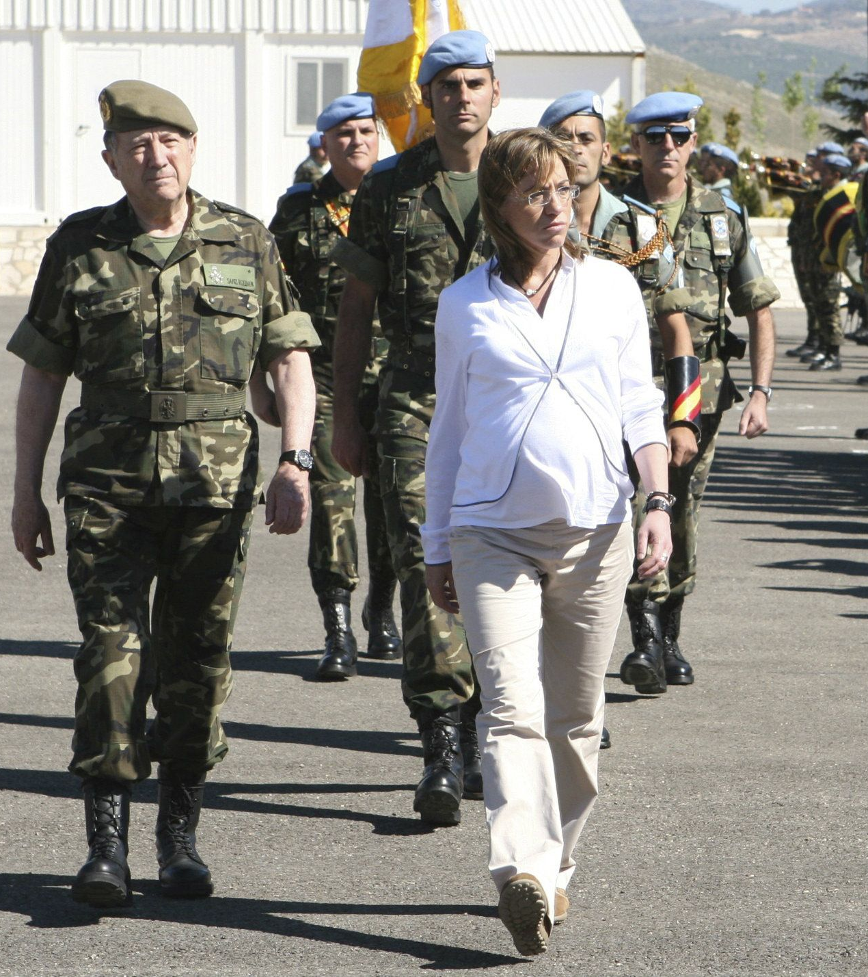
Difficulties
Role of a woman
Being nice or “man murdering power woman”?
Family and motherhood
Marriage difficulties
Benazir Bhutto had to get married
To have children or not to have children?

Slide 35
Thank you!
Email questions to hrbkova@mail.muni.cz

