Slide 1
The history of struggle for women‘s suffrage
POL612, 27 February, 2018

Slide 2
How does suffrage relate to democracy?
What does democracy mean?
Democracy in Athens:
  Exclusion foreigners, slaves, workers.
  How about women?
  Why?
It was not necessary to mention women AT ALL. Until the 19th century.
First electoral norm to mention gender: the Reform Act 1832 (male citizens)
Is there a difference in exclusion based on money, taxes, age and based vs. gender or race?

Slide 3
Women’s status
Dependence on men
Economically, legally
Lack of autonomy
Early feminists demanded:
  Education
  Change of legal status of married women
  Better working conditions
  How about suffrage?
  The first exception: Seneca Falls Convention in 1848: Declaration of Sentiments and Resolutions

Slide 4
Who should be included?
Women’s question was/is a political issue
To make changes there needs to be a coalition of interests
But whose interests?
Intersectionality of gender issues
Cleavages across classes, religion, race
The 14th and 15th Amendments to the US constitution
Europe: Should we demand suffrage on equal terms with men??
  Emmeline Pankhurst and Women’s Social and Political Union in the UK vs. Carla Zetkin and Damenwahlrecht in Germany

Slide 5
Opponents' ARGUMENTS (Dahlerup 2018)
1) God and Nature: distinction between private and public spheres
2) Damaging effects: to family, to the system
3) Incompetence of women:
J. J. Rousseau: female reproductive functions made women incapable of rational thinking and, therefore women inherently could not exercise political rights
Do we still hear the same arguments today? (What about the quota discussion?)

Slide 6
Suffragists' Arguments
1) The Rights Argument: “We hold these truths to be self-evident: that all men and women are created equal, that they are endowed by their Creator with certain inalienable rights, that among these are life, liberty, and the pursue of happiness.“ Seneca Falls Declaration of Sentiments and Resolutions, 1848
2) Different Experience: suffrage as a means of change of policy; purifying force
3) Conflict: the difference leads to conflicts in interests (such as biased marriage laws)

Slide 7
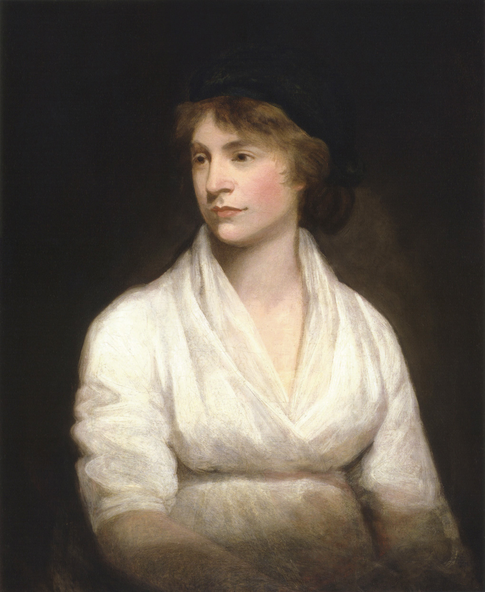
Mary wallstonecraft: The vindication of the women’s rights
1792, a powerful critique of Rousseau’s ideas
Arguments about liberty and equality
Demanded inclusion of women into the concept of citizenship
Education for girls
Women in medicine and politics
Equality in various areas, such as morality

Slide 8
Todays arguments:
Equality, difference, and conflict still prevail
4) The Democracy Argument: Beijing Platform for Action , the 4th UN World Conference on Women 1995: not only women will benefit. Gender parity is essential for democracy. Success!
5) The Utility Argument: neoliberal approach, conflicts the justice argument (in a way)

Slide 9
THREE WAVES OF WOMENS’ SUFFRAGE
1st wave:: the 1890s and 1910s, including the period after the first world war.
2nd wave: Around the second world war
3rd wave: decolonization processes in 1960s

Slide 10
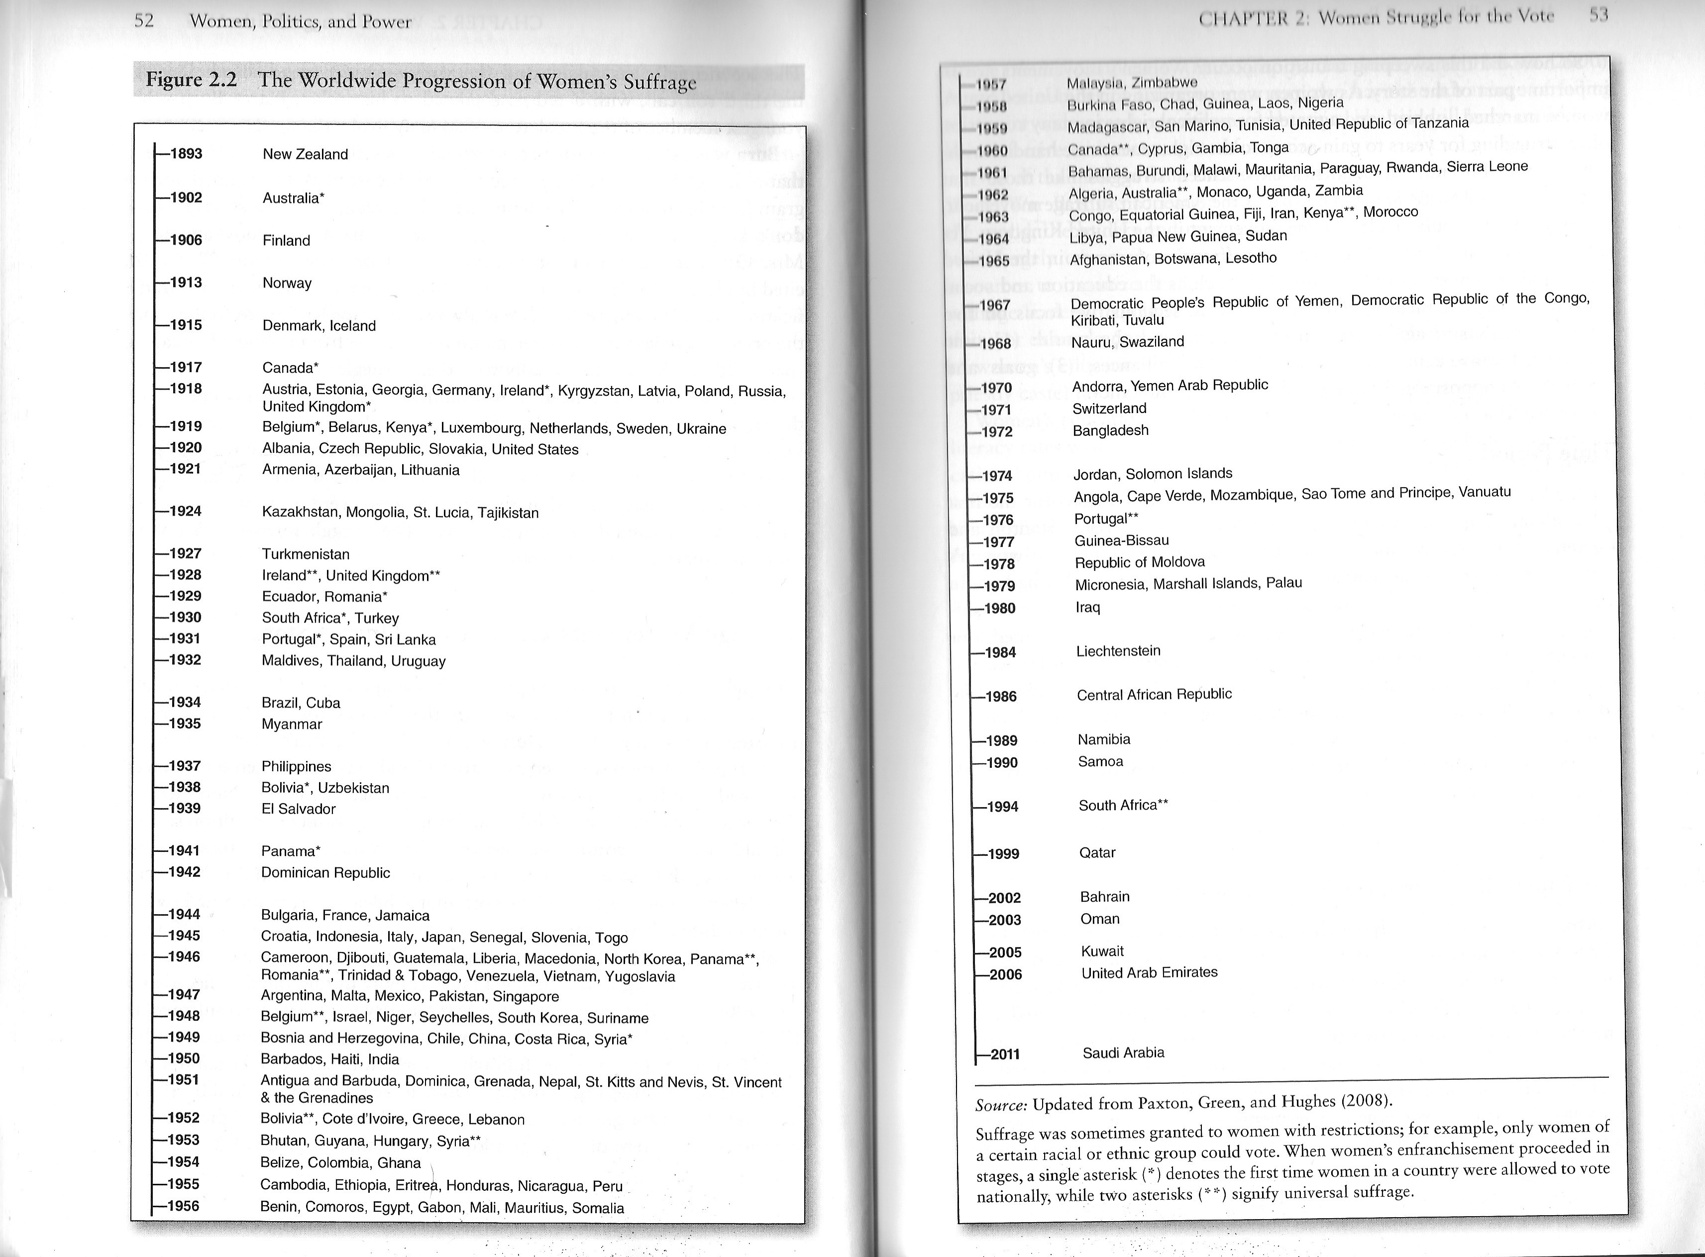

Slide 11
Defining democracy
Can we speak of democratic order when women and minorities are exclude from the right to vote?
Criteria of democracy
In principle
Paxton 2008: discrepancies between definition of democracy by various scholars and their actual dating of when a country became democratic

Slide 12

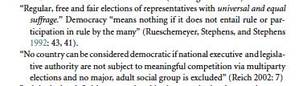
Definitions of democracy

Slide 13
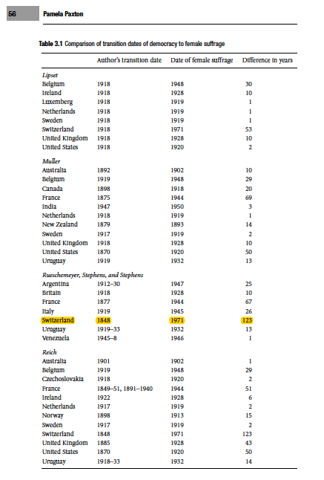

Slide 14
After the gain of political rights
The goal was met
The movement lost its unifying element
Change of agenda
Political rights not sufficient to achieve equality
New goal: changing deeply-rooted cultural prejudices and socialization patterns
Sexism encompassed in cultural prejudices and structural mechanisms, women in subordinate positions
Also other types of rights
Liberal feminists demanded equal access to male-dominated insituttions
Radical feminists demanded redefinition o the entire social order
Third-wave feminism: early 1990s, need for intercultural dialogue, global inequalities.

Slide 15
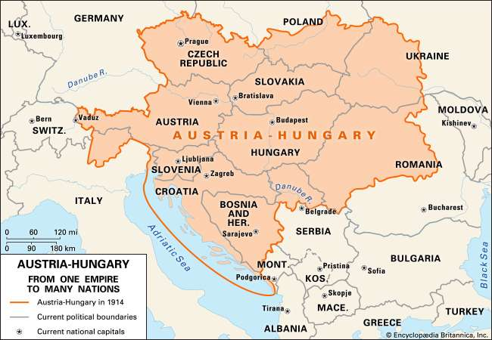
THE CZECH WOMENs’ movement
(in Austrian-Hungarian empire)

Slide 16
THE CZECH WOMENs’ movement
(in Austrian-Hungarian empire)
The general political goal of the Czech people: NATIONAL EMANCIPATION
Struggle for the Czech language, political rights and representation (neo-absolutism after 1848 to early 1860s)
Settlement of the Czech-Austrian relationship
The mainstream ideology: Liberal nationalism
Most of the women's movement within this political camp

Slide 17
Implication of nationalism for women’s emancipation?
Women’s political efforts perceived negatively, distraction form nationalist goals, disintegration of the national block (opponents’ arguments not only antifeminist but also nationalist)
It was also a strong case for women’s suffrage, it would strengthen the Czech voice in the monarchy (but not other progressive measures usually supported).

Slide 18
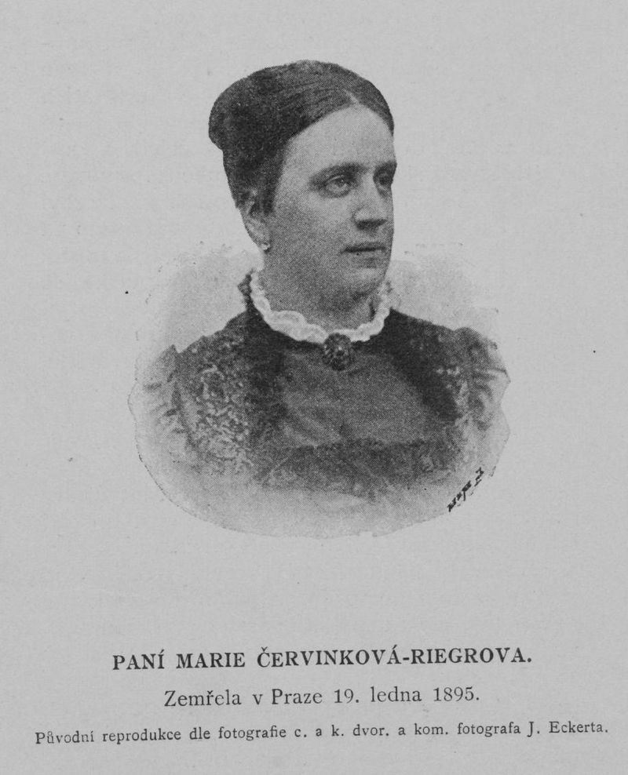
Marie červinková-riegerová
“ Man is meant to establish laws of social order …. , woman’s place is to eagerly fulfill higher laws – those of humanity, she is meant to govern the empire of mercifulness”.

Slide 19
THE CZECH WOMENs’ movement
(in Austrian-Hungarian empire)
Women excluded from political life in the monarchy by law (1867)
Not sufficient prerequisites for political participation (first grammar school in 1880, first university graduates 1901)
Women expected to be good patriots, sufficient manifestation of political maturity
Female public activities: charity work, philanthropy
Non-political clubs could be established (since 1861)
1865: The American Ladies’ Club in Prague (goal to bolster patriotism, this was ture for most women’s clubs in the 19th century)

Slide 20
Two main competing trends
1) nationalism, women’s effort to benefit the nation, ender issues subordinated to national interests.
  These women did not participate in the movement
  Charity work
  Patriotic clubs
  Renáta Tyršová (wife of Miroslav Tyrš): refused to run for the leadership of the the Women’s Suffrage Committee: “I have not been interested in politics – and I will not be. I do not understand politics and I don’t like what is being called politics these days. In my patriotic feelings I am not a progressivist, I always see the matter of the nation first – not the interest of any class or gender.”

Slide 21
Two main competing trends
2) progressive trend, represented by Teréza Nováková (editor of Women’s Papers)
  Fighting for women’s suffrage
  Activist movement (speeches, articles
  Friend of Charlotte Garriggue Masaryk
  Intellectual-feminist camp

Slide 22
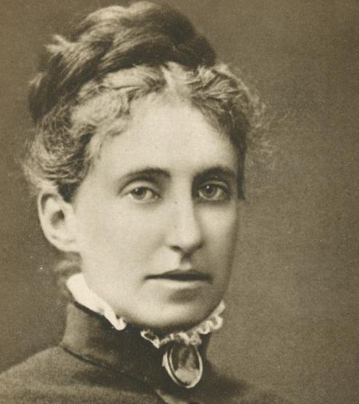
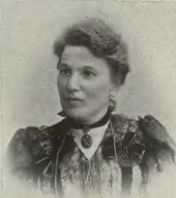

Slide 23
THE CZECH WOMENs’ movement
(in Austrian-Hungarian empire)
The progressive camp strengthened in 1890s
The struggle peaked in 1905-07
New generation of educated women, need for modernization
1st congress of Czech women in 1897
1903 establishment of the Czech Women’s Central Club (Ústřední spolek českých žen), issued paper Women’s World
1905 eshtablishment of the Committee for Women’s Sufrfage (Výbor pro volební právo žen) by teréa Nováková and Františka Plamínková, political (informal and thus not illegal) body of the Central Club
Support by influential politicians like TGM, Václav Choc, Bohuslav Franta

Slide 24
Political parties
Refused suffrage for women
One exception: The Czech Progressive Party (Tomáš Garrigue Masaryk)
National Socialist Party included women’s suffrage in the program
Fear of clericalism
Czecho-Slavic Social Democratic party did not even participate on the Women’s Suffrage Committee
Women could be members of parties (social democrats first to admit women)

Slide 25
The Czech Suffragist’s arguments
Natural right
Refused to understand rights only in terms of male rights
Civil rights and civil duties
Women’s duties in the society = being mothers, raising new generations of Czechs (equivalent of military duty)
Women = only half-citizens (only duties, no rights)
Liberal women vs. socialist women

Slide 26
1907 electoral reform
Abolished the curia system (voting in curia: group of voters based on their property, five groups in Austria: large landowners, business and trade, industrial cities, country, and so called universal curia for men over 24 – since 1896) – suffrage for men bud unequal
Women in the landowners’ curia could vote (not directly)
New las: “universal right” to vote only for men, setback for women!
Protests of women
Change of strategy: looking for lacunas in the electoral law

Slide 27
FIRST FEMALE CANDIDATES
The Bohemian Regional Assembly did not explicitly ban femal candidates
First candidates in 1908
First women elected: Božena Viková-Kunětická in 1920
She was joint candidate of political parties

Slide 28
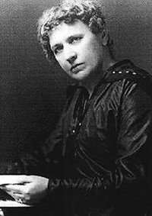
Viková-Kunětická
Radical nationalism and chauvinism
Conflict with Charlotte Garrigue Masaryk
National not women’s emancipation
The first women to be elected in Central Europe
Boycott of the International Women’s Suffrage Alliance congress in Budapest in 1913 for nationalist reasons
She was not allowed to enter the Assembly

Slide 29
Independent CZECHOSLOVAKIA
28 October 1918
Female members of the Revolutionary National Assembly
Total of 10 women – nominated by parties (not elected)
One of them Alice Masaryková (gave up her seat in 1919)
Women of various classes
The suffrage for women granted by the Constitution in 1920
Equality of all citizens regardless of origin and sex
Voting right for all citizens over 21 (the Chamber of Deputies) and 26 (the Senate)
Between 1920-1938:
  total of 29 women in the Chamber of Deputies and 16 in the Senate.

Slide 30
Czechoslovakia
Female politicians founded an association called Women’s National Council (Ženská národní rada)
Very successful and influential advisory body, broad coalition of women from various parties and institutions
Chaired by Plamínková (between 1923 and 1942), after renewed the second world war under leadership of Milada Horáková
Only after the second war, women in the presidency of the parliament (1946) and appointed minister (1947, Ludmila Jankovcová, minister of industry)
After 1948 the gender issue considered to be irrelevant, ideology of equality, candidates chosen by the leadership of the Communist Party

Slide 31
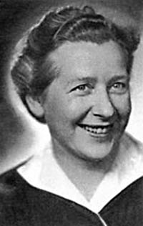
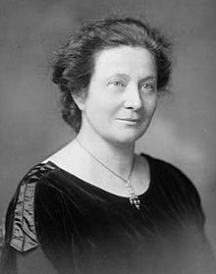

Slide 32
Czech struggle for female suffrage
Very restrained movement
No violent actions
No radical actions (as in UK or USA, different contexts)
Given by the context: no inherent political conflict with men, the main goal was national
Gradual development
Key factor: the foundation of a new independent state

Slide 33
Conclusions
What are the main arguments for and agaionst women’s suffrage
Do we see analogies today?
The main ideologies behind the political rights of women
Intersectionality
Three waves of suffrage
Individual differences across states (see literature)
Can we talk about democracy?

