Slide 1
Social structure and representation of women
POL612 April 17, 2018

Slide 2
Two basic set of factors
Demand factors: characteristics of the country, factors making it more likely that women will be elected
Supply factors: determine the pool of women with the will and experience to run
Social structure as one of the key supply variables
Where social structure treats both genders equally, women compete with men
Family, education system, labor force etc.

Slide 3
Theoretical traditions
THE RESOURCE MODEL OF POLITICAL PARTICIPATION
  Individual inequalities in prerequisites such as money, time, skills
ELITE THEORIES
  Research of political decision-making and characteristics of elites (education, profession)
GENDER STRATIFICATION THEORIES
  Inequality as a result of economic power, economic control before political power

Slide 4
Seven structural factOrs
1) Money
2) Time
3) Civic skills and community participation
4) Education
5) Work and Economic power
6) Informal networks
7) Media and pop culture

Slide 5
MONEY
Campaigns are expensive
Wealthy and well-connected people (Trump? Babiš?)
Pinto-Duschinsky 2002: 104 countries, 59% no limits on campaign spending, 72% no limits on financial contributions by individuals
In general, women have less money
Less full time jobs, lower income

Slide 6
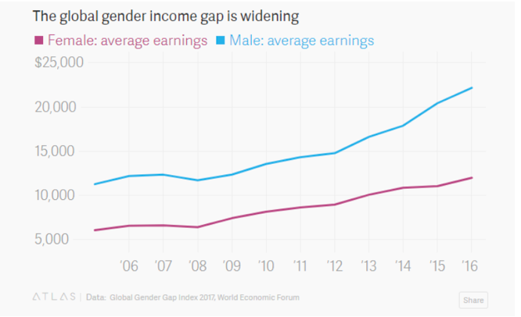
GLOBAL GENDER PAY GAP

Slide 7
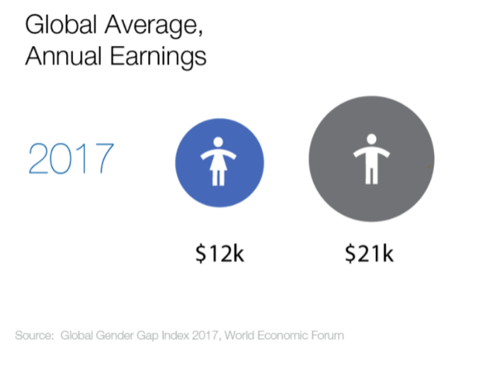
http://reports.weforum.org/global-gender-gap-report-2017/dataexplorer/

Slide 8
Adriana Munoz (MP in Chile, PPD):
“Being a candidate is difficult for a woman because you need to have a lot of money. We have little help economically. Men have access to circles or networks where money is let – they are friends with bank managers. But we are not supported this way. For us, it’s pretty complicated, this arena of power and money.“ (quoted in Franceschet 2001).

Slide 9
Factors promoting equality:
Public financing of elections
Subsidies for campaigns
Free allocated broadcast time
NGOs
Most famous organization: EMILY‘s list (Early Money Is Like Yeast )
https://www.emilyslist.org/pages/entry/women-we-helped-elect
Shifts in strategies, nowadays they choose already viable candidates

Slide 10
TIME
Valuable resource
Political involvement is time demanding
Women‘s burden: care, child bearing, housework, family responsibilities
Second shift (Arlie Hochschild 1989)
Is politics a third shift?

Slide 11
TIME
Women are afraid to “sacrifice” their families
Golda Meir (PM, Israel): “At work, you think of the children you’ve left at home. At home, you think of the work you’ve left unfinished. Such a struggle is unleashed within yourself, your heart is rent.”
Women politicians less often married, more often childless
Structural problem: differences across countries with different social welfare and culture

Slide 12
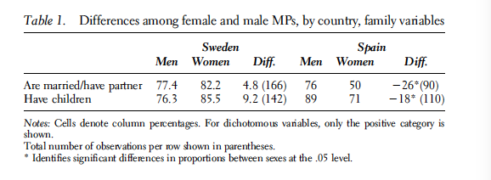
Galais, Ohberg, and Coller, 2016.

Slide 13
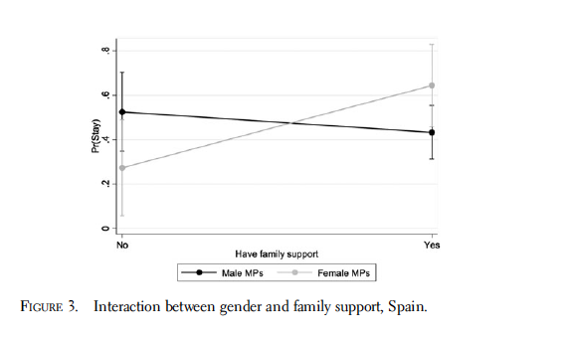

Slide 14
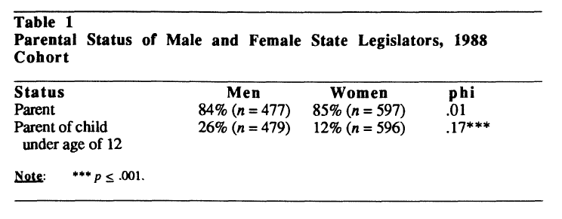
USA STATE LEGISLATORS (Dodson 1997)

Slide 15
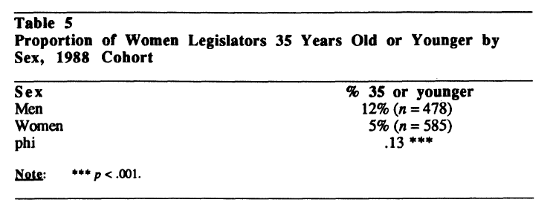

Slide 16
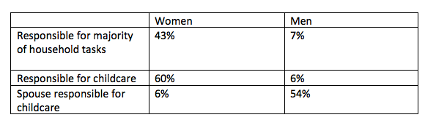
Fox and lawless 2014:

Slide 17
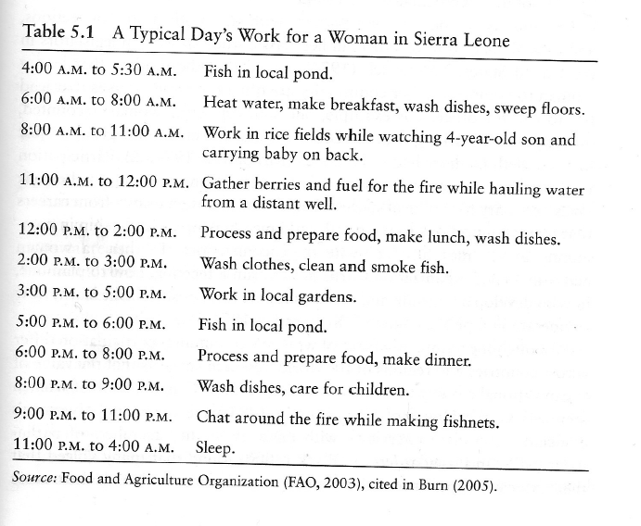
GLOBAL SOUTH
In developing countries women have significantly less free time
How could a typical woman in Sierra Leone enter politics?

Slide 18
CIVIC SKILLS
Abilities that allow citizens to use time and money effectively in political life
Ability to speak in public
Run a meeting
Understanding budgets
Navigate through parliamentary procedures

Slide 19
CIVIC SKILLS
Through employment
Activity in non political organizations
Unequal distribution
For women voluntary work is more important
Different impact of voluntary associations on men‘s and women‘s political participation (US data)
Also networking, motivation to enter politics (as a next step?)
Typical also for developing countries (Rwanda, South Africa, Uganda etc.)
What is the effect of PROFESSIONALISATION of politics?

Slide 20
EDUCATION
Elites = educated
Where women have access to education = more women in politics
  True?
Developed world, usually graduate and postgraduate degrees (also Latin America), not much educational gender gap, sometimes women better educated (CR)
Developing world: situation serious
Women more likely to be illiterate then men

Slide 21
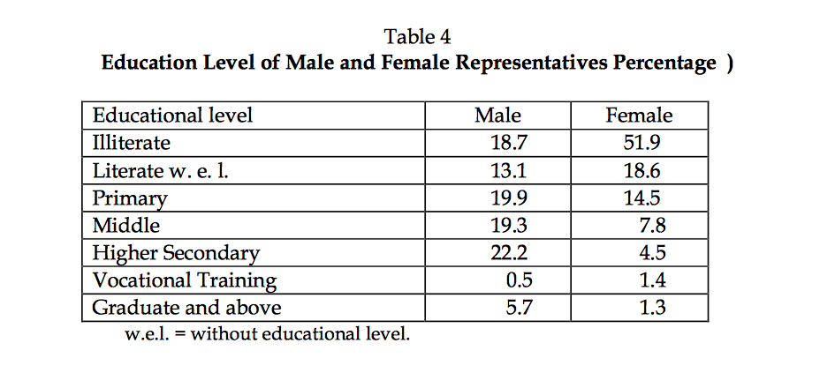
Example: INDIA (after 1993 quota rule)

Slide 22
UGANDA 1997 local government act
Requirement of secondary education excluded most rural women
Protests and change of the law

Slide 23
UNESCO 2015
In developing world:
  90% of boys are literate, 85% of girls are literate
  Regional differences (e.g. Nigeria: only 80% of boys and 65% of girls are literate)

Slide 24
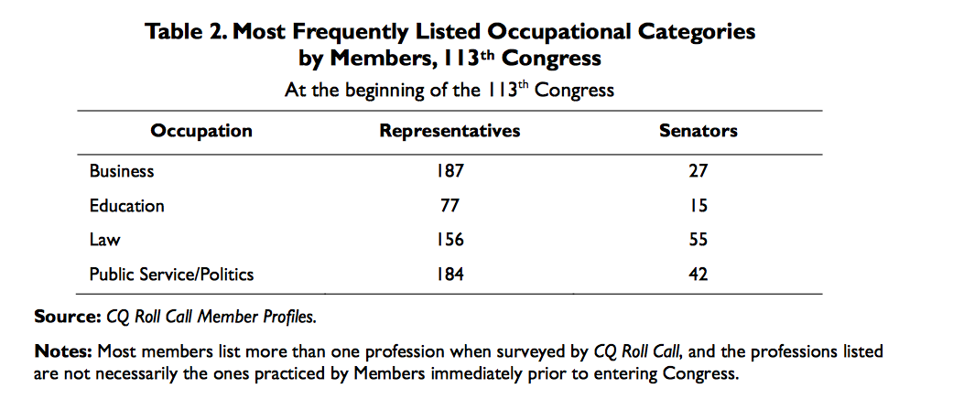
WORK
Elites = educated and SUCCESSFUL in professions
Latin America: Law, medicine, business
Czech Republic:
If women have limited access to prestigious and highly skilled position in labor force they will fail to be represented politically

Slide 25
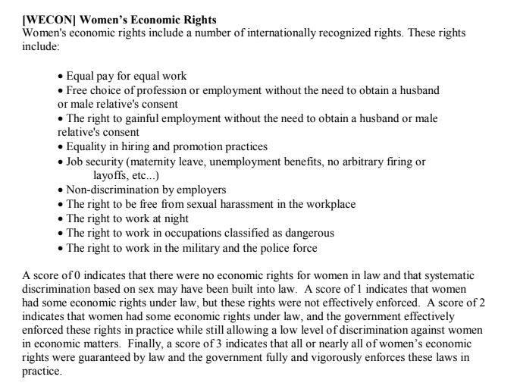
Cingranelli and Richards: Human Rights Dataset

Slide 26
Human Rights Dataset
Most equal: equal pay for equal work, free choice of employment, freedom from sexual harassment, right to work at night: only 22 countries in 2011 (e.g. Australia, Denmark, Iceland, Korea, New Zealand, Norway etc.)
Middle categories: toleration of discrimination, lack of government enforcement of equality laws: most countries in the world, including Japan, Spain, CZE.)
Unequal countries: no economic rights, discrimination built into law (Nigeria, Mali, Cameroon, Chad, Afghanistan, Saudi Arabia, Kuwait etc.)

Slide 27
Problems
We don‘t have enough information
What are the pipeline jobs?
Do women have sufficient human capital and just work too many hours?
Women‘s career paths to politics are different, their resources my be different
Work and position on the labor market is not sufficient
ECONOMIC POWER: control over means of production and allocation of surplus
Control over labor and income matters (as the gender stratification theorists say)

Slide 28
INFORMAL NETWORKS
Statistics sometimes does not work
Can‘t capture informal structures
Results of many experiences (education, organization membership, profession etc.)
Revealed in qualitative intervies:
The old boys‘ network in New Zealand local politics (Marianne Tremaine)
“Another woman mayor was concerned about the existing culture of having the “real'' meeting over drinks after the meeting, so she stopped the restocking of the drinks cabinet and caused a furore. She had support from the other women on council, but not from the men.”

Slide 29
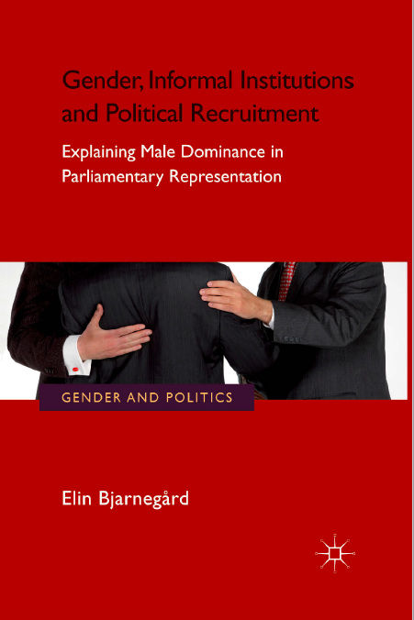
INFORMAL NETWORKS
Informal structures in form of clientelism
Informal structures influence candidate selection processes
Male dominance reproduces through informal structures

Slide 30
MEDIA
Reproductions of stereotypes
Reduction of female political efficacy and motivation (see you at the next session for more)
http://l23movies.com/watch/pxwDo9Gz-miss-representation.html

