Slide 1
Women and parliaments
POL612 Women and Politics
Masaryk University, Spring 2018

Slide 2
Does Suffrage lead to representation?
When did women get suffrage vs. when they got seats in parliaments?
Reluctance of voters to vote for women
Still unequal representation in most parliaments

Slide 3
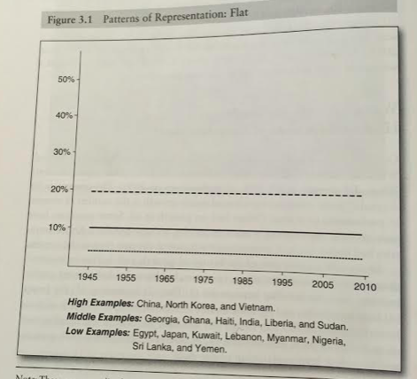
Paxton AND HUGHES

Slide 4
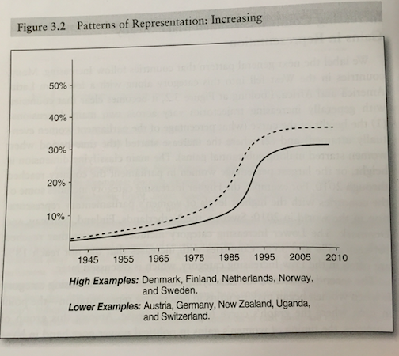

Slide 5
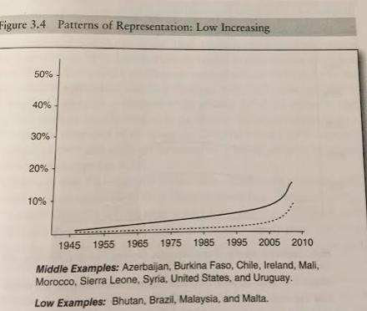

Slide 6
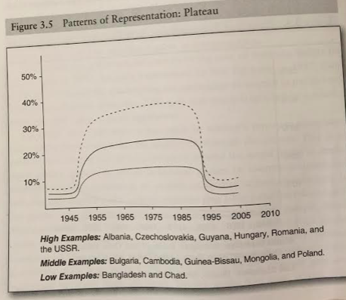

Slide 7
Czech Republic: The lower house
1992: 10,5%
1996: 15%
1998: 15%
2002: 20%
2006: 15,5%
2010: 22% (and the Chair of The Chamber of Dep.)
2013: 19, 5%
2017: 20%

Slide 8
Number of women in legislatures
Increasing world-wide
In 1999 11,7% in average
2009: 18.3% in average
2017: 23.5%

Slide 9
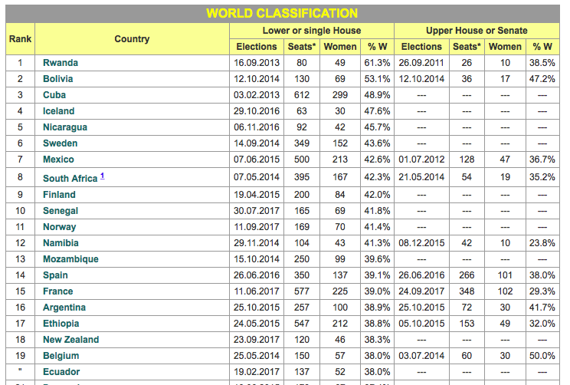
2017
Top 20 source: www.ipu.org

Slide 10
Women in legislatures
The Czech Republic:
  Rank: 97
  Lower House: 40 out of 200 (20%)
  Upper House: 15 out of 81 (15.5%)
Slovakia:
  Slovakia:
  Rank 97
  National Council: 30 out of 150 (20%)
USA:
  Rank: 101
  Lower House: 84 out of 433 (19.4%)
  Upper House: 21 out of 100 (21%)
UK:
  Rank: 38
  Lower House: 208 out of 650 (32%)
  Upper House: 207 out of 805 (25.7%)

Slide 11
Women in legislatures
MPs as the main form of political representation
The question of political representation of women
Are women represented enough?
Two approaches:
  Descriptive representation
  Substantive representation

Slide 12
Politics of presence
Anne Philips, The Politics of Presence 1995
Women are best represented by women MPs
How descriptive is political representation ?
Why are women better representatives of women’s interest?
  Men and women have different life experiences
  Child bearing, education, professional life, division of paid and unpaid labor, harassment, violence etc.
  Women MPs share this experience with other women

Slide 13
Descriptive representation
Longer tradition of research
More elaborated
M. Duverger (1955), electoral systems influence number of female MPs
What is the dependent variable?
  The number of women elected into office
Topic of recruitment of women in politics (mostly in Western democracies)

Slide 14
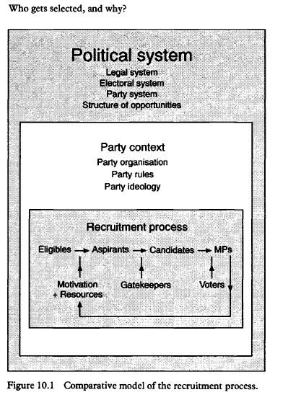
Parliamentary Recruitment model: p. Norris a LOvenduski (1993)

Slide 15
Parliamentary recruitment
1) SYSTEMATIC FACTORS
  Legal system
  Electoral system
  Party system
  Structure of opportunities
2) POLITICAL PARTY FACTORS
  Party ideology
  Party organization
  Rules
3) INDIVIDUAL FACTORS
  Resources of candidates
  Motivation

Slide 16
Cultural and socioeconomic factors
Women’s representation conditioned by culture
What are the values of the society?
Values of equality are necessary
Gender-equality culture and social mobility
Traditional gender roles culture
Inglehart and Norris 2000: post-material values lead to gender equality
  Attitudes to female leaders, professional rights, education and maternal role
  G-E scale correlates with number of women in parliament

Slide 17
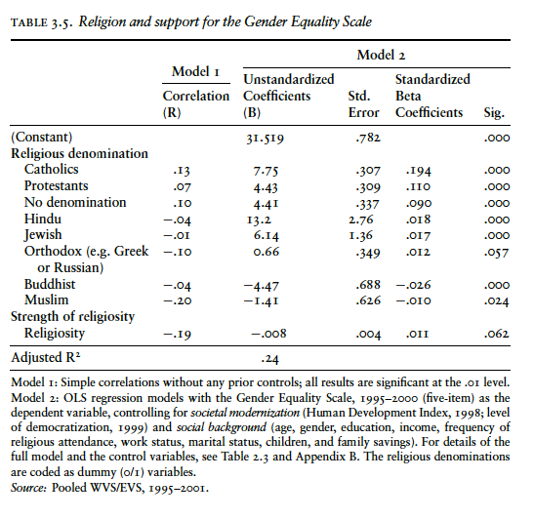
InGLEHART and NOrris

Slide 18
Cultural and socioeconomic factors
Before 1989:
  Women’s enfranchisement
  Communist regime
After 1990:
  Proportional electoral system and gender quotas
  Protestantism
  High level of economic development (Wilde 2006)

Slide 19
QUOTA TREND
A formal measure
Goal: to increase women’s representation
In a constitution or electoral laws (legislative quotas)
Or party quotas (implemented by individual parties)
Trend from 1970s
Norwegian Socialist Party
Milestone in 1995, the UN 4th World Conference in Women, Beijing
    Beijing Action Platform (removal of obstacles for women)
Increasing representation mainly in the West (what is the difference with other regions?)
Sweden vs Rwanda?

Slide 20
Welfare state
Nordic/ Scandinavian exceptionalism
Welfare state facilitates women’s participation
Women can enter paid workforce
Public sector jobs
Increase in state expenditure correlates with increase in no. of female MPs
But parties are still the gatekeepers
Parties use female candidates to exploit the gender gap
Iversen and Rosenbluth 2008: political arena as a job-market

Slide 21
Substantive representation
What do women do in parliaments?
Do they represent women’s interest?
Less mature research
What effects of higher representation should we expect?
Is substantial change in the representation caused only by the presence of women in the parliament?

Slide 22
Precondition for change
Is there a “tipping point”?
Critical mass theory
Mostly 30 % (some say 15%, some 40 %)
Kanter 1997, study of corporations
  Absence of greater number of minority group unable to create a counterculture, little choice about accepting the dominant culture
Or critical acts?
  Who is pushing for change?
  What kinds of strategies are useful?

Slide 23
Precondition for change
Dahlerup extends Kanter’s research on politics
6 areas where women have impact
  Reactions to women politicians
  Performance and efficiency of female politicians
  Social climate of political life
  Political discourse
  Policy agenda
  Power of women in general
Role of CRITICAL ACTS
  Few strong representatives can have an impact
    Recruitment of other women, introduction of quotas, equality legislation..
  Critical acts lead to critical mass

Slide 24
How much seats is the Critical mass?
40% (Kanter 1977)
30% (Dahlerup, 1988, 2006)
15% (Bystydzienski 1992)
How many countries meet the 40 % treshold?
How many countries meet the 30% treshold?
The number of case is increasing, theory more testable
How to isolate other factors?

Slide 25
OBstacles
Hostile reactions to women
Incompatibility with family life
Male-dominated networks

Slide 26
DO women influence culture in political institutions?
Possible factors:
  Position of the politician in the institution (time in institution, ideology and party ideology)
  Numbers and newness (Beckwith 2007)
  Larger number often comes with newness
    For change: numbers and incumbency needed
  Grey (2006) study of New Zealand : numbers not enough, can lead to backlash

Slide 27
Women in parliamentary committees
Thomas 1994: How Women Legislate
Women concentrated in a few committees in 1970 US
Proportion of women in other committees increasing
However still gendered assignment
Is this an institutional pressure or MPs own choice?
Sweden: gender patterns almost non-existent since 1994

Slide 28
Politics of presence
Women are more suited to represent women. They share life experience.
How to proceed methodologically?
  Longitudinal studies
  Cross-sectional study with wide scope of indicators
    Legislative procedures: speeches, work with colleagues, bargaining with lobbyists; gender gap closing I USA (Thomas 1994)
    Legislative products: are voting, attitudes, policy priorities, gap not closing (Thomas 1994)

Slide 29
Attitudes
Gender differences identified often
Disagreement about their magnitude
Agreement about the direction of the difference
  Women are more leftist then men
  Women more in favor of new policies
  Women more interested in issues related to social policy (more permissive), pornography (skeptical), affirmative action (in favor).
  Gendered issues = those not crucial for parties

Slide 30
Attitudes
Importance of partisan affiliation
Some issues divide men and women along ideological divides (Pornography)
Some issues divide men and women along gender divide – in case of SOME parties
Women mostly more liberal on welfare and social issues, economic issues
Difference between POSITIONS on issues and PRIORITIES

Slide 31
declared goals
Survey or interview with politicians
Women more often declare representation of women's interests as their goals
Self-defined champions of women’s interests more active (Nordic countries, USA)

Slide 32
Case study: SWEDEN
Wangnerud’s (2006)
Member‘s of parliament attitudes across 20 years
Social policy, Family policy, care for elderly, healh care as a campaign issue or as a personal interset

Slide 33
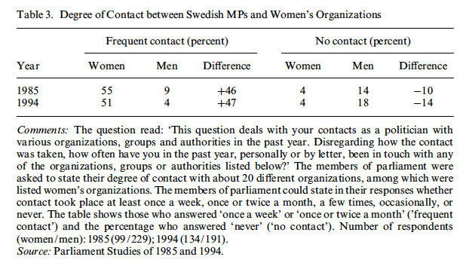
Case study: Sweden

Slide 34
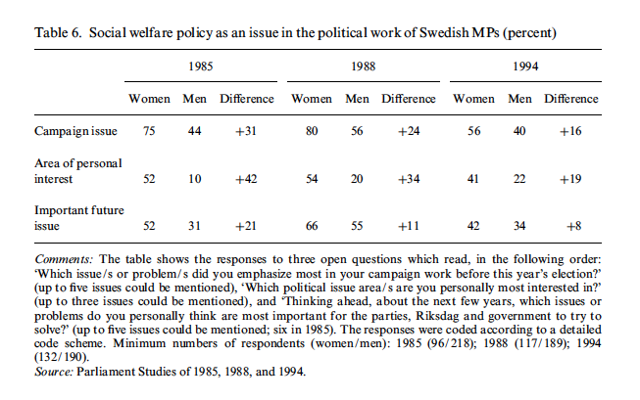
Case study: Sweden

Slide 35
Case study: Sweden

