Slide 1
Psychological factors of women‘s voice in politics
POL612 April 24

Slide 2
Factors influencing women‘s political life
Political factors
Structural factors
Cultural factors
What about psychology?

Slide 3
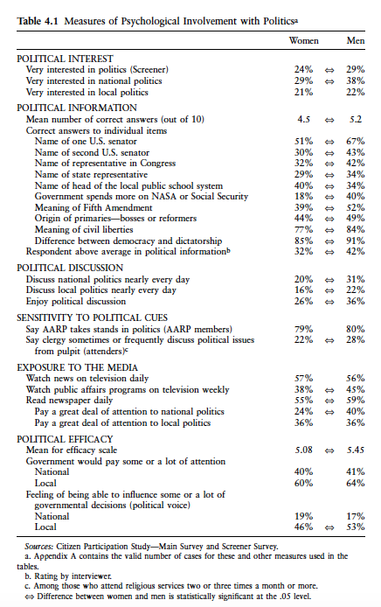
How involved are women?
Consistent gender gaps in political interest
How much knowledge people have?
How much they participate in discussions
How much they consume the media
Efficacy?
- an important predictor of political behavior!

Slide 4
Gap in political engagement
Women‘s policy preferences matter less in public discussion
Depriving women of representation
Why??
Structural resources )education, income, woring outside home)
Psychologcal resource (confidence, awareness)

Slide 5
Atkeson, Lonna R., Rapoport, Ronald B. 2003

Slide 7
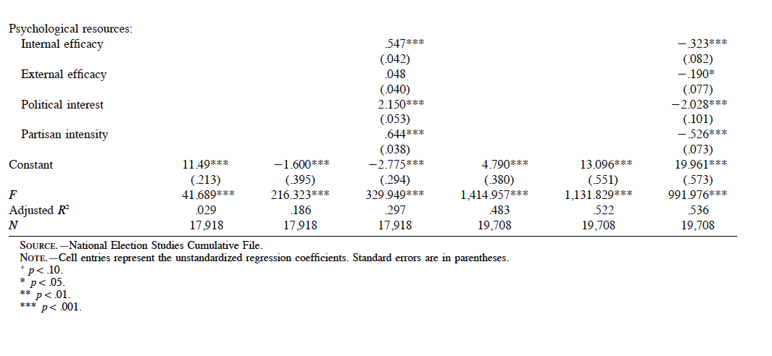

Slide 8
Atkeson, Lonna R., Rapoport, Ronald B.
Role of socialization in family!
Women influenced by political interest of their mothers
Reported highly interested mothers -> reported high interest
Problem? (only 20 % of all respondents reported to have highly interested mothers)
No such effect for men
Female role models!

Slide 9
Gender gaps in knowledge?
Consistent
Across countries
Persistent
Women are less knowledgeable than men

Slide 10
Explaining knowledge gap
SURVEY QUESTIONS
Men have high “propensity to guess”
Women select “Don‘t know“ option
SOCIETAL STRUCTURE AND RESOURCES
Surveys ask for specific type of knowledge
Women have different experiences (more practical, public services, welfare) (Dolan 2011)
Political attentiveness, education, socialization, motivation
POLITICAL INSTITUTIONS
Proportional electoral rules provide additional incentives for parties to mobilize women , this leads to more engagement (Kittilson and Schwindt-Bayer 2012)

Slide 11
Jessica Fortin-Rittberger: CROSS-NATIONAL GENDER GAPS IN POLITICAL KNOWLEDGE
106 post-election studies, 74 countries, 1996-2011
Positive Knowledge Scale (only correct answers)
Political Expression Scale (any indicated answers)
Political Accuracy Scale (without DKs)

Slide 12
CROSS-NATIONAL GENDER GAPS IN POLITICAL KNOWLEDGE

Slide 13
Interesting results
Highest gap: Greece (2009), Switzerland (1999, 2003, 2007), and Taiwan (1996, 2004, 2008)
Finland 0.03 in 2011; but 0,15 in 2003
Mexico (same questions): from 0.06 to 0.14 over four elections
What warning does it give us?

Slide 14
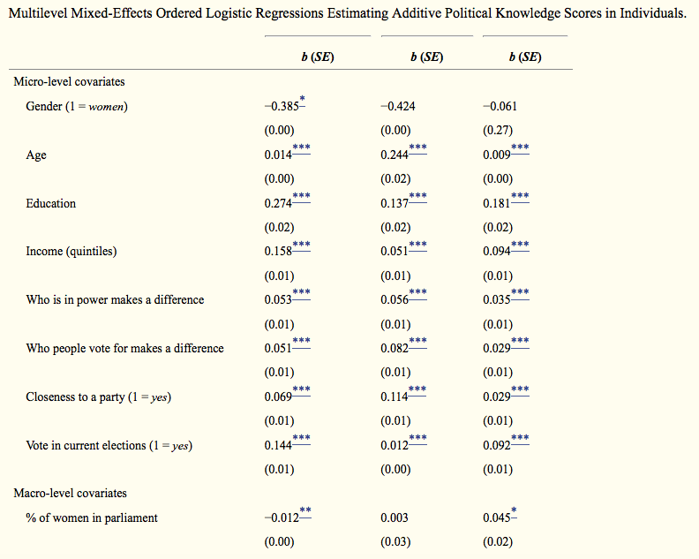
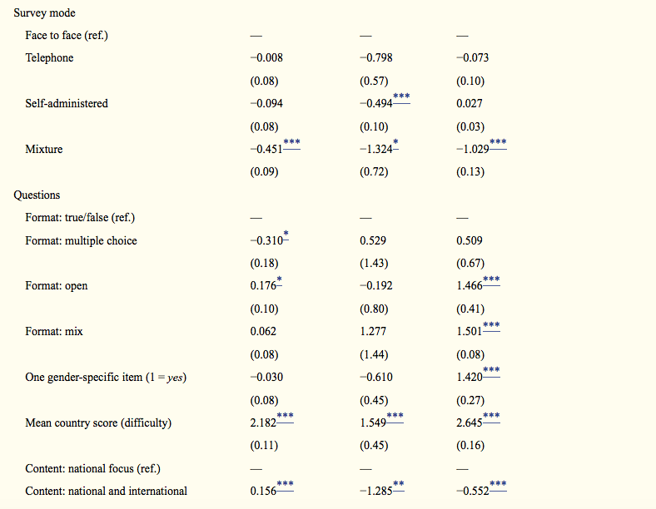

Slide 15
Mondak, Jeffrey, Anderson mary R. 2004
Men are less prone to indicate DK
Women less pro ne to guessing, indicate DK
Vocabulary data for Citizen Participation Study
Women indicate more DKs in vocabulary test then men
The phenomenon related not only to politics

Slide 16
Mondak and Anderson 2004

Slide 17
HOW ABOUT ROLE MODELS IN POLITICS?
Presence of women in politics
Descriptive representation
Substantive representation
Feedback to voter that women can win
Descriptive underrepresentation creates psychological barriers
Signals uneven status

Slide 18
Atkeson, Lonna R. 2003.
Visibility of the female candidate is curtail
Not visible candidates = not powerful
Visibility as viability

Slide 19
Female politicians as role models for adolescents
“What made the 1994 campaign [for governor] worthwhile was the realization that I had become a role model for women and young girls,” Collins said, adding that a girl told her after the election, “You made me feel I could do anything.” – Susan Collins (R, ME), U.S. Senator

Slide 20
VISIBILITY OF CANDIDATES
Character of office
Viability
When gender is salient
The first woman to run

Slide 21
Adolescents‘ political engagement (Campbell and Wolbrecht)

Slide 24
Gender gap in political abitions
Politics as a reasonable career for men not for women
Women in eligible positions consider political career less often

Slide 25
Lawless and fox 2014

Slide 26
Lawless and fox 2014

Slide 27
WHY?
Parties ask women less then men to run
Women tend to perceive themselves as underqualified
Gap in perceived objective skills and confidence
Men more likely to be confident in skills they do not possess and confident in skills they possess (Kling et al. 1999)
Women modest in their achievement (Wigfield, Eccles, Pintrich 19996)
Men overestimate intelligence and women underestimate intelligence (Furnam Rawles 1996)

Slide 28
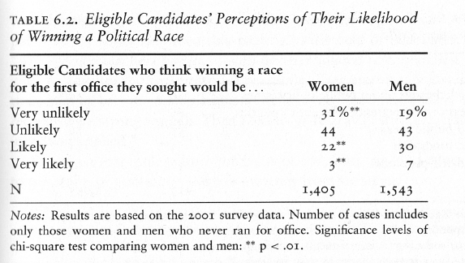
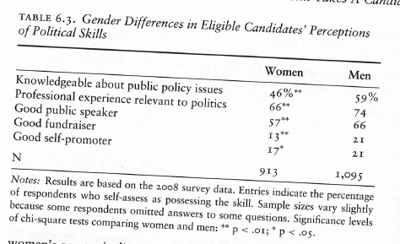

Slide 29
Actual decisions to run

Slide 30
IS women‘s voice actually heard
Question of equal participation
Is presence of women enough?
Women‘s contributions to debates less valued
Not all reasons and forms of communication constructed socially equal

Slide 31
Karpowitz, Christopher F., Mendelberg, t.
Gap in authority!
Results in gap in interaction in discussions
Women not motivated or able to articulate their views
Women less comfortable in competitive discussions (role of norms of the institution)
Gap in deliberation exists, but not based on ability!
Gender composition and norm of decision making rules matter

Slide 32
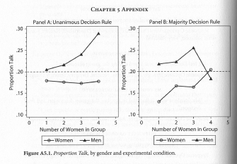

Slide 33
SILENT SEX?
“Early in my career, I went to numerous meetings where I was the only woman present. I would want to contribute to the conversation but would think, if I say that, everybody will think that it‘s really stupid.“ – Madeleine Albright

Slide 34
Confidence gap
Confidence stereotypical masculine
Schools and gap in perception of boys and girls, girls are silenced in classrooms
Emphasis on physical appearance, low self-esteem

