Slide 1
Procommunist Europe and women’s representation
POL612 Women & Politics, May 15, 2018

Slide 2
Central and eastern Europe: FACTORS
1. Communist regime and ideology of equality
2. Transition to democratic regime and capitalism
3. EU accession

Slide 3
Women in politics in postcommunism
End of state socialism brought drop from high levels of representation to very low levels of representation
Severe underrepresentation in all post-communist countries

Slide 4
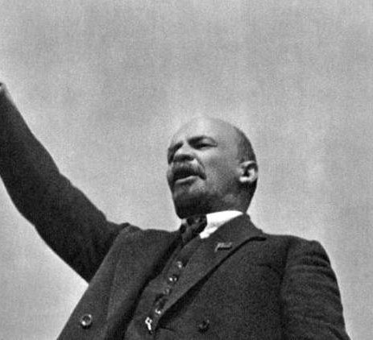
v.i. Lenin 1920
“In law there is naturally complete equality of rights for men and women. And everywhere there is evidence of a sincere wish to put this equality into practice. We are bringing the women into the social economy, into legislation, and government. All educational institutions are open to them, so that they can increase their professional and social capacities…. In short, we are seriously carrying out the demand in our program for the reference of the economic and educational functions of the separate household to society. That will mean freedom for the woman from the old household drudgery and dependence on man. That enables her to exercise to the full her talents and her inclinations. “

Slide 5
Communist regimes
Women formally equal
High levels of education, employment, political representation
Communist ideology = dissolution of the PUBLIC and PRIVATE spheres
Gender inclusiveness beneficial
East Germany (GDR): decree for equal work in 1946!
USSR: 17% of women in national legislature in 1946!
GDR: 30% of women in parliament (Sweden didn’t reach 30% until 1985)

Slide 6
Communist regimes
Society as patriarchal as in liberal democracies
Fodor 2002: Just as in liberal capitalist societies, women’s assumed inferiority was tied to their reproductive duties under state socialism too. However, while in liberal political ideology, pregnancy and childbearing were seen to damage women’s rationality and individuality, in Hungary, these were considered to impair women’s political devotion and reliability. As a result, women could never be fully trusted and could never be integrated at equal subject status into the state socialist political system
Proclaimed equality did not reduce women’s domestic and reproductive responsibilities
No reorganization of labor in the household
(Even though some measures helped a lot: free nursery, child care centers, generous maternity leave policies reduced the family burdens a lot. Most evident when the support system disappeared in 1989)

Slide 7
Women’s participation under communism
No free political competition
Prerequisite to political career: working class background, political reliability
One-party party list
Candidates centrally nominated
Internal informal quota measures for women

Slide 8
Women’s participation under communism
In USSR, internal quota 33% in the highest Soviet
Most influential office held by women: ministry of culture
Minister of culture: Ekaterina Fucevova
  Entered KOMSOOL (youth communist organization) at the age of 13
  Working class family
  Studied Party College
  Member of the part at the age of 20
  8 years in Central Committee of Communist Party, 14 years as minister, 4 years in leadership of the highest Soviet
  Accused of illegal enrichment and excluded from list of candidates
  Typical political career

Slide 9
Women’s participation under communism
In Czechoslovakia no official quota
Women represented in the parliament
Real power held by the Communist Party politburo (leadership
1948-1989 only three women in leadership of the Party!
Marie Švermová, Ludmila Jankovcová and Marie Kabrhelová
East Germany = no woman in party politburo in its history

Slide 10
TRANSITION TO DEMOCRACY
Big question of 199s: Would women’s past role in politics allow them to compete for power???
Clear answer: NO
Immediate fall of numbers of women in politics
Kostova (1998): “Many of the women were workers, seamstresses, heroes of socialist labor, women with low status jobs. The fact that these women did not have experience to be taken seriously in important decision-making was exactly the reason why they were chosen”.

Slide 11
transition
Women marginalized during the period of transition
Even though they participated on the protests against old regime
Withdrawal from politics in the new regime
Explanation: little to no activity of women’s movement!
  In the Leninist ideology women’s movement was part of the great revolution, no need for independent organization of women
Conservative view of feminism and gender equality
Women had little opportunity to develop organizational skills, reluctant to identify with any ideological position, including feminism
Parties faced no internal nor external pressure to place women on the ballot

Slide 12
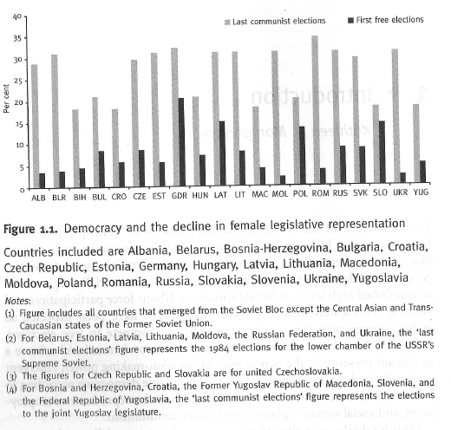
transition

Slide 13
Some data from the European value study

Slide 14
Some data from the European value study

Slide 15
quotas
Not perceived positively
Informal measures during communism delegitimized quota
During 1990s post-communist governments resisted quota politics

Slide 16
Changes after 2000
Year | Country | Measure | % of women in parliament
2001 | Bosnia and Herzegovina | 40 % of candidates on a list (placement rule) | 21%
2004 | Serbia | 30 % candidates of each sex at least (1 for every 3 on a list) | 34%
2004 | Uzbekistan | No less than 30 % women on a list | 16%
2006 | Slovenia | 35 % of both sexes at least | 36%
2006 | FYROM | In every 3 places at least one reserved for underrepresented sex | 31%
2007 | Armenia | 20 % of any integer group of five candidates starting from the second number on a list | 17%
2007 | Kyrgyzstan | 30 % of either sex on a list, no more than 3 positions can separate men and women | 19%
2008 | Albania | 30 % of candidates, one of the first three candidates | 27,9%
2011 | Montenegro | At least 30 % of underrepresented sex, no rank order | 23%
2011 | Poland | There cannot be less then 35 % of men or women on a list | 27%

Slide 17
EU accession
Gender equality measures
European Commission required gender equality aquis commnunitaire to be incorporated into the national law of candidate countries

Slide 18
EU accession: Czech Case
Gender equality perceived as less important issue by Czech representatives
Incorporation of the gender equality EU directives perceived as simple and technical task
By 2004 equality bodies established at governmental levels
However the changes only formal, issue undervalued, process ineffective (Hašková, Křížová 2008)
Support to NGOs (from the EU and government – as part of the goal to increase activity of civil society)
Professionalization and project-based orientation of women’s interest groups

Slide 19
SLOVENIA
Exceptional success
until 2005: only 3 ministers, 6 % of mayors, 12 % of local councilors, 14 % of MPs
2001 women formed the Coalition for Parity and took advantage of Slovenian accession period (2001-2004) to lobby for a change
40 % quota to the European Parliament,
20 % quota to local election
20% quota to the Parliament
35% quota to the Parliament
Women’s representation peaked at 37% in 2014
One female prime minister.

Slide 20
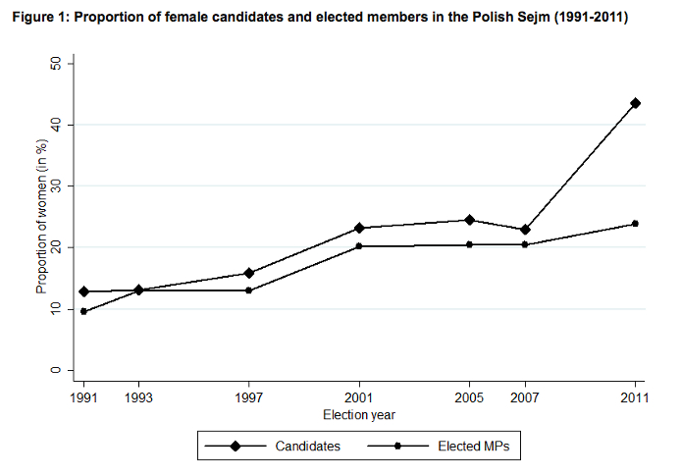
POLAND
Pre-quota: 20, 4 % in 2007
In 2011: 23,9 %
In 2015: 24,1%
Today: 28%

Slide 21
Conclusion
Communist regime = lack of viable women’s movement
Transformation = led to marginalization of women
Incapable of effective organized activity
Conservatism and nationalism brought more conservative approach to gender roles in societies
Quota discredited
Positive influence of the EU
Development not linear in the region
Some countries more progressive than others
Not all quota provisions effective in the same way (mainly due to the lack of rule of distribution of positions on the ballot)
Number of women in parliaments still lower compared to the communist era (on average)

