Slide 1
ÚVOD DO PSYCHOLOGIE ZÁVISLOSTÍ
PSY109 APLIKOVANÁ SOCIÁLNÍ PSYCHOLOGIE
Jarní semestr 2018

Slide 2
Do we need definition?
Clinicians: who to treat?
Health insurances: whose treatment to pay?
Legal concern: to what extend are addicts responsible for their actions?
Philosophical: do we have free will?
Public: how to think and feel about people involved in addictions?
Scientists: what concept can be tested/ used in research?
Some models of addiction serve only some of these groups and may sometimes contradict each other

Slide 3
A repeated powerful motivation to engage in a purposeful behavior that has no survival value, acquired as a result of engaging in that behavior, with significant potential for unintended harm.
Robert West (2013) Theory of Addiction
http://www.emcdda.europa.eu/system/files/publications/728/TDXD13014ENN_443320.pdf

Slide 4
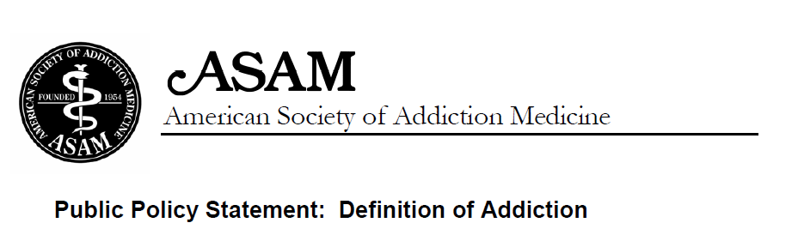
Addiction is a primary, chronic disease of brain reward, motivation, memory and related circuitry. Dysfunction in these circuits leads to characteristic biological, psychological, social and spiritual manifestations. This is reflected in an individual pathologically pursuing reward and/or relief by substance use and other behaviours.
Addiction is characterized by inability to consistently abstain, impairment in behavioral
control, craving, diminished recognition of significant problems with one’s behaviors and interpersonal relationships, and a dysfunctional emotional response.
Addiction often involves cycles of relapse and remission.
Without treatment or engagement in recovery activities, addiction is progressive and can result in disability or premature death.

Slide 5
Episodic intoxication in traditional societies
Substance use known throughout time and cultures
Limited access – psychoactive substances are rather rare and expensive
Heavy societal control for who, when and where can have access to. E.g.: heavy drinking during festivals; altered states of mind during religious rituals; use for medical purposes (pain relief)

Slide 6


Slide 7
Epidemic spread of drugs
16th century
New discoveries and globalisation of trade
Cheap and slave labour
Advancement in agricultural technology
Intensification of substances – stronger, cheaper, easily transportable, available worldwide
e.g. introduction of tobacco in Europe, export of cheap alcohol to Europe, export of opium to far east Asia and Europe
First attempts to solve the problem: taxation and market limitation

Slide 8
Addiction as immoral conduct
First model to appear in 16th century and still living today
Substance use is not seen as a disease but as a personal moral failure, sinful and criminal act
Excessive substance use is considered as a behaviour of choice and not as loss of control and thus subject of legal action and punishment
Understanding still preferred right-wing political ideology. E.g. war on drugs
It is simple, clear and straightforward
BUT it is oversimplification – in contradiction to current knowledge (e.g. genetic predisposition). And leading to even bigger problems - escalation of violence, organized crime networks, prisons overload

Slide 9
Addiction as immoral conduct
Believe in just world (just world hypothesis)
Consequences are result of one's actions (you reap what you sow)
Often used as blaming of victims of crimes, poverty etc. (raped woman was too seductive; poor people are too lazy,…)
Connected to believe in destiny & higher order and often found in right-wing and religious ideology
Guilt reduction, discomfort reduction (discomfort caused by empathy with victims), anxiety reduction (anxiety caused by uncertainty and unpredictable world)
The poor homosexuals — they have declared war upon nature, and now nature is exacting an awful retribution (Pat Buchanan, 1983) – summary of why not do anything with spreading HIV epidemic in US during Reagan‘s administration

Slide 10


Slide 11
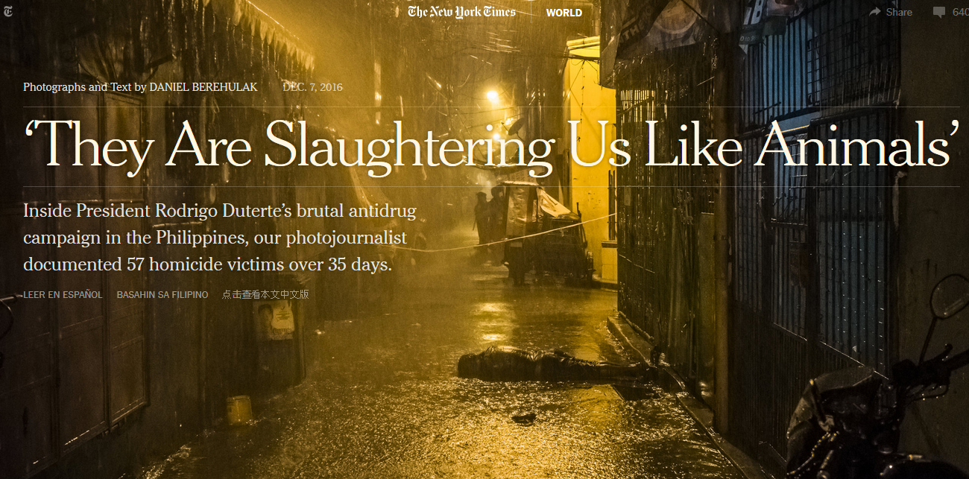
http://www.nytimes.com/interactive/2016/12/07/world/asia/rodrigo-duterte-philippines-drugs-killings.html?_r=0

Slide 12
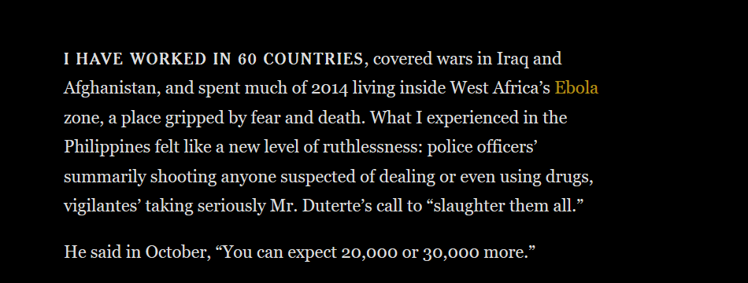

Slide 13
Temperance model of addiction
In the most primitive form – preternatural model – the substances are demonic and can take possession over human mind (demon alcohol)
Addict does not have ability to control him/herself
Addiction is a form of involuntary mental condition.
It is the substance to be blamed
It is reasonable to abstain from the use completely
Sympathize with addicts but rejects mild users

Slide 14
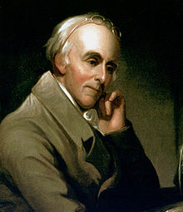
Temperance model of addiction
Benjamin Rush (1745-1813)
Founding fathers of the United States
Founding father of American Psychiatric Association
Alcohol use is behind poverty, health issues, violence, crime, family disruptions
Addiction is also a disease – addicts should be treated
Taste not, handle not, and touch not!

Slide 15
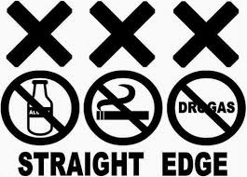
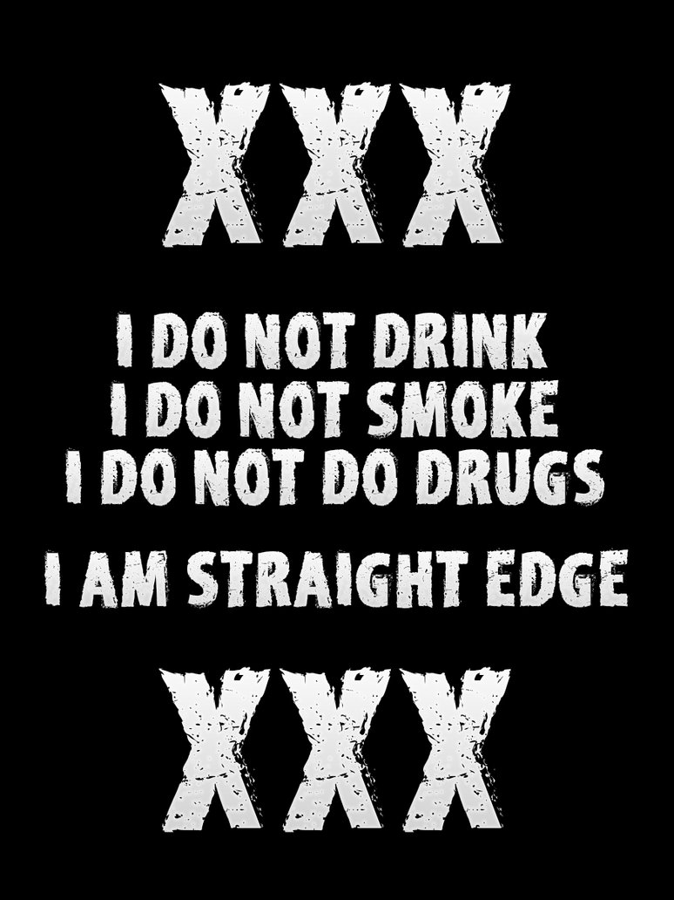
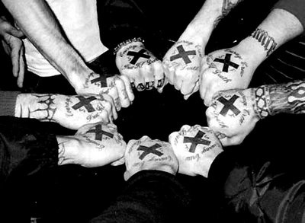
Temperance model of addiction

Slide 16
Illness & personality disorder models of addiction
Evolved in 1800s in USA – asylums in rural areas that supported people with food and shelter. No access to the substance
People in such treatment where in miserable conditions and had to accept themselves as ill. Often moral semi-religious treatment
Addict has a personality disorder – excessive substance user often shows array of antisocial and maladaptive behaviours.
The person is untreatable and unrepairable
Rise of self-help communities

Slide 17
12 step program – Alcoholics Anonymous
1939 - Alcoholics Anonymous: The Story of How More Than One Hundred Men Have Recovered from Alcoholism
self-help group
admitting that one cannot control one's alcoholism, addiction or compulsion;
recognizing a higher power that can give strength;
examining past errors with the help of a sponsor (experienced member);
learning to live a new life with a new code of behavior;
helping others who suffer from the same alcoholism, addictions or compulsions.
Steps 1 through 3 newcomers to becoming aware of their lack of ability to control their sexual behaviour.
Steps 4 through 9 aim to expand self-examination and incorporate the outcomes of self-reflection into actions.
Steps 10 through 12 focus on maintaining positive changes in behaviour and the recovery process. The recovery process includes attending meetings, listening to other members at different recovery stages and working on the 12 steps with a sponsor, who is an experienced member who is encouraged to complete all of the steps.

Slide 18


Slide 19
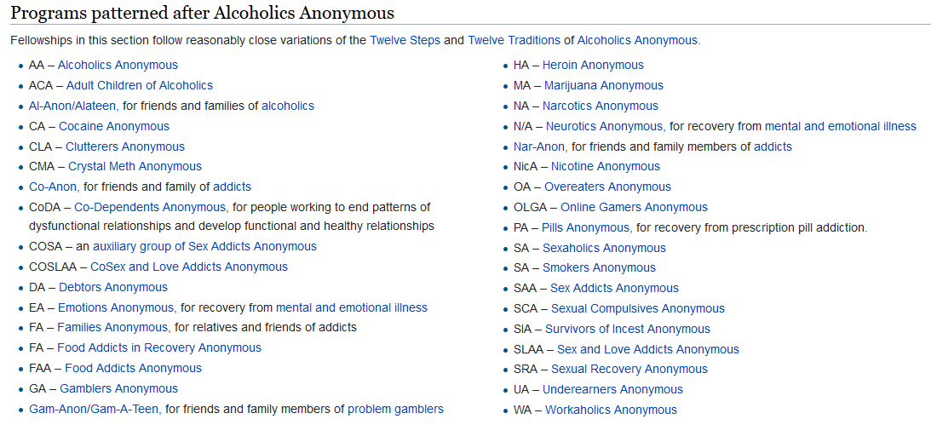

Slide 20
Disease model of addiction
Created in mid 20th century by Elvin Morton Jellinek
Addiction comes from underlying disease processes
At first, these processes were not understood. But it was assumed it is 1) brain disease and/or 2) genetic susceptibility
Addicted person is a victim of this disease - it is not chosen and it is not an act of free will
Loss of control & craving as the common processes in addictions
Consumption of the substance (even a small amount) causes craving for further dozes (through at first unknown psychological and neurological mechanism)

Slide 21
Disease model of addiction
Since the person is ill and suffering, he/she should be subject of medical treatment
At first, the treatment was based on management of medical complications (stomach ulcer, liver disease,…) and raising patient health education – supervision of a physician
Therapy-like approach heavily influenced by 12 step program and 12-step programs take ideological support from scientific approach of disease model

Slide 22
Disease model of addiction
Addiction as a primary disease – addiction is not understood a result of another condition (other psychiatric condition, stress,…) but rather their cause
Addiction as a progressive disease - addiction is understood as a disease that has its course. E.g.: 1) adaptive stage (increasing tolerance) 2) (withdrawal and maintenance usage) dependent stage 3) deterioration (resulting into major health and social problems)
Addiction as a chronic disease – addiction is understood as a disease that will never disappear and the person will never be fully cured. Thus complete sobriety is the only way

Slide 23
Disease model of addiction - pros
Big leap in understanding and knowledge
Removes stigma from suffering people
The classic disease model is still very simple to be understood by general public
When addiction became a disease (1954 alcoholism as disease was acknowledged by American Medical Association), the help also became more accessible

Slide 24
Disease model of addiction - cons
Despite huge advancement in knowledge (thanks to this model), it was only poorly incorporated into this model. E.g. proofed usefulness of light substance taking contradicts chronic disease; natural remission and maturing out contradicts progressive disease; much stronger environmental factors contradict primary disease
Ignoring context - too little emphasis on psychological and social factors
The treatment method, although advancement at the beginning, is way behind treatments based on psychological and social models

Slide 25
Physical dependency theory
By suing the substance, the person can gradually develop a physical dependence
Physical dependence is a condition in which the person needs the substance otherwise suffers from various withdrawal symptoms
This theory assumes that addiction = physical dependence
NOT PROVED – many substances do not create physical dependence nor physical withdrawal symptoms. Many addicts return to addiction after period of treatment in which they were detoxified
Avoiding negative effects plays a role, however, more crucial proofed to be the pleasure-seeking

Slide 26
It is about (anticipated) pleasure
Positive-incentive theory - all drugs have pleasurable effects
Positive-incentive value is usually much higher than hedonic value – anticipated pleasure is much higher than actual pleasure
Incentive-sensitization theory – repeated exposure to potentially addictive drugs leads to various changes in brain. The most important is sensitization = hypersensitivity to the incentive motivational effects of drugs and drug-associated stimuli that creates pathological wanting. Addiction is not about the drug effect, it is about the anticipation of the effect. Addiction is motivation disorder

Slide 27
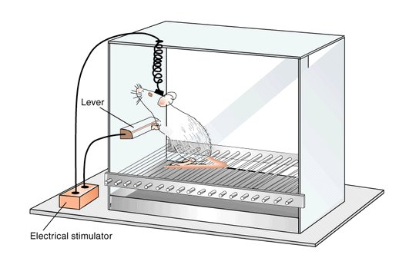
Intracranial self-stimulation

Slide 28
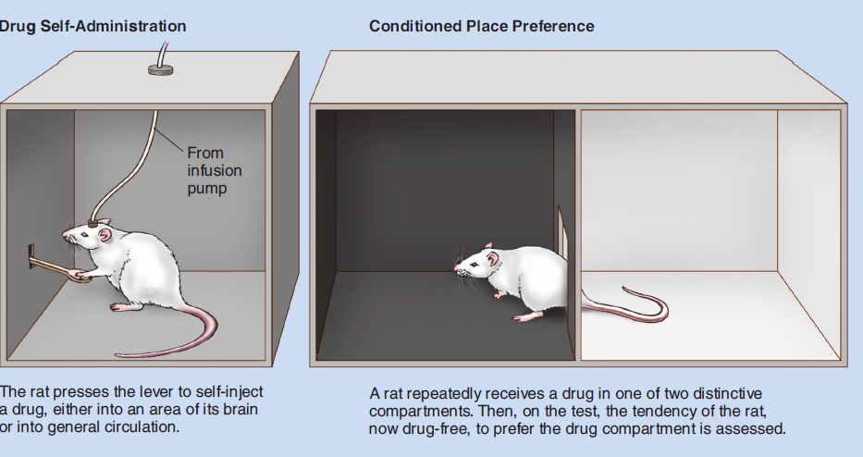

Slide 29
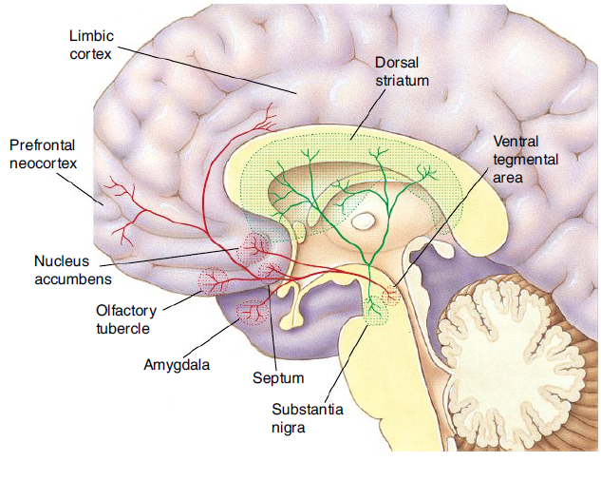

Slide 30
Mesolimbic dopamine pathway
Regulates motivation cognition and behavior and reinforcement learning – e.g. regulates behaviours related to food, drinks, safety, sex
Primary neurotransmitter – dopamine
The mesolimbic pathway connects the Ventral Tagmental Area near brainstem to the Nucleus Accumbens and to the Prefrontal Cortex. Important role further plays amygdala and hippocampus

Slide 31
Mesolimbic pathway and addiction
In animals, drugs self-administered to nucleus accumbens had stronger effect and were preferred. It correlated with increase on dopamine release
All drugs affect dopamine functions. Many drugs work as direct dopamine agonists and the rest of drugs have indirect effect
Brain imaging technics showed massive dopamine involvement nucleus accumbens. They also showed decrease of dopamine D2 receptors availability in addicts leading to increasing tolerance
Mesolimbic pathway gradually sticks to the addiction object to which it is hypersensitive while under sensitive to other stimuli – highjacked brain

Slide 32
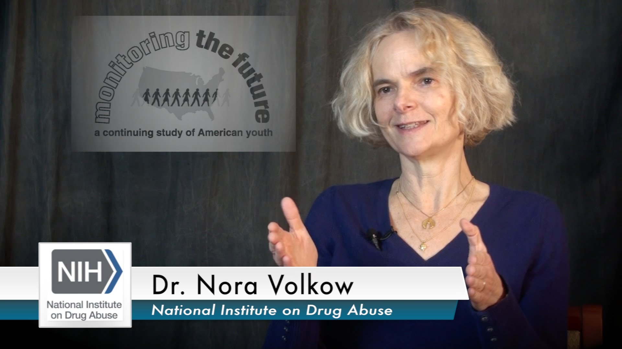

Slide 33
ADDICTION AS LEARNED BEHAVIOUR
Classical conditioning
I. Pavlov & J.B. Watson
Learning is a result of pairing of a unconditioned stimulus with a neutral / conditioned stimulus. After repetition of such paring, original reaction to unconditioned stimulus becomes conditioned.
In addictions – drug effect is paired with environmental stimuli – cues and they may trigger craving – overwhelming desire for the substance/behaviour
Cue reactivity – learned response that involves psychological and physiological reactions to drug related cues
Cues are one the most important factors of relapse

Slide 34
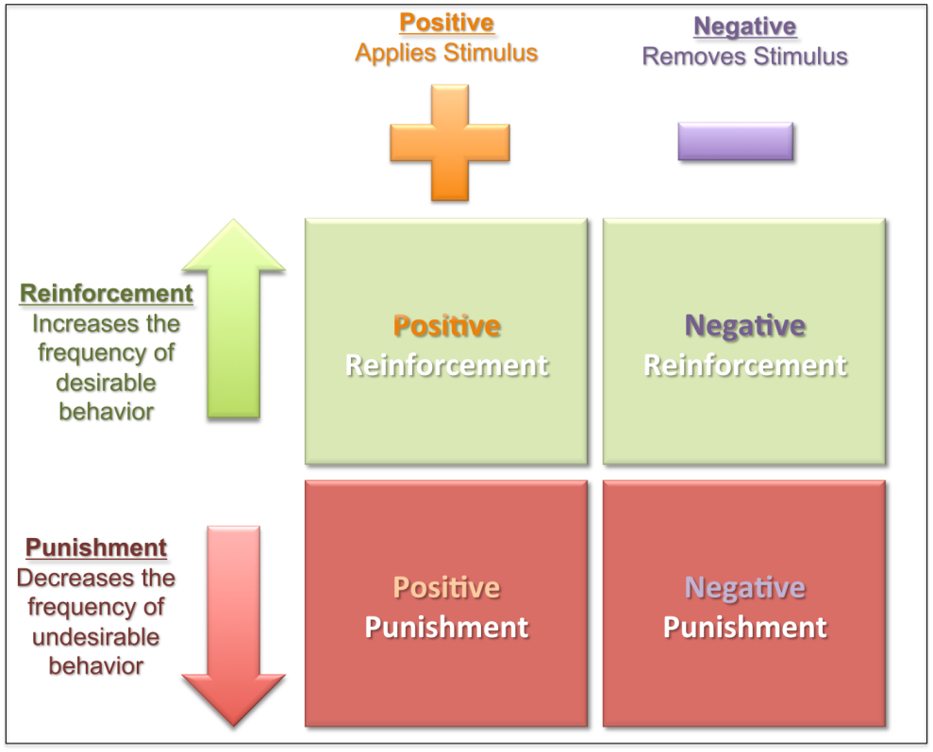
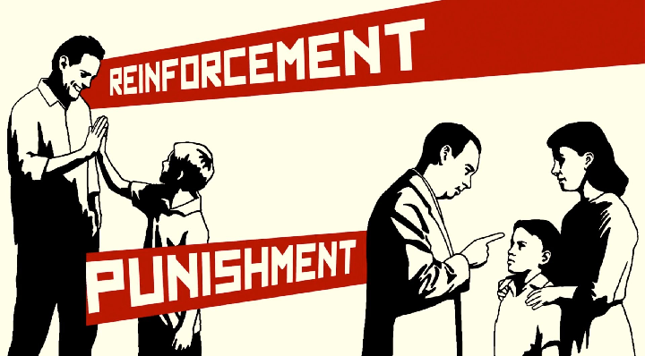
Instrumental conditioning
B.F. Skinner
Experience of reinforce or punishment increases or decreases likelihood of certain behaviour

Slide 35
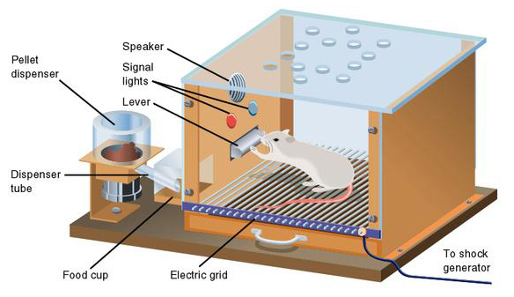

Slide 36
Drugs and certain behaviours (sex, gambling) are strongly pleasurable and serve as positive reinforcer
Decreasing level of drug in body after some time unbalances physiological system - withdrawal symptoms - and thus serve as negative reinforcer
Occasional reinforcement – reinforcement is stronger when there is certain level of randomness - activity to get the reward increases. Especially strong in gambling and gaming addiction
Secondary reinforcement – cues learned via classical conditioning may be experienced as reinforceres themselves

Slide 37
Prevention and treatment should focus on blockade of cues – associations then gradually become weaker and weaker
Drugs and certain behaviours are powerfully rewarding themselves, but addiction arises through experience and repetition
Involved processes are automated and are not reflective
Pre-conscious cue processing - addiction related cues are mentally prioritized without knowing

Slide 38
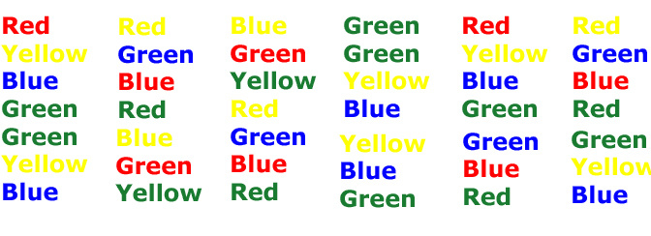
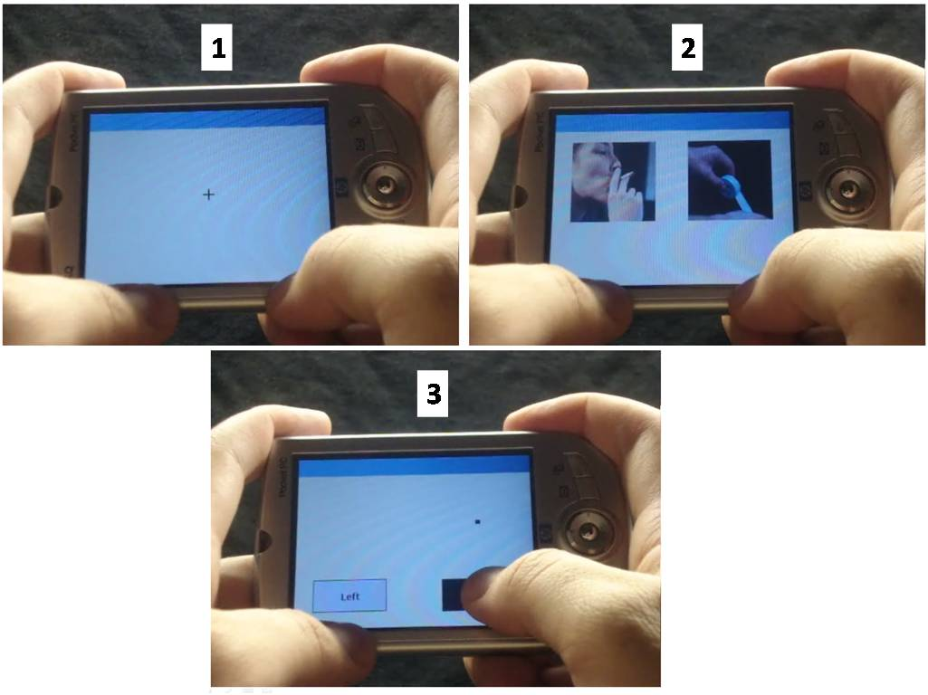
Stroop test
Visual probe task

Slide 39
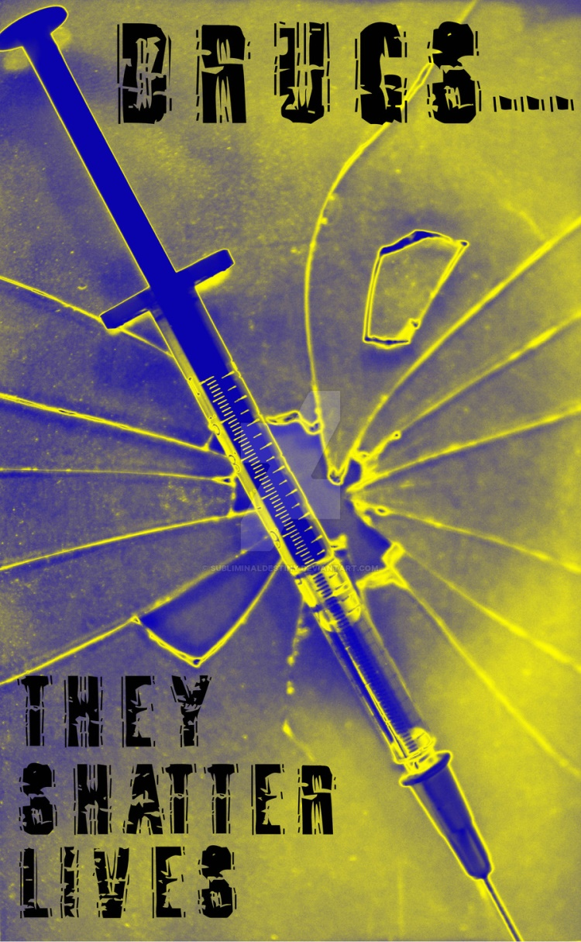
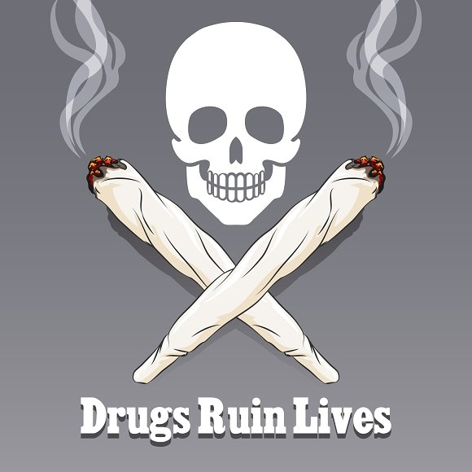


Slide 40
ADDICTION AS IMITATED BEHAVIOUR
Social learning theory
Albert Bandura
Learning in social environment through observing and listening to others
Addiction is learned through imitation of and identification with role-models
Social identity – whom I follow, what is the group I belong to,…

Slide 41
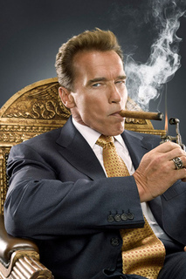


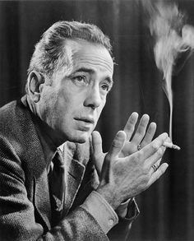
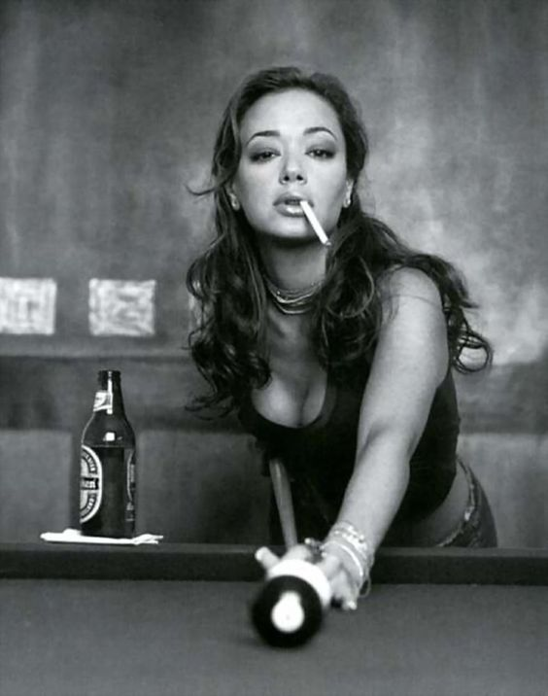

https://www.youtube.com/watch?v=EJT0NMYHeGw

Slide 42
SELF-EFFICACY
Albert Bandura
Individual believe in own ability to perform certain behaviour
High self-efficacy – set higher goals, invest more effort and energy. More resistant to stress and negative experience and able to try various coping strategies.
Low-self efficacy – lower effort, cease treatment more quickly. Lower stress resistance, often use substances as the first coping strategy
Interventions targeting self-efficacy have one of the best results – overcoming addiction is extremely difficult and an addict must believe he/she can do it

Slide 43
TAKING DRUGS AS COPING
self-medication model of addiction
Taking drugs or involvement in problematic behaviour is a coping strategy with negative and unpleasant mood states and/or negative life experiences
People with some mood disorder or problematic affect regulation are more prone to develop addiction (e.g. higher depressiveness, higher anxiety, personality disorders like antisocial or borderline)
People with experience of child abuse, trauma or childhood neglect are much more prone to develop addiction

Slide 44
Psychodynamic psychology – emphasizes feelings and emotions as forces that shape our behaviour, focus on early child experience
S. Freud – psychoanalysis - use of drugs with oral administration (alcohol, tobacco,…) are a form of regression to the first year of life (oral stage – when pleasure is experienced through mouth). Oral stage is about gaining trust in others – addicts usually have underdeveloped trust and show unhealthy relationship profiles (avoidance and/or overdependency).

Slide 45
M. Klein – object relation theory
Birth and first months are extremely stressful for the child. Chaos, anger, fear are the dominant emotions – they must be cultivated in contact with parenting figure. Parenting figure is internalised as a mental object – parent (mother) within
Relationship with this internalized object affects social relationships throughout our lives - what develops in early childhood stays for lifetime
Good object relation is good affect regulation (positive mood, ability to cope with unpleasant, more resilient), poor object relation is poor affect regulation.

Slide 46
H. Harlow, J. Bowlby, M. Ainsworth – attachment theory
Children internalize cognitive and affective representation of self and others based on their early attachment experiences.
Attachment to the parenting figure (significant other) is created especially in the first 6 months.
Attachment attitudes are persistent and lead our relationship to others and our affective regulation during our lives
Insecure attachment is strongly related to lifetime depressiveness and affective disorders, low self-esteem, lower social support. It creates fertile ground for substance use and other behavioural addictions
Self-medication model does not explain all cases of addiction – many addicts did not have affective difficulties, insecure attachment, child trauma or neglect.

Slide 47
DEVELOPMENTAL MODEL OF ADDICTION
Two main risk periods – early childhood (attachment) and adolescence
E. Erikson – psychosocial stages of development – adolescence is about identity crisis, time of storm and stress, and increasing power of peer groups. Substance use may develop as a mean to gain status in peer groups, it may become part of personal and social identity
Addiction may be understood as an externalized pathological behaviour. Externalized behaviour includes conduct problems (verbal and physical aggression, lying, risk taking, vandalism), ADHD, various addictions
Any externalized behaviour may be replaced by another externalized behaviour
Externalized behaviour may occur in childhood as a reflection of internalized disorders (anxiety, trauma, neglecting parental approach)

Slide 48
Addiction as rational choice
cost-benefit analysis – taken from economy theory. Addiction behaviour is consumer behaviour
We do things because they bring some benefits. We know about the negatives, but benefits out-weight them
Weighting benefits (pleasure) and costs (e.g. money, legal consequences, health consequences). In stressful times, benefits of drugs are getting higher. Why are some substances much more often used – costs are not that high (it is legal, health effects only slowly accumulates over time,…).
Assumptions are rather vague. Detailed analysis (e.g. using mathematic formulas) usually wrong. E.g. theory predicts older people to be more involved in addictions, but in reality it is the opposite

Slide 49
Why do we engage in addictive behaviours?
Improve social interaction
Improved physical & sexual appearance
Improved cognitive performance
Improved sexual performance
Improved self-esteem and feelings of self-worth
Coping with stress
Pleasure-seeking
Sensation & novelty seeking
Overcoming boredom
Reduce psychiatric symptoms
And others…

Slide 50
I prefer my life of a drinker
To outsiders, it may seem out-of-control, but the person prefers the life that way. Person is happier with the drug that he/she would be without it.
We imagine alternative life for the addict but the addict imagines different alternative for him/herself
Language and discourse used by addicts serves some function (addiction vocabulary used for psychologist, family members, but totally different language among other addicts)

Slide 51
Is rat park model right?
https://www.youtube.com/watch?v=ao8L-0nSYzg

