Slide 1
Online aggression and current youth
Dr. Hana Macháčková

Slide 2
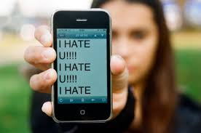
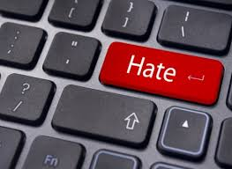

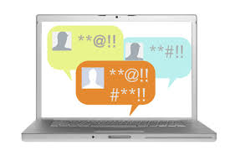
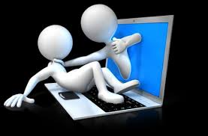
Aggression online
Seemingly ubiquitous
Everyday experience?
  Discussions: increased hostility, prejudices,
  intolerance, aggressivity…
Without boundaries?

Slide 3
Aggression online
In the form of direct interpersonal attacks
  E.g. discussions on SNS
In the form of shared information and materials
  On a specific websites
Often both
  E.g., comments below the articles

Slide 4
Aggression
Broad and complex term
Aggression is….“any form of behavior directed toward the goal of harming or injuring another living being who is motivated to avoid such treatment“ (Baron & Richardson, 2004, p.7)
It can take many forms:
Direct/nondirect
Verbal/physical/sexual….
Other-oriented/self-oriented
Interpersonal/intergoup
Etc.
Online/offline

Slide 5
Aggression
Broad and complex term
Aggression is….“any form of behavior directed toward the goal of harming or injuring another living being who is motivated to avoid such treatment“ (Baron & Richardson, 2004, p.7)
It can take many forms:
Direct/nondirect
Verbal/physical/sexual….
Other-oriented/self-oriented
Interpersonal/intergoup
Etc.
Online / offline
Need to specify type of aggression we are talking about

Slide 6
Aggression online
Various types
  Mirroring offline ones
  Cyberbullying, online harassment, cyberhate, cybercrime, cyberterrorism…

Slide 7
Aggression online
Various types
  Mirroring offline ones
  Cyberbullying, online harassment, cyberhate, cybercrime, cyberterrorism…
We will focus on cyberbullying and cybehate

Slide 8
Aggression online
Various types
  Mirroring offline ones?
  Cyberbullying, online harassment, cyberhate, cybercrime, cyberterrorism…
Interconnection with offline life
  Extension, augmentation, blending…
Cyberspace: Important aspect of everyday life
  „virtual“ but „real“
Cyberspace: specific social environment

Slide 9

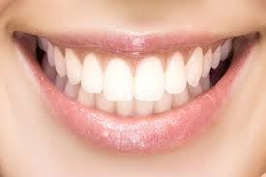
Differences from offline environment(s)
Computer-mediated communication (CMC)
  Text, visuality, hypertexts
  A/synchronic communication
  Absence of many cues
    Currently, more rich (emoticons, audio-visual cues etc.)
    „say it with gif“, memes
LOL

Slide 10
Differences from offline environment(s)
Control of self-expressions
Asynchronous communication
Visuals (graphs), hyperlinks
No others clues (gestures, posture, voice, speach)
  The lack of cues as a source of misunderstandings
  BUT, they may pose a barrier in communication offline
  Distance, anonymity, invisibility….
Storing, sharing, spreading
  Materials and information
24/7 accessibility
  countries with high internet penetration
  Digital divide

Slide 11
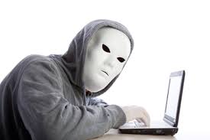
Online disinhibition effect (Suler, 2004)
Anonymity, invisibility, asynchronicity, solipstic introjection, dissociative imagination, minimization of status and authority
Toxic and benign
  hostillity x self-disclosure and support
Developed before web2.0
Anonymity???

Slide 12
Online disinhibition effect (Suler, 2004)
Anonymity, invisibility, asynchronicity, solipstic introjection, dissociative imagination, minimization of status and authority
Toxic and benign
  hostillity x self-disclosure and support
Developed before web2.0
Anonymity???
Still applicable
Psychological vs.
informatial

Slide 13
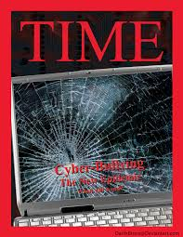
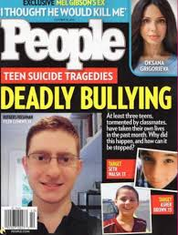
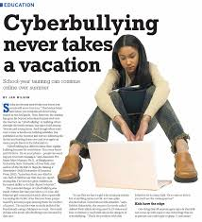
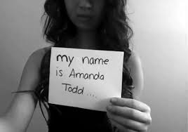
Cyberbullying and online aggression (harassment)
Cyberbullying: do you know the term?
Highly medialized
Contrast with empirical evidence

Slide 14
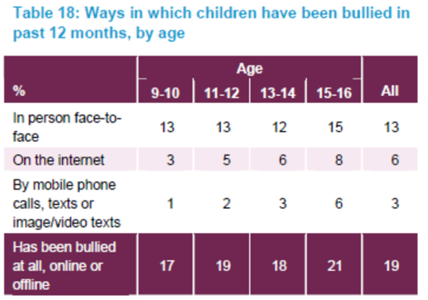
Cyberbullying and online aggression (harassment)
Cyberbullying: do you know the term?
Highly medialized
Contrast with empirical evidence
Kowalski et al. (2014): 10% - 40%
Also 3% - 70%

Slide 15
Cyberbullying and online aggression (harassment)
Definition of school bullying (Olweus, 1991) – criteria of
1) Intentional, causing harm
2) Repetitive
3) Power imbalance
Also many forms:
Overt/covert
Relational/Physical/Social
Physical/verbal attacks, degradation/humiliation, blackmailing, destroying things, social exclusion, ignoring…

Slide 16
Cyberbullying and online aggression (harassment)
Cyberbullying: intentional and aggressive act carried out through electronic media, which may be repetitive in nature (Nocentini et al., 2010; Tokunaga, 2010)
What are the forms here?
Verbal attacks, insults, threats, gossips…
Spreading of personal and sensitive information
  Without consent
Identity theft, mascarade
Social exclusion, ostracism
Publishing of harmful audiovisual material (changed)
Happy slapping
...

Slide 17
Cyberbullying and online aggression (harassment)
We are talking about cyberbullying if the aggressive attacks :
are conducted via internet or mobile phones
are intentionally harmful (conducted by individual or group)
  and are harmful for victim
are repeated (however….)
there is power imbalance – the victims can‘t easily defend themselves

Slide 18
Cyberbullying and online aggression (harassment)
We are talking about cyberbullying if the aggressive attacks :
are conducted via internet or mobile phones
are intentionally harmful (conducted by individual or group)
  and are harmful for victim
are repeated (however….)
there is power imbalance – the victims can‘t easily defend themselves
Harm is not always present!
Difficulties of harm assessment

Slide 19
Cyberbullying and online aggression (harassment)
We are talking about cyberbullying if the aggressive attacks :
are conducted via internet or mobile phones
are intentionally harmful (conducted by individual or group)
  and are harmful for victim
are repeated (however….)
there is power imbalance – the victims can‘t easily defend themselves
Repetition: problematic online
„once published, always online“
Important in messaging (email, phones…)

Slide 20
Cyberbullying and online aggression (harassment)
We are talking about cyberbullying if the aggressive attacks :
are conducted via internet or mobile phones
are intentionally harmful (conducted by individual or group)
  and are harmful for victim
are repeated (however….)
there is power imbalance – the victims can‘t easily defend themselves
Digital skills?
Always online
Aggressors‘ anonymity (not so common)

Slide 21
Cyberbullying and online aggression (harassment)
We are talking about cyberbullying if the aggressive attacks :
are conducted via internet or mobile phones
are intentionally harmful (conducted by individual or group)
  and are harmful for victim
are repeated (however….)
there is power imbalance – the victims can‘t easily defend themselves
If these criteria are not fullfilled:
online aggression/harassment

Slide 22
Cyberbullying and online aggression (harassment)
„New bottle, old wine“?
What is „new“?
No time/space limits – no escape
Distance – the victim does not have to be present (adding comments, likes, spreading of information….)
Wide audience - potential
Spreading and sharing – easy and fast, unlimited
No control over the content
Can be „hidden“ – out of control of adults

Slide 23
Cyberbullying and online aggression (harassment)
„New bottle, old wine“?
What is „new“?
Victims – offline often vulnerable
In cyberbullying: potential for new vulnerability
Remember „diminishing of authority“, anonymity?
More often: frequent internet users, users of webcams and IM

Slide 24
Cyberbullying and online aggression (harassment)
Cyberbullying: detrimental effect on victims
Similar to offline bullying
Including:
Internalization and externalizing behaviors
Emotional problems (depression, anxiety, suicidal thougths)
Social problems
Lower self-esteem
Helplessness
Academic problems
Etc.

Slide 25
Cyberbullying and online aggression (harassment)
The impact depends on the severity of the attacks
- importance to distinguish cyberbullying and harassment!
CB could be more harmful then offline
  Especially cases of public forms, and especially including audiovisual materials (Sticca & Perren, 2013)
Depends on the interconnection with offline bullying
- usually connected („double whammies“)
Also depends on coping with cyberbullying

Slide 26
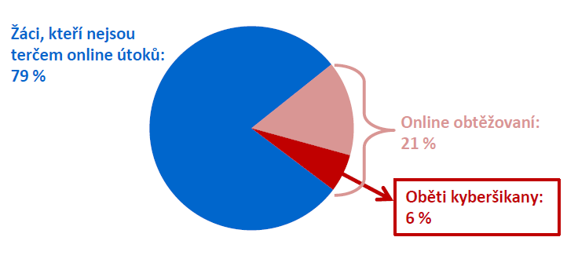
Cyberbullying and online aggression (harassment)
The impact depends on the severity of the attacks
- importance to distinguish cyberbullying and harassment!
Could be more harmful then offline
  Especially cases of public forms, and especially including audiovisual materials (Sticca & Perren, 2013)
Differences in prevalences and impact
Cyberbullying: less common, but more severe
Czech project: 79% no victimization
21% harassment
http://irtis.fss.muni.cz/wp-content/uploads/2013/06/COST_CZ_report_II_CJ.pdf
6% CB victims

Slide 27
Cyberbullying and online aggression (harassment)
The impact depends on the severity of the attacks
- importance to distinguish cyberbullying and harassment!
Could be more harmful then offline
  Especially cases of public forms, and especially including audiovisual materials (Sticca & Perren, 2013)
Depends on the interconnection with offline bullying
- usually connected („double whammies“)
Also depends on coping with cyberbullying

Slide 28
Cyberbullying and online aggression (harassment)
Coping with cyberbullying
Many different strategies
Emotion/problem focused
Mal/adaptive?
Similar to offline responses
new – „technological coping“
Question of effectiveneess in coping with online attacks

Slide 29
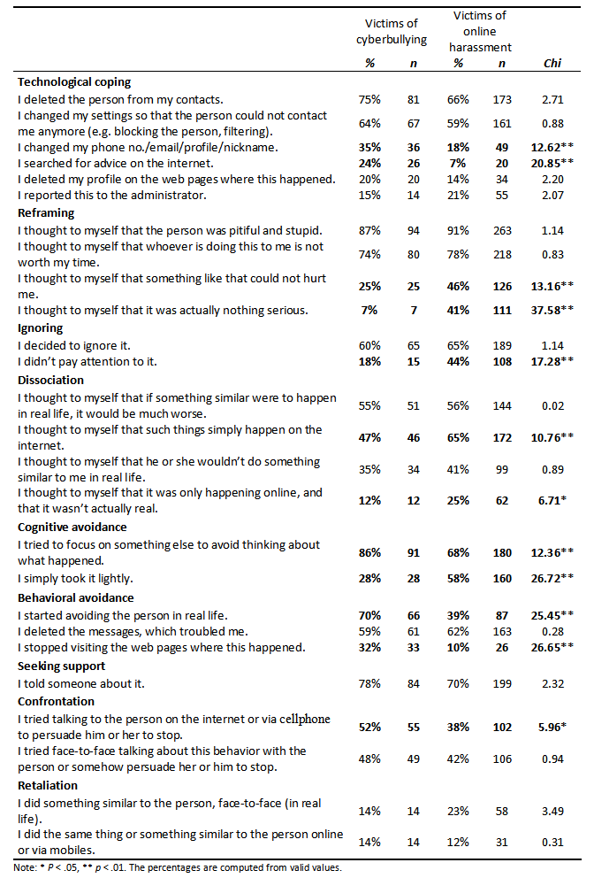
Strategies applied
CB victims more active
Cognitive strategies:
- reframing to depreciate the bully and avoided or purposefully ignored them
cognitive distancing
not much disociation
Tech. Coping – not so often
Machackova, H., Cerna, A., Sevcikova, A., Dedkova, L., & Daneback, K. (2013). Effectiveness of coping strategies for victims of cyberbullying. Cyberpsychology: Journal of Psychosocial Research on Cyberspace, 7(3), article 5. doi: 10.5817/CP2013-3-5

Slide 30
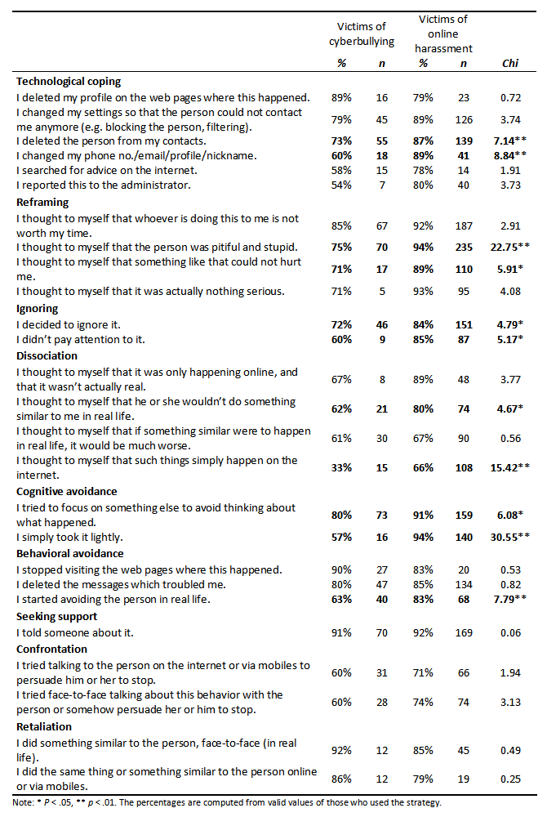
Strategies helping emotionally
- generally, less often effective among CB victims
- effective cognitive strategies
not all, exceptions: „taking it lightly“ it „happens online“

Slide 31
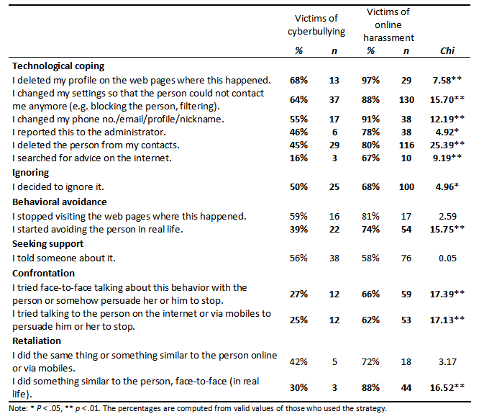
Strategies helping stop the attacks:
- technological coping
- but not all (and often not applied)
Ignoring
Confrontation or retaliation not very effective

Slide 32
Cyberbullying and online aggression (harassment)
Outcome also depends on the context
Including responses of others – the audience
Bystanders in cyberbullying
much more common than victimization
Czech project: 53%

Slide 33
Cyberbullying and online aggression (harassment)
What can they do? (online and offline)
Support the victim: emotionaly, advice provision, confrontation of aggressor…
Reinforce the bully: joining in, reposts, sharing, likes, comments…
Passivity: most common
Helpful:
decreases impact, can stop the attacks, help to cope

Slide 34
Cyberbullying and online aggression (harassment)
What can they do? (online and offline)
Support the victim: emotionaly, advice provision, confrontation of aggressor…
Reinforce the bully: joining in, reposts, sharing, likes, comments…
Passivity: most common
Increases the impact, especially when wide audience, causes of repetiveness…

Slide 35
Cyberbullying and online aggression (harassment)
What can they do? (online and offline)
Support the victim: emotionaly, advice provision, confrontation of aggressor…
Reinforce the bully: joining in, reposts, sharing, likes, comments…
Passivity: most common
Harmless? No
Increases impact, may be interpreted as silent approval by both victim and aggressor
Metadata: visits, views…

Slide 36

Cyberbullying and online aggression (harassment)
Who helps victim?
Empathy, prosocial behavior, norms, relationship with the victim…
Who reinforces bully?
Low empathy, aggressive beliefs, relationship with aggressor…
Who stays passive???
Despite common antibullying norms

Slide 37
Cyberbullying and online aggression (harassment)
What is „new“? – Context
Specific communication and environment
Distance
Lack of cues
Wide audience

Slide 38
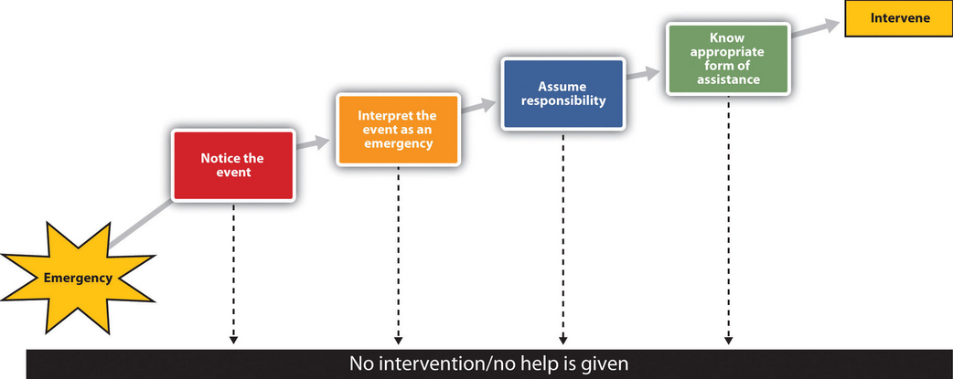
Cyberbullying and online aggression (harassment)
Latané & Darley (1970)

Slide 39
Cyberbullying and online aggression (harassment)
Attention and distractions

Slide 40
Cyberbullying and online aggression (harassment)
Complicated assessment, „just a joke“, not serious

Slide 41
Cyberbullying and online aggression (harassment)
Wide audience, who (where) is victim, ongoing event?

Slide 42
Cyberbullying and online aggression (harassment)
Assessment, self-efficacy, own victimization, aggravation of problem?

Slide 43
Audience in aggressive events
These aspects concern also responses to other aggressive events
What is your experience with online aggression?

Slide 44
Cyberhate
Another type of aggression encountered on the internet
Intergroup aggression
The potential for reaching very wide audience
Detrimental effect for individuals and society
Today one of major topic on international level

Slide 45
Hate speech, cyberhate
Greenawalt (1989): hate speech causes offence, may deeply wound those targeted, might provoke a response of violence, have a degrading effect on social relationships within any one community
Council of Europe, 2013:
Hate speech has no particular definition in international human rights; it is a term used to describe broad discourse that is extremely negative and constitutes a threat to social peace.
It covers all forms of expression which spread, incite, promote or justify racial hatred, xenophobia, anti-Semitism or other forms of hatred based on intolerance.
(http://www.coe.int/en/web/freedom-expression/hate-speech)
Cyberhate: "similar to cyberbullying, but online extremist and hate material aim the abuse at a collective identity rather than a specific individual" (Hawdon et al.,2015)

Slide 46
Cyberhate
Roots in offline world
Attitides, opinions
Social norms
Group identity
In-groups and out-groups
Prejudices

Slide 47
Cyberhate
Online
Increasing? (increasing internet use)
Dispersing?
many new platforms
prominently SNS

Slide 48
Cyberhate
Online disinhibition
  Hostility
  Anonymity, invisibility, asynchronicity, solipstic introjection, dissociative imagination, minimization of status and authority
SIDE model
  Strengthening of social identity (Tajfel, Turner)
  Potential for expression of normatively negative attitudes, behavior
Anonymity vs. identifiability
  still no such constrains to join such group/express an attitude

Slide 49
Cyberhate
  Anonymity
  Lower anonymity connected to decrease of aggressive comments in online discussion (Cho & Kwon, 2015)
Czech study: Constent analysis of 1,080 comments under 54 posts on 9 FB pages arguing against specific social group (1.1. - 12.4.2016)
The more anonymous autor is, the more vulgar comment and the more negative „atmosphere“ of the statements
Group processess
The more negative attitudes towards out-group by administrators, the more negative emotions in following comments.
(Jitka Čurdová (2016). Vliv anonymity, deindividuace a skupinové normy na míru vyjadřované agrese v komentářích na sociální síti Facebook. Diplomová práce, Masarykova Univerzita.)

Slide 50
In the past 12 months, have you seen websites where people discuss hate messages that attack certain groups or individuals ? (EUKO, 2010; NCGM, 2013)

Slide 51
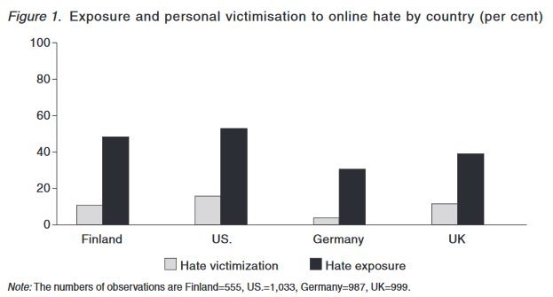
„In the past three months, have you seen hateful or degrading writings or speech online, which inappropriately attacked certain groups of people or individuals”?
“I have personally been the target of hateful or degrading material online“.
AGE 15-30
Hawdon, J., Oksanen, A., & Räsänen, P. (2015) Online Extremism and Online Hate.

Slide 52
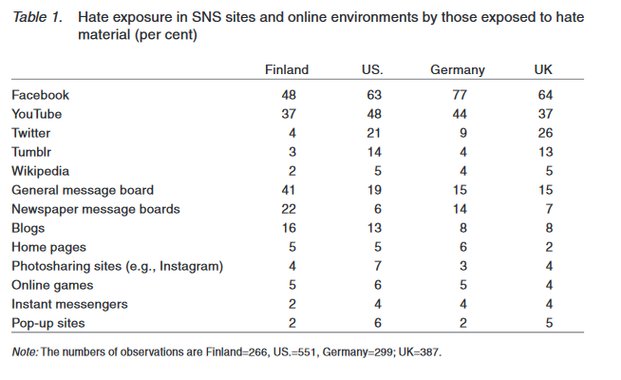
Hawdon, J., Oksanen, A., & Räsänen, P. (2015) Online Extremism and Online Hate.

Slide 53
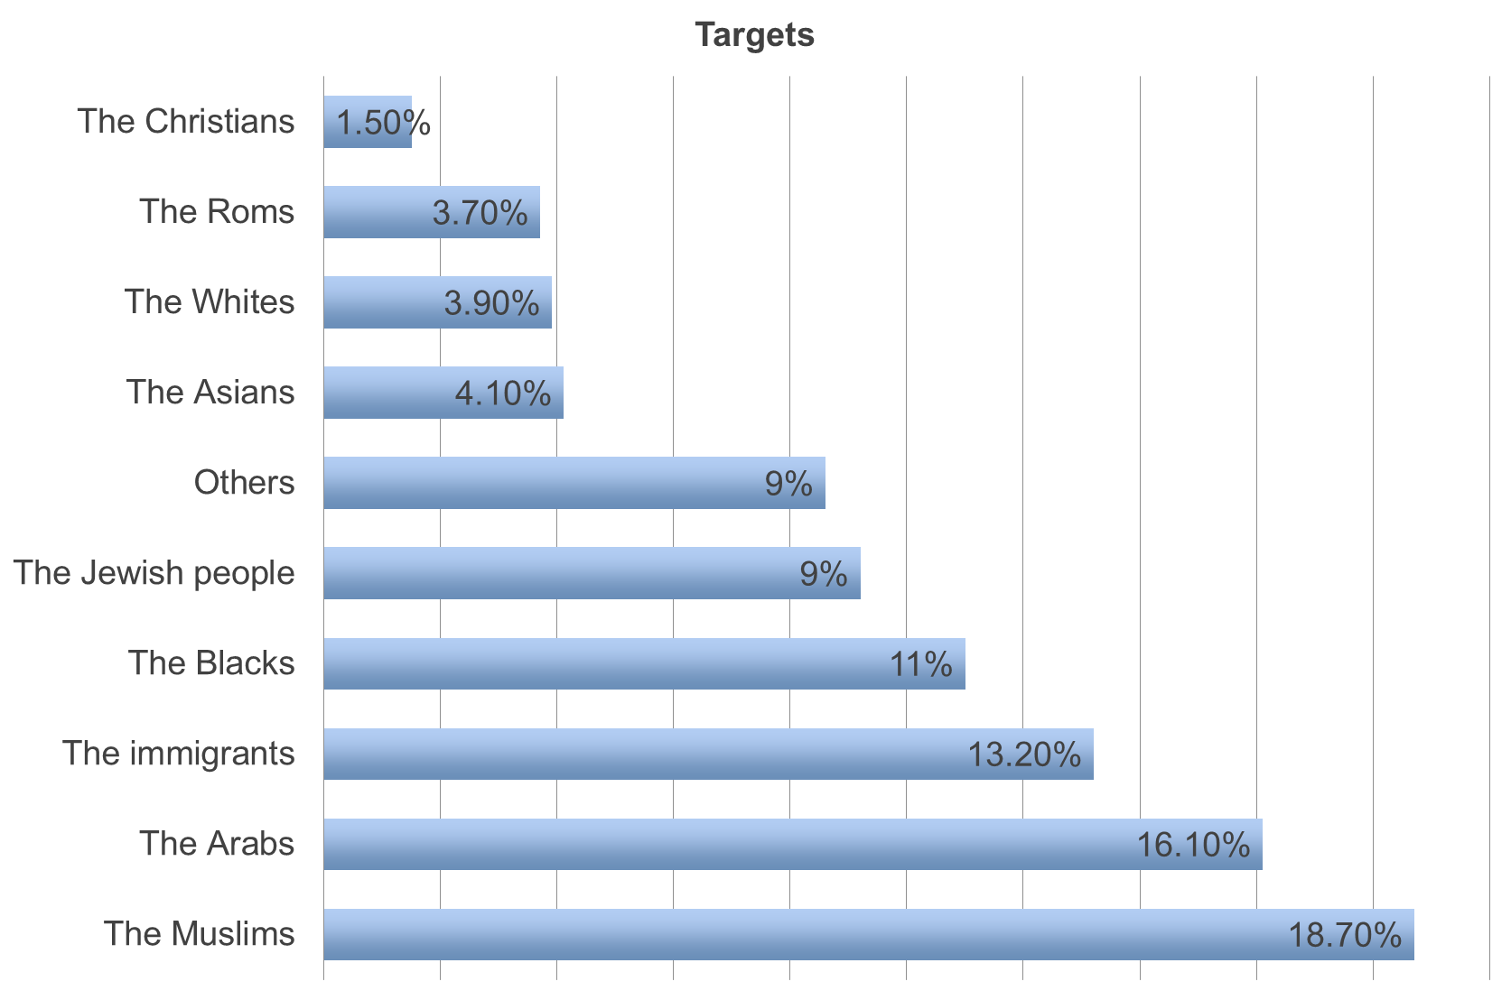
French study on cyberhate
Online questionnaire survey with students aged 11-20.
Exposure to cyberhate: 35,2%
Blaya, C. et al. (2016). The involvement of the young people in cyberhate. Presented at the ECREA conference, Prague.

Slide 54
Hateful information online
Internet as a source of information
  Huge diversity
  Sources, mediums, channels
The information and messages are shaped by social environment they are coming from and embedded into
  „Facts“, „information“ – socialy constructed
  „Depending on“ the character of the source
  Creating, spreading, sharing…
  Selecting specific type of information to present (and to conceal)
We often pre-select the sources which we use
  Similarity to our opinions
  Confirmation bias
Echo chambers – which information is faciliated, repeated? Which is absent?
  specific social spaces in which is/are certain information/attitudes/views predominant
  Based also on diverse algorithms (Google, Facebook…)

Slide 55
Hate communities online/Hate sites
ONLINE COMMUNITIES
Specific online places in which and through which people interact
Shared interests, goals, identity (sense of belonging)
Opportunity for self-expression
  Individual and group level
Opportunity for sense of belonging
  And in-group behavior
Discourse, materials
Source of biased information
Reinforced by the members

Slide 56
Hate communities online/Hate sites
Positive and negative outcomes
  Sometimes very hard to untangle
  For whom?
Clash of different (offline) communities online
Attacks on and from specific (online) communities/groups
Example: extreme right communities

Slide 57
Hate communities online/Hate sites
„Link, educate, recruit“ (Douglas, 2007)
Persuasion:
  Not often advocating violence as such
  „Objectivity“
  Establishing specific discourse and norms
  In-group

Slide 58
„Socialy creative“
Moral disengagement
Bandura: Morality – norms, social and internalised sanctions
Self-monitoring, evaluation, regulation (affective)
Moral disengagement: cognitive restructuring of inhumane conduct into a benign or worthy one
moral justification, sanitizing language, and advantageous comparison;
disavowal of a sense of personal agency by diffusion or displacement of responsibility;
disregarding or minimizing the injurious effects of one 's actions
attribution of blame to, and dehumanization of those who are victimized.
Bandura, A. (1999). Moral disengagement in the perpetration of inhumanities. Personality and social psychology review, 3(3), 193-209.

Slide 59
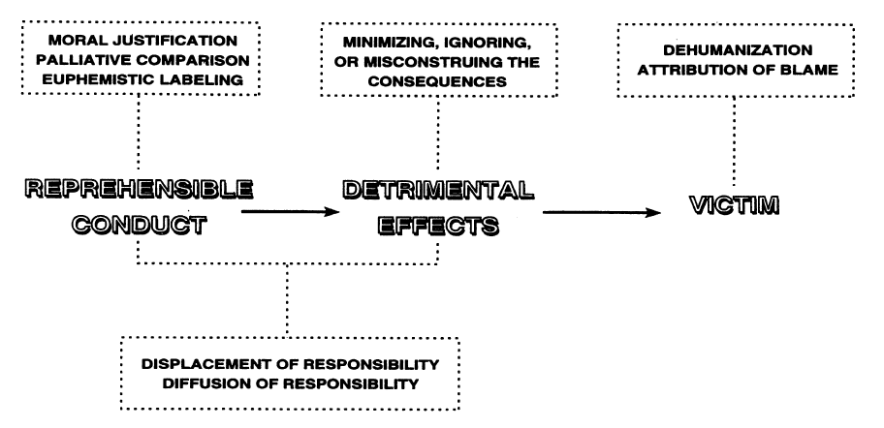

Slide 60
„We are saving humanity“
„Its better then what they did!“
„War vs. Fight for freedom“

Slide 61
„Nobody did nothing“
„It was an order“
„I was just a messanger“

Slide 62
„It was not that bad“
„Its not like we killed them“
„We just teached them a lesson“

Slide 63
„They are like rats“
„They just got what they deserved“

Slide 64
Hate communities online/Hate sites
Concentrated materials, information – selected discourse, concealment and repression of opposite views
  support in the community
  approving comments
  reinforcement of attitudes
  shared identity, belonging
  providing space for self-expression
  delineating out-group („media“, „liberals“,…)
  framing aggression as a mean to – seemingly justified - end

Slide 65
Hate communities online/Hate sites
Concentrated materials, information – selected discourse, concealment and repression of opposite views
  support in the community
  approving comments
  reinforcement of attitudes
  shared identity, belonging
  providing space for self-expression
  delineating out-group („media“, „liberals“,…)
  framing aggression as a mean to – seemingly justified - end
Specific discoursive space
Supporting one ideology
Strengthening social identity

Slide 66
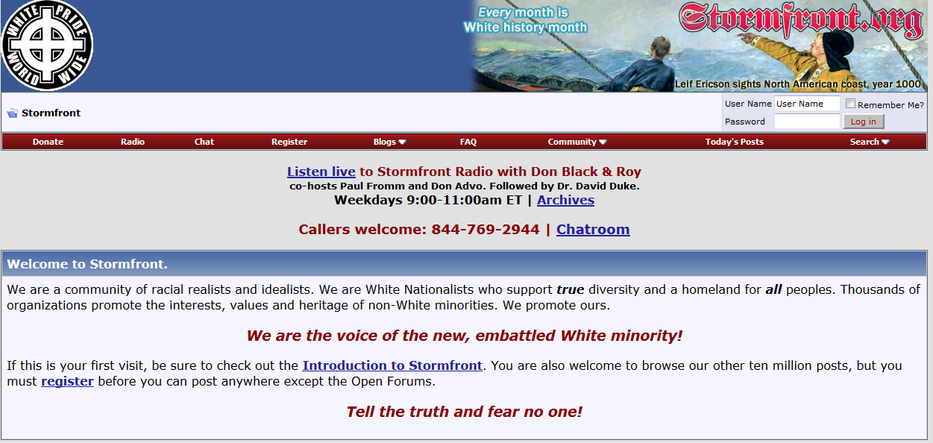
Example: https://www.stormfront.org/

Slide 67
Combating hate online?
Problem with evaluation
What is normal? What is moral? Legitimate? Legal? Normative?
Across cultures?
Back to conceptualization aggression – different types
Different purposes
Treshold?

Slide 68
Combating hate online?
Problem with evaluation
…and freedom of speech
Ban
  Resistance, strengthening of identity?
  Free speech?
Law
  no united international law
General protest
Humor, sarcasm
Trolling
http://www.adl.org/combating-hate/
http://www.hatefree.cz/
https://cs-cz.facebook.com/CeskeObludarium

Slide 69
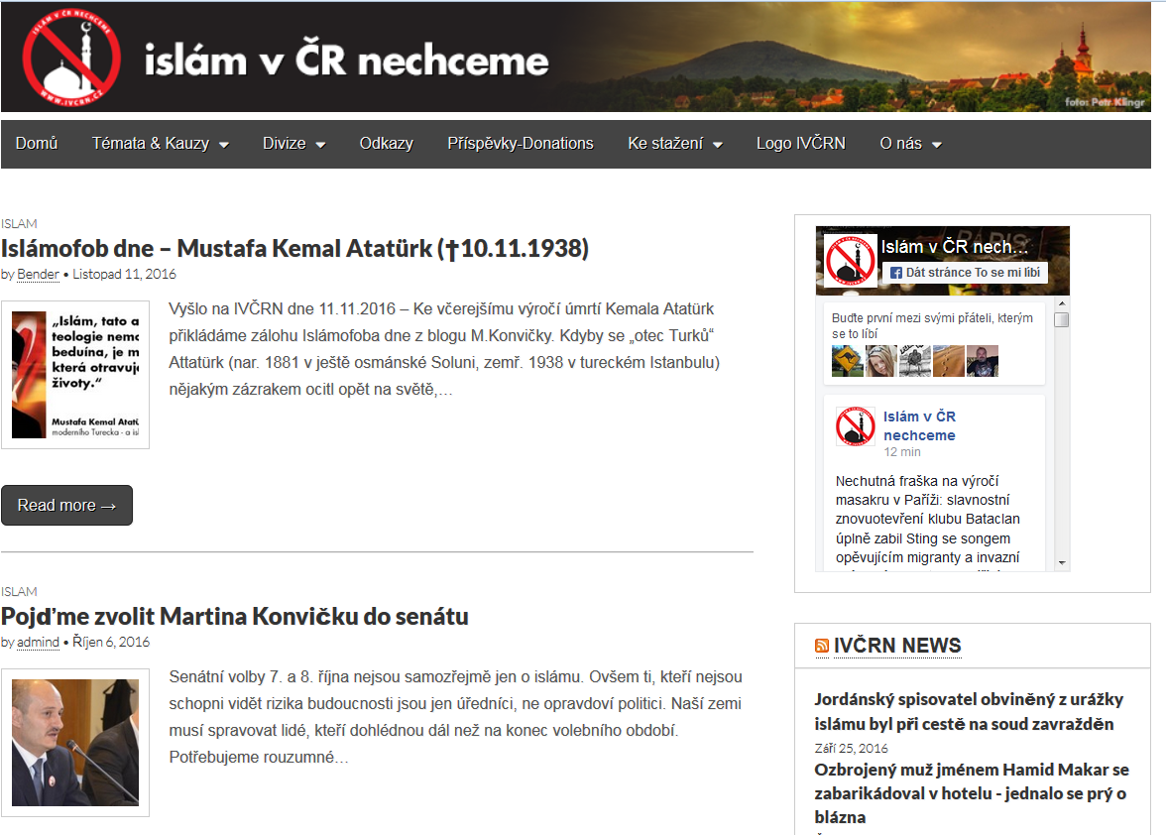
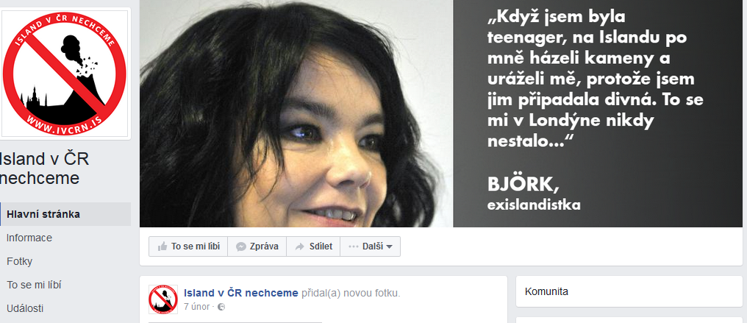
We do not want islam in the Czech Republic
We do not want Iceland in the Czech Republic
„We just want to say that our site does not have anything against normal Icelandic people, because those are just victims of the criminal ideology and perverted lifestyle called ICELAND! Help us to stop this filth which wants (similarly to volcano ash) to cover our beautiful country!

