Slide 1
Media effects
Lukas Blinka

Slide 2
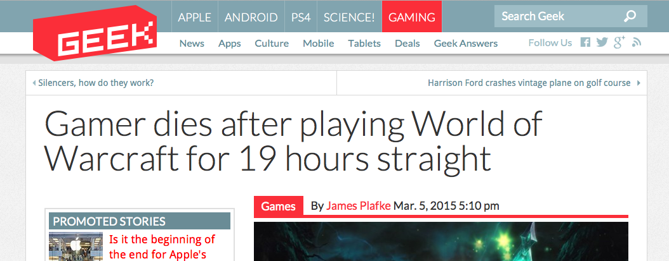
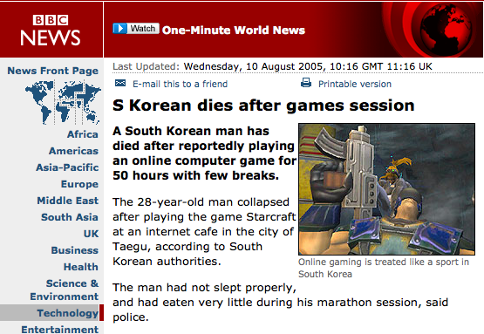
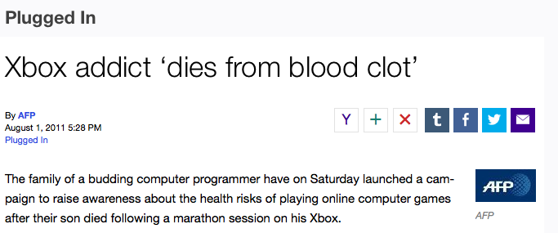
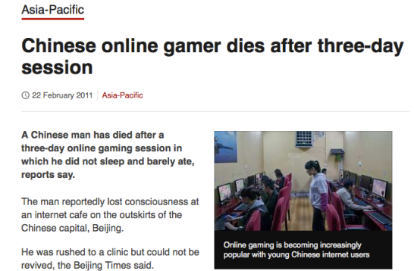
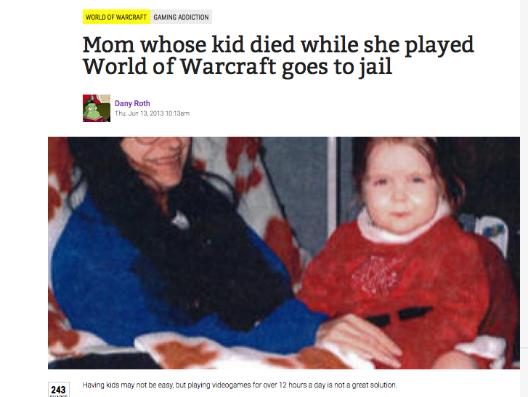

Slide 3
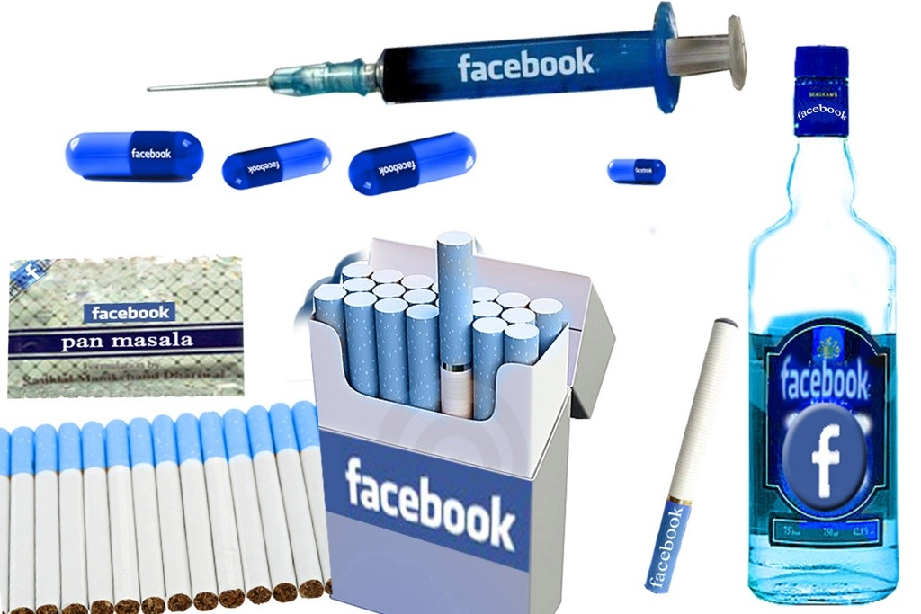

Slide 4
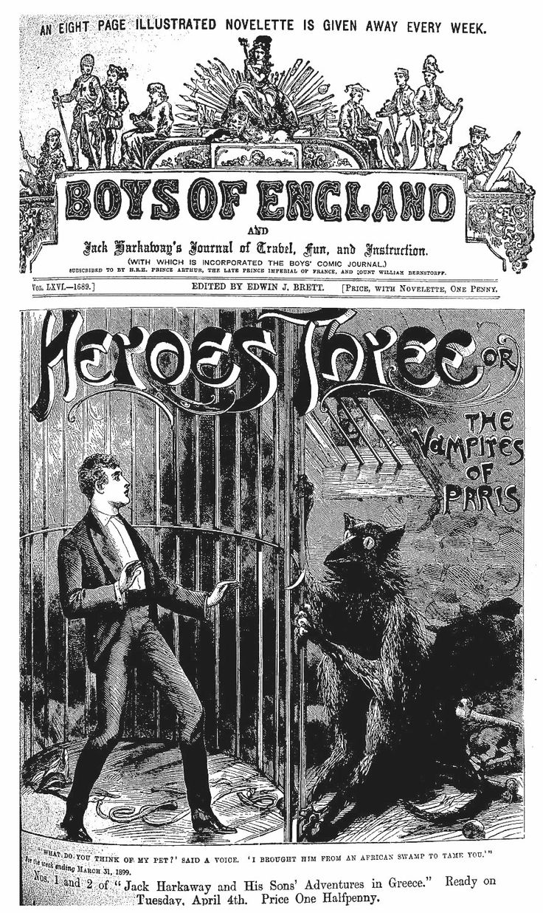

Slide 5
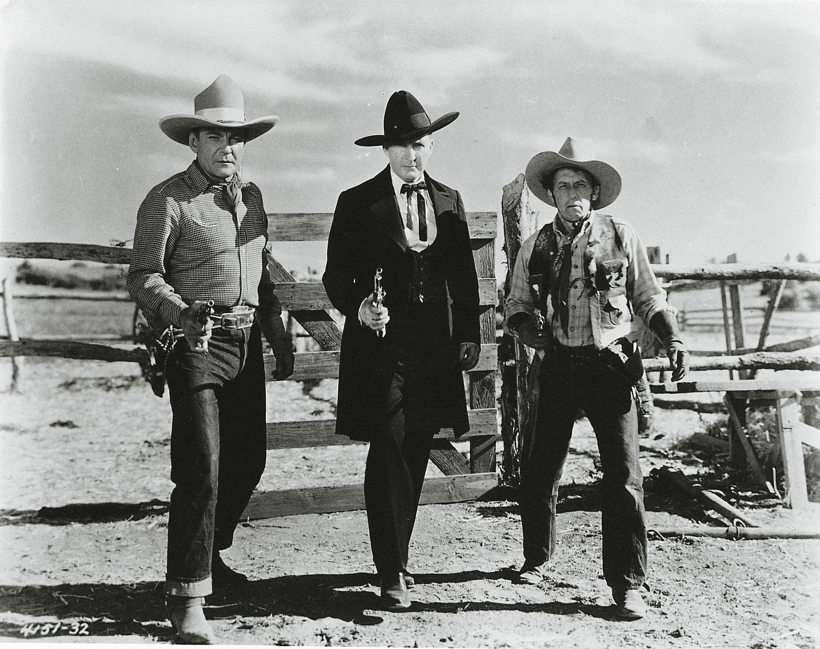

Slide 6
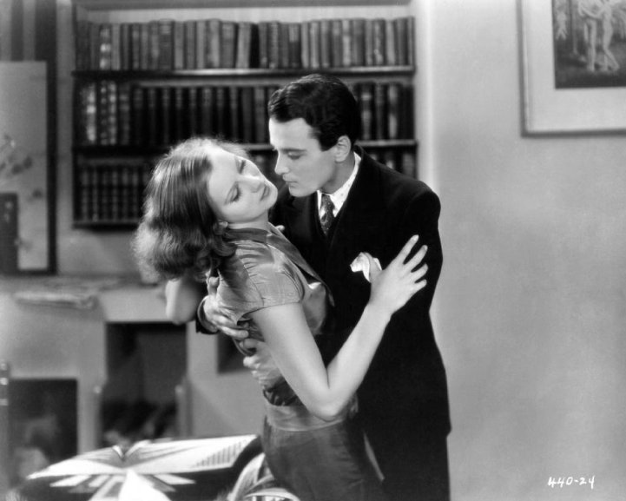

Slide 7
1929 – The Payene Fund Studies
How cinema effects children?
Measuring galvanic skin reaction while watching movie sequences
Romantic scenes did not effect children at all but sex scenes blew the sixteen-year-olds off the graphs
Survey part with parents and teachers – children are heavily under influence of bad moral in films

Slide 8
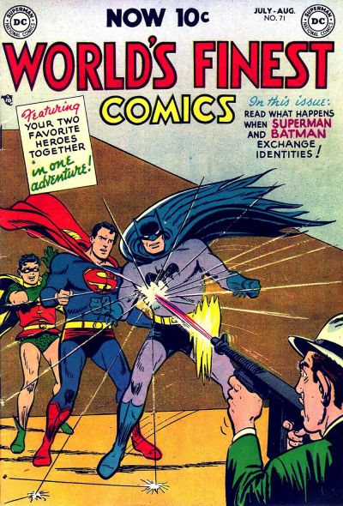

Slide 9
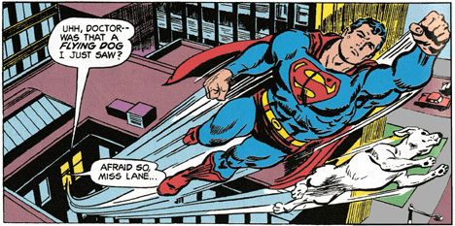

Slide 10
40s-50s – Wertham's studies
Comic books are evil!
Youngsters spend up to 3 hours a day reading them!
Surely they have lost their sense of reality!
Content analysis of popular comic books
Tried to find and match between unrealistic hero behaviour and cases when children died

Slide 11
50s Television studies
Frankfurt school, T. Adorno – critique of the pop – low- culture
Televize – serialization, advertising, parasocial relationships

Slide 12
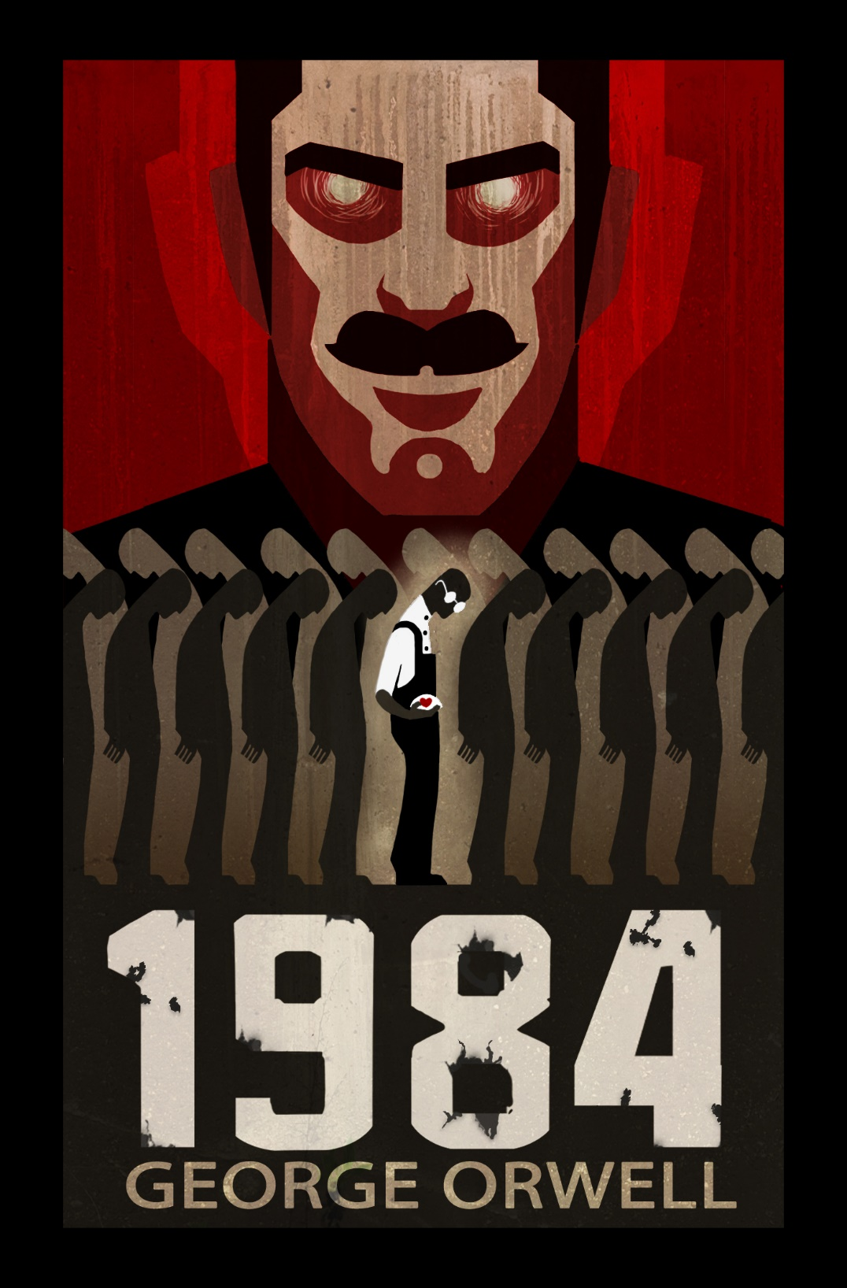

Slide 13
60s behaviorism
A. Bandura – social learning theory
Bobo doll experiment
https://www.youtube.com/watch?v=NjTxQy_U3ac&t=2s

Slide 14
BIG MEDIA EFFECTS
Direct and causal relationship between media use and effect (on attitudes, moods, behaviours,…)
Technological determinism
Internet, computer games, Facebook, smartphones,… make us addicted, aggressive,…

Slide 15
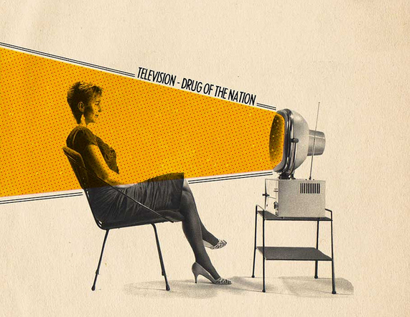
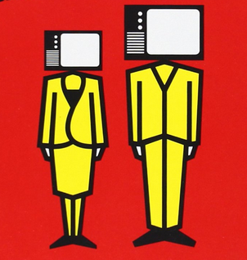
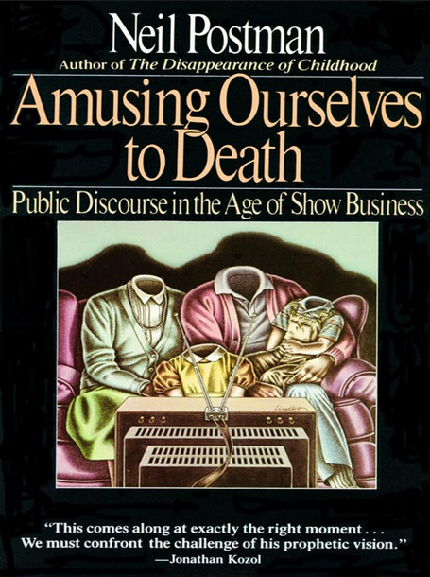
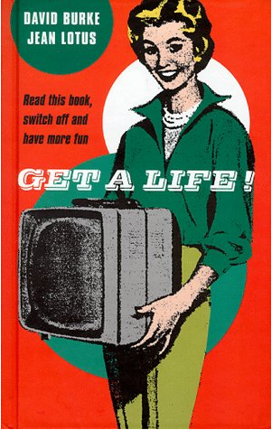
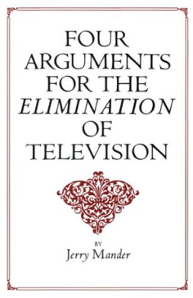
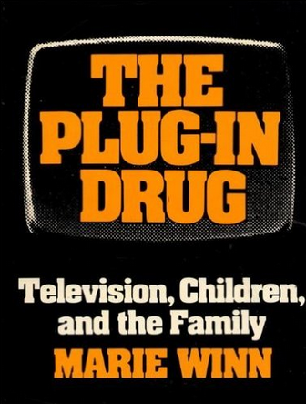
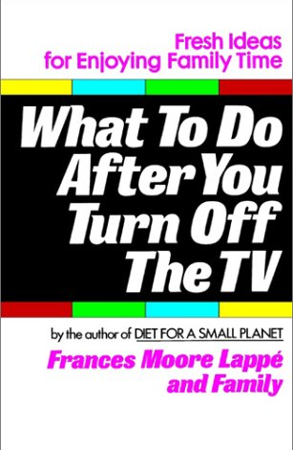
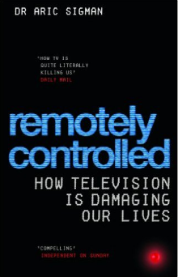
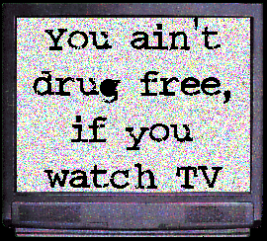
Notes:
Nadměrná konzumace televize
- hloupnutí, pasivita, lenost, obezita, vyšší kriminalita a ochota k násilí, těhotenství nezletilých...
Frankfurtská škola – televize odvádí pozornost od podstatných věcí
Boom kritiky televize v USA 70-90. léta, v ČR 90. léta a později
Williams (1975): flow jako sekvence nebo sada sekvencí obsahů

Slide 17
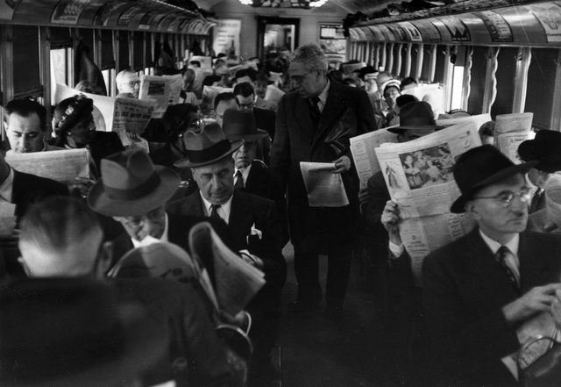

Slide 18
SMALL MEDIA EFFECTS
Media panic, it tend to diminish over time
We tend to be blind on media that has become common
E.g. Paul Felix Lazarfeld studies on political campaigns

Slide 19
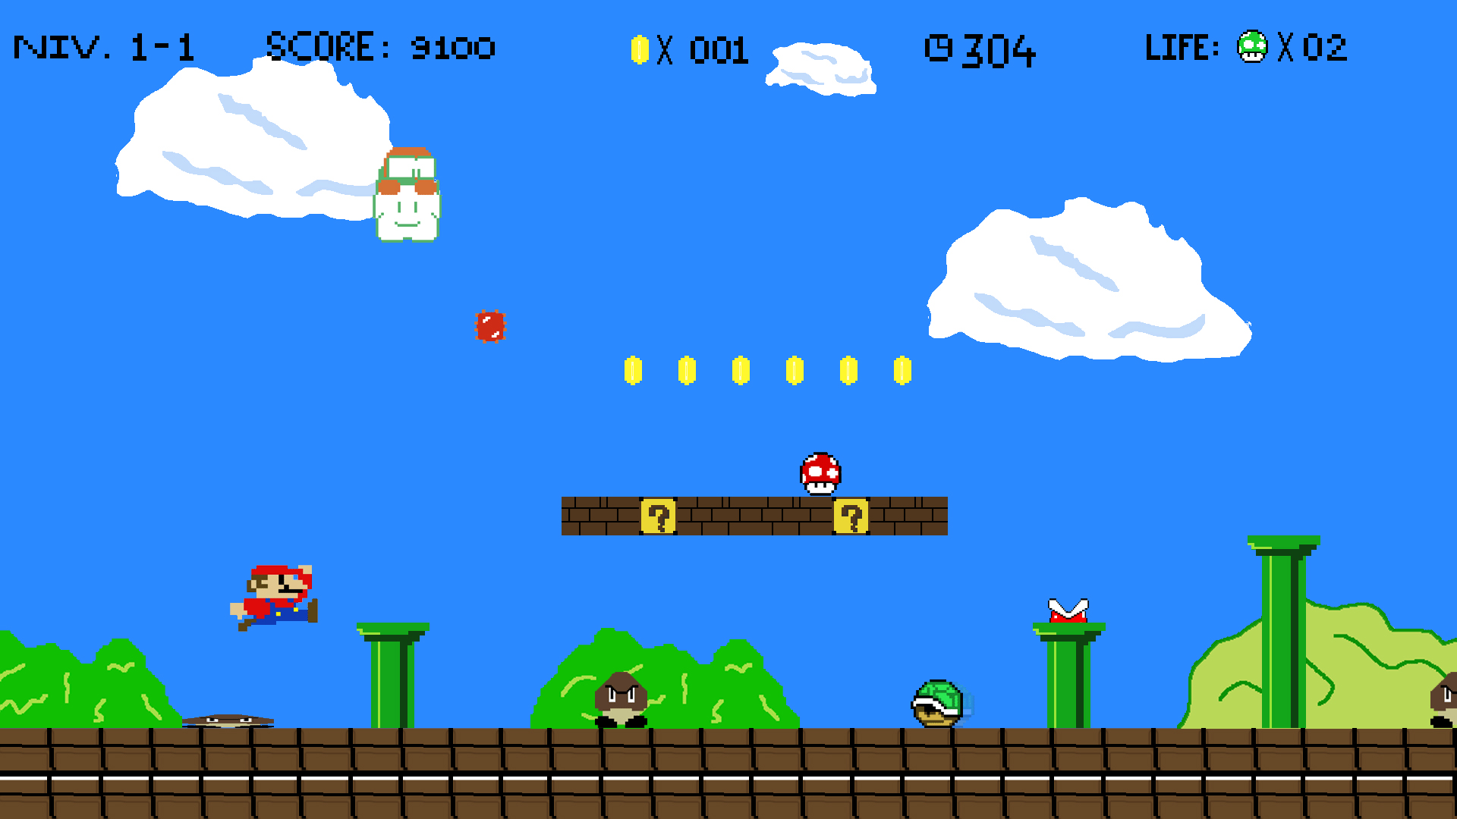

Slide 20
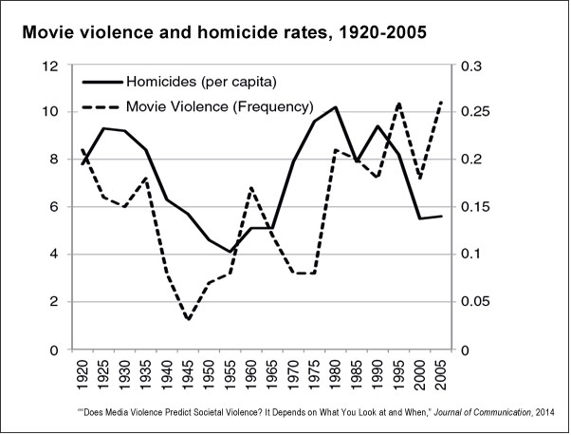
Does Media Violence Predict Societal Violence? It Depends on What You Look at and When

Slide 21
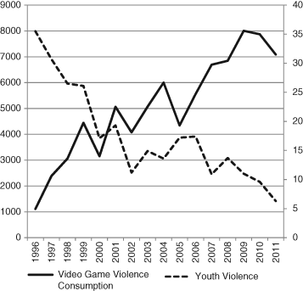
Does Media Violence Predict Societal Violence? It Depends on What You Look at and When
Journal of Communication Volume 65, Issue 1, pages E1-E22, 5 NOV 2014 DOI: 10.1111/jcom.12129 http://onlinelibrary.wiley.com/doi/10.1111/jcom.12129/full#jcom12129-fig-0003
Notes:
Societal videogame violence consumption and societal youth violence, 1996–2011.
IF THIS IMAGE HAS BEEN PROVIDED BY OR IS OWNED BY A THIRD PARTY, AS INDICATED IN THE CAPTION LINE, THEN FURTHER PERMISSION MAY BE NEEDED BEFORE ANY FURTHER USE. PLEASE CONTACT WILEY'S PERMISSIONS DEPARTMENT ON PERMISSIONS@WILEY.COM OR USE THE RIGHTSLINK SERVICE BY CLICKING ON THE 'REQUEST PERMISSIONS' LINK ACCOMPANYING THIS ARTICLE. WILEY OR AUTHOR OWNED IMAGES MAY BE USED FOR NON-COMMERCIAL PURPOSES, SUBJECT TO PROPER CITATION OF THE ARTICLE, AUTHOR, AND PUBLISHER.

Slide 22
Meta-analytical studies show very small correlations about r= .1
Not surprising in complex systems
But surprising because it does not agree with case studies
Example: effect of scary media content on fear reaction of small children: generally small r=.18, but number of clinical case studies showed extreme reactions (Pearce & Field, 2015).

Slide 24
MIXED MEDIA EFFECTS Schramm, Lyle, Parker, 1961
For some children under some conditions some television is harmful.
For other children under the same conditions or for the same children under other condi­tions it may be beneficial.
For most children under most conditions, most tele­vision is probably neither particularly harmful nor particularly beneficial.

Slide 25
Factors of
susceptibility:
personality
development
social
cognitive, emotional,
physiological reaction
Media use
Media effects
Valkenburg, P. M., & Peter, J. (2013). The differential susceptibility to media effects model. Journal of Communication, 63(2), 221-243.

