Slide 1

Introduction to
STATA
Week 1 – Revision of basic statistical concepts

Slide 2
Teachers
Tomáš Katrňák
  katrnak@fss.muni.cz
  Office hours: Wednesday 11.15-12.30
Tomáš Doseděl
  dotomas@mail.muni.cz
  Office hours: upon e-mail request

Slide 3
Course outline
How to deal with STATA
Variable transformation
Descriptive data analysis
Multivariate data analysis

Slide 4
How to succeed
Submit a short paper: till the end of semester
  Project proposal, hypotheses: till the end of 3rd week
  Descriptive analysis: till the end of 7th week
  Multivariation analysis: till the end of 10th week
Final paper presentation
Active participation

Slide 5
Assessment
Submit a short paper: up to 23 points
  Project proposal, hypotheses: up to 10 point
  Descriptive analysis: up to 10 points
  Multivariation analysis: up to 10 points
Final paper presentation: up to 23 points
Active participation: up to 24 points (2 pts/week)
90-100 points: A | 80-89 points: B | 70-79 points: C
60-69 points: D | 50-59 points: E | 0-49 points: F

Slide 6
Revision of basic statistical concepts

Slide 7
Variables
What is a variable?

Slide 8
Variables
What is a variable?
  Age Gender Height Income
  „an abstraction of any possible object of the given class“

Slide 9
Variables
What is a variable?
Variable types

Slide 10
Variables
What is a variable ?
Variable types
  nominal

Slide 11
Variables
What is a variable ?
Variable types
  nominal
  name color gender occupation
  „nominate different attributes without the possibility to order them “

Slide 12
Variables
What is a variable ?
Variable types
  Nominal
  Ordinal

Slide 13
Variables
What is a variable ?
Variable types
  Nominal
  Ordinal
  Education level rank in a queue
  „we can order the values but are unable to decide their distance“

Slide 14
Variables
What is a variable ?
Variable types
  Nominal
  Ordinal
  Interval / Continuous

Slide 15
Variables
What is a variable ?
Variable types
  Nominal
  Ordinal
  Interval / Continuous
  Height Income Years spent in education
  „we can both order the values and decide about their distance “

Slide 16
Data matrix

Slide 17
Data matrix
Id | Gender | Age | Education | …
1 | Male | 19 | Tertiary
2 | Female | 27 | Secondary
3 | Male | 17 | Primary
4 | Male | 23 | Tertiary

Slide 18
Matice dat
Id | Gender | Age | Education | …
1 | Male | 19 | Tertiary
2 | Female | 27 | Secondary
3 | Male | 17 | Primary
4 | Male | 23 | Tertiary
Id | Gender | Age | Education | …
1 | 1 | 19 | 3
2 | 2 | 27 | 2
3 | 1 | 17 | 1
4 | 1 | 23 | 3

Slide 19
Correlation

Slide 20
Correlation
The strength of a relation between two variables
Both variables are in a relation (co-relate), if one changes, change the other
Doesn’t necessary mean causality!

Slide 21
Linear regression (OLS)

Slide 22
Linear regression (OLS)

Slide 23
Linear regression (OLS)

Slide 24
Linear regression (OLS)
y = a + bx
a – intercept
b – slope

Slide 25
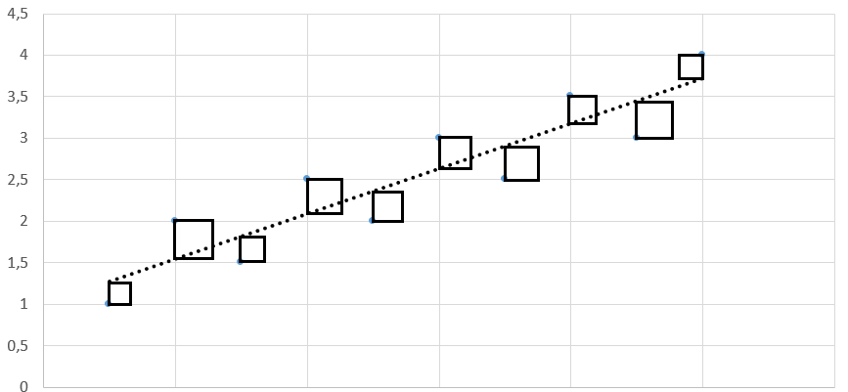
Linear regression (OLS)
Ordinary least square – tries to find a solution for which the sum of the squares is minimal. Squares are defined by the distance of respective point from the line.

