Slide 1
Michel
Foucault
Jan Kříž, Markéta Skopalová, Marianna Mikešová

Slide 2
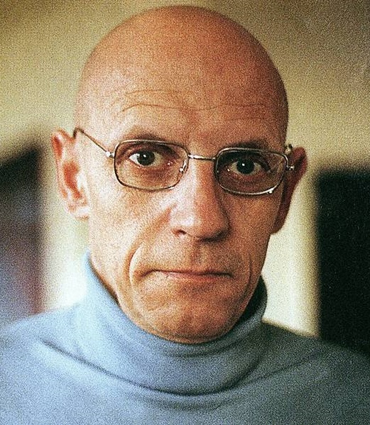
Biography
Born in 1926
French nationality
Homosexual
Suicidal tendencies
Philosophy and psychology
Member of French Communist Party
Political activist
Died of AIDS in 1984

Slide 3
Foucalt‘s philosophy
Foucault does not fit into traditional schools of thought
He did not write just for academic audience
He did not see himself as advancing general theory

Slide 4
Concept of power and knowledge
Prison and disciplinary institutions
Power
  How it is exercised
  Micro-level
  Repression, violence
  Agents
  Politics of everyday life

Slide 5
Discipline
Aspects of power and knowledge which are masked
Blockdisciplinary blocks
Abilities, resources, relationships, communication
Conditions:
  Ideal model: Panopticon
  Activities are planned and broken down into stages
  Efficiency
Social control
The role of school

Slide 6
The modern school
How does it change through years?
Governance
Modern power as a technique
Normalising function
Turning morality into a set of skills/desirable attitudes

Slide 7
Michel Foucault: Discipline & Punish
1975
changes of the Western penal system
influenced by Nietzsche and structuralism
power/knowledge relationship

Slide 8
Michel Foucault: Discipline & Punish
Panopticon – Bentham`s power/knowledge technique
Panopticism – social theory by Foucault
Discipline – technique of mass control

