Slide 1
ORIENTALISM
EDWARD W. SAID
Monika Forethová
Volkan Yalvacli
Yessenia Lizbeth Soto Castro

Slide 2
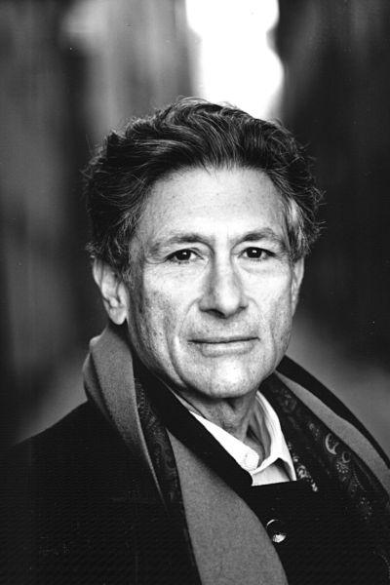
EDWARD WADIE SAID
Born on 1 November 1935, Jerusalem.
Founder of the academic field of postcolonial studies.
Influenced by Gramsci, Foucault, Fanon, Césaire and Adorno.

Slide 3
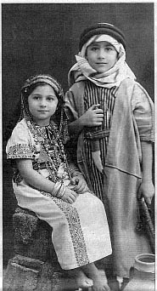
ORIENTALISM
'Edward' is the name of British, 'Said' is a arabic name.
1948 Israel established, 1967 first war between Palestine and Israel. (Colonel Bagshot -Six Day War 1971)
Princeton & Harvard University
1978 – Orientalism
Died in New York, 2003.

Slide 4


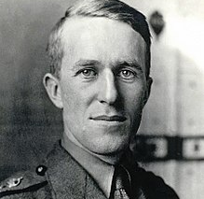

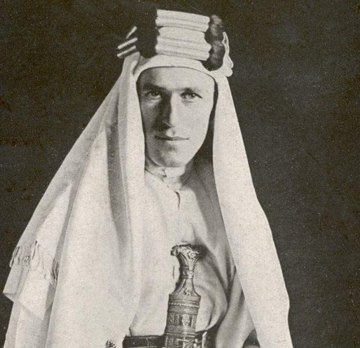
Before the Book and Term of ‘Orientalism’
Good or Bad ‘Orientalist’
Thomas Edward Lawrence or Arab Lawrence
Artists, painters, writers..
They cannot represent themselves; they must be represented. -Karl Marx

Slide 5
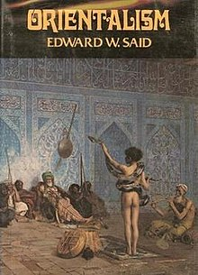
ORIENTALISM - 1978
Known for the book ORIENTALISM, a critique of the cultural representations that are the bases of orientalism (how the Western world perceives the Orient).
Living in the Western Region as a native of the Arab
Applied his education and bi-cultural perspective to illuminating the gaps of cultural and political understanding between the Easter and Western world.

Slide 6
ORIENTALISM
The relationship between Occident and Orient is a relationship of power, of domination, of varying degrees of a compex hegemony.
Orientalism for information or Orientalism for dominate ?
As a Western style for dominating restructuring, and having authority over the Orient

Slide 7
ORIENTALISM
1 - Academic study field (Orient languages and literatures)
2- Is a style of thought based upon and ontological and epistemological distinction made between “the Orient” and most of the time “the Occident”.
3- Corporate institution

Slide 8

Occidentalism
Criticizes the rationalism, individualism and mechanization (industrialization) in the West.

Slide 9
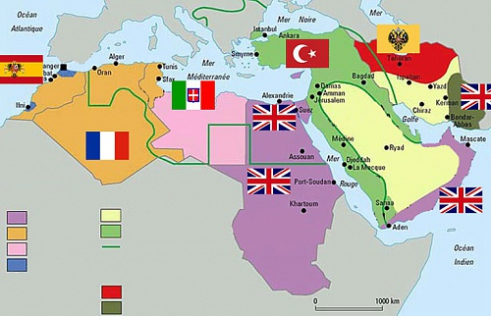
THE DISTINCTION BETWEEN PURE AND POLITICAL KNOWLEDGE
Be nonpolitical or not?
Historical connection
The importance of three great imperiums

Slide 10
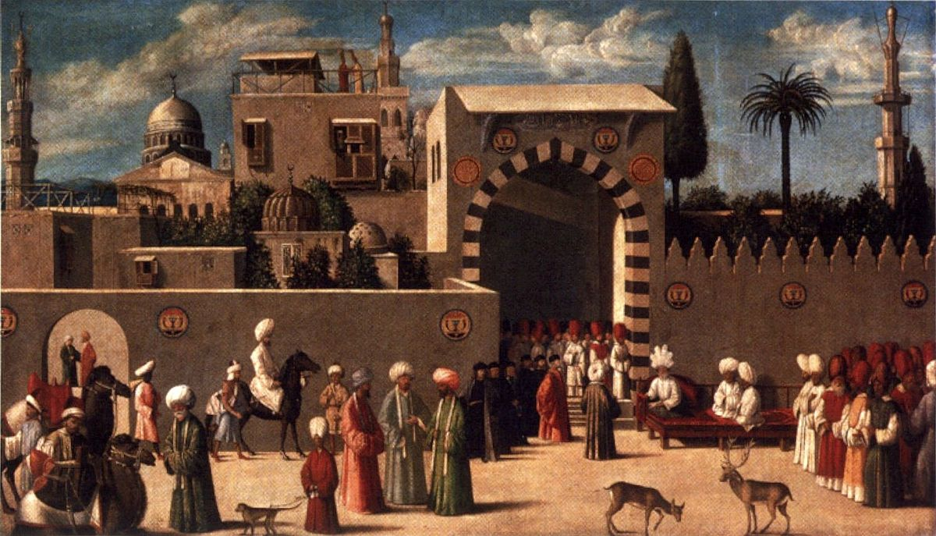
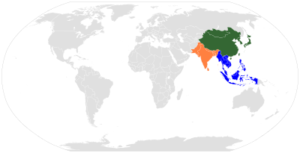
THE METHODOLOGICAL QUESTION
Starting point of his project
British, French and American experience
British and French orientalism

Slide 11

THE PERSONAL DIMENSION
Personal historical circumstances
Stereotypes, racism, dehumanizing ideology, anti-semitism, cultural dominance
Raymond Williams - „unlearning of the inherent dominative mode“

Slide 12

OTHER CONCEPTS
Zygmunt Bauman, Tim May – „We“ and „others“
Michel Foucalt, Jacques Derrida – „They“
Theodor Adorno – Authoritarian society
Norbert Elias - Theory of established and outsiders

Slide 13
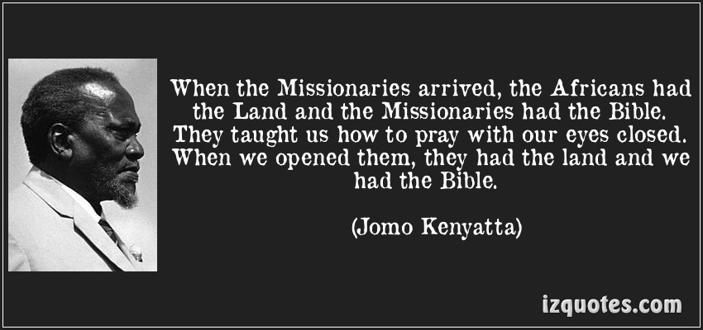
ORIENTALISM
THANK YOU FOR YOUR ATTENTION
Monika Forethová, Volkan Yalvacli, Yessenia Lizbeth Soto Castro

