Slide 1
SEMIOTICS
Pavlína Hornová, 438574
Kateřina Ševčíková, 422176
Michaela Reisiglová, 405911

Slide 2
What is Semiotics?
study of sign processes (semiosis) / signification and communication, signs and symbols
three branches:
Semantics - meaning of signs
Syntactics - mutual relations between signs
Pragmatics - use of signs; relations between signs and their users
Notes:
Semiotics is the study of sign processes (semiosis), or signification and communication, signs and symbols, and is usually divided into three branches: Semantics which is concerned with meaning the of signs, Syntactics which examines mutual relations between signs, and Pragmatics which is concerned with the use of signs and relations between signs and users of those signs

Slide 3
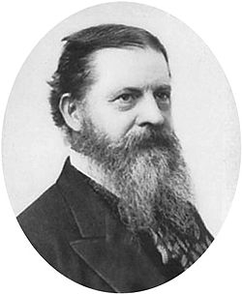
Firstness, Secondness, Thirdness
founder of modern Semiotics - American philosopher Charles Sanders Pierce
Peirce`s work on Semiotics inspired by Immanuel Kant
Firstness - pure modes of being, something that does not depend on our cognition or actions, e. g. feelings, senses
Secondness - polarities of action-reaction, effort-resistance...involves acting and percieveing, the struggle etc.
Thirdness - utmost importance in philosophy, ideas our minds produce, brings a first into relation to a second
Notes:
Modern Semiotics was founded by an American philosopher Charles Sanders Peirce. Peirce`s philosophy was influenced by Immanuel Kant, in fact Peirce simplified Kant’s twelve categories of metaphysics into three: category of firstness, secondness,thirdness.
Firstness contains pure modes of being, objects and things without presupposing interventions of the human mind, it is something that doesn`t depend on our cognition or our actions - for example feelings or senses.
Secondness is the dynamic, two-sided encounter and opposition found in the polarities of action-reaction or effort-resistance and it involves the effort of acting and perceiving, the struggle to achieve something and to feel something, the shock of sensing change.
Thirdness has according to Peirce the utmost importance in filosophy, because it is the ideas our minds produce, the third is something which brings a First into relation to a Second

Slide 4
Icon, Index, Symbol
need of an interpretation that brings sign and object into relation
=> Peirce`s distinction between icon, index and symbol
icon - based on analogy/similarity, e. g. painting
index - forces attention to a certain object, factual link e. g. smoke signifies fire
symbol - signifies object via association or habitual connection, e. g. a word such as “dog”
Notes:
In a relation between a sign and an object there needs to be an interpretation that brings those two terms in the relation. Therefore Peirce introduced a distinction in terms of how a sign and an object are related. That is the well-known distinction called icon, index and symbol.
Icon exhibits a similarity or analogy to the subject of discourse, it can be for example a painting.
Index forces the attention to the particular object intended without describing it, there is a factual link, for example a smoke signifies a fire
Symbol is the general description which signifes its object via association of ideas or habitual connection between the name and the character signifed. It can be a word for example a dog - because when someone mentions the word we know what to visualize.

Slide 5
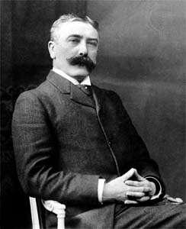
Life of Ferdinand de Saussare
*1857, 十1913
Born in Geneva, Switzerland
Very talented and intelligent from very young age
Interested in studying languages
He taught in Geneva, Paris and Liepzig
Founder of semiotics
Main work Course in General Linguistics published by his students after his death

Slide 6
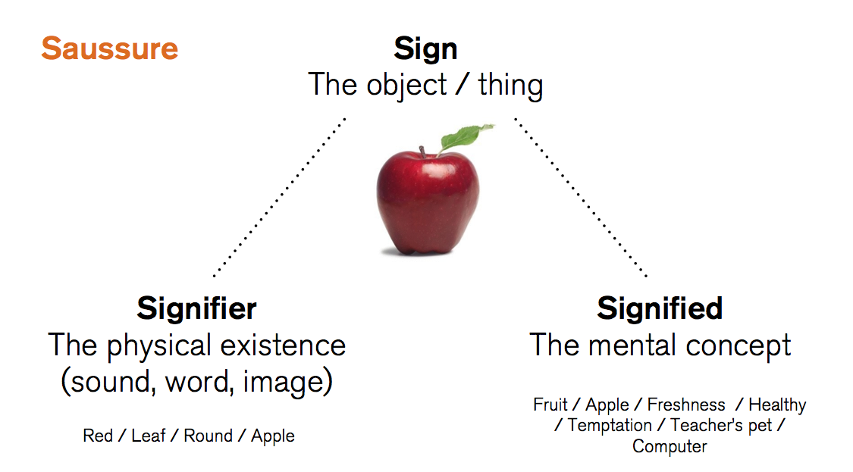
Sign, signifier, signified
Sign is a form made up of signifier and signified.
Signifier: something physical – sounds, letters, gestures
Signified: image or concept to which the signifier refers
Signification: relation between signifier and signified

Slide 7
Langue, parole and other key concepts
Saussure made distinction between langue (language) and parole (speech)
Langue: system of rules and conventions or habits which is independent on individual users
Parole: its use in particular instances
Emphasis on langue because most important are underlying structures and rules of a semiotics system as a whole
Study of signs:
Synchronic: studying signs at given point in time
Diachronic: how signs change in form and meaning over time

Slide 8
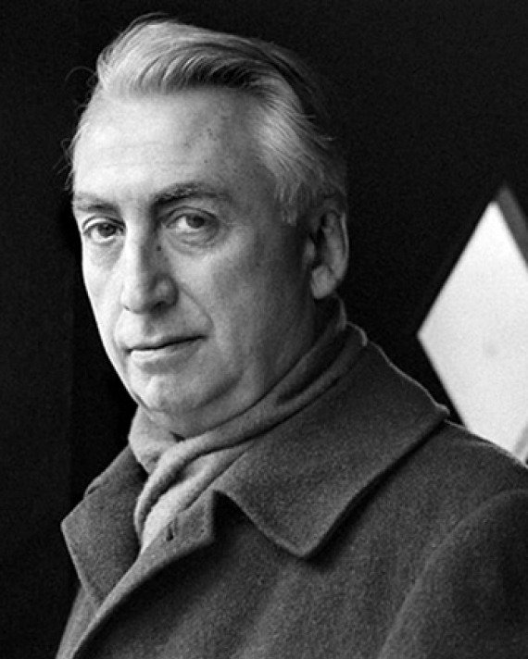
Roland Barthes (1915-1980)
concept of myth
all the apparently spontaneous forms and rituals of contemporary bourgeois societies are subject to a systematic distortion
objects are organized into meaningful relationships by narratives that expressed collective cultural values
he was analyzing the popular, consumer culture of post-war France:
The whole of France is steeped in this anonymous ideology: our press, our films, our theatre, our pulp literature, our rituals, our Justice, our diplomacy, our conversations, our remarks about the weather, a murder trial, a touching wedding, the cooking we dream of, the garments we wear, everything in everyday life is dependent on the representation which the bourgeoisie has and makes us have of the relations between men and the world. (Barthes, 1972)
Image source: https://www.laphamsquarterly.org/sites/default/files/styles/tall_rectangle_custom_user_large_1x/public/images/contributor/barthes_360x450.jpg?itok=WkwNJRXE&timestamp=1421787021

Slide 9
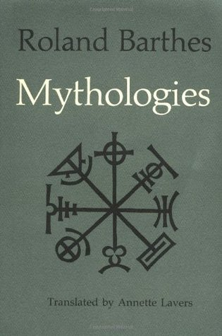
Mythologies
Barthes’ notion of culture extends beyond the library, the opera-house and the theatre to cover everything in everyday life
everyday life is more insidious and more systematically organized than people think
Mythologies: Barthes’ collection of essays published in 1957
he examined hidden set of rules, codes and conventions through which meanings particular to specific social groups (i.e. those in power) are rendered universal and “given” for the whole of society
Image source: https://images.gr-assets.com/books/1440640494l/51715.jpg

Slide 10
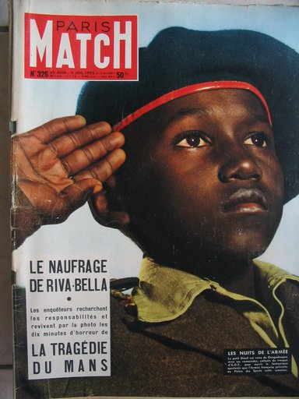
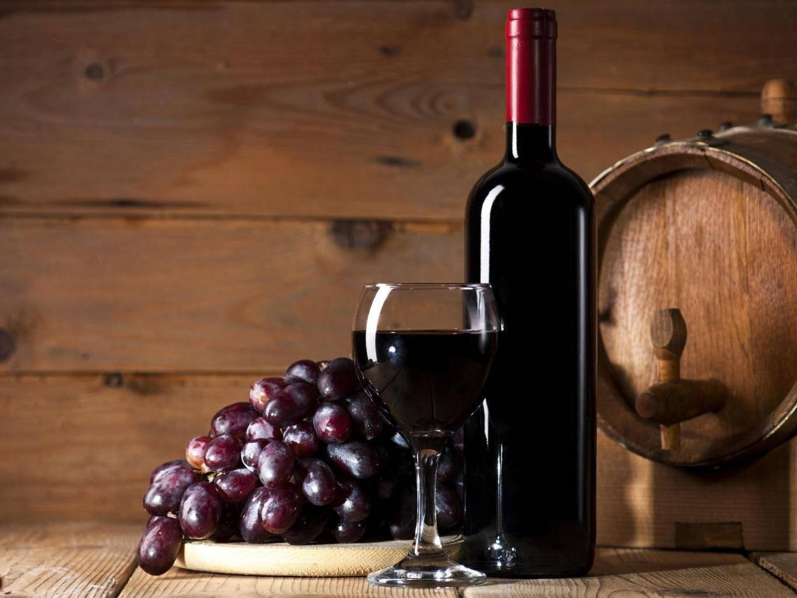
Examples
myth = second-order semiological system
(1) a gesture of loyalty,
(2) “France is a great empire, and all her sons, without colour discrimination, faithfully serve under her flag”
(1) an alcoholic beverage,
(2) the idea of healthy and relaxing experience
Image sources: http://www.muhlemann.ch/os_comm/catalog/popup_image.php?pID=2404&osCsid=c6170e2f3333d2b98ff5492a9caf5646, https://static.independent.co.uk/s3fs-public/styles/story_large/public/thumbnails/image/2016/09/22/12/wine.jpg

Slide 11
Sources
Hamel, S. C. (2011). Semiotics: Theory and Applications. Nova Science Publishers.
Pietarinen, A. V. (2015). Signs systematically studied: Invitation to Peirce’s theory. Sign Systems Studies, 43(4), 372-398.
Joseph, J.E. (2012). Saussure. OUP Oxford.
Sebeok, T. A. (2001). Signs: an introduction to semiotics. 2nd ed. University of Toronto Press.
Chandler, D. (2017) Semiotics for Beginners. Retrieved from http://visual-memory.co.uk/daniel/Documents/S4B/sem01.html
Barthes, R. (1972). Mythologies. London: Paladin.
Hebdige, D. (1979). From culture to hegemony. In Subculture: The Meaning of Style, 5–19. New York and London: Routledge.
Huppatz, D. J. (2011). Roland Barthes, Mythologies. Design and Culture, 3(1), 85-100.

