Slide 1
Brexit
James Beeson
Head of Policy
British Embassy Prague

Slide 2
Outline
The vote
The negotiations
Legislation
The Withdrawal Agreement + Political Declaration
UK Parliament procedure
Next Steps
Future Relationship
No Deal

Slide 3
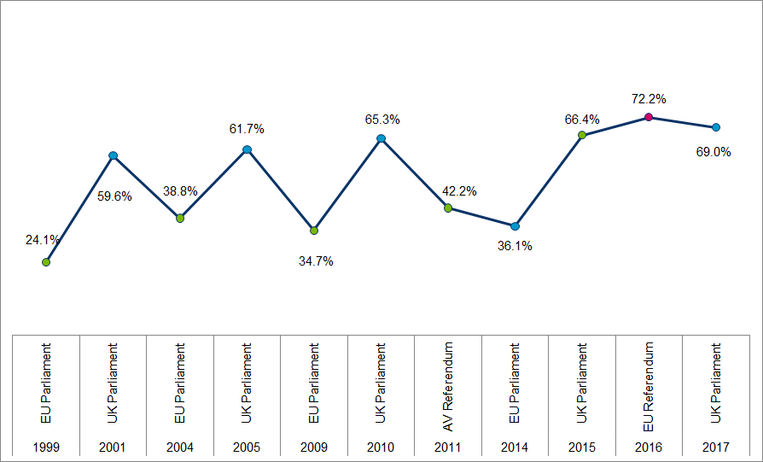
The Vote – 23/6/2016

Slide 4
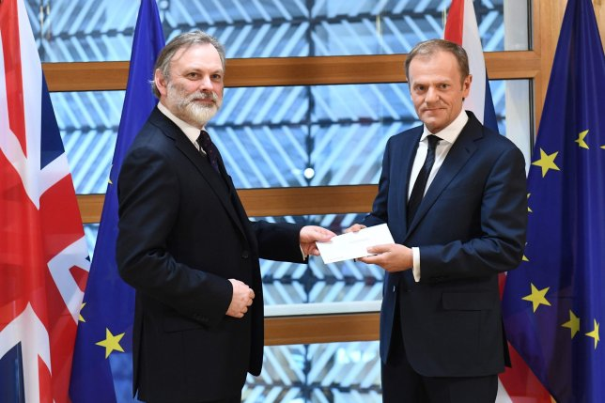
The negotiations
UK preparation to start negotiations
Conservative Party leadership elections
Theresa May becomes leader of party – 11 July
DExEU formed – 14 July
Launch Article 50 – 29 March 2017
Two year deadline set

Slide 5
The Withdrawal Agreement + PD
Withdrawal Agreement
Two year transition Period
Continues relationship
Backstop for Northern Ireland
Political declaration
Sets out terms for future relationship
Finally agreed on 25 November 2018
European Council

Slide 6
UK Parliamentary Procedure
Three things needed to ratify agreement:
Meaningful Vote – agree in principle to WA & PD
Passage of Brexit Legislation – put legislation in place for WA
CRaG – To ratify an international treaty

Slide 8
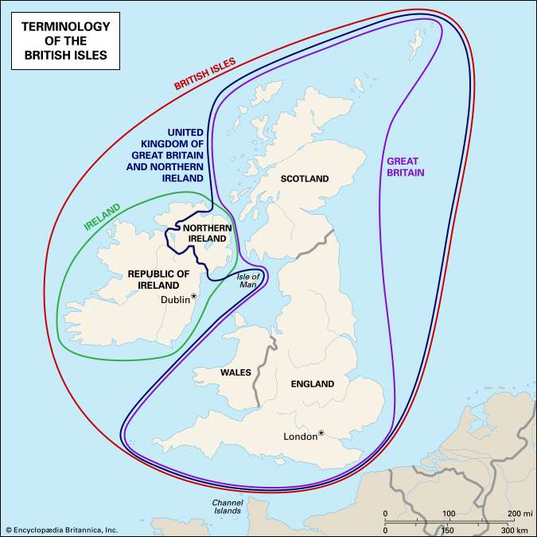
UK Parliamentary Procedure
Stuck on the Meaningful Vote
The backstop . . .

Slide 9
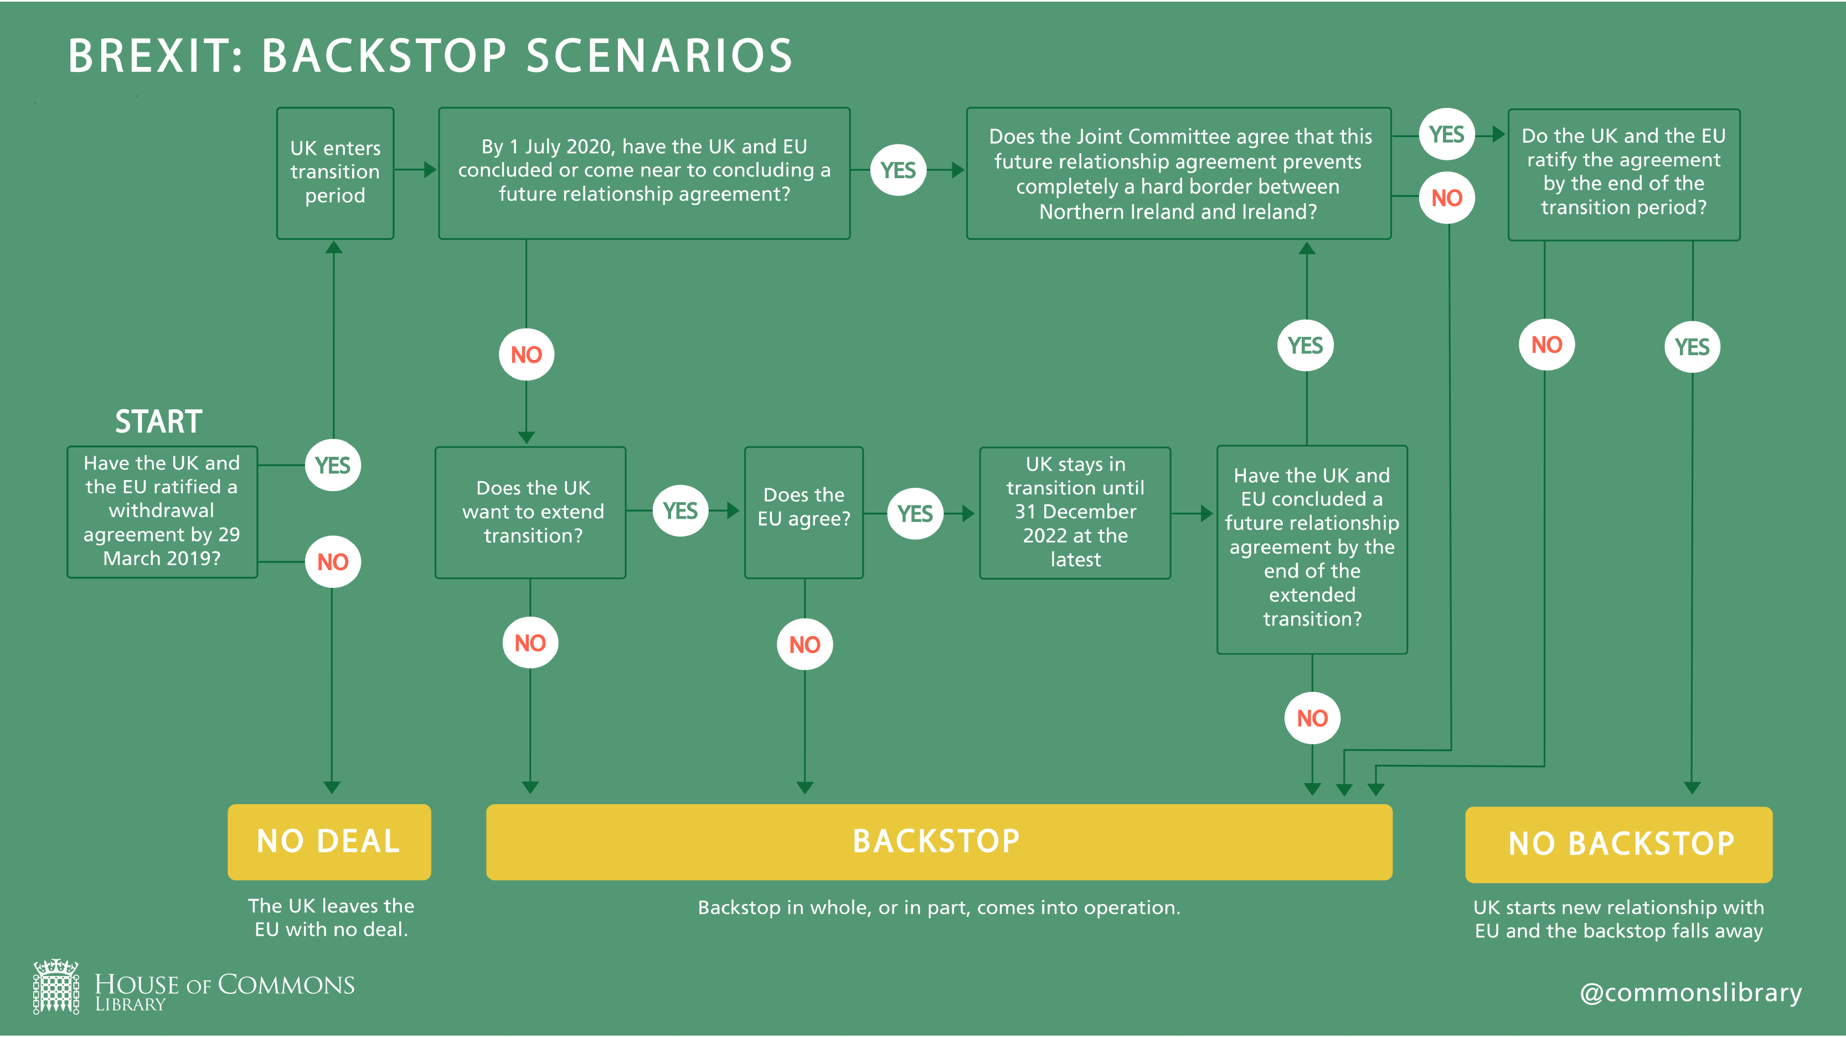

Slide 10
Next Steps
Secure support for a Meaningful Vote
Put legislation in place
Negotiate Future Relationship

Slide 11
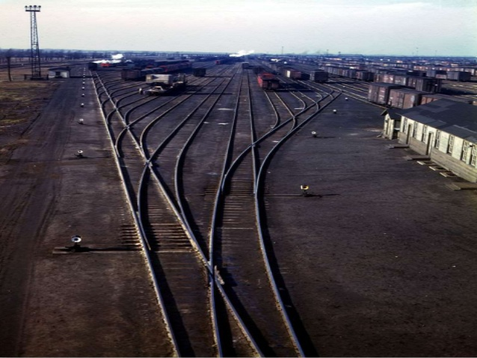
Next Week
Currently finding solution to the backstop
Meaningful vote – by 12 March
No Deal vote – 13 March
Article 50 Extension – 14 March

Slide 12
No Deal
UK would cease to be an EU country after 29 March
Drop out of EU institutions and frameworks
Impact on
People
Business

Slide 13
Future Relationship
Withdrawal Agreement gives time to agree a future relationship
Political Declaration gives the structure for this
Implementation period runs to end-December 2020
One opportunity to extend this by 2 years – agree by July 2020

