Slide 1
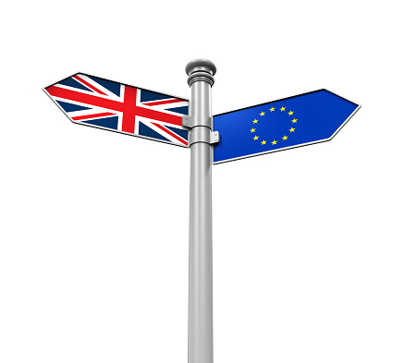
Understanding the background to Brexit:
Brief history of UK-EU relations
Dr Monika Brusenbauch Meislová
EVS465: Brexit: Politics, Policies and Processes

Slide 2
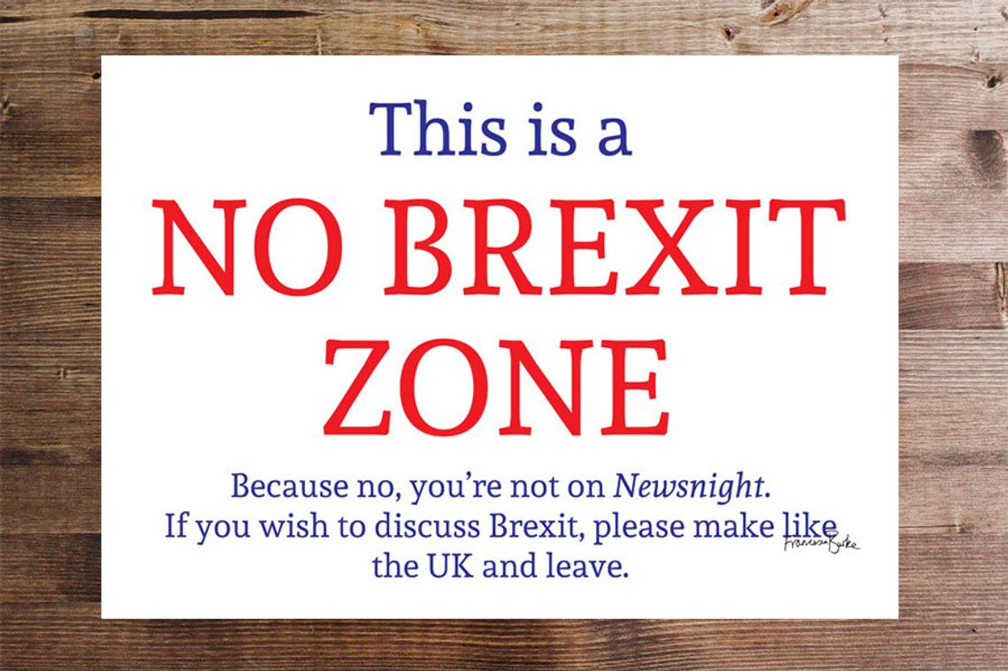

Slide 3
Introduction
EU as a toxic, one of the most divisive and emotive issues in British politics (division between parties + deep divisions within the parties).
According to some, fundamental conflict/cleavage in post-war British politics is not so much between left and right as between those who believe that Britain's future lies with Europe and those who believe it does not.

Slide 4
What is Brexit?
Oxford English Dictionary (2016): The withdrawal of the United Kingdom from the European Union.
  Who coined it?
  Technically inaccurate.
Brexit = a series of overlapping processes and debates taking place at many levels and involving multiple actors across the UK and the EU.
It confronts the UK with many questions and debates on identity, society, political economy, trade, security, party politics.

Slide 5
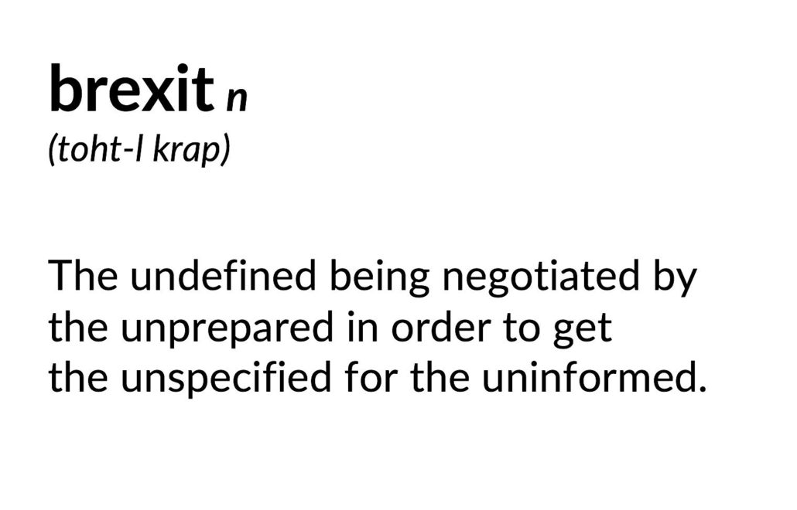

Slide 6
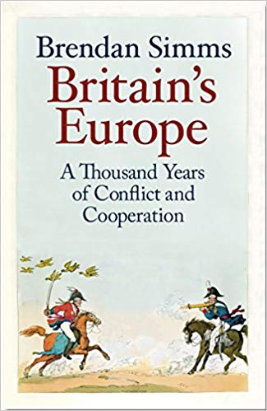
When is Brexit?
Brexit-related processes and debates are not limited to a certain time frame.

Slide 7
What is so special about Brexit?
Ideal topic though which to understand a changing UK.
  Brexit as a critical juncture?
UK and Brexit as a fascinating case study for the social sciences.
  UK: long a good case study in international relations, political science, political economy.
Pointers to the future of the EU and global politics.

Slide 8
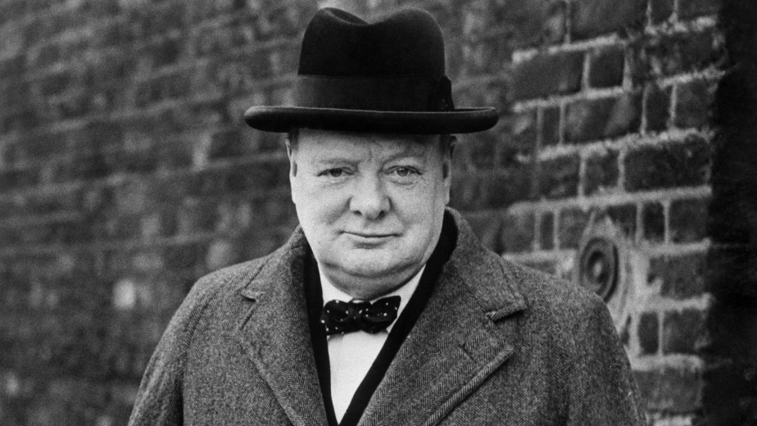
Why did the UK join so late?
Britain was involved in some way from the start.
  Winston Churchill: United States of Europe (September 19, 1946. University of Zurich)
  We must build a kind of United States of Europe. In this way only will hundreds of millions of toilers be able to regain the simple joys and hopes which make life worth living. The process is simple. All that is needed is the resolve of hundreds of millions of men and women to do right instead of wrong and to gain as their reward blessing instead of cursing.

Slide 9
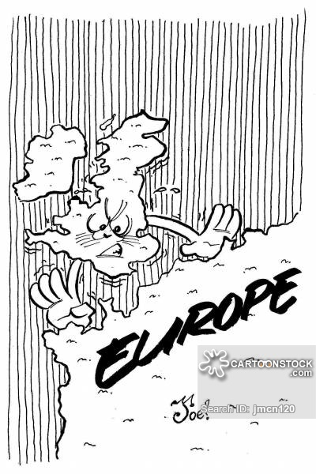
Why did the UK join so late?
Insular mentality.
Power and prestige.
  Imperial hubris
Strategic lessons from the 2WW.
  British narrative of 2WW important: the UK standing alone.
Europe as only one of the three circles of British power.
  UK at the heart of 3 overlapping circles that defined its place in the world: Europe, US and British Empire.

Slide 10
Why did the UK join so late?
Unsure of its role in the world.
  Imperial hangover
  1962: Dean Acheson (former US Secretary of state). Speech at US military academy West Point.
    Great Britain has lost an empire and has not yet found a role. The attempt to play a separate power role — that is, a role apart from Europe, a role based on a ‘special relationship’ with the United States, a role based on being head of a ‘commonwealth’ which has no political structure, or unity, or strength — this role is about played out. Great Britain, attempting to be a broker between the United States and Russia, has seemed to conduct policy as weak as its military power.

Slide 11
Why did the UK join so late?
Shifting economics
  Profound shifts in the UK‘s trading patterns.
  Establishment of EFTA (1960)
Doubts across the political spectrum.
  Both on the left (The Durham miners won’t wear it) and on the right.
UK’s political and constitutional set-up.
  No codified constitution.
  Majoritarian system of govt.
    Confrontational political system.
    Adversary politics.
    Westminster-style zero-sum mentality.
  Parliamentary sovereignty.

Slide 12
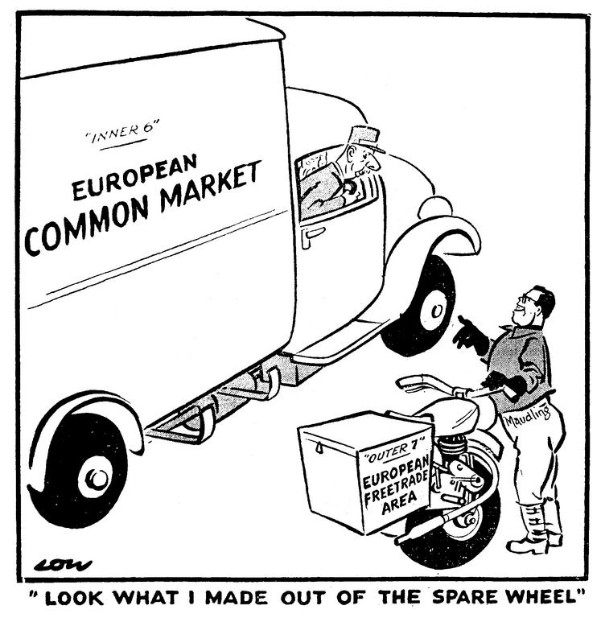

Slide 13
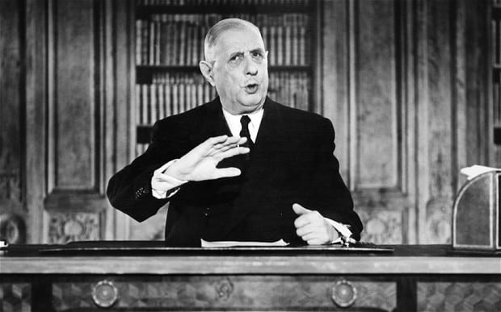
Why did the UK join so late?
Cultural and demographic differences.
Repeated attempts at membership
  1961: First British application for EEC membership (Harold Macmillan).
  1963: First French veto against British membership.
    deep-seated hostility" towards European construction; American Trojan Horse.
  1967: Second British application for EEC membership (Harold Wilson).
  1967: second French veto against British membership.
  1971: Third British application for EEC membership (Edward Heath).

Slide 14
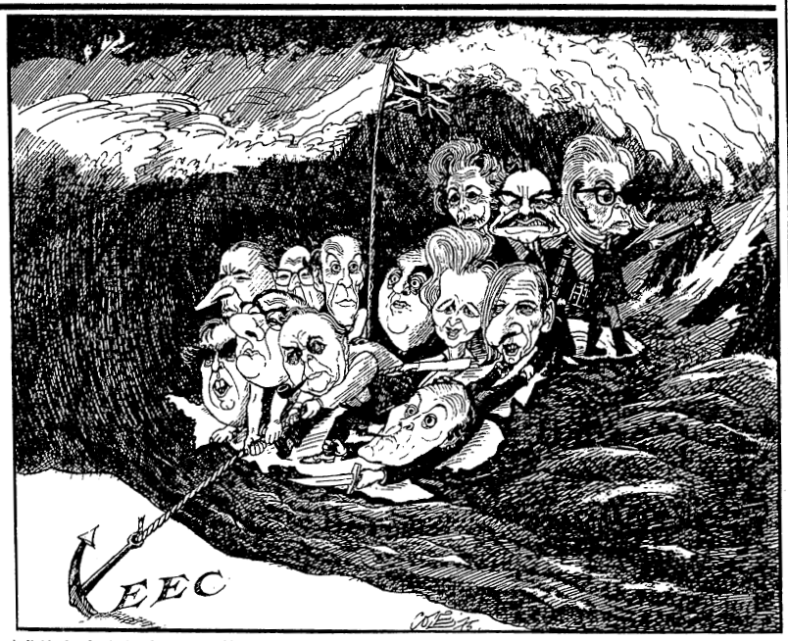

Slide 15
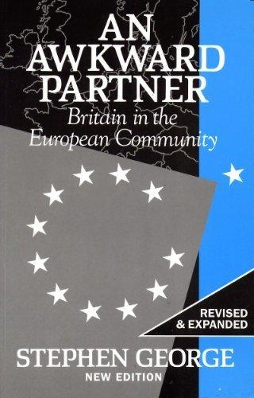
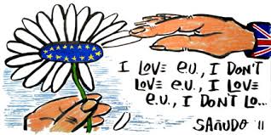
The UK as a two-faced European
Two-faced (Janus-faced) approach: awkward partner but at the same time (sometimes) a constructive one (quiet European).
Good example of this approach: Margaret Thatcher Speech at the College of Europe in Bruges 1988.

Slide 16
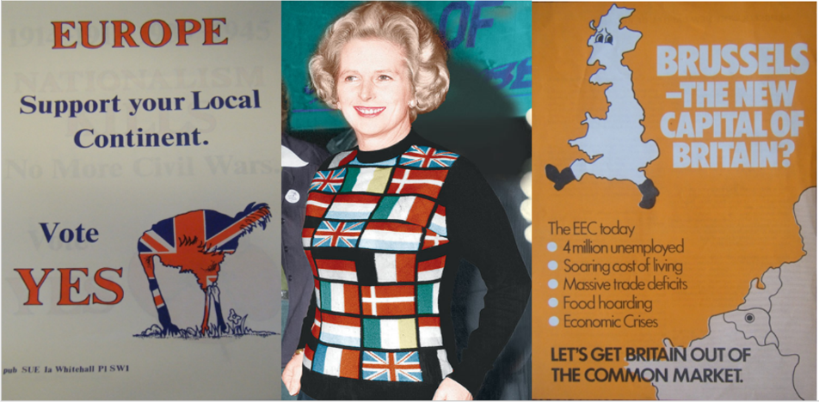
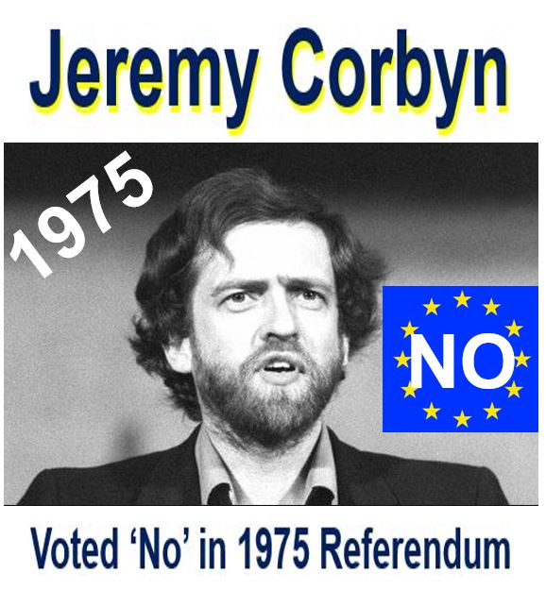
Awkward partner
Struggling to fit with the EU’s set-up.
  BBQ (Bloody British question); rebate.
Trying to fit and change the EU caused tensions in UK politics.
  1975 referendum.
    Organised by Labour Party (Harold Wilson)
    In favour of continued membership (66% voter turnout, 2/3 said yes)
    Remain supported by Britain's three main parties and all its national newspapers
Transactional approach to the membership.
The UK has secured many opt-outs.
  Feeling of unfairness and special treatment.

Slide 17
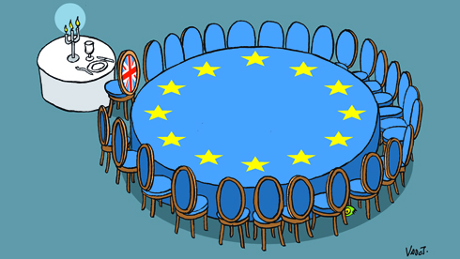

Slide 18
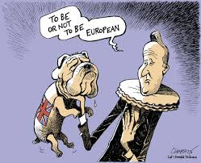
Awkward partner
EC/EU has been the bane of many PMs’ time in office.
Public and media debate defined by Euroscepticism.
  Constraining public debate.
  Negative, alarmist and sensationalist approach by the British media.
UK as the bad cop of European integration.
  Willing to say no; shield for others
UK has too often looked to the US.
Awkward because of its size.

Slide 19
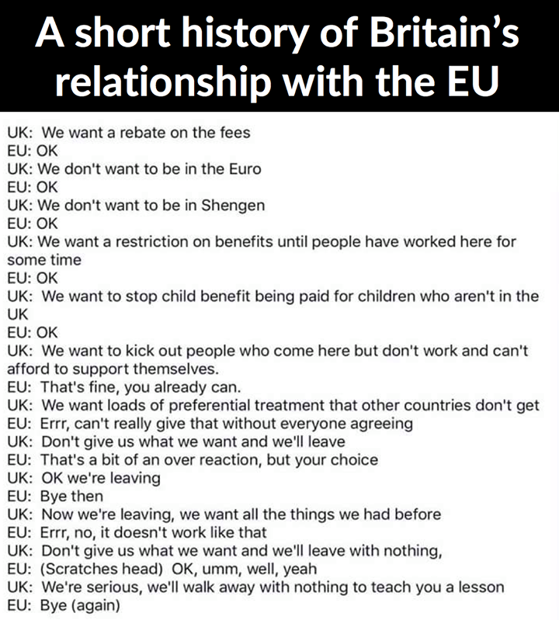

Slide 20
Quiet European
Effective member state.
Had to assert itself to be taken seriously.
Atlanticism as the norm in EU.
UK has won on many policy areas.
Good enforcer of EU laws.

Slide 21
History of UK-EU relations: key moments
History of UK-EU relations. For a timeline and key moments, see, for instance:
https://ukandeu.ac.uk/explainers/factsheet-on-timeline/
https://www.bbc.com/news/uk-politics-26515129

Slide 22
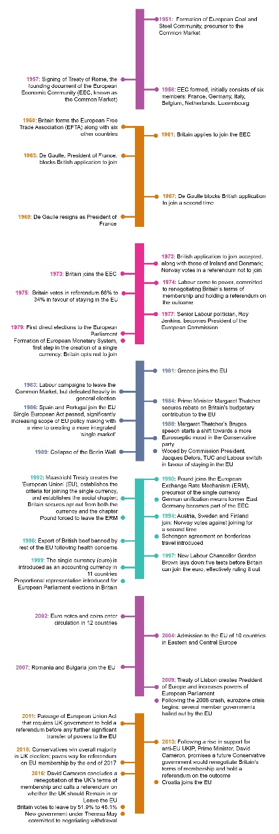

Slide 23

The crystal ball excercise
What will the “Brexit situation“ look like on 29 March 2019?

Slide 24
Thank you very much for your attention
(brusenbauch.meislova@email.cz)

