Slide 1
The referendum result
Dr Monika Brusenbauch Meislová
EVS465: Brexit: Politics, Policies and Processes
26 March 2019

Slide 2
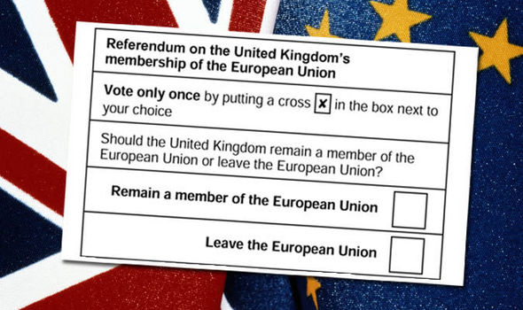
The referendum result
How the UK voted

Slide 3
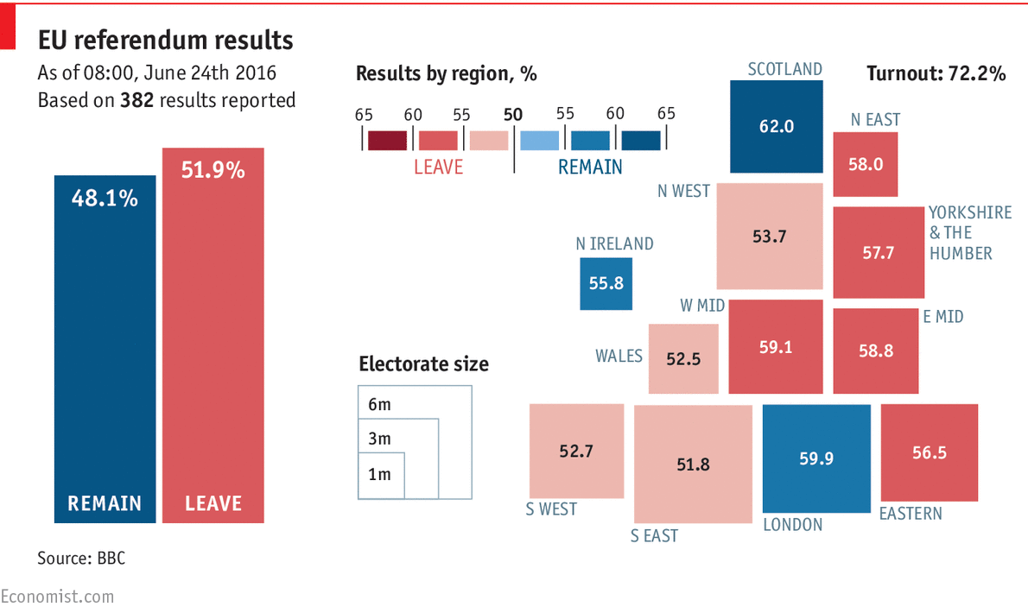

Slide 4
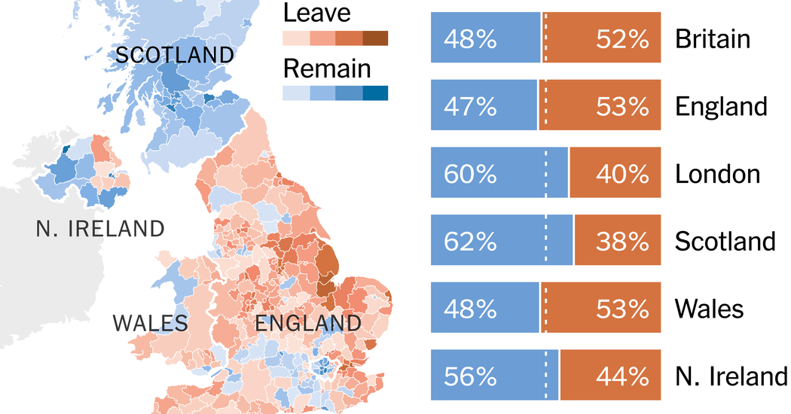
The referendum result
Clear geographical differences

Slide 7
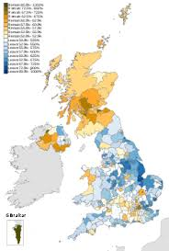
The referendum result
Many constituents voted differently from their MPs

Slide 8
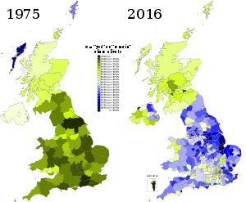
The referendum result
Changes between referenda in 1975 and 2016

Slide 9
The referendum result

Slide 10
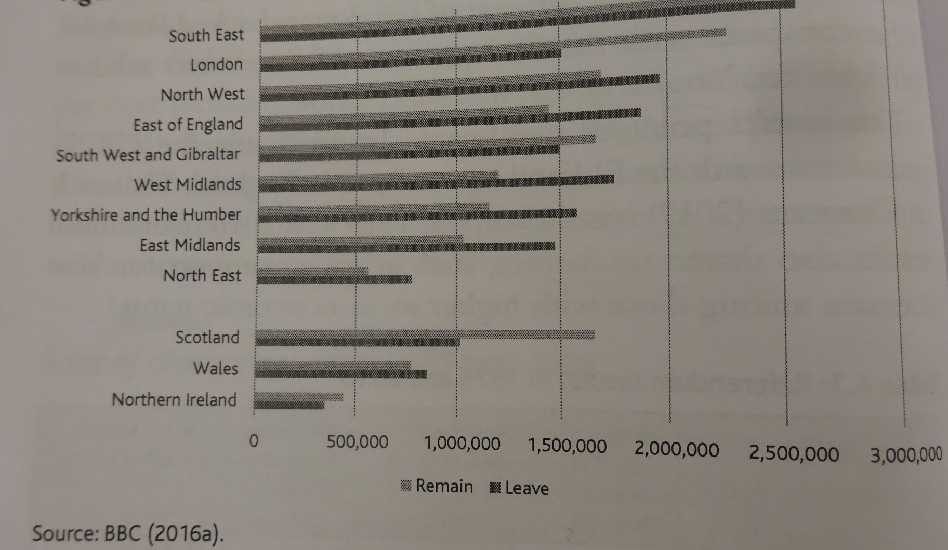
The referendum result
The referendum was decided in England
Total votes cast in each UK region

Slide 11
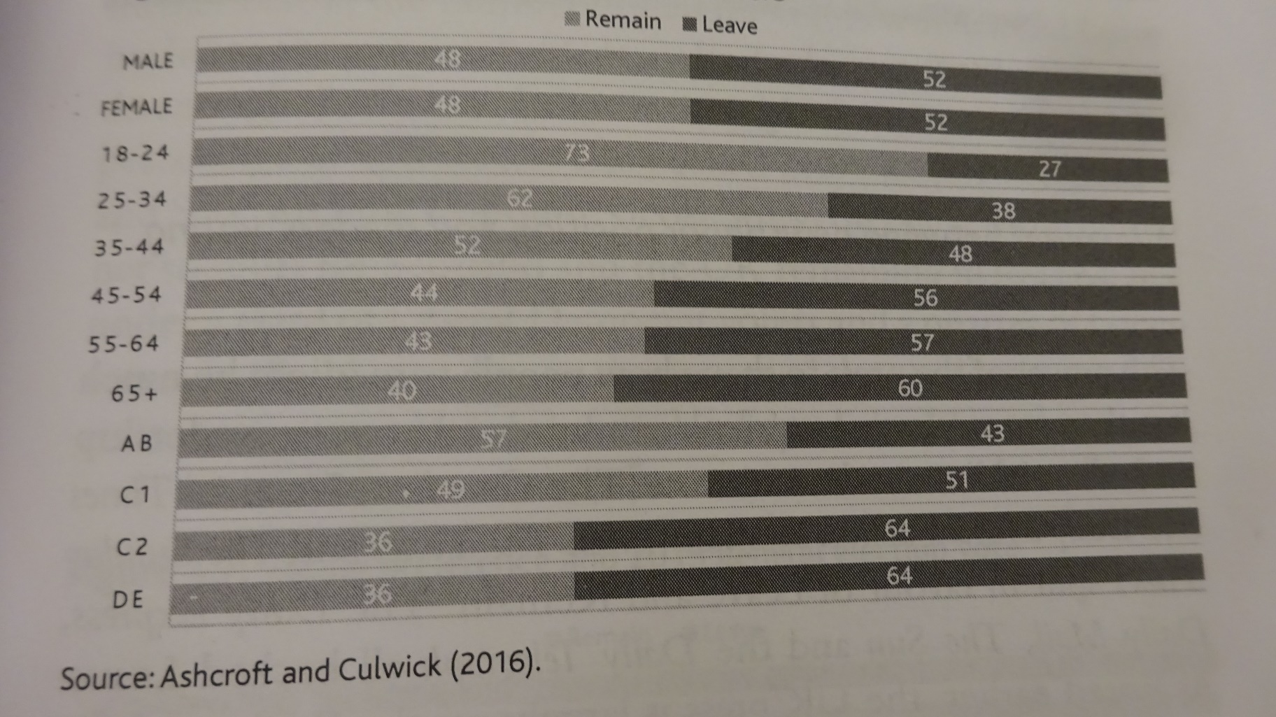
The referendum result
Clear social and age differences in how people voted
Demographic breakdown of voters

Slide 12
The referendum result
Educational background as a strong indicator of voting intention
Educational levels of Remain and Leave voters

Slide 13
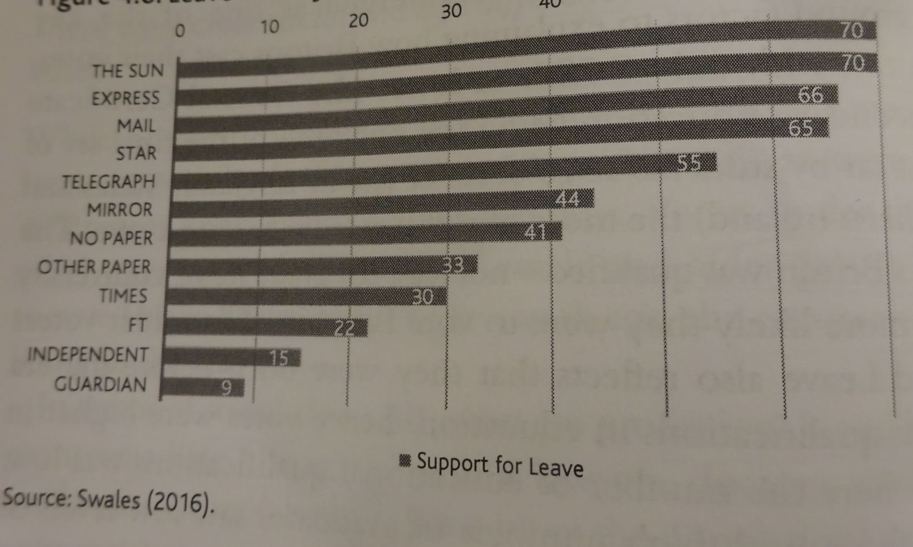
The referendum result
Alignment between newspaper position and readers‘ voting intention
Leave vote by newspaper read most often

Slide 14
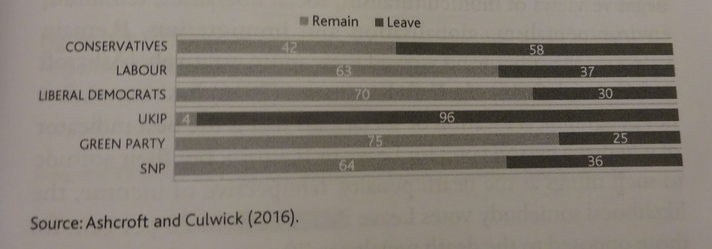
The referendum result
Large numbers of people voted differently from the position of the party they voted for in the 2015 election
Votig preference and 2015 general election vote

Slide 15
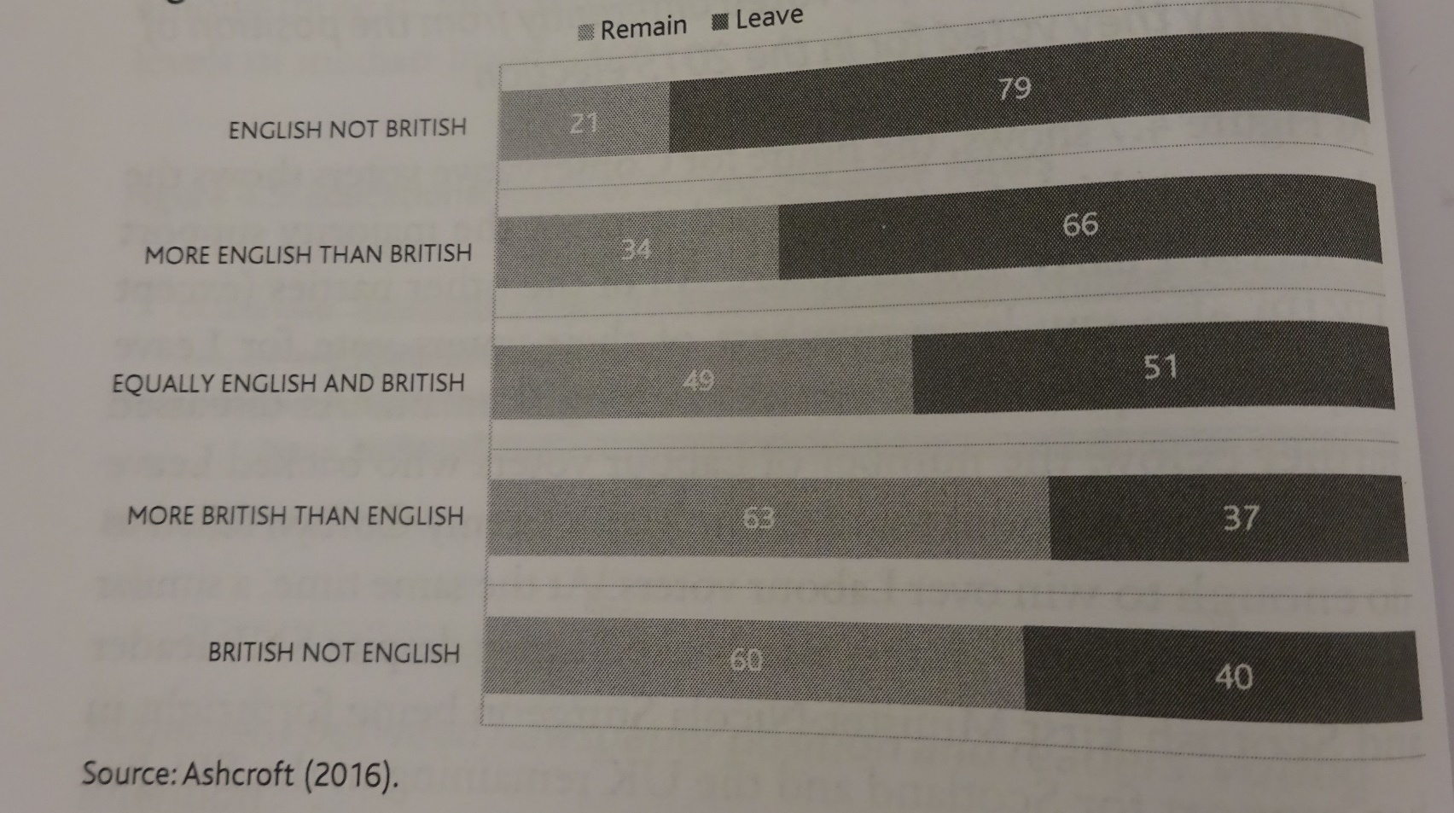
The referendum result
Voters who identified themselves as English voted strongly for Leave
Votes according to strength of English and British identity

Slide 16
The referendum result
Remain and Leave voters divided by values

Slide 17
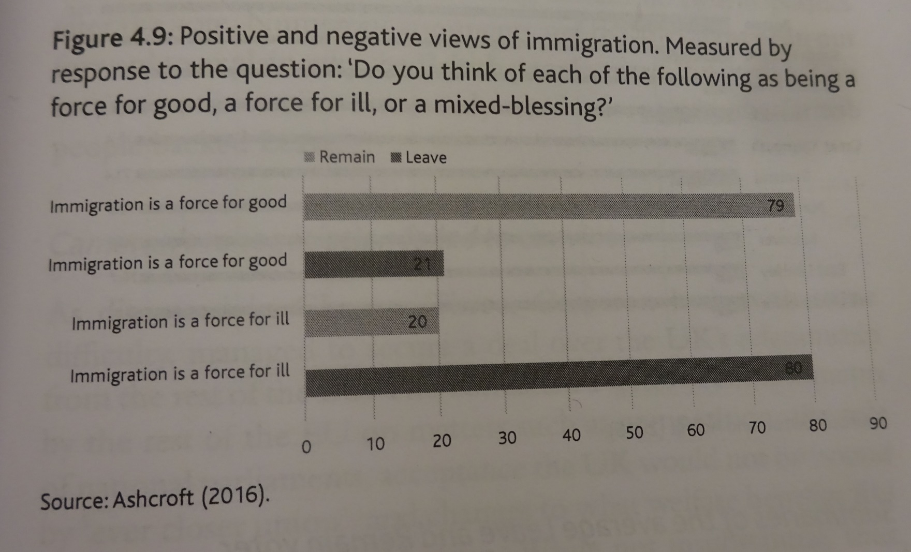
The referendum result
Views and experiences of immigration were important dividing lines

Slide 18
The referendum result
The 10 districts with the lowest Leave votes and the percentage of non-UK residents in each

Slide 19
The referendum result
The 10 districts with the highest eave votes and the percentage of non-UK residents in each

Slide 20
The referendum result
Summaries of an average Leave and Remain voter

Slide 21
☺

Slide 22
☺

Slide 23
☺

Slide 24
Food for thought:
Anne Applebaum: Theresa May isn’t the adult in the room. She’s part of the problem. Washington Post, 22 March 2019.
https://www.washingtonpost.com/opinions/global-opinions/dont-pity-theresa-may-shes-the-worst-prime-minister-in-living-memory/2019/03/22/405920e6-4ca5-11e9-93d0-64dbcf38ba41_story.html?fbclid=IwAR2YlMydv7SOt9OVCTjZeBG6o-WPX22oQmk1sXBQ0QyblZnjN0BXSqxFogA&noredirect=on&utm_term=.2ff7a03efc9b

Slide 25
☺

Slide 26
Thank you for your attention

