Slide 1
BEHAVIOURAL ADDICTIONS – INTRO &
PATHOLOGICAL GAMBLING
ADDICTION

Slide 2
Behaviours that:
Have a potential to produce short-term reward
Individuals tend to engage these behaviours repetitively and with diminished control
With persistent pattern of engagement in these behaviours it leads to problems and conflicts over time
Behaviours that have similar symptoms as substance addictions (in Griffiths’ model salience, euphoria, tolerance, conflicts, relapse & reinstatement. Questionable presence of withdrawal symptoms).

Slide 3

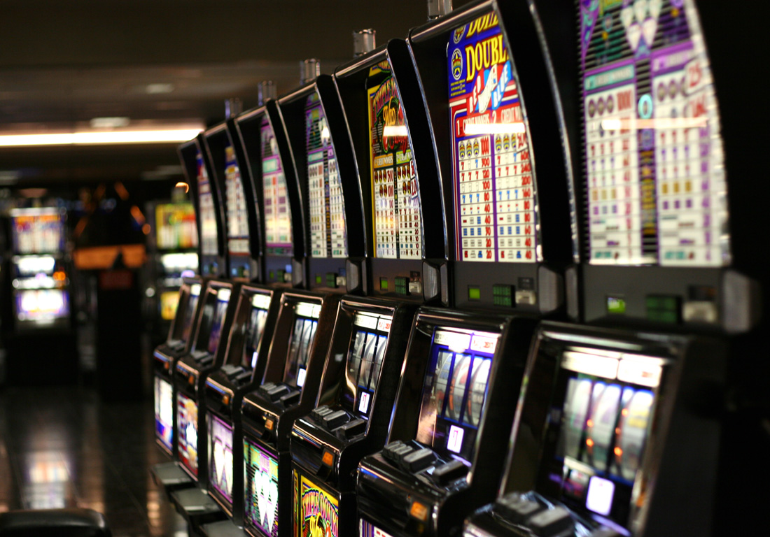
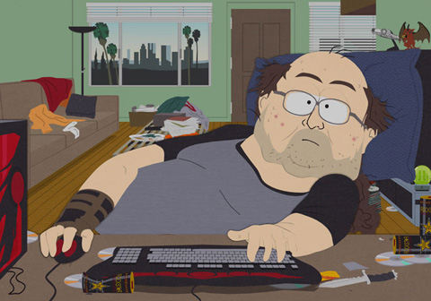




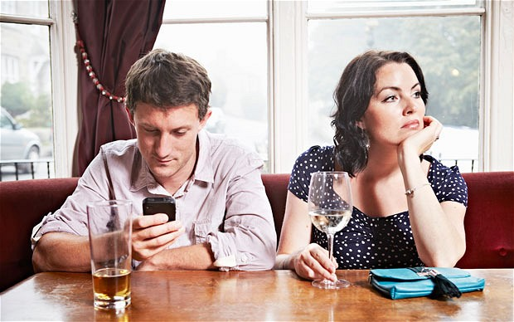
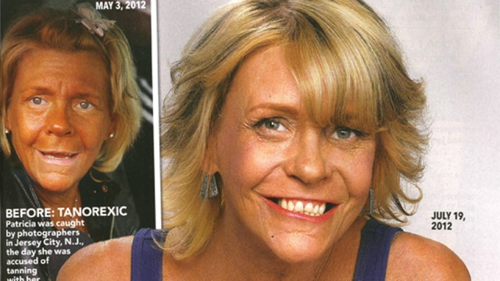

Slide 4
Similarities with substance addiction
Both have similar course: they start as ego-syntonic and slowly develop into ego-dystonic (love-hate relationship with the subject of addiction). Ego-syntonic = in harmony with ego (its values, goals, needs) ego-syntonic = opposite to one’s needs, values, self. Ego-syntonic nature of these behaviours is the reason why we do not label them as obsessive-compulsive disorders.
High mutual cooccurrence – gamblers often show pathological use of alcohol, nicotine, or even amphetamines. Pathological gamblers have several times higher chance of being diagnosed as addicts to some substance. Cooccurrence of behavioural addiction and substance addiction predicts increased severity of each
Similar personality profiles – males of younger age are more susceptible. Increased impulsivity, sensation-seeking, ADHD and decreased harm avoidance (internet based addictions are exception – harm avoidance is increased). Increased comorbidity with depressive symptoms

Slide 5
Similarities with substance addiction
Similar cognitive deficits - e.g. cues related to addiction are processed faster. Cue-association found in the same brain areas
Alteration in functioning of mesolimbic dopamine pathways reported – both substance and behavioural addictions are primarily disorder of motivation and learning
Parkinson patients treated by dopamine agonists found (is some cases) to develop behavioural addictions like
Reward deficiency syndrome (gene-based decreased number of dopamine D2 receptors) found also in gamblers
Behavioural component is very strong also in substance addictions
Similar responsiveness to treatment - in most cases, even substance use treatment targets the behavioural/cognitive/psychological component of addiction. No medication for behavioural addictions yet, but promising results in use of opioid antagonists used for alcohol and opioid addictions.

Slide 6
But it may just not exist because
We know too little. 1) evidence comes mostly from gambling studies- are there any other behavioural addictions at all? 2) no animal studies 3) only few and short longitudinal studies 4) very limited family and genetic studies
Normativity issue – is behavioural addiction just a new label for bad behaviour? Aren’t we over-pathologizing certain behaviours? Aren’t we spreading unnecessary panic?
Problems with tolerance and especially withdrawal symptoms – behavioural and substance addiction may be less similar than we think. However, all research in this field was done through optics of substance addictions and thus may be biased from the beginning

Slide 7
diagnostics
Gambling included in DSM-IV and ICD10 under umbrella of Impulse Control Disorders = disorders characterized by failure in temptation (e.g. kleptomania, pyromania,…). Other potential behavioural addictions could be diagnosed as “impulse control disorder unspecified/other”
DSM-5 (2013) included gambling as addiction. Internet gaming disorder included only as experimental diagnosis
ICD11 (2018) included both gambling and gaming plus “other”
Other behavioural addictions rely on survey questionnaires – we do not have sufficient data even for gaming.

Slide 8

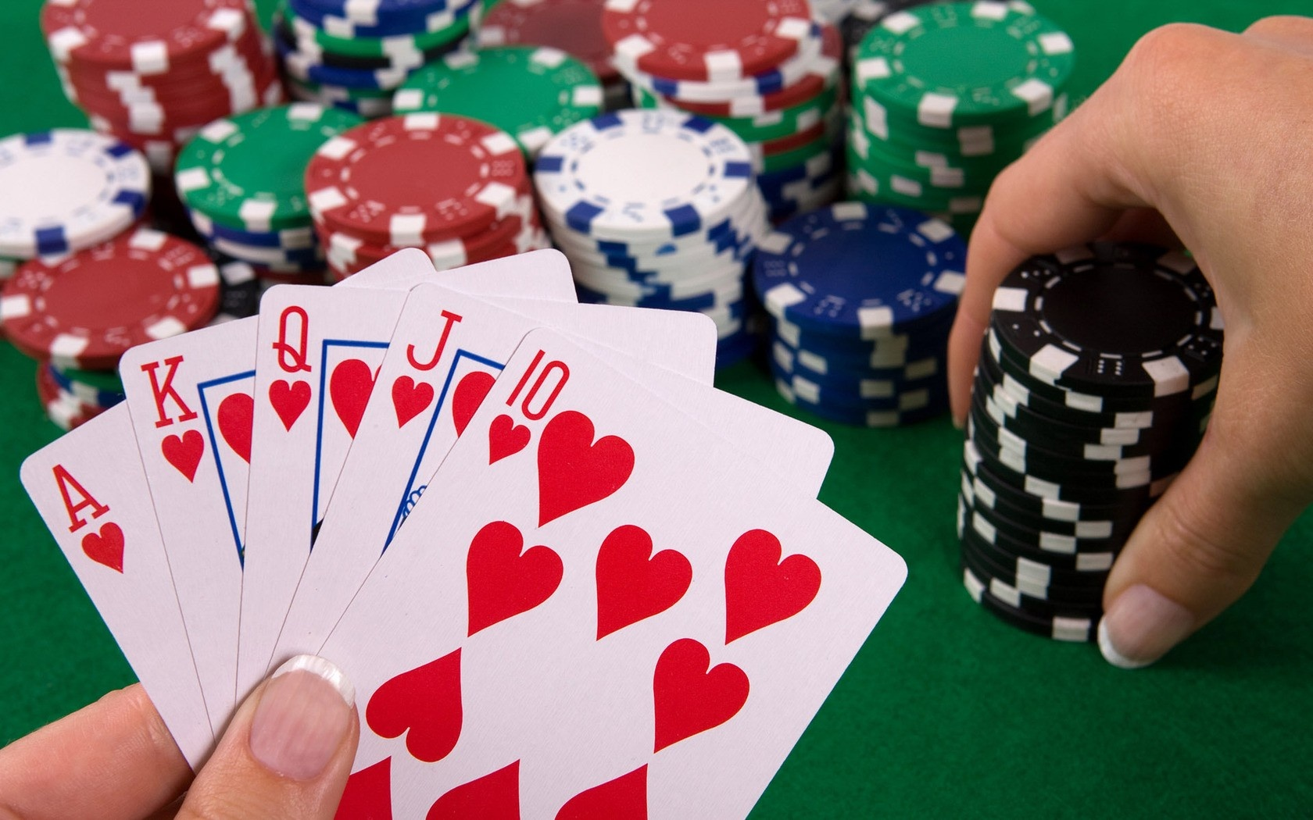
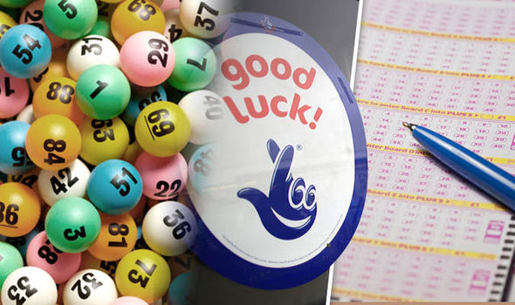
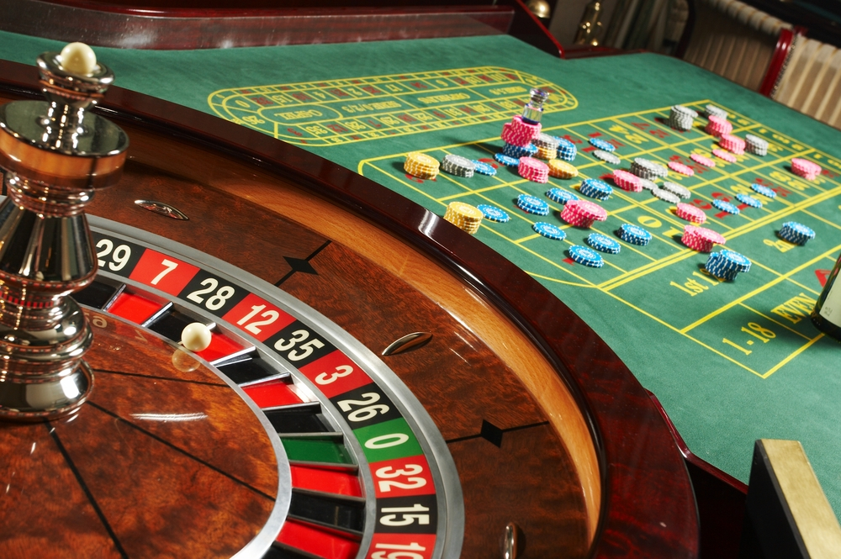
GAMBLING

Slide 9
gambling
Popular entertainment from the beginning of mankind
“a game o chance”
Games differ in speed (tempo); size of bet, prize structure; frequency of win/reward; role of skill
Games of pure chance: lottery, slot-machines
Games of skill: sport betting, poker

Slide 10
Pathological gambling in ICD 11
Gambling disorder is characterized by a pattern of persistent or recurrent gambling behaviour, which may be online (i.e., over the internet) or offline, manifested by:
1) impaired control over gambling (e.g., onset, frequency, intensity, duration, termination, context)
2) increasing priority given to gambling to the extent that gambling takes precedence over other life interests and daily activities
3) continuation or escalation of gambling despite the occurrence of negative consequences. The behaviour pattern is of sufficient severity to result in significant impairment in personal, family, social, educational, occupational or other important areas of functioning.
The pattern of gambling behaviour may be continuous or episodic and recurrent. The gambling behaviour and other features are normally evident over a period of at least 12 months in order for a diagnosis to be assigned, although the required duration may be shortened if all diagnostic requirements are met and symptoms are severe.
Exclusion criteria: bipolar disorder

Slide 11
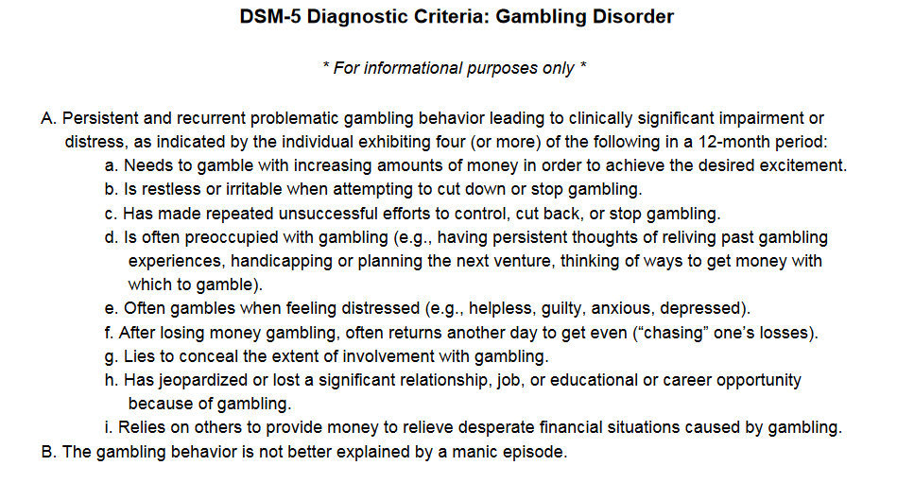
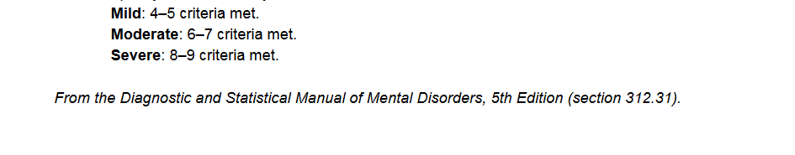

Slide 12
pathological gambling prevalence
Prevalence varies in European countries between 0.5-2% (more in Finland 3%)
Prevalence is several times higher in adolescents – up to 12%
Huge differences between countries even of similar cultural background suggest strong influence of legal status of gambling (availability)

Slide 13
Risk factors – social & demographic
Age – usually starts and peaks in older adolescents. Exposure in this age correlates with severity in adulthood
Gender – males gamble more often and face more sever pathology. Males prefer skill games (betting, poker), females prefer slot machines (for dissociation).
Social economical status – lower SES correlates with gambling
Accessibility – close proximity to gambling places highly increases likelihood of the behaviour
https://www.youtube.com/watch?v=1W2HqF4x8Bc
Marital status – singles are more at risk
Family background – living in one parent family or
Social modelling – positive attitudes towards gambling in family or peer group
Experience – winning large sum at the beginning of gambling carrier predicts more persistent and stronger pattern of behaviour

Slide 14
Risk factors – psychological & psychiatric
Depressiveness – 50% of gamblers have lifetime mood disorder. Gambling usually precedes depression
Anxiety – up to 40% of gamblers have lifetime anxiety disorder or obsessive-compulsive disorder
Substance use – majority use alcohol, up to 40% use other (illegal) drugs. Substance abuse increases risk of remission, overal pathology, suicidality
Early childhood trauma – emotional up to 60%; physical 40%; sexual 20%. Presence of trauma correlates with severity of pathology. Abuse was significantly more common condition for women.
Sensation seeking – under-aroused, prone to boredom, hypomanic

Slide 15
Risk factors – irrational cognition
Illusion of control – superstition tendency, believe in skill is often magnified (too high self-confidence). https://www.youtube.com/watch?v=I0xOoyMeSF8
Recall bias - wins are overestimated in their strength and frequency while losses are underestimated and forgotten
Gamblers fallacy – believe that even totally random events are influenced by past events. If something happens more frequently now, it is going to happen less frequently in future
Near miss phenomenon - a failure that is felt to be close to win and thus raising hope for future success. Gives wrong information and produces excitement. Produces illusion of control even in pure games of chance. It would be foolish to stop when I am so close… https://www.youtube.com/watch?v=uAZu0coArhI
https://www.youtube.com/watch?v=6NZuyfpQTms

Slide 16
Negative effects
Crime – majority of pathological gamblers have some experience with theft, fraud, robbery, assault & blackmail
Bankruptcy and other financial issues
Deterioration of family situation
Suicide – some suicidal intention in almost half of pathological gamblers
Very high comorbidity with substance use – especially alcohol, nicotine, amphetamines – increase all health risks typical for those substances

Slide 17
Pathway – antisocial impulsivist
Predominantly males
Highest severity of pathology
Common personality disorders, substance abuse, suicidality, criminality, low frustration tolerance, higher impulsivity and attention deficits
Under-stimulated – tendency to experience boredom

Slide 18
Pathway – emotionally vulnerable
Higher rates of emotional difficulties, anxieties, depressiveness
Gambling to cope with negative emotions, escape from life troubles (overstimulated)
Lower rates of criminal activity compared to antisocial impulsivits
More typical for female gamblers
Telescopic effect -women start later in life but pathology develops in shorter time.
However women tend to seek treatment more quickly than men

Slide 19
Pathway – behaviourally conditioned
Irrational believes, poor decision making
Lower psychological, psychiatric conditions compared to other groups
Lower severity of pathology – so called sub-pathological population population
Probably the largest group

Slide 20
Gambling online
casinos (roulette, slot machines)
poker
sport betting & live betting
lotteries, bingo
skilful gaming (mah-jong, chess, knowledge games)
Even regular computer games include more and more gambling features

Slide 21
Gambling online
Even when legal and thus accessible – increase in prevalence of gambling is rather small in general population
However increase in adolescents who are not allowed to gamble otherwise – online gambling may serve as a gateway for regular gambling or may develop to pathology itself
Attractive for males, younger, with above average income BUT pathological online gamblers have rather below average income

Slide 22
Gambling online
Pathological offline and online gambling are not necessarily related
For some online gambling is only a momentary activity when (preferred) offline gambling is not accessible
Both offline and online venues attract different personalities
Lower related risks – lower exposure to substance use and criminal environment

Slide 23
Gambling online
Online gambling is potentially riskier because
Accessible anytime anywhere
Lower social control when on computer – what one does may not be transparent for long time.
Anonymity on the internet
Significantly lower age of most online gamblers
Online casinos use strategies like training rooms, play for free etc. – online gambler may be pre-conditioned even before regular gambling starts
Electronic money not as real as real money
Higher illusion of skills involved

