Slide 1
Spaces and practices of consumption: Shops, supermarkets, departmental stores, malls; McDonaldization
Week 10, SAN266, 2019, 24th April

Slide 2
Spaces and practices: origin of consumer society
Slater, Don. 1997. Consumer Clture ad Modernity:
Origin of consumption today as well as origin of consumer society is related to the change of the spaces of consumption
dependence between creation of subjectivities and identities, media, consumption of commodities and changing spaces of public life
Bowlby, Rachel. 2000. Carried Away: The Invention of Modern Shopping
shoppping as a sphere of expansion of commercial sphere into everyday life. People become consumers and through consumption they become advertising of themselves

Slide 3
Spaces and practices: origin of consumer society
Industrialisation:
Transfer of work from home to highly organized institutions (e.g. factory, office)
Separation of consumption and production, work and rest, work and family, public and private, personal and economic
Consumption as non-production – rest, leisure
Shopping as one of scenes where commercial capitalism is played out

Slide 4
Origin of consumer society – malls and departmental stores
Changes in production require more effective sale – bigger amount of affordable commodities, fast turnover, fixed prices -> leads to increase in profit
2 types of new consumption spaces: luxurious arcades and departmental stores with higher amount of affordable goods
Half of the 19th century – origin of departmental stores – an important moment in the origin of consumer society
„the early department stores pioneered transformation of traditional customers into modern consumers and of „just merchandise“ into spectacular „commodity signs“ or „symbolic goods“. Thus they laid the cornerstones of culture we still inhabit.“ (Larmans 1993:94)

Slide 5
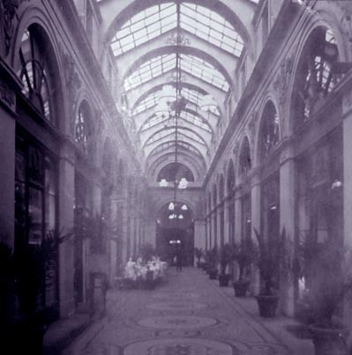
Arcades
Benjamin, W.1999. Passagenwerk (The Arcade Project):
„The arcades and interiors are residues of a dream world “
Buck-Morss, S. 1989. The Dialectics of Seeing: Walter Benjamin and Arcades Project.

Slide 6
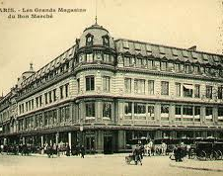
Bon Marché – 1838, Paris
First departmental store in history
E. Zola, Au Bonheour des Dames (U štěstí dam; (Ladies’paradise) – novel about its development

Slide 7
Malls and departmental stores: places of enchantment
Industrially produced commodities are cheap, but association with cheapness is not positive – spaces are constructed as luxurious
Victorian ideas of progress and industrialisation – railway stations, factories and departmental stores as cathedralls
New type of architecture: spatious, glass, marble, cast iron
big buildings (suggests you can find everything you need there)
Display of huge amounts of various foods - connection with power – rulers who provide everything, create debt.
Change of cities, relation to transport (also nowdays)
Employees: disciplined, nice, cultivated, increasingly female

Slide 8
Malls and departmental stores: places of enchantment
Advertising makes commodities objects of desire – objects of need change into objects of desire
Shopping as attraction, spectacle, display and exhibition
„The early department stores were theatres as much as art galleries, where everything was put in a magical context“ Corrigan
For Benjamin, The arcade was the Ur-form, the originary form, of modernity, for it incubated modes of behaviour – distraction, seduction by the commodity spectacle, shopping as leisure activity, self-display

Slide 9
Malls and departmental stores: places of enchantment
New experience with shopping:
Fixed prices (no haggling)
Goods are displayed you can see what you need
Free entry: everybody can enter, even if s/he does not buy anything – entry is not absolutely free (prescribed patterns of behavior, excluded parts of population)
Targeted to middle classes, democratisation of luxury
Laermans ( 1993): atractive, because they create a feminine public space –Important for emancipation

Slide 10
Malls and departmental stores: consumption as passive
Richard Sennet, 1976. The Fall of Public Man:
Free entry and fixed prices – passivity becomes a norm – consumer does not have to haggle
Departmental stores are explicit expression of public-private devide: private even secret pleasures at home, silent public watching in departmental stores
With commodities and sale becoming more spectacular, consumers become only audience in the comedy of commercial spaces of modernity

Slide 11
Malls and departmental stores: consumption as active
On the other hand – pleasure and fun recquire work: creation and learning of meanings and new lifestyles
John FiskeUnderstanding Popular Culture (1989)
mall is potential place of resistance – social life of women, tactices of resistence of marginal groups

Slide 12
Malls and departmental stores
Places where capitalism is reproduced
Places of mobilisation and resistence (women, minorities)
Places of homogeneous view on identities (Figurine – the body is subordinated to the abstract model created by marketing and commerce, it should have form corresponding to the dress)
Places enabling various identities
Places of enchantment

Slide 13
Group work 1
https://www.youtube.com/watch?v=Fdy1AgO6Fp4
From 40.s.
Watch the video.
In the group :
1. Define what is macdonalization
2. List 5 aspects of Macdonalization

Slide 14
Supermarket as an example of macdonalization
Ritzer, 1993. G. The McDonaldization of Society
Fast-food restaurant – organizing force representing process of racionalization of society
Macdonaldization:
“the process by which the principles of the fast-food restaurant are coming to dominate more and more sectors of American society as well as the rest of the world. “(Ritzer 1993:1)
Increase of chain mentality

Slide 15
5 aspects of macdonaldization
Efficiency – the optimal method for accomplishing a task (self-serve gasoline, self-serve soda fountains)
Predictability – the attempt to structure our environment so that people know what to expect.
Calculability - objective should be quantifiable (large amount of product delivered to the customer in a short amount of time, e.g. the Big Mac, food sold by it’s weight )
increased control and the replacement of human by non-human technology.
Iracionality of racionality – dehumanization of both employees and consumers

