Slide 1
Home as a site and object of consumption
SAN266, 11th week, 2nd May 2019

Slide 2
Group work:
Question: How can house/home be linked with consumption?
Provide three examples

Slide 3
House as a metaphor: folk model of economic behaviour
Gudeman and Rivera. 1990. Conversations in Columbia.
Gudeman. 2001. The anthropology of Economy: community, market and culture
People everywhere create models directing their economic behavior; these models have a form of a metaphor/cultural idiom.
House model:
rural Columbia, medieval and early modern Europe
inward directedness; purpose to reproduce intself as a selfcontained entity
‘Base’ – wealth, the basic element of the house; the purpose of the house is to maintain the base, preferable enlarging it; the base can be increased or decreased by the connections with the outside world.

Slide 4
House as a metaphor: folk model of economic behaviour
Miller, Daniel. 1998. Theory of Shopping
Shopping as a ritual involves:
transformation of spending to saving (transcendental transformation) : the inward directedness as in the Gudeman’s model
prax negating discourse – the aim is transcendence – shopping is saving, household is centre

Slide 5
Home as a space of consumption
capitalist industrialization simultaneously created revolutions in both production and consumption as well as both the factory and the home
Factory and office as a place of work, home as a place of non-work, domesticity and consumption
Specificity of housework and its relation to consumption: from 1980’s housework is not compatible with lifestyle and leisure of middle classes in Western world

Slide 6
Home as a space of consumption
20th century
The great shift from the role of the house as a source of moral welfare to the role of the house as a source of physical welfare. This corresponded to a change from the home as a place of beauty to the home as a place of efficiency.
shift from the inculcation of collective sentiments of good behaviour, honesty and respect for property through drawing room beauty to the efficient production of individual human bodies

Slide 7
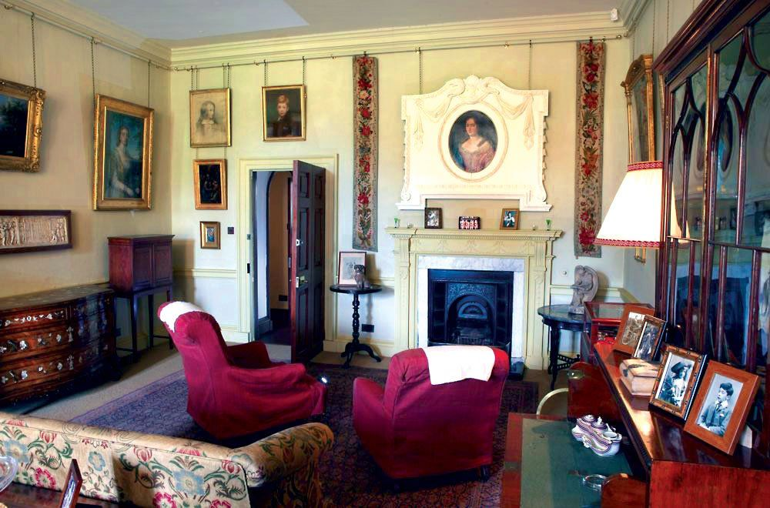
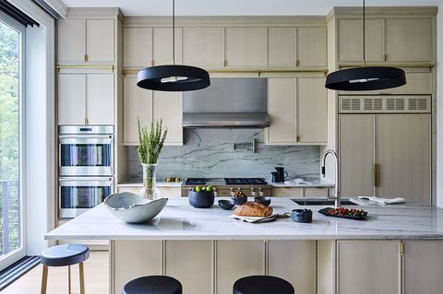
If the nineteenth century was the century of the drawing room, the twentieth century was the century of the kitchen

Slide 8
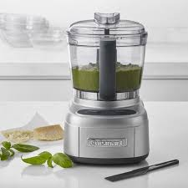
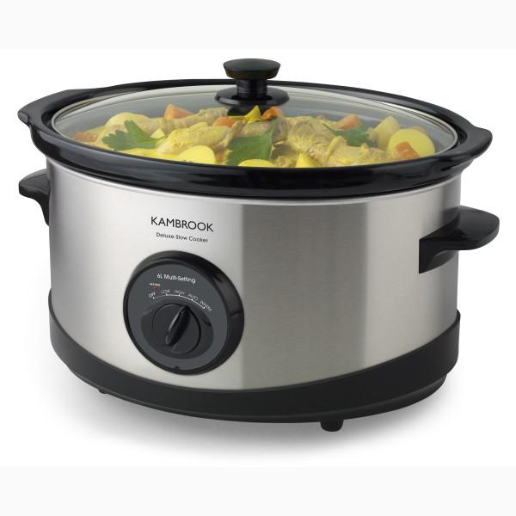
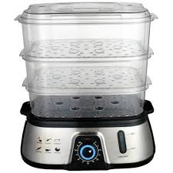

Home as a space of consumption
If the nineteenth century was the century of the drawing room, the twentieth century was the century of the kitchen
kitchen as the central room for the production of the healthy individual body; multifunctional kitchen appliances; kitchen as a place of modernity

Slide 9
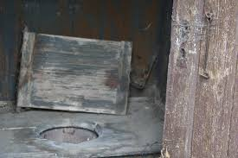
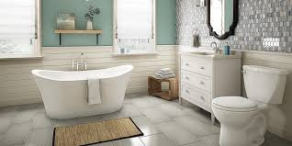
Home and hygiene: Home as a space where order is established
Late 19th century: rapid social change; boundaries became uncertain when working-class movement tincreased in power; bourgeois preoccupation with cleanliness as a way of preordering life
In 20th century hygiene relate to socialist modernisation>:
Buchli. 1999. Archaeology of socialism

Slide 10
Home as an object of consumption: ownership and appropriation
Miller. 1988. Appropriating the state on the Council Estate. Man 23: 354-372; Daniel Miller. (ed.) 2001. Home possessions.
Relation between state, dwelling and person; the role gender
The role of objects in aesthetic schemes and relations (haunted house)
Alison Clarke – Aesthetics of social aspiration
Taste preferences– in relation to social aspirations and ideas of idealized future
Relations and meanings change also because of aesthetic schemes
Sarah Pink. Home Truth
Zmyslové vnímanie domova. Domov definovaný cez zmyslovú skúsenosť – nielen vizualita, ale všetky zmysly
Pranie, pračky, vôňa jedla

