Slide 1
Consumption and political economy; consumption in socialist and capitalist societies
SAN261, week 3, 2018

Slide 2
Political economy
explains mutual relations between political (political institutions, law, governance) and economic (production, trade, consumption, and distribution of resources) systems
Themes: the role of consumption in origin and expansion of capitalism (colonialism, transatlantic trade, slavery, postsocialism); practices of consumption under various political regimes (consumption as an example of everyday life); consumption as an act of resistance
Group work:
How can political institutions/state/governance influence consumption? Describe at least 2 mechanisms

Slide 3
Consumption and origin/expansion of capitalism
Mintz, Sidney W. 1986. Sweetness and Power: The Place of Sugar in Modern History
Sugar becomes from luxury used sparsely by elites becomes everyday necessity for wide strata of society
Increase in demand related to wider accessibility related to interests of capitalist traders
One of commodities motivating proletariat to work
Fast energy
Tea as “British drink” (civilized, socially safe – it is not alcohol, it is a source of energy)

Slide 4
Expansion of capitalism and the birth of consumer society
McKendirck, Brewer and Plumb. 1982. The Birth of a Consumer Society.
2. ½ 18th Century – beginning of Consumer Revolution:
„the consumer revolution was the necessary analogue to the industrial revolution, the necessary convulsion on the demand side of the equation to match the convulsion on the suply side“ (McKendrick. 1982: 9).

Slide 5
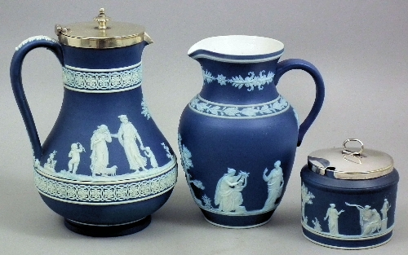
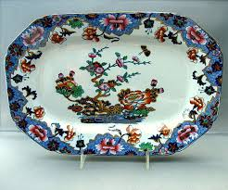
Expansion of capitalism and the birth of consumer society
The source of inspiration is not only the courte, but also trade: Sophisticated methods of sale feeding status aspirations
Wedgewood – uses aspirations of bourgoisy; produces affordable but sophisticated goods; plans production according to consumers’ wants

Slide 6
Capitalism, consumption and alienation
Marx, K. In Capital, but also in Economic and Philosophical Manuscripts
Human relations are organised through relations of production (not consumption)
Follows objects within a broader theory of development of capitalism; meaning of objects depends on political economy
To understand objects means to understand totality of human existence – commodity as basic unit of analysis: Commodity as symbol of exploitation and alienation

Slide 7
Capitalism, consumption and alienation
Lukács:
Reifikation – objects of consumption are bearers of capitalist ideology. Act of shopping embeddies burgois ideology and reproduces capitalist relations.
Frankfurt school (Addorno, Hokheimer, Marcusse):
Consumer culture suppresses aesthetic abilities and critical thinking
consumer desires enslave people
new forms of social control based on controling consumer desires

Slide 8
Capitalism, consumption and alienation
Miller, Daniel. 1987. Material Culture and Mass Consumption
Material culture as „relationship through things are created as social forms“ – objectification
Commodities and mass culture as a „dominant context through which we relate to objects “ through mass culture we become agents of historical processes
„consumption as work may be defined as that which translates the object from an alienable to an inalienable condition; that is, from being a symbol of estrangement and price value to being an artefact invested with particular inseparable connotations“ (Miller, 1987: 190)

Slide 9
Group work:
How is consumption defined and organized in capitalist resp. socialist societies?

Slide 10
Capitalism and consumption
Early capitalism – focus on capital goods, not on consumer goods
Fordism – mass production and consumption, commodities are material things
Postfordism – production and consumption of services, events and information, commodities are dematerialized, niche marketing

Slide 11
Socialism and consumption
Socialism as modernisation programme – consumption as both indicator and means of modernisation
Space for creation of relations with regime – paternalistic redistributionand dependence on state leads to resistence, desire fore Western goods
Economics of shortages
Contributes to the fall of regime – free choice and power over goods on market

Slide 12
Good bye Lenin
https://www.youtube.com/watch?v=iJb4efZcFUM

