Slide 1
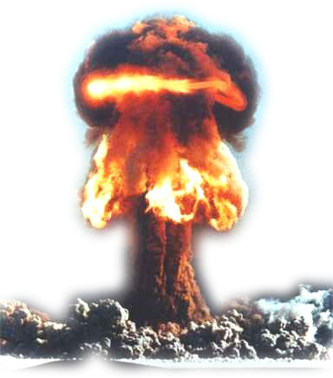
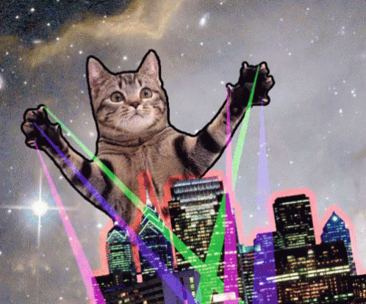
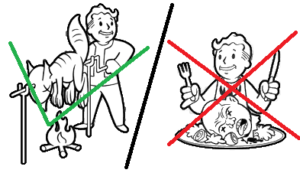
Preppers
aka
how not to be forced to kill and eat your neighbour
Mgr. Michael Myklín, 23.4.2019

Slide 2

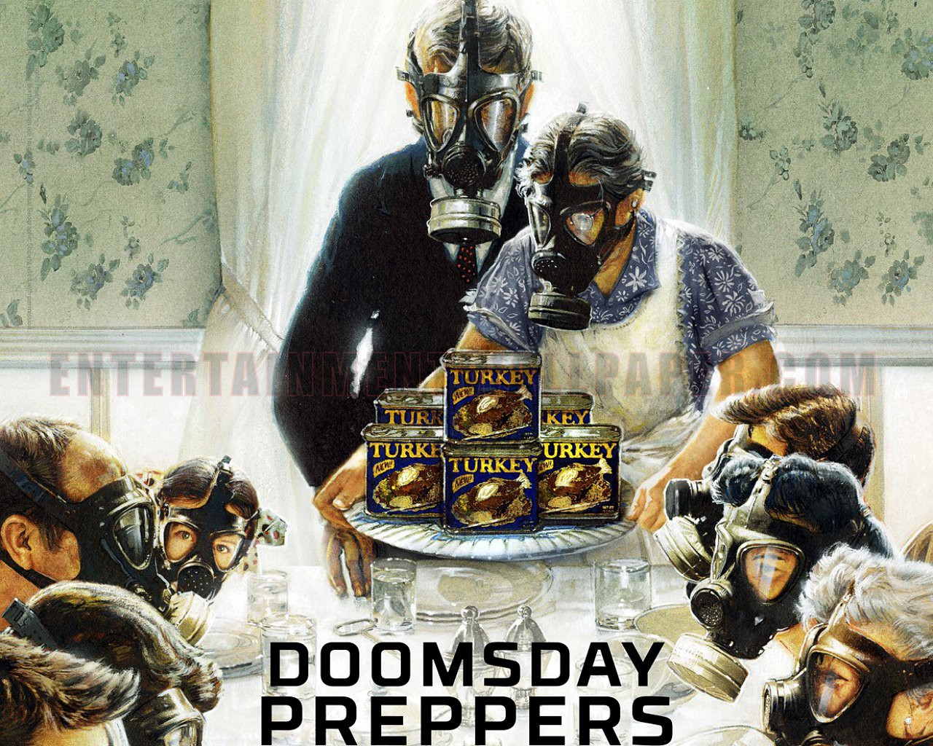
Preppers
People who are constantly preparing for the emergencies, natural disasters, impending societal collapse due to pandemics, a shortage of resources, economic downfall, or an unexplained apocalyptic event
Origins in 1940s and 1950s with civil defense programs in USA promoting protection against nuclear weapons
From avoiding inconvenience, through being prepared for emergencies or war to surviving zombie apocalypse
  Universal set of skills and supplies for most situations
Preppers are often viewed as insane, paranoid, conspiracy theorists or pessimists towards society/humanity
Can be considered subculture
Notes:
Paranoia as a norm, as well as a pessimimsm toward society/humanity
Preppers aim to be as much selfreliable as possible and no relly on govenrment in the time of crisis

Slide 3
Preper Dictionary
BIB (Bug in Bag)
BOB (Bug out Bag)
BOL (Bug out Location)
Golden Horde
G.O.O.D (Get Out of Dodge)
TEOTWAWKI (The End of the World as We Know It)
WTSHTF (When the Shit Hits the Fan)

Slide 4
Preppers vs survivalists
Prepping – learn how to effectively survive disasters and adapt to long-term change within a local area
  Need of food, water and safety as a number one priority
Survivalism – usually understood as a more hardcore form of prepping, including white supremacism, antigovernment groups, apocalyptic cults and wide range of militias (Barlet 2004; Lamy 1992; Weeber and Rodeheaver 2003)
  Often depicted as shaved-headed youths, marching about with swastikas, US flags or other symbols. Also depicted with weapons, carrying paramilitary training scenarios or preaching that the „End is coming“ (Lamy 1992)
  Focus on dystopian scenarios following some cataclismating event (social/political/economic collapse) where they will need to defened themselves and their families from those that they perceive as a threat

Slide 5
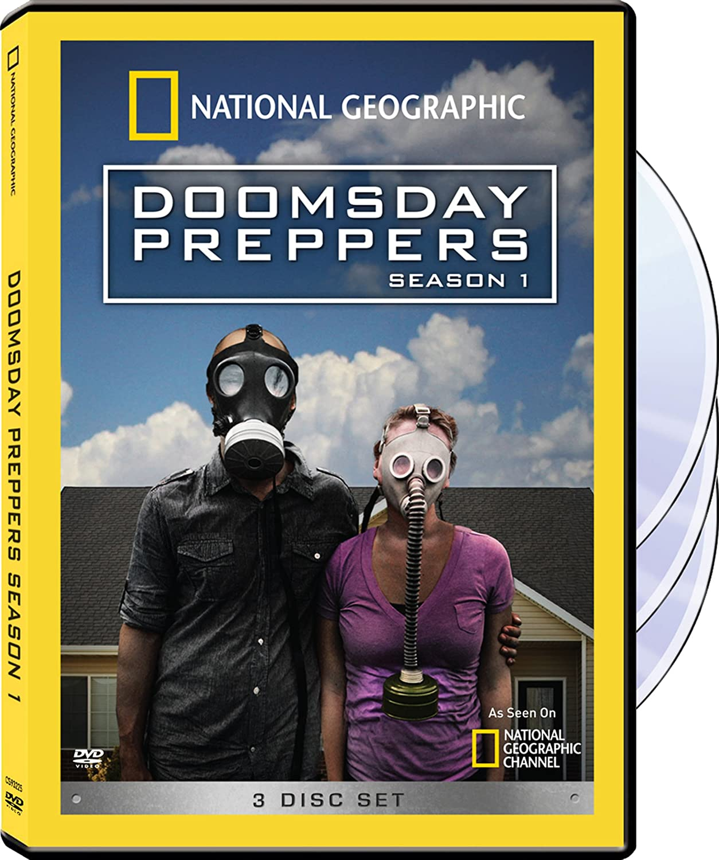
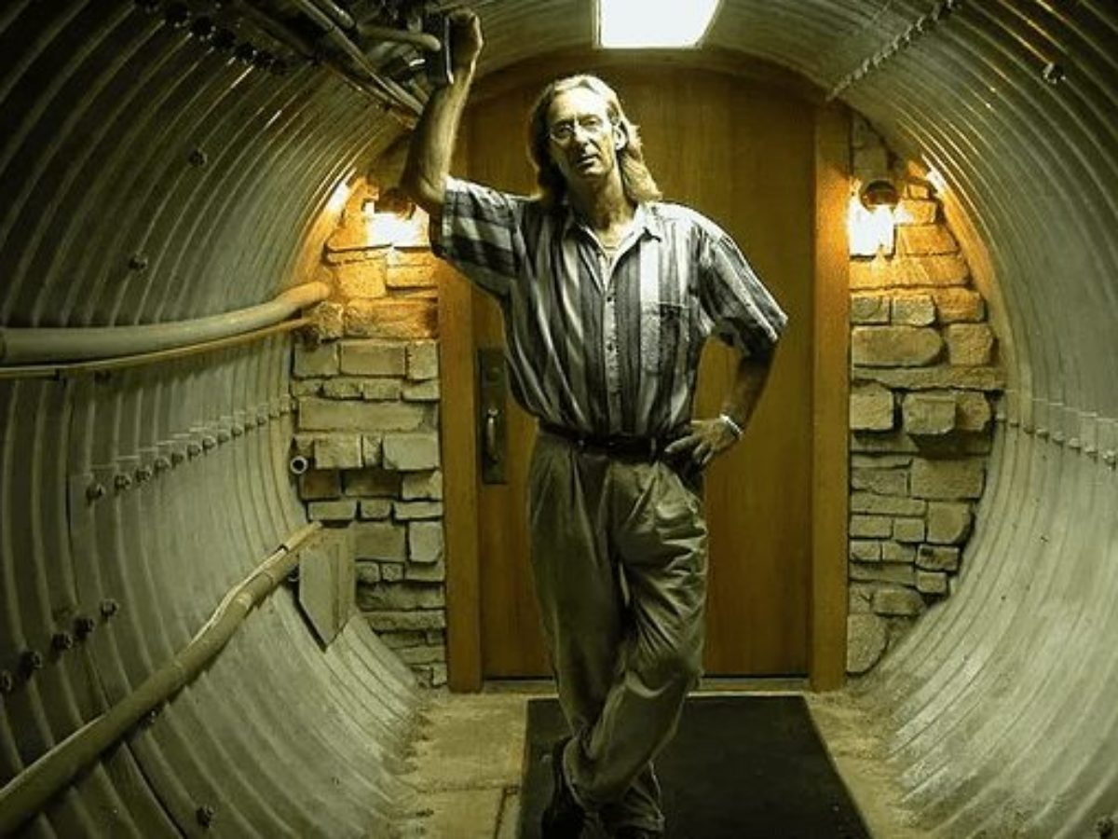
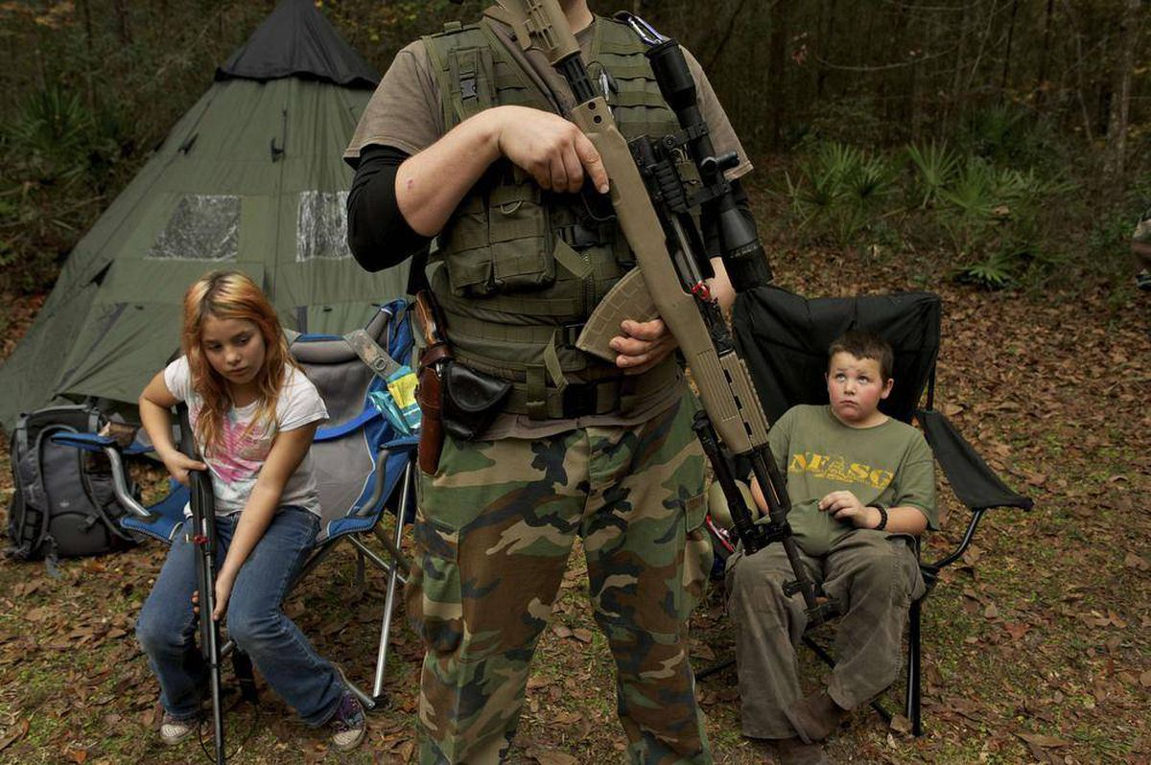
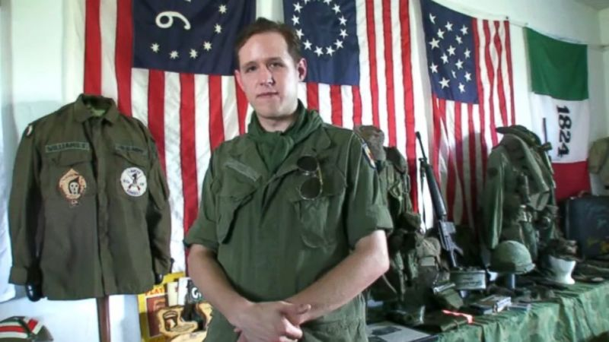
Media depiction of preppers

Slide 6

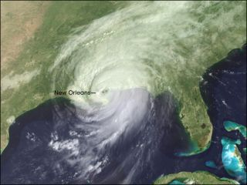
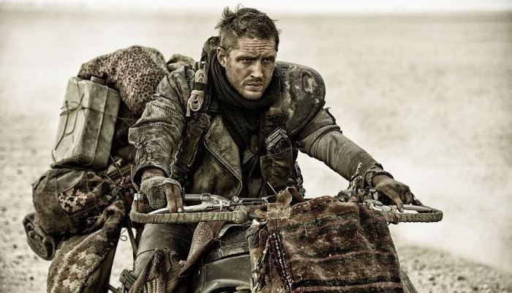
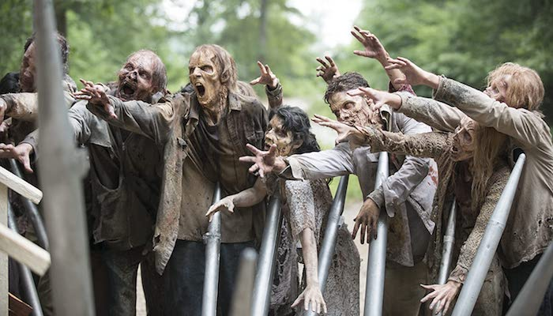
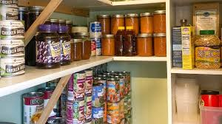
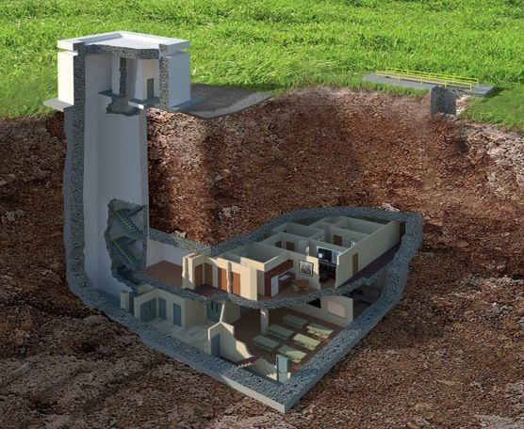
Reality
Normal people with emergency supplies vs. doomsday survivalists living in wilderness
Different countries = different threats = different prepper cultures
TLDR: Most preppers are just regular people who plan ahead and prepare for short-term emergencies
VS

Slide 7
Your government probably wants you to prepp!
Prepping is not limited to individuals or communities but it is recommended and endorsed by numerous governments around the world
The more people are prepared, the less people might die/require assistence
Manuals represent different issues, threats and recommendations specific to individual countries
Governments themselves are also prepping - stockpiles of strategic resources and materials (oil, food, medical materials) – often classified
  USA - National Strategic Stockpile
  Czech Republic - The Administration of State Material Reserves
  Finland - National Emergency Supply Agency
As COVID-19 showed - many countries were unprapered for the situation, most notably USA
  Numerous budget cuts in emergency response – hurricane Maria, COVID-19
Notes:
Finland - https://www.nytimes.com/2020/04/05/world/europe/coronavirus-finland-masks.html

Slide 8
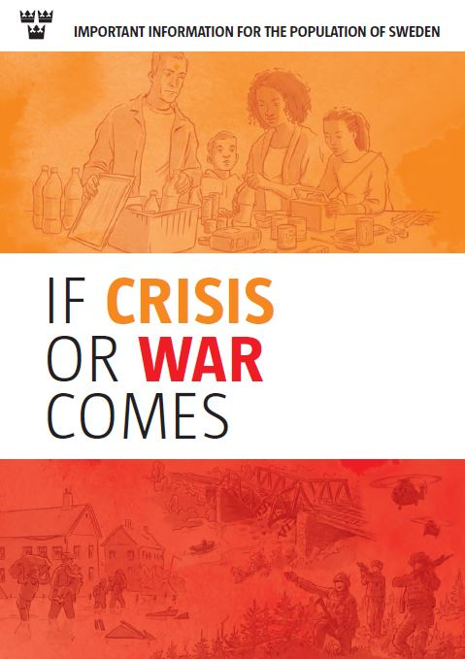
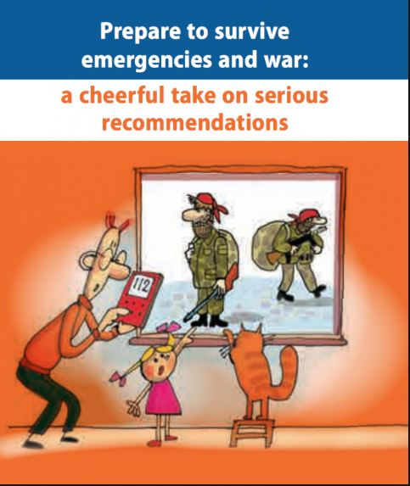
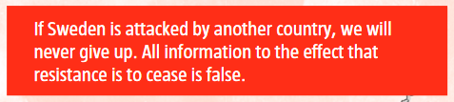

Slide 9
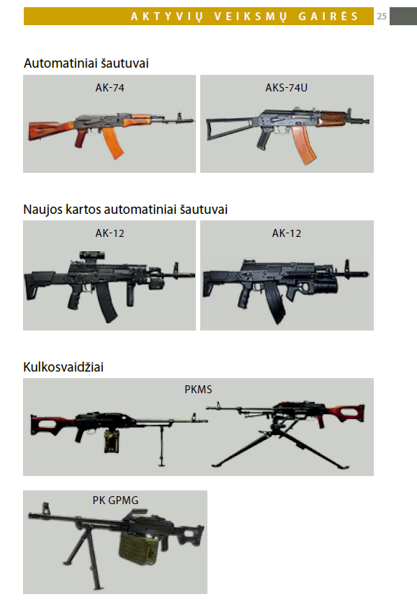
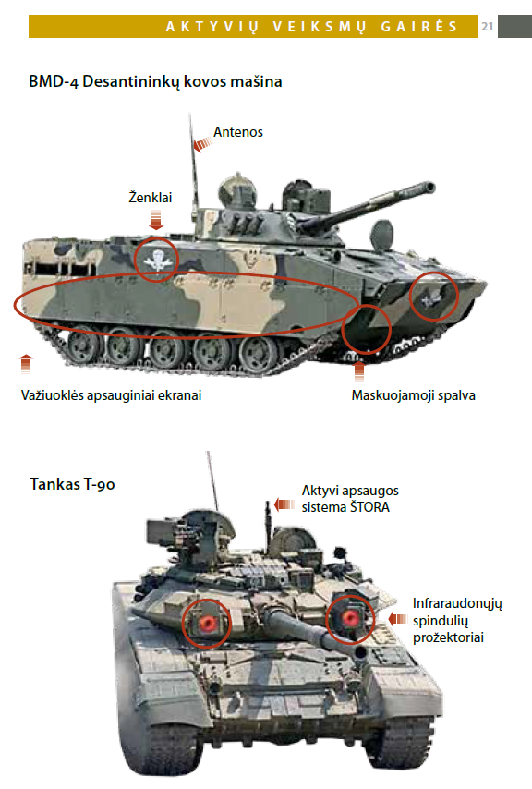


Slide 10
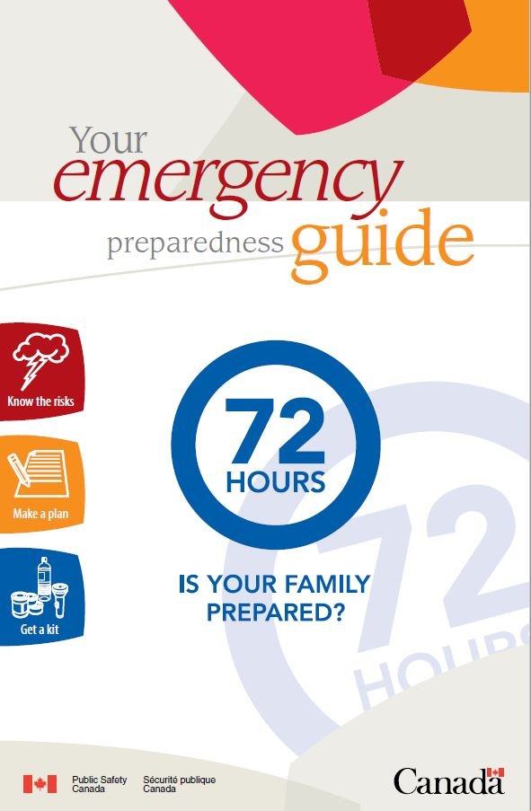
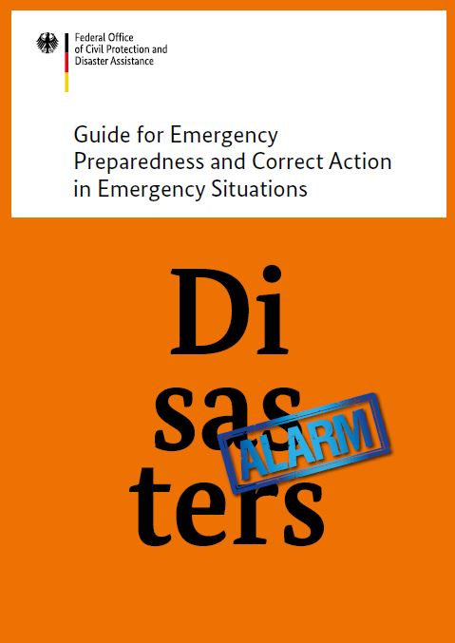

Slide 11
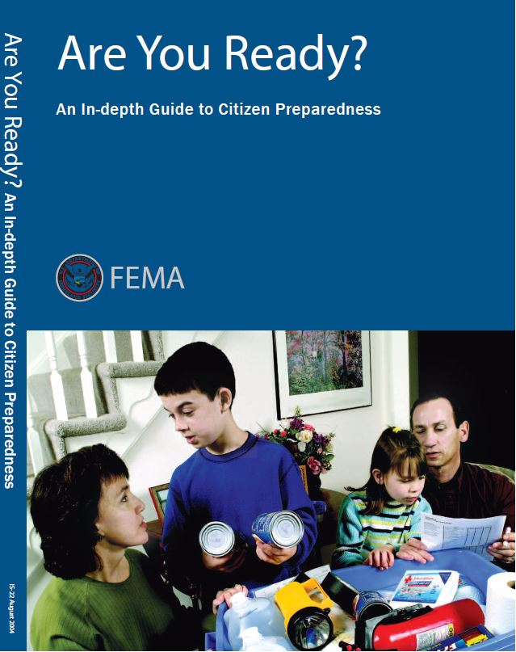
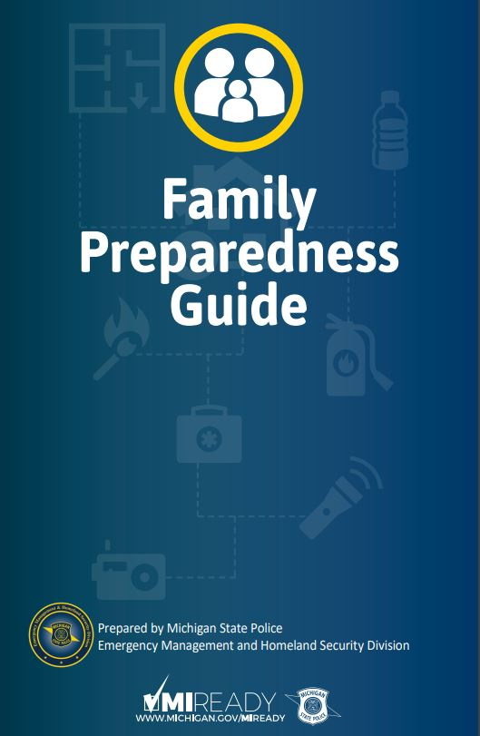

Slide 12
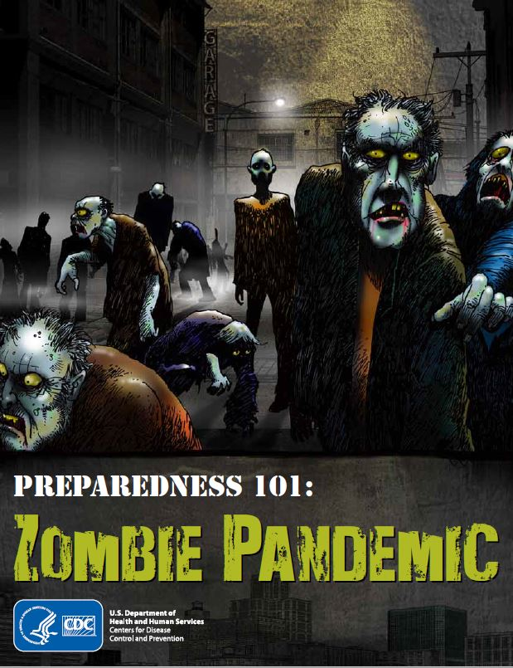
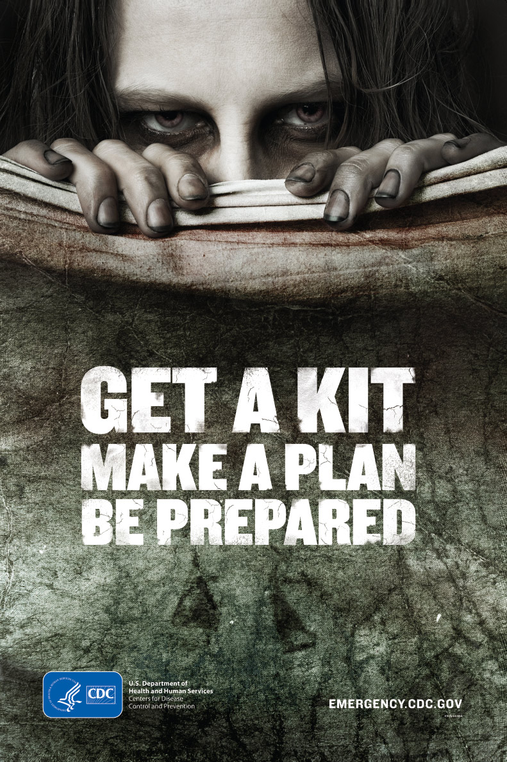

Slide 13
Links to emergency prepardness manuals
Sweden
  https://www.msb.se/upload/forebyggande/krisberedskap/krisberedskapsveckan/fakta%20om%20broschyren%20om%20krisen%20eller%20kriget%20kommer/if%20crises%20or%20war%20comes.pdf
Latvia:
  https://kam.lt/download/50720/ka%20turime%20zinoti%20praktiniai%20patarimai%20en--el.pdf
Lithuania:
    https://kam.lt/download/55077/2016%20aktyviu%20veiksmu%20gaires%20internetui_.pdf
Canada
  https://www.getprepared.gc.ca/cnt/rsrcs/pblctns/yprprdnssgd/index-en.aspx
German:
  https://www.bbk.bund.de/SharedDocs/Downloads/BBK/DE/Publikationen/Broschueren_Flyer/Fremdsprach_Publikationen/disasters_alarm_en.pdf?__blob=publicationFile
USA – FEMA
  https://www.fema.gov/media-library-data/20130726-1549-20490-4633/areyouready_full.pdf
USA – Michigan
  https://www.michigan.gov/documents/familypreparedness_color_62898_7.pdf
USA – CDC
  https://blogs.cdc.gov/publichealthmatters/2011/05/preparedness-101-zombie-apocalypse/

Slide 14
COVID-19 and prepping
Stigma of prepping – preppers as paranoid hoarders
Notes:
The current situation showe us a limits of todays globalized society – canned food, pasta, rice or flour sometimes not available at the stores becouse people were buying it in the begining of the pandemy. On the top of that, there are many people with health conditions that should not go outside becouse the virus is death sentence for them.
There are of course solutions like delivery service, but that might not be avalilable immidiately – when the emergency state begun, i ordered food from tesco online delivery service and the closes delivery date was in two weeks.
Pandemy also showed us that we should not relly on governmant all the time – in Czech republic, there still is a very distinct and visible lack of long term or mid term plan – officials are changing their mind from day to day – how can be citizen sure the shops wont be next to be closed? Even for short period of time? If your own government doesnt knwo what it will do in next two days, hwo can you be sure it will také care of you?

Slide 15
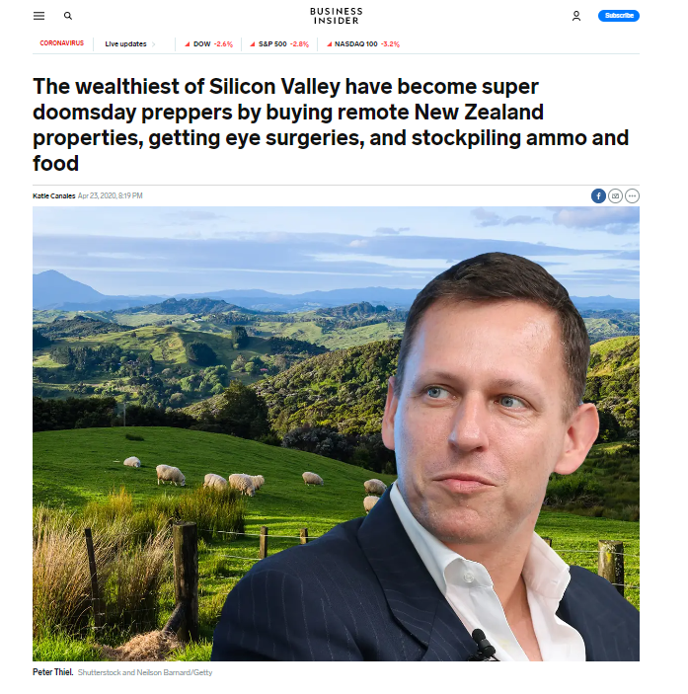
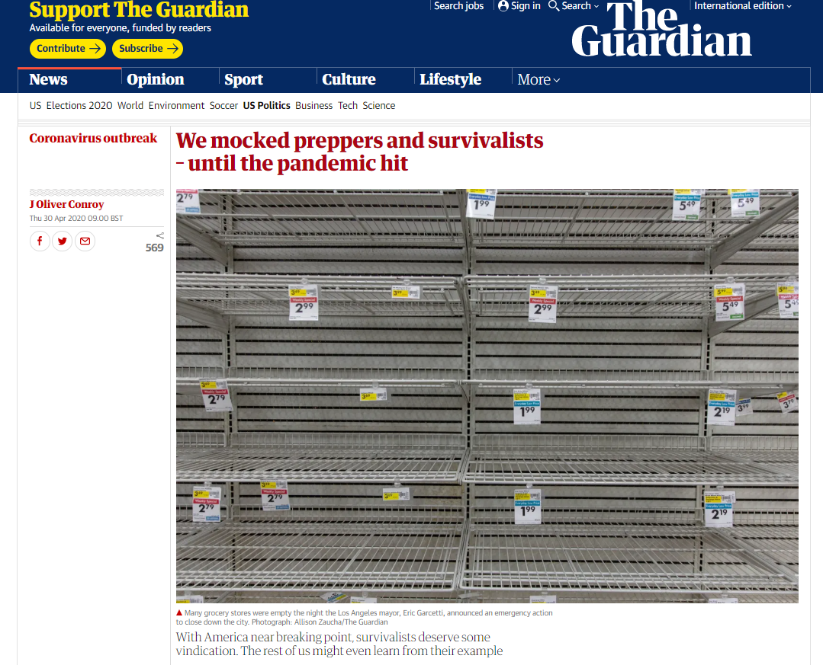
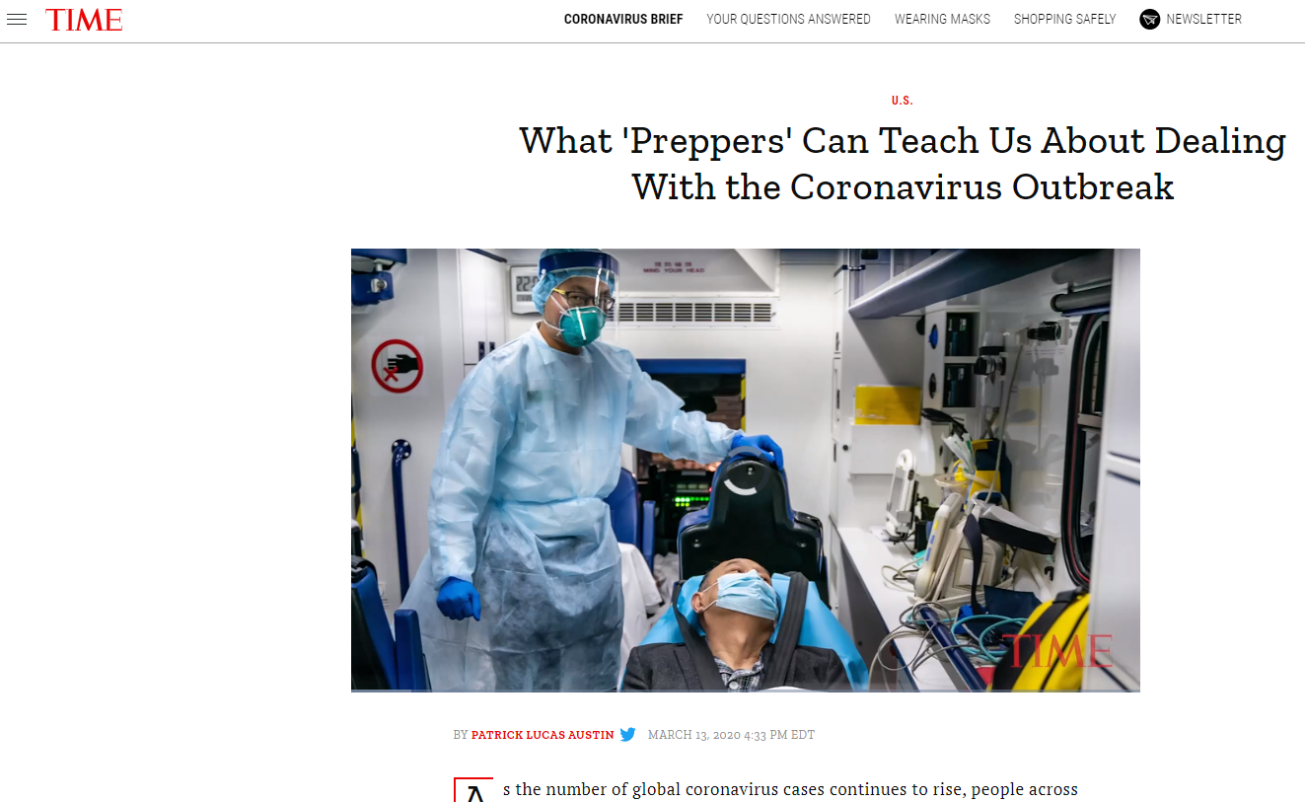
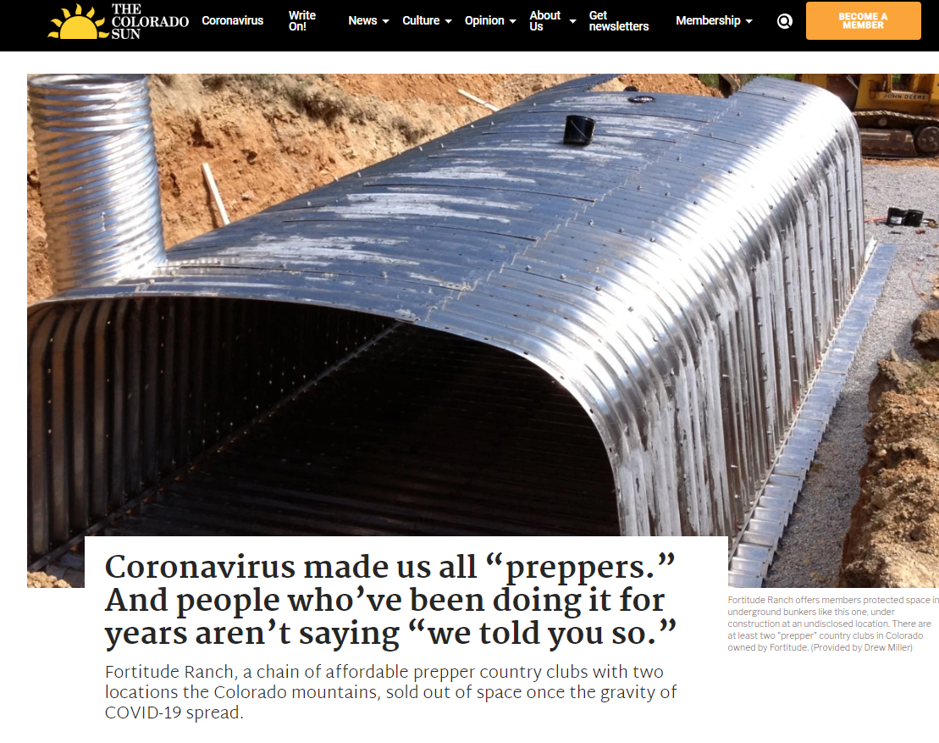
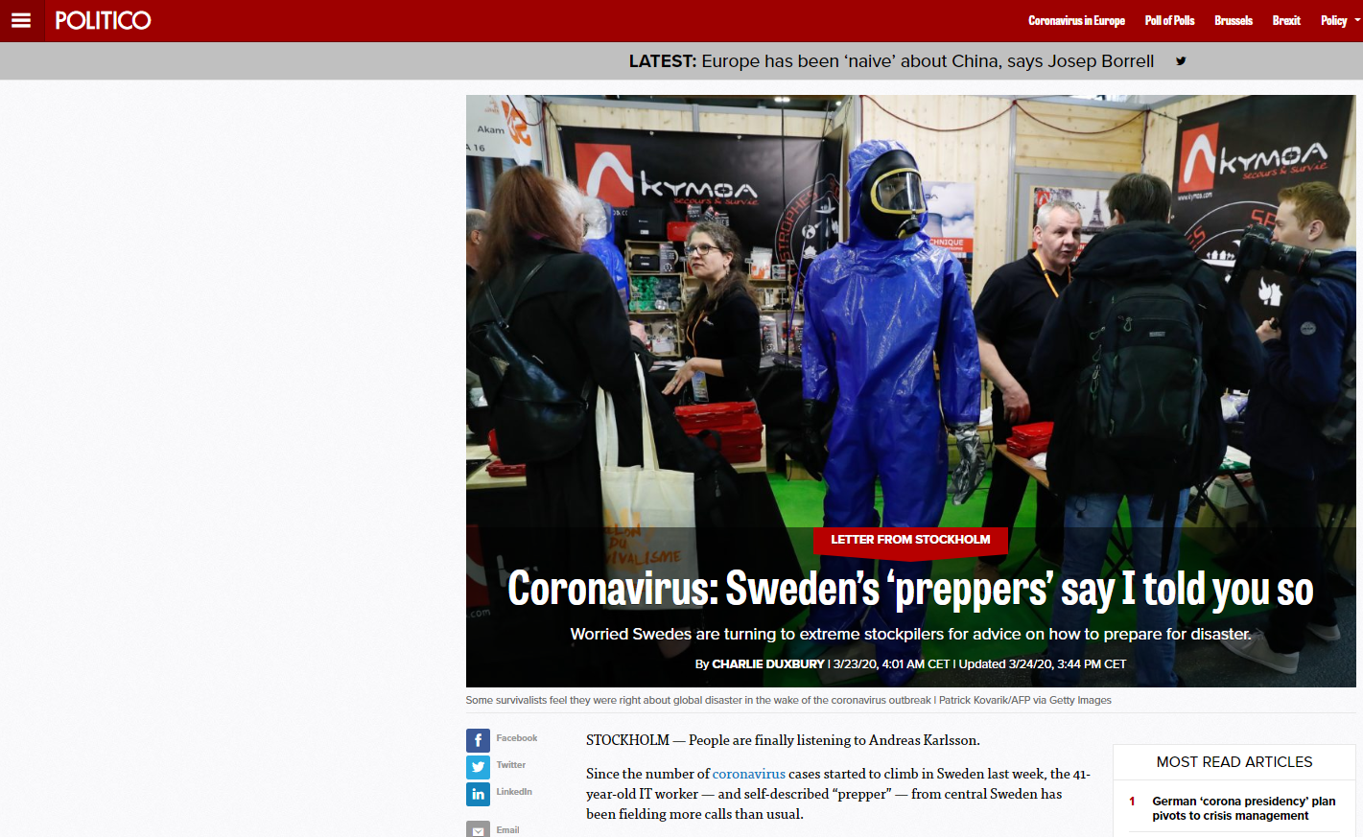
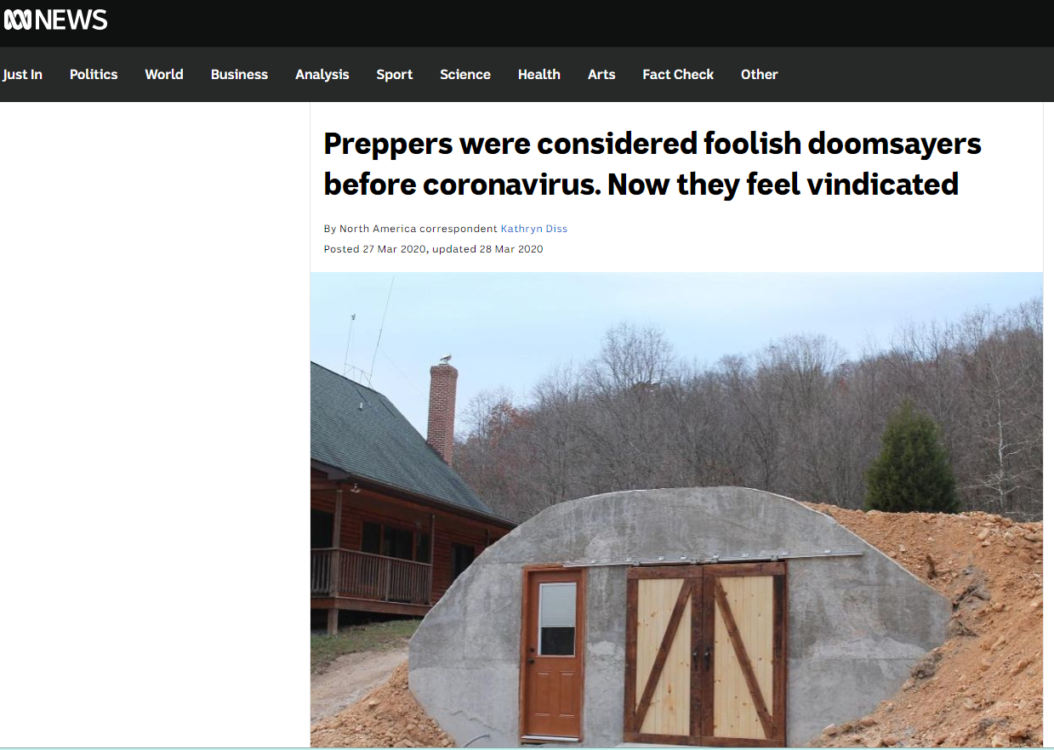
https://www.businessinsider.com/silicon-valley-doomsday-preppers-new-zealand-2020-3; https://www.theguardian.com/global/2020/apr/30/preppers-survivalists-disasters-lessons; https://time.com/5797950/coronavirus-preppers/ ; https://coloradosun.com/2020/04/03/coronavirus-preppers-fortitude-ranch/; https://www.abc.net.au/news/2020-03-28/coronavirus-fears-see-ameri; https://www.politico.eu/article/coronavirus-swedens-preppers-say-i-told-you-so/cans-stockpile-guns/12088298

Slide 16
COVID-19 and prepping
Stigma of prepping – preppers as paranoid hoarders
Failure of governments to provide leadership and supplies
More preppers in the future + more tolerant views on prepping in general population
  Especially in Europe

Slide 17
Prepping for economic collapse: Argentina 1998
1998-2002 – Argentine great depression
Widespread unemployement, riots, fall of the government, default on the country´s foreign debt
Over 50 % of Argentinians loved below the official poverty and basic needs of 25 % of Argentinians were unmet, violent crime became a rampant problém
Rapid inflation = prices of some food and other articles doubled overnight
How can prepping help to come and mitigate effects of financial crisis on individual?
  Food stockpiles
    Comes in handy when prices of food skyrocket
    In case of riots and highed crime rates there is no need to go to the shop
  Anyhting else is bonus – weapon, car, gas, wood, skills…
Notes:
So, we survived covid-19, but what about the post-covid world? The economy is gona také very heavy beating, people are and will be unemployed, prices will go up, salaries worn.. I think it is safe to say we are slowly but surely heading to economic recesion. One of the most serious cases of contemporary economic crisis and subsequent collapse of a country is Argentina in 1998.

Slide 18
How to prepp reasonably?
Preparedness saves lives and self-sufficiency beats dependency
  Do not count on emergency services (firefighters, ambulances, police) or emergency public services (tanks with water) to be available in time
Basic prepping for short-term emergencies (72 hours) is relatively cheap
How to be prepared?
  Emergency supplies for short-term emergencies (food and water) for at least 72 hours
  General emergency supplies (fire extinguisher, proper first aid kit, radio)
  „Grab bag“ with basic necessities for sudden evacuation (food,water, blanket, radio, first aid kit, flashlight)
  Car emergency kit (proper first aid kit, jumper cables, rope, water, food, extra clothing, blanket)
Prepping supplies can be very useful during individual financial difficulties (unemployment etc.)
Notes:
Different states reccomend different amount of supplies – german government recommends 10 days
Hard to plan for apocalypse scenario – solar flares – asteroid – supervulcano - supervirus

Slide 19
Emergency supplies
Survive 14 days in your home without services (shops, water, elektricity, heating)?
  Preparation for short/mid term events (blackout, natural disaster, riots…)
Food
  Canned food with long shelflife (sauces, beans, legumes, tuna, vegetable, fruit)
  Rice, pasta, potatoes
  Flour
  Oil
  Snacks, alcohol, coffee,, tea (morale booster)
  Spices (salt, pepper)
Water (drinking, cooking and hygiene)
  Bottled water, water filter, purifying tablets
Light
  Fleshlight, candles, oil lamp
  Matches/lighter
Cooking
  Outdoor cooker with spare propane fillings
Others
  Can opener
  Radio with spare bateries
  Trash bags
  CASH
  Ducktape
  Fire extinguisher
Hygiene
  Toilet paper
  Hand sanitiser
  Wet wipes
  Bleach
First aid kit
  Disinfection (peroxide)
  Basic meds (ibuprofen, paralen)
  Gloves
  Bandage

Slide 20
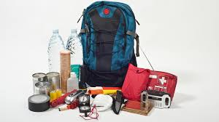
Emergency evacuation bag
Prepared backpack/bag in case of sudden crisis (flesh flood, fire)
  Food/snacks (energy bars, dried meat, nuts, canned food, MRE)
  Bottle of water
  First aid kit
  Flashlight
  Raincoat
  Emergency blanket
  Matches/lighter
  Pocket knife
  Hand sanitiser
  Paper tissues
  Toiletries (tooth brush, tooth paste, soap)
  Extra underwear
  Copy of ID and other important documents
  Cash

Slide 21
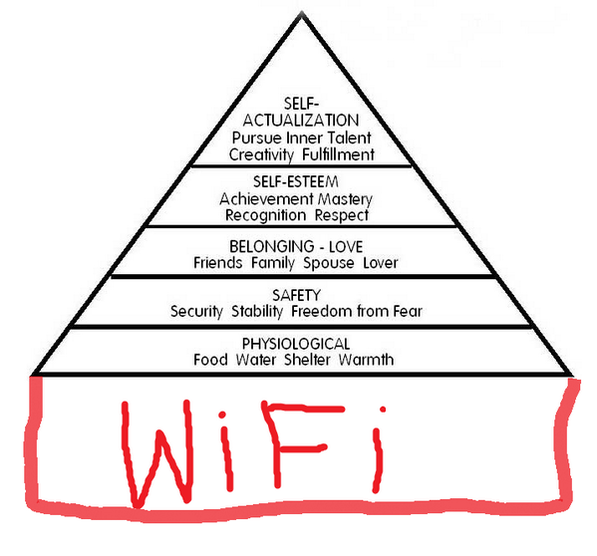
Would you comfortably survive 72 hours without electricity, water and with closed shops?

Slide 22
Sources
Barel, C. 2004. Militias in the frame. Contemporary Sociology 33(5): 514-521
Lamy, P. 1992. Millenialism in the mass media: The case of „Soldier of Forture“ magazine. Journal for the Scientific Study of Religion 31(4):408-424
Lamy, P. 1996. Millennium rage. New York: Plenum Press.
Weeber, S. and D. Rodeheaver. 2003. Militias at the millennium: A test of Smelesr¨s theory of collective behavior. The Sociological Quarterly 44(2):181-204

Slide 23
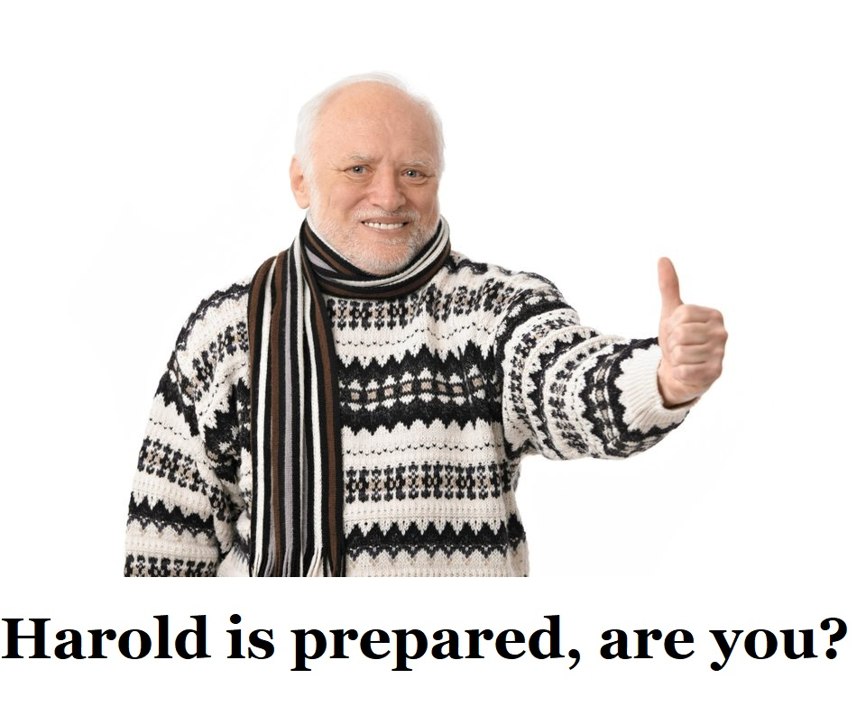
Questions?
myklin.michael@gmail.com

