Slide 1
language
week 3 (4th March 2020)

Slide 2

the importance of the language...

Slide 3

the importance of language for culture
which came first - culture or language?
multilingual / multicultural idioms and proverbs
degree of formality
phrasal verbs versus non-phrasal verbs
academic word-list
E.Hall: low-context versus high-context cultures

Slide 4
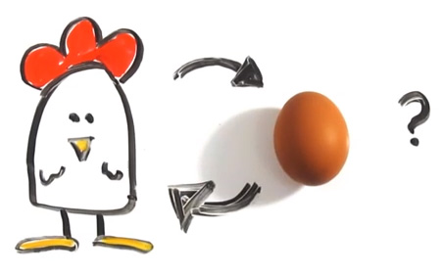
a hen or an egg? a culture or a language?

Slide 5
“It´s all Greek to me…” (“Je to pro mě španělská vesnice…”)
هل أنا بتكلم هندي1.
2. Говориш ми на патагонски
3. 雞腸
4. C'est de l'hébreu pour moi
5. За мене тоа е шпанско село
6. ਕੀ ਮੈਂ ਫਾਰਸੀ ਬੋਲ ਰਿਹੈਂ?
7. Þetta er hebreska fyrir mér
8. Ez nekem kínai
9. Dat is Chinees voor mij

Slide 6
“It´s all Greek to me…” (“Je to pro mě španělská vesnice…”)
هل أنا بتكلم هندي1.
2. Говориш ми на патагонски
3. 雞腸
4. C'est de l'hébreu pour moi
5. За мене тоа е шпанско село
6. ਕੀ ਮੈਂ ਫਾਰਸੀ ਬੋਲ ਰਿਹੈਂ?
7. Þetta er hebreska fyrir mér
8. Ez nekem kínai
9. Dat is Chinees voor mij
Arabic
Bulgarian
Chinese
French
Macedonian
Punjabi
Icelandic
Hungarian
Dutch

Slide 7
“It´s all Greek to me…” (“Je to pro mě španělská vesnice…”)
هل أنا بتكلم هندي1.
2. Говориш ми на патагонски
3. 雞腸
4. C'est de l'hébreu pour moi
5. За мене тоа е шпанско село
6. ਕੀ ਮੈਂ ਫਾਰਸੀ ਬੋਲ ਰਿਹੈਂ?
7. Þetta er hebreska fyrir mér
8. Ez nekem kínai
9. Dat is Chinees voor mij
Arabic
Bulgarian
Chinese
French
Macedonian
Punjabi
Icelandic
Hungarian
Dutch
Am I speaking Hindi?
You're speaking to me in Patagonian
it's like chicken intestines
It's Hebrew to me
That's a Spanish village to me
Am I speaking Farsi?
This is Hebrew to me
This is Chinese to me
That's Chinese for me

Slide 8
“It´s all Greek to me…” (“Je to pro mě španělská vesnice…”)
https://www.omniglot.com/language/idioms/incomprehensible.php

Slide 9
multilingual / multicultural idioms and proverbs
your examples...

Slide 10
register / degree of formality

Slide 11

register
Oh man, this sucks. I have this running nose and keep like sniffling and sneezing! I have this like allergy. And the doc is a real weirdo. He´s nuts! I Hate spring. It´s only March now! Weeks to go. Oh man...
❔
When daffodils begin to peer,
With heigh! the doxy, over the dale,
Why, then comes in the sweet o’ the year;
For the red blood reigns in the winter’s pale.
Hey Bunny, you are my little Easter baby...
Spring is beautiful, but it's also a key time of year for seasonal allergies. As plants release pollen, millions of people with hay fever start to sniffle and sneeze. There's no cure but you can take steps to curb springtime allergies, from medication to household habits.
The spring season associated with the vernal equinox, called astronomical spring, takes place around March 20 in the Northern Hemisphere, however meteorologists recognize March 1 as the first day of meteorological spring, which is based on annual temperature cycles and the Gregorian calendar. Leap years and the elliptical shape of that orbit around the sun affect when the astronomical seasons, or summer/winter solstices and vernal/autumnal equinoxes, occur.
❔

Slide 12
When daffodils begin to peer,
With heigh! the doxy, over the dale,
Why, then comes in the sweet o’ the year;
For the red blood reigns in the winter’s pale.
The spring season associated with the vernal equinox, called astronomical spring, takes place around March 20 in the Northern Hemisphere, however meteorologists recognize March 1 as the first day of meteorological spring, which is based on annual temperature cycles and the Gregorian calendar. Leap years and the elliptical shape of that orbit around the sun affect when the astronomical seasons, or summer/winter solstices and vernal/autumnal equinoxes, occur.
Spring is beautiful, but it's also a key time of year for seasonal allergies. As plants release pollen, millions of people with hay fever start to sniffle and sneeze. There's no cure but you can take steps to curb springtime allergies, from medication to household habits.
Hey Bunny, you are my little Easter baby...
Oh man, this sucks. I have this running nose and keep like sniffling and sneezing! I have this like allergy. And the doc is a real weirdo. He´s nuts! I Hate spring. It´s only March now! Weeks to go. Oh man...

Slide 13
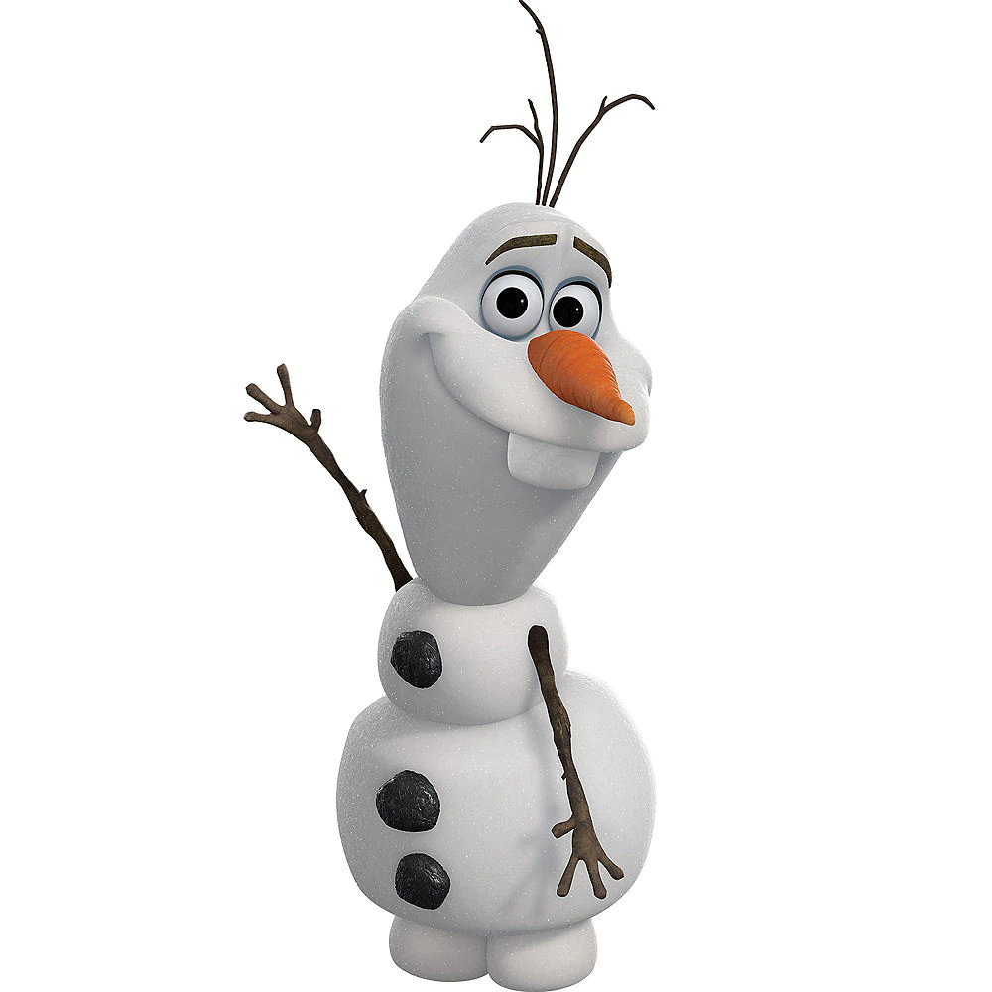
FROZEN literally “frozen” in time and form
FORMAL impersonal, complete sentences, no slang, may use technical or academic vocabulary, used for scientific publishing
CONSULTATIVE used when consulting an expert such, formal register in conversation
CASUAL conversational tone, among and between friends; general words, rather than technical; may include slang and colloquialisms
INTIMATE private conversations, restricted to families, bedrooms etc.
Sarah Elaine Eaton: Language Register and Why It Matters (Or: Why You Can’t Write An Academic Paper in Gangsta Slang). Retreived from https://drsaraheaton.wordpress.com/2012/05/22/language-register-and-why-it-matters-or-why-you-cant-write-an-academic-paper-in-gangsta-slang/

Slide 14
FROZEN - archaisms, unusual word forms...
FORMAL - scientific and academic language, facts and exact data, words of Norman and Latin origin (long words), long complex sentences that link ideas together (linking words)
CONSULTATIVE - neutral language, proper words, to the point
CASUAL - colloquialisms, contracted forms, emotions, unfinished sentences, cursing
INTIMATE - very emotional, nicknames, diminutives...

Slide 15
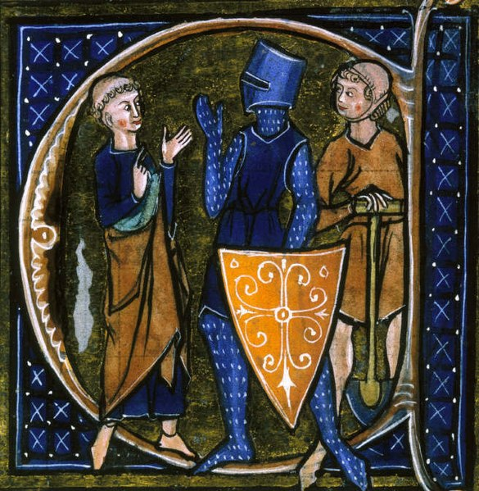
register and synonyms
nobility / aristocracy
clergy
commoners / peasants

Slide 16
register and synonyms
nobility / aristocracy
French (Norman)
clergy
Latin
commoners / peasants
English (Anglo-Saxon) - https://www.youtube.com/watch?v=MDs71AgphkI

Slide 17
phrasal verbs

Slide 18
academic word-list
http://www.uefap.com/vocab/select/awl.htm

Slide 19
Edward Hall
HIGH CONTEXT CULTURE
https://www.youtube.com/watch?v=9oYfhTC9lIQ
LOW CONTEXT CULTURE

Slide 20
Edward Hall
HIGH CONTEXT CULTURE
high level of shared context
Implicit language
significance of non-verbal elements in communication
relationships built on trust and developed slowly
centralization of social structure and authority
people sensitive to signs of disagreement
space is communal, sharing space ok
difficult to schedule time
time belongs to others and to nature
change is slow
groups are preferred
accuracy is valued in performance
https://www.youtube.com/watch?v=9oYfhTC9lIQ
LOW CONTEXT CULTURE
low level of shared context
explicit and precise language
disagreement is depersonalized
addressing of the issues is direct
relationships begin and end quickly
decentralization of social structure
privacy is important
scheduling tasks
Time is “owned” by an individual
focus on individual orientation
speed and achievements are valued
From https://online.seu.edu/articles/high-and-low-context-cultures/

Slide 21
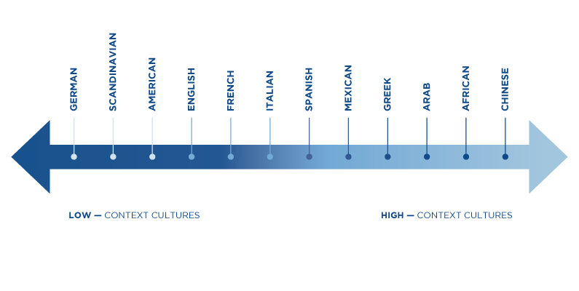
Edward Hall
From https://online.seu.edu/wp-content/uploads/795x400-InternationalBusiness-Chart-SEU.png

Slide 22
HW for next week
Choose a genre (tweet, email, facebook post…)
Write it in formal and informal English
Bring the two texts to our next class
Keep them in your portfolio...

