Slide 1


In/out referendum campaign
Dr Monika Brusenbauch Meislová
EVS465: Brexit: Politics, Policies and Processes
24 March 2020

Slide 2


Slide 3
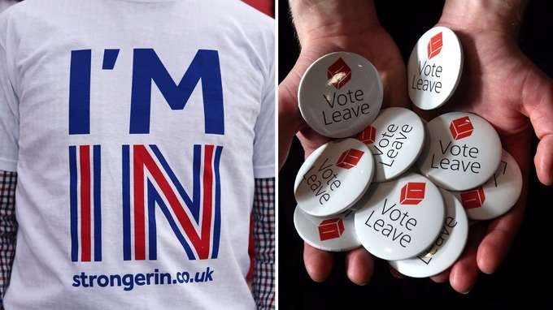
Referendum campaign
unofficial beginning: 20 February 2016 when PM announced that a referendum would be held)
official beginning: 15 April 2016
poll/referendum: 23 June 2016
duration: 10 weeks
Electoral Commission selected two official groups:
  Designated official leading Remain campaigning group: Britain Stronger in Europe
  Designated official leading Leave campaigning group: Vote Leave

Slide 4
Referendum campaign
Cabinet divisions
Dilemma → suspension of collective cabinet responsibility by Cameron
6 of 24 cabinet ministers rejected the government position
importance of Boris Johnson’s decision to back Leave (DC wanted to avoid any sense of infighting/“blue on blue” attacks)
Tensions over the use of govt officials.

Slide 5

Remain campaign
Focus on economic costs of brexit (Treasury, IMF, Bank of England)
  the one issue the Remain campaign could unite around
  conglomerate of campaigners
  focus was on the transactional, business-like partnership
Intervention by Obama
Project Fear
Pro-Remain campaign no illustration history in UK politics
The leadership of the campaign rested with the PM
Corbyn hesitant in his support for Remain
Lib Dem recovering from a heavy 2015 defeat
Other Remain-backing parties (SNP, Greens, Lib Dem) uneasy at sharing a campaign with Cameron

Slide 6
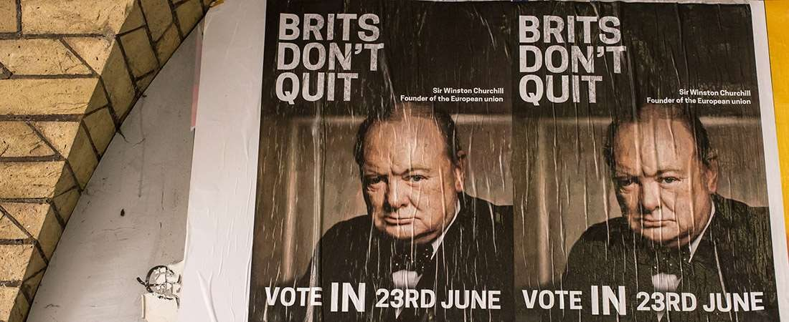

Slide 7
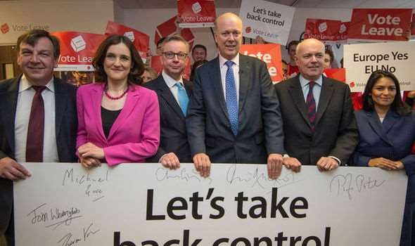
Leave campaign
Many Leave campaign groups
Vote Leave: official campaign, a cross-party campaign run by Matthew Elliot and Dominic Cummings
Boris Johnson, Michael Gove, Labour MP Gisela Stuart
Leave.EU – a group connected to UKIP and funded by Aaron Banks
→ Tensions between the two groups (but allowed for a series of messages to be communicated to different groups of voters instead just one single message)
Initial focus on the economic and sovereignty argument → quickly moved to an immigration territory
UKIP connections

Slide 8

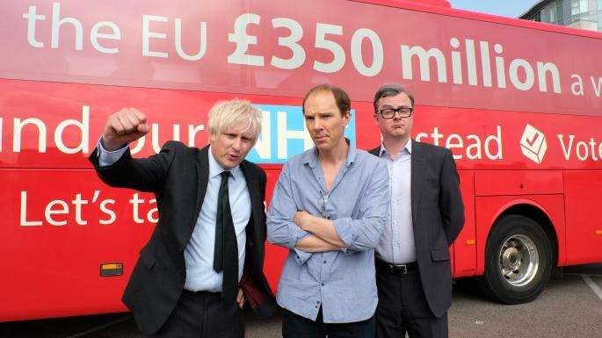
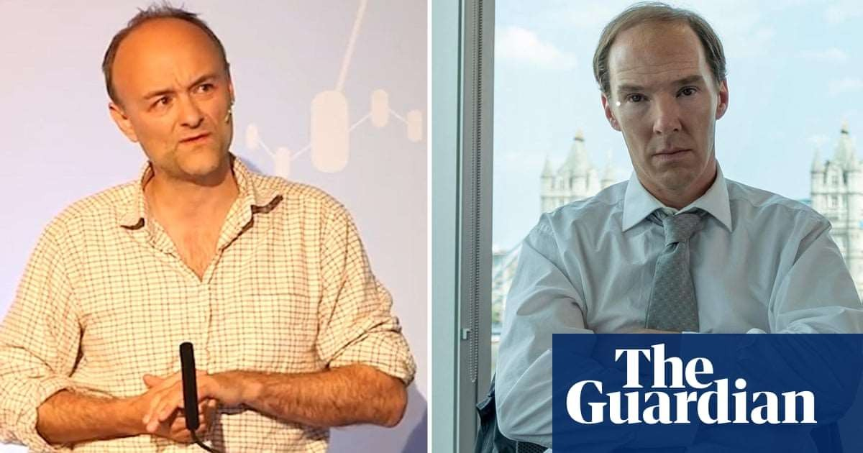

Slide 9

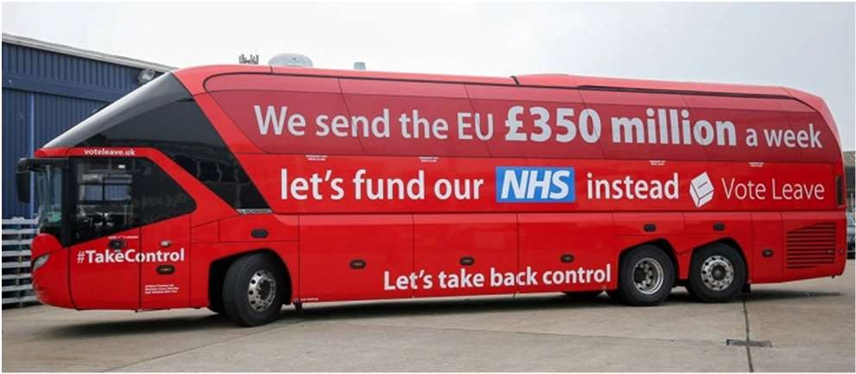
Leave Campaign
Immigration as the predominant issue in the debate
  Leave campaign able to draw on people’s concerns about immigration with regard to security, identity, welfare, cost, border control + repeated failures of govt.
A post-truth political campaign/fact-free campaign
  unlike general elections, there is no set date for another vote
  Both sides made much disputed claims!
  Most notorious (Vote Leave): we send 350 million the EU a week – let’s fund our NHS instead.

Slide 10
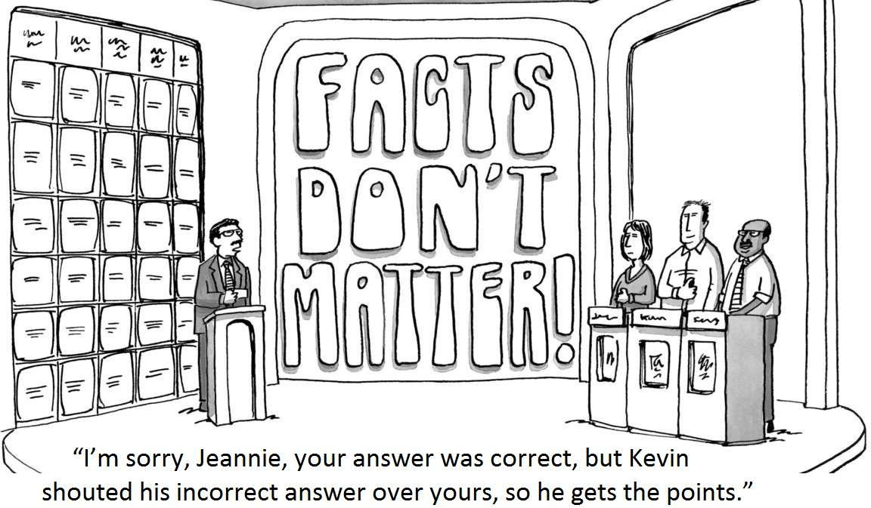

Slide 11
Thank you very much for your attention
(brusenbauch.meislova@email.cz)

