Slide 1
Friends and Enemies
MVZ248 Week 5

Slide 2
New strategy approach
Diplomacy, economics, information, military (Murray)
Europe, America’s, Soviet Union/Russia, Asia
Controversial and pragmatic.
Evolved during decades
Survival
Growth and Development
Leadership positions

Slide 3
Israel
Create security and Secure
Unofficial relations with Arab neighbors
Official diplomacy only past 30 years.
Controversial and pragmatic
West/East Germany, Soviet Union/Russia

Slide 4
Friends
After joining the UN in May 1949, Israel maintains diplomatic ties with 157 countries.
Iran from 1949-1979. Iran was 2nd MM nation to recognize Israel
Extensive foreign aid and educational programs in Africa
agriculture , water management, and health care
Turkey on-off positive relations in 2000s and after 2011.
Greece, Cyprus (Energy Triangle), China and India
Israeli high-tech economy
Notes:
During the 2000s, the foreign ministry warned that the increasing influence of the EU would further isolate Israel in global affairs.^{[5][6]} In the wake of a series of diplomatic rifts with Turkey and the rise of the Muslim Brotherhood in Egypt in 2011, Israel has had less than friendly relations with those countries.^{[7]} During roughly the same period, Israeli relations with many countries in Europe including Greece and Cyprus in the context of the Energy Triangle and in Asia, including China and India, were enhanced, largely on account of the growth of Israel's high-tech economy.^{[8]}

Slide 5
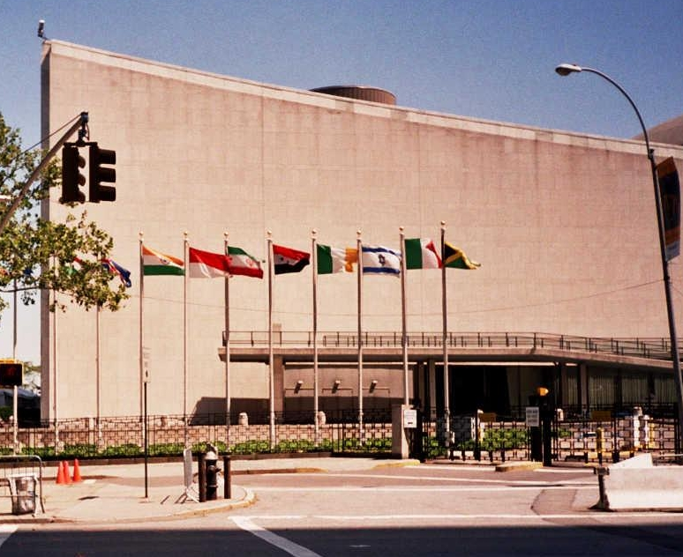
Diplomatic Relations
Recognition, but no diplomatic relations
Taiwan
Diplomatic relations, now broken; resumed
Bolivia, Cuba, Nicaragua, Chad, Mali and Niger, Iran
Economic ties (trade offices) short of full diplomatic relations several ties.
Bahrain, Morocco, Oman, Qatar and Tunisia
Notes:
Some states recognize Israel as a state, but have no diplomatic relations. Several countries once had diplomatic relations with Israel, but have since broken or suspended them (Bolivia, Cuba, Nicaragua and Venezuela in Latin America; Mauritania in the Arab League; Chad, Mali and Niger in non-Arab Africa; and Iran until the Islamic revolution). Some of these countries have since resumed relations. In addition, a number of countries (all members of the Arab League) that at one time had formal economic ties (primarily trade offices) with Israel that fell short of full diplomatic relations, have severed such ties (Bahrain, Morocco, Oman, Qatar and Tunisia).

Slide 6
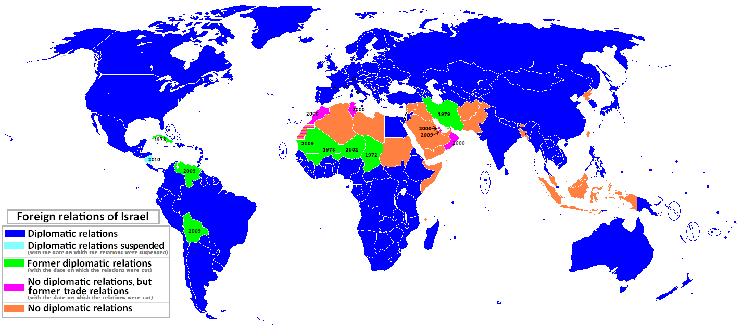

Slide 7
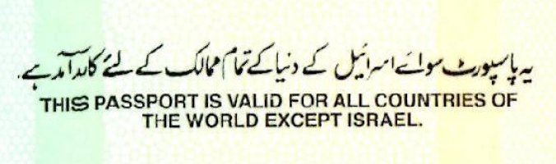

Slide 8
International Institutions
Member of UN; (ironic membership)
UNESCO, UNHCR, FAO
International Organizations
IAEA and WHO
Within UNESCO, membership in international programs and organizations
Man and Biosphere Program (MAB), Oceanographic (IOC),(Hydrological) IHP
Other organizations Israel is active member include
European Centre for Higher Education (CEPES), WHC
Notes:
Israel is a member of many agencies within the UN, including the United Nations Educational, Scientific and Cultural Organization (UNESCO), the Office of the United Nations High Commissioner for Refugees (UNHCR), and the Food and Agriculture Organization (FAO). Israel also participates in other international organizations such as the International Atomic Energy Agency (IAEA) and the World Health Organization (WHO).^{[9]}
Within the UNESCO, Israel is a member in many international programmes and organizations. In the area of science Israel is an active member of the Man and the Biosphere Programme (MAB), the Intergovernmental Oceanographic Commission (IOC), the International Hydrological Programme (IHP), the International Centre for Synchrotron-Light for Experimental Science Applications in the Middle East (SESAME), and the International Geoscience Programme (IGCP). Other notable organizations Israel is an active member of include the Education For All movement, the European Centre for Higher Education (CEPES), the World Heritage Committee (WHC), the International Centre for the Study of the Preservation and Restoration of Cultural Property (ICCROM), and the International Council on Monuments and Sites (ICOMOS).^{[10]} Relations are carried out through the Israeli National Commission for UNESCO.^{[11]}
Israel has joined the European Union's Framework Programmes for Research and Technological Development (FP) in 1994,^{[12]} and is a member of the European Organization for Nuclear Research (CERN),^{[13]} the European Molecular Biology Organization (EMBO) and the European Molecular Biology Laboratory (EMBL).^{[14]} It is also a member of the Bank for International Settlement (BIS) since 2003.^{[15]}
On 10 May 2010, Israel was invited to join the Organization for Economic Cooperation and Development (OECD).^{[16]} Israel is a member of NATO's Mediterranean Dialogue forum.^{[17]} In 2014 Israel joined the Paris Club.^{[18]}

Slide 9
International Institutions
European Org. Nuclear Research (CERN)
European Molecular Biology Org. (EMBO)
European Molecular Biology Laboratory (EMBL)
Bank for International Settlement (BIS)
Org. for Economic Cooperation and Development (OCED)
NATO’s Mediterranean Dialogue forum
Paris Club (2014) as creditor for debt relief
Notes:
the European Organization for Nuclear Research (CERN),^{[13]} the European Molecular Biology Organization (EMBO) and the European Molecular Biology Laboratory (EMBL).^{[14]} It is also a member of the Bank for International Settlement (BIS) since 2003.^{[15]}
On 10 May 2010, Israel was invited to join the Organization for Economic Cooperation and Development (OECD).^{[16]} Israel is a member of NATO's Mediterranean Dialogue forum.^{[17]} In 2014 Israel joined the Paris Club.^{[18]}

Slide 10
Foreign Aid
Officially very low for OECD member (less than 0.1%)
Instead use the Mashav, Israeli Center for International Cooperation
Participates in projects worldwide on economics and humanitarian
Agriculture, education to disaster relief, reconstruction and refugee absorption
1970s Israel grant safe haven to refugees and foreign nationals
1980s Israel has provided humanitarian aid to places affected by natural disasters
1995 Permanent humanitarian and emergency aid unit
Haiti and Italy
Notes:
Israeli foreign aid ranks very low among OECD nations, spending less than 0.1% of its GNI on foreign aid. Individual international charitable donations are also very low, with only 0.1% of charitable donations being sent to foreign causes.^{[303]}
Israel has provided humanitarian assistance to developing countries in Asia, Africa, South America, Oceania, and Central Europe through the activities of Mashav,^{[304]}the Israeli Center for International Cooperation, created in 1958, with the goal to give developing countries the knowledge, tools, and expertise that Israel gained in its own development, and its ability to "make the desert flourish". This center trains course participants from approximately 140 countries on healthcare, as well as emergency and disaster medicine, and has participated in dozens of projects worldwide in fields economic fields such as agriculture, education, development, employment, and healthcare, as well as humanitarian fields such as disaster relief, reconstruction, and refugee absorption.^{[305]}
In the 1970s, Israel broadened its aid agenda by granting safe haven to refugees and foreign nationals in distress from around the world. Since the 1980s, Israel has also provided humanitarian aid to places affected by natural disasters and terrorist attacks. In 1995, the Israeli Foreign Ministry and Israel Defense Forces established a permanent humanitarian and emergency aid unit, which has carried out humanitarian operations worldwide.^{[306]} As well as providing humanitarian supplies, Israel has also sent rescue teams and medical personnel and set up mobile field hospitals in disaster-stricken areas worldwide.

Slide 11
High-Tech (Informational)
World leader in fundamental scientific research (pre-48 to the present)
5th ranked for most innovative in Bloomberg Innovation Index
Contributions to natural sciences, agricultural, electronics, computer & life sciences; robotics, and various fields of engineering
1998 Tel Aviv named as one of ten most tech. influential cities in the world.
Techinon (Israeli Institute of Technology)
Silicon Wadi (pun from Arabic from colloquial Hebrew)
Notes:
sraeli scientists and engineers have contributed to the advancement of the natural sciences, agricultural sciences, electronics, computer sciences, life sciences, robotics, and various fields of engineering. Israel is home to major players in the high tech industry and has one of the world's most technologically literate populations.^{[9]} In 1998, Tel Aviv was named by Newsweek as one of the ten most technologically influential cities in the world.

Slide 12
Informational = diplomacy by other name
Local demand fueled Israeli industrial expansion for over 50 years
World demand nowadays for advanced tech.; software, electronics, sophisticated equipment.
Google, Amazon, Facebook, IBM, etc.
Emphasis on higher education and research and development
Additionally openness to immigration, government assistance and unique audacity
Israeli grads more likely to become IT entrepreneurs or startup = 2x US grad.
Notes:
For more than 50 years, local demand fueled Israeli industrial expansion, as the country's population grew rapidly and the standard of living rose. More recently, world demand for Israeli advanced technologies, software, electronics, and other sophisticated equipment has stimulated industrial growth. Israel's high status in new technologies is the result of its emphasis on higher education and research and development. Cultural factors contributing to the expansion includes chutzpah and openness to immigration.^{[8]} The government also assists industrial growth by providing low-rate loans from its development budget. The main limitations experienced by industry are the scarcity of domestic raw materials and sources of energy and the restricted size of the local market. One certain advantage is that many Israeli university graduates are likely to become IT entrepreneurs or join startups, about twice as much as US university graduates, who are also attracted to traditional corporate executive positions

Slide 13
Importance for 21st Century
Silicon Wadi recognized by Wire mag. in 2000 ranking Israeli high-tech the same ranking as Boston, Helsinki, London. Second only to Silicon Valley
In 2006, over 3,000 startups created (US is 1st)
Tel Aviv named best place for high tech startup behind US S.V.
As of 2010, over 35,000 professionals employed in multinationals.
Strategic technological development
60 foreign R&D centers operate in range of activities from machinery to flash memory, computer hardware, semiconductors and internet.
Notes:
With such an impressive record for creating profit driven technology, Israel has become the top choice for many business leaders and high technology industry giants. As of 2010, more than 35,000 professionals are employed in multinationals research and development centers across Israel, making 'Silicon Wadi' a source for worldwide strategic technology development. Around 60 foreign R&D centers are engaged in a diverse range of activities including chemicals, industrial machinery, communication equipment, scientific instruments, medical devices, flash memory storage equipment, computer hardware components, software, semiconductors and internet.

Slide 14
Military
Rejection for weapons and technologies + massive rearmament of Arab countries.
Arms embargo
IDF relies heavily on local (Israeli) military tech. and high tech weapons systems from manufacturers in Israel.
Uzi submachine gun, Merkava tank, Arrow missile and Iron Dome (2011)
Recon. satellites
UVA’s (big exporter of drones)
Notes:
Notable technology includes the Uzi submachine gun, introduced in 1954,^{[72]} the country's main battle tank, the Merkava, and the jointly designed Israeli and U.S. Arrow missile, one of the world's only operational, advanced anti-ballistic missile systems.^{[73]} The Iron Dome mobile air defense system developed by Rafael Advanced Defense Systems is designed to intercept short-range rockets and artillery shells. The system was created as a defensive countermeasure to the rocket threat against Israel's civilian population on its northern and southern borders, and was declared operational and initially deployed in the first quarter of 2011.^{[74]} It is designed to intercept very short-range threats up to 70 kilometers in all-weather situations.^{[75]} On April 7, 2011, the system successfully intercepted a Grad rocket launched from Gaza, marking the first time in history a short-range rocket was ever intercepted.^{[76]}
Israel has also developed a network of reconnaissance satellites.^{[77]} The Ofeq (lit. Horizon) series (Ofeq 1 – Ofeq 7) were launched between 1988 and 2007.^{[78]} The satellites were carried by Shavit rockets launched from Palmachim Airbase. Both the satellites and the launchers were designed and manufactured by Israel Aerospace Industries (IAI), with Elbit Systems' El-Op division supplying the optical payload.
Israel also has the first all-around operational active defense system for tanks named Trophy, successfully intercepting anti tank missiles fired at Merkava tanks.

Slide 15
U.S.
Spheres of Influence
Cold War policies and contradictions
Chile, Iran and Iraq, China/Taiwan
post-Cold War realities

Slide 16
Foreign Relations: bi-lateral
Formal diplomatic relations with most nations. All UN member states except Bhutan, Iran, North Korea and Syria.
Diplomatic relations with EU, Holy See and Kosovo.
Notes:
The United States has formal diplomatic relations with most nations. This includes all UN member states except for Bhutan, Iran, North Korea and Syria. Additionally, the US has diplomatic relations with the European Union, the Holy See and with Kosovo.

Slide 17
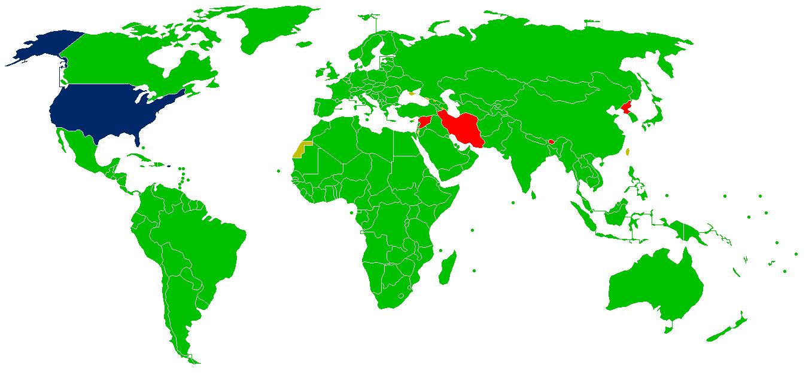

Slide 18
Diplomatic Relations
France (Spain), Dutch
Iroquois (Confederacy)
U.K. (1782)
18-19th Centuries establishing recognition, borders, and survival
20th Century assuming both colonial and super-power status

Slide 19
International Institutions
Most, not all
UN
Co-creator, but not signatory
ICC
Issue-specific treaties (Climate and Nuclear)

Slide 20
Foreign Aid
Usually thought of within 2 broad categories: military and economic assistance
USAID; American foundations, churches
Most famous after WWII (ERP)
Since 2000, operates 5 major categories of foreign assistance: bilateral (largest), economic (political and security), humanitarian, multilateral, military aid.
Since 2010 focus on effectiveness (Millennium Development Goals) to ensure money, food, medicine, etc used so that in future no longer needed.
Fiscal year 2014-2015 less than 1%
Notes:
It can be divided into two broad categories: military aid and economic assistance. Other large sums are given to non-government agencies and individuals in other countries through American foundations, churches and other organizations. Millions of individuals in the United States remit sums to their own relatives abroad, but that is not counted as "foreign aid". Foreign aid has been given to a variety of recipients, including developing countries, countries of strategic importance to the United States, and countries recovering from war. The government channels about half of its economic assistance through a specialized agency, the United States Agency for International Development (USAID). Government-sponsored foreign aid began a systematic fashion after World War II, with the Marshall Plan of 1948 and the Mutual Security Act of 1951-61. It has been politically highly charged, as most Americans believe the amount of aid given is much higher than the amount stated by the government.^{[1]} In the 21st century, the US government operates five major categories of foreign assistance: bilateral development aid (the largest amount), economic assistance supporting U.S. political and security goals, humanitarian aid, multilateral economic contributions, and military aid.^{[2]}
In fiscal year 2014-15, less than 1% of the national budget goes to foreign assistance.^{[3]}
the UN Millennium Development Goals summit in September 2010 that the United States was changing its policy towards foreign aid. The President said the country would focus more on effectiveness, and make sure donated food, medicine, and money help countries get to the point where they no longer require such aid.

Slide 21
Enemies
For both US and Israel similar issues facing grand strategies
Terrorism
Information campaigns (propaganda) that are in context and character ‘anti’
Western; BDS
Conventional enemies for much of 20th Century has become increasingly become hybrid.

