Slide 1
2020 General Election
Peter Spáč

Slide 2
Support of SMER-SD (2012-2016)

Slide 3
2016 General Election

Slide 4
New Government
Drop of SMER-SD excluded a one-party government
Two scenarios:
SMER-SD + several partners
Grand coalition without SMER-SD
Final outcome:
SMER-SD, SNS, Most-Hid, Network
Fico as the PM for the third time
Network collapsed shortly after that and part of its MPs went to Most
“The barrier against extremism”

Slide 5
Acceptance of the government SMER-SD, SNS, Most-Hid, Network
 | Acceptable | Not acceptable | Do not know
SMER-SD | 85 | 11 | 3
SNS | 60 | 29 | 12
Most-Hid | 39 | 47 | 13
Network | 36 | 45 | 18
KDH | 31 | 53 | 16
We are Family | 23 | 62 | 15
LSNS | 19 | 71 | 10
SaS | 19 | 77 | 4
SMK | 16 | 84 | 0
OLaNO | 13 | 84 | 3
Non voters | 30 | 45 | 25
All | 39 | 47 | 14

Slide 7
The Breaking Point in February 2018
Murder of investigative journalist J. Kuciak and his fiancée M. Kušnírová at their home
Tremendous consequences:
Public impact comparable to November 1989
Mass demonstrations around the whole country
Shifts in public opinions
Personal earthquake in the government
Negative effect primarily on SMER-SD

Slide 8
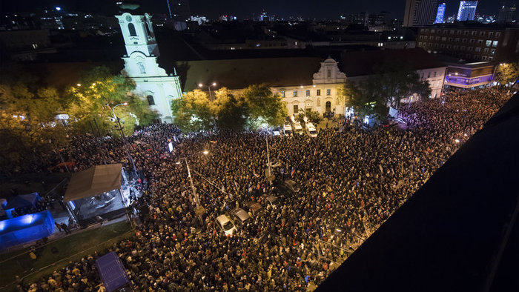
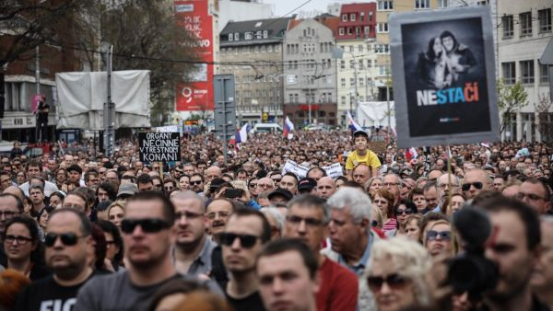
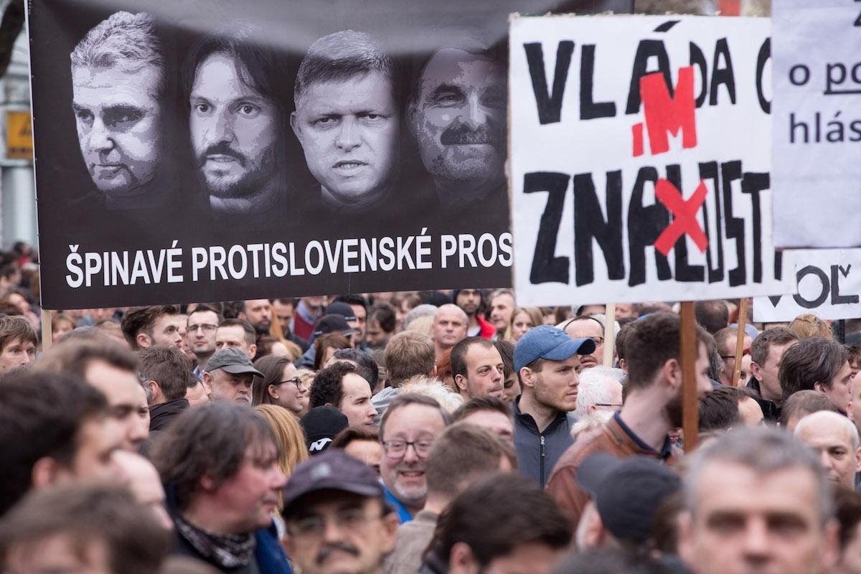
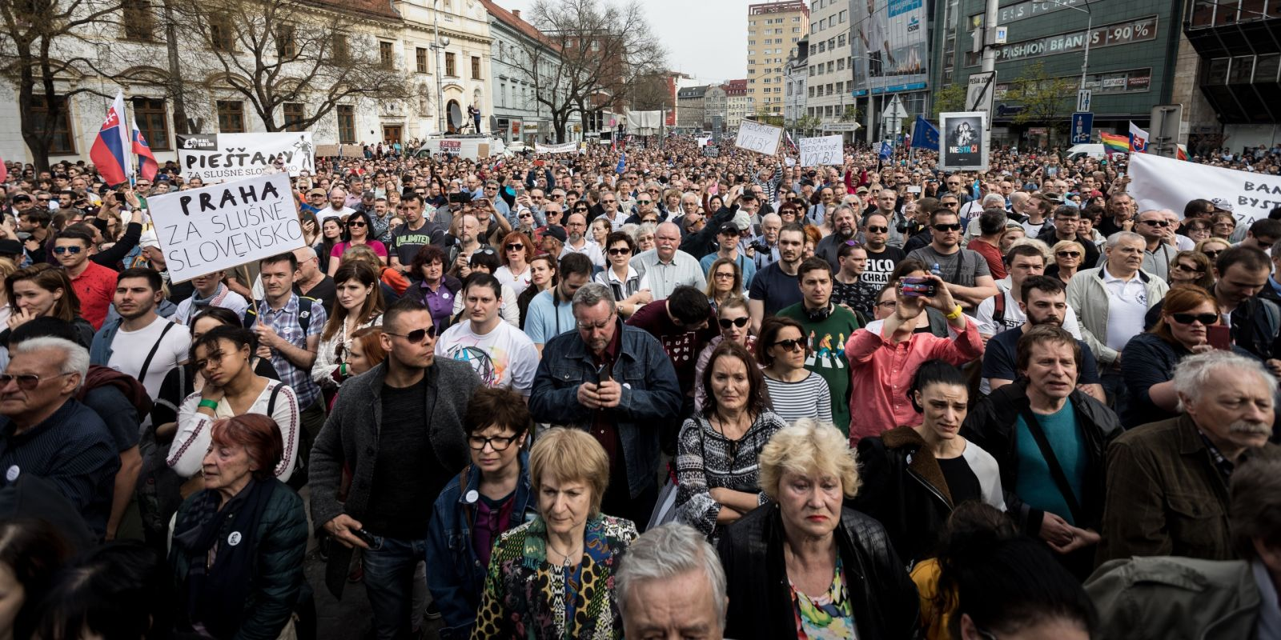

Slide 9
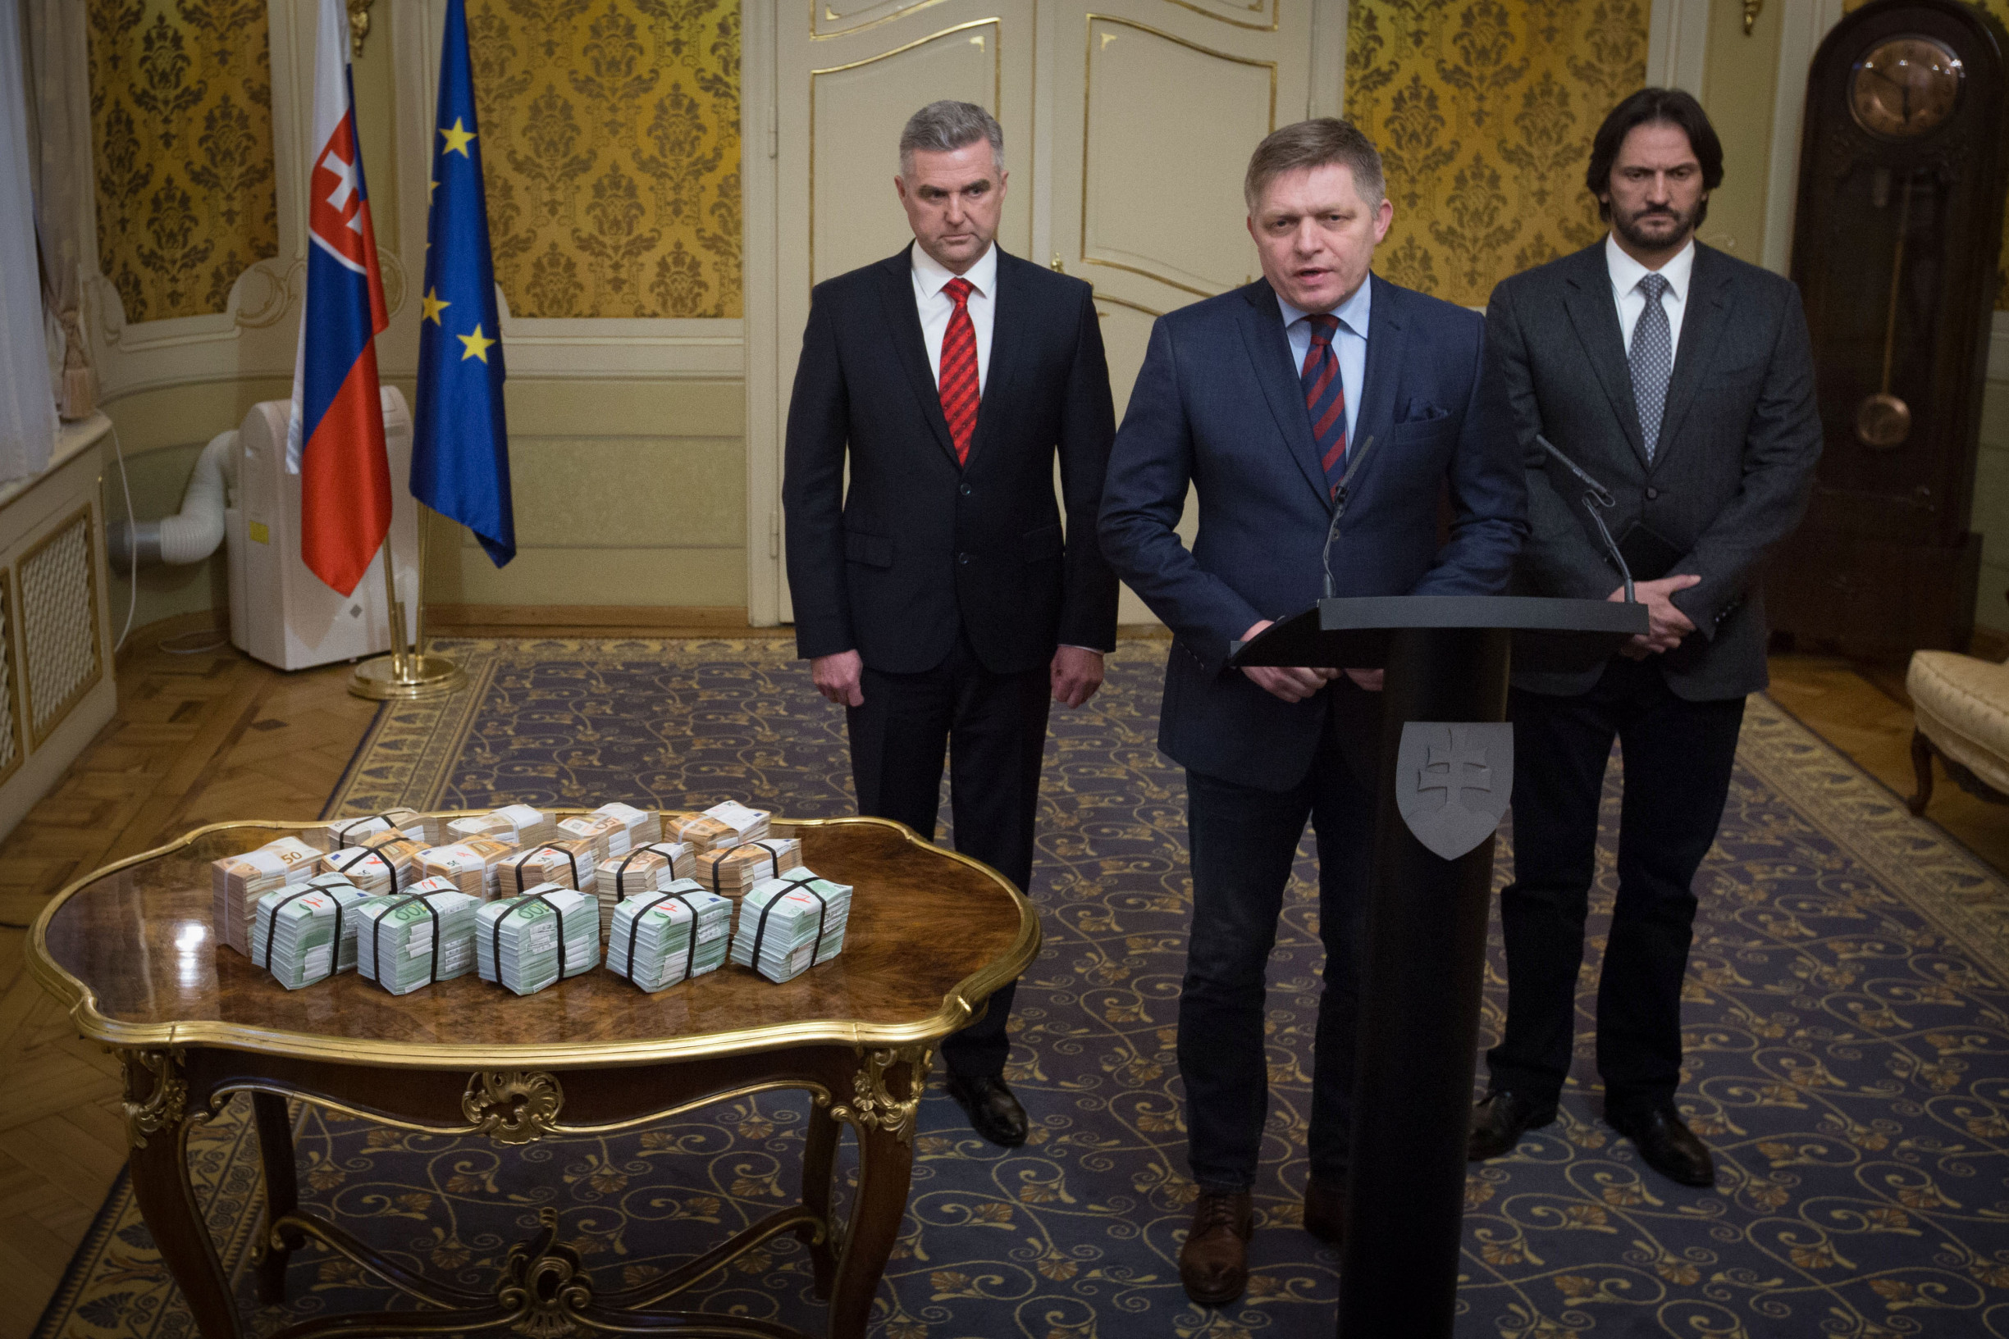

Slide 10
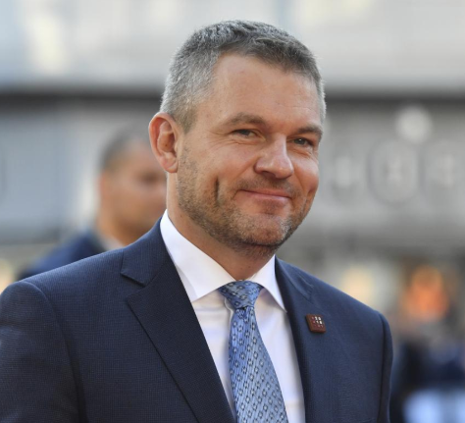
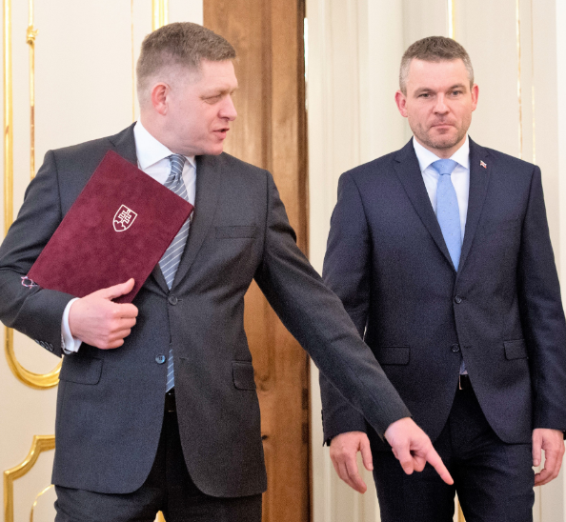
Personal Consequences
Various prominent officials forced to step down
PM Fico
Minister of Interior Kaliňák
President of the Slovak Police Force Gašpar
Peter Pellegrini as the new PM (SMER-SD)
Fico remained as SMER-SD leader
The General Attorney promised to unleash “hell”

Slide 11
Support of SMER-SD

Slide 12
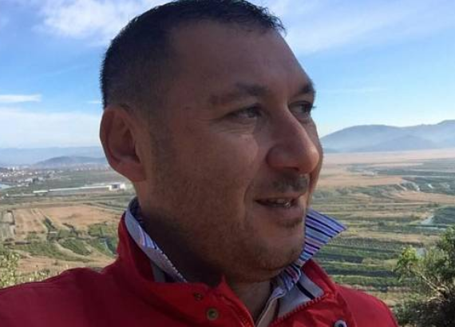
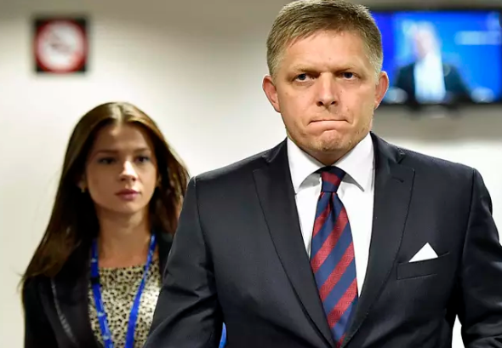
Investigation (1)
The Italian scenario

Slide 13
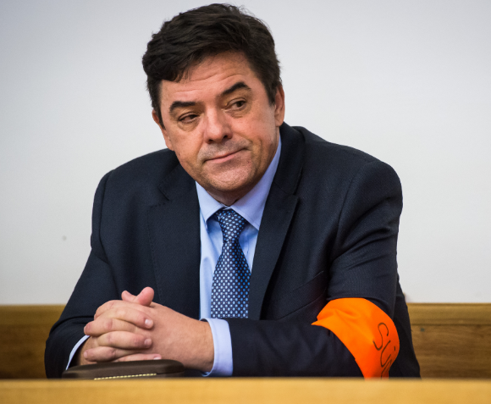
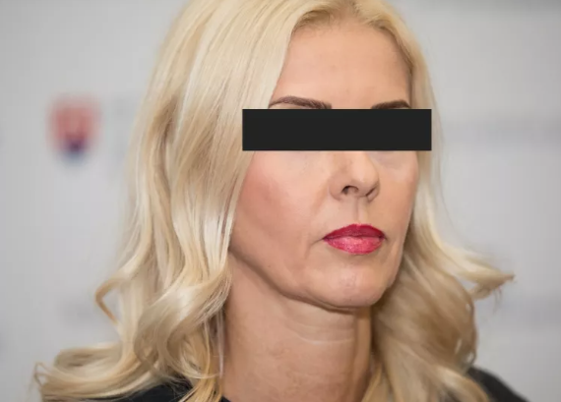
Investigation (2)
The Kočner network scenario
Murder as revenge
Network of judges granting him protection
Threema

Slide 14
New parties in the opposition
Progressive Slovakia (centre-left and liberal)
Together – Civic Democracy (centre-right)
Successful cooperation in 2018 local and 2019 presidential election
For the People:
Established by Andrej Kiska after finishing his mandate
More conservative leaning

Slide 15
Four Months Before Election
Party | Votes in % | Votes - Threshold | Projected Seats
SMER-SD | 20.0 | 15.0 | 36
PS – Together | 11.7 | 4.7 | 21
For the People | 10.6 | 5.6 | 19
LSNS | 10.3 | 5.3 | 19
We are Family | 7.0 | 2.0 | 13
SNS | 6.8 | 1.8 | 13
KDH | 5.7 | 0.7 | 10
OLaNO | 5.7 | 0.7 | 10
SaS | 5.0 | 0.0 | 9
Most-Hid | 4.1
Survey by Focus Agency, October 30 – November 6, N = 1,020

Slide 16
Integration Attempts
“Democratic” opposition:
PS-Together, For the People, OLaNO, SaS, KDH
Separate line of KDH
For the People only accepted a cooperation of all parties or nothing
as a result, all parties continued alone (and PS-Together as a coalition)
„If there are too many parties just above the threshold, it is naive to expect that voters will coordinate their behavior to save all of them”
Peter Spáč, 11.11.2020
(https://dennikn.sk/1647669/volby-2020-nerozhodnu-vitazi-ale-porazeni/)

Slide 17
Further Integration Attempts
Hungarian parties:
Both Most-Hid and SMK (now as MKO-MKS) below the threshold
Too many Hungarian parties for the single Hungarian minority
Initial hope ended without any result
Far right and protest parties:
LSNS and the newly emerged Homeland
Kotleba and Harabin scored 530,000 votes in 2019 presidential election (roughly ¼ of all votes)
Discussions on integration failed

Slide 18
Main Topics in the Campaign
The 2018 murder
Second anniversary only a few days before the election
Corruption, scandals of SMER-SD, linkages to Kočner
Rise of LSNS and extremism in general
Unsuccessful attempt to bring back “old” topics, e.g. immigrants

Slide 21
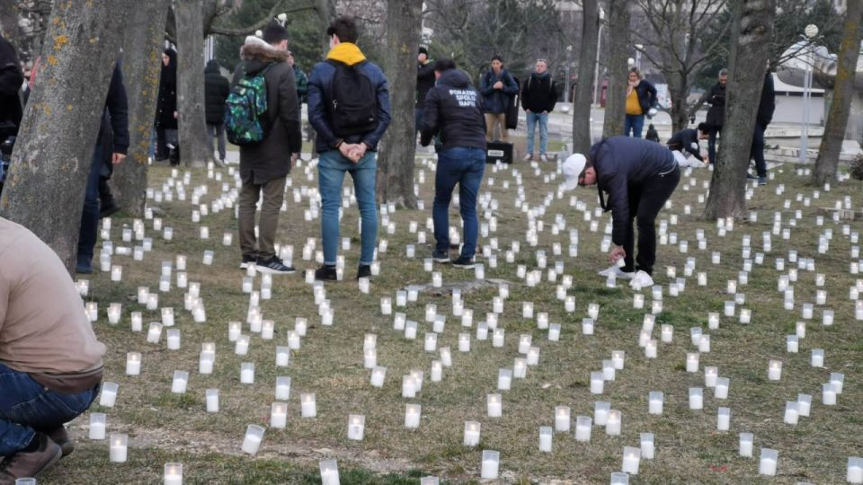
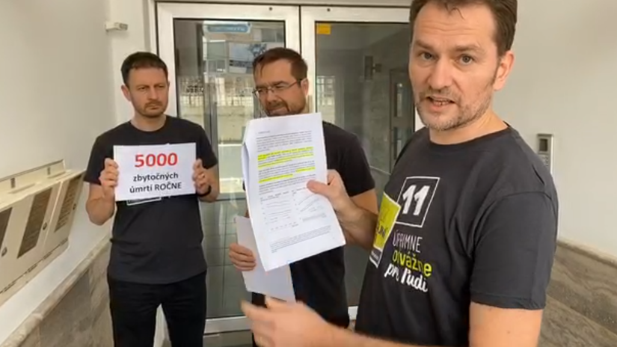
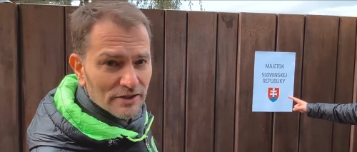

Slide 22
Expert Evaluation of the Campaign (N = 56)

Slide 23
Few Days Before the Election
SMER and SNS announced vast social benefits before the election
13th pension
Doubling of child allowances
Abolishment of highway tolls
Only the pensions were passed in parliament
SMER-SD, SNS, LSNS, We are Family

Slide 24
2020 general election

Slide 25
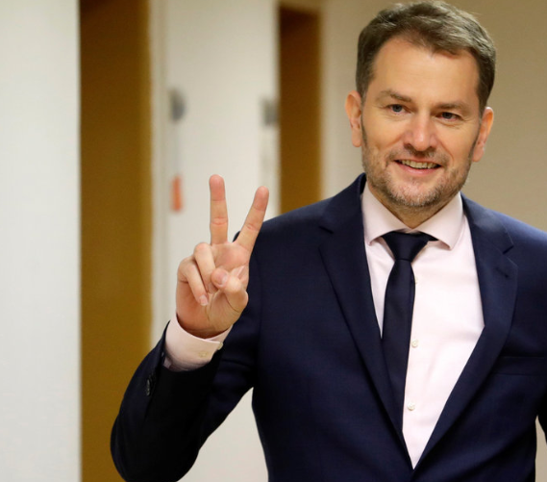
New Government
OLaNO, We are Family, SaS, For the People
PM Matovič
95 MPs (90 required to amend the Constitution)
Question of stability and survival

