Slide 1
PSY 291 General psychology as a story telling
and adventure (optional)
School of Social Studies
Spring, 2020
Lecturer: Doc. Lubomír Kostroň, Jan Širůček

Slide 2
Course Objectives
To discover: behind the theories in general psychology there are hidden names, faces and life-stories of an authentic people,
to play: become a designer –
choose two, three of the questions presented, find enough of relevant information and compose a fresh, coherent view of them.
Put old concepts into a new light.
Tell your own story - how will psychology look like in about ten years?
What psychological tools should you master to make a living? Even better – became an a new tool maker yourself!
To improve the English proficiency

Slide 3
This course requires students
1 - to choose one topic from the presented variety, which they feel interested enough
2 - to research independently some more information about it (see www.kostron.cz)
3 - to compose a 15 minutes presentation for a class (and to consult it in advance by e-mail : l.kostron@seznam.cz)
4 - to present it to the class and to participate in the presentations´assessment

Slide 4
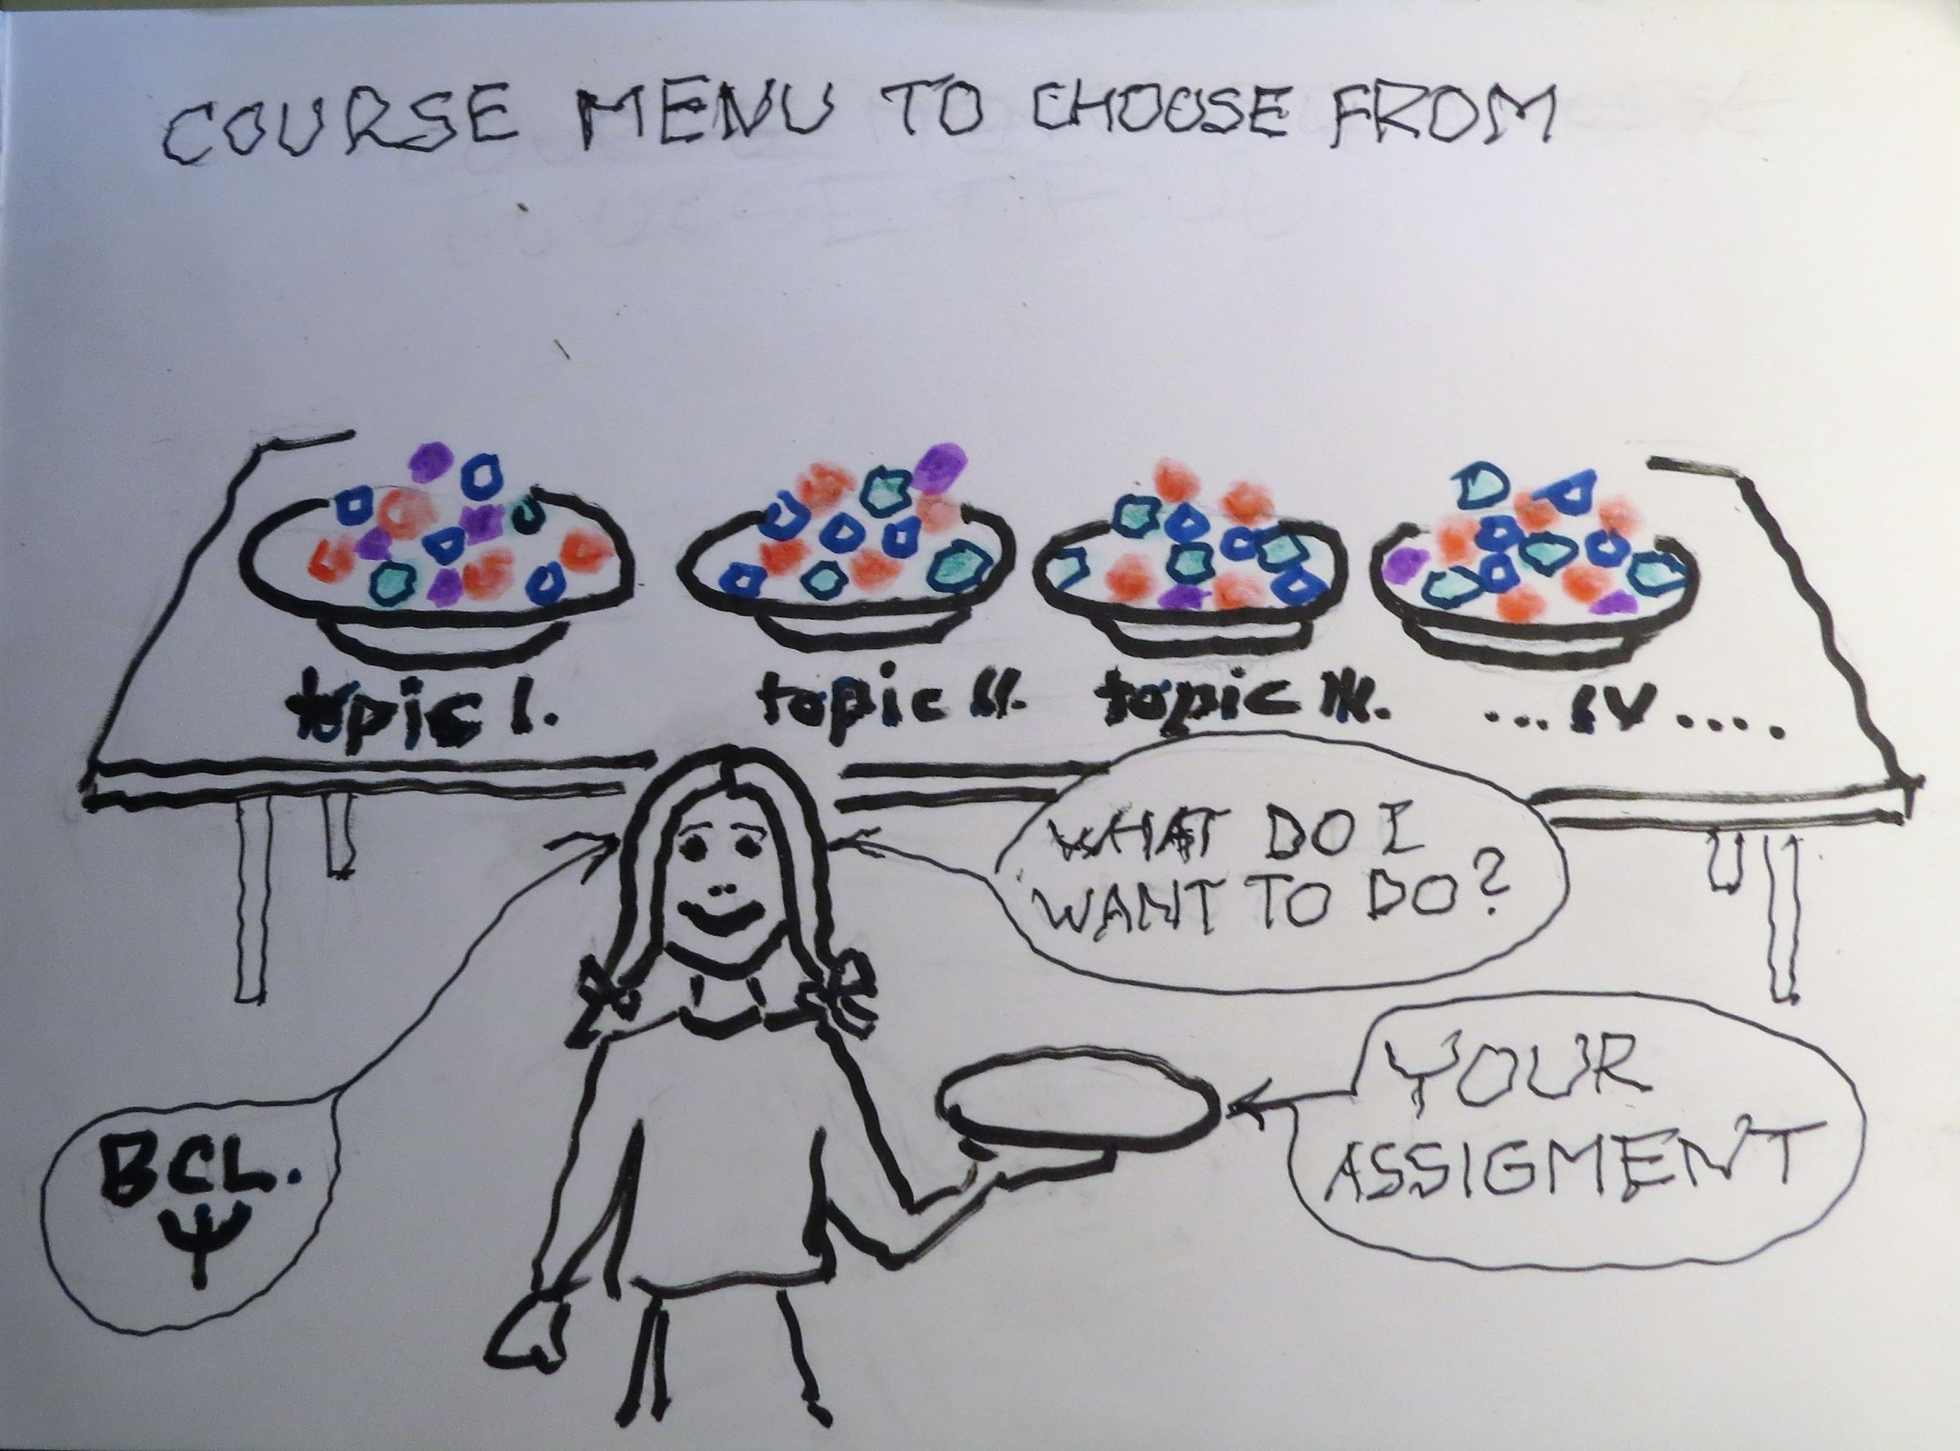

Slide 5
The choice of topics is the following one:
A - Perception, judgment (how Viennese logical positivist Egon Brunswik met with Californian behaviourist, Edward C. Tolman and what resulted from their co-operation)
B - Social judgment theory (how Kenneth R. Hammond at the University of Colorado competed with Kahneman in Princeton and Twersky of Oregon Research Institute – and lost).
C - The nature of information and knowledge (how simply Stanislaw Lem sees the transformation of percept impulses into an information)
D - Model of general psychology (building mysterious Golem of Rabi Jehuda Leva ben Becalel on our own ) beyond cognition - what to add?
E – GP and the concept of personality (what fits with what?),

Slide 6
F - Ill- defined problems´ solution (history of naval catastrophes - stories of reasoning, emotions and social context. The theory of tasks (John Rohrbaugh), situations and the environment/ecology).
G - The decision-making under uncertainty, social context and group support (Thomas Stewart, Ray W.Cooksey, others…)
H - System dynamics (tell your story of how a structure was transformed into a process)
I - Interpersonal cognitive conflict solution (workshop with POLICY DOS software; how the judgment analysis is done nowadays)
J - The eternal puzzle of Consciousness (will the quantum physics approach meet with the molecular neurology?)
K - The ultimate aim of knowledge – the art of asking the right questions
L - Metapsychology (how do you see the future of psychology?) ….

Slide 7
Course Format
Four blocks of lectures and discussions,
e-mail consultations and feedback,
the fifth block is the assignment presentation.
On the last meeting about 10 works will be presented to the class, discussed and group graded.
The extent: 15 minutes presentation (plus 15 minutes discussion) or about 10 pages essay.
It is strongly recommended to check the timing of presentation while preparing it.
The grading of the presentations by students will be recorded on prepared marking sheets.
Those, who prefer it, may submit their paper for lecturer´s grading only.

Slide 8
Course Materials
The course materials include
a - three sets of Powerpoint presentations together with recommended literature.
B – The Strory of Brunswikians
to be downloaded.
The sources of information are indicated during the lecture.
A considerable proportion of the reading is to be discovered by students themselves, as they proceed with the assignment composition.
Otherwise, students are free to explore any internet sources which seem to be academically relevant. The sources used are to be identified in their presentation as it is usual.

Slide 9
Course Evaluation Criteria & Grading Scale
Suggested Criteria to be Used
The high grade papers will be those with a reasonably complex topic, proving high ingenuity, originality and independent approach in thinking as well as searching for information sources.
A good example, used in the presentation, will be also appreciated.
A 93 and higher | B 83 - 86.99 | C 70 – 76.99
A - 90 - 92.99 | B- 80 - 82.99 | D 60 – 69.99
B+ 87 - 89.99 | C+ 77 – 79.99 | F 59.99 and below

