Slide 1
Intellectual Property Rights
Henry Loeser

Slide 2
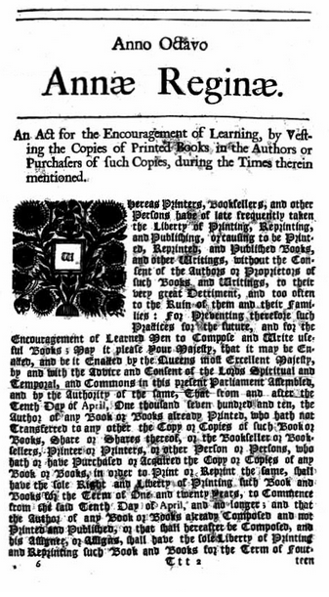
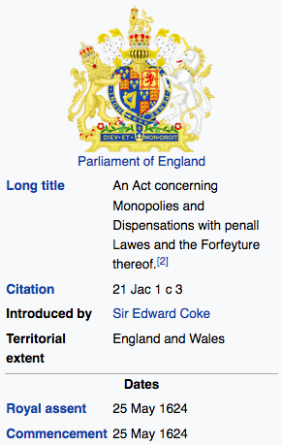
Origins of IPR

Slide 3
Types of IPR
Patent
Trademark
Trade Secret
Copyright

Slide 4
Patent
- Protects useful and non-obvious scientific and technological advancements and inventions
- must be new and novel
Purpose – To promote development of new ideas and new inventions by protecting the return on investment
Rights & Responsibilities
- Exclusive rights to make and/or sell your invention (and close equivalents)
- 20 years

Slide 5
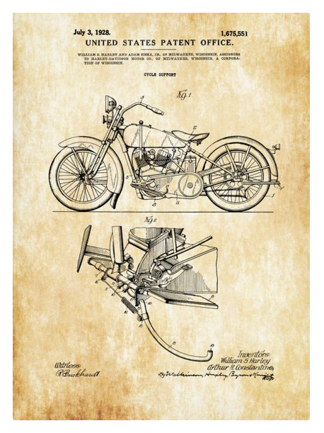
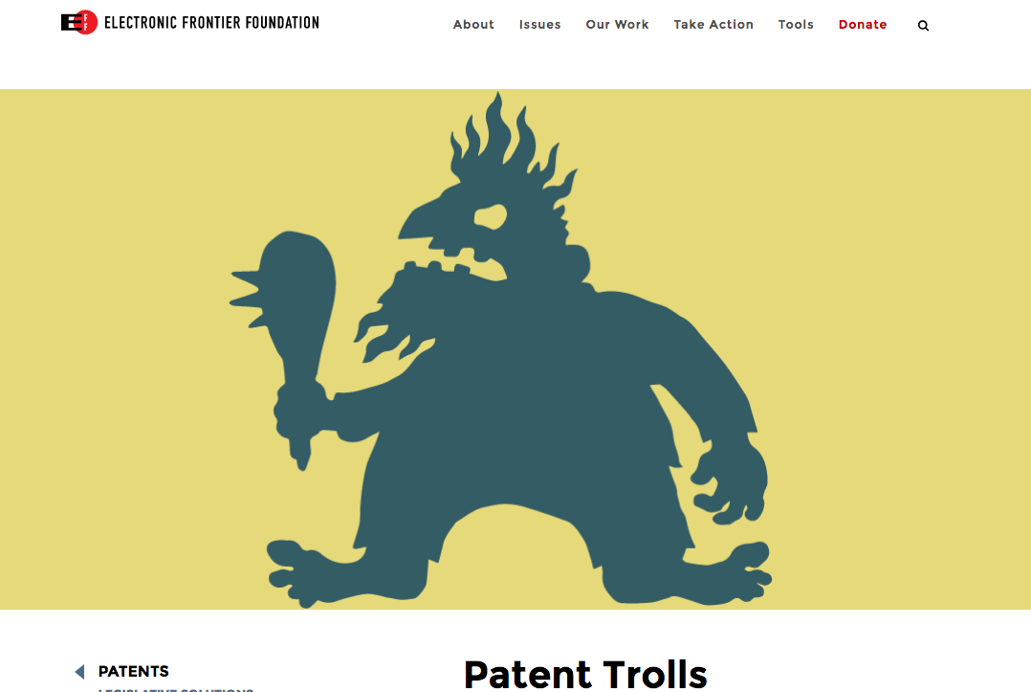
Patent

Slide 6
Trademark
- Protects marks and/or symbols that represent products
Purpose
- Enabling consumers to identify the source of products
- Enabling producers to distinguish their brands

Slide 7

Trademark

Slide 8
Trade Secret
Formula, process, device, or other business information that companies keep private to give them a business advantage over their competitors.
Physical and digital protection of ideas is also necessary

Slide 9

Trade Secret
Formulas
Customer lists
Survey results
Computer algorithms

Slide 10
Copyright
A set of legal rights that arise from literary and/or creative work.
Any creative expression fixed in a tangible medium.

Slide 11
Copyright
- books, poems, songs, films, paintings, dances, sculpture
Purpose
- Incentivize creative output through protection of work
Rights & Responsibilities
- Exclusive right for copies
- Or any substantially similar work or derivative (but not facts or style)
- Distribution and/or public display
- Lifetime +70 years

Slide 12
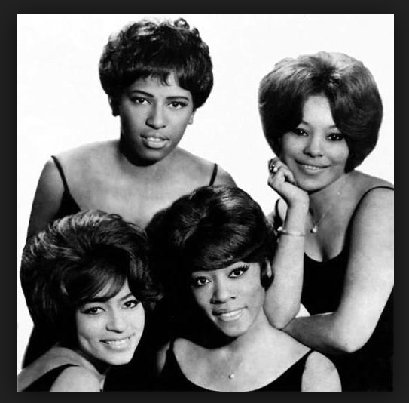
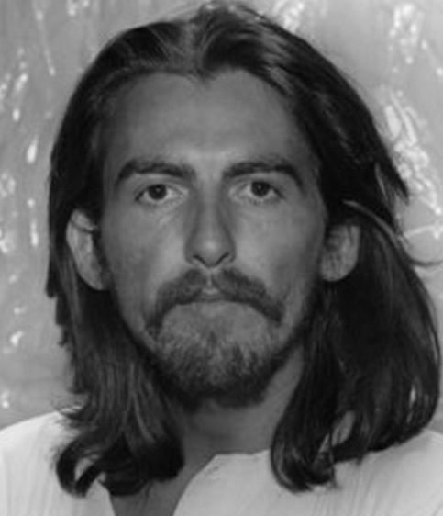
Copyright

Slide 13
Copyright
Types of Rights for Broadcasting
- Authors
- Publishers
- Recordings
- Performances

Slide 14
Copyright
Uses
- Descriptions, accounts, reuse, rebroadcast
- Any media
- Any public use

Slide 15
Copyright
Copyright Management
Laws and Regulations
Copyright Management Organizations (CMO’s)

Slide 16
Copyright
Terrestrial Broadcasting
- Legacy Radio & Television
Online Broadcasting
-Streaming vs. Podcasting

Slide 17


Copyright

Slide 18

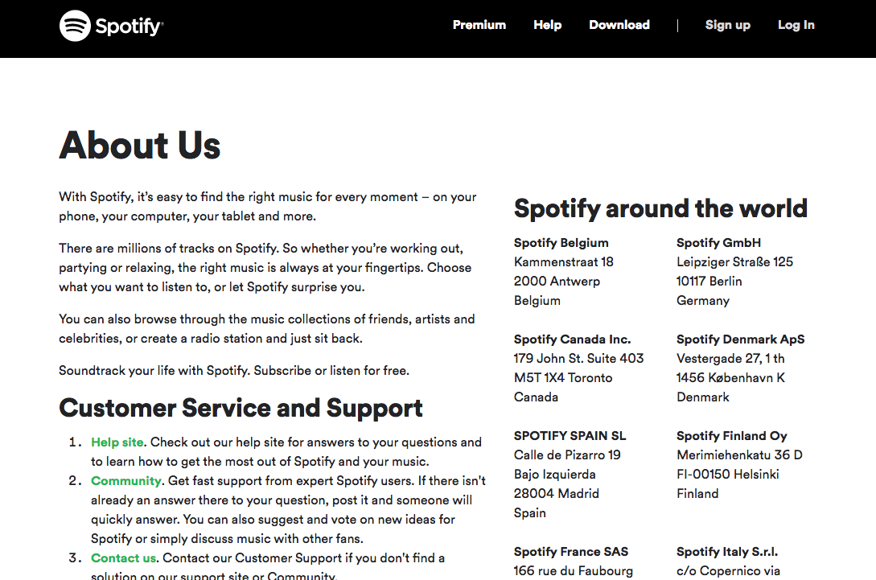
Copyright

Slide 19
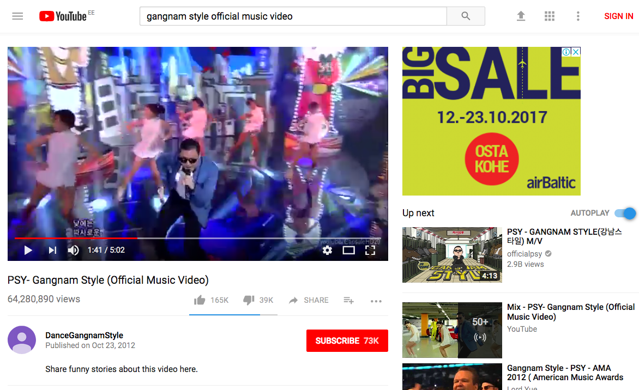
Copyright
The YouTube Rule: Three Strikes

Slide 20
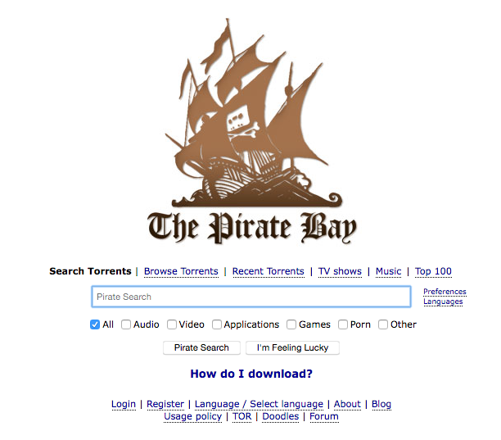
Copyright

Slide 21
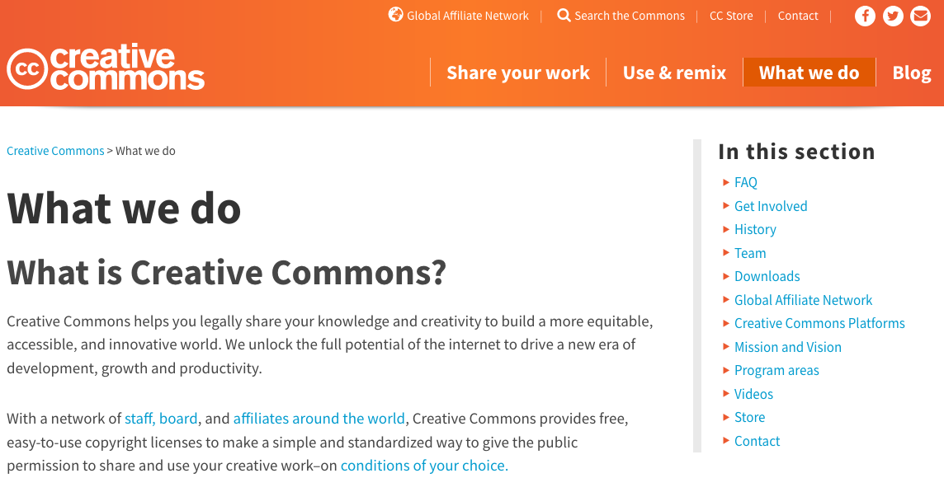
Copyright

