Slide 1
Local Media Market Analysis
Henry Loeser PhD

Slide 2
Agenda
What media?
What is local?
What’s the picture?
It’s all about advertising
Definitions
Examining the radio sector
Ratings/revenue matrix
Making the case for your radio

Slide 3
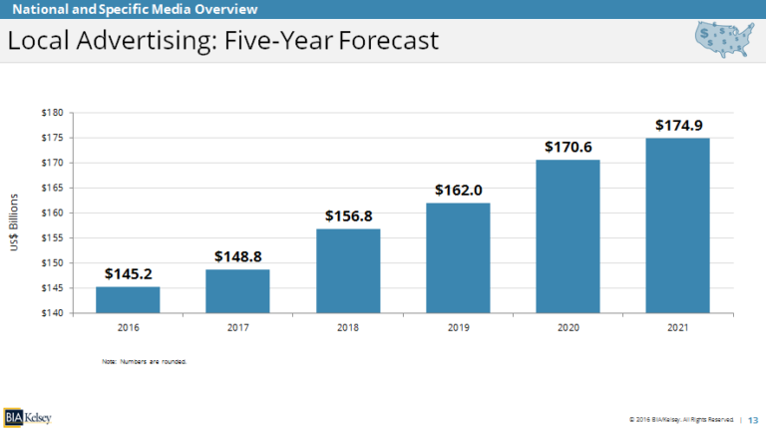
Local Ad Revenue

Slide 4
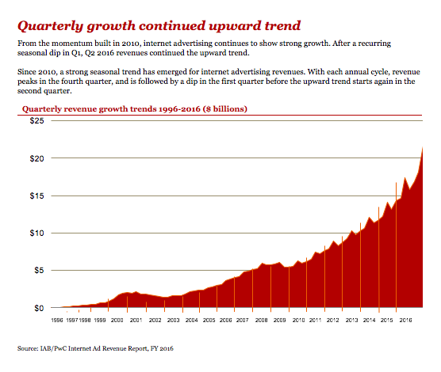
Internet Ad Revenue

Slide 5
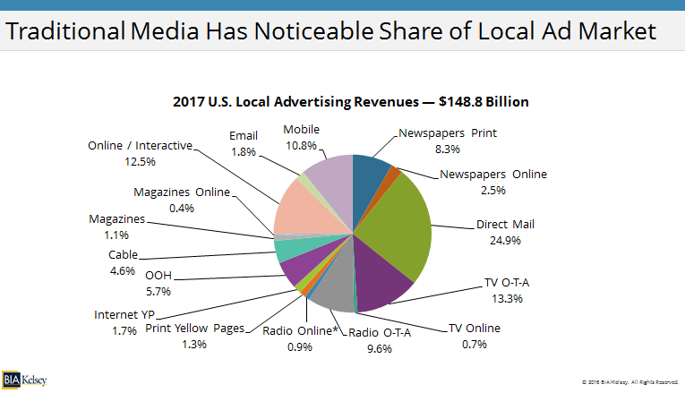
Local Ad Revenue Share

Slide 6
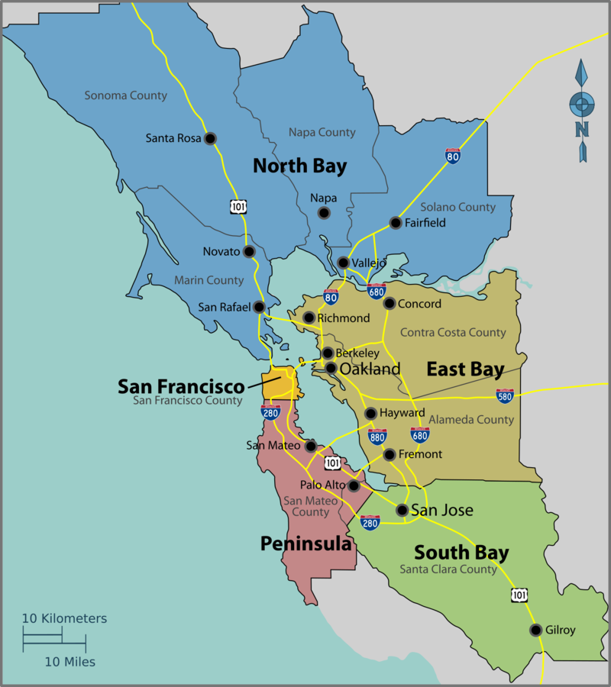
SF

Slide 7
https://en.wikipedia.org/wiki/Media_in_the_San_Francisco_Bay_Area

Slide 8
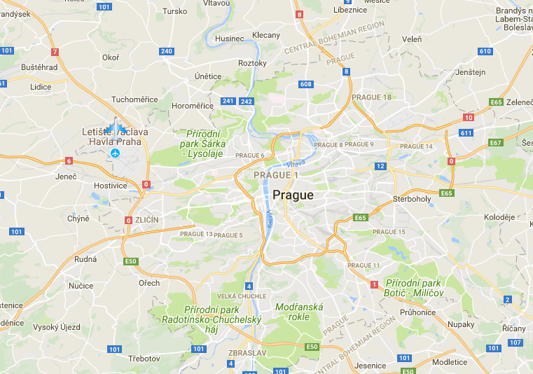
Prague

Slide 9
Matrix
Where’s the money?
Where’s the opportunity?
Who is the competition?

Slide 10
Additional Reading
Doyle (2002) Understanding Media Economics - Updated 2013 (pages 1-17)

Slide 11
Thx for your attention ☺
Henry Loeser
hloeser@tlu.ee

