Slide 1

Publics, Participants and Policies: Examining Community Broadcasting in Austria and the Czech Republic
Henry G. Loeser
Masaryk University

Slide 2
Aims and Questions
Volunteer participants are a key component of community broadcasting, and thus an important source for understanding the phenomenon.
- Question #1: “What values of community broadcasting are important?”
Media policy is recognized as a major factor in the efficacy of community broadcasting, so evaluating policy can be a useful tool.
- Question #2: “To what extent do media policies in Austria and the Czech
Republic align with participants’ values?

Slide 3
Research Project Summary
Online surveys by volunteer participants in Austria (n=340) and the Czech Republic (n=85):
- Measure the importance of community broadcasting values
- Evaluate alignment of community broadcasting policy
Findings reveal that surveyed participants in Austria and the Czech Republic consider most (but not all) widely-recognized values of community broadcasting as important.
Findings reveal that community broadcasting policy documents from both countries show some elements of positive alignment with surveyed participants’ views.

Slide 4
Community Broadcasting
Definitions, Descriptions and Values
- IAMCR, Jankowski, Lewis, Howley
- Radio & TV orgs, AMARC, CBA, NFCB, CMFE, UNESCO, COE, VFRO
- National policy & regulatory texts / guidelines
Worldwide History
- The Americas, Australia, Africa, Europe

Slide 5
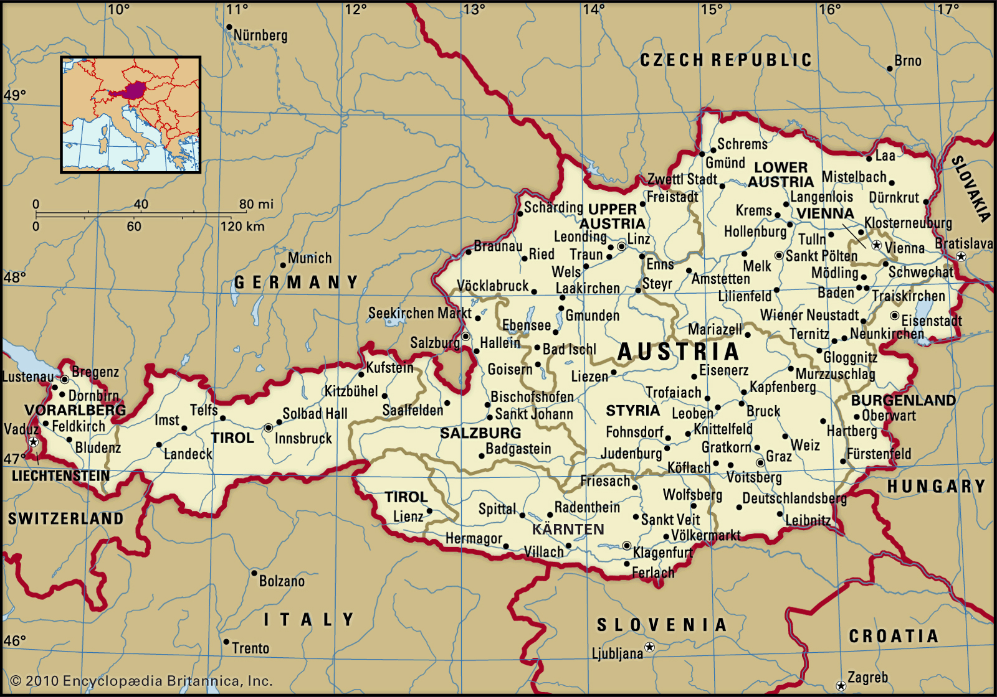
Austria
14 FM Community Radios; 3 Community Televisions

Slide 6
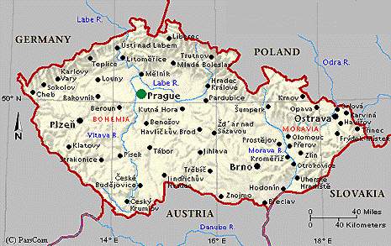
Czech Republic
No FM Community Radio / No Television (6 online community radios)

Slide 7
Theory and Literature
Community
Toennis: “gemeinschaft” / Williams: “knowable communities” / Deleuze, La Tour: “rhizome effect” / Putnam: “community networks”
Civil Society
Aristotle: “society apart from family & government” / Hegel: “burgerliche gessellschaft” / Heller: mosaic of identities” / Habermas: “communicative action in possibility spaces” / Bordieau, Giddens: “media reproduces culture in civil society”
The Public Sphere
Habermas: “forum for culture and politics co-opted” / Edwards: “multiple public spheres” / Fraser: “issues of class & gender” / Foucalt: “multidirectional power generation from discourse” / Herbst: “mobilize political resources”

Slide 8
Theory and Literature
Community Broadcasting
Publics
Ibrahim: “90% community” / Carpentier et al: “Rhizome effect within/without civil society” / Herman & Chomsky: “vs. dominant media”
Participation
Melucci: “as actor and member” / Lewis: “access” / Carey: “defines social roles” / Rodriguez: “promotes democratic ideals” / Carpentier: “supplement mainstream media content, seek to provide accurate representations, and resist dominant paradigms”
Policy
Buckley: “has a profound effect” “should be developed in consultation with civil society” / Hallin & Mancini: product of larger political paradigm” / EPRA: “community media are essential to pluralism”

Slide 9
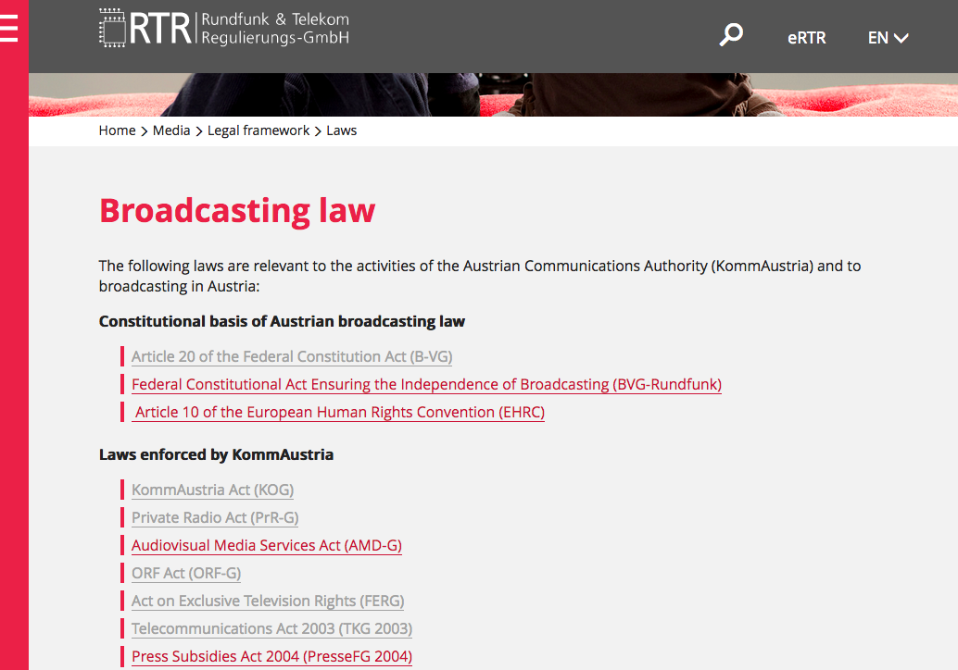
Methods: Text analysis
Austria

Slide 10
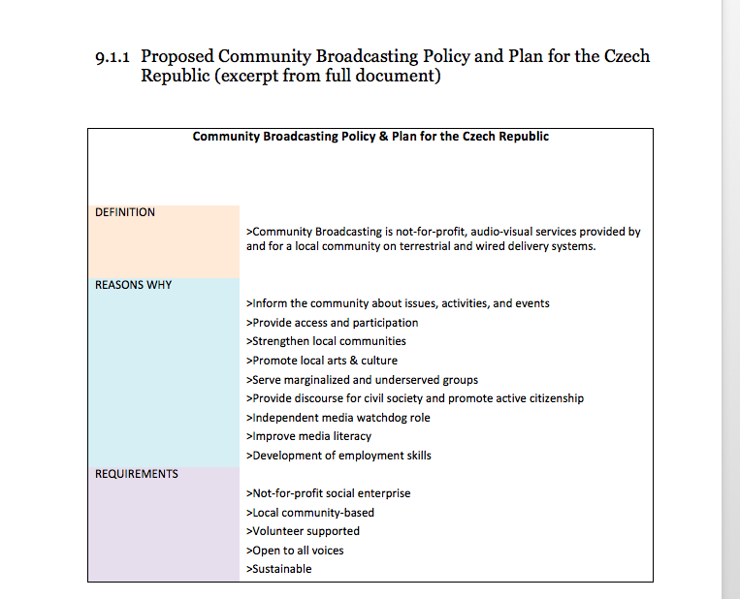
Methods: Text Analysis
Czech Republic

Slide 11
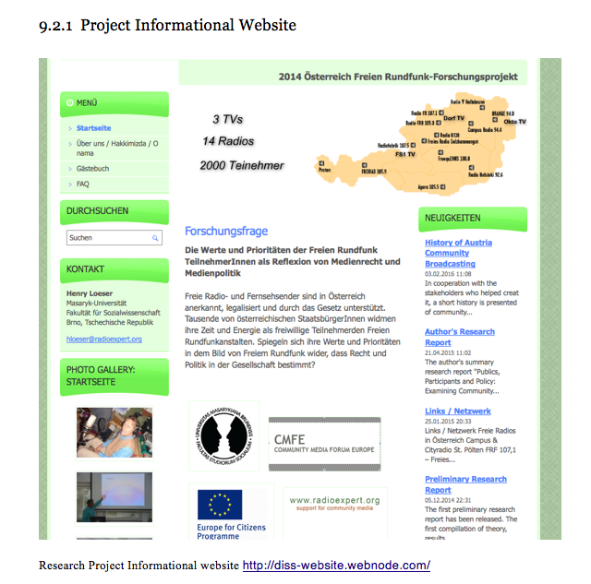
Methods: Population and sample
- Austria: 340/2600 (est.) = 13%
- Czech Republic: 85/390 (est.) = 22%

Slide 12
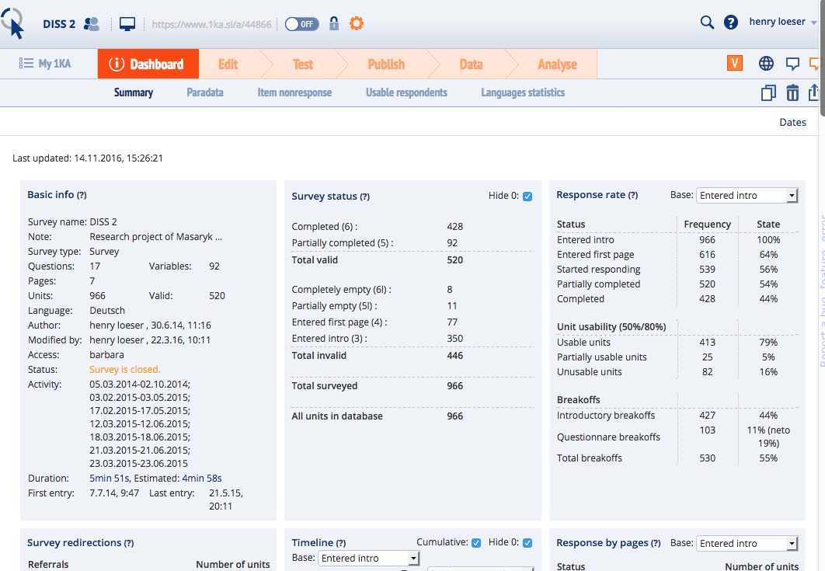
Methods: Survey Instrument
1KA University of Ljubljana
- 17 questions, 92 variables, 4 languages
- demographics
- “importance” of organizational attributes, values

Slide 13
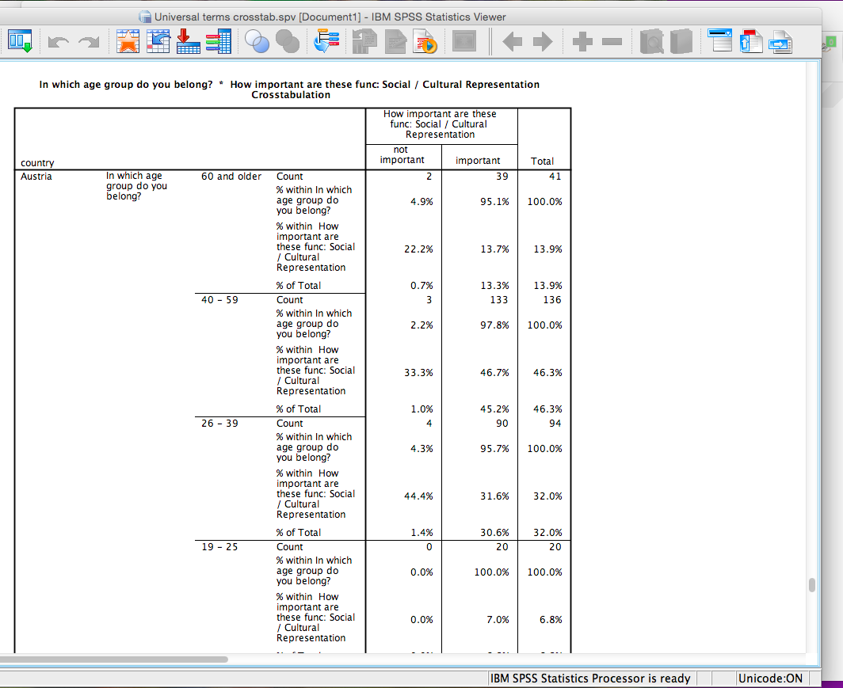
Methods: Data analysis
Data Analysis (SPSS) (MS Excel)
- demographic/organizational data cross tabulations
- ranking of values by “importance” scores
- overlay of policy terms

Slide 14
Findings: Demographics
Austria
- Age: <26 years = 9%
- Participation: <2 years = 27%
- Importance: Facebook = 52%
Czech Republic
- Age: <26 years = 45%
- Participation: <2 years = 65%
- Importance: Facebook = 94%

Slide 15
Findings: Values (Austria)

Slide 16
Findings: Values (Czech Republic)

Slide 17
Findings: Policy Alignment (Austria)

Slide 18
Findings: Policy Alignment (Czech republic)

Slide 19
Conclusions: Publics and Participants
Austria
- Legitimate and sustainable community broadcasting sector supported by government
- Mixed-model broadcasters providing social, cultural and political programs
- Concerns about age of participants and technology
Czech Republic
- No terrestrial community broadcasting sector
- Online sector small but growing
- Young digital natives embracing the community radio concept

Slide 20
Conclusions: Values
Findings emphasize the overall importance participants place on the role of community broadcasting as a unique and legitimate space for communicative action.
Findings support theoretical approaches that contend community broadcasters supplement mainstream media content, seek to provide accurate representations, and resist dominant paradigms.
Low scores for some values perhaps reflect the respective societal paradigm in each subject nation, but also inform the body of knowledge about community broadcasting, and suggest the need for further research to better understand the views of participants.
The issue of gender balance is highlighted by the fractured composition of support, and the conspicuous absence of the term from both policy documents.

Slide 21
Conclusions: Policy Alignment
Austria
The policy document “Funding Guidelines for Non-Commercial Broadcasting” is well-aligned with the views of Austrian survey participants, suggesting an endorsement of the collaborative process by which it was enacted, and informing the body of knowledge about best practices in policy development.
Czech Republic
The ”Proposed Community Broadcasting Policy and Plan for the Czech Republic” exhibits a positive, yet mixed, picture of alignment with the views of Czech survey participants. This suggests its adequacy as a foundation for community broadcasting legislation, and informs the discourse regarding establishment of a legitimate ”third pillar” community broadcasting sector.

Slide 22
Publics, Participants and Policies: Examining Community Broadcasting in Austria and the Czech Republic
Henry G. Loeser
Masaryk University
hloeser@radioexpert.org

